Slide 1
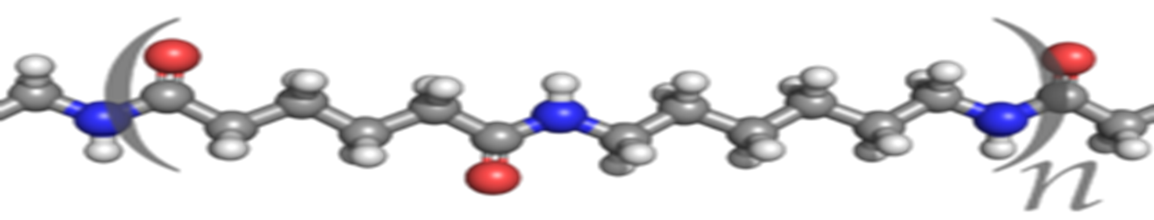

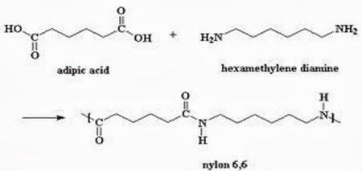





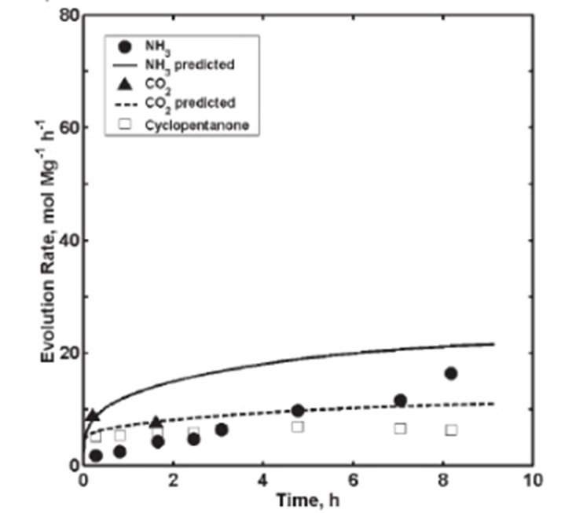
Manufacturing Nylon 66 from the Ground Up
Team USA Leif Burgess Kevin LaSalle Erin Tiedemann
Objectives
Class 4 estimation
85 million pounds annually
Parameters of Interest
  Minimize Branching
  Controlled Viscosity
Safety
What is Nylon 66?
Why Nylon 66?
Process Flow Diagram and Material Balance
Nylon 66
Highly exothermic reaction
Block A
Corrosion
Economic Analysis
Our team would like to thank the entire Chemical Engineering Department for their guidance and assistance. We would also like to thank Kurtis from Eddy Pumps for providing pricing information.
/
Safety and Other Considerations
Conclusions and Recommendations
Ammonia
  Toxic
  20 g/hr
Cyclopentanone
  Explosive
  506 g/hr
3.13$/kg
DCFRR: 192%
NPT: 0.25 yrs
NPV_{i=10%}: 101 MM$
Sell price: 2.50$/kg DCFRR: 68% | Replace Compressor Future Safety Analysis Block A Pump corrosion
This plant is a ‘GO’
Acknowledgments
2.50$/kg
DCFRR: 68%
NPT: 1.4 yrs
NPV_{i=10%}: 21 MM$
Bibliography
http://pngimg.com/img/sport/parachute
https://www.google.com/search?q=toothbrush.png&source=lnms&tbm=isch&sa=X&ved=0ahUKEwjHhcSo2tHTAhUm_4MKHQ_qAYEQ_AUICigB&biw=1422&bih=735#imgrc=pRnfAu90TY3Z4M
https://www.google.com/search?q=toothbrush.png&source=lnms&tbm=isch&sa=X&ved=0ahUKEwjHhcSo2tHTAhUm_4MKHQ_qAYEQ_AUICigB&biw=1422&bih=735#imgrc=pRnfAu90TY3Z4M
https://dsrleasing.com/car-listings/2017-dodge-viper-gts-coupe-lease-1359-mo/
http://www.pslc.ws/macrog/nysyn.htm
http://pslc.ws/macrog/kidsmac/basics.htm
Notes:
This is only a template. You may chose to use or not use this format. I highly recommend you use a format that works for your group.

