Slide 1

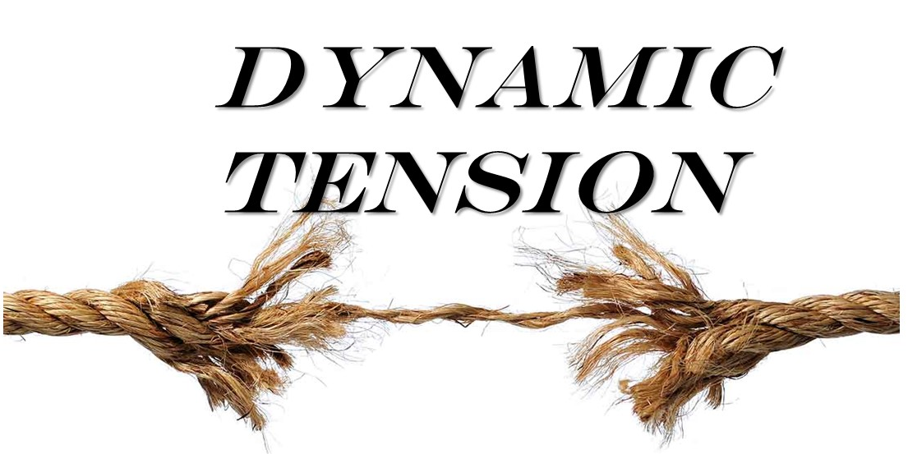
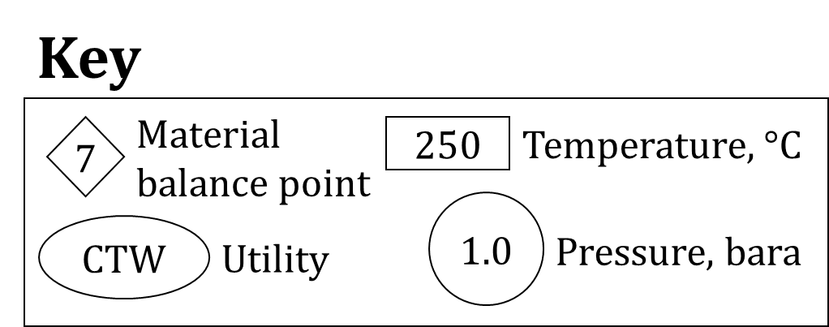
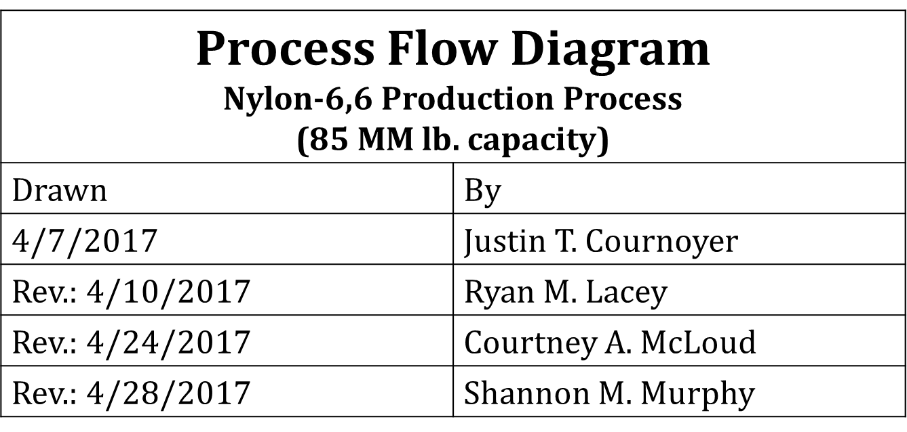
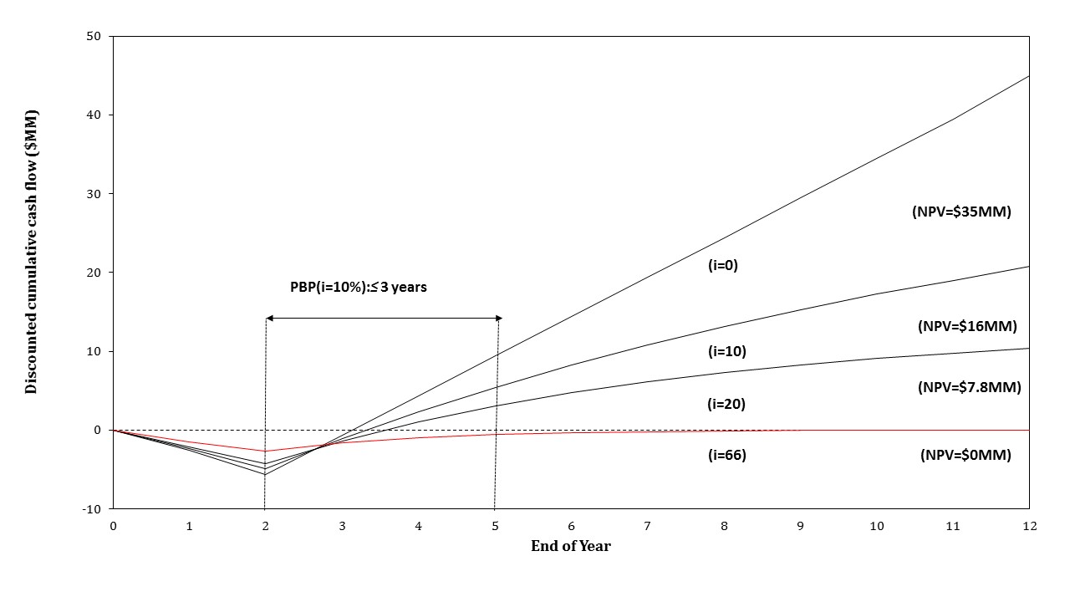
Continuous Production of Nylon-6,6
Justin Cournoyer, Ryan Lacey, Courtney McLoud and Shannon Murphy
Objectives and Introduction
Produce 85 million lb of nylon-6,6
Inherently safe continuous process
$3.7 Billion Industry
Textile and Automotive: 44% Market
Block Flow Diagram
Adipic Acid
Polymerization Reactor
Separation
Final Polymerization Reactor
Extruder
Phosphoric Acid
Nylon-6,6
HMDA
Water
Water, Ammonia, HMDA, Adipic Acid, Phosphoric Acid
Water
Continuous Material Balance 100%
Component (lb/hour) | Stream 1 | Stream 2 | Stream 3 | Stream 4 | Stream 5 | Stream 6 | Stream 7 | Stream 8 | Stream 9 | Stream 10 | Stream 11 | Stream 12 | Stream 13 | Stream 14 | Stream 15 | Stream 16 | Stream 17 | Stream 18 | Stream 19 | Stream 20 | Stream 21
Adipic Acid | 8823.025 | 0 | 0 | 0 | 882.302 | 294.1 | 0 | 294.1 | 588.2 | 294.1 | 0 | 294.1 | 294.1 | 294.1 | 0 | 294.1 | 0 | 0 | 0 | 0 | 0
HMDA | 0 | 7015.713 | 0 | 0 | 701.5716 | 0 | 0 | 0 | 701.713 | 0 | 0 | 0 | 701.713 | 0 | 0 | 0 | 701.713 | 701.5716 | 0 | 0 | 0
Water | 0 | 0 | 20590.36 | 0 | 20590.36 | 144.897 | 144.897 | 0 | 20445.463 | 144.897 | 144.897 | 0 | 20300.566 | 144.897 | 144.897 | 0 | 20155.669 | 14568.79 | 5586.879 | 5000 | 586.879
Phosporic Acid | 0 | 0 | 0 | 364.3 | 364.3 | 0 | 0 | 0 | 364.3 | 0 | 0 | 0 | 364.3 | 0 | 0 | 0 | 364.3 | 364.3 | 0 | 0 | 0
Ammonia | 0 | 0 | 0 | 0 | 46.26923 | 0 | 0 | 0 | 46.26923 | 0 | 0 | 0 | 46.26923 | 0 | 0 | 0 | 46.26923 | 46.26 | 0 | 0 | 0
Nylon Salt | 0 | 0 | 0 | 0 | 14254.87 | 0 | 0 | 0 | 14254.87 | 0 | 0 | 0 | 14254.87 | 0 | 0 | 0 | 14254.87 | 0 | 14254.87 | 0 | 0
Nylon 6,6 | 0 | 0 | 0 | 0 | 0 | 0 | 0 | 0 |  | 0 | 0 | 0 | 0 | 0 | 0 | 0 | 0 | 0 | 0 | 0 | 10732.32
Total | 8823.025 | 7015.713 | 20590.36 | 364.3 | 36839.6728 | 438.997 | 144.897 | 294.1 | 36400.8152 | 438.997 | 144.897 | 294.1 | 35961.8182 | 438.997 | 144.897 | 294.1 | 35522.8212 | 15680.9216 | 19841.749 | 5000 | 11319.199
Critical to Quality Variables
Cleaning and Maintenance
Full Separation of Raw Materials
Product Efficiency
Purity
Temperature Control
Ammonia by-product removed
Packaging
Extruded into Pellets
Economic Analysis
Conclusions & Recommendations
Spun into Fibers
Continuous design is profitable
  DCFRR = 66%
Continuous process is inherently safer than the semi-batch alternative
Safety and Other Considerations
Inherently Safe
  Substitute
  Moderate
  Minimize
  Simplify
HAZOP
  R-110
  Q-150
Material & Health Concerns
  AA and HMDA, Ammonia
Relief Valves
Other Considerations
From both a safety and economic standpoint, the proposed continuous design is recommended as a GO
Acknowledgements
Dynamic Tension would like to thank Professor Halpern for his support throughout the last semester
DCFRR=66%
ROI=84%
Notes:
This is only a template. You may chose to use or not use this format. I highly recommend you use a format that works for your group.

