Slide 1

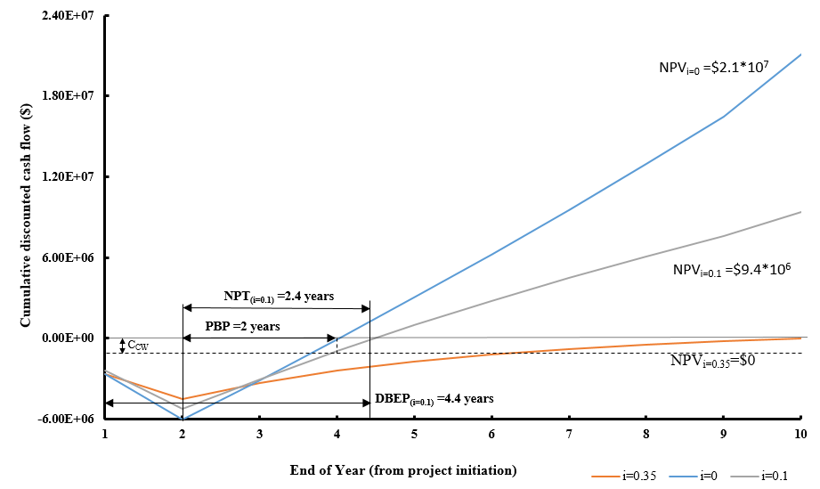
Nylon 66 Production: Chips and Fibers
Group CHEM: Samuel Allen, Taylor Crawford, Donatus Obot-Etiebet
Objective
Design a profitable, flexible, and safe production method for nylon 66 chips and fibers using a continuous process.
Critical to Quality Variables
Nylon 66 products must be high quality and have high tensile strength.
Molecular weight range : 13000 to 16000 g/mol
High operating temperatures: T > 200⁰C
High operating pressures: P > 60 barg
Safety
Temperatures will be monitored with control loops
Intermediates will have limited exposure to oxygen
Materials will be kept in cool, well ventilated areas
Operators should wear protective gear at all times
Pressure relief valves will be equipped on every vessel
Economic Analysis
Total actual bare module cost (Cª_{BM}) | $ 4,043,611
Contingency and fees cost (C_{C} + C_{F}) | $ 727,850
Total module cost (C_{TM}) | $ 4,771,461
Auxiliary facilities cost (AF) | $ 1,213,083
Grass roots capital (C_{GR}) | $ 5,256,694
Conclusions
The full 85-million-pound capacity can be split between granules, filaments, and different grades with ease, based on control design.
A continuous process is recommended due to better safety, profitability and flexibility.
The fixed capital investment required is $6.05MM.
After-tax rate of return of 96%, DCFRR of 35%, and NPV of $21,000,000.
Recommendation
The process has a GO recommendation based on profitability and safety.
A capital investment of $6,045,198 is required in the first 2 years for the construction of the plant.
Nylon 6’6 would be sold at $1.67/kg for granules and $1.5/kg for filaments
Between the 3rd and 9th year, the plant would maintain an average profit of $3,900,000.
A profit of $4,600,000 is made in the 10th year due to working capital returns.
Revenue of $135,000,000 a year
Acknowledgments: We thank the faculty and staff of UNH’s Chemical Engineering Department for all their hard work in preparing us to be able to complete this project. We could not do it without them.

