Slide 1
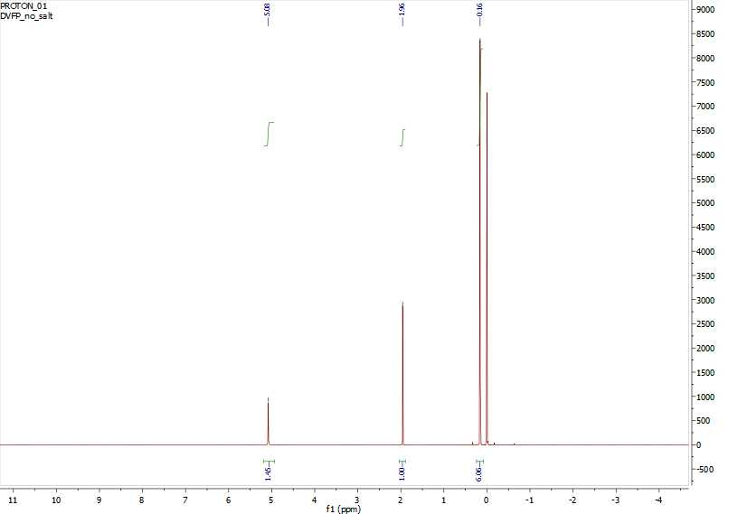
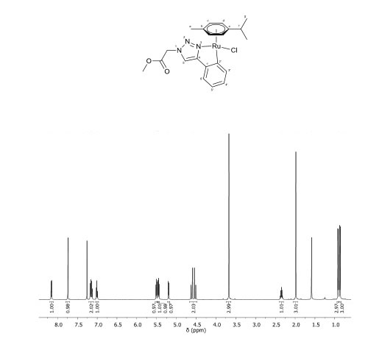
The Development of Cytotoxic Ruthenium (II) Arene Cyclometalates Using Various pH Dependent Ligands
Drew Verrier, Alyssa Bangrazi, Janie Berger, Erin Braker, Zane Relethford, Roy Planalp
University of New Hampshire, Department of Chemistry
drv2000@wildcats.unh.edu
Introduction
Results
Conclusion
Promising new metallo-drugs have recently been emerging as effective ways to combat cancerous cells. Using the ruthenium (II) arene cyclometalate scaffolding presented by Riedl et al.¹ we examined new ligands of varying pH to better understand the conditions under which these drugs can be utilized. By varying the pH of the ligands, a more comprehensive view of what properties dictate the permeability of cancer cells can be obtained, since the pH of cancer cells is slightly lower than healthy cells.² The procedures used for this experiment were adapted from Riedl et al.
Synthesis of the desired product proved difficult and ultimately failed. In the first step to make the triazole intermediate (B) there was no precipitate but instead the solution was an oil mixture and hard to separate. In an attempt to separate the product is was extracted with THF in a separatory funnel and concentrated via rotary evaporation. This isolated product was then used in the second step to be added to the ruthenium center. The aquation-anation reaction was inconclusive. The failure of the synthesis could be contributed to a number of things such as altered reaction times due to time restrictions, or the polarity of the molecule. It could also be contributed to the change in solubility when the ligand was coordinated to the ruthenium center, making it difficult to obtain an accurate NMR.
Although the synthesis with the acetophenone ligand was unsuccessful, the synthesis using the methylpropane ligand and the acetanilide ligand appears to have been successful. The ¹H NMR of the product using this ligand has similar peaks as to what was expected. The synthesis using the ligand 3-chlorophenol was unsuccessful, however.
The synthesis of the ruthenium based organo-mettalo complex using acetophenone as the variable portion of the 1,2,3-triaxole ligand was unsuccessful based on the NMR.
Future Work
Since this reaction was unsuccessful, future work will include altering the conditions of the synthesis to optimize the reactions progress. This will be done by using different solvents, temperatures, and reaction times. Once the desired product has been obtained, tests to determine the compounds reactivity in cancer cells such as aquation-anation can be run, as well as tests to determine the molecules ability to pass through semi-permeable membranes can be measured through dialysis.
R = acetophenone
R = 3-chlorophenol
R = methylpropane
R = acetanilide
References
Experimental Design
Christoph A. Riedl, Lea S. Flocke, Michaela Hejl, Alexander Roller, Matthias H. M. Klose, Michael A. Jakupec, Wolfgang Kandioller, and Bernhard K. Keppler. Inorganic Chemistry 2017 56 (1), 528-541
Acid pH in Tumors and Its Potential for Theraputic Exploitation, Ian F. Tannock, Daniela Rotin. Perspectives in Cancer Research 1989
The halide 2-bromoacetophenone (A) along with sodium azide, sodium ascorbate, phenylacetylene, and an aqueous copper sulphate catalyst were used to make the triazole intermediate (B). This was then attached to the ruthenium center via a reaction with the metal dimer [Ru(cym)Cl₂]₂ and sodium acetate catalyst to produce the product (C).
Acknowledgements
A
Figure 1: ¹H NMR spectra of the final product [chlorido(1-acetophenone-4-(2’-κC)-phenyl-(3- κN)-1,2,3-triazole)(η⁶-p-cymene) ruthenium(II)]
Figure 2¹: ¹H NMR of [chlorido(methyl1-2’’-(4-(2’-κN)-1,2,3-triazole-1-yl)acetate)(η⁶-p-cymene)ruthenium(II)]
Special thanks to Zane Relethford, Roy Planalp, and the Department of Chemistry at UNH for funding this project. Also thank you to Alyssa Bangrazi, Janie Berger, and Erin Braker for their contributions to this project.
B
C
The general procedure from Riedl et al. was adapted to fit the parameters of the experiment including altering amounts and times of reaction.

