Slide 1

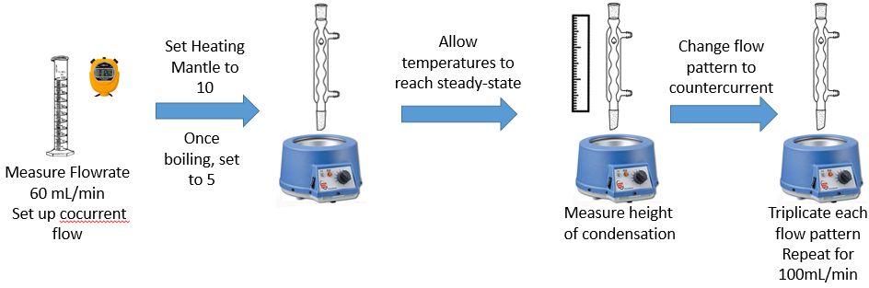
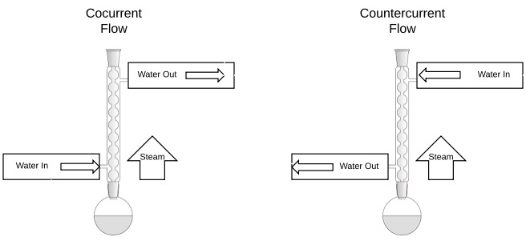
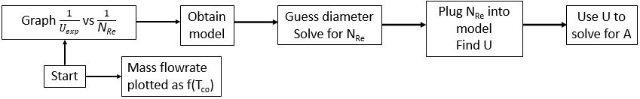
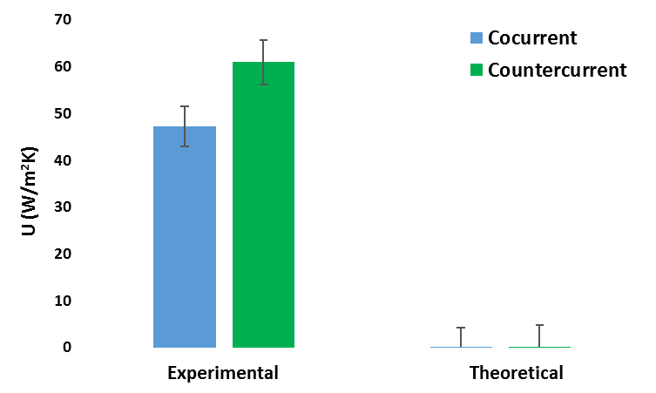
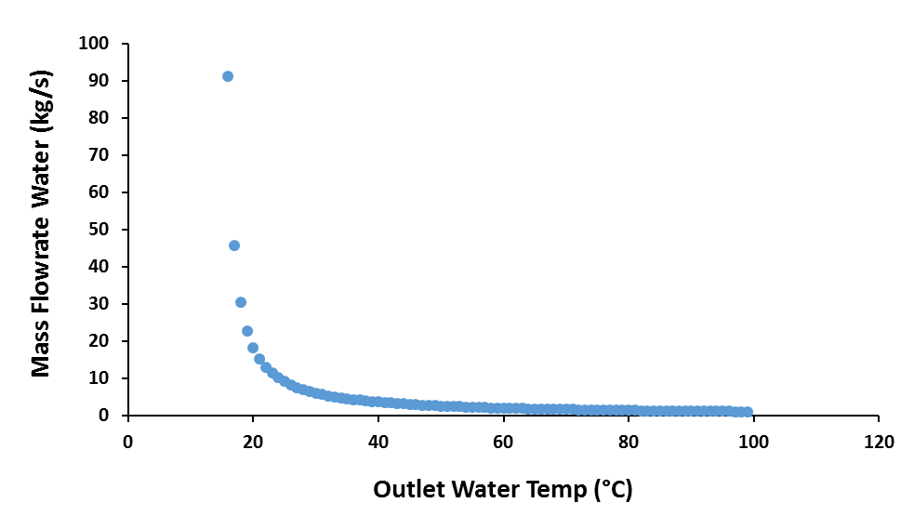
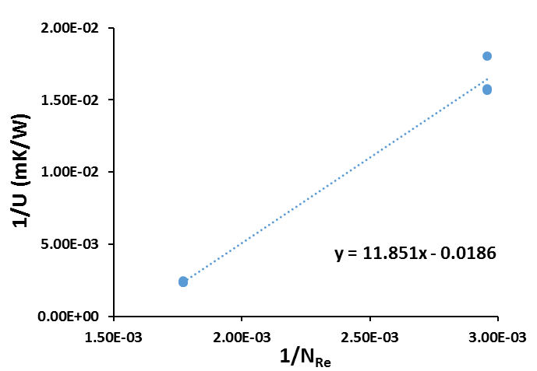
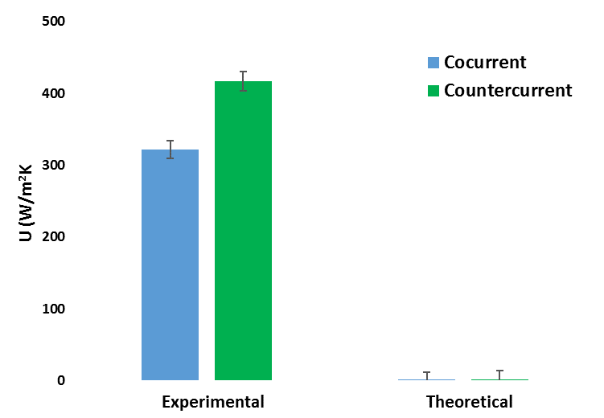
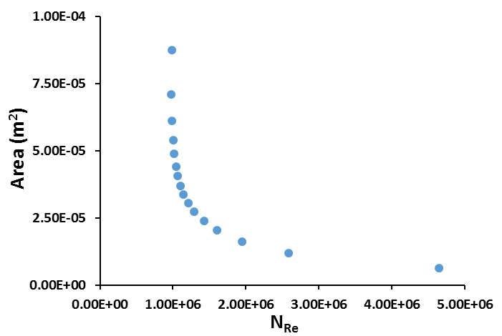
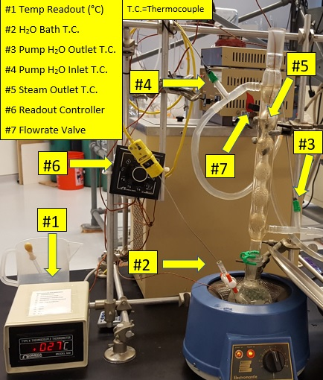
An Examination of Heat Exchange in
Condensing Systems
Jackson Kaspari, Sarah Lambert and Minghao Wei
University of New Hampshire, Chemical Engineering Department, Durham, NH 03824
Acknowledgement: Dr. St. Jean and the University of New Hampshire Chemical Engineering department
Introduction
Methods
Discussion
When vapor condenses on a vertical plane or tube and flows due gravitational forces this is known as film-type condensation.¹
Water based condensing systems are utilized for refrigeration, heat exchangers, chemical industries, and desalination units.²
Two types of flow in a condensing system
  Cocurrent
  Countercurrent: Known to be a more effective flow pattern
↑ Flowrate causes ↓ residence time = ↑ U
T-test → all comparisons significant
Inconsistent pump → inconsistent flowrate → U error
Inability to dry condenser → heat transfer area uncertainty
Design Solution
Results
*
Figure 3. Range of mass flow rates (water) dependent on the outlet water temperature range. Values limited to those that satisfy the design problem.
*
34500% Error
30000% Error
$q=UA∆T_{lm}$ $\frac{1}{UA}=\frac{1}{h_{i}A_{i}}+Rw+\frac{1}{h_{o}A_{o}}$ $∆Tlm=\frac{∆T_{2}−∆T_{1}}{ln[⁡(∆T_{2})/(∆T_{1})]}$
*
*
Figure 4. Correlation plot used to predict a design U value based upon corresponding Reynolds numbers.
Goal: Determine the effect of flow pattern and rate on resulting overall heat transfer coefficient. This will result in the development of parameter correlations essential to solving the design problem.
Figure 1. Average experimental and theoretical overall heat transfer coefficient values for cocurrent and countercurrent flow patterns studied at 60(mL/min). Stars indicate statistical significance.
Apparatus: Water Cooled Allihn Condenser
*
*
Figure 5. Contact area values of design condenser based upon a range of Reynolds numbers using 0.05m as the condenser diameter.
Cold water is circulated and flow rate is controlled using Isotemp Refrigerated Circulator Model 9100.
Boiling chips added to prevent bumping and ensure consistent boiling.
Flow pattern changed by swapping the line input positions.
86000% Error
85000%
Error
*
*
Figure 2. Average experimental and theoretical overall heat transfer coefficient values for cocurrent and countercurrent flow patterns studied at 100(mL/min). Stars indicate statistical significance.
Conclusion
Error associated with pump flowrates led to unreasonable design U values. The best solution utilized countercurrent flow, has T_{water,o}=40°C at a flowrate of 36.5 kg/s and an area of 2.3x10⁻⁵ m² and a height of 1.5x10⁻⁴
Using theoretical values for the design problem, at the same T_{water,o} and flowrate and a diameter of 0.05m the contact area of the condenser was 0.09m² and the height was 0.6m
References
Geankoplis,J C. Transport Processes and Separation Process Principles, 4th ed,; Prentice Hall: New Jersey,2011.
Charef, A.; Feddaoui, M. B.; Najim, M.; Meftah, H. Desalination2017, 409, 21–31.
Notes:
Cocurrent/countercurrent diagram

