Slide 1

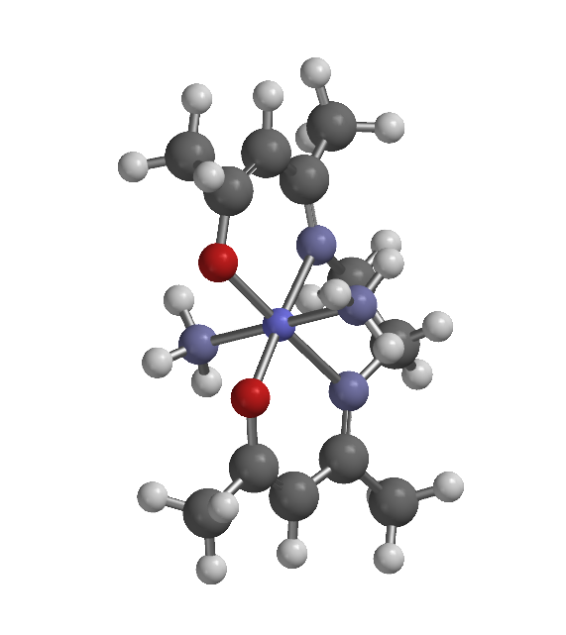
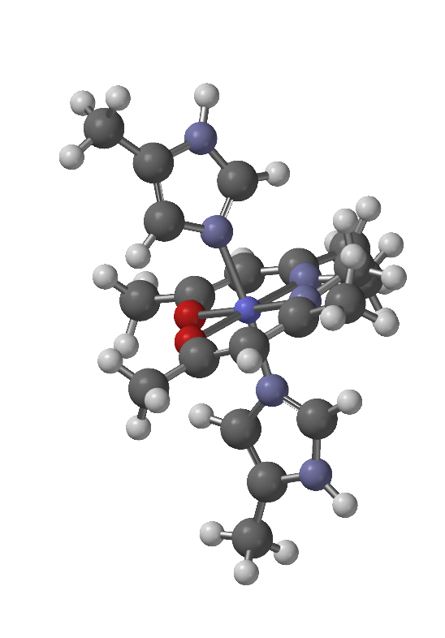
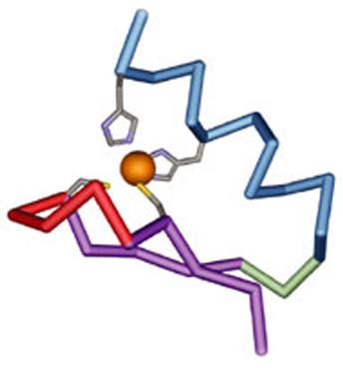
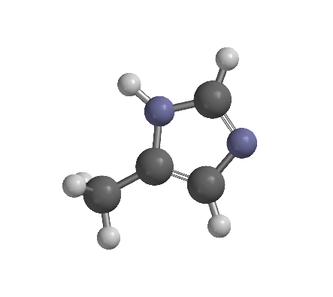
Axial Ligand Exchange of Cobalt(III) Complexes
Claudia Willis, Thomas Williams, Tim Tetrault, Matt Currier
csw2002@wildcats.unh.edu, Department of Chemistry, University of New Hampshire, Durham, NH
May 4, 2017
Introduction:
Co(III) Schiff base complexes are important complexes in enzyme and transcription factor inhibition. These complexes, which have the general formula of [Co(acacen)L₂]⁺, are metal-based therapeutics. Ligand exchange on the complex allows the cobalt to bind to the transcription factor, which causes inhibition¹. Six Co(III) complexes will be synthesized with different ligands, including ammonia (NH₃) imidazole (Im), pyridine (Py), N-methylimidazole (NMeIm), 2-methylimidazole (2MeIm) and 4-methylimidazole (4MeIm). Spartan will be used to compute and predict which complexes will have favorable ligand exchanges with 4MeIm. 4MeIm will be used as the substitution ligand, because it is a histidine analog. These predictions can then be tested by monitoring the ligand exchange of each complex with 4MeIm by NMR.
Figure 1. General [Co(acacen)L₂]⁺ complex and ligands that will be used in the six Co(III) complexes (left to right: ammonia, imidazole, 4-methylimidazole, 2-methylimidazole, N-methylimidazole, and pyridine).
Experimental Design:
Acacen, the tetra-dentate ligand on the Co(III) complexes, was first synthesized by adding ethylenediamine dropwise to a solution of acetylacetone in ethanol. The solution was cooled overnight, and product was collected by vacuum filtration and verified by ¹H NMR.
Scheme 1. Acacen synthesis
Each complex was synthesized using the same general procedure. Acacen and CoBr₂•6H₂O (the NH₃ complex used CoCl₂•6H₂O ) were dissolved in methanol and stirred at room temperature under nitrogen for two hours. The desired ligand was then added, and the solution continued to stir under the same conditions overnight. Solvent was concentrated down, then diethyl ether was added to form precipitate. Solid product was collected by vacuum filtration.
Results:
Table 1. Yields from each of the six Co(III) complexes synthesized
Figure 2. Example of an axial ligand exchange generated by Spartan using the [Co(acacen)(NH₃)₂]⁺ complex substituted with 4MeIM.
Table 2. Spartan predictions of 4MeIm ligand exchange with each of the other Co(III) complexes.
Exchange of 4MeIm with each complex using a different ligand was predicted to be favorable according to the Spartan computations. VTNMR studies were done on 2MeIm and Py at 37°C, but were inconclusive. ¹H NMR was taken for acacen to verify the ligand and check purity.
Discussion:
Each of the six Co(III) complexes were synthesized, and a came out to be a green or brown precipitate. Im, NMeIm, 2MeIm, 4 MeIm, NH₃ and Py complexes were formed with low yields (Table 1), and were not further purified before use in NMR studies.
Spartan computational studies predicted that the ligand exchange of 4MeIm with each of the other complexes would have a decrease in energy, showing the ligand exchange would be spontaneous and favorable (Table 2). Py and 2MeIm complexes have the most negative change in energy, due to greater steric hindrance on the complex, which makes it more favorable for them to exchange with 4MeIm. 4MeIm was used as the substitution ligand, because it is a
histidine analog. Ideally, the Co(III) complexes
would bind to a histidine amino acid in order to
prevent folding of a zinc finger, which would
ultimately inhibit an enzyme by destabilizing it.
VTNMR studies monitoring substitution of
2MeIm and Py complexes with 4MeIm were
inconclusive, possibly do to impurities.
Figure 3. Zinc finger²
Future Work:
Co(III) complexes could be further purified in order to improve VTNMR results. Once Co(III) complex substitution with 4MeIm is successfully monitored, further application of these complexes to zinc finger inhibition can be explored.
Conclusion:
Spartan predictions show each Co(III) complex should have a favorable exchange with 4MeIm, a histidine analog. Each of the six Co(III) complexes were synthesized, but VTNMR studies of the exchange with 4MeIm are so far inconclusive.
Acknowledgements:
I would like to thank Tom, Matt and Tim for all the work they put into the project. I would also like thank Luke Fulton, Zane Relethford and Professor Planalp, as well as the Planalp group, the Caputo group, the Boudreau group and the UNH Department of Chemistry.
References:
Manus, L.M.; Holbrook, R.J.; Atesin, T.A.; Heffern, M.C.; Harney, A.S.; Eckermann, A.L.; Meade, T.J. Axial Ligand Exchange of N-heterocyclic Cobalt(III) Schiff Base Complexes: Molecular Structure and NMR Solution Dynamics. Inorg. Chem. 2013, 52(2), 1069-1076.
Kadrmas, J.L.; Beckerle, M.C. The LIM Domain: From the Cytoskeleton to the Nucleus. Nature Reviews Molecular Cell Biology. 2004, 5, 920-931.
Ligand | Yield | Percent Yield
Imidazole | 0.175 g | 18%
NMeIm | 0.160 g | 16%
2MeIm | 0.103 g | 10%
4MeIm | 0.422 g | 26%
Ammonia | 0.353 g | 35%
Pyridine | 0.383 g | 38%
Ligand on Complex | Energy Difference (kJ/mol)
Imidazole | -11.73
NMeIm | -1.21
2MeIm | -51.59
4MeIm | 0.00
Ammonia | -17.29
Pyridine | -54.41
2

