Slide 1

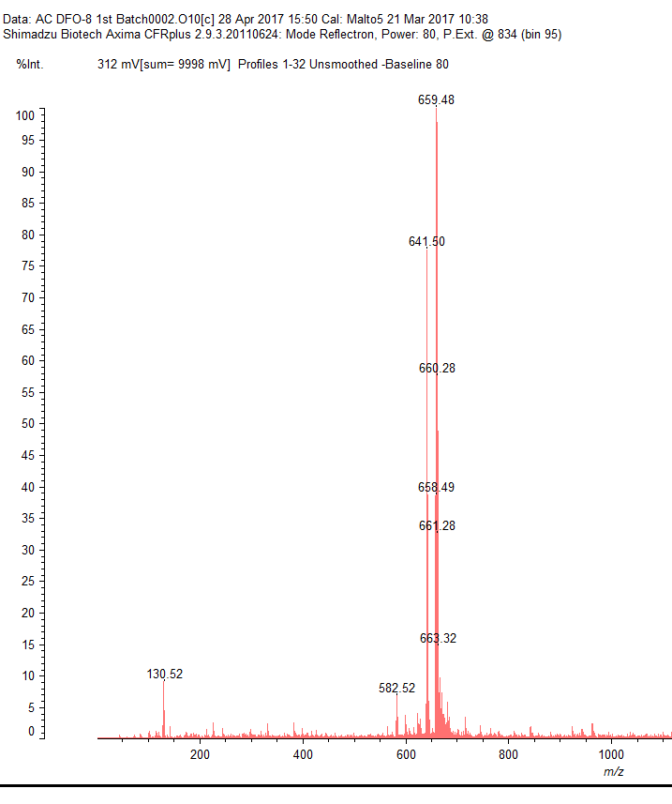
The Synthesis of DFO-8 for Positron Emission Tomography
Aaron Chung, Mahmoud Abdalrahman, Dr. Planalp
ac2017@wildcats.unh.edu, Department of Chemistry, University of New Hampshire
Durham, New Hampshire, 03824
5/4/17
Introduction
Positron Emission Tomography (PET) is a powerful clinical imaging technique that is used to detect various pathogens, including cancers. PET scans are an important technique in clinics because they allow for a physician to diagnose a patient’s illness, prescribe treatment, and monitor treatment efficacy. Traditional PET isotopes include ¹⁸F, ¹⁵O, ¹³N and ¹¹C, but due to their lengthy radiosyntheses and short half-lives only early time points were available for imaging, leaving investigations of biological processes, which occur over duration of hours or days, difficult to explore.¹ As a result, an ideal radioisotope used in PET scans involves matching the physical half-life to the pharmokinetic half-life of the immunoglobulin.² The desire for an ideal isotope in antibody-based imaging has led to the emerging research on ⁸⁹Zr based imaging. ⁸⁹Zr has favorable physical characteristics for antibody-based imaging, with a half-life of 78.4 hrs and a relatively low positron energy of 395.5 keV. The current ligand employed to ⁸⁹Zr is Desferrioxamine (DFO), which binds six times through oxygen atoms, leaving two binding sites on the metal exposed to solvent (H₂O). Not filling all of the coordination sites on the zirconium metal creates instability in the complex and will result in demetallation.³ To combat this, a better ligand can be designed and synthesized; a ligand that will fill all eight binding sites on Zr⁺⁴, creating a stronger chelate effect. This will be done by attaching aminomalonic acid, which will be synthesized by the hydrolysis of dimethyl aminomalonate, to the existing DFO ligand by HATU Coupling reaction. This will result in an octadentate ligand, yielding a greater chelate effect and an ideal binding agent. If successful, this ligand will minimize the release of free zirconium ions targeting the bones of organisms, providing a safer way of utilizing PET scans.
Results and Discussion
Aminomalonic acid was recovered with an 82% yield. ¹H NMR reveals a 3:1 ratio of starting material to product. ¹³C NMR illustrates three peaks, suggesting that only one side of the molecule was protonated. IR spectrum suggests aminomalonic acid was successfully prepared as the carbonyl of the carboxylic acid is shifted more upfield than the carbonyl of the ester.
DFO-8 was recovered with a 61% yield. MALDI TOF mass spectroscopy shows a major peak of a molecular weight (MW) of 660, matching the predicted MW of the desired product.
Figure 1. ¹³C NMR of Aminomalonic Acid
Future Work
Once the success of the synthesis of DFO-8 can be confirmed, binding affinity will be measured through ligand binding assay (LBA). Further studies will be made in preparation of the Zr⁺⁴ complexation with DFO-8. If proven successful, preparations may be made to distribute the chelator to clinics for trials.
Conclusion
The success of the multi-step synthesis is inconclusive as MALDI TOF mass spectroscopy, alone, is insufficient in determining the identity of the compound. Additional characterization techniques, such as ligand binding assay (LBA) need to be performed in order to identify the ligand. Due to time constraints the hydrolysis of the starting material, Dimethyl Aminomalonate (DMA), was not performed in a sufficient way to yield a significant turnover of desired product.
Figure 2. IR of Aminomalonic Acid vs Dimethyl Aminomalonate
Experimental
A multistep synthesis was performed starting with dimethyl aminomalonate (DMA) to yield DFO-8. The hydrolysis of DMA yielded aminomalonic acid (AMA).
Scheme 1. Hydrolysis of Dimethyl Aminomalonate
Aminomalonic acid was attached to Desferrioxamine by HATU Coupling reaction to yield DFO-8.
Scheme 2. HATU Coupling with DFO and AMA
Acknowledgements
I would like to thank the UNH Chemistry Department, Mahmoud Abdalrahman, Luke Fulton, Zane Relethford and Dr. Planalp.
Figure 3. ¹H NMR of Aminomalonic Acid
References
1. Thaddeus J. Wadas, Edward H. Wong, Gary R. Weisman, Carolyn J. Anderson; Coordinating Radiometals of Copper, Gallium, Indium, Yttrium and Zirconium for PET and SPECT Imaging of Diseases. Chemical Reviews. 2010, 110, (5).
2. Positron Emission Tomography (PET) Scan | Cleveland Clinic. Cleveland Clinic. 2014.
3. Melissa A. Deri, Brian M. Zeglis, Lynn C. Francesconi, Jason S. Lewis; PET Imaging with ⁸⁹Zr: From Radiochemistry to the Clinic. Nuclear Medicine and Biology. 2013. (3-14).
4. Francois Guerard, Yong-Sok Lee, Martin W. Brechbiel; Rational Design, Synthesis, and Evaluation of Tetrahydroxamic Acid Chelators for Stable Complexation of Zirconium(IV). Chemistry a European Journal. 2014, 20, (5584-5591).
Figure 5. MALDI TOF Mass Spectroscopy of DFO-8
Figure 4. ¹H NMR of Dimethyl Aminomalonate

