Slide 1

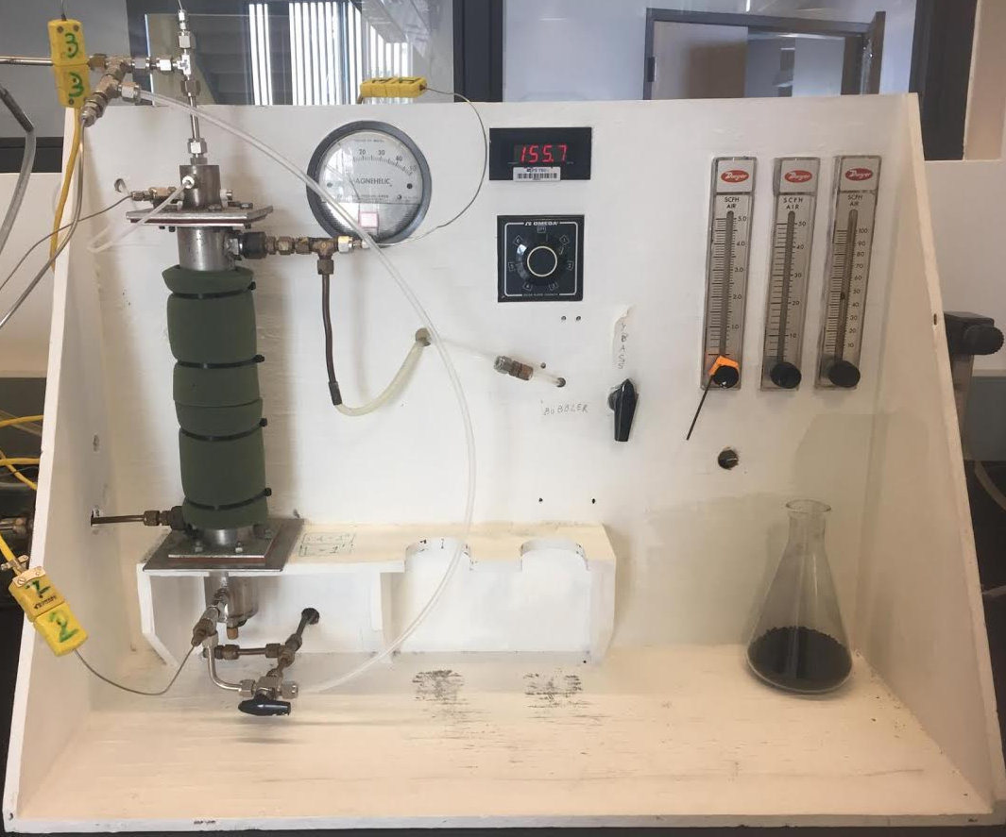
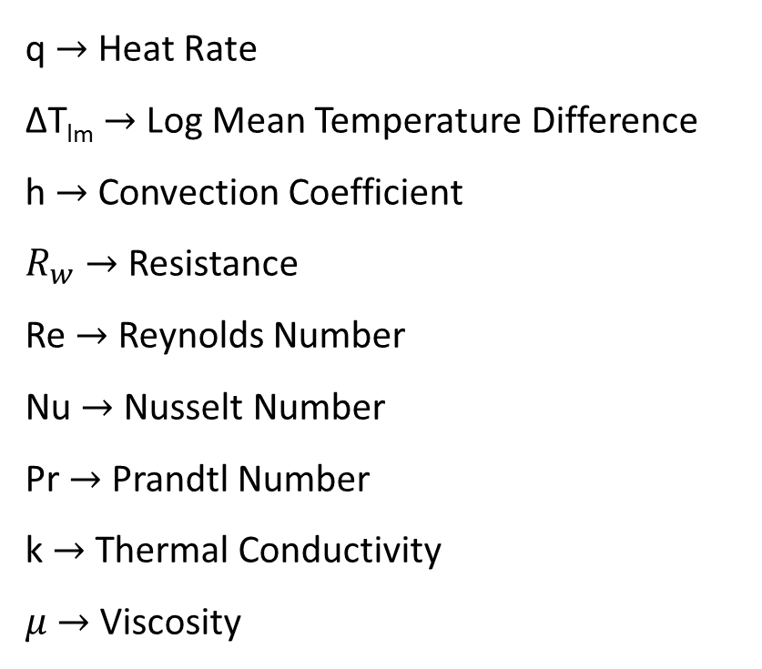
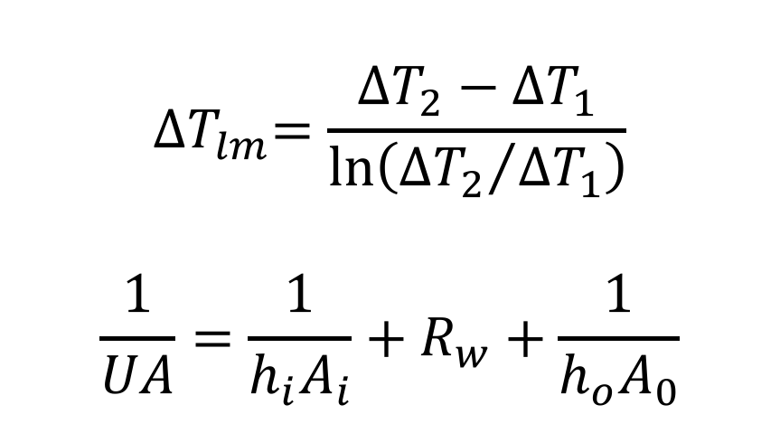

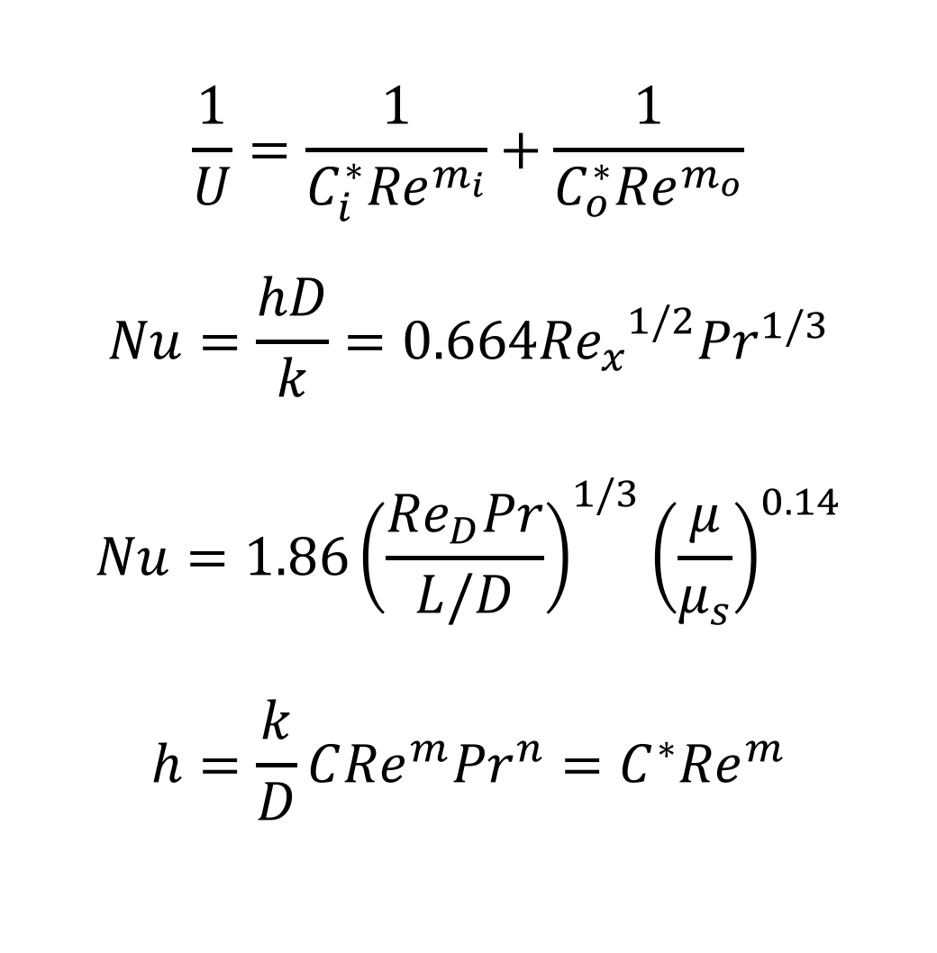
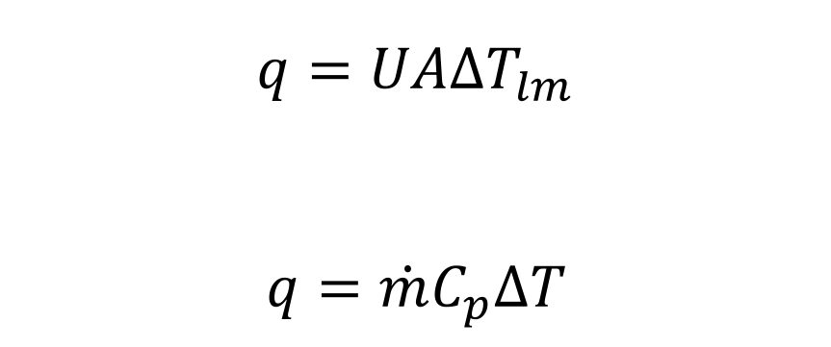
M
C
B
Characterization of a Carbon Packed Bed Heat Exchanger
Mariah Arral – Chris Bales – Brandon Musitano
Department of Chemical Engineering, University of New Hampshire
Introduction
Results
Design Problem
Packed bed heat exchangers and reactors are used in industry¹
Important for catalytic reactions and heating or cooling a system¹
Packed beds can be packed with a variety of materials¹
Carbon or catalytic particles are common packings¹
Countercurrent or cocurrent flow patterns are used
Heat transfer is affected by flow rate and pattern
Effect of Flow on Overall Heat Transfer Coefficient
Water Out
Air In
75˚C
100 SCFH
Top View of Packed Bed
Countercurrent
Cocurrent
T_{o}=?
Full Diameter Packed Bed
FD=?
Packed Bed
L=?
Inner Diameter Packed Bed
ID= ?
Water In
Air Out
30˚C
Given Conditions
Gas product with air like properties
Packed bed with carbon particles
T_{i}=?
u=?
Figure 1: Packed bed reactors in industry²
Assumptions
Inlet water temperature of 25˚C and outlet of 60˚C
Reynolds numbers of 82.3 for water and 9.71 for air
Area of 0.1174 m² and Length of 0.2 m
Countercurrent flow
Objectives
Determine the overall heat transfer coefficient (U)
Understand the effects of flow rate of water and air on U
Effect of cocurrent and countercurrent flow patterns on U
Create appropriate correlations to solve the design problem
Figure 2: Overall heat transfer coefficients for countercurrent and cocurrent flow in a carbon particle packed bed heat exchanger. Stars indicate statistically significant data (p<0.10). Percentages indicate approximately how different each data set is from one another. Countercurrent flow is statistically different from cocurrent (p<0.10).
Laminar flow for all tested flow rates
U calculated from heat rate of air (Eq. 1-3)
Air flow rate had a significant effect on U
No significant difference in U with change in water flow rate
Countercurrent flow is preferred and statistically different than cocurrent
The higher the U the more heat transfer per unit area and per unit driving force
Calculations
From assumed Reynolds numbers for water and air U can be found
ID can be found from Re of air and assumed area and length (Eq. 9)
FD calculated from assumed area and ID
Heat rate can be found from given air conditions (Eq. 1)
Velocity (u) of water can be found from Re of water (Eq. 9)
Treatments
Countercurrent
Cocurrent
Overall Heat Transfer Coefficient Correlations for Countercurrent
2.7 ^{L}/_{min} Water Flow Rate
3.9 ^{L}/_{min} Water Flow Rate
2.7 ^{L}/_{min} Water Flow Rate
3.9 ^{L}/_{min} Water Flow Rate
10 SCFH
Air
30 SCFH
Air
50 SCFH
Air
30 SCFH
Air
50 SCFH
Air
Calculations
Reynolds number and U are related by (Eq. 4-5)
h determined from (Eq. 6-9 )
Assumed cylinder acted like flat plate (Eq. 6)
Calculated Values
U= 39.43 W/Km²
ID= 0.061 m
FD=0.126 m
q= 42.14 W
u= 1.9 L/min
Validating Assumptions
The ID is smaller than the FD
Reynolds numbers are within experimental range
q obtained from air 42.15 W (Eq. 2)
System was allowed to achieve steady state
Experiments run in triplicate
Experimental
1
7
1 – Water Inlet/Outlet
2 – Heated Air Outlet
3 – Carbon Particle Packed Bed
4 – Room Temperature Air Inlet
5 – Water Inlet/Outlet
6 – Air Rotameters
7 – Digital Temperature Display
8 – Water Rotameter
Figure 3: Correlation between U and Reynolds number for water in countercurrent flow
Figure 4: Correlation between U and Reynolds number for air in countercurrent flow
ANSWER
ID= 0.061 m
FD=0.126 m
L= 0.2 m
2
3
Clear indicator that air flow rate has greater effect on U than water flow rate
Packed Bed Length: 1’
ID: 1’’
OD: 2.812’’
6
8
Equations³⁻⁴
5
4
$$q=UA{∆T}_{lm}$$
$$q=\dot{m}C_{p}∆T$$
$$\frac{1}{U}=\frac{1}{C_{i}^{∗}{Re}^{m_{i}}}+\frac{1}{C_{o}^{∗}{Re}^{m_{o}}}$$
$$Nu=\frac{hD}{k}=0.664{{Re}_{x}}^{1/2}{Pr}^{1/3}$$
$$Nu=1.86{\left(\frac{{Re}_{D}Pr}{L/D}\right)}^{1/3}{\left(\frac{μ}{μ_{s}}\right)}^{0.14}$$
$$h=\frac{k}{D}C{Re}^{m}{Pr}^{n}=C^{∗}{Re}^{m}$$
$$Re=\frac{Duρ}{μ}$$
Conclusion
(1)
(2)
(3)
(4)
(5)
(6)
(7)
(8)
(9)
Countercurrent is preferred and statistically different from cocurrent
Statistically significant effect of air flow rate on U
No statistical significance in the change of water flow rate on U
For design problem, length of packed bed was 0.2 m and the inner diameter was 0.061 m while the outer diameter was 0.126 m
Possible error in experimentally achieving steady state
References
q $→$ Heat Rate
∆T_{lm} $→$ Log Mean Temperature Difference
h $→$ Convection Coefficient
$R_{w}$ $→$ Resistance
Re $→$ Reynolds Number
Nu $→$ Nusselt Number
Pr $→$ Prandtl Number
k $→$ Thermal Conductivity
$μ$ $→$ Viscosity
Geankoplis, C.J., “Principles of Steady-State Heat Transfer,” in Transport Processes and Separation Process Principles, 4th ed. Upper Saddle River, Pearson Education Inc., 2003, ch. 4, pp. 235-356
“Our Solutions | Tracerco,” Our Solutions | Tracerco. [Online]. Available: https://www.tracerco.com/processdiagnostics/our-solutions. [Accessed: 01-May-2017].
Bergman, T.L., Lavine, A.S., Incropera, F.P., Dewitt, D.P., “External Flow,” in Fundamentals of Heat and Mass Transfer, 7th ed. Hoboken, John Wiley & Sons, Inc., 2011, ch. 7, pp. 433-515
Bergman, T.L., Lavine, A.S., Incropera, F.P., Dewitt, D.P., “Internal Flow,” in Fundamentals of Heat and Mass Transfer, 7th ed. Hoboken, John Wiley & Sons, Inc., 2011, ch. 8, pp. 517-592
$${∆T}_{lm}=\frac{{∆T}_{2}−{∆T}_{1}}{\ln\left({{∆T}_{2}}/{{∆T}_{1}}\right)}$$
$$\frac{1}{UA}=\frac{1}{h_{i}A_{i}}+R_{w}+\frac{1}{h_{o}A_{0}}$$
Acknowledgements: Prof. St. Jean, UNH Department of Chemical Engineering, and College of Engineering and Physical Sciences

