Slide 1

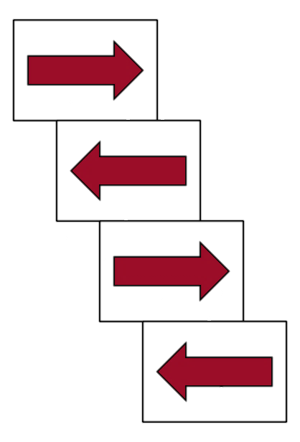



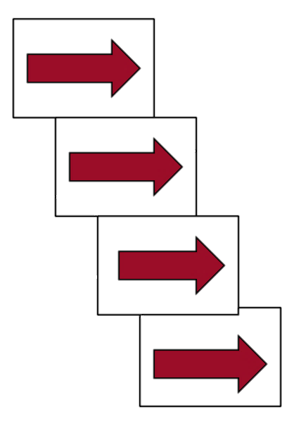
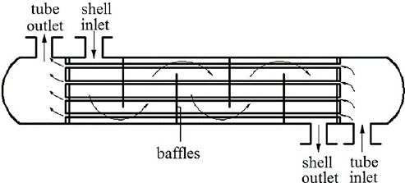
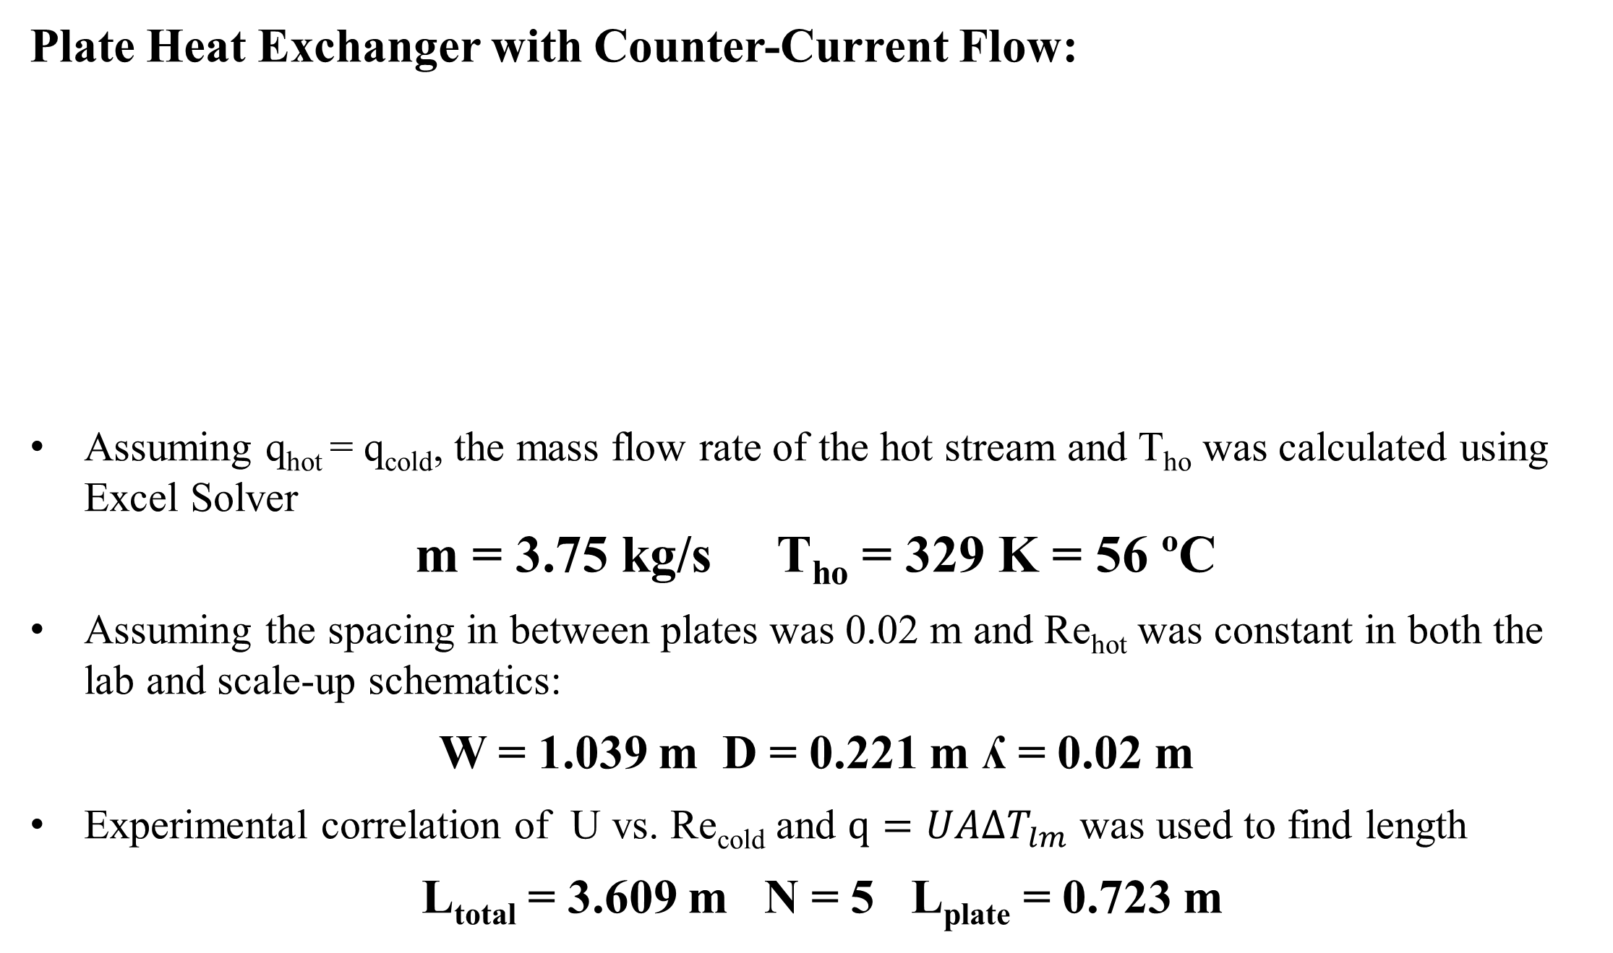
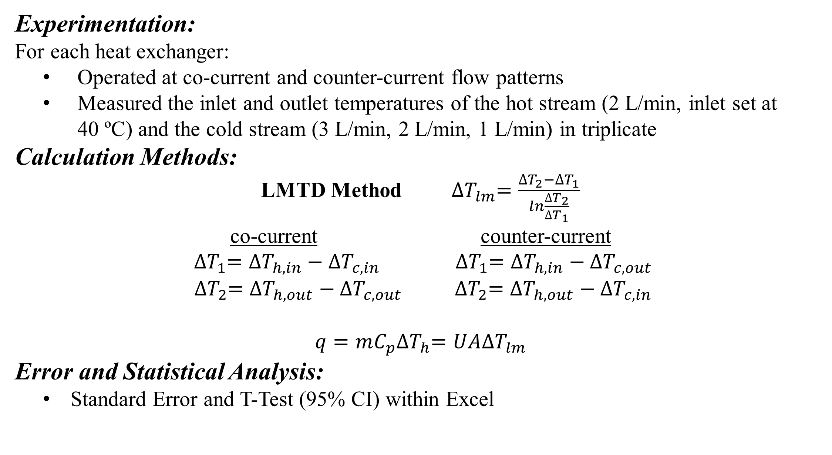
Comparison of Heat Exchangers
Double-Plate, Shell-and-Tube, & Plate
Trevor Campbell, Thomas Higgins, Jaclyn Kinson
Department of Chemical Engineering, University of New Hampshire
Introduction
Results
Discussion
Transfer of heat between two fluids in industrial processes are carried out by heat exchangers (e.g. oil and gas, energy production, chemical processes)
Heat exchangers can operate at both co-current and counter-current flow patterns
Co-current flow Counter-current flow
Hot Hot
Cold Cold
The log mean temperature difference method (LMTD) is used when hot and cold fluids are in true co-current or counter-current flow^{[1]}
Without directly measuring surface temperature, Wilson Plots estimate the convection coefficients in heat exchangers^{[2]}
A)
A)
Counter-current flow patterns produce a greater overall heat transfer coefficient than
co-current flow patterns
Cold water flow rate increases, the overall heat transfer coefficient increases
Interestingly, U of shell-and-tube was the lowest value
    Likely because the cold water velocity was so small
Convection coefficient hot water > convection coefficient cold water
The convection coefficients of the Shell-and-Tube vary significantly
    Also, due to the small cold water velocity
Co-current convective heat transfer coefficients (h) seemed to be higher than
counter-current heat transfer coefficients for all three heat exchangers
GOALS:
Compare the overall heat coefficients for each heat exchangers at
co-current and counter-current flow rates, using the LMTD method
Perform a Wilson Plot Analysis to find the average convection coefficients of the cold and hot water
Solve the design problem
Design Problem
B)
B)
Plate Heat Exchanger with Counter-Current Flow:
Assuming q_{hot} = q_{cold}, the mass flow rate of the hot stream and T_{ho} was calculated using Excel Solver
m = 3.75 kg/s T_{ho} = 329 K = 56 ºC
Assuming the spacing in between plates was 0.02 m and Re_{hot} was constant in both the lab and scale-up schematics:
W = 1.039 m D = 0.221 m ʎ = 0.02 m
Experimental correlation of U vs. Re_{cold} and $q=UA{∆T}_{lm}$ was used to find length
L_{total} = 3.609 m N = 5 L_{plate} = 0.723 m
Dimensions of the Heat Exchanger:
ʎ=? W=? L=? D =?
50 ºC
T_{ho} =?
80 ºC
m=? kg/s
Experimental Apparatus
20 ºC
3 kg/s
Double-Pipe: hot fluid flows through the inner pipe while the cold fluid flows through the outer pipe
1-1 Shell-and-Tube: hot fluid flows Plate: pack of plates in which hot and
through the 7 inner pipes while the cold fluid flow on opposite sides^{[3]}
cold fluid flows through the shell with
cross baffles to induce cross-flow
C)
C)
[1]
Conclusion
The overall heat transfer coefficients of a double-pipe, shell-and-tube, and plate heat exchanger were compared using the LMTD method
    The plate heat exchanger had the highest overall heat transfer coefficient
The average heat transfer convection coefficients were compared using the Wilson Plot method
    The Plate Exchanger had higher values than the Double-Pipe
A plate heat exchanger would be the best option to heat the fluid, as described in the design problem
    Dimensions: W = 1.039 m D = 0.221 m ʎ = 0.02 m L_{plate} = 0.723 m N = 5
    Hot Stream: T_{hot} = 56 ºC m_{hot} = 3.75 kg/s
Methods
Figure 1. The comparison of the overall heat coefficient of each heat exchanger A) Double-Pipe
B) Shell-and-Tube and C) Plate. The Plate Heat Exchanger has the highest overall heat transfer coefficient (U). For co-current patterns, the percent difference is 54.9% for Double-Pipe and 86.6% for Shell-and-Tube. For counter-current patterns, the percent difference is 44.7% for Double-Pipe and
89.4% for Shell-and-Tube. The stars represent statistically significant data.
Figure 2. The comparison of the convective heat transfer coefficients of the hot and cold water for A) Double-Pipe B) Shell-and-Tube and C) Plate. The Shell-and-Tube Exchanger had both the highest value of h_{hot} and the lowest value of h_{cold}. The Plate Exchanger has higher coefficient values than the Double-Pipe Exchanger.
Experimentation:
For each heat exchanger:
  Operated at co-current and counter-current flow patterns
  Measured the inlet and outlet temperatures of the hot stream (2 L/min, inlet set at 40 ºC) and the cold stream (3 L/min, 2 L/min, 1 L/min) in triplicate
Calculation Methods:
LMTD Method ${∆T}_{lm}=\frac{{∆T}_{2}−{∆T}_{1}}{ln\frac{{∆T}_{2}}{{∆T}_{1}}}$
co-current counter-current
${∆T}_{1}={∆T}_{h, in}−{∆T}_{c,in}$ ${∆T}_{1}={∆T}_{h, in}−{∆T}_{c,out}$
${∆T}_{2}={∆T}_{h, out}−{∆T}_{c,out} { ∆T}_{2}={∆T}_{h, out}−{∆T}_{c,in}$
$$q=mC_{p}{∆T}_{h}=UA{∆T}_{lm}$$
Error and Statistical Analysis:
  Standard Error and T-Test (95% CI) within Excel
References
Figure 3. The Wilson Plot of the Plate Heat Exchanger for both co-current and counter-current flow patterns. Using the slope and intercept of each trendline, the values of “h” were extracted for the hot and cold streams.
[1] C. Geankoplis, Transport Processes and Separation Process Principles (Includes Unit Operations), 4th ed. New Delhi: Pearson India Education Services, 2016, pp 293.
[2] J. Fernandez-Seara, F. Uhia, J. Sieres and A. Campo, "A general review of the Wilson plot method and its modifications to determine convection coefficients in heat exchangers devices", Science Direct, pp. 1-13, 2007.
[3] “HT32/HT37: Plate Heat Exchangers”, Discoverarmfield.com, 2017. [Online]. Available: http://discoverarmfield.com/en/products/view/ht32-ht37/plate-heat-exchangers. [Accessed: 26-Apr-2017].
Acknowledgments
Dr. Adam St. Jean
Funding provided by the Department of Chemical Engineering

