Slide 1

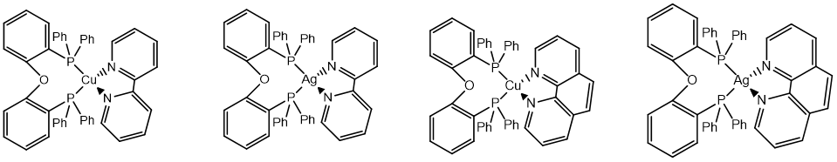
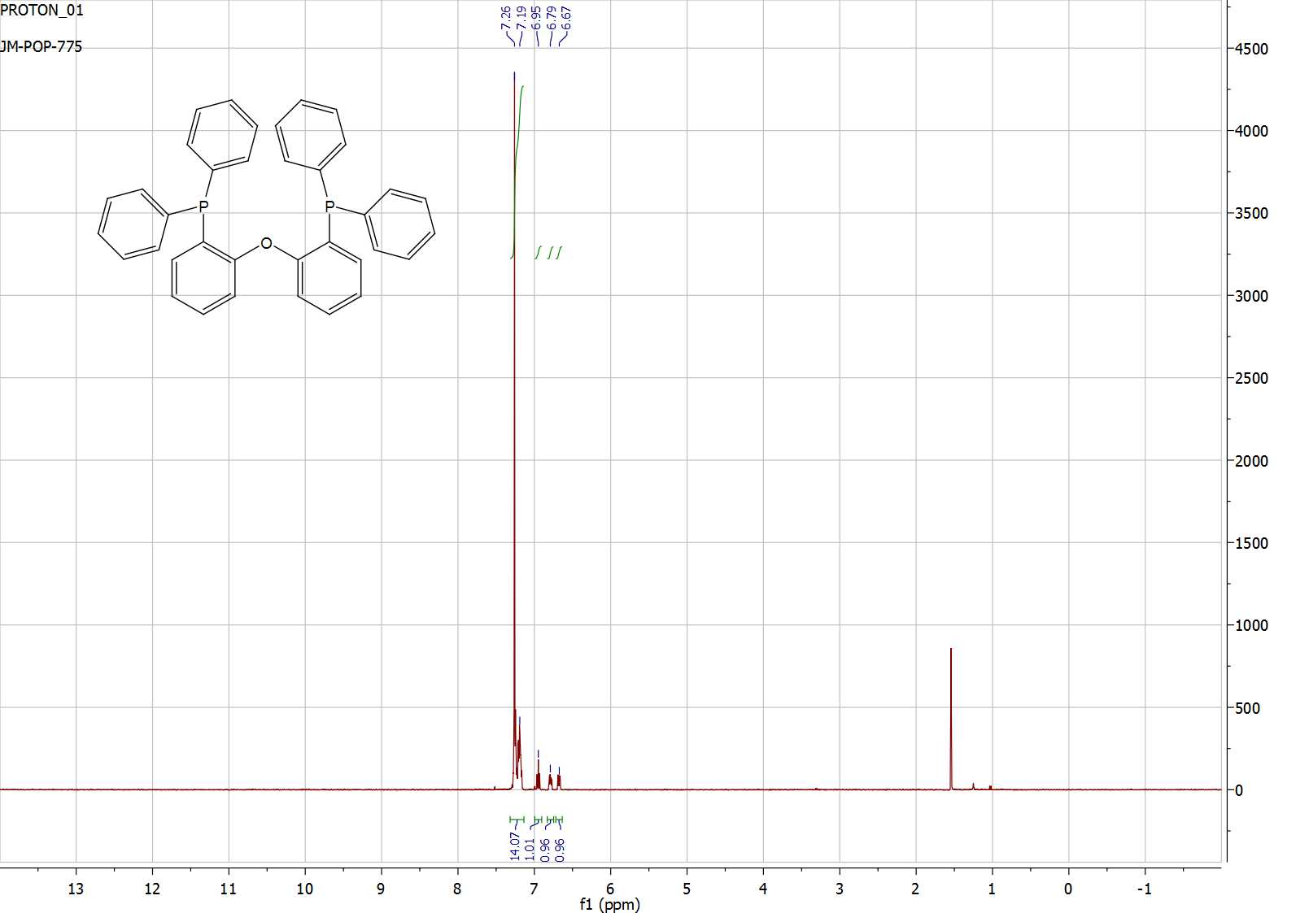
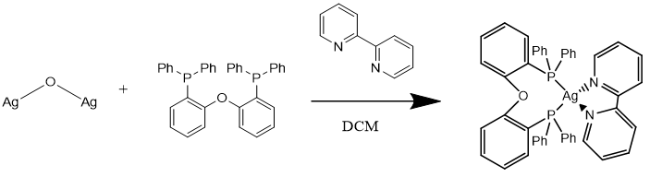
Spectral and Electrochemical Characteristics of Silver Complexes and their Potential Metal-to-Charge Transfer Capabilities
Matthew Reuter, Roy Planalp, Zane Rutherford mbr2003@wildcats.unh.edu, Department of Chemistry, University of New Hampshire, Durham, NH
5/05/17
INTRODUCTION
Organic light emitting diodes (OLEDs) are considered the next step in flat panel displays, as they faster and more efficient than previous displays¹. These luminescent properties have been dominantly observed from metal-to-ligand charge transfer (MLCT) in d¹⁰ transition metals. Previously, ligands with high substitution and electron-withdrawing groups have been synthesized to incite these characteristics².
RESULTS AND DISCUSSION
The reaction worked well to produce 1. However, 1 did not absorb in the UV/Vis region, and fluorescence measurements could not be taken. CV indicated reversible reactions.
FUTURE WORK
The successful synthesis of 1 indicates easy reproducibly. However, it became apparent that only copper-based complexes absorbed in the UV/Vis region. As such, future reactions focused on MLCT and OLEDs research would be conducted on copper-complexes.
CONCLUSIONS
The synthesis of 1 and the subsequent UV/Vis measurements indicate that silver-based complexes would not be suitable for MLCT and OLEDs, but copper-based complexes provide potentially suitable alternatives.
Scheme 1. Desired complexes with potentially photoemissive properties.
EXPERIMENTAL
The synthetic route where bipyridine(bis 2-(diphenylphosphino)phenyl ether)silver (I) 1 was formed from 2,2-bipyridine 2, bis 2-(diphenylphosphino)phenyl ether 3, and silver (I) oxide 4. ¹H NMR and IR were used to identify the presence and purity of product, while UV-Vis, Fluorescence, and Cyclic Voltametry was used to identify any characteristic photoemissive properties.
ACKNOWLEDGEMENT
I would like to acknowledge the Zane Rutherford, Roy Planalp, and the UNH Department of Chemistry for their support.
REFERENCES
Chen, Z.; Gong, Q.; Kido, J.; Kong, S.; Luo, J.; Qu, B.; Xiao, L. Adv. Mater. 2011, 23, 926 – 952.
(2) Chang, C. H.; Chen, P. Y.; Chi, Y.; Chou, P. T.; Chung, M. W.; Hsu, C. W.; Lee, G. H.; Lin, C. C. J. Am. Chem. Soc. 2011, 133, 12085–12099.
~87%
Scheme 2. Experimental synthesis of Ag(POP)(bipy).
Scheme 3. ¹H NMR of 1, 2, and 3, respectively.

