Slide 1

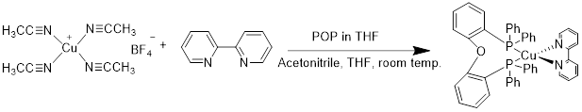
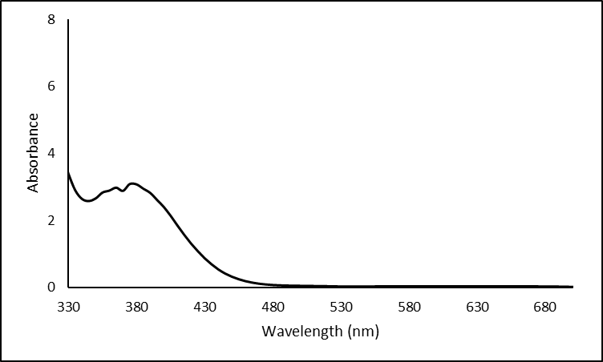
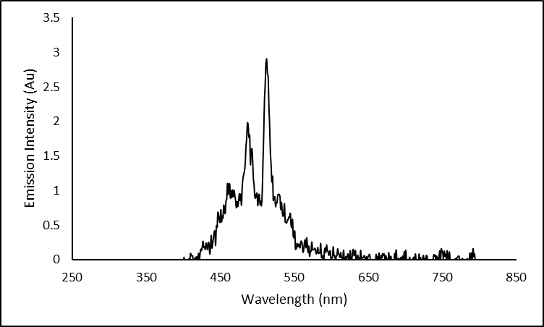
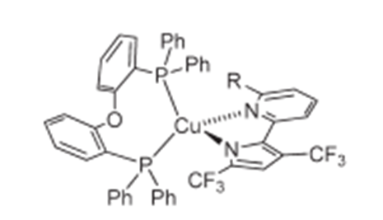
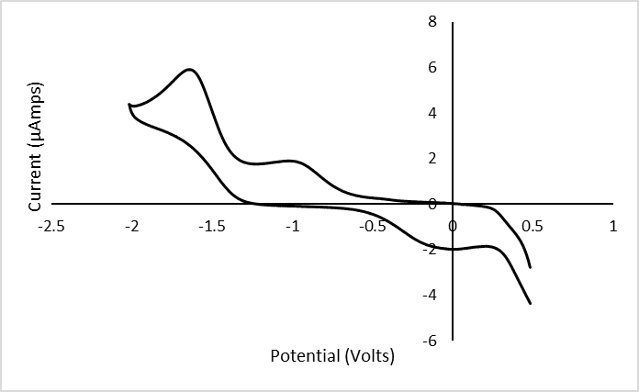
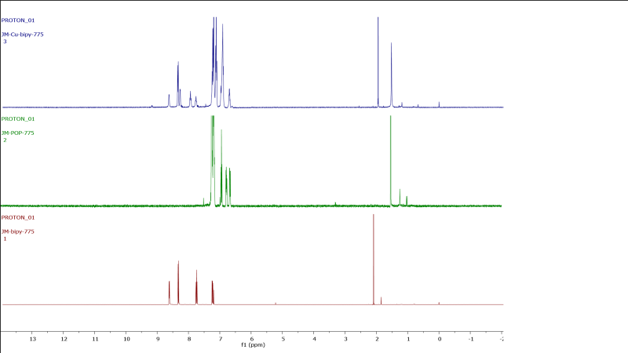
Investigation of the Effect of Ligands on Metal-to-Ligand Charge Transfer Transitions using d¹⁰-complexes of Group 11 Elements
Joey Mancinelli, Zane Relethford, Roy Planalp
jpm2006@wildcats.unh.edu, Department of Chemistry, University of New Hampshire, Durham, NH
5/4/17
Introduction:
Recently, there has been substantial interest in the properties of luminescent transition metal complexes which are dominated by metal-to-ligand charge transfer transitions^{[1]}. Previous studies have found that higher a ligand field strength and lower oxidation state of the metal center contributed to better metal-to-ligand charger transfers^{[1]}. The study performed by Hsu, et al. used the d¹⁰ metal centers Cu(I) and Ag(I) and used (Oxydi-2,1-phenylene)bis(diphenylphosphine) [POP] and several different dinitrogen bidentate ligands^{[1]}. Cu(I) and Ag(I) were used because of their relatively low cost, their environmental friendliness, and their enhanced metal-to-ligand charge transfers because of their lower oxidation states^{[1]}. The study showed that the complexes were isolated in considerable yields and also exhibited metal-to-ligand charge transfer transitions^{[1]}. Shown below is the structure of one of the complexes from Hsu, et al. The synthesis of this complex (Figure 1) was used to synthesize this target complex Cu(bipy)(POP).
Project Goals:
The goal was to use the same reaction schemes from Hsu, et al. and determine if the same metal-to-ligand charge transfer transitions could be observed with different bidentate dinitrogen ligands. The hope is that these complexes exhibit metal-to-ligand charge transfers and can be used to make new organic light-emitting devices and other organo/inorgano-electronics. These devices will someday replace outdated, archaic electronics. The light produced by these electronics will be much brighter than conventional LEDs, and OLEDs have been found to be more efficient than conventional LEDs^{[2]}. Because OLED’s are synthetic, they can be more easily fine tuned to any structure.
Discussion:
Synthesis of the target complex was conclusive by proton NMR. Ligand peaks broaden slightly in the proton NMR of the complex, indicating bonding between metal and ligand. Complex exhibited maximum absorbance at 375 nm. The fluorimetry study at this wavelength showed an emission at 515 nm. Since the complex showed fluorescence, it can undergo metal-to-ligand charge transfers when excited at a wavelength of 375 nm. CV data showed the complex had a reversible peak potential of -0.839 V. Data from Hsu, et al. for copper complex 1 gave a reversible peak potential of 0.43 V. The difference in potentials is likely due to the difference in ligands between the complexes.
Future Work:
Since the synthetic route proved sound, it could be scaled up to isolate more product. The extent to which this complex underwent metal-to-ligand charge transfers could be studied further using fluorimetry studies as well as phosphorescence studies. The quantum efficiency of the complexes could be further studied by taking electroluminescence spectra; specifically, looking at the current-density-voltage-luminance characteristics. Continued attempts to use computational modeling to model the metal-to-ligand charge transfers and model the HOMO-LUMO gap could also be carried out, as initial attempts were unsuccessful.
Conclusions:
Synthesis of the target complex was conclusive by proton NMR. Ligand peaks showed broadening, indicating bonding between ligand and metal. Complex exhibited an emission of 515 nm at an excitation wavelength of 375 nm, indicating the presence of metal-to-ligand charge transfers. CV data was very dissimilar to CV data from Hsu, et al.
Acknowledgements:
I would like to thank Zane Relethford, Luke Fulton, and Roy Planalp. I would also like to thank the University of New Hampshire Chemistry Department.
References:
1. Hsu, C-W.; Lin, C-C.; Chung, M-W.; Chi, Y.; Lee, G-H.; Chou, P-T.; Chang, C-H.; and Chen, P-Y.; J. Am. Chem. Soc. 2011, 133, 12085-12099.
2. Kamtekar, K. T.; Monkman, A. P.; Bryce, M. R. (2010). "Recent Advances in White Organic Light-Emitting Materials and Devices (WOLEDs)". Advanced Materials. 22 (5): 572–582.
Results:
Scheme 1. Synthetic route to obtain Cu(bipy)(POP). Yield: 72% (120 mg).
Figure 2. UV-Vis Spectrum of Cu(bipy)(POP)
Figure 3. Fluorescence Spectrum of Cu(bipy)(POP)
Figure 1. One of the Copper (1) complexes from Hsu, et al., named copper complex 1.
Figure 4. CV study on Cu(bipy)(POP)
Figure 5. ¹H NMR of Ligands and Complex.

