Slide 1

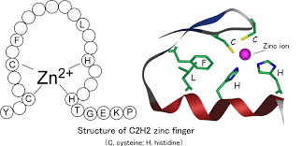
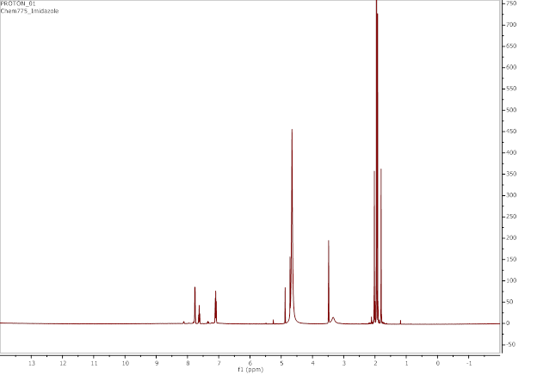
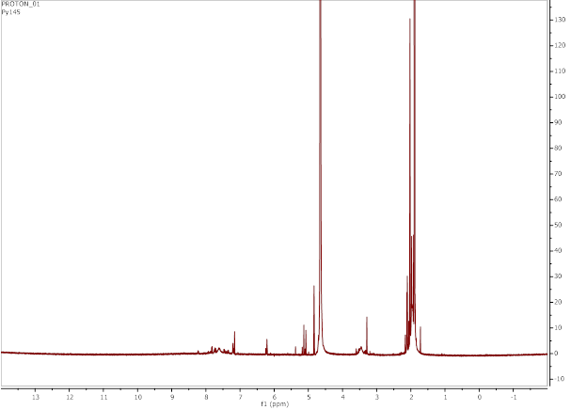
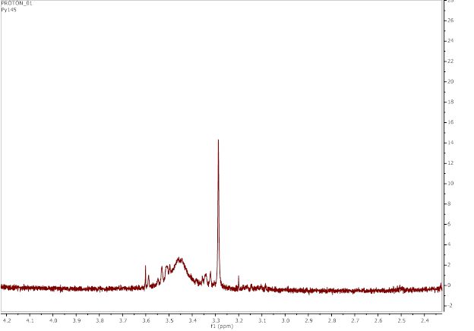
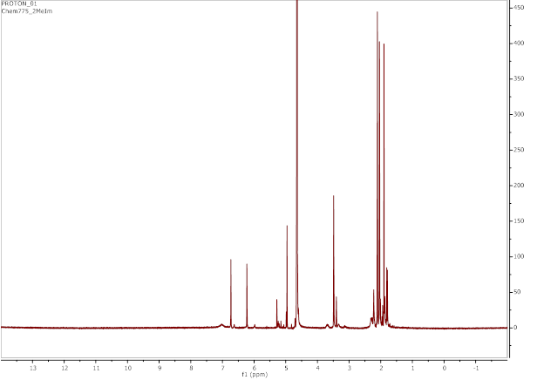
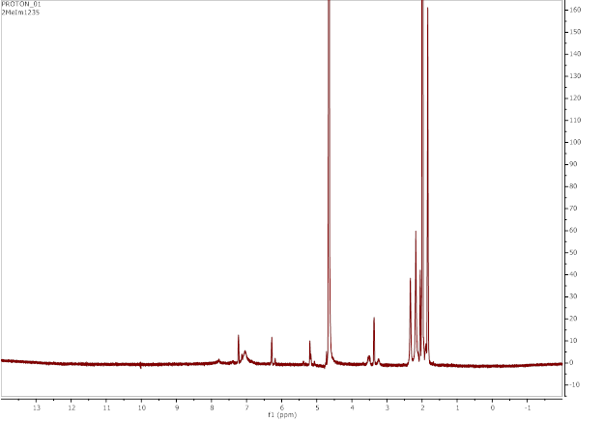
Synthesis, Characterization, and Computational Modeling of [Co(acacen)L₂]⁺, an Inhibitor of Zinc Finger Proteins¹
_{Timothy J.} Tetrault*, Claudia S. Willis, Matthew E. Currier, Thomas J. Williams, and Roy P. Planalp
University of New Hampshire, Department of Chemistry, Durham, New Hampshire 03824
tjt2002@wildcats.unh.edu, csw2002@wildcats.unh.edu, mc1151@wildcats.unh.edu, tjw2001@wildcats.unh.edu, roy.planalp@unh.edu
Introduction
Synthesis and Analytical Design
Ligand Exchange Trends: VT-NMR and Computation
Zinc finger proteins are constituted by a peptide chain with two closely spaced cysteines and two closely separated histidine 12 amino acids later. The zinc ion then coordinates to the four said amino acids, allowing for its unique folding.² Zinc finger proteins are involved with DNA recognition in transcription, of which there are an enormous number of roles they can play throughout the body.³⁻⁴ Due to vastly diverse amount of zinc fingers with different functions and structures in biological systems, zinc finger protein inhibitors have been developed. These inhibitors can be developed to disrupt the DNA replication induced by an undesired, functionally specific zinc finger without affecting other zinc fingers throughout the body that are necessary for vital biological processes.⁵
Six [Co(acacen)L₂]⁺ complexes were synthesized for further analysis of their expected axial ligand exchange properties:
Computational Prediction of Exchange Trends
The ligand exchange energy difference of different ligands used on the Cobalt Schiff base complex in the presence of 4-MeIm was calculated using the Spartan computational package. It was theoretically found that all complexes [Co(acacen)L₂]⁺ favourably exchange their axial ligands with free 4-MeIm, including the complex [Co(acacen)(OH₂)₂]⁺. The favourability of [Co(acacen)(OH₂)₂]⁺ exchanging axial ligands with 4-MeIm shows that even if water exchanges with one of the [Co(acacen)L₂]⁺ complexes in the body, the formation of [Co(acacen)(4-MeIm)₂]⁺ is still likely to occur.
Figure 3. The energy difference of [Co(acacen)L₂]⁺, including L = OH₂, with respect to [Co(acacen)(4-MeIm)₂]⁺.
Scheme 2. The general synthetic scheme for the isolation of the potential zinc finger protein inhibitors, where X is Br for all ligand complexes except L = NH₃ where X is Cl, and L is the various axial ligands used in the synthesis (Figure 2).
VT-NMR Prediction of Exchange Trends
Due to limitations, only two complexes were analyzed for their exchange trends via VT-NMR at 37 ºC: [Co(acacen)(Py)₂]⁺ and [Co(acacen)(2-MeIm)₂]⁺.
(A)
(B)
(C)
Figure 1. How the zinc ion fits into the peptide chain.
Source: Hatayama et. al. 2008. http://www.med.nagasaki-u.ac.jp/phrmch1/lcn/interspersed_NLS.htm (accessed Apr 30, 2017).
Cobalt-Schiff Base Compounds
Cobalt-Schiff base compounds are a Co(II) or Co(III) coordinated to a tetradentate Schiff base, preferably containing two oxygen and two nitrogen atoms as coordinating atoms, and two specific axial ligands. These compounds are known to inhibit the enzyme thrombin.⁶ A primary function of thrombin is as a coagulant and anticoagulant, though when one’s thrombin acts as an anticoagulant more than a coagulant, medical practices seek to inhibit the body’s thrombin production.⁷ Previously done research showed that the tetradentate acacen ligand was successful as a Schiff base for the inhibition of thrombin.⁸
Figure 4. (A) The ¹H NMR spectrum of [Co(acacen)(Py)₂]⁺. (B) The ¹H VT-NMR spectrum of [Co(acacen)(Py)₂]⁺ at 37 ºC, 15 min after 2 mol equiv of 4-MeIm was added in solution. (C) A zoomed in portion of a peak of interest on the ¹H VT-NMR spectrum of [Co(acacen)(Py)₂]⁺ at 37 ºC, 15 min after 2 mol equiv of 4-MeIm was added in solution.
(A)
(B)
Biological Conditions and Histidine Binding
Simulation of biological conditions throughout the experimental determination of the usefulness of a potential zinc finger inhibitor is vital. Due to human body temperatures being at 37ºC, experiments must accommodate to this condition. Also, due to the binding of the inhibitor to imidazole side chain of histidine, 4-methylimidazole (4-MeIm) was used to mock the binding of the potential cobalt Schiff derivative to histidine.⁹
Figure 2. The six ligands used for the synthesis of the Cobalt Schiff Base complexes with their abbreviations. The respective yields for each reaction are listed below the name of each ligand.
Design to Determine Exchange Trends of Complexes in the Presence of 4-MeIm
The Cobalt Schiff bases were further analyzed to determine certain trends they may undergo under biological conditions. The trend of interest was to analyze how each complex would undergo an axial ligand exchange in the presence of 2 moles of 4-MeIm in solution at a temperature of 37 ºC. These conditions were implemented to determine the zinc finger protein inhibitors’ interaction with the imidazole side chain of histidine, as well as having the temperature mimicking that of the human body. Variant temperature (VT)-NMR and Spartan Software was utilized to give insights to the trends of the synthesized products in the human body, since they are intended for pharmaceutical purposes.
(C)
Figure 5. (A) The ¹H NMR spectrum of [Co(acacen)(2-MeIm)₂]⁺. (B) The ¹H VT-NMR spectrum of [Co(acacen)(2-MeIm)₂]⁺ at 37 ºC, 15 min after 2 mol equiv of 4-MeIm was added in solution. (C) A zoomed in portion of a peak of interest on the ¹H VT-NMR spectrum of [Co(acacen)(2-MeIm)₂]⁺ at 37 ºC, 15 min after 2 mol equiv of 4-MeIm was added in solution.
Observed Peak Shifts
[Co(acacen)(Py)₂]⁺: The spectrum without the presence of 4-MeIm (Figure 4A) has a CH₂ peak at 3.48 ppm, whilst the spectrum with 4-MeIm present (Figures 4B-C) has the CH₂ peak shifted to 3.29 ppm.
[Co(acacen)(2-MeIm)₂]⁺: The spectrum without the presence of 4-MeIm (Figure 5A) has a imidazole-derivative peak at 6.73 ppm, whilst the spectrum with 4-MeIm present (Figures 5B-C) has that respective peak at 7.23 ppm.
References
Meade, T. J.; Manus, L. M.; Holbrook, R. J.; Atesin, T. A.; Heffern, M.C.; Harney, A. S.; Eckermann, A. L. Inorg. Chem. 2013, 52(2), 1069-1076.
Campbell, M. K.; Farrell, S. O. Biochemistry, 7th ed.; Brooks/Cole, Cengage Learning: Belmont, CA, 2012.
Protein Data Bank. Molecule of the Month: Zinc Fingers. https://pdb101.rcsb.org/motm/87 (accessed Mar 29, 2017).
HUGO Gene Nomenclature Committee. Gene Family: Zinc Fingers. http://www.genenames.org/cgi-bin/genefamilies/set/26 (accessed Mar 29, 2017).
Turpin, J. A.; Schito, M. L.; Miller Jenkins, L. M.; Inman, J. K.; Appella, E. Advs. Pharma. 2008, 56, 229-256.
Meade, T. J.; Takeuchi, T.; Gray, H. B.; Simon, M.; Louie, A. Y. WO 9721431 A1, June 19, 1997.
Lee, C. J.; Ansell, J. E. Br. J. Clin. Pharmacol. 2011, 72(4), 581-592.
Meade, T. J.; Takeuchi, T.; Gray, H. B.; Simon, M.; Louie, A. Y. US 6008190 A, Dec. 28, 1999.
Fujii, Y. Bull. Chem. Soc. Jpn. 1972, 45, 3084.
Scheme 1. The axial ligand exchange of the Cobalt Schiff base used in this experiment with 4-methylimidazole (Figure 2).
Conclusion
Acknowledgements
The Spartan computational trends and NMR trends match in that they both show evidence the ligand exchange of 4-MeIm with the coordinated Py and 2-MeIm ligands is favoured. Though, since the computational calculations are only theoretical, the NMR data is not reliable, and more biological factors were not factored, further studies must be conducted.
I would like to thank the UNH Department of Chemistry, Pat Wilkinson, Luke Fulton, Zane Relethford, the Boudreau Group, the Caputo Group, and my Father.

