Slide 1


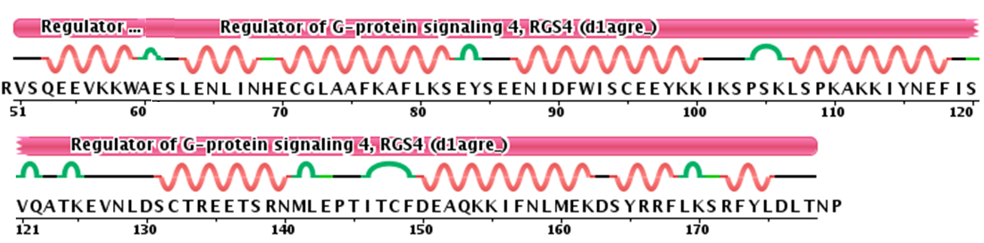
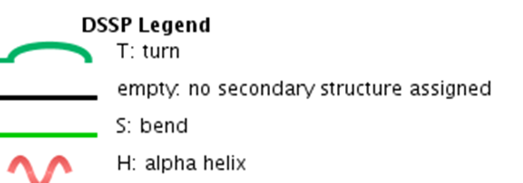
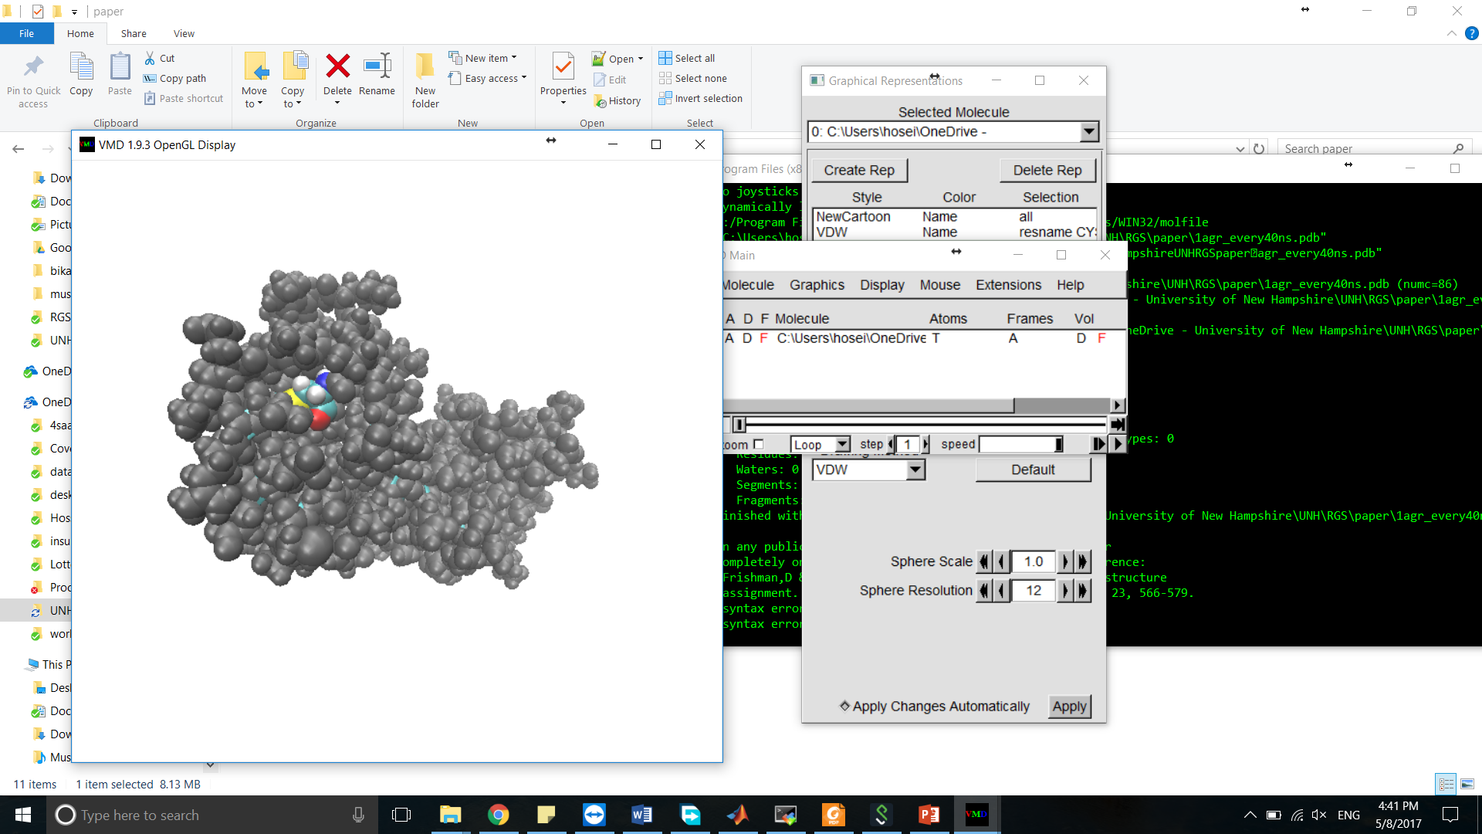
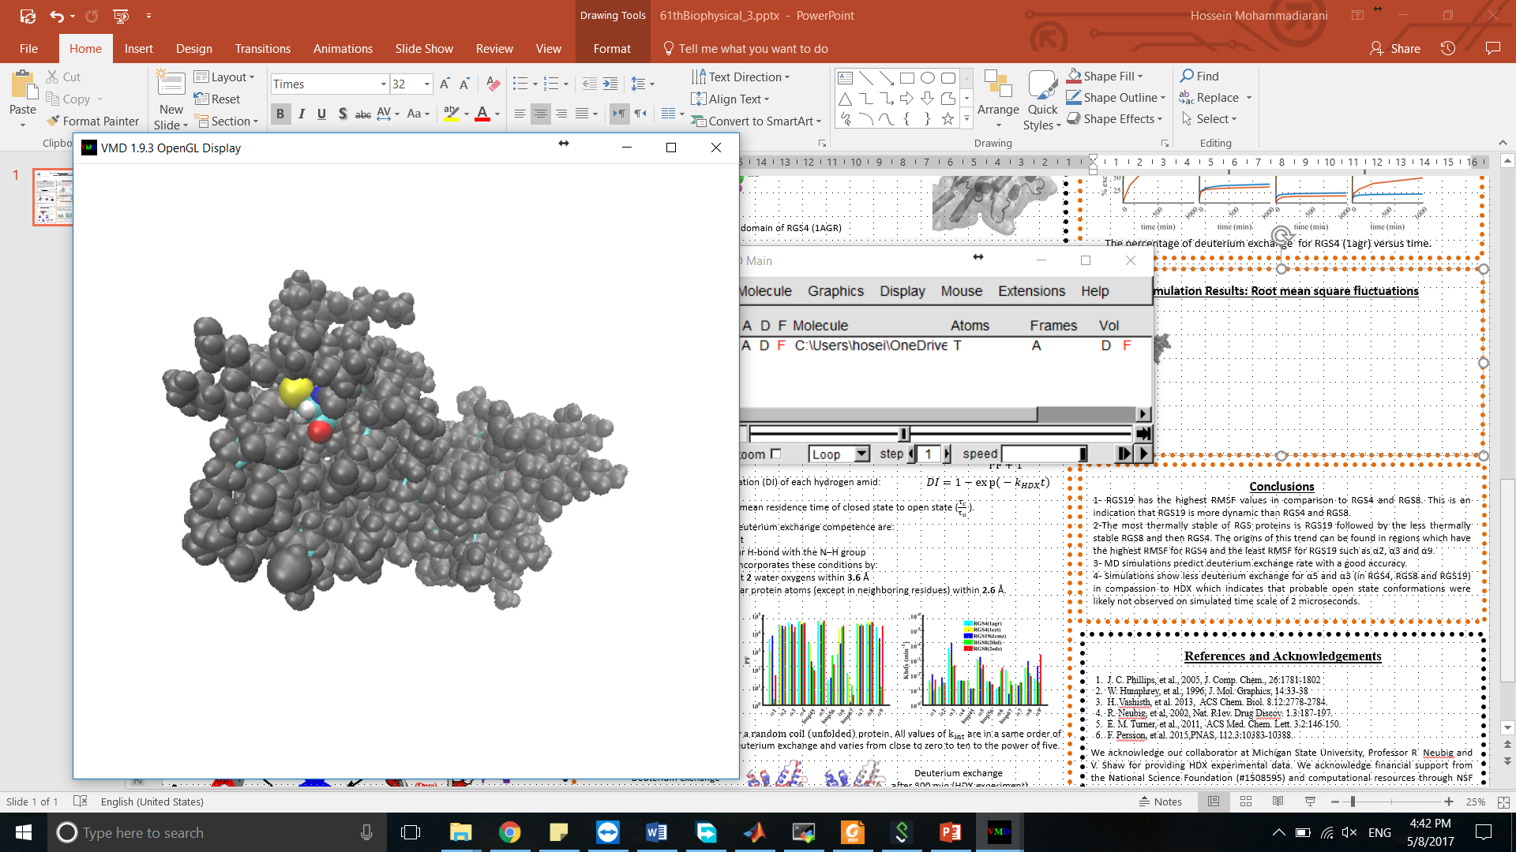
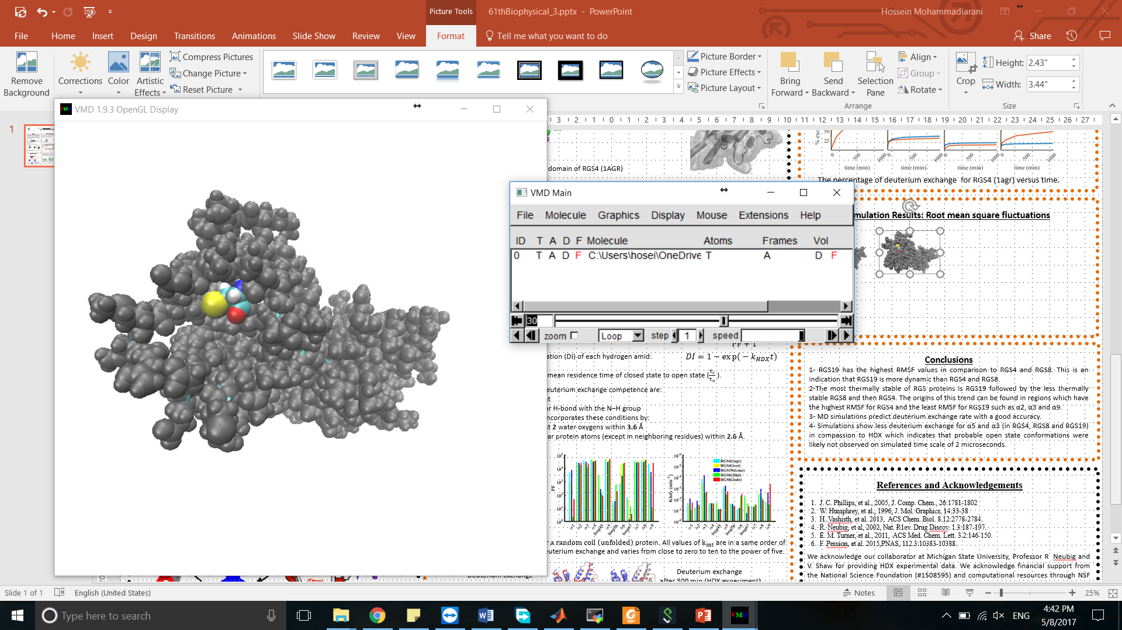
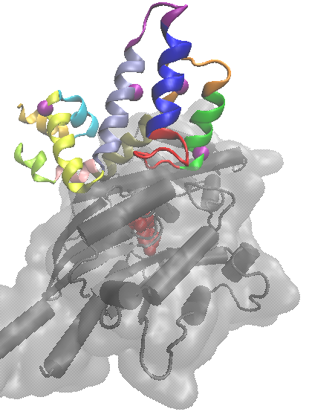
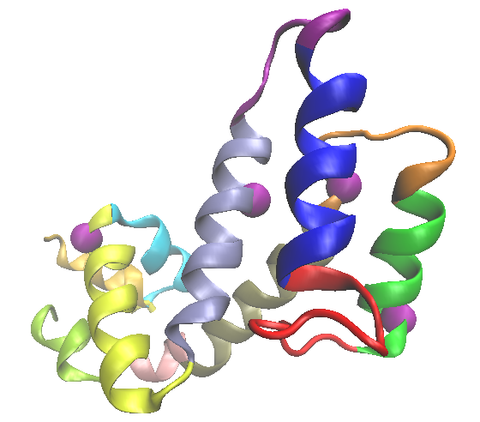
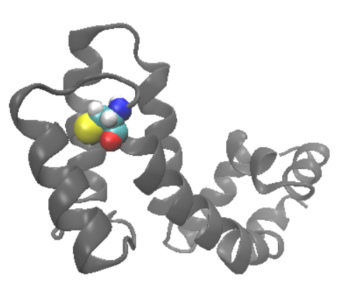
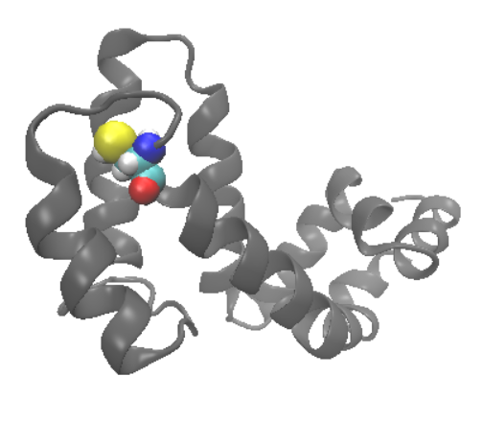
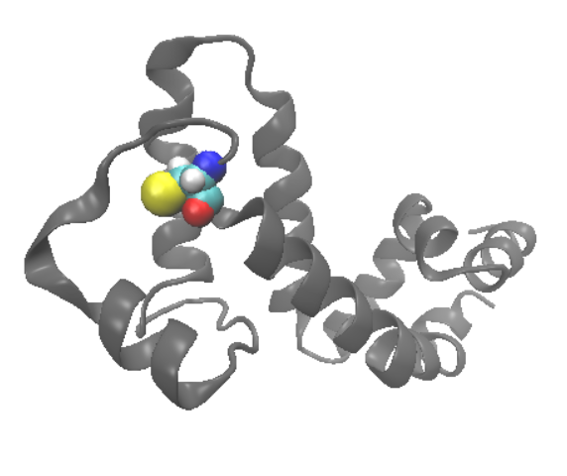
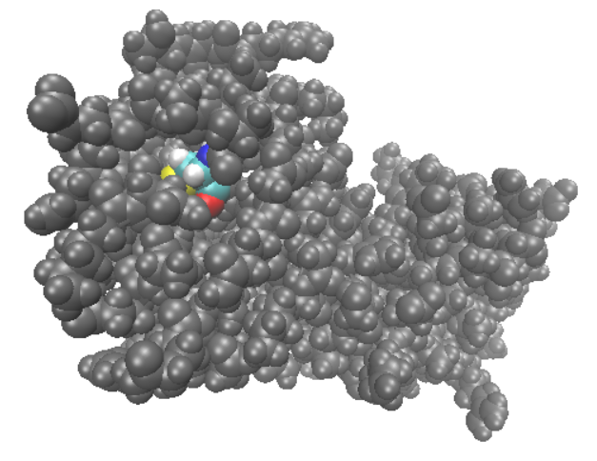
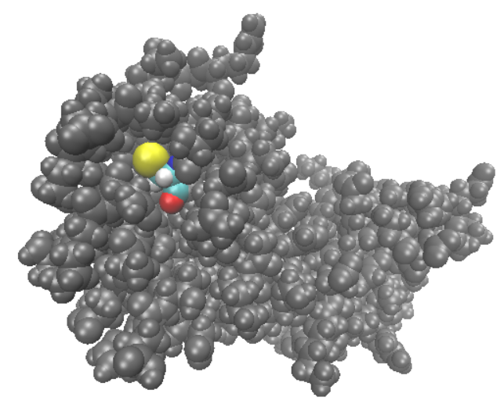
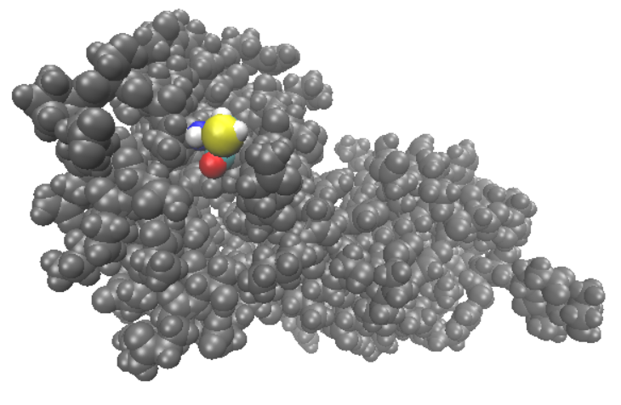
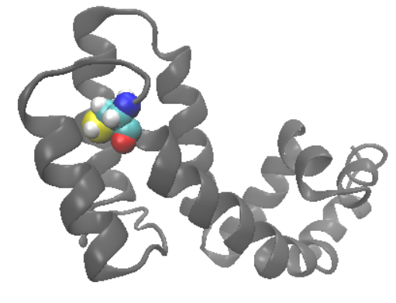
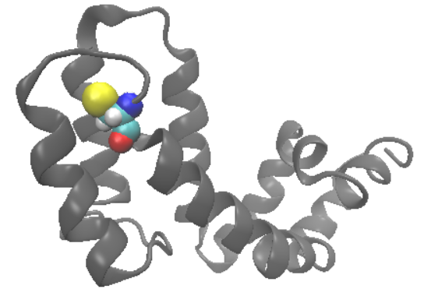
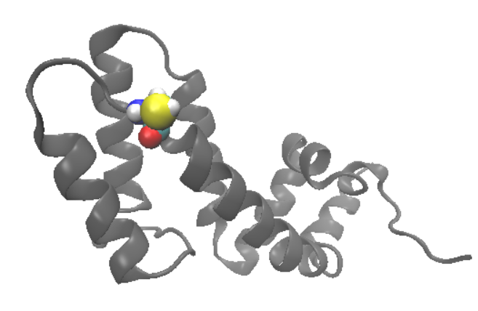
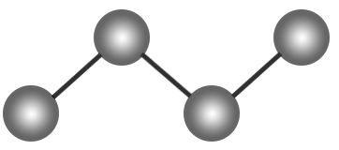
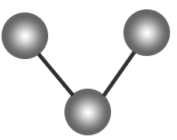

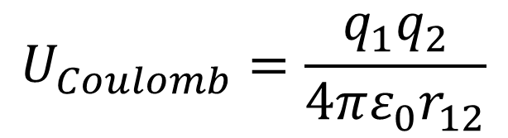
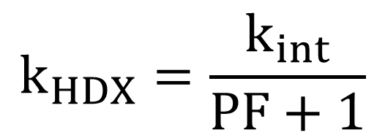
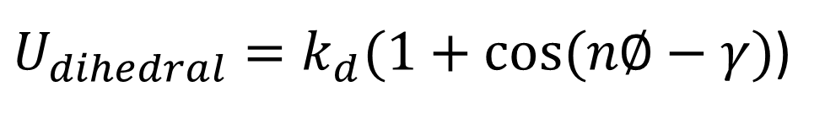
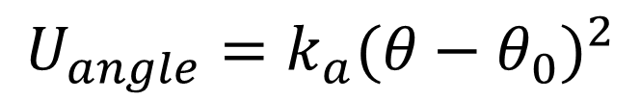
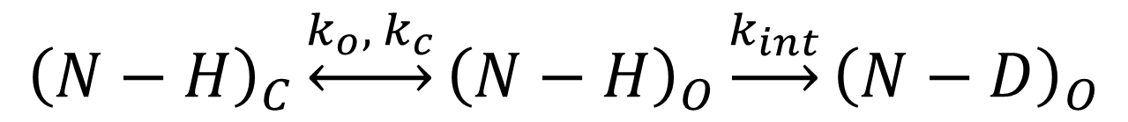
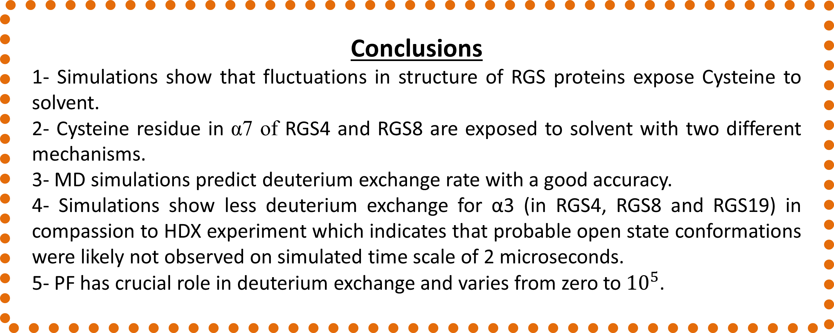

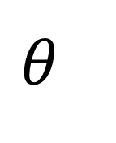

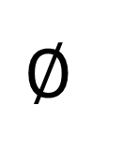
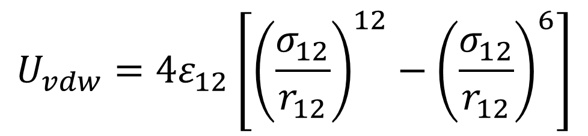
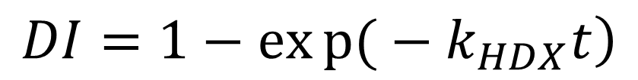
Molecular Dynamics Simulation Studies of Signaling Proteins
Hossein Mohammadiarani and Harish Vashisth
Department of Chemical Engineering, University of New Hampshire, Durham, NH
SUPPORT: National Science Foundation CHE—1508595
Abstract
Regulators of G protein signaling (RGS) proteins modulate GPCR signaling by decreasing the duration and strength of the receptor’s signals with binding to Gα-subunits heterotrimeric G proteins. RGS is a therapeutic target to be directly or allosterically inhibited from binding to Gα. We have studied two structures of RGS4, two structures of RGS8 and one structure of RGS19 by conventional molecular dynamics each of which was 2 µsec long with AMBER and CHARMM forcefields. Analyzing the trajectories reveals high fluctuations in α5, α6 and the loops are connected to these moieties. These perturbations are in the interface of RGS-Gα residues and in the vicinity of cysteine which is target for binding allosteric inhibitors. These findings help in developing new drug molecules which may be fitted in the perturbed pockets in RGS proteins.
Structure and Sequence of RGS Proteins
Simulation Results: Exposure of Cystein to solvent
Cysteine (which is prone to form bond with inhibitor) in α7 is exposed to solvent with two different mechanisms:
expansion of pocket (happens in RGS4)
B) rotation of residue (happens in RGS8)
A)
loopN
α5
RGS4 - PDB: 1AGR
α4
loopC
Methods and Software
NAMD (NAnoscale Molecular Dynamics) is a parallel molecular dynamics code designed for high performance simulation of large systems of particles based on Newtonian equation of motion:
VMD (Visual Molecular Dynamics) is a molecular visualization software for displaying and analyzing MD simulations.
α1
α2
RGS4-Gi.α1 complex
0 μs
1.2 μs
α3
α6
0.8 μs
α3
α8
α7
loopN
B)
$m_{i}\vec{{\ddot{r}}_{i}}=−\frac{∂}{∂\vec{r}}U_{total} i=1, 2, 3,…,N$
Cartoon representations of the box domain of RGS4 (1AGR)
$U_{total}=U_{bond}+U_{angle}+U_{dihedral}$+$U_{vdw}$+$U_{coulomb}$
MD Simulations of RGS Proteins (RGS4, RGS8, RGS19)
RGS8 - PDB: 2ODE
$$U_{Coulomb}=\frac{q_{1}q_{2}}{4πε_{0}r_{12}}$$
$$U_{vdw}=4ε_{12}\left[{\left(\frac{σ_{12}}{r_{12}}\right)}^{12}−{\left(\frac{σ_{12}}{r_{12}}\right)}^{6}\right]$$
Equilibration simulation parameters:
RGS immersed in water box (~70 Å x ~65 Å x ~65 Å )
Neutralized in saline water (0.05 mol/L KCl)
Periodic boundary conditions
Number of atoms: ~29000 atoms
Equilibration steps:
1- 0.4 ns in NPT ensemble
2- ~ 2 µs in NVT ensemble
$$∅$$
$$θ$$
$$r$$
Force fields:
CHARMM force filed (CHARMM36, tip3p)
AMBER force filed (ff14SB, tip3p)
0 μs
0.9 μs
2 μs
Simulation Results: HDX kinetic rate from MD simulations
$U_{dihedral}=k_{d}(1+cos⁡(n∅−γ)$)
$$U_{angle}=k_{a}{(θ−θ_{0})}^{2}$$
$$U_{bond}=k_{b}{(r−r_{0})}^{2}$$
The reaction path for HDX :
$${\left(N−H\right)}_{C}\underset{↔}{k_{o}, { k}_{c}}{\left(N−H\right)}_{O}\underset{→}{k_{int}}{\left(N−D\right)}_{O}$$
The superficial HDX kinetic rate is a function of PF and intrinsic kinetic rate:
$$k_{HDX}=\frac{k_{int}}{PF+1}$$
$k_{int} is the intrinsic kinetic rate for a random coil \left(unfolded\right)$protein.
Conclusions
1- Simulations show that fluctuations in structure of RGS proteins expose Cysteine to solvent.
2- Cysteine residue in α7 of RGS4 and RGS8 are exposed to solvent with two different mechanisms.
3- MD simulations predict deuterium exchange rate with a good accuracy.
4- Simulations show less deuterium exchange for α3 (in RGS4, RGS8 and RGS19) in compassion to HDX experiment which indicates that probable open state conformations were likely not observed on simulated time scale of 2 microseconds.
5- PF has crucial role in deuterium exchange and varies from zero to${10}^{5}$.
Role of RGS Proteins in GPCR Signaling
PF can be expressed as the ratio of mean residence time of closed state to open state ($\frac{τ_{c}}{τ_{o}}$ ).
The fraction of deuterium incorporation (DI) of each hydrogen amid is calculated by:
$$\left.DI=1−exp{(}−k_{HDX}t\right)$$
The two necessary conditions for deuterium exchange competence are:
1- direct access to external solvent
2- disruption of any intramolecular H-bond with the N–H group
In this work, open state definition incorporates these conditions by:
1- the amide hydrogen has at least 2 water oxygens within 3.6 Å
2- the amide hydrogen has no polar protein atoms (except in neighboring residues) within 2.6 Å.
References and Acknowledgements
J. C. Phillips, et al., 2005, J. Comp. Chem., 26:1781-1802
W. Humphrey, et al., 1996, J. Mol. Graphics, 14:33-38
H..Vashisth, et al. 2013, ACS Chem. Biol. 8.12:2778-2784.
R. Neubig, et al, 2002, Nat. R1ev. Drug Discov. 1.3:187-197.
E. M. Turner, et al., 2011, ACS Med. Chem. Lett. 3.2:146-150.
F. Persson, et al. 2015,PNAS, 112.3:10383-10388.
These figures represent comparison of computational HDX and experimental HDX. MD simulations are able to precisely predict deuterium incorporation particularly with CHARMM forcefield.
We acknowledge our collaborator at Michigan State University, Professor R. Neubig and V. Shaw for providing HDX experimental data. We acknowledge financial support from the National Science Foundation (#1508595) and computational resources through NSF XSEDE mechanism (#TG-MCB140029) and a Cray supercomputer at UNH (supported via NSF#PHY-1229408).
Notes:
G-protein-coupled receptors (GPCR’s): these are the largest of all the cell surface receptors. They activate membrane-bound, trimeric GTP binding proteins (G-proteins) which then activate either an enzyme or an ion channel (effector) in the plasma membrane, initiating a sequence of other effects. These receptors mediate responses involving hormones, local mediators and neurotransmitters. Due to the large variety of cellular processes that GPCR’s are involved in, they are usually an attractive target for the development of drugs to treat a variety of disorders. About half of all known drugs work through GPCR’s. All GPCR’s have been analysed and are believed to have similar structures. A signalling molecule binds to a GPCR which causes a conformational change in the receptor. The GPCR now binds to an inactive G-protein, causing a GTP to displace the GDP (nucleotide exchange) on the alpha subunit of the G-protein. The GTP-bound G-alpha dissociates from the G-beta/gamma complex and the GPCR and binds to a specific effector and activates it, triggering a cascade of responses (Figure 7).

