Slide 1


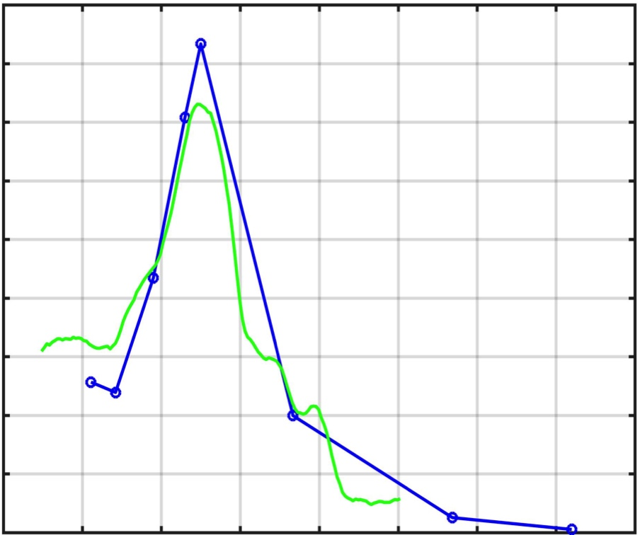
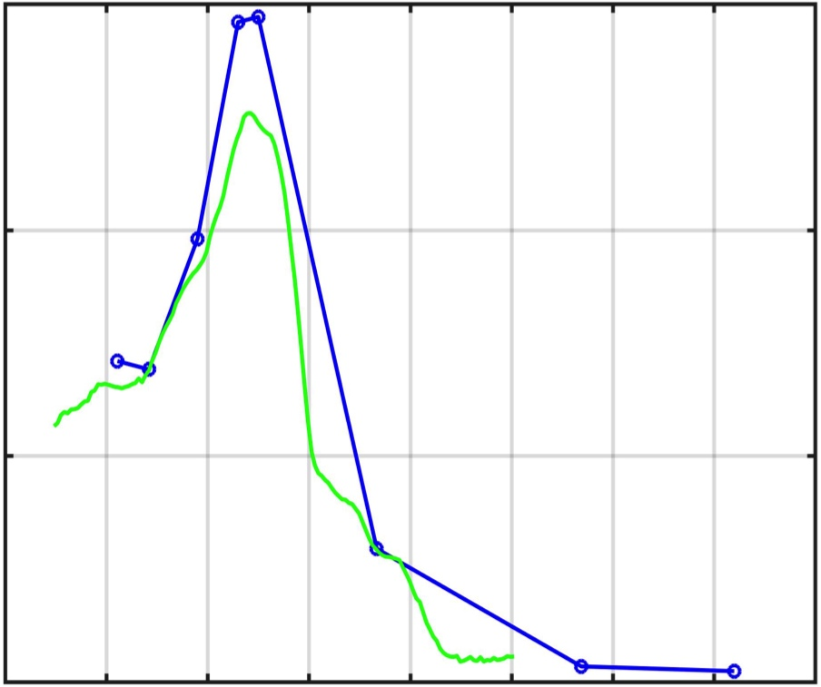
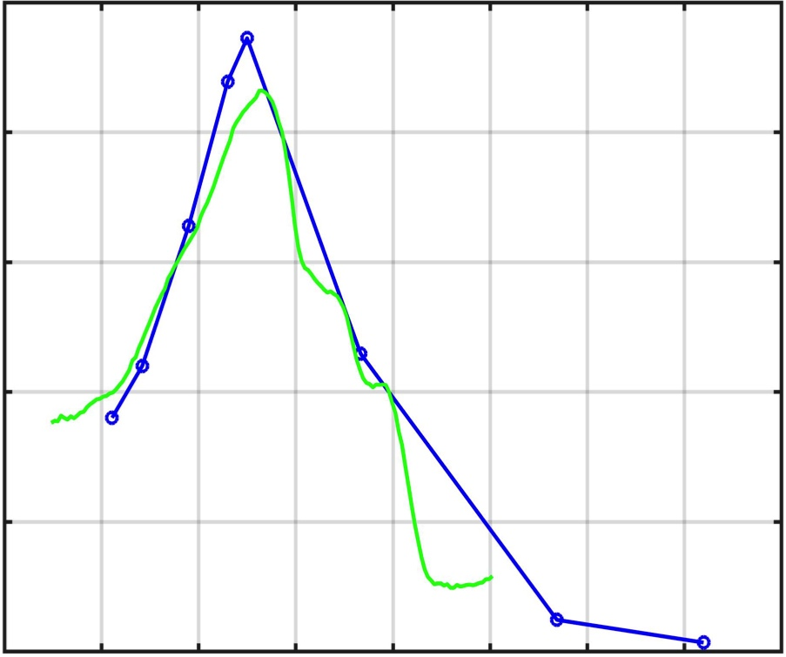
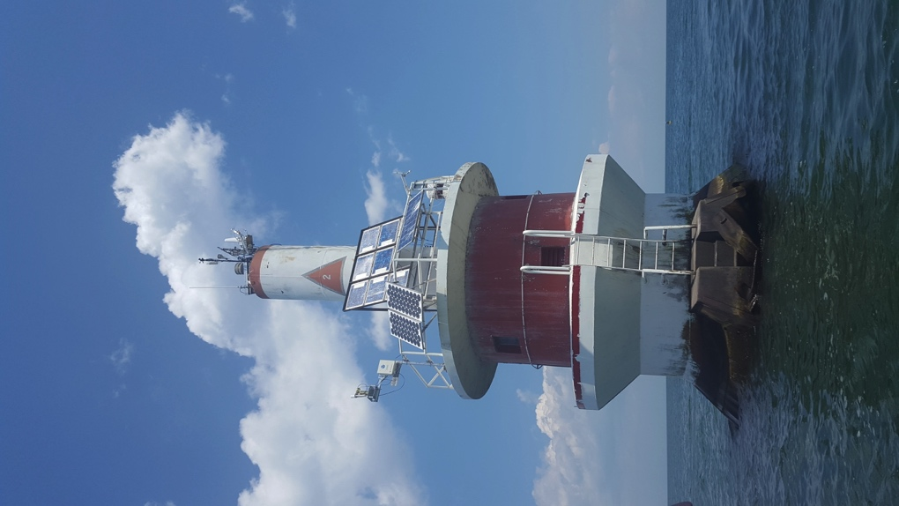
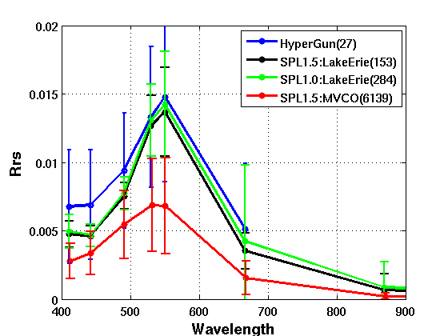
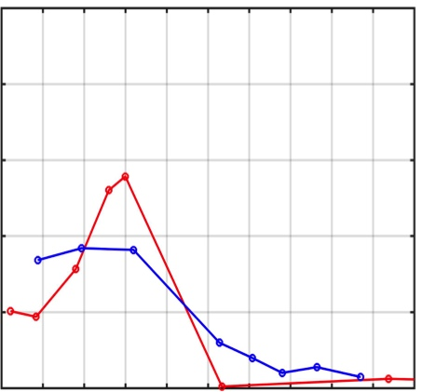
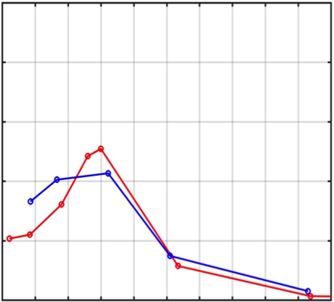
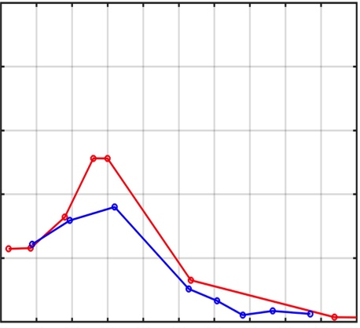
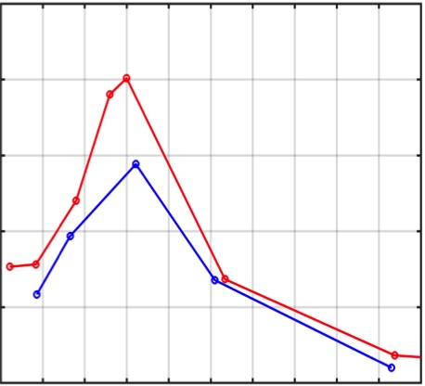
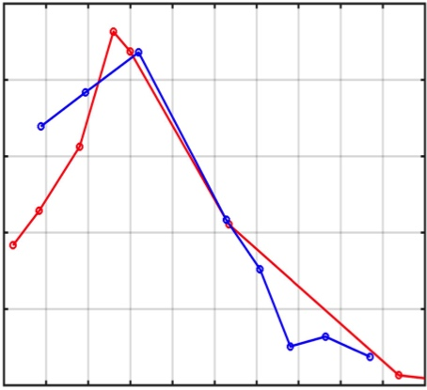
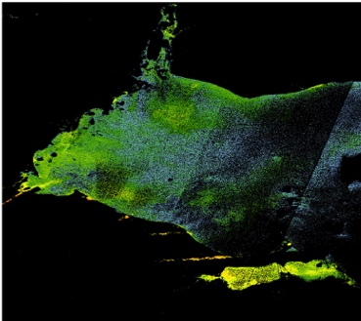
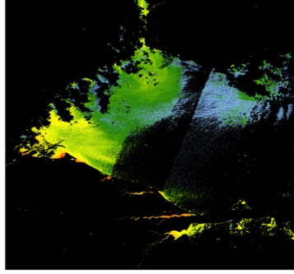
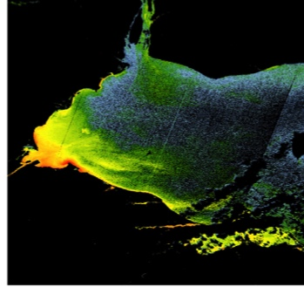
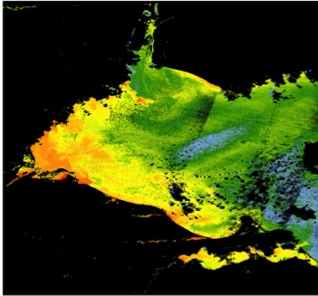
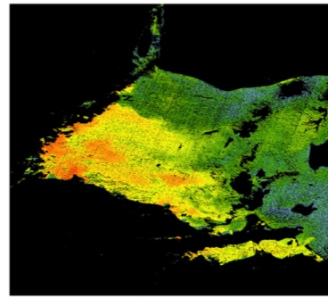
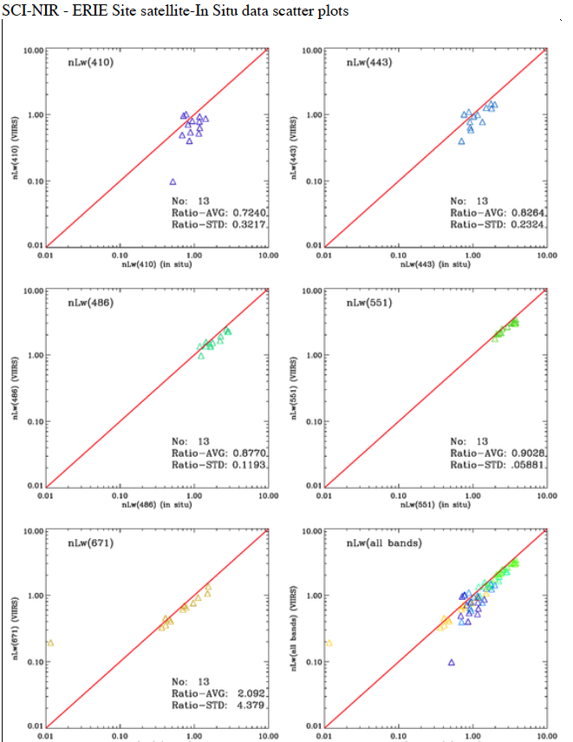
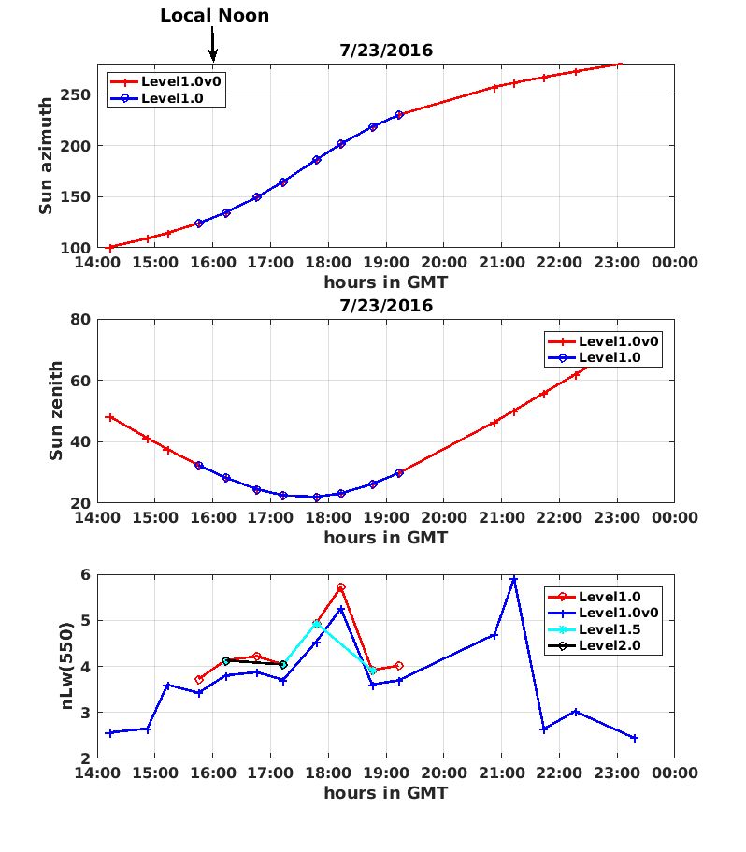
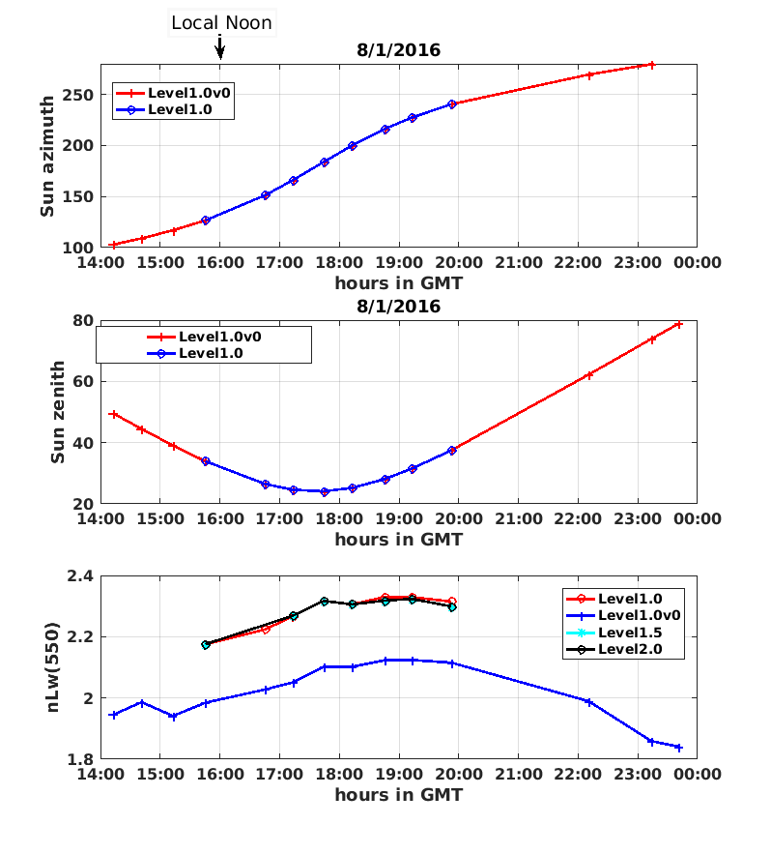
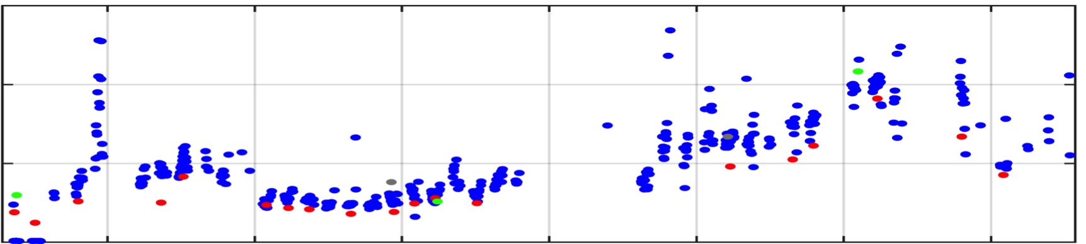
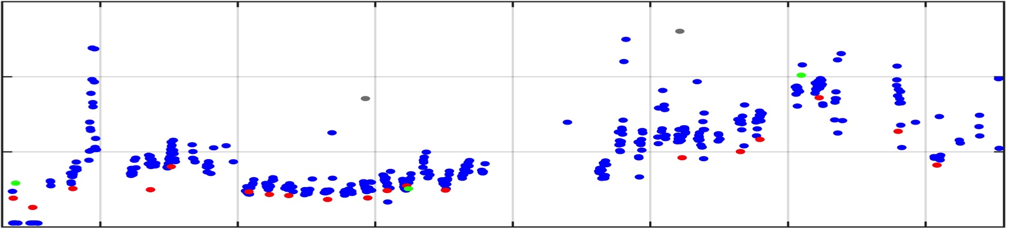
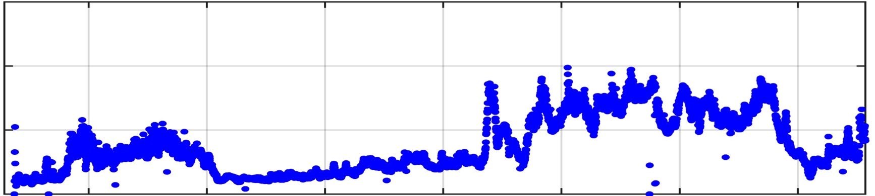
Preliminary results from SeaPRISM measurements in western Lake Erie
Timothy S. Moore¹, Hui Feng¹, Steve Ruberg², Menghua Wang³, Paul DiGiacomo³, Veronica Lance³, Ron Muzzi², Tom Johengen⁴, Steve Constant², and Kyle Beadle²
¹University of New Hampshire, Durham, NH
²Great Lakes Environmental Research Laboratory, NOAA, Ann Arbor, MI
³NOAA/NESDIS Center for Satellite Applications and Research (STAR), College Park, MD
⁴Cooperative Institute for Limnology and Ecosystems Research, University of Michigan, Ann Arbor, MI USA
Abstract
In the summer of 2016, a SeaWiFS Photometer Revision for Incident Surface Measurements (SeaPRISM) instrument was deployed in western Lake Erie and integrated into the AERONET-OC network (Figure 1). This is the first lake SeaPRISM deployment in North America, serving as a Cal/Val site supporting ocean color remote sensing data product evaluation, and as part of an observational system for real-time monitoring of water quality for GLERL’s HAB program. The site location is at a boundary between cyanobacteria and cyanobacteria-free waters, providing a window into the optical dynamics of this region, including cyanobacteria bloom formation, diurnal development floating cyanobacteria mats, and turbidity responses to wind events. Matchup data sets with satellite sensors were developed for NASA’s VIIRS and Landsat-8/OLI, and ESA’s Sentinel-2A/MSI. Initial results indicate good performance of these sensors in a turbid lake environment. In 2017, we will deploy a new 12-channel version that will include bands in the red/NIR region, important for lake cyanobacteria monitoring.
July 25, 2016
0.015
August 1, 2016
0.025
August 29, 2016
0.016
Chla = 11.4 ug/L
Chla = 4.2 ug/L
0.020
Chla = 10.0 ug/L
Results (cont’d)
Matchup data with Satlantic hyperspectral radiometer shows good agreement (Figure 3).
Lake Erie waters are turbid, and R_{rs} is higher compared to coastal waters (Figure 4).
Matchup data with L8/OLI and S2A/MSI shows good agreement with shape, but lower green R_{rs} for both sensors compared to SeaPRISM (Figure 5).
Matchup data with VIIRS processed by NOAA shows very good agreement across wavelength (Figure 6).
There is a shadow effect from the tower on the daily radiances measured by the SeaPRISM mostly impacting morning measurements (Figure 7).
0.012
0.010
SeaPRISM
R_{rs} (sr⁻¹)
Hypergun
0.015
0.008
0.005
0.010
0.004
400
600
800
1000
400
600
800
1000
0.005
400
600
800
1000
Wavelength (nm)
Figure 3. SeaPRISM vs in situ Satlantic Hypergun
SeaPRISM 1.0v0 data and SeaPRISM nLw data converted to R_{rs} (nLw/F0)
SeaPRISM R_{rs} in green bands are slightly higher than Hypergun.
SeaPRISM 490 & 667nm band in good agreement with Hypergun.
More in situ Hypergun matchup data will be needed to understand differences.
HyperGun: Hyperspectral above-water measurements in Lake Erie at SeaPRISM site (2013-2015)
SPL1.5LakeErie: SeaPRISM Level1.5 in Lake Erie ( inland water)
SPL1.0LakeErie: SeaPRISM Level1.0 in Lake Erie ( inland water)
SPL1.5MVCO: SeaPRISM Level1.5 in MVCO ( coastal ocean )
Jul 19, 2016
Aug 7, 2016
Aug 8, 2016
Aug 23, 2016
Aug 28, 2016
0.02
S2A
L8
S2A
L8
S2A
sr⁻¹
satellite
0.01
SeaPRISM
400
600
λ
800
400
600
λ
800
400
600
λ
800
400
600
λ
800
400
600
λ
800
sr⁻¹
Rrs664
Rrs655
Rrs664
0.09
Rrs655
Rrs664
Figure 1. The SeaPRISM was mounted on the west side of a Coast Guard tower in western Lake Erie, at approximately 6m height and 8 km from the nearest shoreline. The tower is part of NOAA GLERL’s real-time observational network (ReCON), equipped with instruments that measure a variety of atmospheric and water properties.
0.025
0.015
Figure 4. Erie SeaPRISM compared with MVCO SeaPRISM
SeaPRISM at MVCO measurements much lower in comparison (coastal ocean vs. turbid/eutrophic lake).
SeaPRISM Lake Erie measurements compare well with collected radiometry at site by NOAA GLERL.
0.006
Figure 5. Erie SeaPRISM matchups with L8/OLI and S2A/MSI
Five images from L8/OLI (2) and S2A/MSI (3) were matched during the time period.
MSI and OLI images were processed with Acolyte.
Spectral shapes are similar across varying conditions.
Red bands show good agreement for both sensors.
0.0004
Methods & Data
The 9-channel SeaPRISM was deployed on July 19, 2016.
Standard channel configuration: 411, 442, 491, 530, 550, 667, 869, 1020 nm.
A NOAA buoy with Chl, PC and CDOM fluorescence sensors recorded measurements at 15 intervals was adjacent to the tower location.
Discrete water samples were measured weekly over the summer at the tower location.
Hyperspectral above-water radiance was measured weekly at the site with a Satlantic Hypergun.
VIIRS data were processed by NOAA NESDIS.
Landsat-8 and Sentinel-2 data were processed with Acolite.
Daily variations in Rrs
Results
SeaPRISM collected data from July 19, 2016 to Sept. 7, 2016.
Time series shows many clear days during operating period (Figure 2).
Conditions at the site included surfacing cyanobacteria colonies (Jul 23), change in water mass to clearer waters in early August, and development of increasing cyanobacteria at end of August.
In-water turbidity sensor and algorithm turbidity (Nechad et a. 2009) show good agreement.
0.015
R_{rs}
Figure 6. NOAA VIIRS STAT Science Quality (NIR): AERONET LAKE ERIE Site Ocean Color Data Matchups. https://www.star.nesdis.noaa.gov/sod/mecb/color/CalVal.php
VIIRS data are processed using the MSL12 ocean color data processing with the NIR atmospheric correction, including improved NIR water reflectance correction algorithm (called BMW algorithm).
Coincident Matchup data with VIIRS is very good across all wavelengths.
Figure 7. Daily nLw measurements show effects of tower from 2 select days (columns). Top row: Daily solar azimuth and nLw (550nm); bottom: zenith angles and nLw (550nm).
Note that Level1.0v0 used here is the raw data.
July 23 measurements (left) show sharp rise near noon, possibly from cyanobacteria surface aggregation. Aug. 1 measurements show gradual increase likely from tower shading.
Sun azimuth between 120 and 250 degrees is considered acceptable tower shading impact (Zibordi, pers. comm.). Outside the range data is filled “unreasonable”.
0.010
sr⁻¹
0.005
15
Turbidity (R_{rs})
FNU
10
Future considerations
At this site, observations have shown that there is daily variability in near surface optical properties and thus water-leaving radiance. This summer (2017), we will deploy the new 12-channel SeaPRISM with wavelengths centered at: 412, 443, 490, 560, 620, 665, 681, 709, 780, 865, 940, and 1020nm. A primary task will be to investigate on how to best remove or minimize these tower shading in SeaPRISM data in this site.
We will:
Carefully check the sun azimuth Φ₀ and zenith θ₀range thresholds for tower shade perturbations.
Adjust sea-viewing azimuth angle φ wrt. the sun azimuth azimuth Φ₀ to maximize t# of daily measurements without shading impact. Φ=90º is now used, but larger Φ₀ =135º, considered more appropriate, will be tried to see any improvement to avoid tower shadows.
Cross-assessment of above-water measured water leaving radiance by using both SeaPRISM and ASD FieldSpec Pro. The two measurement methods are different in down-welling irradiance incident on the surface.
5
15
Turbidity (buoy)
FNU
10
5
7/24
7/31
8/7
8/14
8/21
8/28
9/4
2016
Figure 2. Erie SeaPRISM time series July 19 – Sep. 7, 2016 at 667nm. Top: Lake Erie SeaPRISM R_{rs} 667nm (blue) and satellite matchups (red: VIIRS, green: Sentinel-2 664nm, grey: Landsat-8 655nm); middle: derived turbidity from Nechad et al. from SeaPRISM and satellite R_{rs}; bottom: turbidity measured by GLERL buoy adjacent to SeaPRISM.
Acknowledgment: We graciously acknowledge the financial support from NOAA’s Satellite & Information Service’s Center for Satellite Applications and Research for funding this activity.

