Slide 1



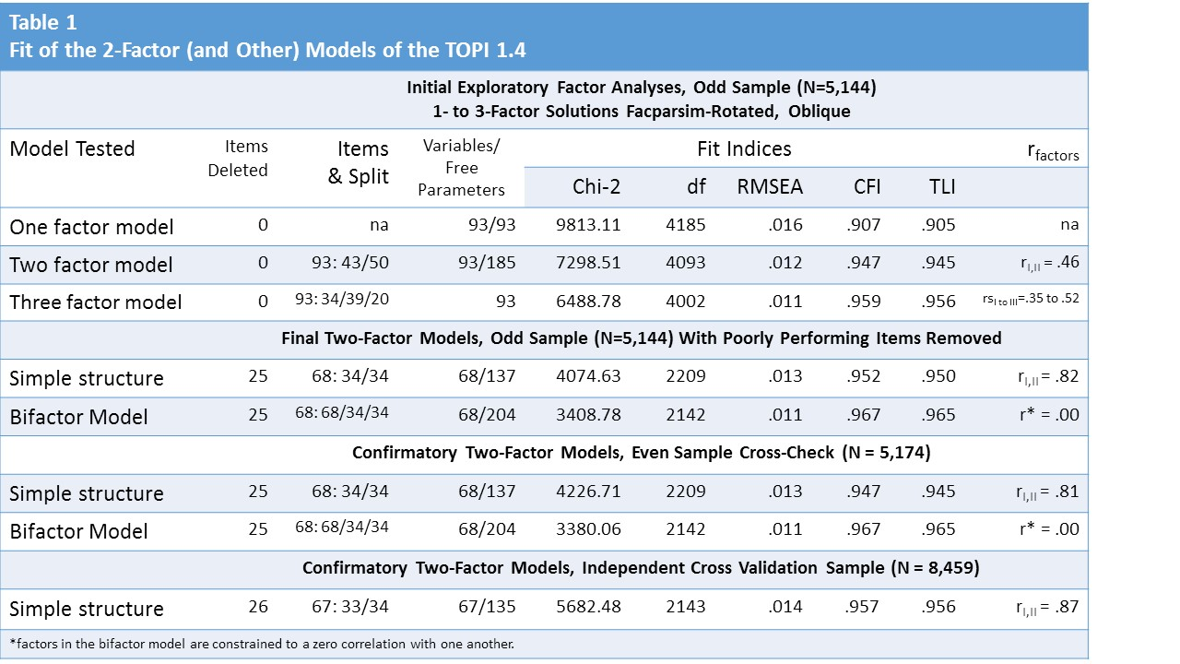
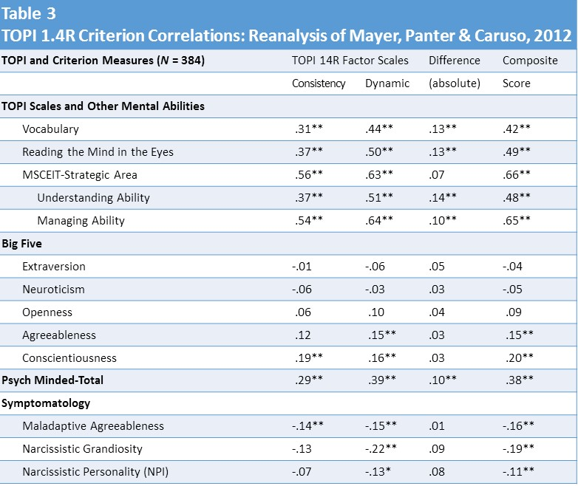

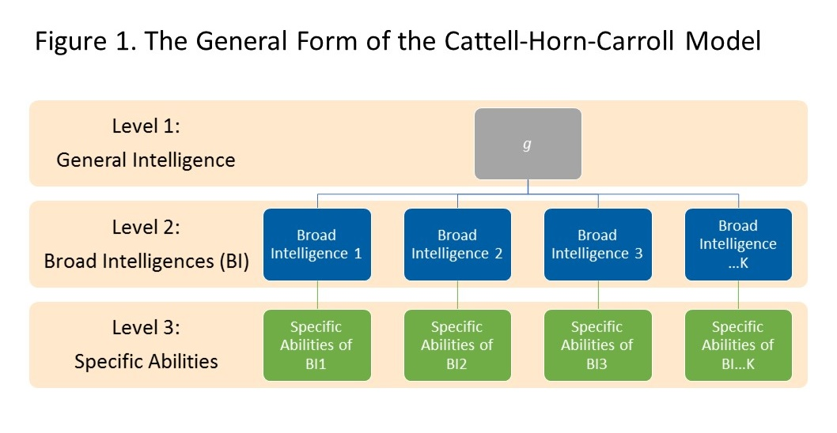
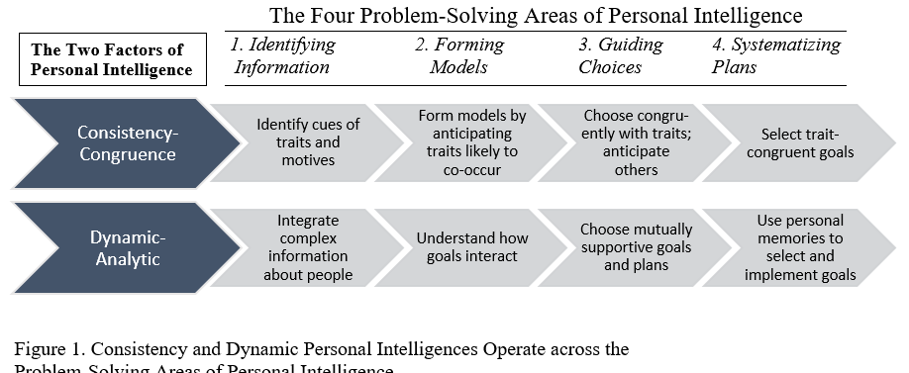
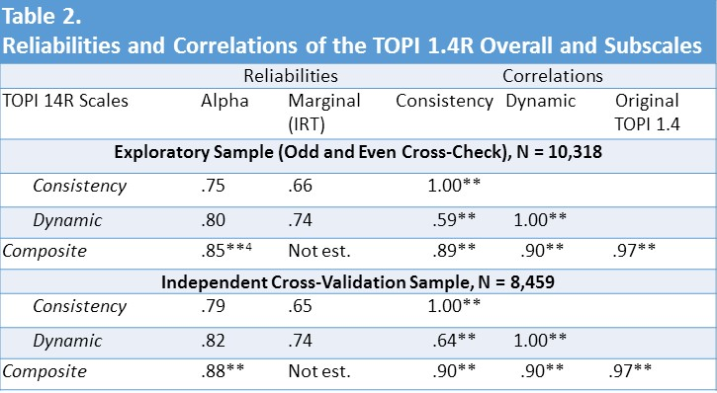
A Closer Look at the Test of Personal Intelligence
John D. Mayer A. T. Panter David R. Caruso
University of New Hampshire University of North Carolina at Chapel Hill Yale University
Overview
Personal intelligence is the capacity to reason about personality and personality-related information. To understand more about the structure of the mental abilities involved in personal intelligence, we fit several factor models to an ability-based test of personal intelligence. A two-factor oblique simple structure model fit the data well. The findings inform us about the nature of abilities people use to understand personality in themselves and others.
Overview of the TOPI Test
The Test of Personal Intelligence Version 1.4
(TOPI 1.4) is an ability-based test developed to measure individuals’ levels of personal intelligence (Mayer, Panter & Caruso, 2012; Mayer & Skimmyhorn, 2017). The test items fall within one of four areas of problem solving just described. A sample item asks:
If a person wants to be with one or more people, talk to them, go out with them, and have a good time, the person is likely going to:
    a. be in love
    b. express warmth toward someone
    c. meet a goal of excellence
    d. socialize
Results
Were the New Scales Predictive of Criteria?
In a further analysis, the two factor scales and their composite exhibited significant relations with g (as a broad intelligences ought to) as well as other relations with criteria comparable to those of the original scale (see Table 3).
Could a Factor Model be Fit to the Test?
We began fitting models by conducting a series of exploratory factor analyses. The 2-factor model exhibited the best fit in the exploratory analysis (Table 1) and appeared interpretable.
Introduction
Personal Intelligence (PI): Quick Background
A number of theories in psychology identify key aspects of understanding personality in oneself and others.
Psychological mindedness is an ability exhibited by some psychotherapy patients to learn about themselves and others (Appelbaum, 1973).
Intra- and interpersonal intelligences include skills for building a coherent identity and understanding other people (Gardner, 1983).
The good judge can perceive the personality of other people more accurately than can an average person (Funder, 2001).
Such concepts share a common focus on the capacity to reason about personality and personality-related information. Mayer (2008; 2014) developed a theory of personal intelligence (parallel to social and emotional intelligences) to synthesize these viewpoints.
The test-taker who answers this item correctly (alternative “d”) must assess the given behaviors and extract from them the most likely motive.
CC 2011 Jeff Tong Photography
Overview of Studies
In order to fit the two-factor model using confirmatory factor analysis, we dropped 25 items, yielding a 68-item test. We then tested a confirmatory factor model: The 2-factor model fit well (Table 1). Subsequently, we dropped one further item based on an IRT model, for a final 67-item test. Model fits for CFI and TLI were around .95 with RMSEA < .02.
Discussion and Conclusions
We tested several factor models of PI by examining item-level responses to the 93-item TOPI 1.4 from two independent samples (Studies 1 and 2), and then created factor-based scales to represent them. We also reanalyzed data from an earlier study (Mayer, Panter & Caruso, 2012) to assess the new tests correlations with criteria (Study 3).
The present research enhances our understanding of the mental abilities underlying personal intelligence. The theory already had specified four key areas of problem solving that help to identify relevant test items to use in measurement:
recognizing personality-relevant information
forming accurate models of personality
guiding choices with such information, and
systematizing plans and goals
Using that division to develop our test-items, we then fit a factor model and concluded that there existed two mental abilities people used to solve such problems: one focused on recognizing the consistencies in personality, and the other more focused on analyzing dynamic and sometimes inconsistent information about a person and making sense of it. The two classifications are depicted together in Figure 2.
Were the Factors Interpretable?
Based on an examination of the highest-loading items on each factor, we identified them as follows:
1. Consistency-Congruence Personal Intelligence (CC). Items loading on this factor asked about consistent patterns across traits. The most common items (20 in number) concerned understanding which socio-emotional traits go together (e.g., liveliness with talkativeness) and how mental states and desires reflect motivational patterns.
2. Dynamic-Analytic Personal Intelligence (DA). Items on this factor involved reasoning about personality dynamics and integrating information. The most common two sets of items (20 altogether) concerned recognizing problematic goals and goal conflicts (e.g., “to be able to please everyone”) and the ability to use personal memories to motivate oneself (e.g., “remembering a careless act that turned out badly so as to be more careful”).
Hypotheses
Our key hypotheses were that:
We could fit a factor model to the test.
The factors would be interpretable.
The resulting factor scales would be reliable.
The scales and their composite would correlate with important criteria.
General and Broad Intelligences
In the Cattell-Horn-Carroll model of intelligences, g (general intelligence), is at the top of a three-tiered hierarchy, with broad intelligences in the middle level and specific skills at the bottom. Figure 1. depicts a schematic illustration.
Methods
Participants
Participants were drawn from three archival samples:
Study 1. 10,318 test-takers drawn from seven samples, mostly from the United States Military, divided into Exploratory (odd-numbered) and Cross-Check (even-numbered) participant subsamples
Study 2. An independent sample of 8,459 military personnel
Study 3. A reanalysis of a sample of 384 test-takers from Mayer, Caruso & Panter, 2012
Were the Factor Scales and Test Composite Reliable?
Both scales yielded coefficient alpha reliabilities of .75 or higher (as did their composite), and exhibited similar, although slightly lower, marginal reliabilities using an IRT model. The latter result was probably owing to less precision of measurement at the higher end of the test scale. The two factors exhibited obtained correlations of r = .59 to 64 across studies (see Table 2 for details).
Figure 2. Consistency and Dynamic Personal Intelligence Operate across the Problem-Solving areas of Personal Intelligence
Key Sources
Measures
The 93-item Test of Personal Intelligence (Version 1.4) described earlier
Assorted criterion scales in Study 3, including:
  A measure of the Big-Five
  Psychological mindedness
  Psychopathological symptom checklists
  The Mayer-Salovey-Caruso Emotional Intelligence Test
  The Reading the Mind in the Eyes Test (a measure of interpersonal sensitivity), and
  An estimate of g (a vocabulary measure)
Appelbaum, S. A. (1973). Psychological-mindedness: Word, concept and essence. The
International Journal of Psychoanalysis, 54(1), 35-46.
Gardner, H. (1983). Frames of mind: The theory of multiple intelligences. New York, NY US: Basic Books.
Funder, D. C. (2001). Accuracy in personality judgment: Research and theory concerning an obvious question. In R. Hogan (Ed.), Personality psychology in the workplace. (pp. 121-140). Washington, DC US: American Psychological Association. doi:10.1037/10434-005
Jeff Tong Photography (2011) Tech Cocktail DC Winter 2011 DSC_7076. Downloaded from: https://www.flickr.com/photos/techcocktail/5412733912
Mayer, J. D. (2008). Personal intelligence. Imagination, Cognition and Personality, 27(3), 209-232. doi:10.2190/IC.27.3.b
Mayer, J. D. (2014). Personal intelligence: The power of personality and how it shapes our lives. New York: Scientific American / Farrar Strauss & Giroux.
Mayer, J. D., Panter, A. T., & Caruso, D. R. (2012). Does personal intelligence exist? evidence from a new ability-based measure. Journal of Personality Assessment, 94, 124-140. doi:10.1080/00223891.2011.646108
Mayer, J. D., & Skimmyhorn, W. (2017). Personality attributes that predict performance of cadets at West Point. Journal of Research in Personality, 66, 14-16.
Personal Intelligence as a Broad Intelligence
We regard personal intelligence as a broad intelligence parallel in many respects to verbal, spatial, and perceptual- organizational intelligences. The theory of personal intelligence divides it into four problem-solving areas:
to recognize personality-relevant information
to form accurate models of personalities
to guide oneself and others’ choices using personality.
to systematize one’s plans so as to achieve one’s aims
Reference: Mayer, J. D., Panter, A. T. & Caruso, D. R. (2017, June). A Closer Look at the Test of Personal Intelligence (TOPI). Poster presented at the biennial meeting of the Association for Research in Personality, Sacramento, CA.

