Slide 1

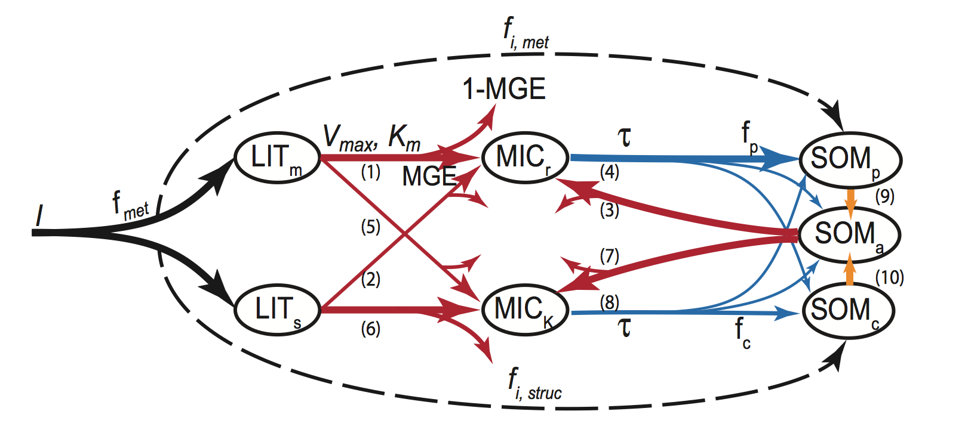
The MIcrobial-MIneral Carbon Stabilization model with coupled N cycling (MIMICS-CN) simulates litter decomposition and soil organic matter dynamics at landscape scales
Emily Kyker-Snowman¹, Will Wieder², Stuart Grandy¹
¹University of New Hampshire, ²National Center for Atmospheric Research
Abstract
Model evaluation: Simulating C and N losses from litter in the LIDET dataset
Model application:
Exploring plant-soil interactions in MIMICS-CN
Microbes are increasingly recognized as critical mediators of climate change effects on soil carbon (C) and nitrogen (N) transformations, both in field studies and theoretical models. The MIcrobial-MIneral Carbon Stabilization model with coupled nitrogen cycling (MIMICS-CN) uses explicit microbial dynamics and microbe-mineral interactions to simulate measured patterns of C and N cycling at landscape scales. The model simulates C and N losses from litterbags in the LIDET study (6 litter types, 10 years of observations, 14 sites across North America) with reasonable accuracy (C: R²=0.61; N: R²=0.29). MIMICS-CN simulations of litterbag N dynamics are as good or better than DAYCENT simulations of the same data based on root mean square error. Across the 14 simulated LIDET sites, MIMICS-CN produces reasonable equilibrium values for total soil C and N, microbial biomass C and N, respiration, inorganic N, and N mineralization rate. We also simulated several idealized litter addition experiments at one of the LIDET sites (Harvard Forest) to explore plant-soil interactions and transient model behavior across microbial and mineral pools. Unlike first-order models where added litter can only result in increases in soil organic matter (SOM) pools, MIMICS-CN allows fresh litter additions to stimulate microbially-mediated C losses and N release from SOM pools.
MIMICS-CN can reproduce site and litter quality effects on litter decomposition C and N dynamics at a landscape scale.
MIMICS-CN can produce dynamic non-linear patterns of C and N response to perturbation (i.e. priming) that are impossible in a linear decomposition model.
Model formulation
Figure 3. MIMICS-CN simulations of C losses (top) and N remaining (bottom) from litterbags in the LIDET dataset versus observed values across litter types (left) and biomes (right).
MIMICS-CN represents C and N flow through metabolic and structural litter, oligotrophic and copiotrophic microbes, and physically protected, chemically protected, and available SOM pools. C dynamics are driven by reverse Michaelis-Menten kinetics, while N dynamics are driven by input and microbial C:N. N leaves the model as leaked inorganic N and C leaves the model as respired CO₂.
MIMICS-CN improves upon DAYCENT simulations.
Table 2. MIMICS-CN performs as well or better than the DAYCENT model at simulating N decomposition dynamics in litterbags based on root mean square error (RMSE).
Figure 6. MIMICS-CN modeled responses to 4 types of pulse input: metabolic litter (black), structural litter (red), simple C added to the “available” SOM pool (green), and desorption of SOM from the “physically protected” pool to the “available” pool (blue). In the first 3 simulations, enough C was added to equal 1% of the total soil C; in the last simulation, no C was added but a similar about of C was transferred between pools to simulate disruption of organo-mineral associations by plant exudates. The model was spun up to equilibrium at Harvard Forest and run for 15 years following each perturbation. Figure panels show model responses for C (left) and N (right) and show either percent change in instantaneous C or N loss rates (top) or cumulative C or N lost relative to equilibrium values (bottom). Dashed lines in lower plots show the amount of C or N added in each type of pulse input.
Parameter | Value (g/g)
CNs | 85
CNm | 12
CNr | 6
CNk | 10
NUE | 0.85
Figure 4. MIMICS-CN captures immobilization-mineralization thresholds across litters of different quality. Litter quality (in terms of C:N and lignin content) decreases from upper left panel to lower right panel. Red dots show model simulations of C losses vs N losses from litterbags in the LIDET study. Colored dots show observed C vs N losses across biomes.
DIN
MIMICS-CN can produce reasonable equilibrium values for a wide range of pools and fluxes.
Table 3. Ranges of MIMICS-CN estimates of steady-state values for a variety of soil pools and fluxes, compared against observed ranges from several continent-wide data synthesis studies. The first column of MIMICS-CN values shows values as calculated in the LIDET site simulations, while the second shows a set of simulations in which turnover was increased 3-fold. MIMICS-CN simulates mineral soils to a depth of 30 cm.
Conclusions
Figure 1. MIMICS-CN model structure and stoichiometric parameters unique to the coupled C-N model. CNs = C:N of structural litter, CNm = C:N of metabolic litter, CNr = C:N of copiotrophs, CNk = C:N of oligotrophs, and NUE = nitrogen use efficiency of both microbial groups.
MIMICS-CN can reproduce site and litter quality effects on litter decomposition C and N dynamics at a landscape scale.
MIMICS-CN improves upon DAYCENT simulations of the same data.
MIMICS-CN can produce reasonable equilibrium values for a wide range of pools and fluxes.
MIMICS-CN can produce dynamic non-linear patterns of C and N response to perturbation (i.e. priming) that are impossible in a linear decomposition model.
Site | MAT (◦C) | MAP (mm) | ANPP (g C m⁻² y⁻¹)
Arctic (ARC) | -7 | 327 | 141
Bonanza Creek (BNZ) | -5 | 403 | 300
Niwot Ridge (NWT) | -3.7 | 1249 | 199
Hubbard Brook (HBR) | 5 | 1396 | 704
Cedar Creek Reserve (CDR) | 5.5 | 823 | 277
Harvard Forest (HFR) | 7.1 | 1152 | 744
Andrews Forest (AND) | 8.6 | 2309 | 800
Shortgrass Steppe (SGS) | 8.9 | 440 | 116
Kellogg Bio. Station (KBS) | 9.7 | 890 | 431
Coweeta (CWT) | 12.5 | 1906 | 1460
Konza Prairie (KNZ) | 12.8 | 791 | 443
Jornada (JRN) | 14.6 | 298 | 229
Sevilleta (SEV) | 16 | 254 | 184
Luquillo (LUQ) | 23 | 3363 | 1050
Acknowledgements
This material is based upon work supported by the National Science Foundation Graduate Research Fellowship under Grant No. DGE-1450271 and by the National Institute of Food and Agriculture, U.S. Department of Agriculture, under Project No. 2015-35615-22747.
Contact me: ek2002@wildcats.unh.edu
Figure 2. LIDET sites included in model simulations. Map borrowed from:
Harmon, M. E. et al. (2009). Long-term patterns of mass loss during the decomposition of leaf and fine root litter: an intersite comparison. Global Change Biology, 15: 1320–1338.

