Slide 1

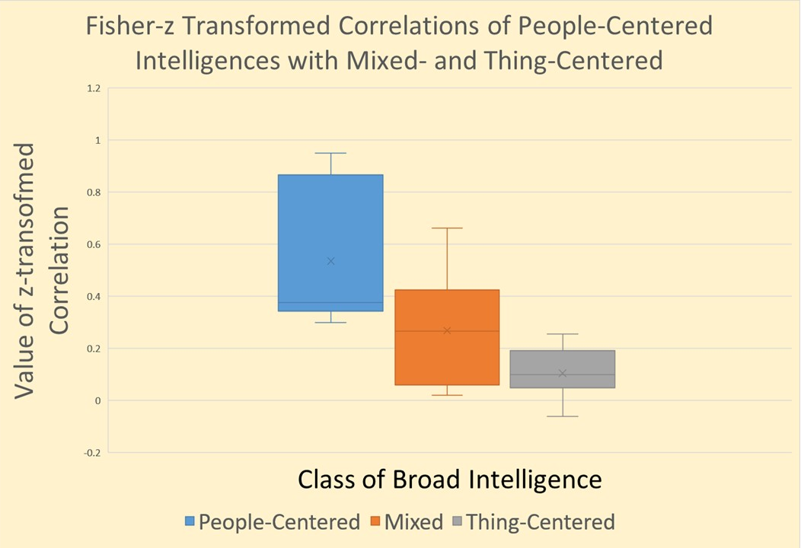
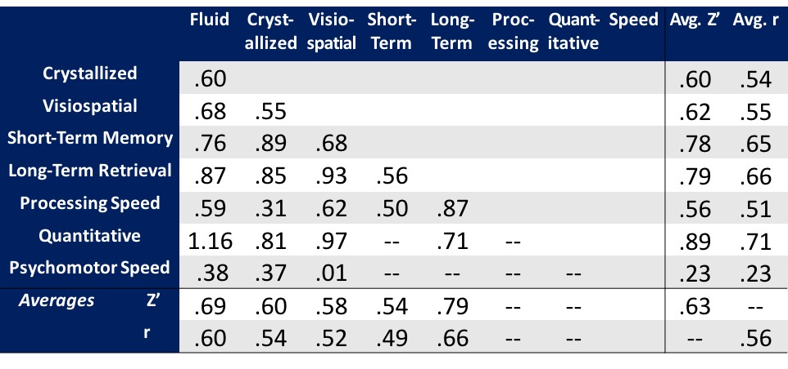
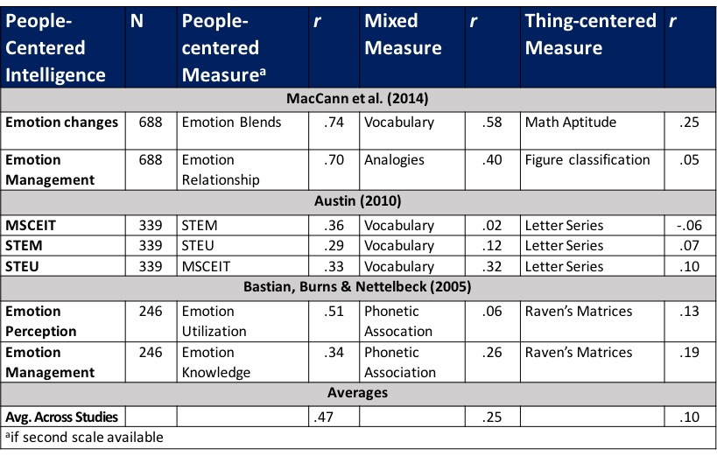
People vs. Thing Intelligences?
Victoria M. Bryan and John D. Mayer
Department of Psychology, University of New Hampshire
Introduction
Results
As predicted, the correlations among the people-centered intelligences are higher than their correlation with mixed (i.e., in-between) intelligences or thing-centered intelligences. To test the significance of the difference, Pearson correlations first were converted to Fisher zs and then analyzed in a one-way ANOVA with three levels. The three groups differed significantly from one another, with F(2,18) = 7.37, p = .005. Planned comparisons confirmed that the correlation between people-with-people-centered intelligences were higher than the people-with-thing correlations (p = .005). We found no significant difference between the average correlations for people-with mixed versus mixed-with-thing correlations (p > .05), thus indicating that the main difference was between people-centered intelligences among themselves versus with all other intelligences. Findings support our hypothesis that broad intelligences vary along a continuum of people vs. thing-centered intelligences.
As researchers explore human mental abilities, and identify people’s capacities to reason with, for example, verbal, spatial, and quantitative intelligences, they have sought an empirically-grounded organization for the intelligences they have uncovered. Current research in intelligence often employs the Cattell-Horn-Carroll (CHC) model of human mental abilities (McGrew, 2009). In the CHC, or three-stratum model, general intelligence exists at the top of the hierarchy and just below g lie somewhere between 8 to 15 wide scope mental abilities referred to as broad intelligences, that have been identified (as has g) using factor analytic techniques (Flanagan, McGrew, & Ortiz, 2000).
As the number of proposed intelligences has grown, the need to organize them has risen. Psychologists often divide these broad mental into different classes. For example, some broad intelligences concern memory (e.g., long-term retrieval), whereas others pertain to specific content areas. Examples of content-focused intelligences include quantitative reasoning, which concerns numbers, and spatial reasoning, which concerns objects and their orientation in space.
Mayer & Skimmyhorn (2017) suggest that the content-focused broad intelligences may vary on a continuum from those that most pertain to reasoning about people (e.g., emotional intelligence and personal intelligences) to those that pertain to reasoning about things (e.g., spatial reasoning and quantitative reasoning), with other broad intelligences such as verbal intelligence falling in-between because they deal with both people and things.
All articles included in the analysis were reviewed and any estimated correlations reported among the factors representing broad intelligence were recorded. We used estimated correlations only because those adjust for differential test reliability.
How High Do Broad Intelligences Correlate?
Average correlations among traditional (non-people-centered) intelligences are presented in Table 1. (Each average correlation is based on a different number of reported relationships depending upon the particular pair of broad intelligences concerned). We next examined the broad intelligences as a group so as to determine the overall average correlation among them. We converted each correlation to a Fisher z, averaged the transformed values, and then transformed them back to an r. The grand mean of the correlations among the intelligences was r = .56.
We also noted that certain broad intelligence factors correlated more strongly with one another than others. For instance, fluid intelligence correlated with quantitative reasoning at r = .82 but correlated with crystallized intelligence at r = .54. Such findings suggest that certain types of mental abilities relate more strongly to one another. In order to explore one quality of these relationships, we tested our second research question.
Table 1. Average Correlation Among Broad Intelligence Factors
People vs. Thing Continuum?
Three of the 14 articles we reviewed included the person-centered intelligences of emotional intelligence and personal intelligences. Correlations among ability-based emotional intelligence measures and measures of other broad intelligences (e.g., quantitative reasoning) were recorded. Comparisons depicting the correlations for people with (a) people-centered intelligences (column 3), mixed-intelligences (column 5), and with thing-centered intelligences (column 7) are shown in Table 2.
Figure 1. People vs. Thing Intelligences
Research Questions
The present reanalysis of published empirical findings set out to test Mayer & Skimmyhorn’s (2017) hypothesis that broad intelligences would vary along a people vs. thing continuum with thing intelligences correlating highly among themselves, people intelligences doing the same, and lesser correlations between them.
Our key interests in the follow study were:
What is the “baseline” correlation among broad intelligence (as estimated in confirmatory factor analyses)? That is, how highly do the factors correlate with one another? There have been, to the best of our knowledge, no prior reviews of this issue to-date.
Do the correlations among broad intelligences vary based on whether they are people-centered, mixed, or thing-centered?
Conclusions
Results from the present study provide a first global estimate of the average correlation among broad intelligences, which we estimate to be in the vicinity of r = .56, and a first global estimate of the different between people-with-people-centered intelligences versus people-with-thing-centered intelligences of r_{diff} = .37. The average correlation among broad intelligences provides a benchmark for determining whether a newly proposed broad intelligence, for example, fits the benchmark of other broad intelligences in its correlations with them. In addition, the difference in correlations along the people-centered vs. thing-centered continuum may help organize at least some content-focused broad intelligences. Such findings may help us refine our understanding of the Cattell-Horn-Carroll model of intelligence, the broad intelligences that make it up, and the burgeoning research that is ongoing with such broad intelligences at present.
Methodology
To explore the average correlation among the broad intelligences, we conducted an archival analysis of publications that plausibly contained findings relevant to the question. Using PsychINFO, we searched broadly for articles using the search term “broad intelligences”. This yielded 190 articles. We identified a further three articles by searching specifically for “emotional intelligence,” “personal intelligence” and “social intelligence” (all measured as an ability). This additional search was carried out as the study of emotional, personal, and social intelligences—the most person-centered among the broad intelligences—are relatively recent and few in number.
For both searches, articles were screened for inclusion criteria that included the article must be:
Peer reviewed
Measure intelligence(s) using ability-based measures
Represent broad intelligences in a confirmatory factor analysis using techniques developed with structural equation modeling
Provide one or more estimates of the correlation among broad intelligences based on such techniques
Have a publication date after 1970 (around the date such contemporary analytic techniques first were introduced).
Fourteen articles met our criteria for inclusion.
References
McGrew, K.S. (2009). CHC theory and the human cognitive abilities project: Standing
on the shoulders of the giants of psychometric intelligence research. Intelligence, 37, 1-10.
MacCann, C., Joseph, D.L., Newman, D.A., & Roberts, R.D. (2014). Emotional
Intelligence is a second-stratum factor of intelligence: Evidence from hierarchical and bifactor models. Emotion, 14, 358-374.
Austin, E.J. (2010). Measurement of ability emotional intelligence: Results for two new
tests. British Journal of Psychology, 101, 563-578.
Bastian, V.A., Burns, N.R., & Nettelbeck, T. (2005). Emotional intelligence predicts life
skills, but not as well as personality and cognitive abilities. Personality and Individual Differences, 39, 1135-1145.
Mayer, J.D., & Skimmyhorn, W. (2017). Personality attributes that predict cadet
performance at West Point. Journal of Research in Personality, 66, 14-26.

