Slide 1



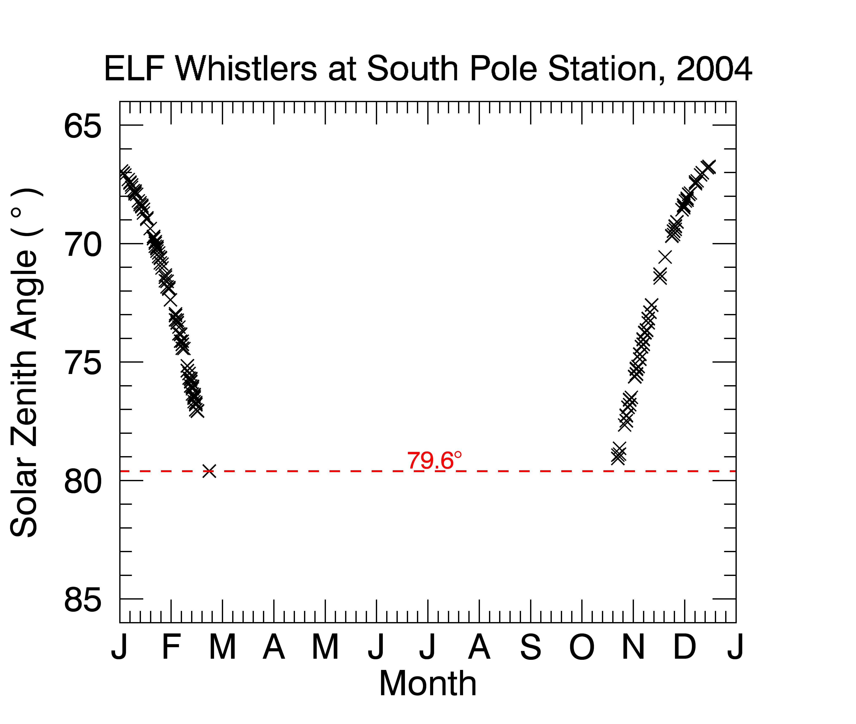
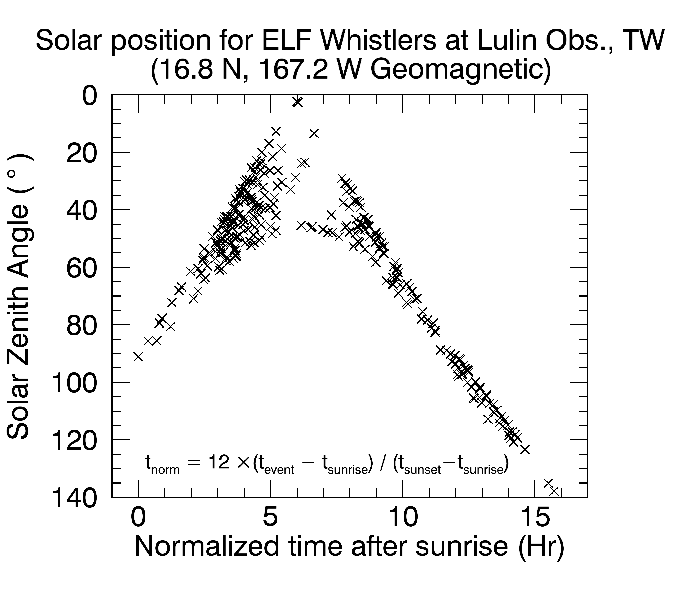
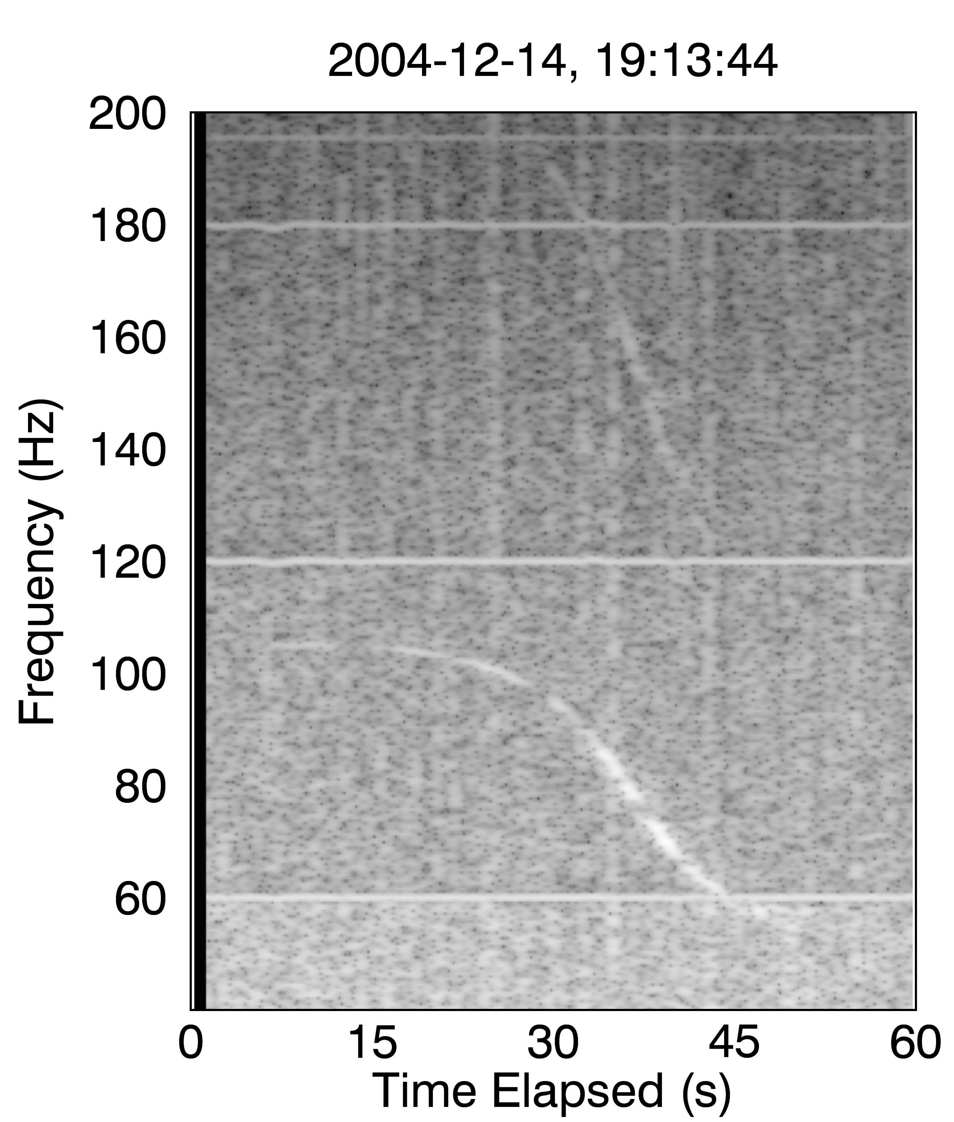
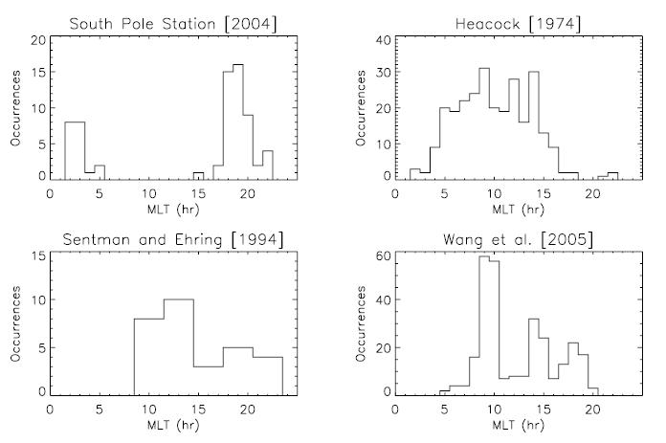
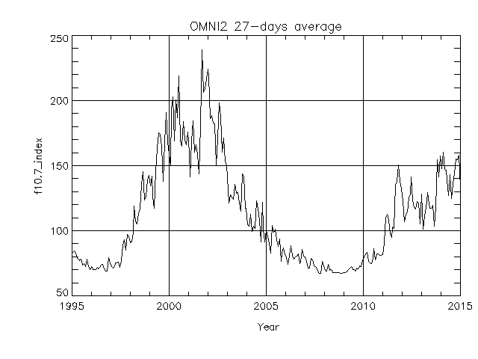
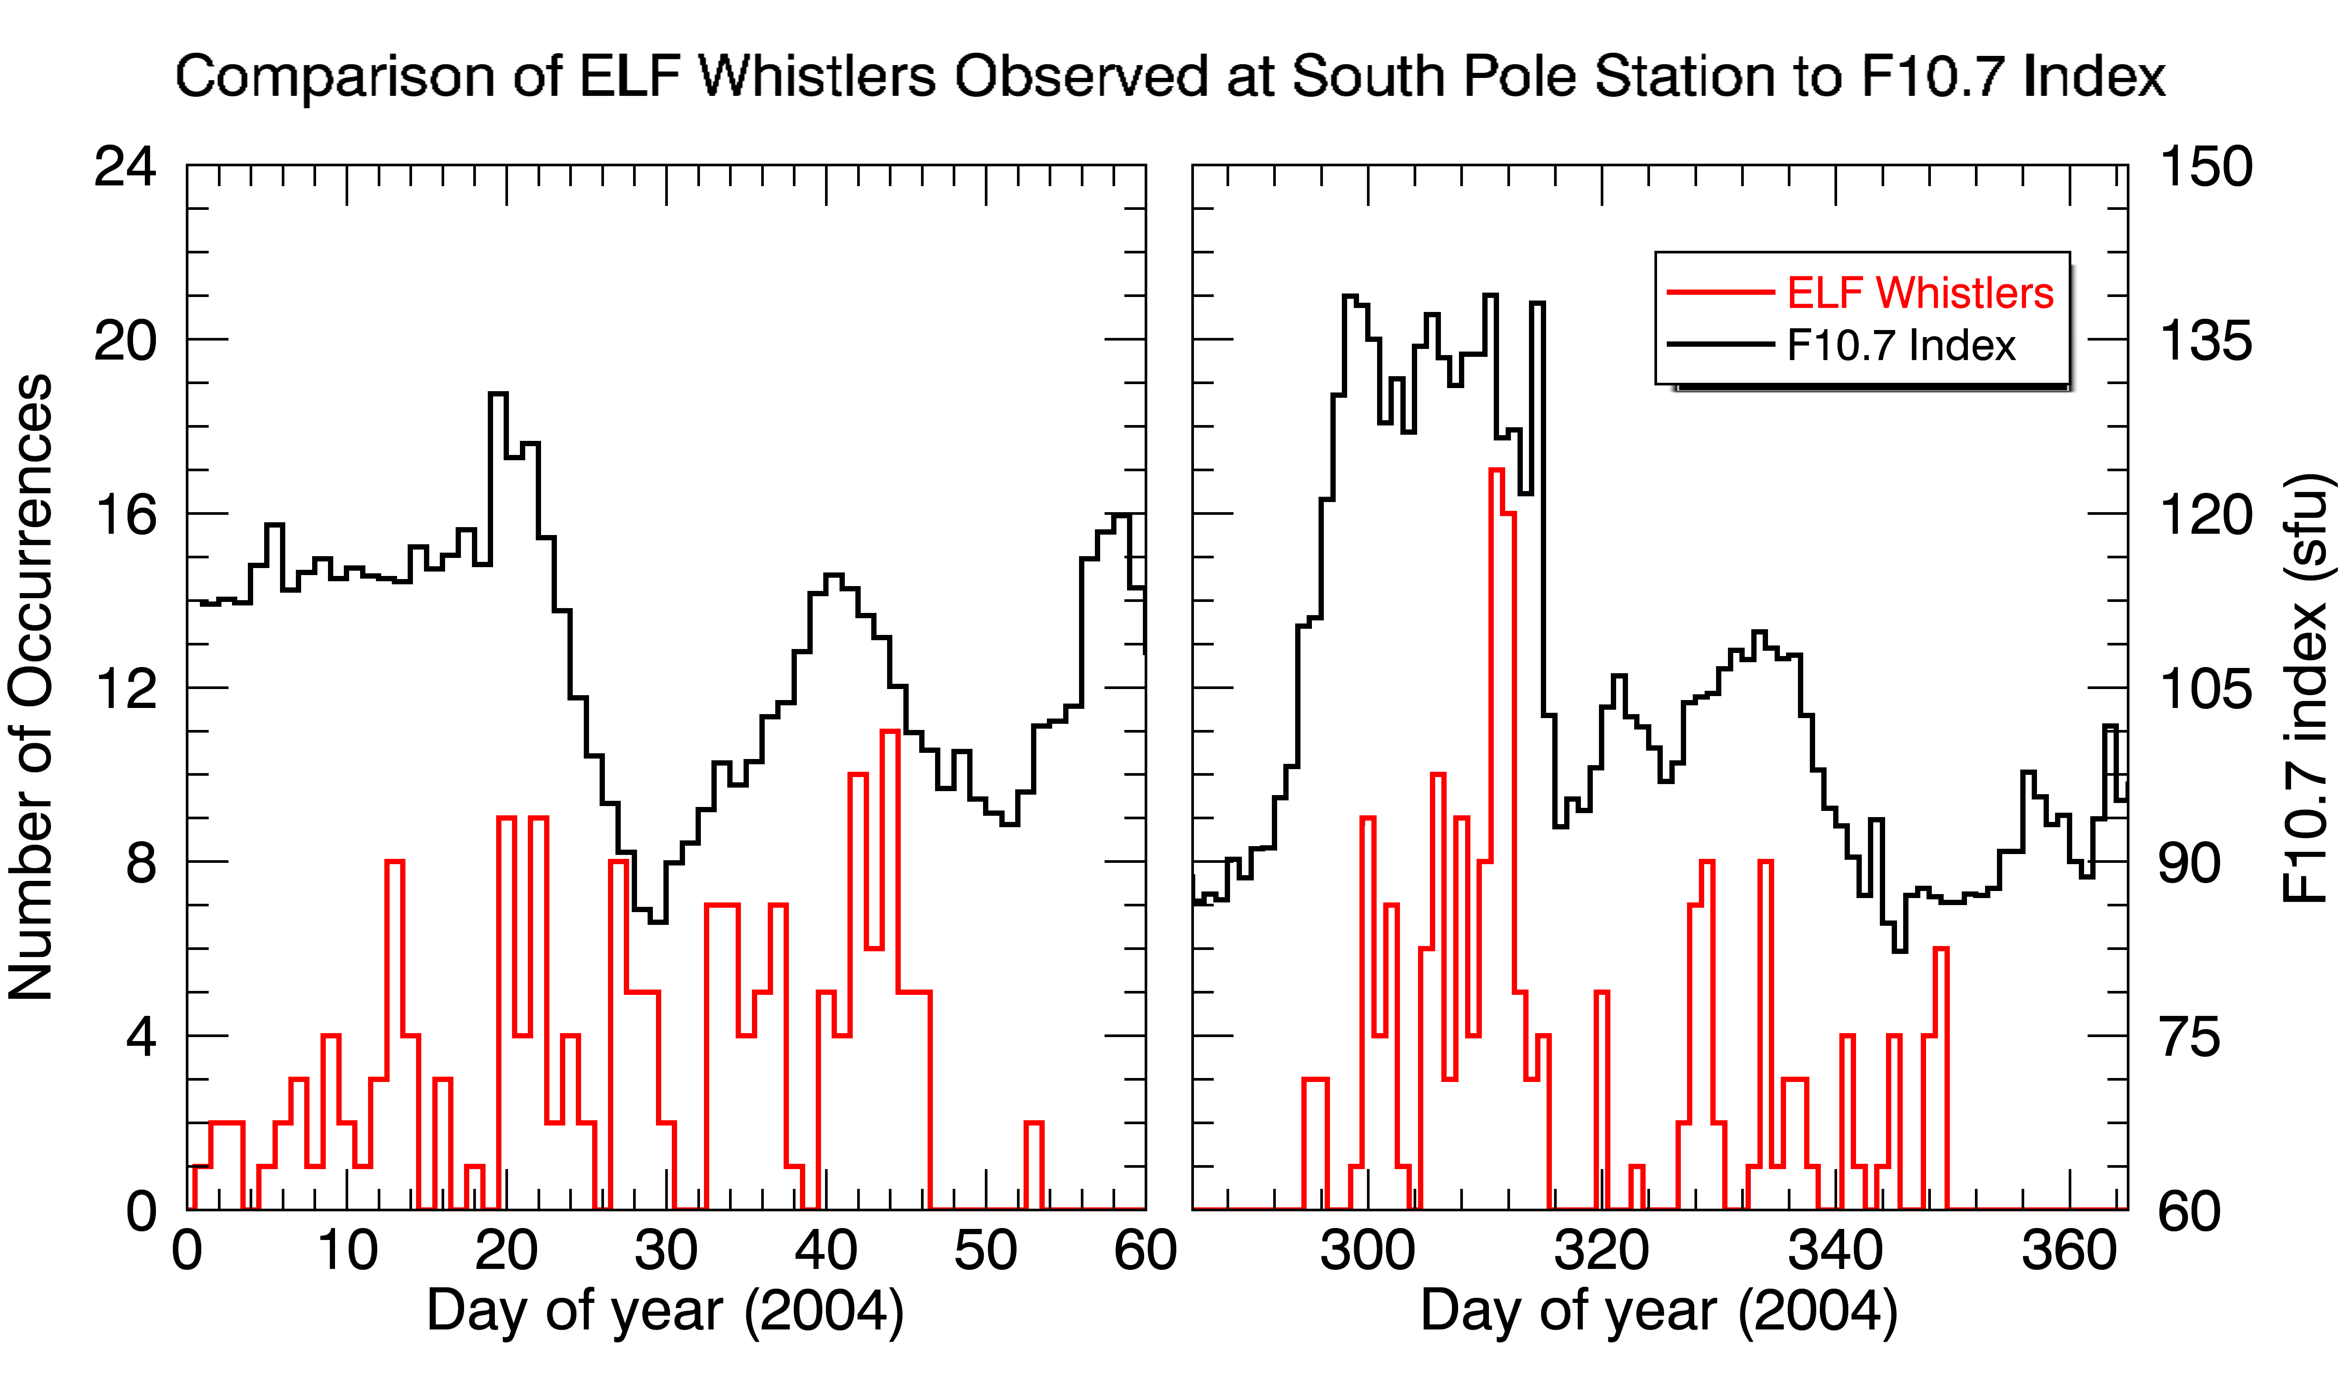
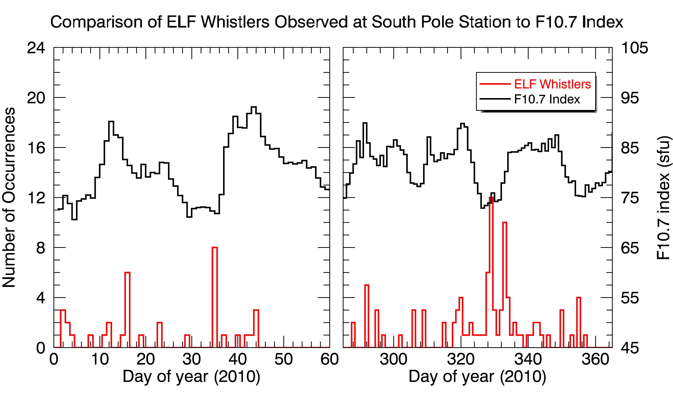
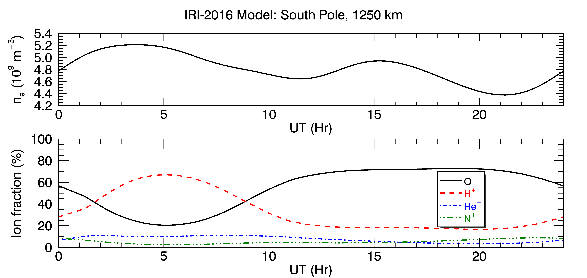
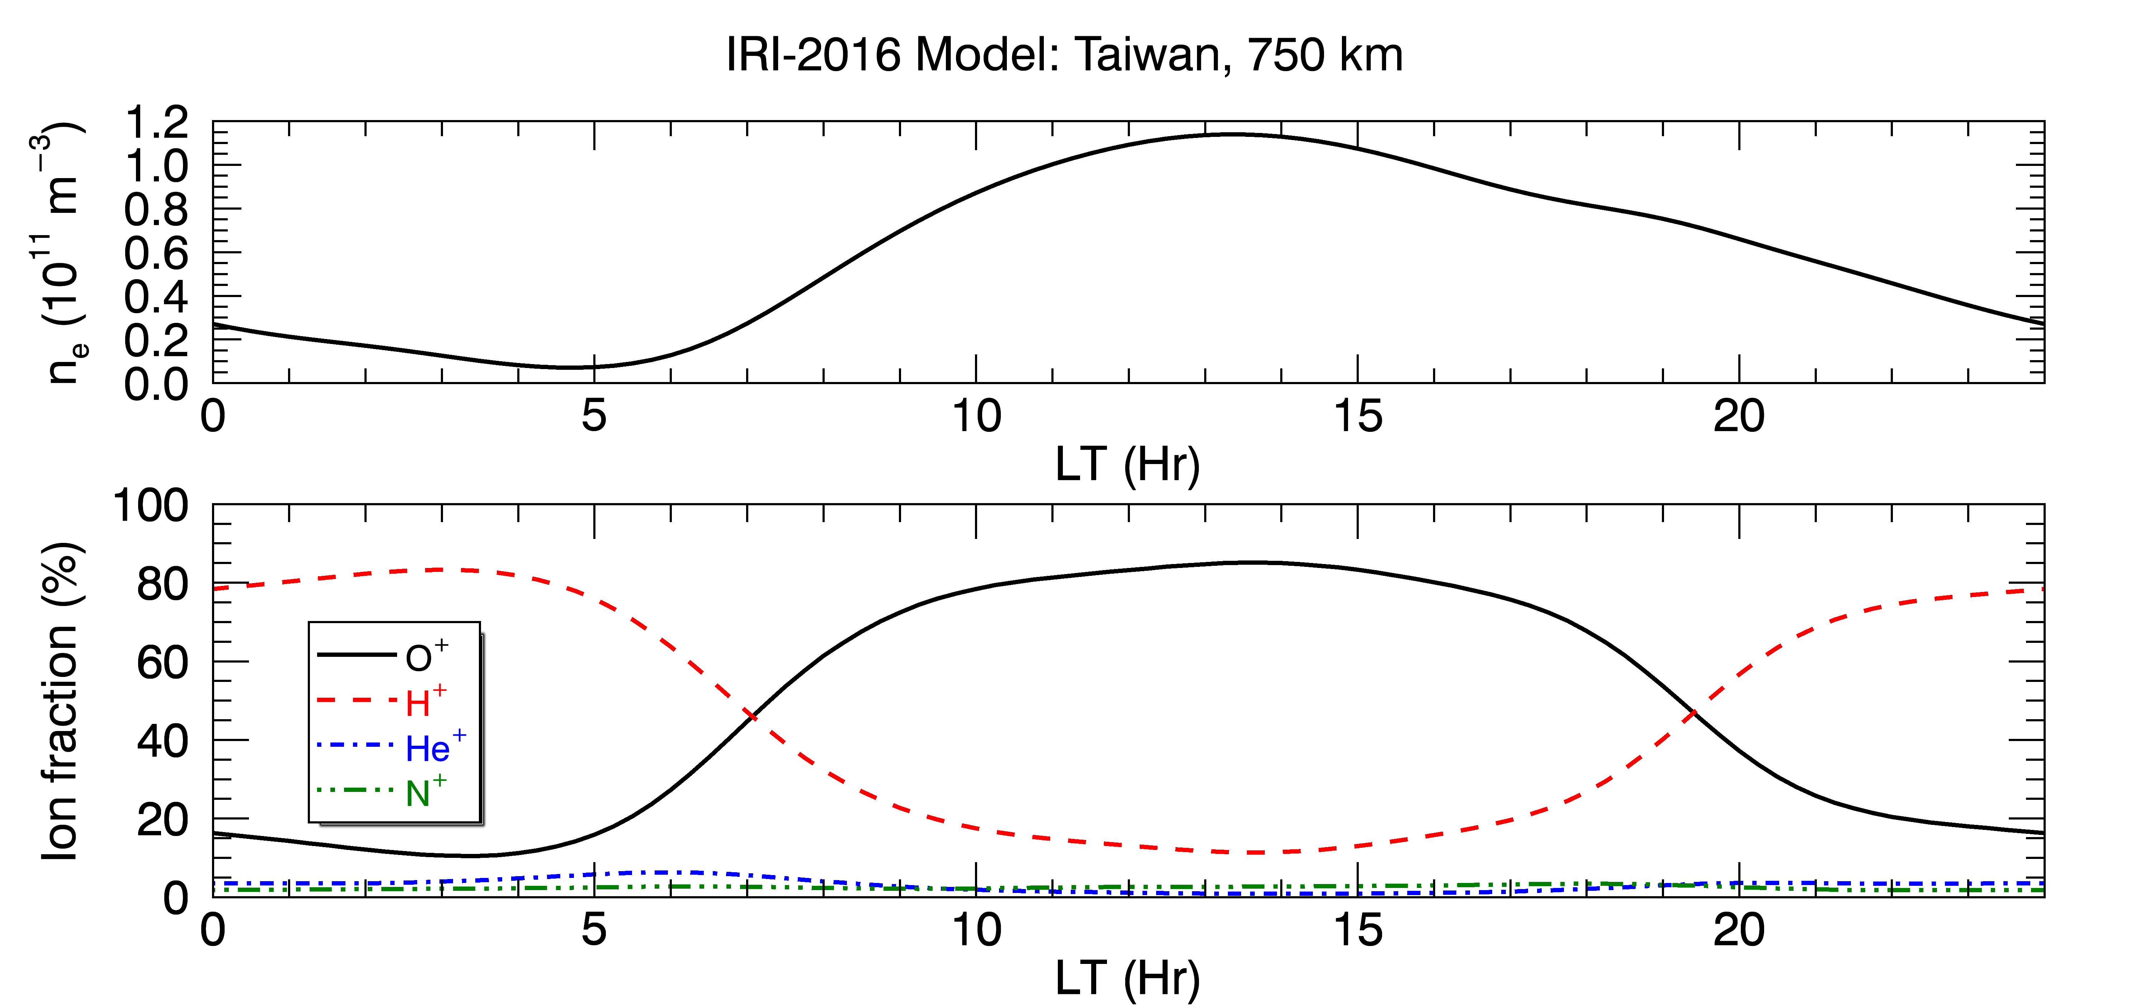
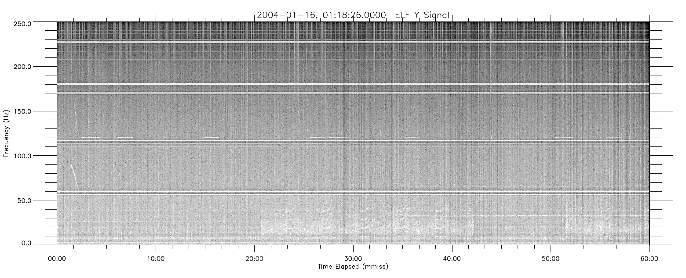
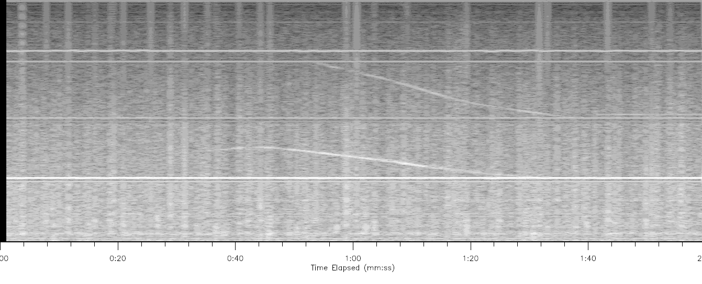
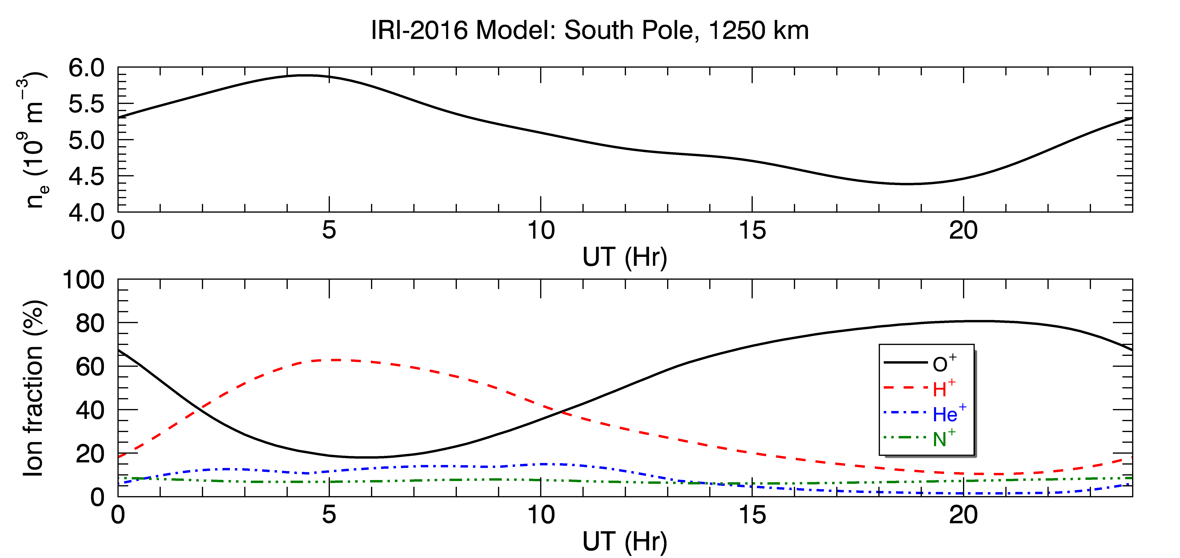
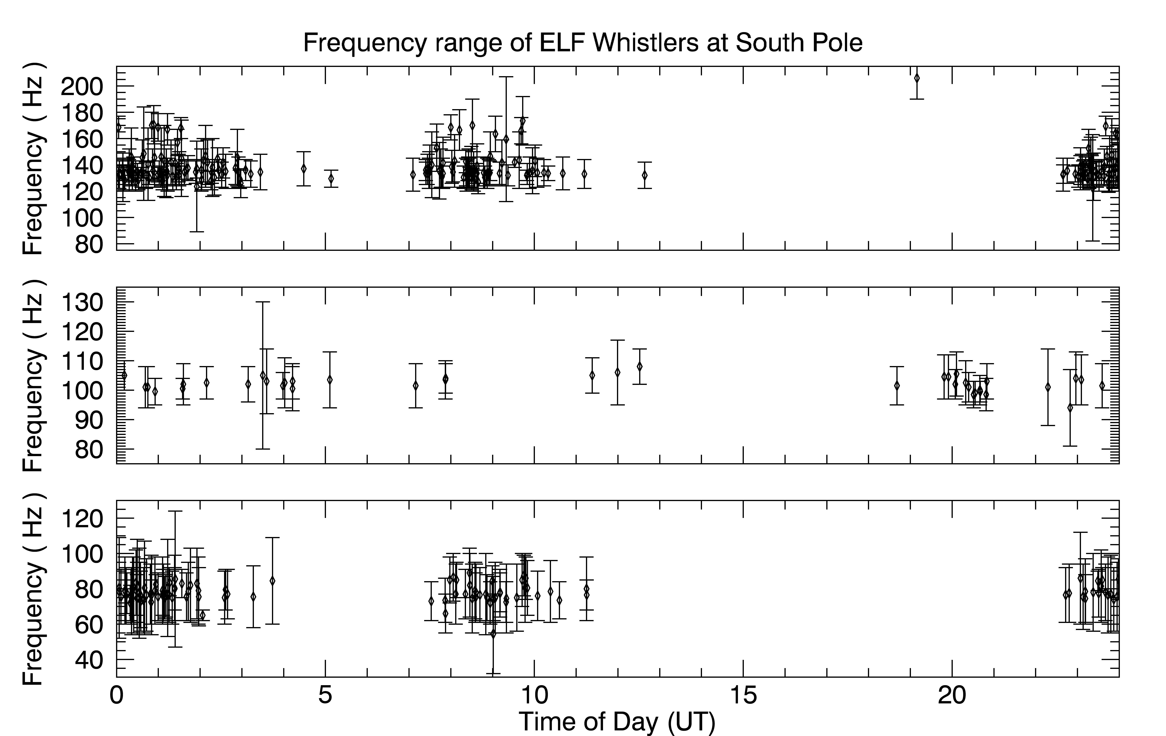
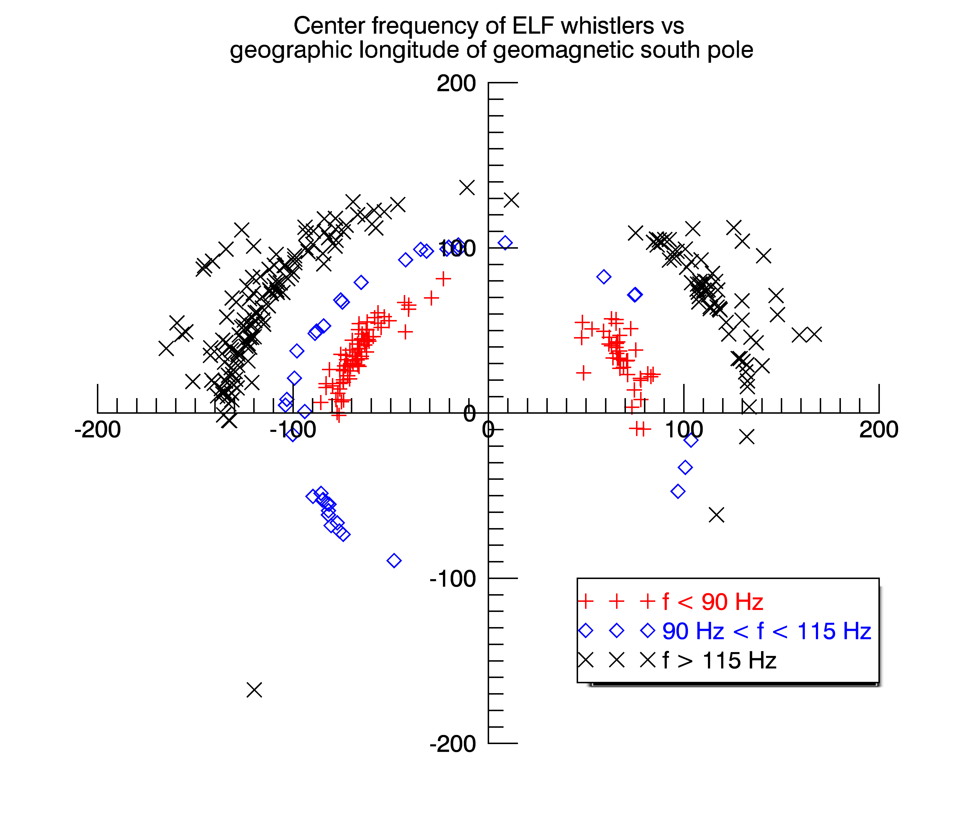
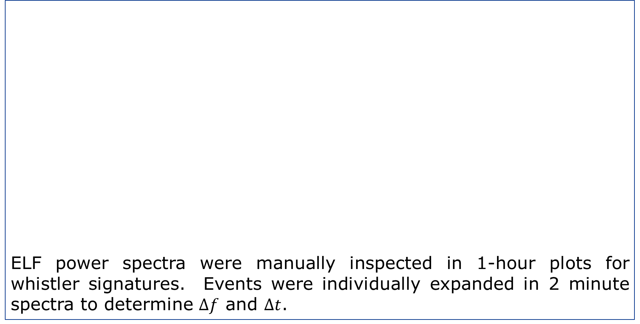
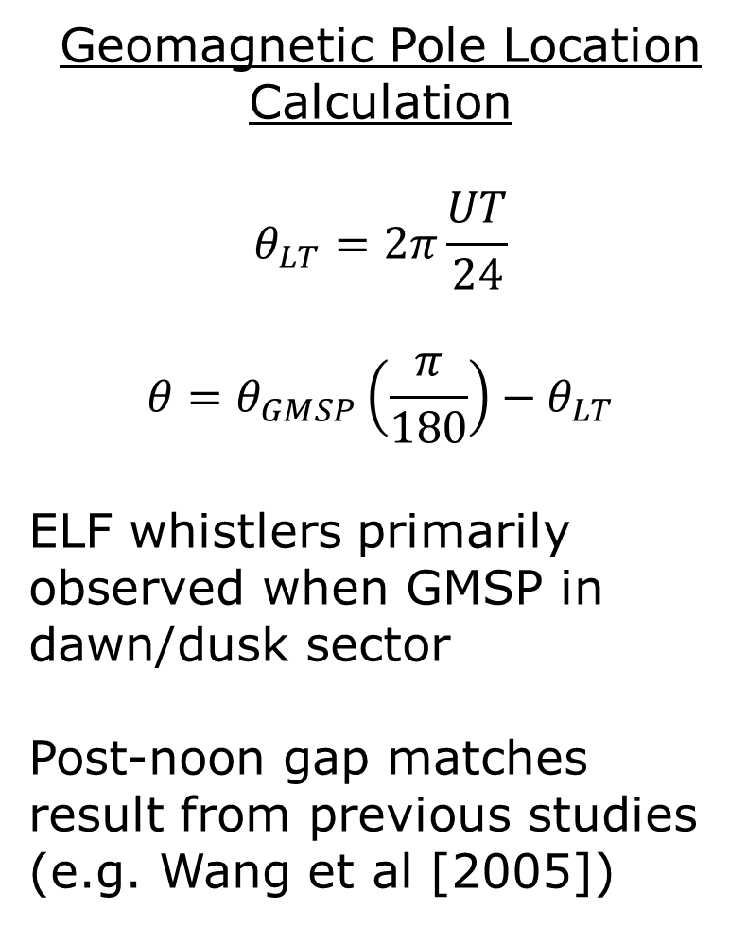

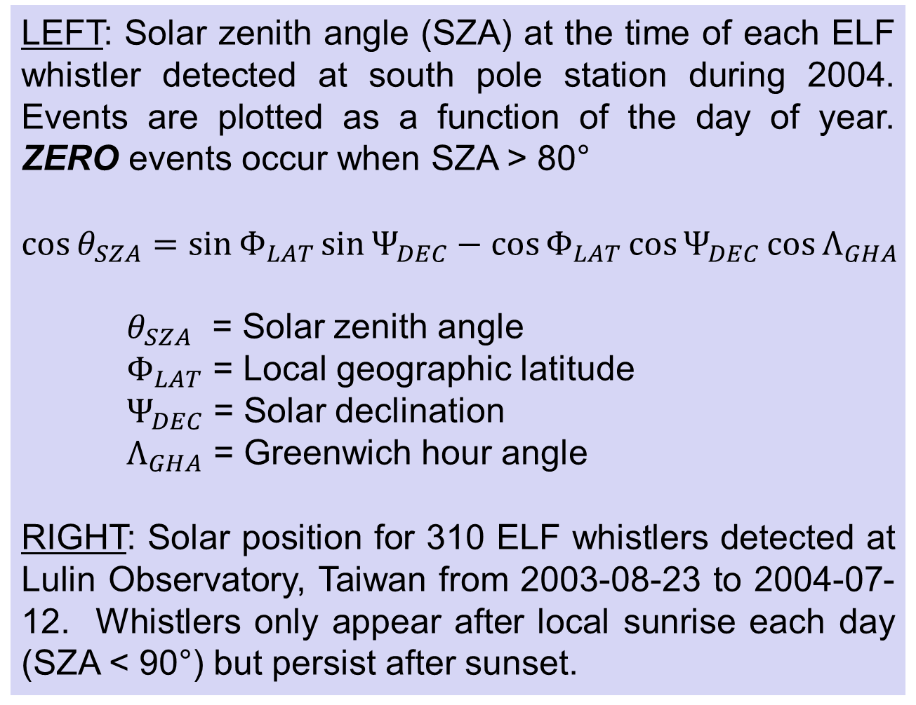

ELF Whistler Dependence on a Sunlit Ionosphere
Bruce Fritz¹, Marc Lessard¹, John Heavisides¹, Hyomin Kim², Matt Young³
Funded by NSF Grant ANT-0513990
Abstract
4. Initial results
Whistler-like spectral features in the extremely low frequency (ELF) range have been observed at the South Pole Station. Analysis of the first full year of data reveal a correlation between the occurrence of ELF whistlers and the solar zenith angle (SZA). ELF whistlers stop appearing for the duration of the polar winter, when the SZA increases to greater than 80°. Previous studies at lower geographic latitudes all observed a noon-time peak in the occurrence rate, which led to speculation of source mechanisms in the dayside magnetosphere. The extended polar winter allows for a separation of “dayside” and “sunlit” conditions. The absence of ELF whistlers in the polar winter implies that ELF whistler explicitly depend on local ionospheric conditions.
LEFT: Solar zenith angle (SZA) at the time of each ELF whistler detected at south pole station during 2004. Events are plotted as a function of the day of year. ZERO events occur when SZA > 80°
$$\cos{θ_{SZA}=\sin{Φ_{LAT}}\sin{Ψ_{DEC}}−\cos{Φ_{LAT}}\cos{Ψ_{DEC}}\cos{Λ_{GHA}}}$$
$θ_{SZA}$ = Solar zenith angle
$Φ_{LAT}$ = Local geographic latitude
$Ψ_{DEC}$ = Solar declination
$Λ_{GHA}$ = Greenwich hour angle
RIGHT: Solar position for 310 ELF whistlers detected at Lulin Observatory, Taiwan from 2003-08-23 to 2004-07-12. Whistlers only appear after local sunrise each day (SZA < 90°) but persist after sunset.
SUNSET
1. Introduction
ELF whistlers are narrow-band dispersive spectral features in the lower ELF range (1-250 Hz) that descend monotonically in frequency, typically over timescales on the order of a minute. Observations were first reported at auroral latitudes [Heacock, 1974], and have since been reported at mid-latitudes [Sentman and Ehring, 1994], low latitudes [Wang et al, 2005], and polar latitudes [Kim et al, 2006].
5. Comparison to F10.7 solar flux index
Sample power spectrum of ELF whistler from 14 December, 2014. Data is from E-W axis relative to the local magnetic field.
Figure from Kim et al. [2006] compares ELF whistler events as a function of MLT. All sub-polar locations all follow a diurnal pattern with a daytime peak occurrence
ABOVE: F10.7 solar flux index is used as a proxy for solar activity. Blue boxed areas highlight the point in the solar cycles where index values are used to compare with ELF whistler database.
RIGHT: F10.7 daily values are compared to daily occurrence rate of ELF whistlers at South Pole Station during 2004 and 2010, summarized in table:
On a daily time scale, there is basically no correlation between solar flux levels and ELF whistlers. On a yearly time scale, ELF whistlers occur less frequently at times of lower F10.7 flux levels.
Wang et al [2011] demonstrated that ELF whistlers are most likely right-hand polarized ion cyclotron waves. However, there is still no established physical basis for why these signatures tend to appear only on the dayside.
The work in this poster examines the first full year of data taken at the geographic south pole and reveals behavior that appears to tie the occurrence of ELF whistlers to a sunlit ionosphere.
Year | Days | Correlation | F10.7 Ave | # Whistlers/Day
2004 | 1-53 | 0.32 | 107.1 | 3.11
2004 | 285-365 | -0.20 | 104.6 | 2.16
2010 | 1-53 | -0.05 | 80.5 | 0.68
2010 | 285-365 | -0.02 | 81.7 | 1.21
Objectives
Demonstrate connection between occurrence of ELF whistlers at the geographic south pole and a sunlit ionosphere
Determine correlation between solar flux levels and the occurrence rate of ELF whistlers
Examine ionosphere conditions during detection of ELF whistlers
6. Comparison with IRI
IRI 2016 Model Inputs
RIGHT: 90.0° S, 0.0° Geographic, 1250 km (2004-02-22, 2004-03-22)
BELOW: 23.5° N, 120.9° E Geographic, 750 km (2004-02-22)
2. Methodology
2004-02-22
ELF power spectra were manually inspected in 1-hour plots for whistler signatures. Events were individually expanded in 2 minute spectra to determine $∆f$ and $∆t$.
$$∆f$$
$$∆t$$
Low latitude ionosphere (above) shows similar behavior as Wang et al. [2011] Figure 3. The dominant species during the day is O⁺ at altitudes above the F-peak.
The ionosphere at the South Pole (right) experiences a similar transition in dominant ion species that is observed at higher altitudes.
Peaks in occurrence of ELF whistlers align with transition times of dominant ion species between H⁺ and O⁺
Ion composition transition still occurs after ELF whistlers stop appearing (03/22), which implies that other factors must still be important
2004-03-22
3. 2004 ELF Whistler Statistics
Caveat: An apparent drift in system time is corrected using 6 hour offset it 2nd half of year. Time offset is verified by technician records at SP station and corroborated by 2010 data set.
7. Bimodal/Diurnal Behavior
8. Conclusions
Frequency bin (by median frequency)
Low
f < 90 Hz
Mid
90 Hz < f < 115 Hz
High
f > 115 Hz
Prior ELF whistler observations exhibit a diurnal variation in the occurrence times, which fits with the connection to a sunlit ionosphere. The south pole data also displays a diurnal pattern, but the SZA is nearly constant over the course of a single day. So what changes?
The orientation of the geomagnetic south pole (GMSP, 79.8° S, 108.2° E) relative to the sun changes as it rotates about the geographic pole.
ELF whistlers with a mean frequency below 90 Hz or above 115 Hz appear almost exclusively when the geomagnetic south pole is on the dayside
ELF whistlers are connected to the effects of a sunlit ionosphere
Higher solar flux levels (as illustrated by F10.7 solar flux index) increase probability of occurrence
Trends in ionospheric composition during occurrence of ELF whistlers matches at both low and polar latitudes
Outstanding Questions:
What causes daily change of ion composition at south pole?
Why does diurnal variation of ELF whistlers track the dayside location of geomagnetic south pole?
What is different about events in 100 Hz bin that causes the cluster in the post-midnight sector?
Geomagnetic Pole Location Calculation
$$θ_{LT}=2π\frac{UT}{24}$$
$$θ=θ_{GMSP}\left(\frac{π}{180}\right)−θ_{LT}$$
ELF whistlers primarily observed when GMSP in dawn/dusk sector
Post-noon gap matches result from previous studies (e.g. Wang et al [2005])
1200
2004 ELF Data Summary
Data available: 94%
X Axis: 67% (37% in summer)
Y Axis: 94% (95% in summer)
ELF Whistler Events
# identified: 342
X Axis: 50% Y Axis: 100%
Average Values
Freq. | Low | Mid | High
Δt (s) | 37 | 28 | 29
Min Δt | 7 | 7 | 5
Max Δt | 73 | 46 | 76
Δf (Hz) | 32 | 15 | 25
High f | 94 | 110 | 151
Low f | 62 | 95 | 126
Δf/Δt | 0.88 | 0.53 | 0.84
f
Acknowledgements: Thanks to Dr. Kaiti Wang for sharing data from Lulin Station for comparison. Thanks to folks who provide IRI model data. Thanks to South Pole support staff who have helped keep the ELF system going over the years. Research at the University of New Hampshire was supported by NSF Grant ANT-0513990.
University of New Hampshire, Space Science Center, Durham, NH
New Jersey Institute of Technology, Center for Solar-Terrestrial Research, Newark, NJ
Corresponding author: Bruce Fritz (bruce.fritz@unh.edu)
3. Center for Space Physics, Boston University
References:
Heacock, R. R. (1974), Whistler-like pulsation events in the frequency range 20 to 200 Hz. Geophys. Res. Lett., 1: 77–
79. doi:10.1029/GL001i002p00077
Kim, H., M. R. Lessard, J. LaBelle, and J. R. Johnson (2006), Narrow-band extremely low frequency (ELF) wave
phenomena observed at South Pole Station, Geophys. Res. Lett., 33, L06109, doi:10.1029/2005GL023638.
Sentman, D. D., and D. A. Ehring (1994), Midlatitude detection of elf whistlers, Journal of Geophysical Research:
Space Physics, 99(A2), 2183–2190, doi:10.1029/93JA02103.
Wang, Y.-C., K. Wang, H.-T. Su, and R.-R. Hsu (2005), Low-latitude elf whistlers observed in Taiwan, Geophysical
Research Letters, 32(8), doi: 10.1029/2005GL022412, l08102.
Wang, K., Y.-C. Wang, H.-T. Su, R.-R. Hsu, and T.-Y. Lin (2011), Wave mode of the low-latitudinal ELF-whistlers, J.
Geophys. Res., 116, A09323, doi:10.1029/2011JA016832.
2400

