Slide 1
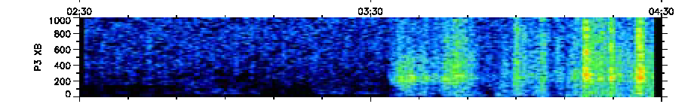
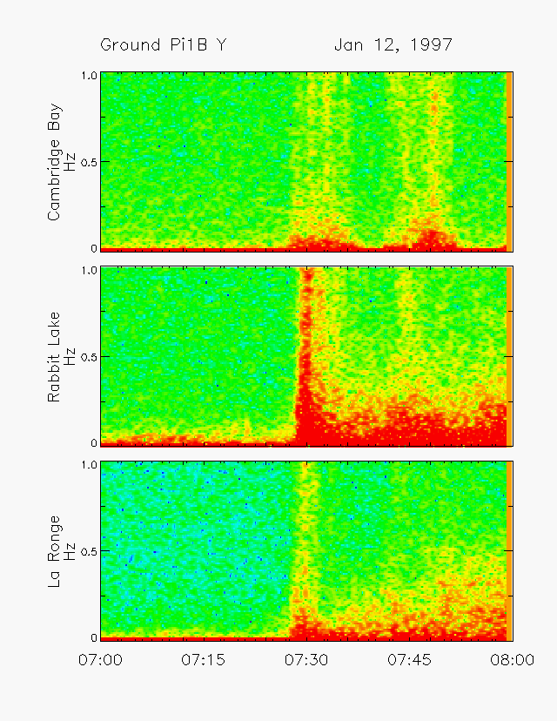
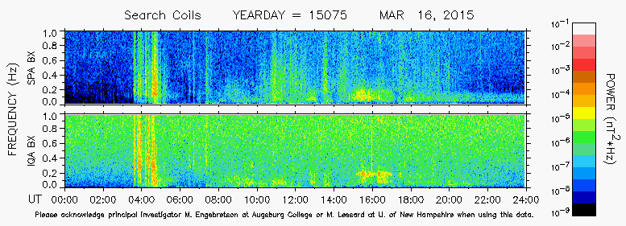
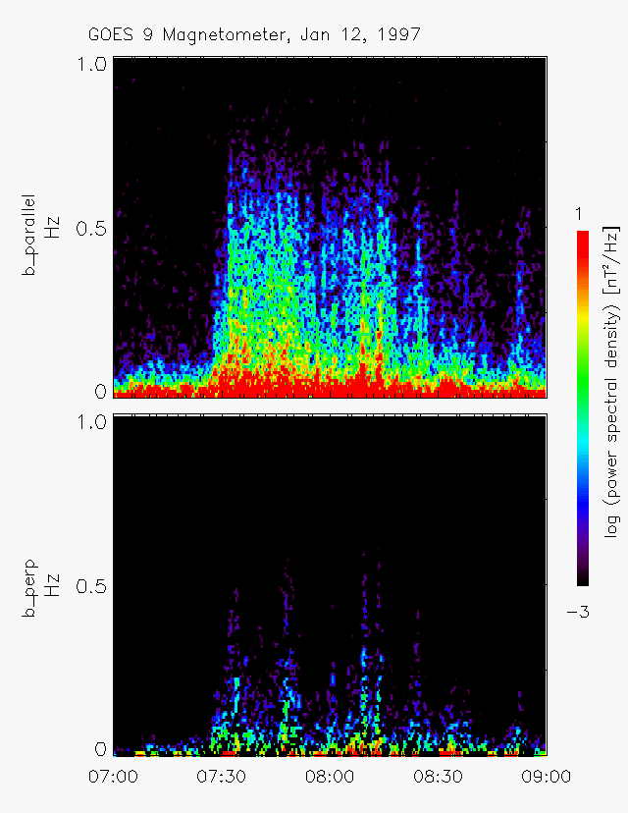
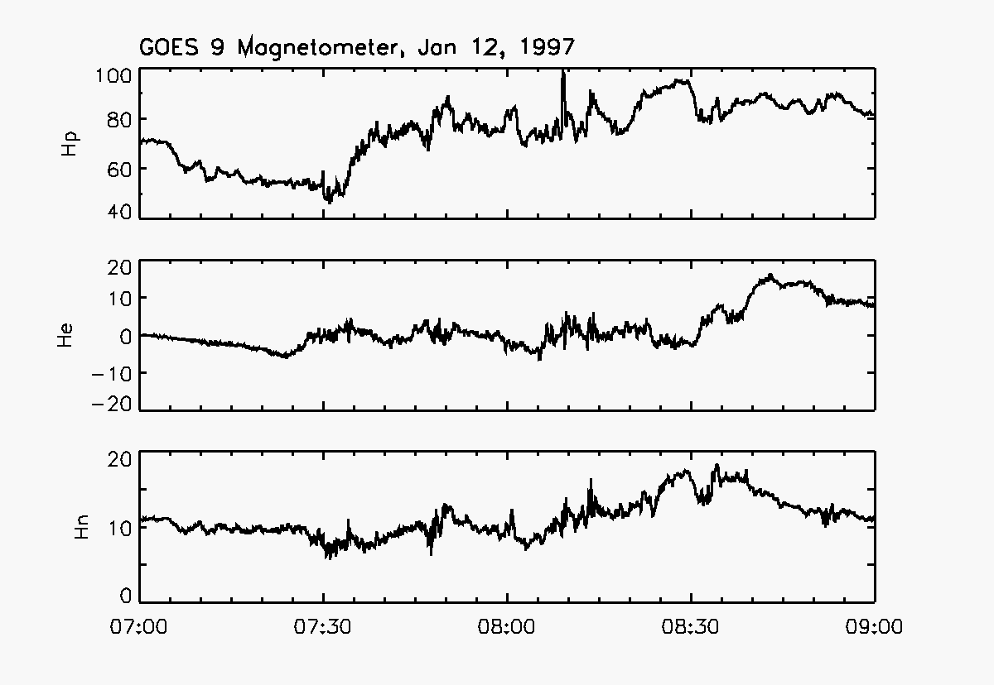
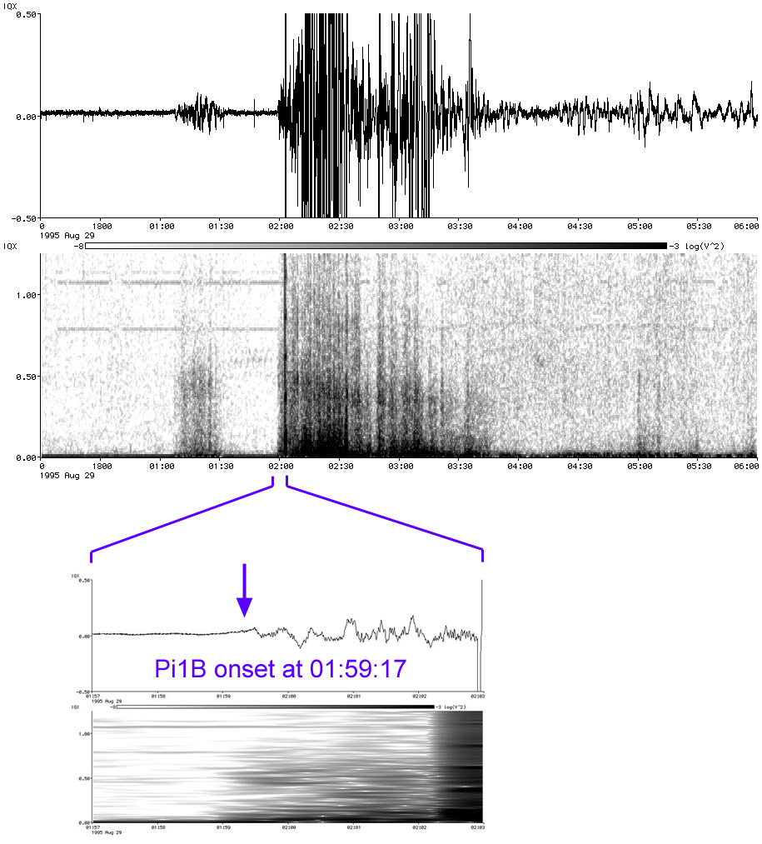
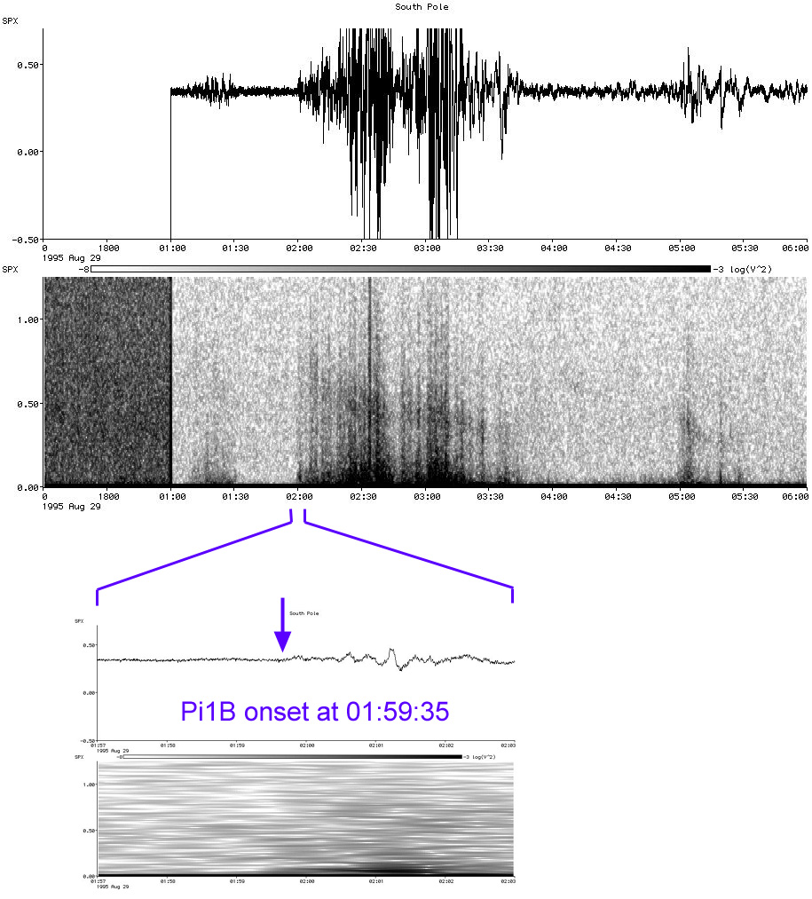
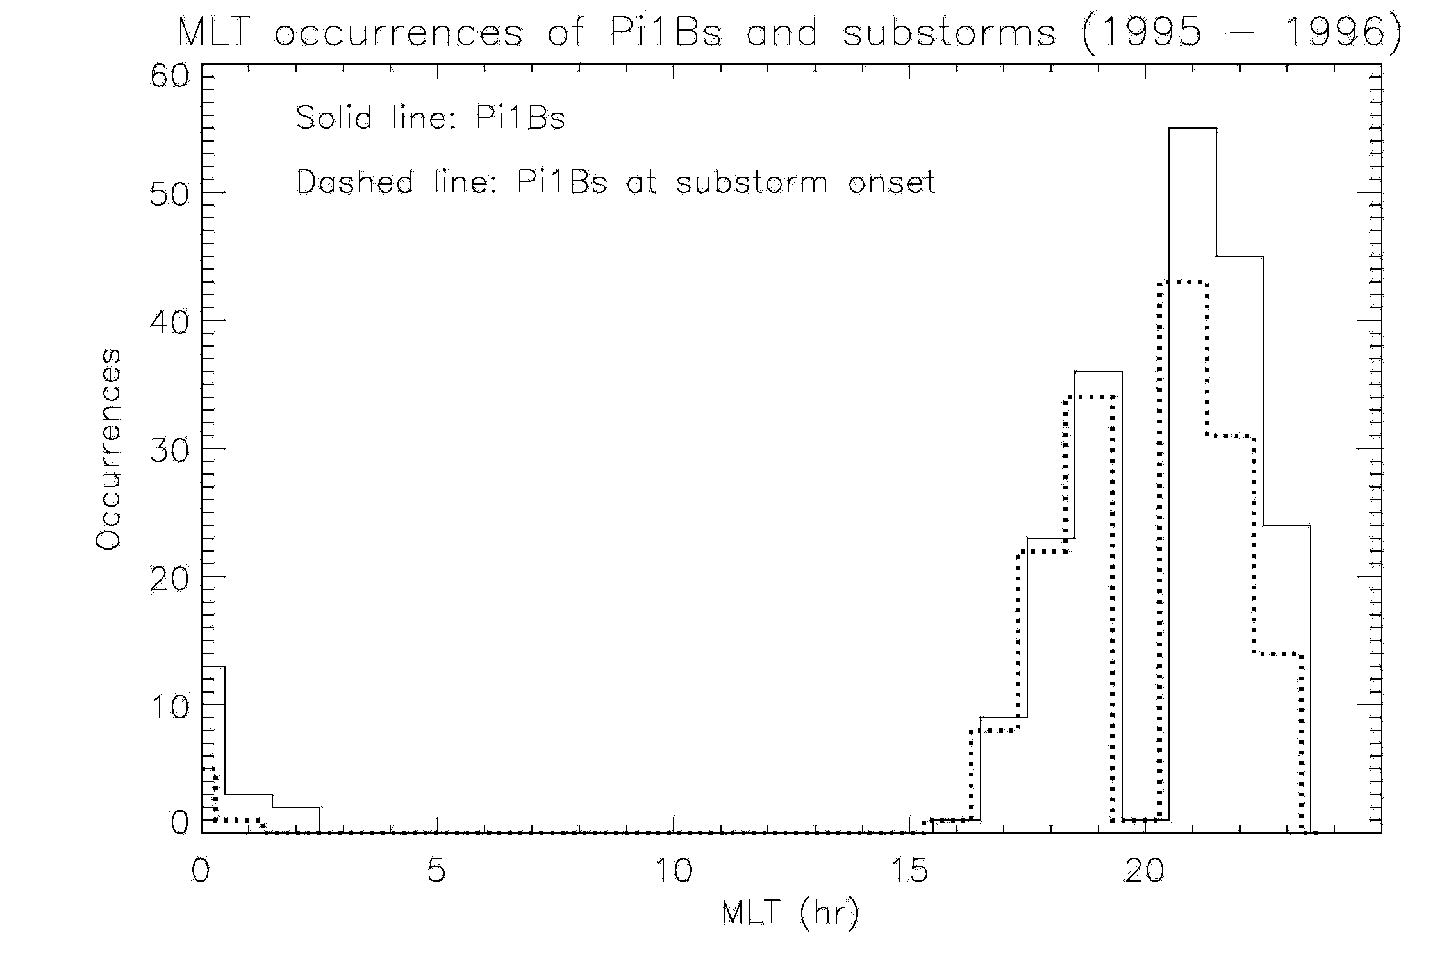
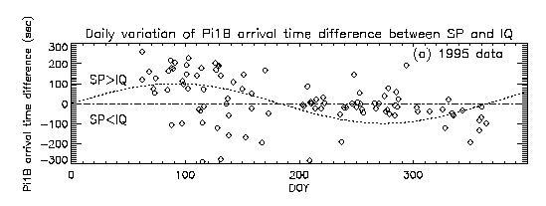
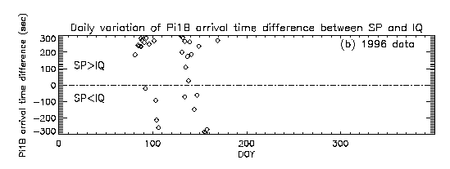
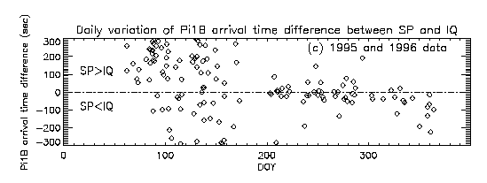
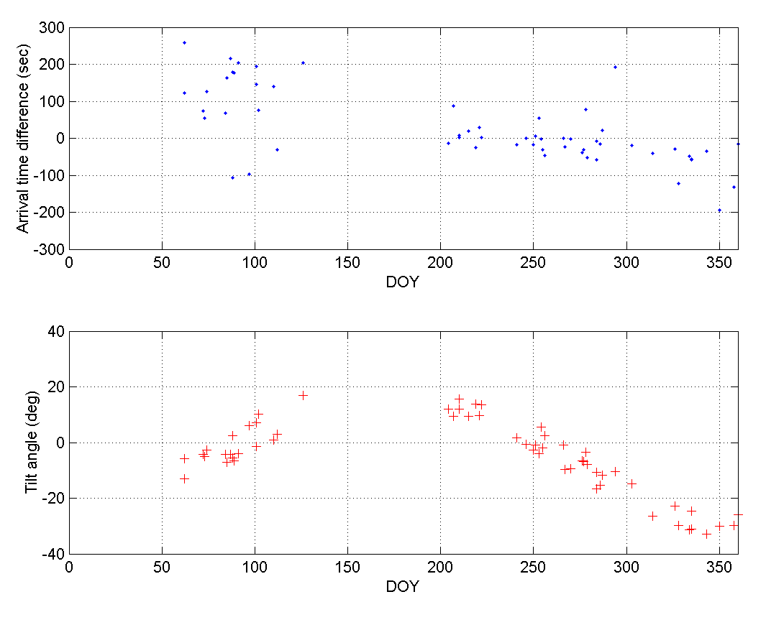
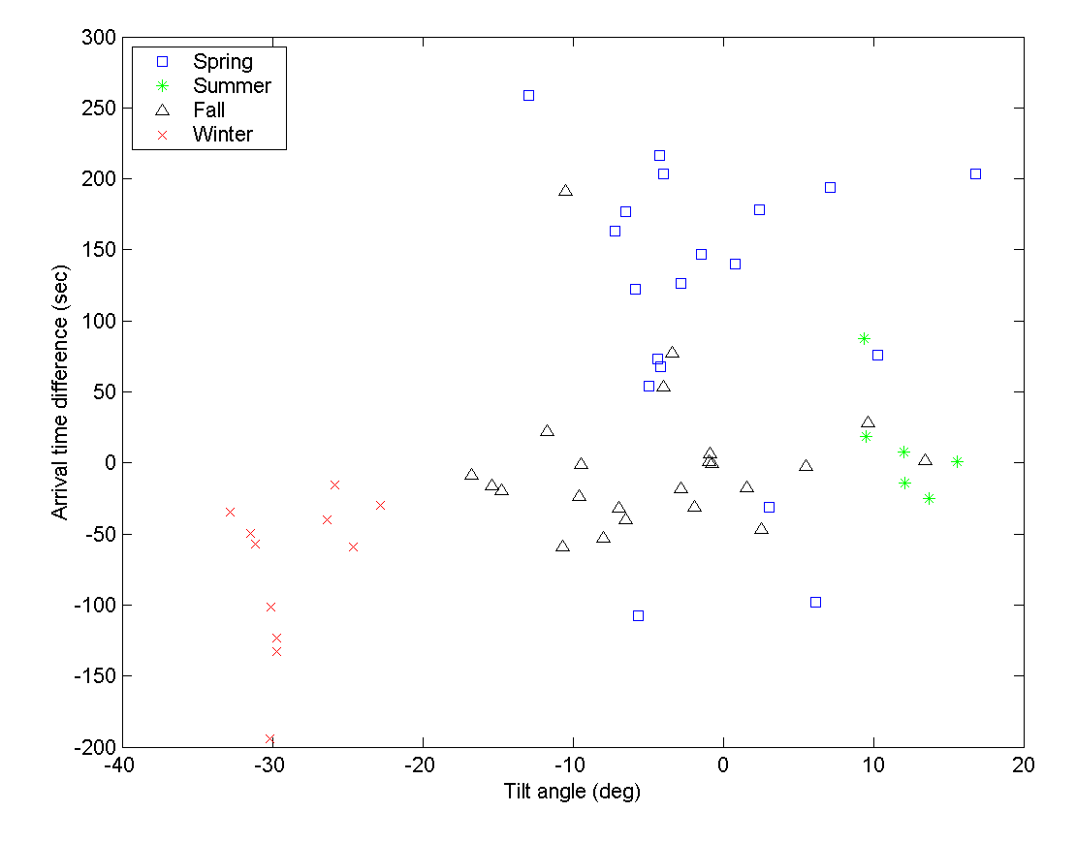
A Statistical Analysis of Interhemispheric Pi1B Seasonal Variations
Michelle Salzano¹, Marc R. Lessard¹, Hyomin Kim², Mark J. Engebretson³ , and Jennifer L. Posch³
¹ Space Science Center, University of New Hampshire, Durham, NH., USA.
² Center for Solar-Terrestrial Research, New Jersey Institute of Technology, Newark, NJ., USA.
³ Physics Dept., Augsburg College, Minneapolis, MN., USA
Abstract
Introduction
Pi1B at Substorm Onset
Pi1B magnetic pulsations are characterized by irregular ULF broadband bursts, with periods of between 1-40 seconds, and are well correlated with substorm onsets. There has been debate over the years regarding the source of these pulsations. Heacock [1967] originally suggested that Pi1B pulsations result from small-scale, local ionospheric currents at substorm onset. Arnoldy et al. [1998] discovered that these pulsations are observed at geosynchronous orbit at onset, implying that they originate beyond geosynchronous orbit and not in the ionosphere. Motivated by papers showing interhemispheric differences in substorm evolution [Papitashvili et al., 2002], as well as the Newell et al. [1996] result, where the authors used satellite data in a comprehensive statistical study to conclude that intense aurora occur only when the background ionospheric conductivity is low (i.e., it is not sunlit), a preliminary study of Pi B pulsation arrival times has been carried out, comparing onset times at the South Pole and Iqaluit, its approximate magnetic conjugate in northern Canada. During the spring of 1995, ground signatures of Pi1B pulsations at the South Pole tended to lead those at Iqaluit often by a minute or two, with a wide distribution in time differences. During the fall of 1995, however, events at Iqaluit tended to lead those at the South Pole, but with significantly smaller time differences and with less scatter than in the spring. This preliminary study suggests the presence of a seasonal dependence in Pi1B onset times in opposite hemispheres. Further work will analyze a much larger data set for purposes of improved statistical significance.
Pi1 pulsations are irregular ULF range (T=1~40 s) magnetic pulsations, which can be divided into two groups, Pi1B (broadband bursts) and PiC (narrowband, continuous typically for several tens of minutes). Pi1B and PiC are observed to occur simultaneously or nearly simultaneously.
Various studies have shown that Pi1B pulsations are associated with substorm onset. Arnoldy et al. [1998] discussed the possibility that the pulsations are not entirely of ionospheric origin, showing that these pulsations are observed at geosynchronous orbit in conjunction with onset, as well as on the ground in the vicinity of the onset location.
A preliminary study conducted by Kim, et al. [2006] shows seasonal variations in inter-hemispheric differences in Pi1B onset times. This will be discussed in subsequent sections of this poster.
For the purposes of this study, data from IQA and SPA will be analyzed. Past studies have focused on these stations as good magnetic conjugates of each other, and they remain so.
Pi1B
PiC
Figure 1 Dynamic spectra of induction coil magnetometer data showing Pi1B and PiC.
Figure 3 (above) Induction coil data which shows clear Pi1B onsets near 072730 UT (courtesy of Dr. K. Hayashi). This data is from stations roughly 1 hour to the west of CANOPUS (i.e., at ~0000 MLT for this event), spanning 60.0 to 77.5 degrees in MLAT.
Figure 2 An example day of spectrogram data from SPA (top) and IQA (bottom). Pi1B waves are tentatively observed on 16 March 2015 at 0400 UT.
Figure 4 (left)
GOES 9 observations of substorm onset (dipolarization). The onset of Pi1B pulsations at GOES 9 is visible at 0727 UT.
Pi1B Arrival Time Difference at Conjugate Hemispheres
Iqaluit South Pole
Figure 5 (left) GOES-9 magnetometer spectra, with the data transformed into parallel and perpendicular components. This plot shows that the Pi1B signature at geo-synchronous orbit for this event was largely compressional.
Seasonal Variations of Pi1B Propagation
212 Pi1B events (obtained in 1995 and 1996) were included in a statistical study to compare substorm onset times at the South Pole and Iqaluit, Nunavut, Canada. 160 events were confirmed to occur during substorm onsets (Figure 7). These two stations are in opposite hemispheres but are nominally conjugate.
Figure 8 Daily variations of Pi1B arrival time difference between South Pole Station (SP) and Iqaluit Station (IQ) obtained in (a) 1995; (b)1996, and (c) 1995-1996. If the waves arrive at SP first (SP>IQ), the difference is a positive number, and negative differences are shown for the opposite case (SP<IQ). It appears that the arrival times are clustered in the upper part (SP>IQ) during the spring season and in the lower part (SP<IQ) during the fall season. A sine curve is plotted in panel (a) to show that the typical arrival time differences in the spring are more scattered and larger than those in the fall.
Figure 6 Pi1B arrival time difference at Iqaluit Station (left) and its geomagnetic conjugate South Pole Station (right).
Pi1B Propagation vs Magnetospheric Geometry
•The compressional nature of the Pi1B waves at geosynchronous orbit suggests that they are fast-mode waves, capable of propagating isotropically. As the waves propagate earthward, they become increasingly parallel to the background field, eventually undergoing a mode conversion to shear mode waves. Lessard, et al. [2006, 2011]
•Under the condition that Pi1B is compressional wave and propagates isotropically, a very simple magnetospheric model, by which the wave travel distance is mostly affected by the tilt angle, might explain the travel time difference between the conjugate hemispheres.
Figure 7 MLT occurrence of Pi1Bs observed at the South Pole and Iqaluit, Nunavut, Canada simultaneously. Solid line represents all the Pi1Bs measured in this study; dashed line is for Pi1Bs that are confirmed to occur during substorm onsets observed by South Pole fluxgate magnetometer (75% of the total Pi1B events observed in this study).
Summary
212 Pi1B events were included in a statistical study to compare the arrival time differences at conjugate stations (the South Pole Station and Iqaluit Station, Nunavut, Canada, observed from1995 to 1996). 160 out of 212 events were confirmed to occur during substorm onsets.
During the spring of 1995, events at the South Pole tended to lead those at Iqaluit often by a minute or two, with a wide distribution in time differences.
During the fall of 1995, events at Iqaluit tended to lead those at the South Pole, but with significantly smaller time differences and with less scatter than in the spring.
To study this seasonal dependence, the solar wind speed and the geometry of the magnetosphere such as tilt angle and clock angle have been examined, which show no clear tendency but tilt angle seems to play a minor role in the arrival time differences.
Pi1B signatures discussed by Lessard et al. [2006, 2011] imply that the source of Pi1B pulsations is deep in the tail, well beyond geosynchronous orbit.
Future work will build on the preliminary study done by Kim, et al. [2006].
Continuous searchcoil data sets from IQA and SPA have been identified, particularly for the 2015 calendar year.
In collaboration with Hyomin Kim and New Jersey Institute of Technology, more thorough statistical analysis will be performed on these data sets.
This statistical analysis will follow similar procedure as Kim’s 2006 work.
Other conjugate stations and other years of continuous data may be identified and analyzed to add to the statistical significance of this work.
Figure 10 Definition of tilt angle: the angle between SM and GSM.
Figure 9 Pi1B propagation time delays due to magnetospheric geometry.
Figure 11 The plot of arrival time difference vs geomagnetic tilt angle shows the events observed in each season were clustered at particular tilt angles and arrival time differences, which might suggest the propagation of Pi1B is controlled by the geometry of the magnetosphere.
Figure 12 Seasonal variation of the arrival time differences and IMF tilt angles. The seasonal variations of Pi1B arrival time differences might be controlled by the geomagnetic tilt angle.
References
Arnoldy et al., Pi1 magnetic pulsations in space and at high latitudes on the ground, J. Geophys. Res., 103, 23,581, 1998.
Heacock, R. R., Two subtypes of Pi micropulsations, J. Geophys. Res., 72, 3905, 1967.
Kim et al., Seasonal Variations of Pi1B Propagation Asymmetries at Conjugate Hemispheres in Association with Substorm Onset, GEM Spring Meeting, 2006.
Lessard, M. R., E. J. Lund, H. M. Kim, M. J. Engebretson and K. Hayashi, Pi1B pulsations as a possible driver of Alfvénic aurora at substorm onset, J. Geophys. Res., doi: 10.1029/2010JA016355, 116, A6, 2011.
Lessard, M. R., E. J. Lund, S. L. Jones, R. L. Arnoldy, J. L. Posch, M. J. Engebretson and K. Hayashi, The Nature of Pi1B Pulsations as Inferred from Ground and Satellite Observations, Geophysical Research Letters, 33, L14108, doi:10.1029/2006GL026411, 2006.
Acknowledgement: This research was conducted under NSF grants ARC-0520475 and ANT-0233169.

