Slide 1



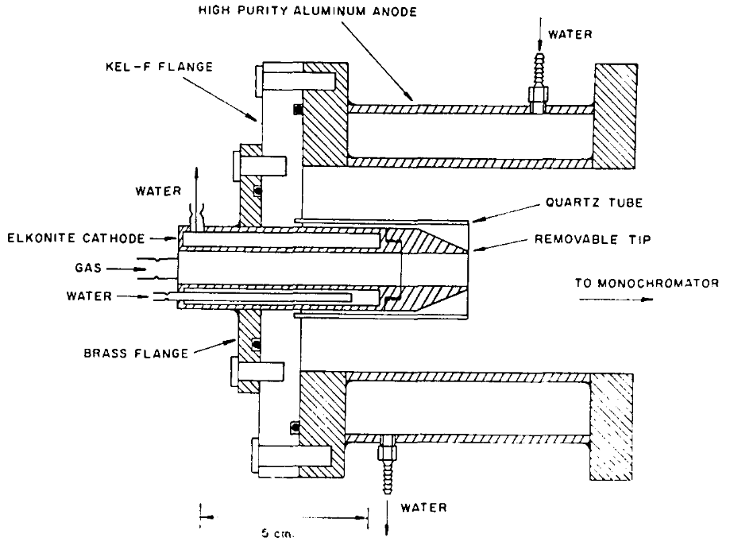
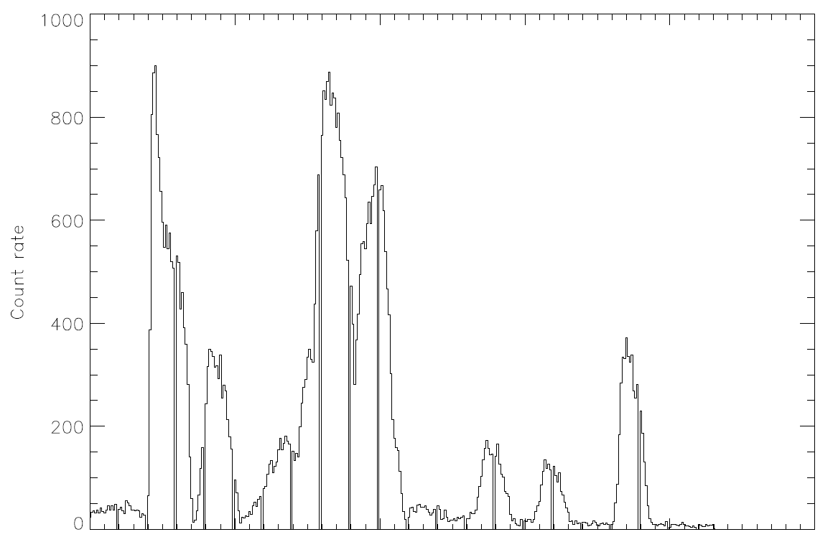
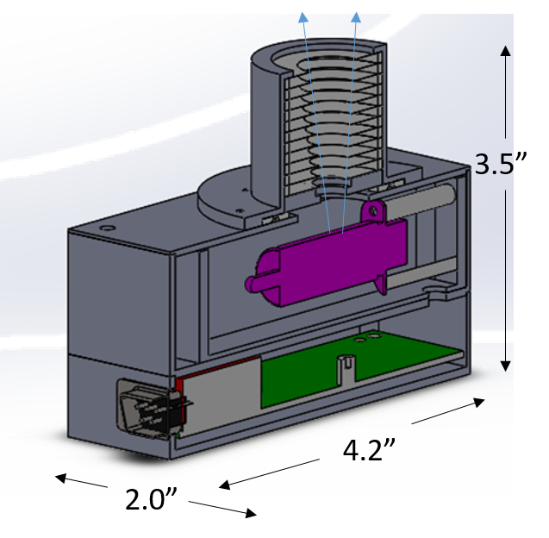
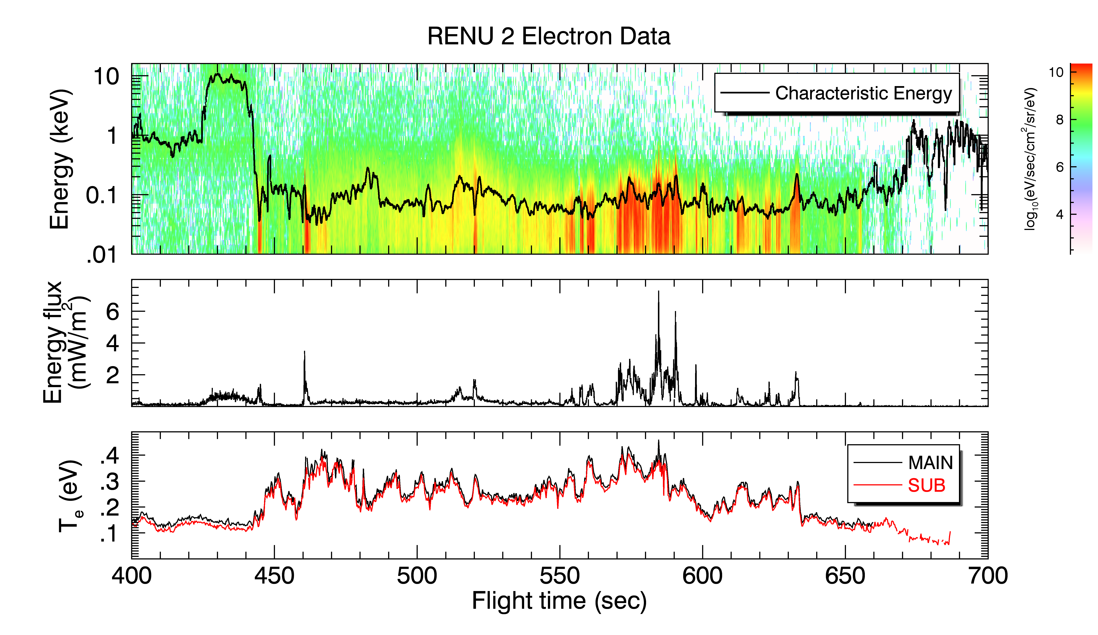
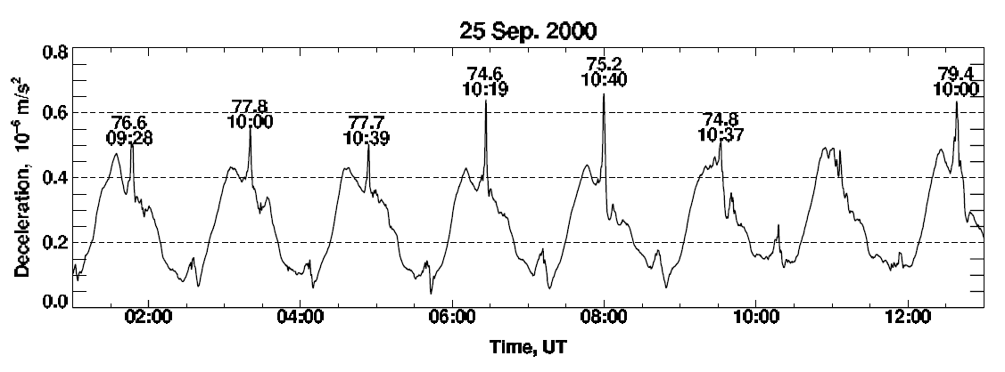
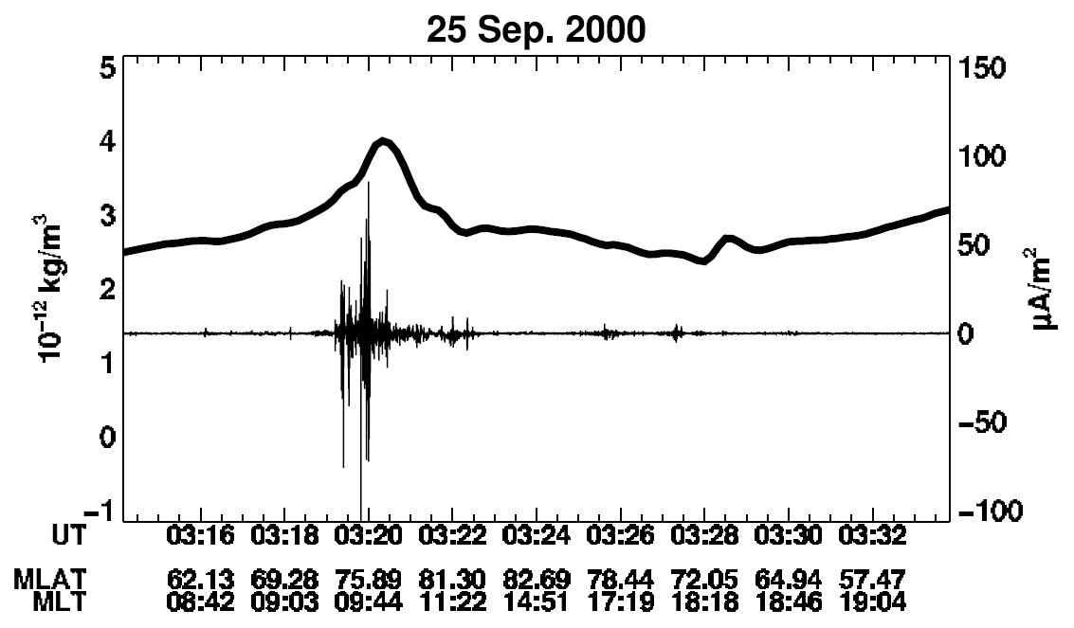
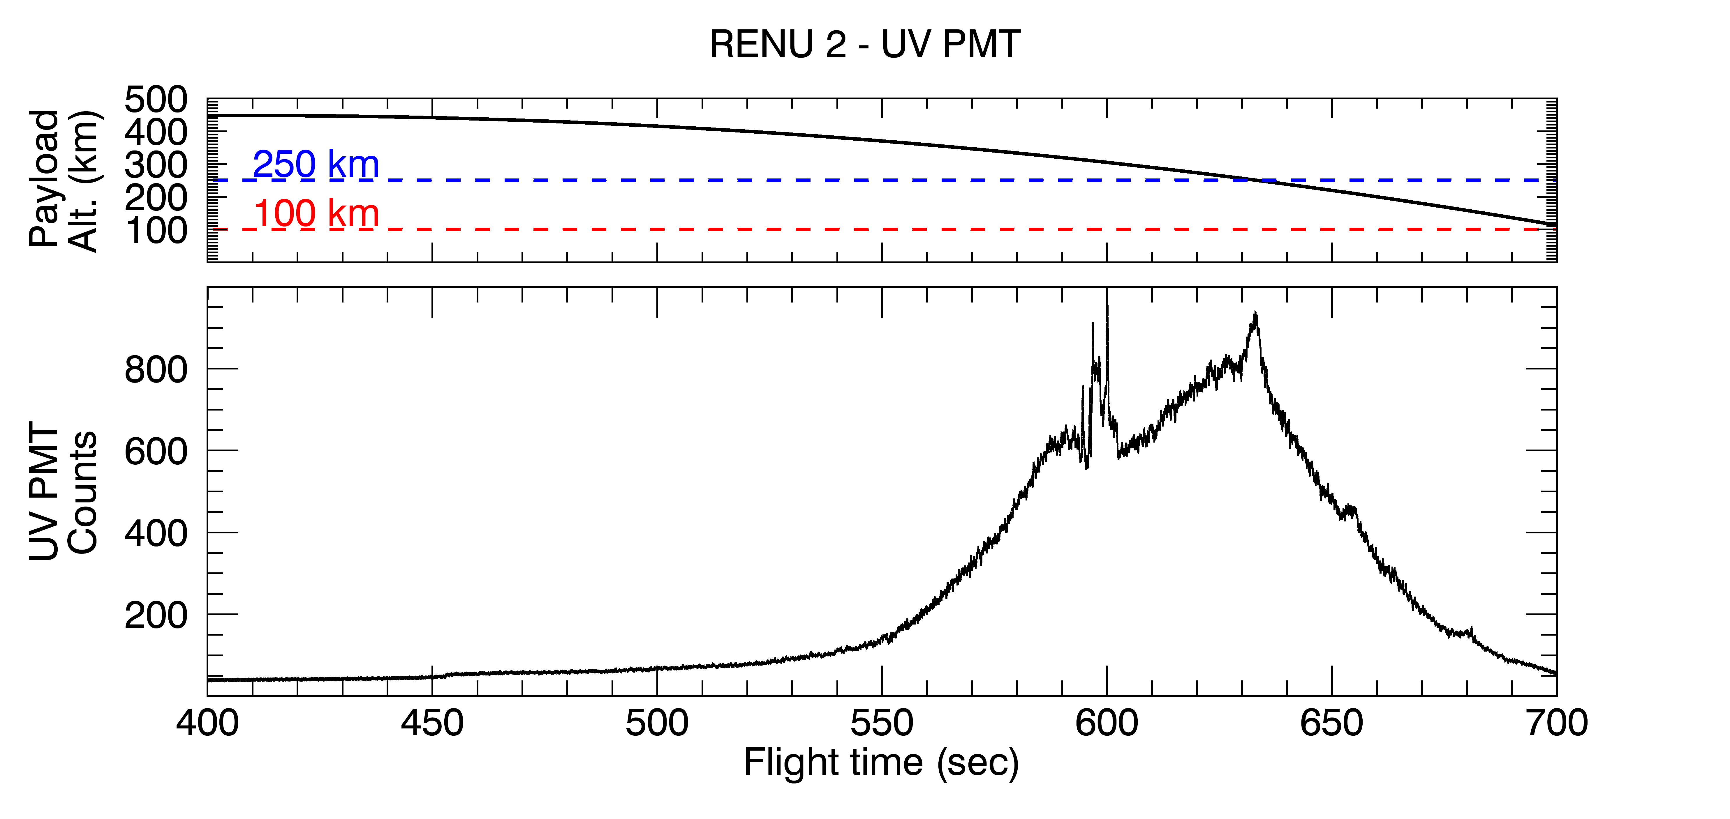
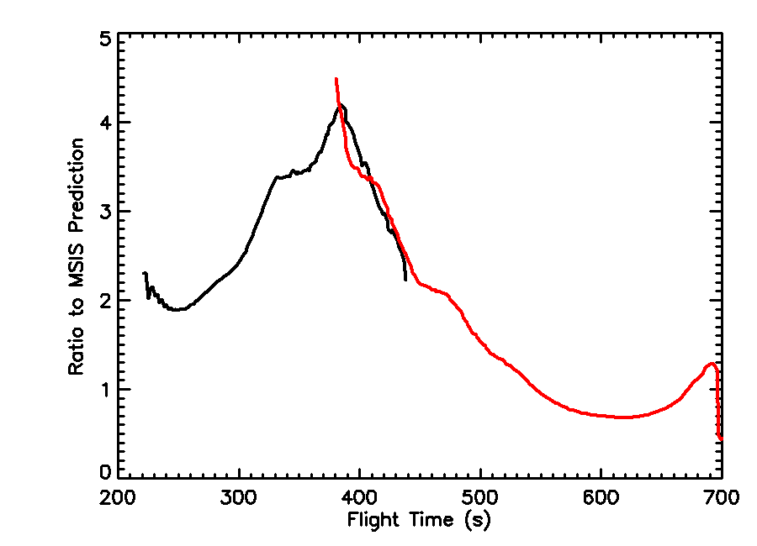
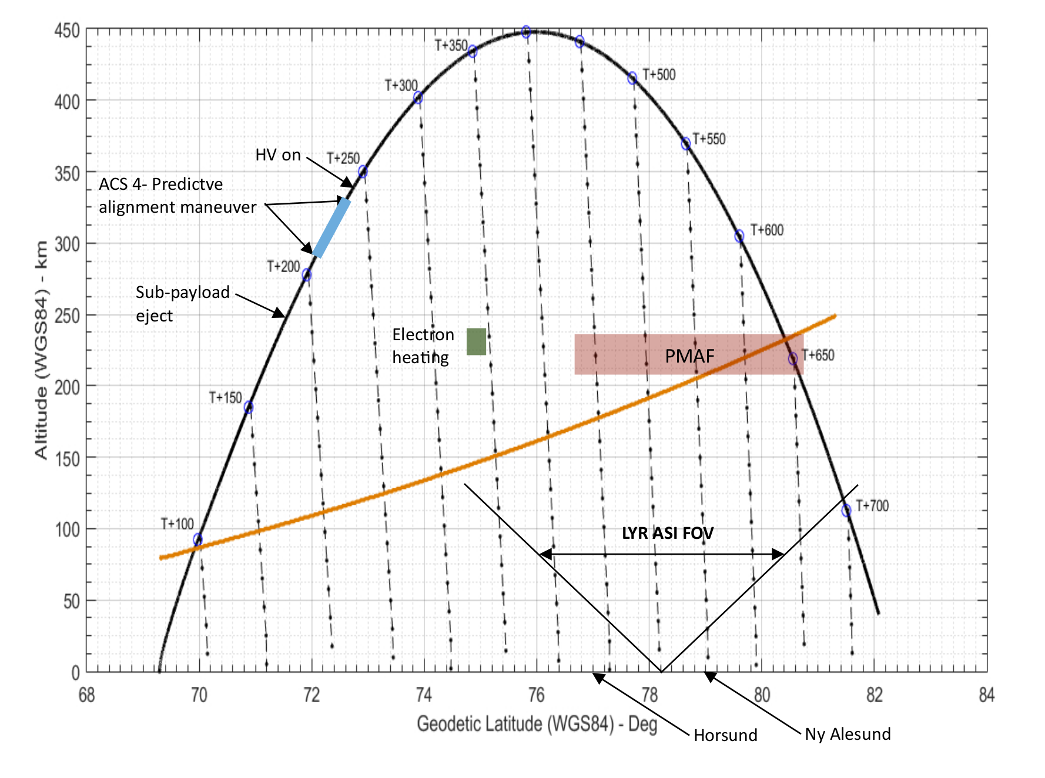
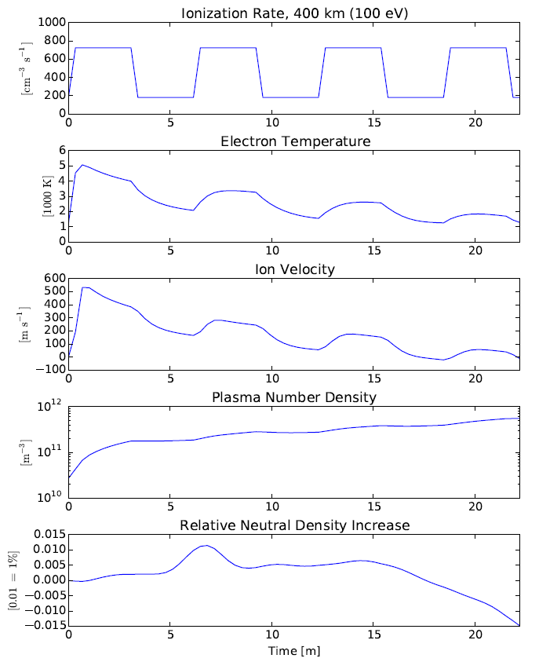
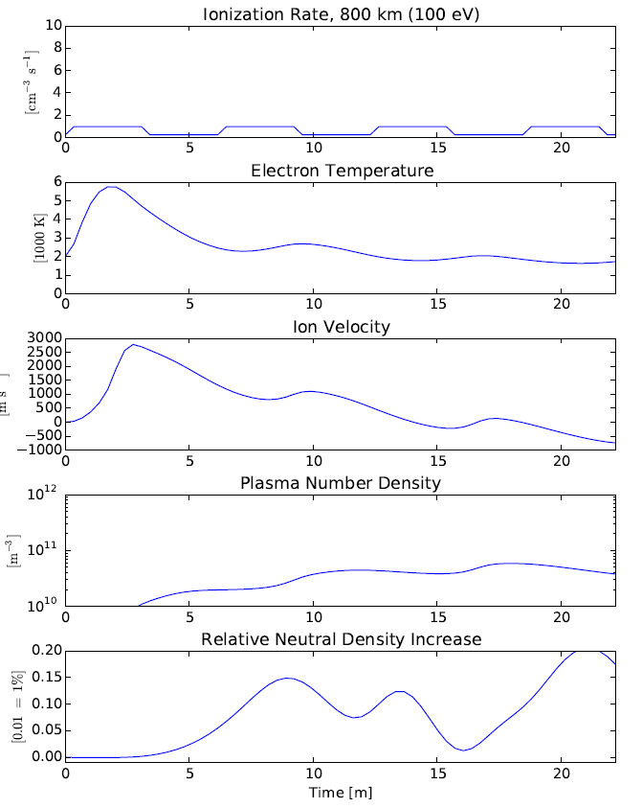
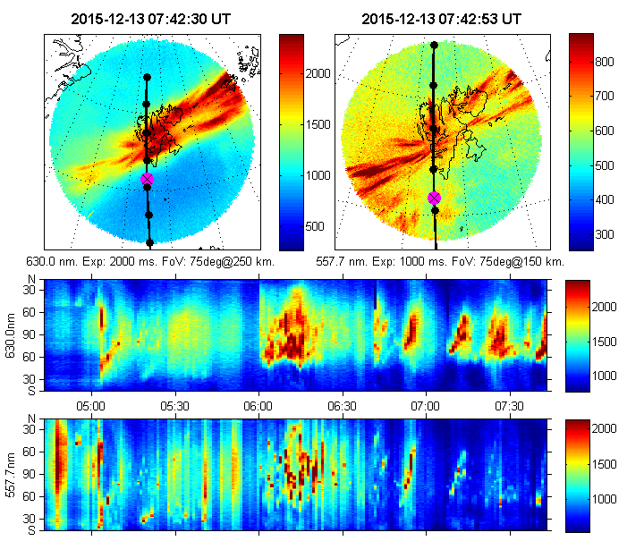
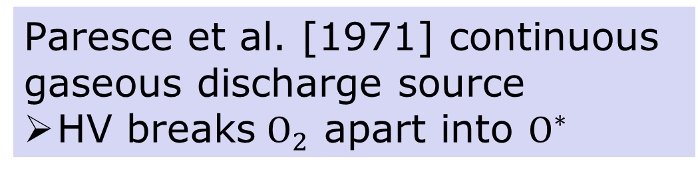
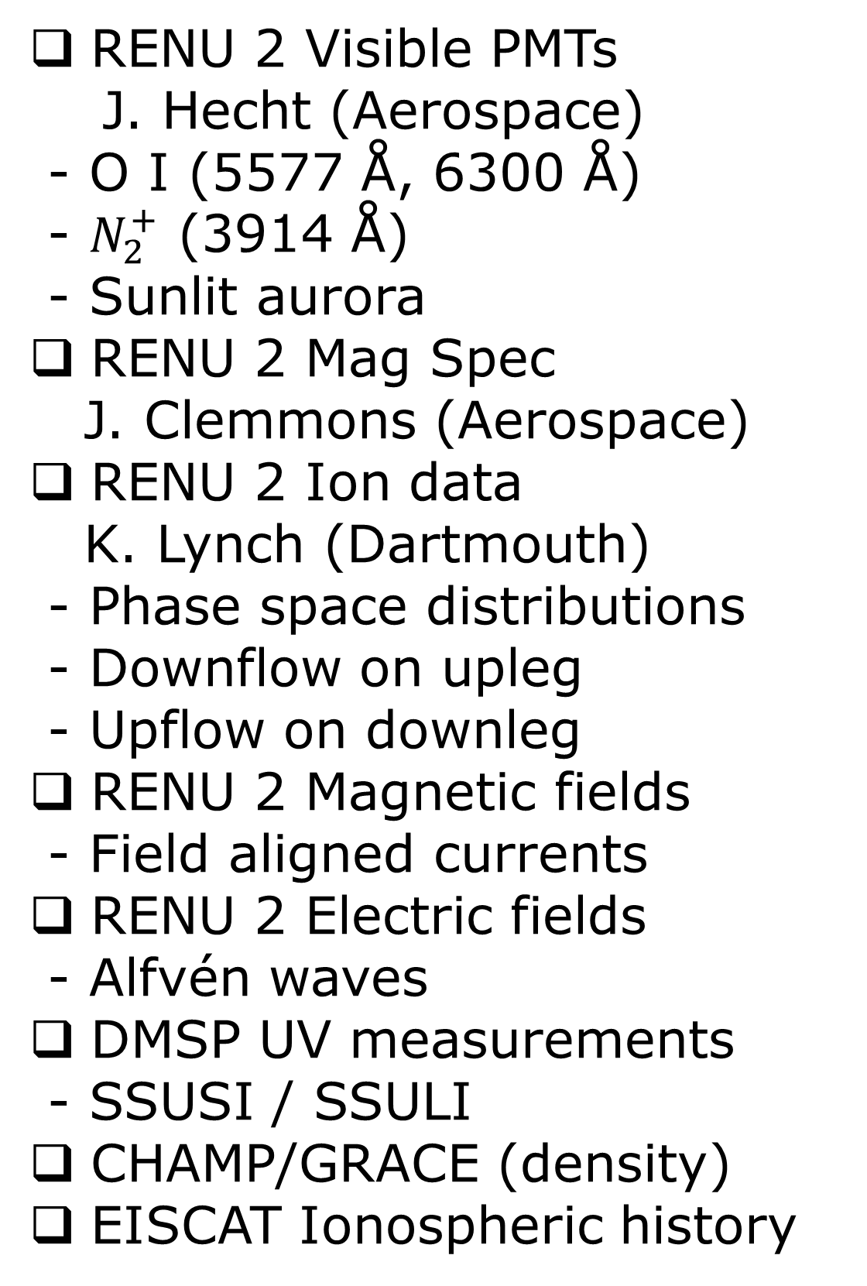
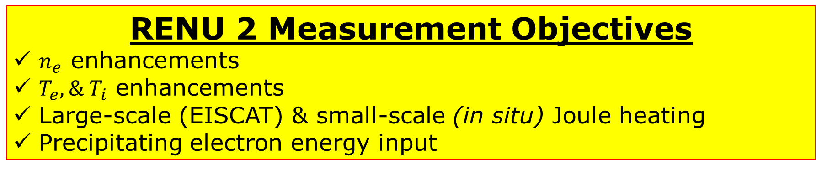
RENU 2 UV Measurement of OI in the Cusp
Bruce Fritz¹, Marc Lessard¹, David Kenward¹, Tim Cook², Jim Clemmons³, Jim Hecht³, Kristina Lynch⁴, David Hysell⁵, Geoff Crowley⁶
Funded by NASA Mission 52.002
Abstract
3. UV PMT Instrument Calibration
The RENU 2 NASA sounding rocket mission launched from the Andøya Space Center on 13 December, 2015 into the dayside cusp region. A UV Photometer (UV PMT) provided by the University of New Hampshire was oriented to look up along the local magnetic field line as the payload passed through a poleward moving auroral form (PMAF). The bandpass filter on the UV PMT isolated emissions of atomic oxygen at both 130.4 nm and 135.6 nm. The instrument measured a clear enhancement in the topside ionosphere as the payload descended through a region of soft electron precipitation. The RENU 2 UV PMT was flown uncalibrated but measured a clear signal with both a major overall structure as well as several smaller peaks of fine structure. An identical spare has been built and calibrated using a Paresce UV light source at UMass-Lowell to compare and correlate with the flight data. An approximation of the flight data luminosity from the spare instrument and other flight data from RENU 2 is used in a radiative transport model to infer structure of upwelling neutral atomic oxygen above the PMAF.
1304 Å
Paresce et al. [1971] continuous gaseous discharge source
HV breaks $O_{2}$ apart into $O^{∗}$
Monochromater isolates emission
Channel electron multiplier records output at exit slit
Hamamatsu R10825 PMT
O I – 1304 Å & 1356 Å
FOV - 12.5°
Sample rate – 10 Hz
1. Science Background
4. Selected mission Results
Lühr et al [2004] measured air drag with the accelerometer on board CHAMP (see figures below). The harmonic variations indicate the range of change in density over an orbit. Superimposed are small-scale features seen near the cusp. The peaks in air drag are labeled by their corrected magnetic latitude and magnetic local time
a)
a) Electrons measured in the loss cone during flight through cusp as function of energy. Characteristic energy emphasized prevalence of soft electron precipitation in the region
b) Energy flux calculated from electron measurements in a)
c) Thermal electron measurements show clear heating of ionosphere right at onset of soft precipitation.
b)
c)
d) UV PMT measurement above payload in the cusp with payload altitude
Many processes are likely contributors. Two of particular interest are:
Joule heating
  (“Type 1” ion outflow)
Soft electron precipitation
  (“Type 2” ion outflow)
e) Ion Gauge measurement shows a neutral density enhancement on upleg (relative to 2 x MSIS prediction) and a depletion on the downleg (J. Clemmons)
FACs are commonly seen along with density enhancements in cusp
e)
Forward Sensor
RENU 2 Measurement Objectives
$n_{e}$ enhancements
$T_{e}, \& T_{i}$ enhancements
Large-scale (EISCAT) & small-scale (in situ) Joule heating
Precipitating electron energy input
d)
Aft Sensor
Enhanced
Region
2. Mission Details
Baseline at 2 × MSIS
Depleted
Region
TERMINATOR
5. Model Results
Other Results
400 km
800 km
RENU 2 Visible PMTs
J. Hecht (Aerospace)
- O I (5577 Å, 6300 Å)
- $N_{2}^{+}$ (3914 Å)
- Sunlit aurora
RENU 2 Mag Spec
J. Clemmons (Aerospace)
RENU 2 Ion data
K. Lynch (Dartmouth)
- Phase space distributions
- Downflow on upleg
- Upflow on downleg
RENU 2 Magnetic fields
- Field aligned currents
RENU 2 Electric fields
- Alfvén waves
DMSP UV measurements
- SSUSI / SSULI
CHAMP/GRACE (density)
EISCAT Ionospheric history
PMAF precipitation
Immediate response
The RENU 2 mission descended into the cusp, moving through poleward moving auroral forms (PMAFs). ACS provided a predictive solution to align the payload at t+200 to the local magnetic field at t+500 as it crossed the EISCAT FOV. Field lines are represented by the dot-dash lines.
~ 10 sec response
Steady increase
Slower response
Models of drivers to consider:
1) Upwelling driven as part of the “Type 2” ion outflow process Sadler & Otto model (above)
2) Joule heating is fundamental driver (TIME-GCM) Crowley et al. [2010], doi:10.1029/ 2009GL042143
3) Soft electron precipitation enhances conductivities in F-region, enables increased Joule heating Zhang et al [2012], doi:10.1029/2012GL053519
4) Direct particle heating Brinkman et al. [2016], doi:10.1002/2015JA021658
We welcome conversation about collaboration using RENU 2 data. Contact Marc Lessard (PI) directly for details:
marc.lessard@unh.edu
Conclusions
RENU 2 successfully launched into cusp aurora on 13 December, 2015
UV PMT observed a measurable signal of O I in the cusp
- Signal above depletion measured by IG agrees with neutral enhancements in Otto-Sadler model
Sharp drop in signal implies discrete horizontal structure above payload
Future plans
Finalize calibration of the PMT at UML
Radiative transfer model to reproduce O I signature of enhancement
Acknowledgements: Thanks to Dr. Kaiti Wang for sharing data from Lulin Station for comparison. Thanks to folks who provide IRI model data. Thanks to South Pole support staff who have helped keep the ELF system going over the years. Research at the University of New Hampshire was supported by NSF Grant ANT-0513990.
University of New Hampshire, Space Science Center, Durham, NH
Lowell Center for Space Science and Technology, U. Mass. – Lowell, Lowell, MA
Aerospace Corporation, El Segundo, CA
Department of Physics, Dartmouth College, Hanover, NH
Department of Earth and Atmospheric Sciences, Cornell University, Ithaca, NY
ASTRA, Boulder, CO
References:
Lühr, H., M. Rother, W. Köhler, P. Ritter, and L. Grunwaldt (2004), Thermospheric up-welling in the cusp region: Evidence from CHAMP observations, Geophys. Res. Lett., 31, L06805, doi:10.1029/2003GL019314.
F. Paresce, S. Kumar, C.S. Bowyer, Appl. Opt., 10 (1971), p. 1904
UiO provided All-Sky Imagers, located at Ny-Ålesund & Longyearbyen. The top plots provided real-time updates on the location of auroral forms in relation to the nominal trajectory of RENU 2. The bottom plots show a time history, or keogram, of a vertical “slice” through the center of the images at top.

