Slide 1
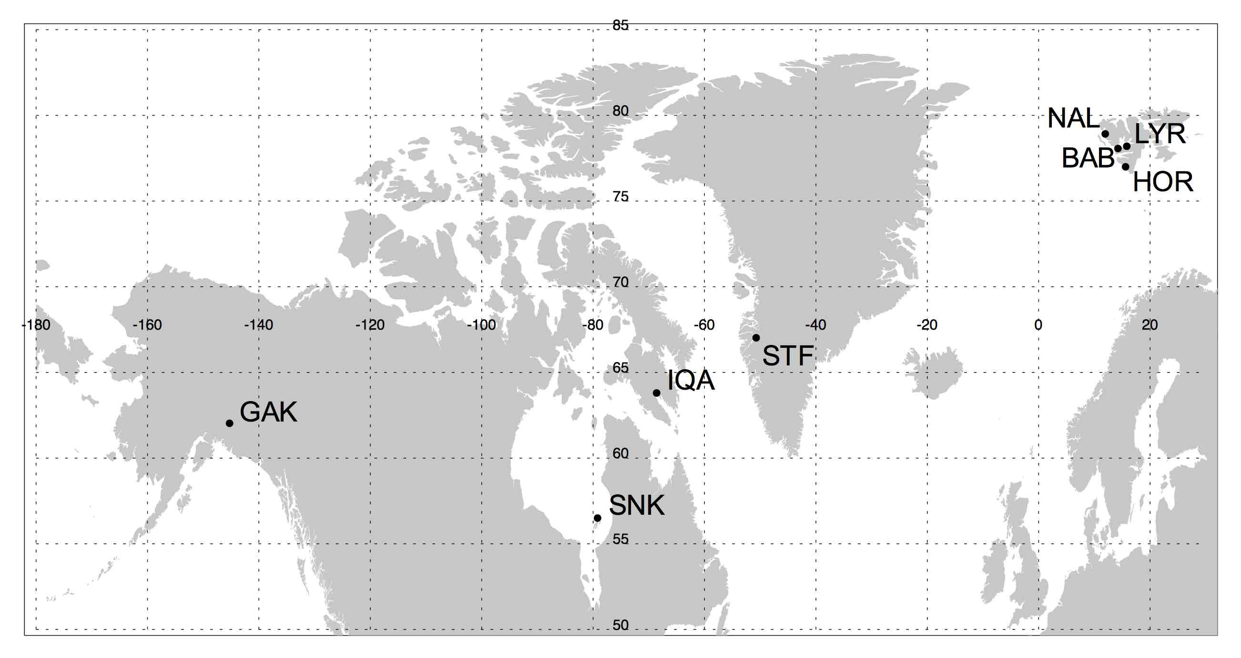
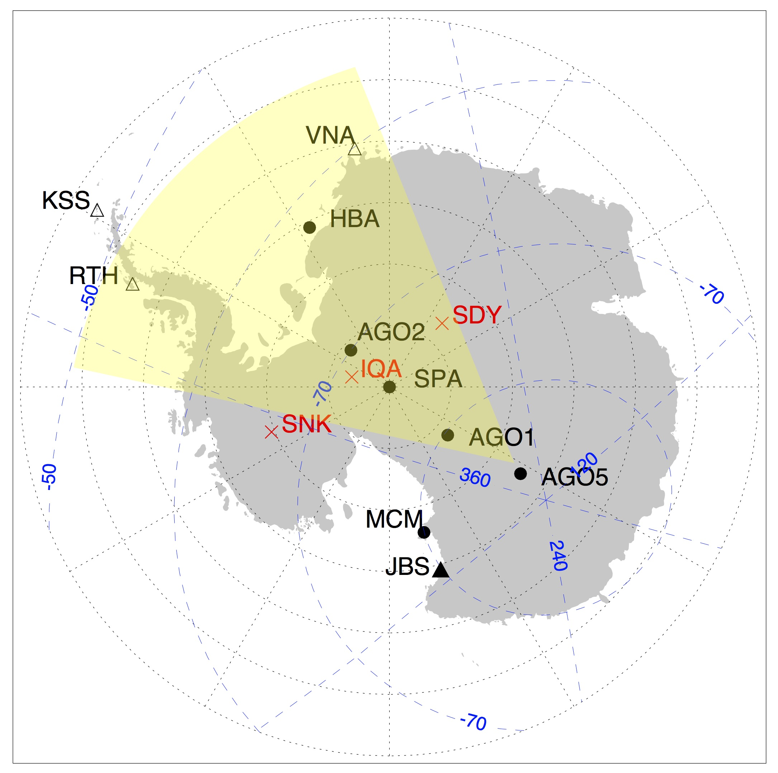
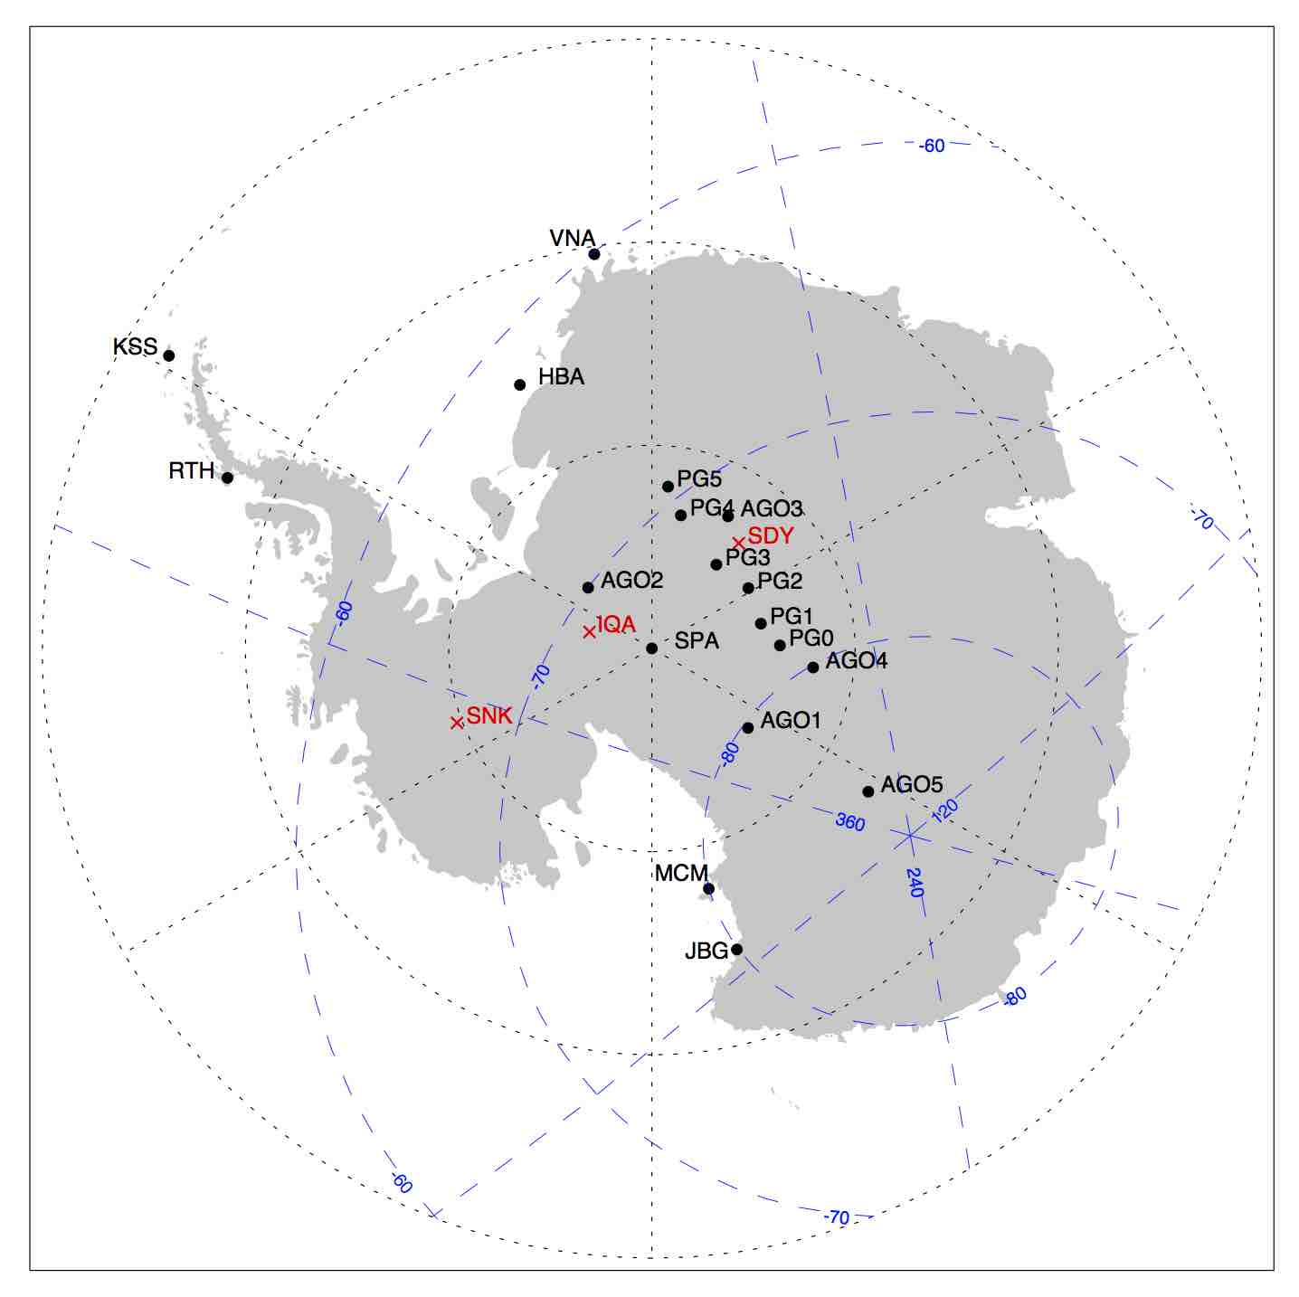
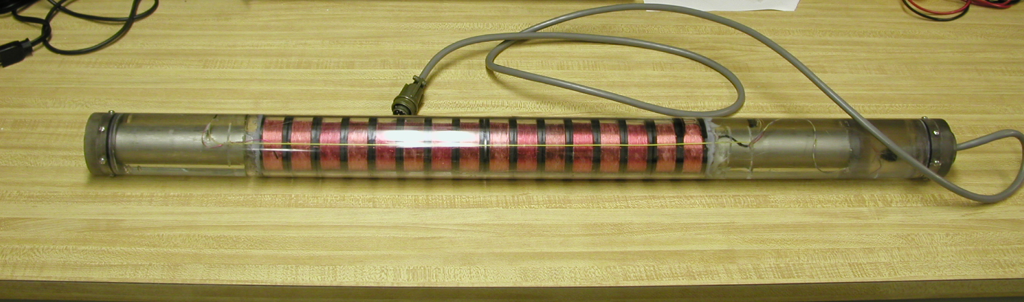
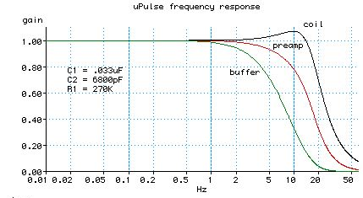
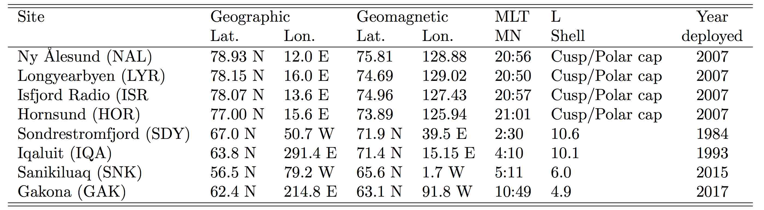
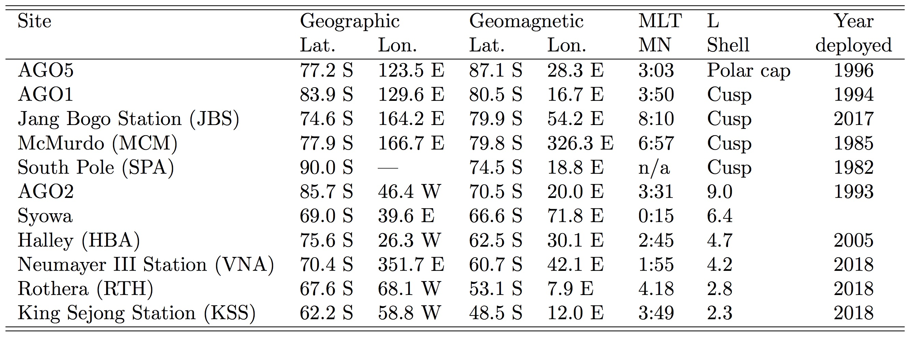
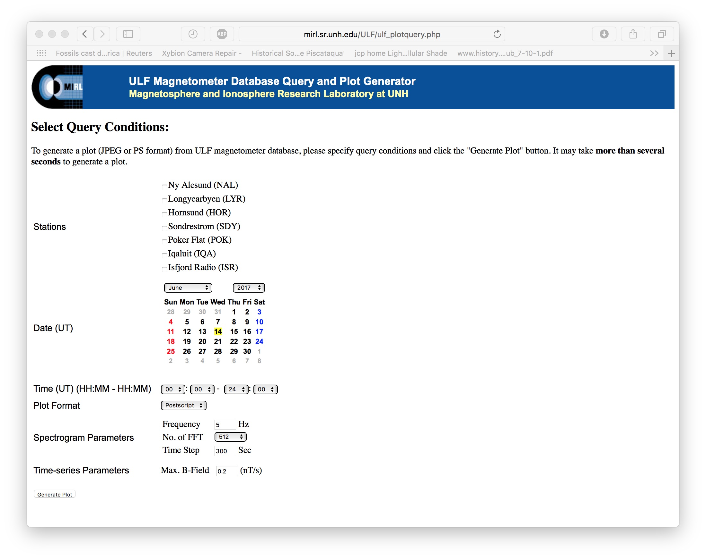
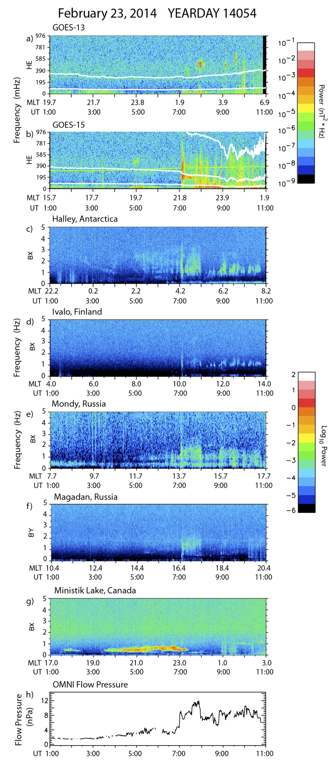
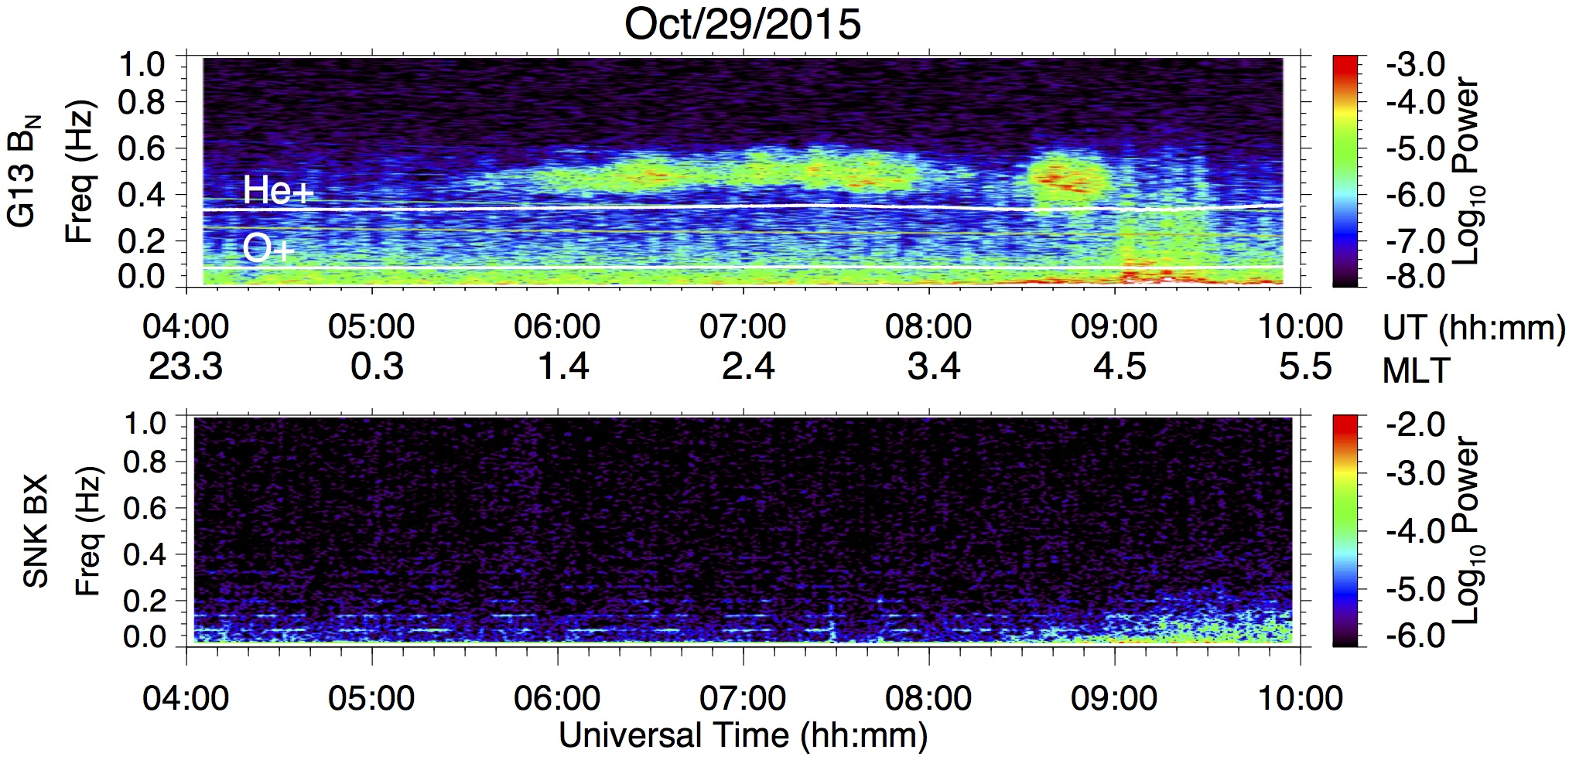
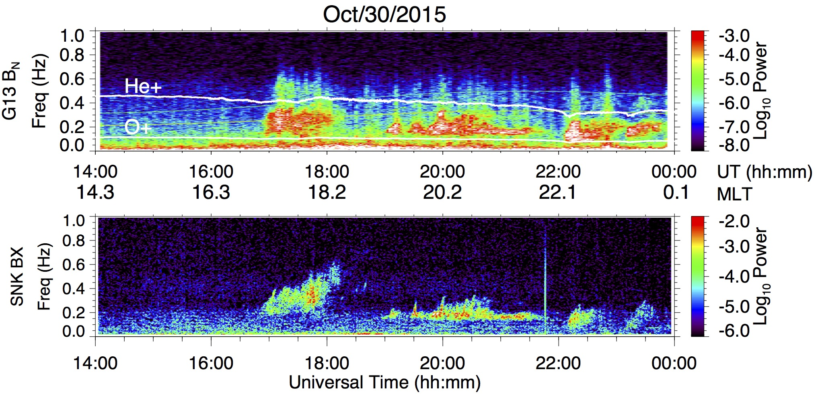
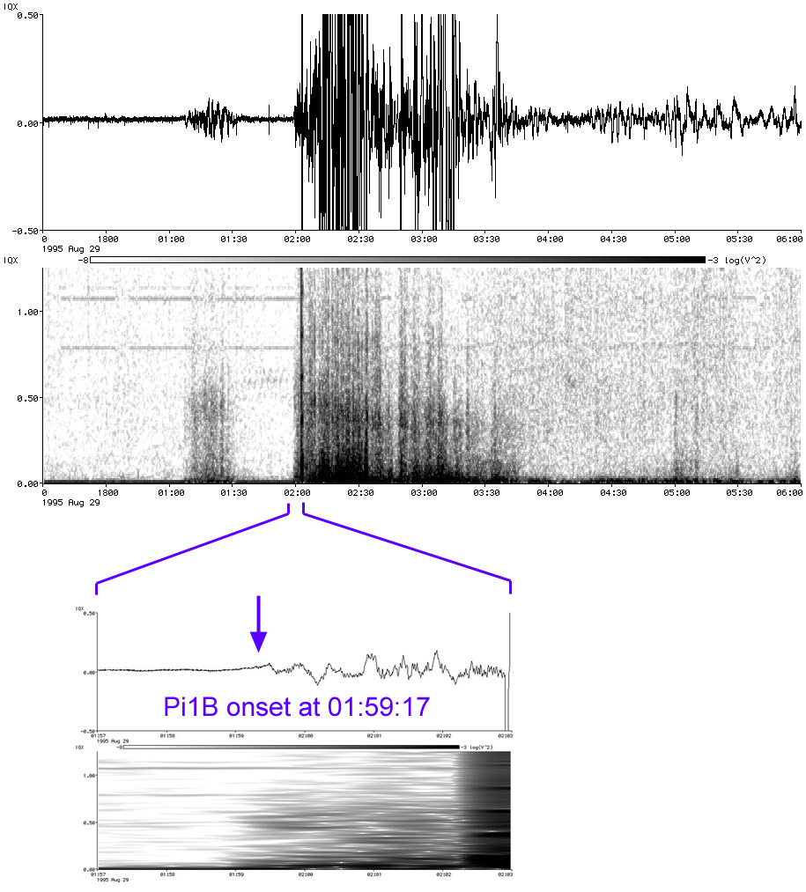
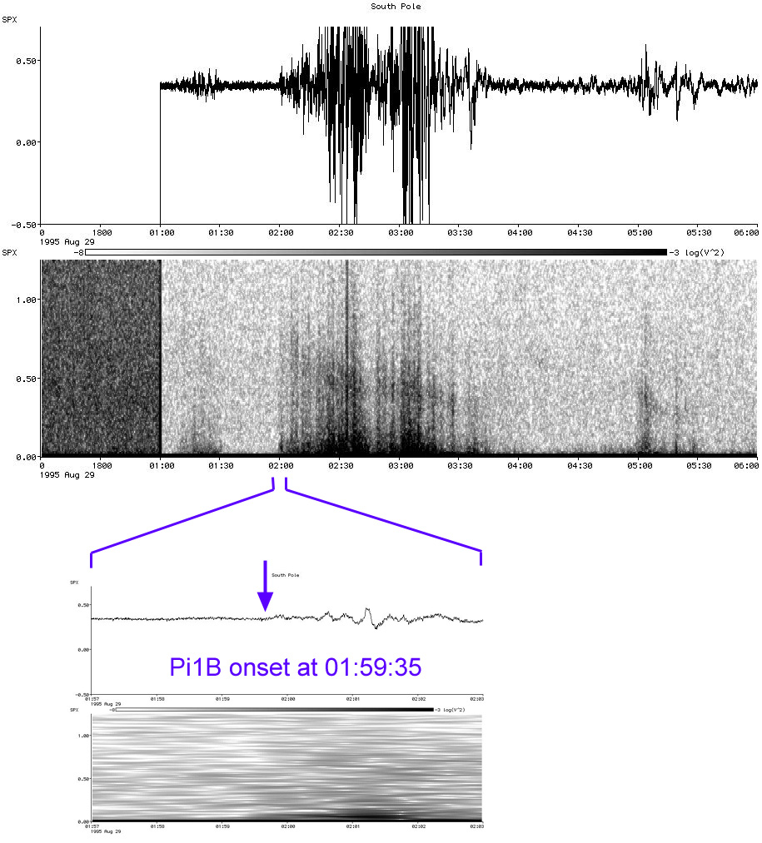
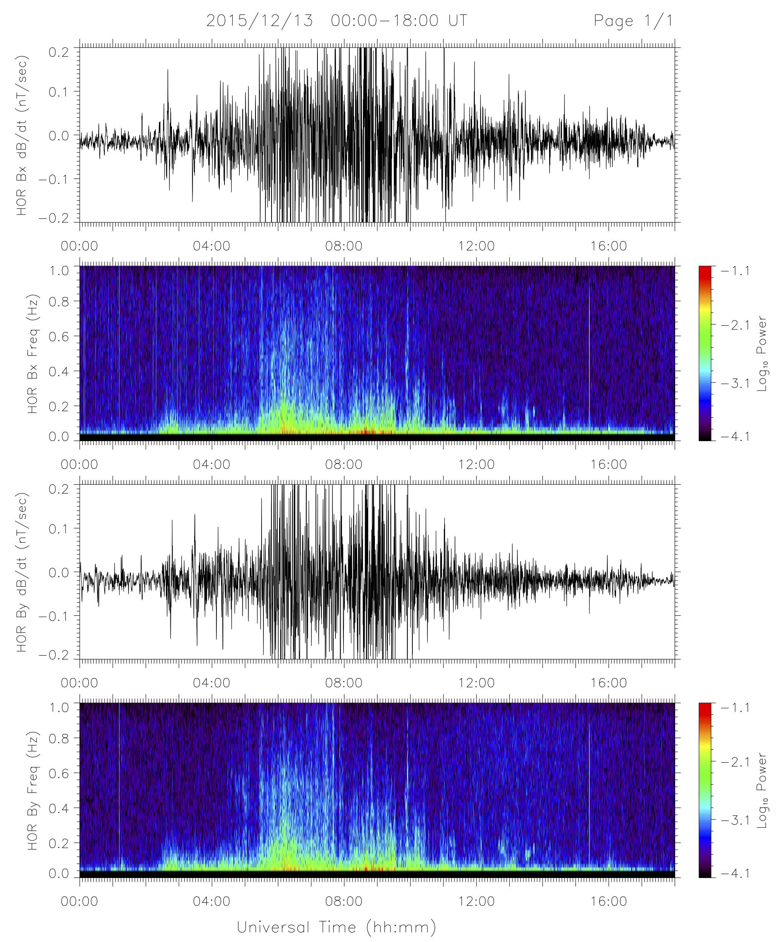
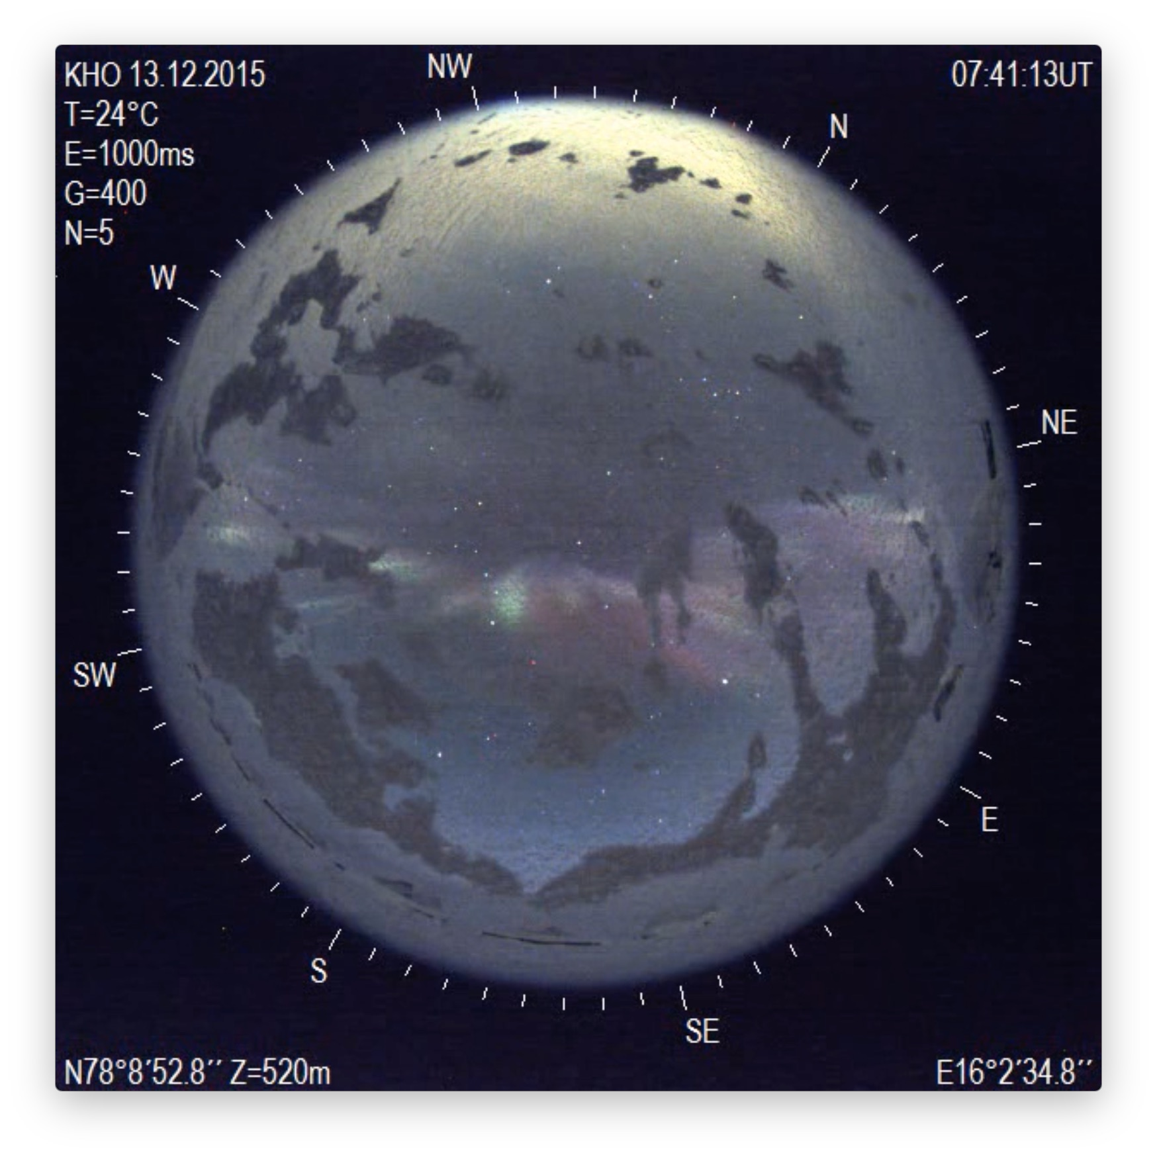
The Magnetic Induction Coil Array, North and South (MICA-N/S)
Marc Lessard¹, Mark Engebretson², Hyomin Kim³, Richard Horne⁴, Nigel Meredith⁴, Khan-Hyuk Kim⁵, Ho Jin⁵, Geonhwa Jee⁶, Juergen Matzka⁷, Tanja Fromm⁷ and Akira Kadokura⁸
¹ Space Science Center, University of New Hampshire, Durham, NH., USA
²Department of Physics, Augsburg College, Minneapolis, MN, USA
³ Center for Solar-Terrestrial Research, New Jersey Institute of Technology, Newark, NJ., USA
⁴ British Antarctic Survey, Natural Environment Research Council (NERC), Cambridge, UK
⁵ School of Space Research, Kyung Hee University, Yongin 17104, Korea
⁶ Korea Polar Research Institute, Incheon, Korea
⁷Helmholtz Centre Potsdam, GFZ German Research Centre For Geosciences, Germany.
⁸National Institute of Polar Research, Tachikawa, Tokyo, Japan
Introduction
Station locations
Induction coil magnetometers have provided important data for space science studies for decades. Historically, various research groups around the world have installed similar versions of this instrument at different locations to target specific science objectives. The MICA effort has the purpose of integrating these data into a single database in order to simply the process needed to use these data and includes the participation of researchers from 6 different countries.
The photo above shows an example of one of these sensors. In this case, it uses 16 spools mounted on a high permeability core, each with 10,000 turns to obtain sensitivity the order of a less than a pT at frequencies near 1 Hz. Unlike a fluxgate magnetometer, induction coils do not provide a measure of the absolute field but have great sensitivities for frequencies greater than ~0.01 Hz. The figure on the right shows the measured frequency response of the coil. A separate coil is needed for each vertor compnent measured.
MICA-N station locations. In nearly every case, sites were selected to focus on specific science questions. Logistics also play a very important role, including the cost of access tothe various locations, the availability of on-site support, data transfer possibilities, etc.
In the northern hemisphere, stations on Svalbard are ideally located for studies of cusp phenomena (and are very well supported with other ground-based instruments there). The Sondrestromfjord system was placed there as part of the larger ISR effort. The Iqaluit site was selected for its conjugacy to the South Pole; Sanikiluaq was chosen for its conjugacy to GOES 13. Gakona was chosen because of its ideal magnetic latitude for radiation belt (and EMIC) studies.
To a large degree, the MICA concept (in both hemispheres) has materialized from the existence of increasing numbers of these sites, with the realization that, in almost all studies, data from distributed arrays are much more scientifically useful than from single locations.
MICA-S station locations. Systems currently exist at the South Pole (SPA), McMurdo (MCM) and Halley (HBA). The U.S. AGO stations are marked as AGO1, AGO2 and AGO5. Jang Bogo (JBS) has just been installed in the austral summer of 2016-17. Rothera (RTH), King Sejong (KSS) and Neumayer III (VNA) stations are expected to be operational by 2018. Locations marked in red show the magnetic footprints of some existing locations in the northern hemisphere. For perspective, SNK and IQA are in central Canada; SDY is in Greenland. The yellow highlighted region (with an apex at the southern magnetic pole) is included to show that these stations more or less encompass a region of a few hours in MLT.
The figure on the right includes the remote Autonomous Adaptive Low-Power Instrument Platform (AAL-PIP) locations (R. Clauer, Virginia Tech, PI). Each of these these solar powered observatories support a fluxgate magnetometer, induction coils and a GPS/TEC instrument.
Examples of ongoing studies
MICA supports the integration of data into a single database (although MICA is still in its infancy and many sites are not yet completely included). An important part of this interface is a web-based GUI that allows the user to select specific sites and to plot spectra with user-selected parameters. Although not yet implemented, ASCII and CDF files (e.g., for Autoplot) will also be available.
An ongoing focus is trying to understand where and under what conditions EMIC are waves generated in the magnetosphere. Under the most intense conditions, global studies are producing quite different signatures from veent to event. The example presented here is one of several that have combined ground- and satellite-based observations in a synergistic manner to reveal the global generation of EMIC waves, as well as energetic particle precipitation apparently driven by these waves (see Engebretson et al., Van Allen probes, NOAA, GOES, and ground observations of an intense EMIC wave event extending over 12 hours in MLT, J. Geophys. Res., 120, 5465Ð5488, doi:10.1002/2015JA021227, 2015).
This shows observations of a wave event on 23 February 2014 that extended over 8 hours in UT and over 12 hours in local time, a region much broader than expected from statistical studies. The activity was stimulated by a gradual 4 hour rise and subsequent sharp increases in solar wind pressure. Large-amplitude linearly polarized hydrogen band EMIC waves (up to 25 nT p-p) appeared for over 4 hours at both Van Allen Probes, from late morning through local noon, when these spacecraft were outside the plasmapause, with densities ~5–20 cm-3.
Waves were also observed by ground-based induction magnetometers in Antarctica (near dawn), Finland (near local noon), Russia (in the afternoon), and in Canada (from dusk to midnight). Ten passes of NOAA-POES and METOP satellites near the northern foot point of the Van Allen Probes observed 30–80 keV subauroral proton precipitation, often over extended L shell ranges; other passes identified a narrow L shell region of precipitation over Canada.
Observations of relativistic electrons by the Van Allen Probes showed that the fluxes of more field-aligned and more energetic radiation belt electrons were reduced in response to both the emission over Canada and the more spatially extended emission associated with the compression, confirming the effectiveness of EMIC-induced loss processes for this event.
Examples of ongoing studies
The goal of this study is to understand differences in observations of EMIC waves observed by GOES 13 and at Sanikiluaq, a ground station at its magnetic footprint in Canada. In the panel on the left, when both platforms were located in the post-midnight (dark) region, EMIC waves are observed by GOES 13 but not on the ground at SNK. In the panel on the right, when the platforms are located near dusk and pre-midnight (but still sunlit), EMIC waves are recorded both by GOES 13 and at SNK.
Whether the difference in signatures is caused by ionospheric effects that might inhibit the transmission of the signal to the ground or whether it is the result of the wave being absorbed in the magnetosphere, understanding EMIC signatures is fundamentally important because of how these data are used in various studies.
Iqaluit South Pole
Pi1B pulsations are signatures of substorm onset, well correlated (in time) with other onset signatures such as the initial auroral brightening. This study examines P1iB onset times in opposite hemispheres, observed at the South Pole and at Iqaluit, in order to characterize interhemispheric differences in the timing of substorm onset. Preliminary results show that during the spring of 1995, events at the South Pole tended to lead those at Iqaluit often by a minute or two, with a wide distribution in time differences. During the fall of that year, events at Iqaluit tended to lead those at the South Pole, but with significantly smaller time differences and with less scatter than in the spring. An apparent seasonal dependence seems to be emerging, as shown in the figure below.
The plot on the left provides a typical example of a “cusp signature” from Hornsund, in Svalbard. The allsky camera image on the right shows (through a snow-covered dome) images of Poleward Moving Aurora Forms. This event coincided with the launch of the RENU2 sounding rocket, which observed Alfvenic electron precipitation during the event. In other words, PMAFs appear to be driven by Alfven waves (from the RENU2 data) and the implication is that the “cusp signature” is a superposition of several of these waves. Also noteworthy, the soft electron precipitation in these events is known to drive Type-2 ion upflow. A new study will consider statistically whether the induction-coil based signature is correlated with ion upflow.

