Slide 1


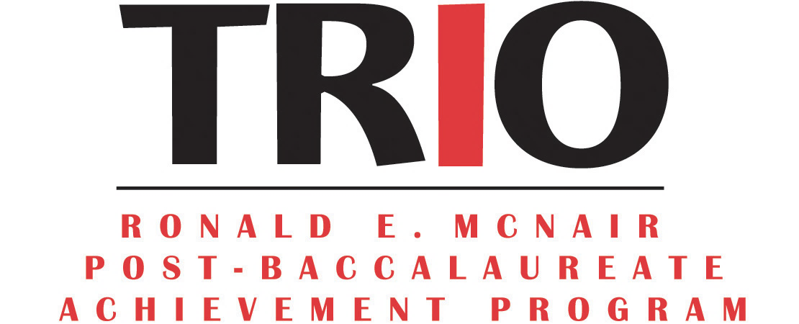
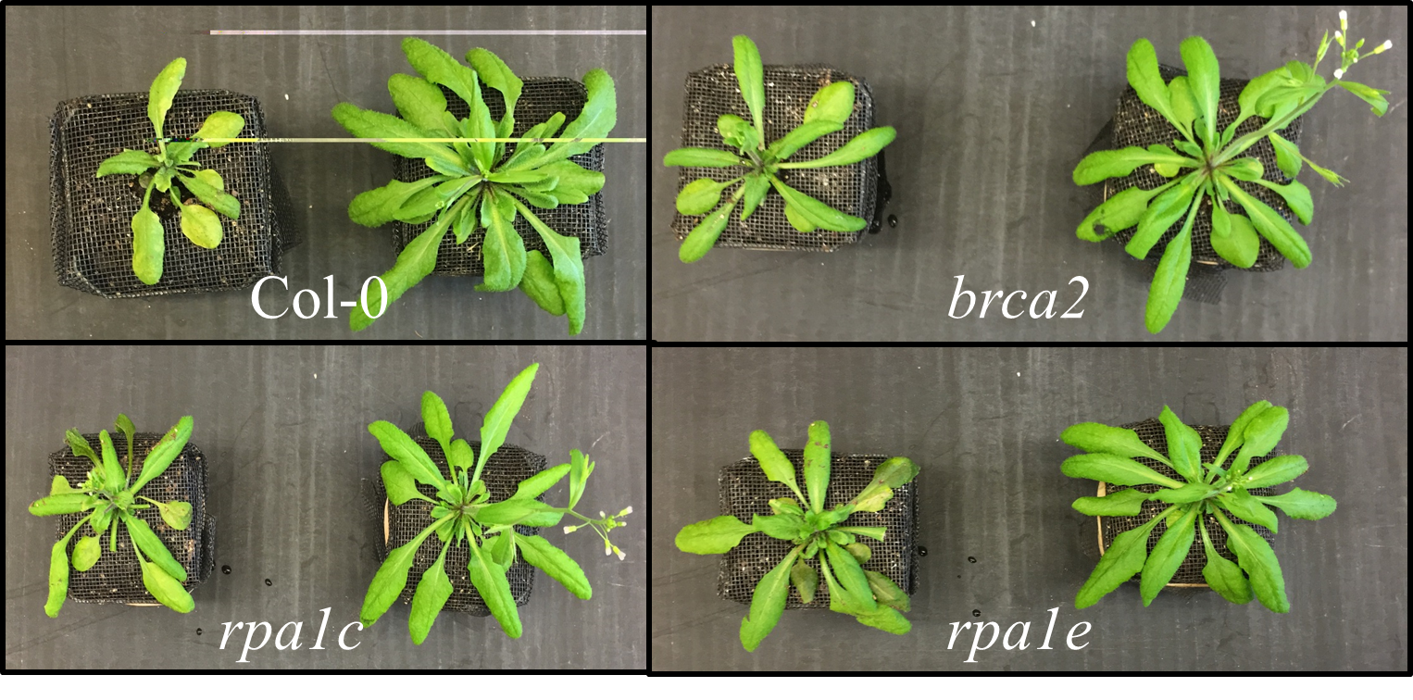
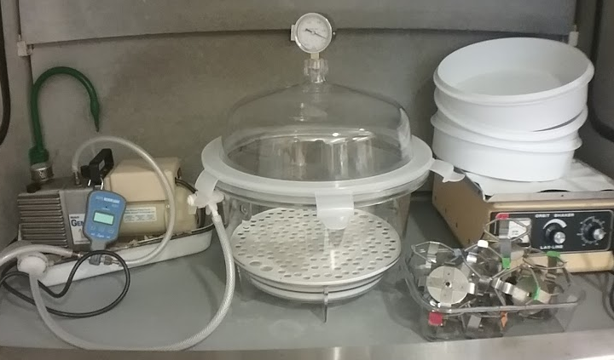
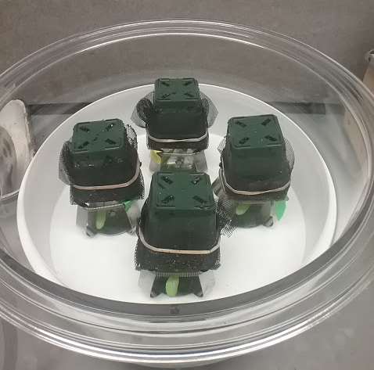
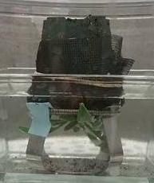
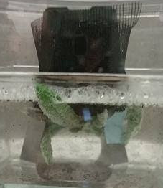
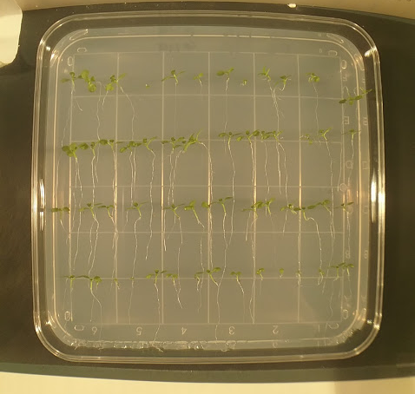
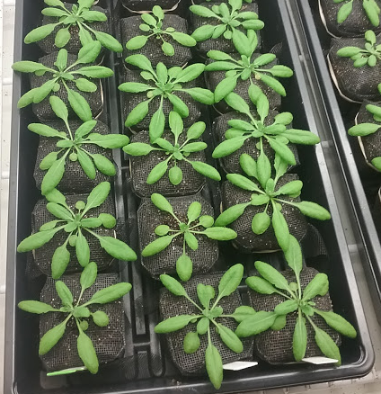
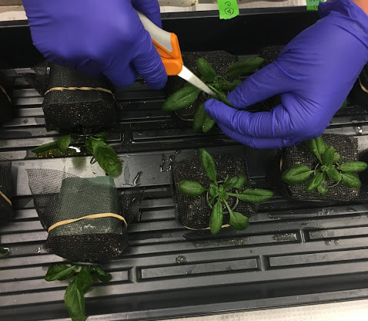
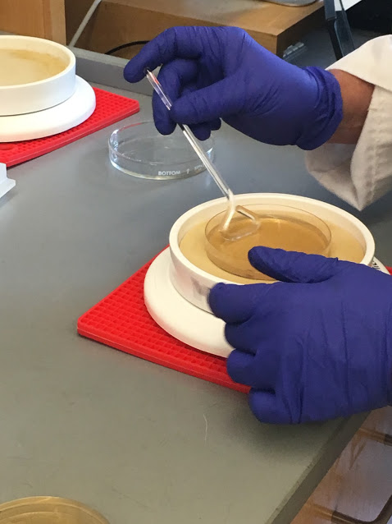
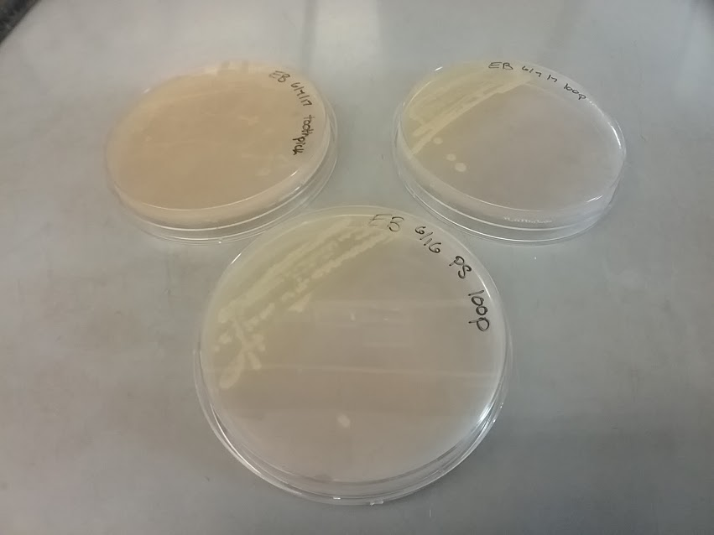
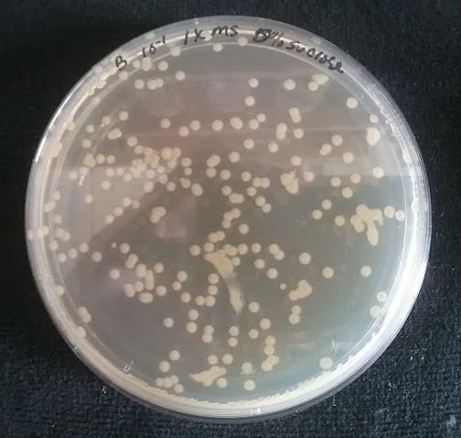
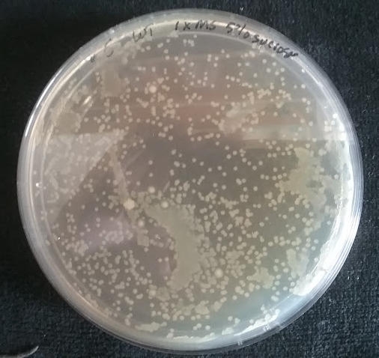
Analyzing the effects of Vibrio parahaemolyticus virulence factors in Arabidopsis thaliana
Emily Berry¹, Nancy Fernandes² and Kevin Culligan¹
¹Department of Molecular, Cellular and Biomedical Sciences
²Department of Biochemistry, University of New Hampshire , Durham, NH 03824
Introduction
Methods
Results
Results
The bacterium Vibrio parahaemolyticus lives in warm salt water, and some pathogenic strains are known to cause illness in humans. With ocean temperatures expected to increase, is also expected that cases of illness from V. parahaemolyticus will also rise. More research about the virulence of V. parahaemolyticus is needed so that we can identify and differentiate the various strains of V. parahaemolyticus.
V. parahaemolyticus has not been studied in the model organism Arabidopsis thaliana, a plant which is commonly used to observe virulence of pathogens as well as DNA damage resulting from these infections. If A. thaliana is susceptible to this pathogen, it will be visible by expressing symptoms seen in humans.
I hypothesize that V. parahaemolyticus may cause disease symptoms in the A. thaliana host because its secretion system is the same as that of other pathogens known to cause disease in this host. If V.parahaemolyticus also induces double-strand breaks, disease may be more severe in A.thaliana strains with mutated repair genes than in the wild type.
3. Plants are brought to lab to acclimate, then placed in a MgCl₂ bacterial solution.
Table 1: Survival rate of A. thaliana leaf tissue after exposure to MgCl₂
Figure 5: The infiltration system used to infect plants with P. syringae or V. parahaemolytcus
Figure 6: A close-up of plants being infiltrated
Figure 1: For each strain, plants on the left were exposed to P. syringae, while the plants on the right were not exposed to any bacteria.
4. The plants and solution are placed in a vacuum, pressure is reduced to 3 Torr.
Conclusions & Future Directions
Conclusions
Arabidopsis thaliana can fully recover from infiltration of up to 30mM MgCl₂
Vibrio parahaemolyticus thrives in Instant Ocean, but this solution kills A. thaliana.
Future Directions
Conduct additional infiltrations with Pseudomonas syringae as a positive control and no bacteria as a negative control
Conduct additional infiltrations to determine the appropriate concentration of MgCl₂ that does not harm V.parahaemolyticus or A.thaliana
Further investigate the sensitivity of the npr A. thaliana strain to V.parahaemolyticus
Table 2: Survival rate of V. parahaemolyticus after exposure to MgCl₂
Methods
Figure 8: One plant being infiltrated, the vacuum has just been turned on
Figure 9: The same plant from figure 8, once the pressure has reached 3 Torr
1. Seeds are sterilized prior to sowing. Seedlings are planted separately.
5. Tissue samples will be collected immediately after infiltration and 3 days later.
Table 3: Colony growth of control pathogen Pseudomonas syringae in each A. thaliana strain
Acknowledgements
New Hampshire Sea Grant (NOAA) Grant for their funding
Trio and the McNair Post baccalaureate Scholarship Program for their funding
Kevin Culligan and Nancy Fernandes for their mentorship
The Whistler lab for providing the strains and data of V. parahaemolyticus
Figure 1: Seedlings are plated on Phyto-agar
Figure 2: A. thaliana plants that are ready for infiltration
Figure 10: Infiltrated leaves are cut for sampling
Figure 11: Infiltrated leaf samples are plated on NYGA
2. Bacteria are cultured weekly. Single colonies are selected to use for infiltration.
5. The data consists of colonies formed on NYGA plates 0 and 3 days after infiltration.
References
Broberg, C. A., Calder, T. J., & Orth, K. (2011). Vibrio parahaemolyticus cell biology and pathogenicity
determinants. Microbes and Infection /Institut Pasteur, 13(1213), 9921001.
http://doi.org/10.1016/j.micinf.2011.06.013
Ham, H., & Orth, K. (2012). The role of type III secretion system 2 in Vibrio parahaemolyticus
pathogenicity. Journal of Microbiology, 50(5), 719-725.
Katagiri, Fumiaki, Roger Thilmony, and Sheng Yang He. "The Arabidopsis Thaliana Pseudomonas Syringae
Interaction." The Arabidopsis Book 1 (2002): n. pag. Web.
Song, J., & Bent, A. F. (2014). Microbial pathogens trigger host DNA double strand breaks whose abundance is
reduced by plant defense responses. PLoS Pathog, 10(4), e1004030.
Vezzulli, L., Grande, C., Reid, P. C., Hélaouët, P., Edwards, M., Höfle, M. G., ... & Pruzzo, C. (2016). Climate
influence on Vibrio and associated human diseases during the past half century in the coastal North
Atlantic. Proceedings of the National Academy of Sciences, 201609157.
Data of CFUs were analyzed using the Analysis of Variance (ANOVA) test for significance.
Figure 3: Quadrant streaks of P. syringae on NYGA growth media
Figure 12: Colonies of P. syringae from infiltrated A. thaliana leaves after being incubated in 28°C for 48 hours
Contact information; Emily Berry esb1003@wildcats.unh.edu

