Slide 1


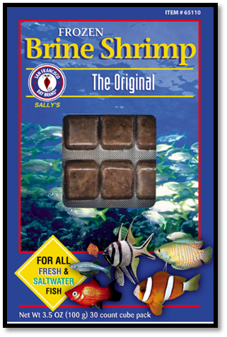
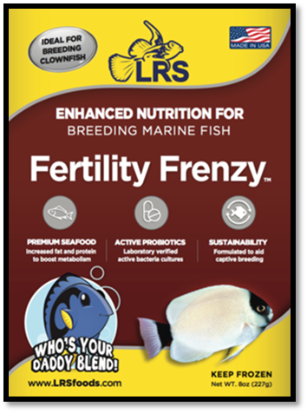
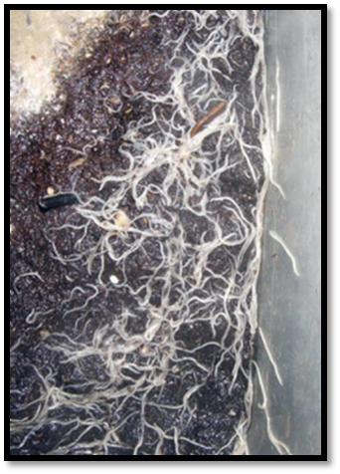
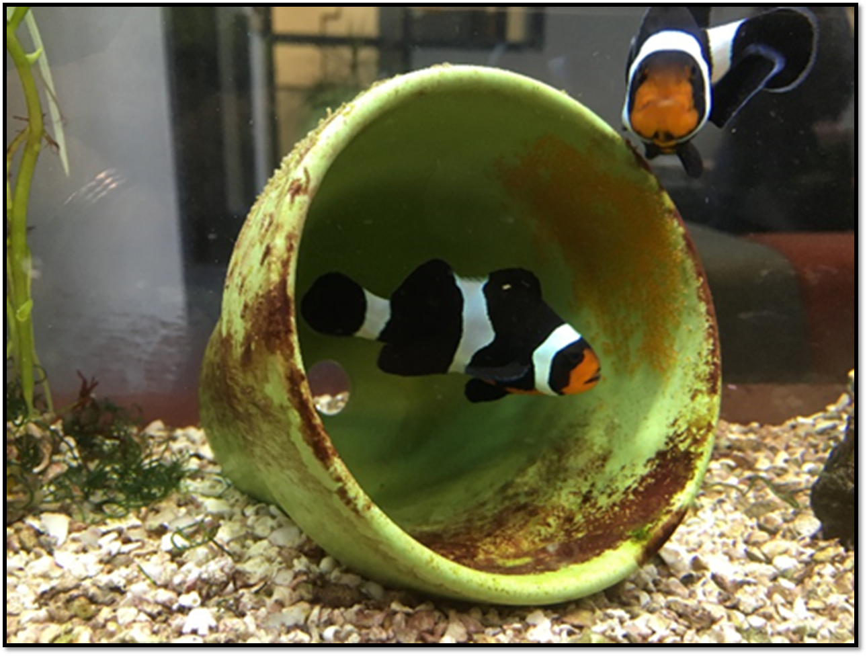
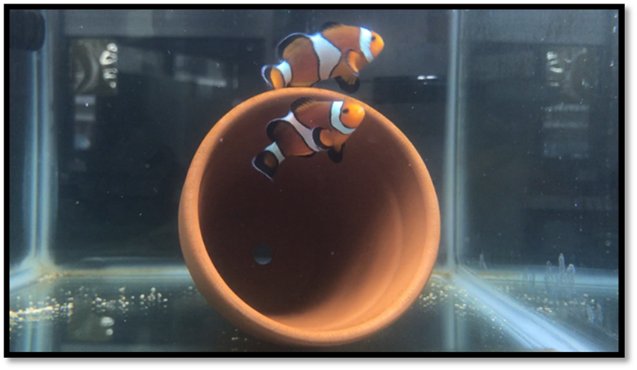
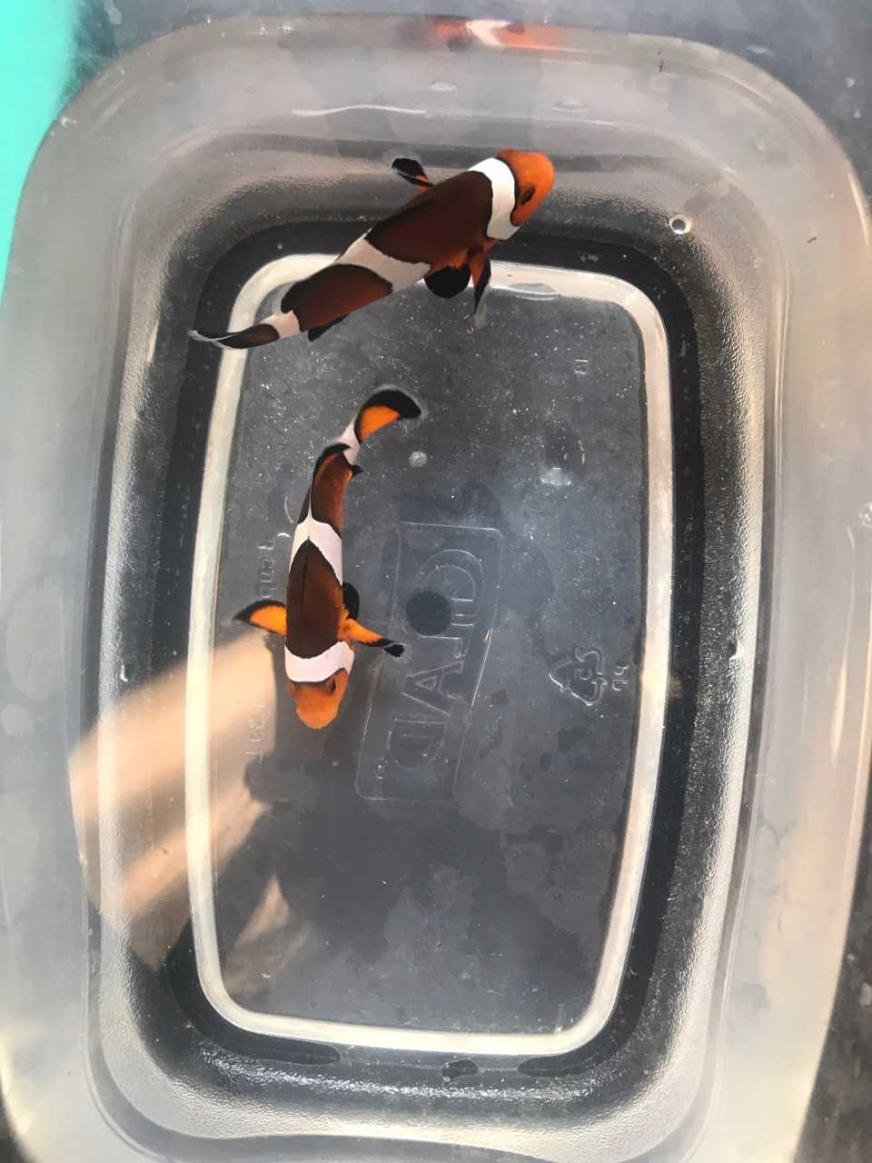
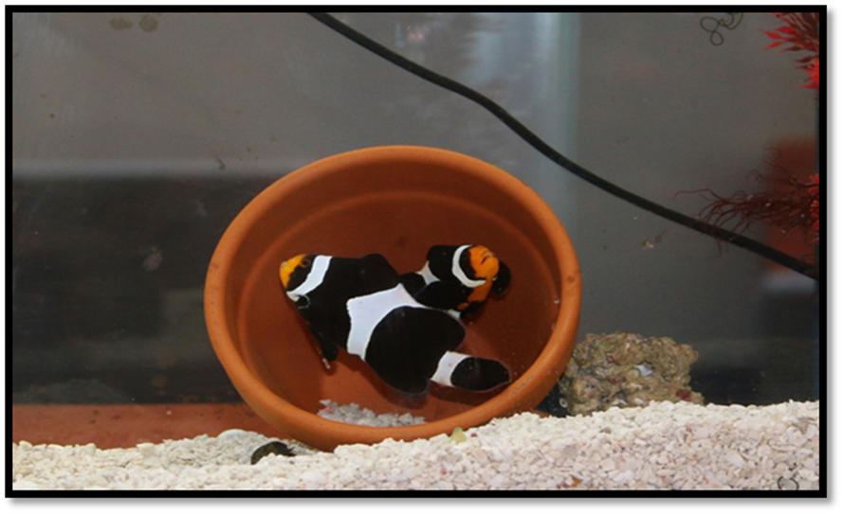
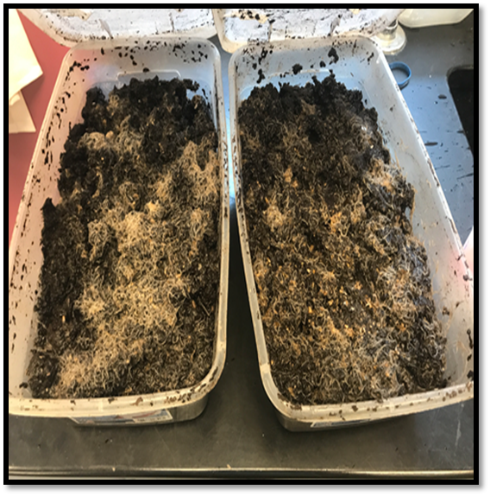
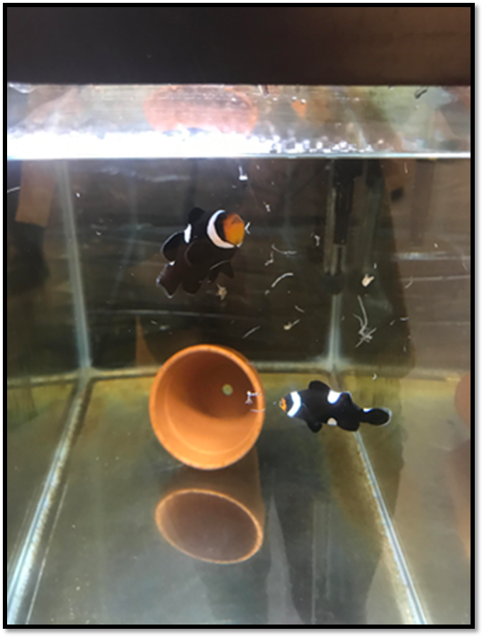
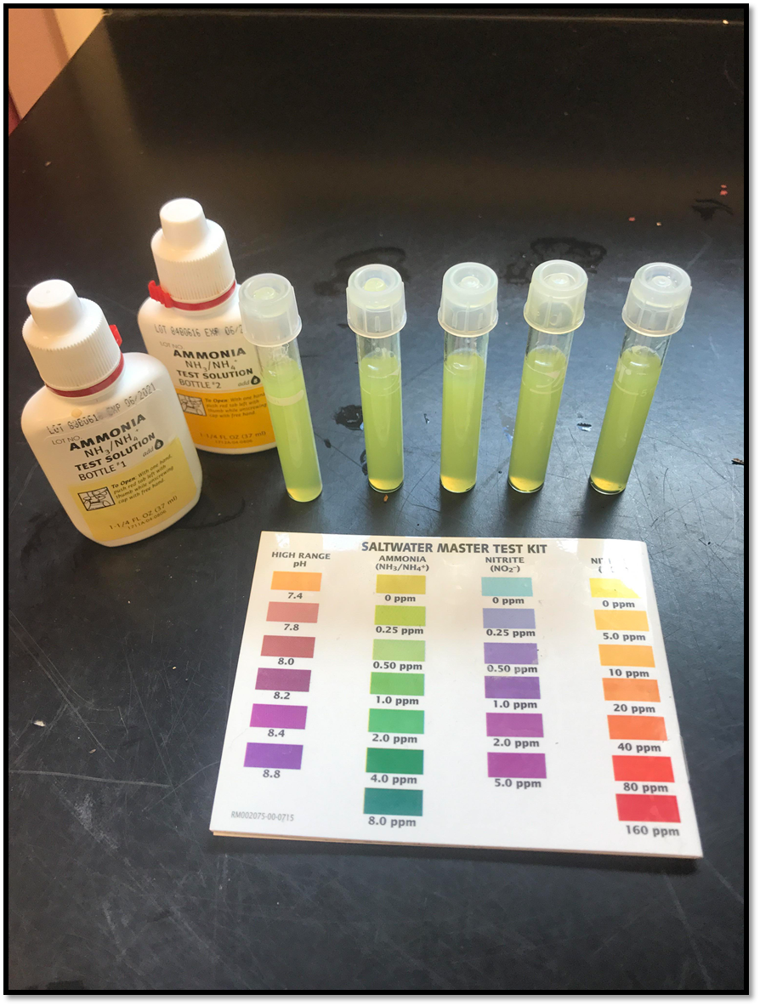
A Comparative Analysis of Conditioning Diets for Breeding Ornamental Clownfish (Ocellaris amphiprion)
Athena Ryan & Michael Chambers
School of Marine Science and Ocean Engineering, University of New Hampshire
Introduction:
Methods:
Future Work:
Sales of marine ornamental species from the wild is vastly expanding. This can put rare and expensive species at risk from reef ecosystems. Advanced breeding technologies now provides some ornamentals to be grown in captivity. Clownfish aquaculture represents a model species that can be grown in captivity and can be used to train students on fish culture practices is a classroom. This study aims to investigate conditioning diets that will allow clownfish pairs to mature faster and produce higher quality eggs. Determining the most effective feed for breeding clownfish allows for higher yields and hatch rates. In this study, three different diets will be compared including: 1) Fertility Frenzy, 2) Brine Shrimp, and 3) White Worms.
This experiment is testing three different feeds to determine the that yields the highest growth rate as well as the greatest reproductive success.
Each pair lives in a 20 gallon tank with a filter, heater, and a clay pot. Three pairs are assigned to each feed replicate to insure statistical results. All of the pairs are fed four times a day to satiation.
The pair will lay and fertilize the eggs. After 7-9 days, the clay pot with eggs will be transferred to a hatching tank with a heater and mild aeration.
Clutch size and amount of juveniles that hatch will be counted. Additional spawns and fitness of the parents will be assessed throughout the experiment.
Brine Shrimp,
Artemia sp.
Fertility Frenzy
White Worms , Enchytraeus albidus
Monthly size sampling and breeding behavior will be monitored throughout the experiment.
Parents care for the clutch by fanning them with their fins and removing infertile eggs. At day 8 post spawn, the clay pot will be removed from the spawning tank and placed into a 10 gallon hatching tank. This tank will use an air stone blowing bubbles through the clutch to keep the eggs oxygenated and clean. The eggs will be counted pre hatch and the larva will be counted 24 hours post hatch. Hatch rate will be determined by euthanasia of the larvae with MS222. Larval fish will be counted and survival will be compared between the three feed treatments.
After this study, research will focus on rearing juvenile clownfish. The hatchlings will then be raised to early adulthood. The larval rearing tank will be stocked with 50 ml of nanocloropsis algae and 10 rotifers/ml. The larvae will be maintained in the green water/rotifer mix for a week. After 14 days, the juveniles will be counted again to determine the rate of survival and size. The juveniles will be continued to be raised and transitioned from a live diet to a dry feed.
This research will continue for a minimum of three years and be used as a hands on experience for students entering into an Aquaculture major at UNH.
Brine shrimp (San Francisco Bay Brand) come in frozen cubes. They are thawed and fed to assigned fish.
Fertility Frenzy (LRS) comes in a frozen block which is cut and thawed before feeding to assigned fish.
White worms are cultured in lab. They are fed brewing grains and algal biomass to add nutrients. The worms are harvested and frozen before feeding to assigned fish.
Table 1: Ornamental Feed Analysis
 | Brine Shrimp | Fertility Frenzy | White Worms
Protein | 4% | 15% | > 45%
Fat | 0.4% | 3% | ~50%
Fiber | 0.5% | 1% | ~5%
Research Obstacles :
The main challenge for this experiment is when or if the pairs will produce and lay viable eggs. This may take many months to a year in a breeding tank. To account for this we have carefully paired fish that are 1-2 years old, placed them into separate 20 gallon tanks, maintain a constant water temperature, salinity and photoperiod cycle and feed them four times/day.
Results:
Table 2. Clownfish Growth (7/10/2017)
Fish | Weight (g) | Length (cm)
1 (F) | 5.84 | 6.25
1 (M) | 5.70 | 6.00
2 (F) | 5.38 | 6.00
2 (M) | 3.78 | 5.50
3 (F) | 7.02 | 6.75
3 (M) | 1.59 | 4.50
4 (F) | 3.21 | 5.50
4 (M) | 1.41 | 4.25
5 (F) | 2.65 | 5.00
5 (M) | 1.15 | 3.75
6 (F) | 4.92 | 5.75
6 (M) | 3.74 | 5.50
7 (F) | 5.29 | 6.00
7 (M) | 2.45 | 4.75
8 (F) | 3.11 | 5.50
8 (M) | 2.28 | 4.75
9 (F) | 3.24 | 5.50
9 (M) | 1.59 | 4.00
Each pair was measured for their length and weight on July 10th 2017. They will all be weighed again each month to determine growth rate.
The clownfish pairs have shown signs of maturity and reproduction by twitching back and forth near the pot and keeping the sides of the pot clean for egg laying.
Water Quality remains constant throughout all tanks.
  Temperature (28ºC)
  pH (7.5 — 7.6)
  Salinity (30 ppt)
  Nitrate (0 ppm)
  Nitrite (0 ppm)
  Ammonia (0 ppm)
Hypothesis:
The prediction for this study is that the white worms will yield the highest growth rate of the adults; as well as the most amount of eggs that will also have the highest survival rate.
References:
Fairchild, Elizabeth A. "Do White Worms Have Commercial Potential as a Feed in the Ornamental Industry?" University of New Hampshire, 2017. Web.
Moe, Martin A. The Marine Aquarium Handbook. Plantation, FL: Green Turtle Publications, 1992. Print.
**Number refers to the tank assigned to each fish. (F) refers to the female clownfish. (M) refers to the male clownfish.**

