Slide 1
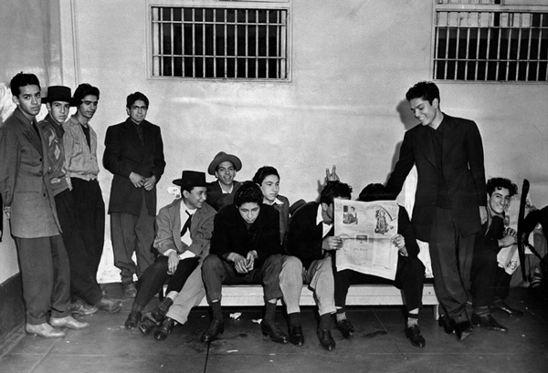
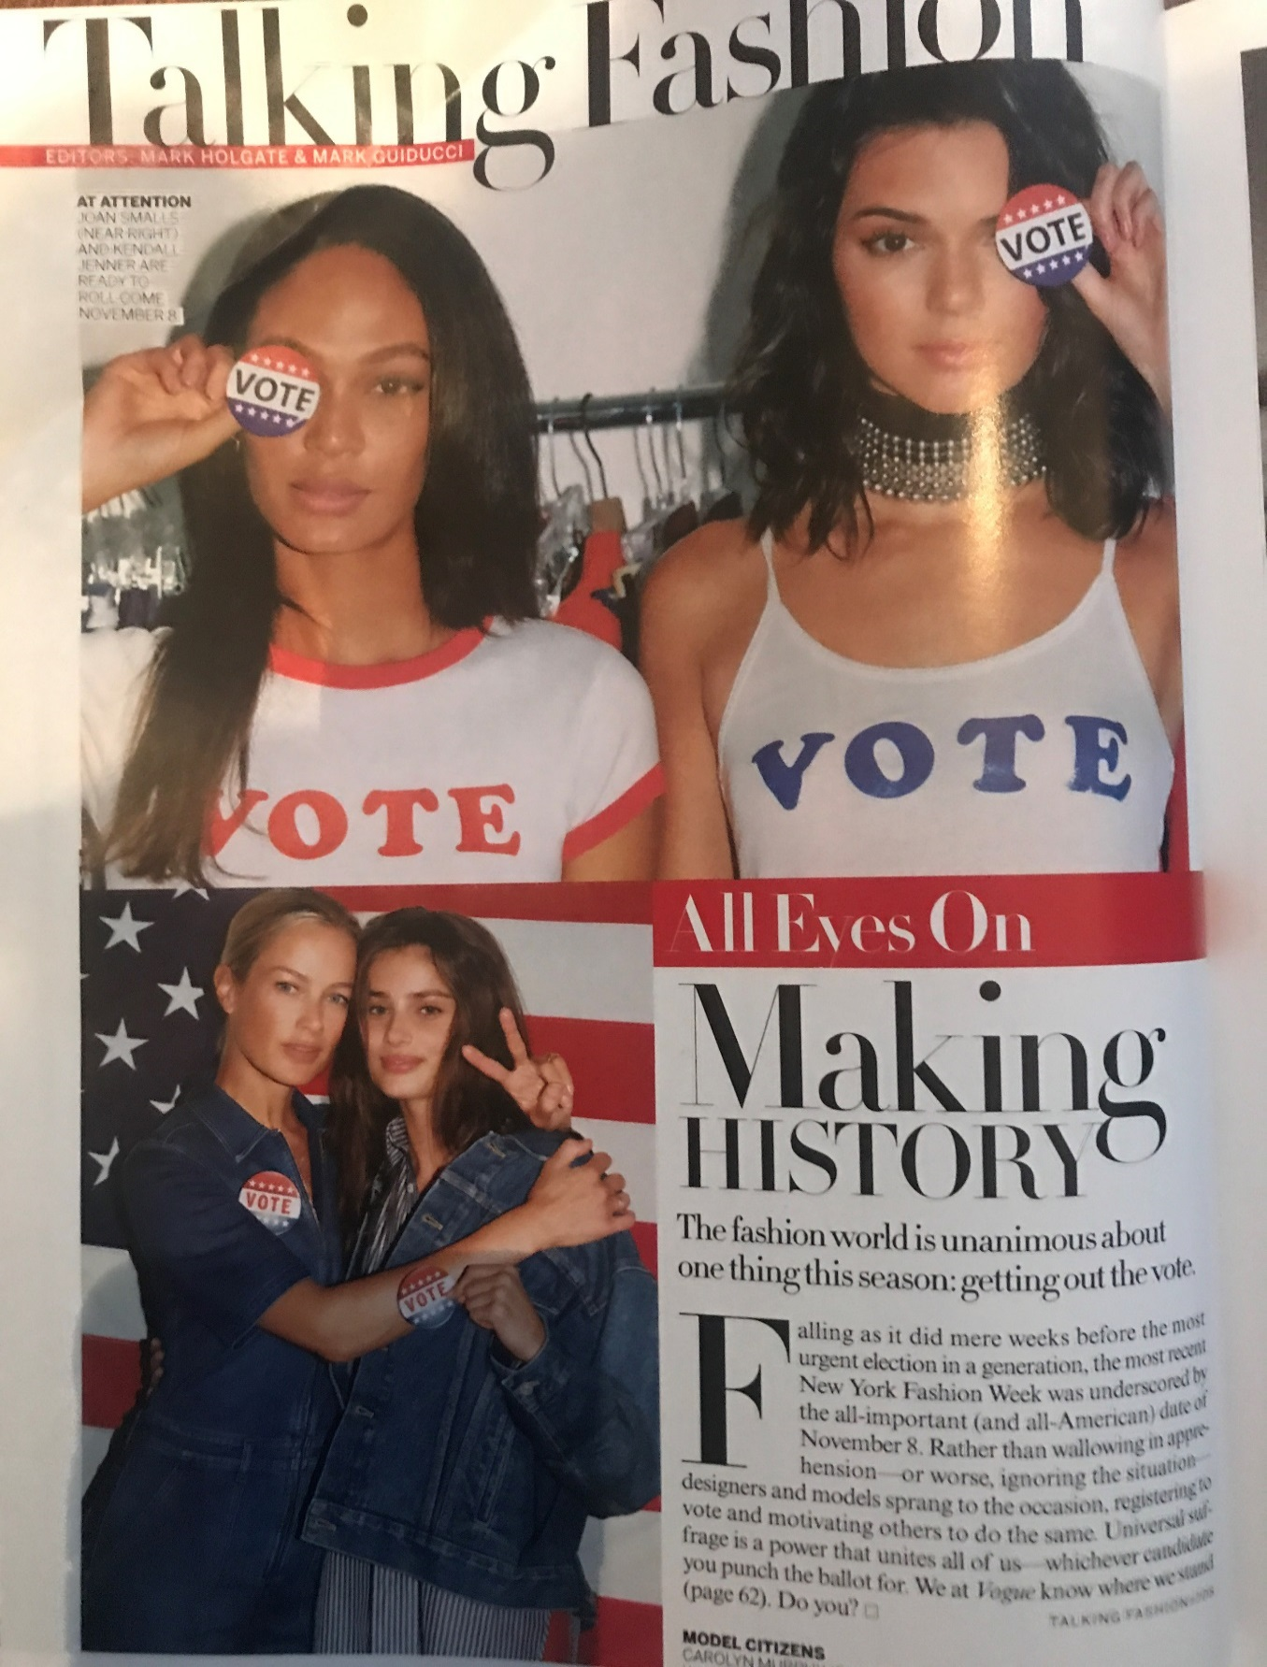
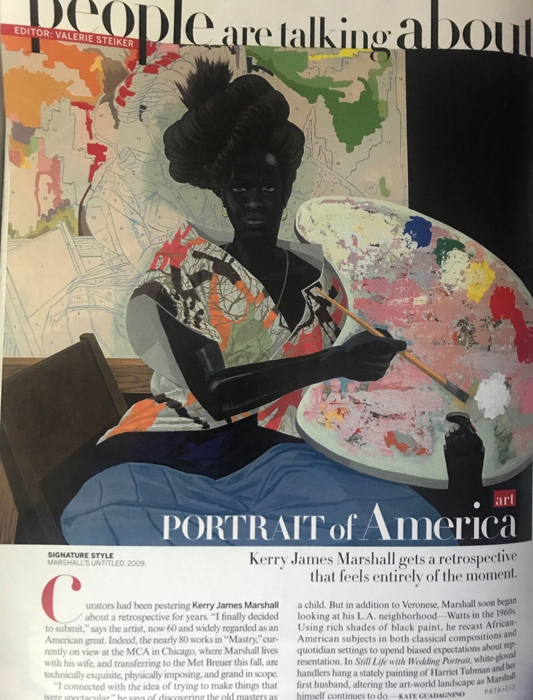
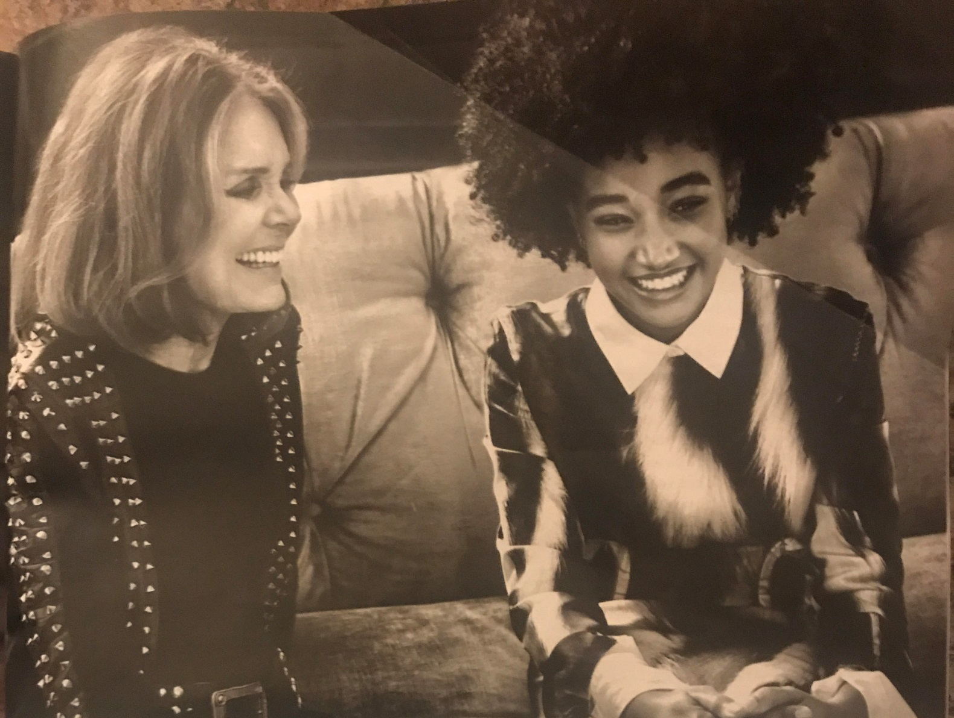
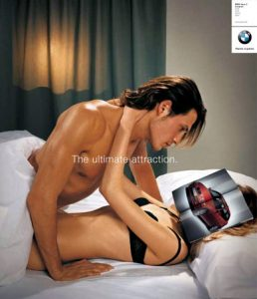
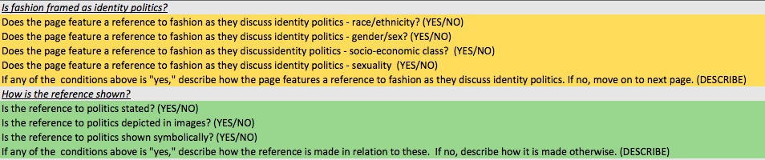
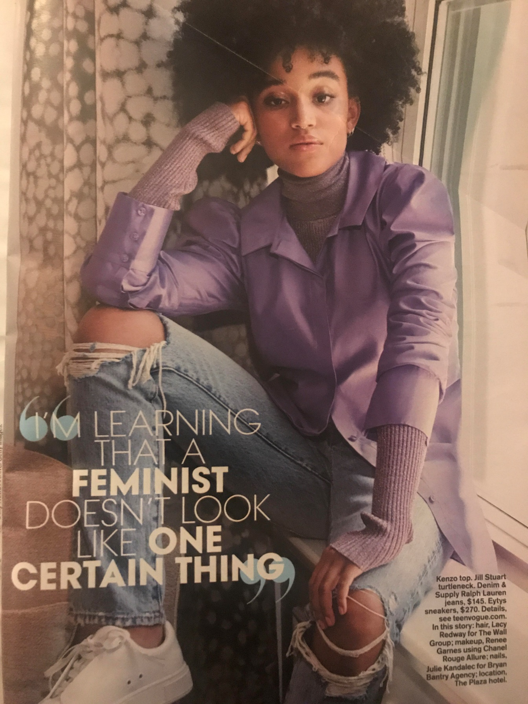
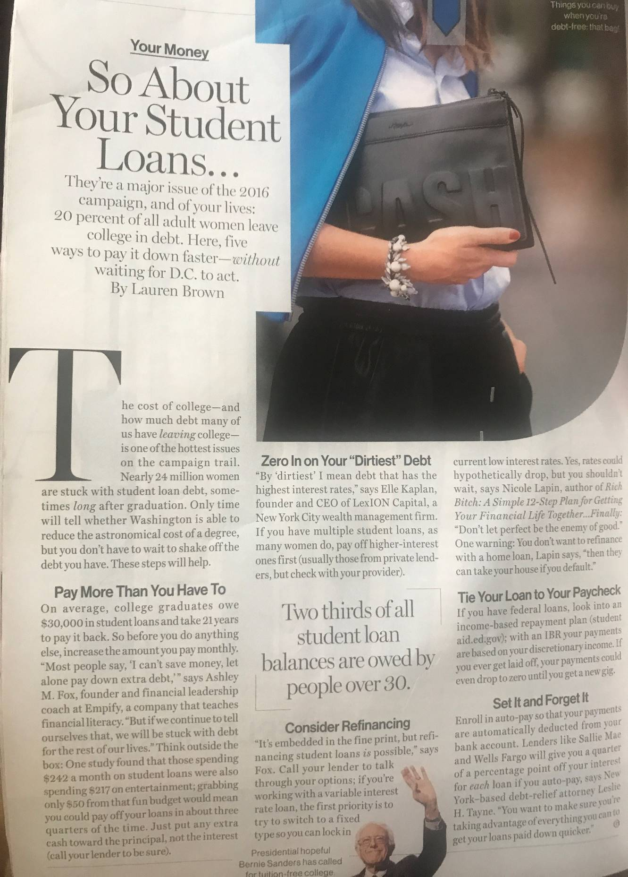
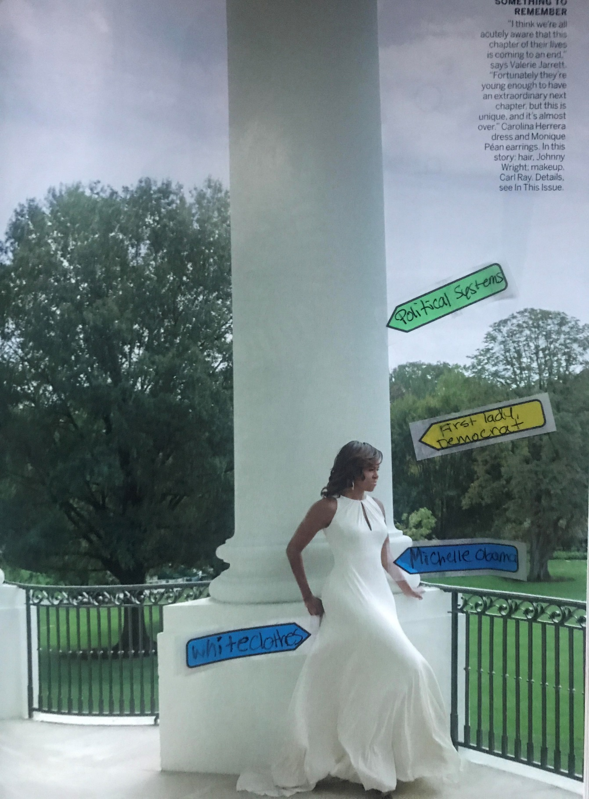
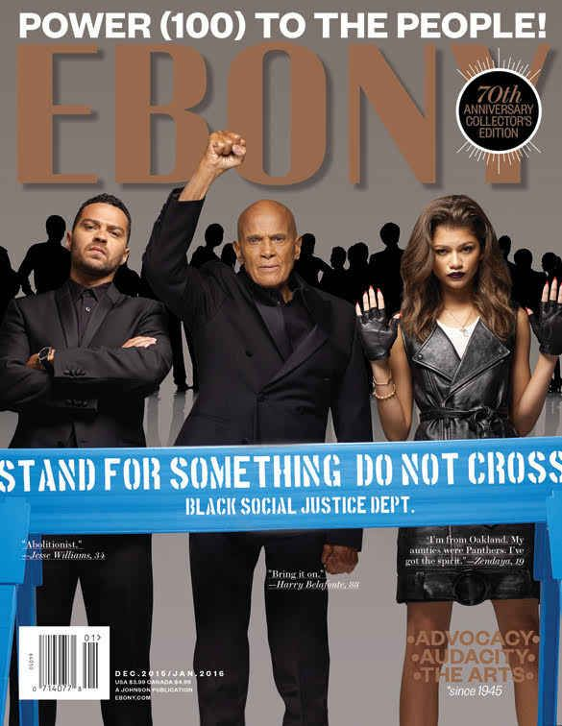
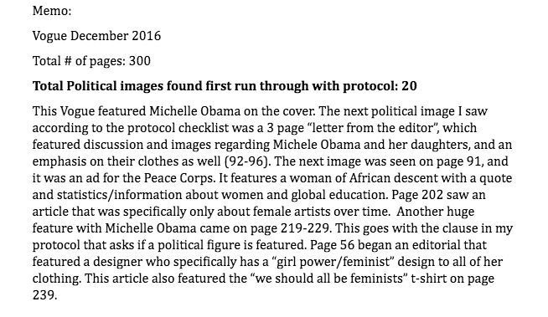


Politicizing Fashion:
Identifying Themes in Popular Fashion Magazines
“Fashion is not something that exists in dresses only. Fashion is in the sky, in the street, fashion has to do with ideas, the way we live, what is happening“
-COCO Chanel
Sala Risby, Undergraduate, Department of Journalism
Sala Risby, Journalism
Mentor: Katherine R. Abbott, Ph. D, Department of Sociology/Justice Studies
University of New Hampshire, Durham, NH
Background and Purpose:
Research Questions and Methods:
Results:
Studies show fashion as political.
  → During the WWII era, black and Latino men (and women) wore Zoot Suits as a political statement. At the same time, they and their outfits were criminalized. (Alvarez, 2008).
Studies of magazines, specifically advertisements, analyze identity politics and the construction of meaning.
  → Advertisements enforce traditional gender norms, depicting women as submissive and men as dominant (Conley, 2011; Jhally & Kilbourne, 1999).
Studies show impact of the messages in magazines and advertisements.
  Lower self-esteem rates in black teens due to under-representation within magazines and advertisements (Duke, 2000).
Magazines are evolving.
  Black fashion magazines purposefully diversifying models and their standards of beauty due to hyper-euro centrism in magazines (Lyden,2014).
.
Phase One: Do fashion magazines frame fashion as political? If so, how?
Themes…
Data collection, Sample: Every 4 months of Vogue, Glamour, Vanity Fair, and Teen Vogue from January 2015 - January 2017​
Data analysis, Ethnographic content analysis: refers to an integrated method, procedure, and technique for locating, identifying, retrieving, and analyzing documents for their relevance, significance, and meaning (Altheide, 1987).
Emerging findings from phase one
  Image 1. Zoot Suits. From the Los Angeles Public Library
Protocol…
Step 1: Identifying if content is political
Vogue, December 2016
Vogue, August 2016
Image 2. BMW Car Advertisement. From Jean Kilbourne
Voting, Millennial Voting, 2016 Election
America, Representation, Citizenship
But…
Coding…
Studies have not examined if and how magazines frame (Altheide, 1987) fashion as political today.
  Social construction theory – knowledge/meaning is found, organized, and changed/adapted in a society (Gergen, 1999).
Nor have they looked at how we interpret this magazine content.
  Symbolic interactionism - humans have specific actions towards items or events based on their meaning in society (Blumer,1969)​.
Thus, by conducting my study, I will…
  →Document if fashion is framed as political in fashion magazines
  →Identify how fashion is constructed as political in fashion magazines
  →Describe how consumers interpret these messages
  →And thus contribute to the literature and our understandings of media’s role in our lives
Step 2: Documenting themes in content
Memos…
Teen Vogue, September 2016
Glamour, August 2016
Step 3: Summarizing emerging findings
Feminism, Women empowerment, Black Feminism, Activism
Student loans, Federal Government, College Tuition
Next Steps:
Image 3. Ebony Magazine Coverpage. From Wordpress.
Phase Two: How do college students interpret this magazine content?
Phase two – focus group - in Fall 2017.
Data collection, Sample: Focus group of 10 college students (University of New Hampshire)
Students will discuss 2 non-political images 2 political images from each magazine that were identified in phase one (and selected using random number generator)
Data analysis, Coding: Transcript of focus group will be coded for themes
References
Altheide, D.L (1987). "Ethnographic Content Analysis”. Qualitative Sociology. Retrieved from: http://www.theculturelab.umd.edu/uploads/1/4/2/2/14225661/ethnographiccontentanalysis.pdf
Alvarez, L (2009). The Power of the Zoot: Youth Culture and Resistance during World War II. Berkeley, Calif.: U of California. Book.
Blumer, H (1969). Symbolic interactionism: Perspective and method. Englewood Cliffs, N.J:Prentice-Hall. Retrieved from: University of New Hampshire Library Database
Chilton, S.A (1988). Defining Political Culture. The Western Political Quarterly, 3, (419). Doi10:2307/448596
Conley, T. D., & Ramsey, L.R (2011). Killing Us Softly? Investigating Portrayals of Women and Men in Contemporary Magazine Advertisements. Psychology of Women Quarterly. Retrieved from: http://journals.sagepub.com/doi/abs/10.1177/0361684311413383
Duke, L (2000). Black in a Blonde World: Race and Girls' Interpretations of the Feminine Ideal in Teen Magazines. Journalism & Mass Communication Quarterly. Retrieved from: http://journals.sagepub.com/doi/abs/10.1177/107769900007700210
Gergen, K.J (1999). An invitation to social constructionism. London: Sage. Book.
Hall, S (1997). Introduction. In Stuart Hall (Ed.), Representation: Cultural Representations and Signifying Practices. London: Sage. Retrieved from: https://faculty.washington.edu/pembina/all_articles/Hall1997.pdf
Jhally, S., & Kilbourne, J (2010). Killing us softly 4: Advertising's image of women. Northampton, MA: Media Education Foundation.
Little (2015). L View Good Reads: Harry Belafonte, Jesse Williams and Zendya covers “Ebony” Magazine L view. Wordpress. Retrieved from:https://littlesview.wordpress.com/2015/11/23/l-view-good-reads-harry-belafonte-jesse-williams-and-zendaya-covers-ebony-magazine/
Lyden, J (2014). "The Ebony Fashion Fair: Changing History On The Catwalk." NPR. Retrieved from: http://www.npr.org/2014/02/15/276987206/the-ebony-fashion-fair-changing-history-on-the-catwalk

