Slide 1
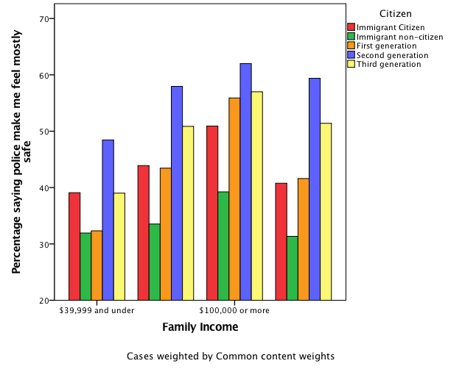
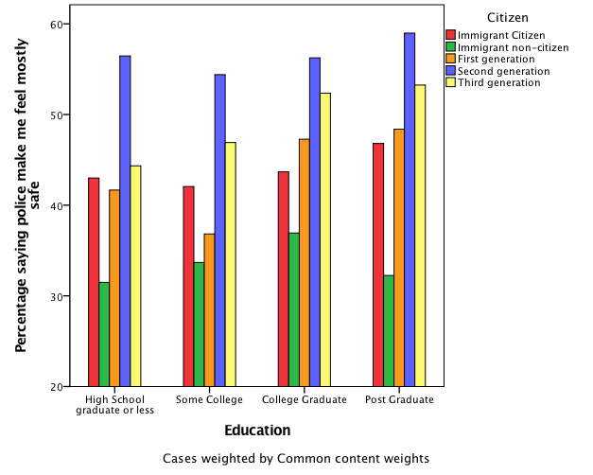
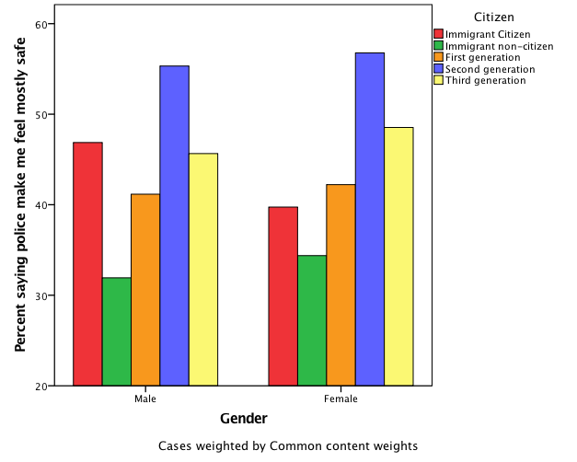
Understanding Immigrants’ Trust
in Public Institutions
Kim Ip
Mentor: Dante Scala
College of Liberal Arts, University of New Hampshire, Durham, NH
Background
Findings
Hypotheses
Acculturation is the process in which immigrants become accustomed to a new country’s culture, language and customs. It has been shown to greatly influence immigrants’ trust in public institutions(Michelson, 2003; Abrajano, 2010).
Immigrants who are represented by elected officials with diverse ethnic backgrounds exhibit a stronger level of government trust and overall higher approval ratings (Baldassare, 1085).
Experiences of racial discrimination are more apt to make immigrants less likely to trust in public institutions. Research indicates that immigrants of African descent possess the lowest levels of trust (Gay, 2002).
Previous research on public trust has focused on Anglo-American citizens or immigrants of African and Latino descent.
There has been less research conducted on immigrants public trust in government.
Always a wise policy to use fewer words.
H1: immigrants who have higher educational attainment will demonstrate higher levels of trust in government.
H2: Immigrants who have higher family incomes will demonstrate higher levels of trust in government than those who are less financially stable.
H3: Men will possess higher levels of trust in government than women.
H4: Overall, immigrants who have gone through the process of acculturation will posses a higher level of trust in government than more recently arrived immigrants.
Methodology
Cooperative Congressional Election Study (CCES )
  National survey of 64,600 respondents pre and post 2016 election.
  Consists of general demographic information
Statistical Packages for the Social Sciences (SPSS)
Cross Tabulations
Might want to say a little more here about the study
Terms
N=64,281
N=64,307
Acculturation: The adoption of new cultural, morals, and language proficiency (Michelson. 320 ).
Trust: constituents’ confidence that they are accurately represented by their elected officials, and belief that the decisions and actions made by public institutions benefit the public good as a whole.
Immigrant: a person who comes to a country to take up permanent residence.
  Second Generation Immigrant: Grandchildren of the immigrants
  Third Generation Immigrant: Great grandchildren of immigrants
Public Institution: A facility that is part of government or is organized by government control.
Significance
In the past there has been much research conducted on American public trust in respect to White Anglo-American’s but not so much in the areas of their minority counterparts. This research will help fill the void in the background of immigrants’ public trust and also provide a concentrated insight of the American public trust as a whole . This research can reaffirm the information that has already been studied.
Objectives & Research Question
This study will examine immigrants’ trust in public institutions through a series of statistical analyses of survey data.
What are the characteristics of immigrants who trust their government?
Future Research
Test with new Variables pertaining with public trust and general demographic information (ex: home ownership status, religion, voter registration).
Cross Tabulations analysis and Chi Square Goodness of Fit Test I expect to find continuance of analysis pattern I hypothesize that the gap from first generation to second generation immigrants will increase and then decrease by third generational status.
Limitations
N=64,301
Difficulty of measuring trust
64,600 respondents
  time & phone/computer privilege
Missing answers from data
Cross tabulations indicate that across generations public trust increases from first to second generations and then levels out after reaching third generational status. This trend remains when controlling for variables such as family income, education and gender.

