Slide 1
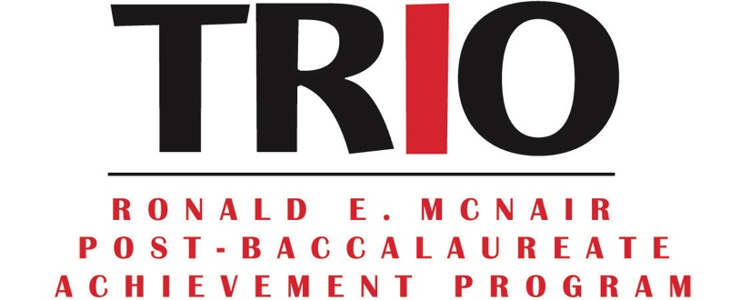

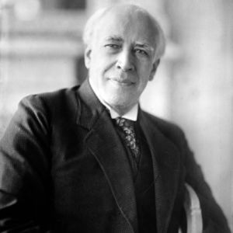
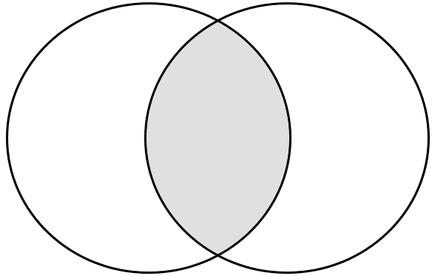
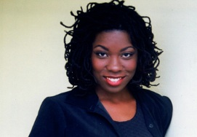
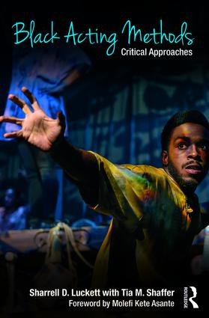
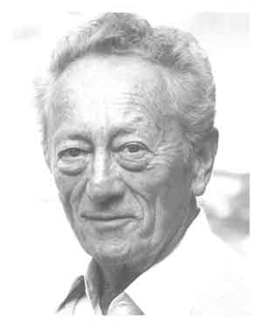
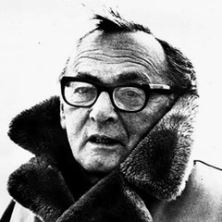
Testing the Uniqueness of Black Acting Methods
Bethany D. Cooper, Department of English, University of New Hampshire
Mentors: Deborah Kinghorn, MFA, and David Richman, Ph.D, Department of Theatre and Dance, University of New Hampshire
Background
Results
Featured Acting Teacher
Acting in the USA has been dominated by methods of Constantin Stanislavsky, a Russian acting teacher, and of other Europeans and white Americans.
Black Acting Methods: Critical Approaches, 2017 (BAM), compiles methods of a variety of black acting teachers and theatre directors.
BAM revolutionizes acting training by presenting Afrocentric techniques as viable additions to the traditional acting classroom.
This research tests BAM’s claim that Afrocentric acting methods are unique from those of traditional theatre.
Eurocentric Methods
Dr. Monica White Ndounou
Afrocentric Methods
Dr. Monica White Ndounou has been an assistant professor at Tufts University and is transitioning to Dartmouth College in the fall. She specializes in the intersection of African American culture and the performing arts. This research addresses her essay, “Exploring Black Culture in the Acting Classroom” (2009).
Constantin Stanislavsky
awe of acting
ancestral prayer
biography.com
word repetition
imagination
social justice
relaxed muscles
communication
African dances
sensory memory
devised work
now.tufts.edu
African Interconnectivity
given circumstances
open discussion
Dr. Ndounou teaches the methods of Arthur Lessac, a Palestinian American teacher, and of Sanford Meisner in her Afrocentric acting class. She finds that Lessac and Meisner’s methods have a spiritual component that complements the interconnectivity of Afrocentric community (Ndounou 96).
extraneous aids
magic “if”
meditation
discipline
attention
journaling
routledge.com
particularizations
catharsis
enterstageright.com
Stella Adler
en.wikipedia.com
Sanford Meisner
azquotes.com
Lee Strasberg
animal exercise
cyclic storyline
Themes
progress theatre.com
Cristal Chanelle Truscott
Tawnya Pettiford-Wates
Oberlin.edu
Justin Emeka
Ndabaonline.ukzn.ac.za.
Ensemble vs. Community
References
Adler, Stella. Stella Adler: The Art of Acting. Ed. Howard Kissel. New York: Applause Books, 2000. Print.
Devine-Sullivan, Maggie. “Meet Our New Associate Professor of Theater! Theater.dartmouth.edu. Trustees of Dartmouth College, 19 Jun. 2017. Web. 21 Jul. 2017.
Luckett, Sharrell D., and Tia M. Shaffer. Black Acting Methods: Critical Approaches. London: Routledge, 2017. Print.
Magershack, David. “Stanislavsky.” The Theory of the Modern Stage. Ed. Eric Bentley. Milwaukee, WI: Applause Theater Book Publishers, 1968, pp. 219-274.
Meisner, Sanford, and Dennis Longwell. Sanford Meisner on Acting. New York: Random House, Inc., 1987.
N.a. “Monica White Ndounou” Dramadance.tufts.edu. Tufts University, 2017. Web. 21 Jul. 2017.
Ndounou, Monica White. "Encountering Black Culture in Acting Classrooms and beyond." Theatre Topics, vol. 19, no. 1, Mar. 2009, pp. 95-102. EBSCOhost, search.ebscohost.com/login.aspx?direct=true&db=a9h&AN=37012006&site=ehost-live.
Pettiford-Wates, Tawnya. “Ritual Poetic Drama Within the African Continuum.” Black Acting Methods: Critical Approaches, edited by Sharrell D. Luckett and Tia M. Shaffer. London: Routledge, 2017, pp. 106-122.
Strasberg, Lee. A Dream of Passion: The Development of the Method. Boston, Davada Enterprises, LTD., 1987.
N.a. “Venn Diagram.” N.d., image. 2424mypicsain.blogspot.com. Blogger, 24 Mar. 2012. Web 12 Jul. 2017.
ancestors
friends actors family
unborn
actors
Research Objectives
Find whether or not there are fundamental differences between black and white acting methods.
Exercises vs. Mindset
Identify emphases from black acting methods that would benefit current, accepted acting pedagogy.
mindset
Acknowledgements
Deborah Kinghorn & Dr. David Richman
The UNH McNair Scholars Program
exercises
exercises
Contact Information
Bethany D. Cooper
Bc2012@wildcats.unh.edu

