Slide 1



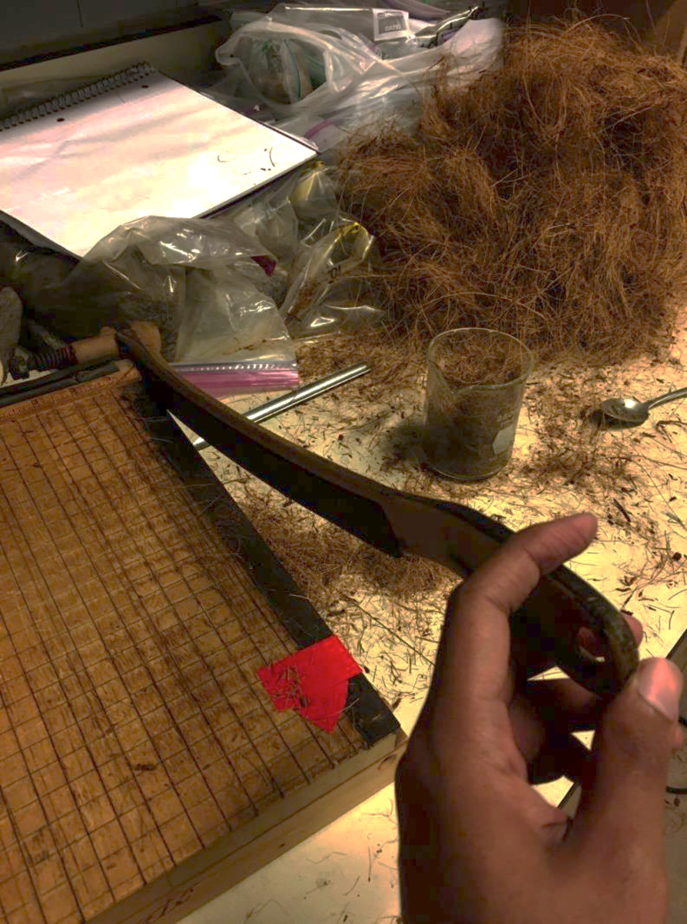
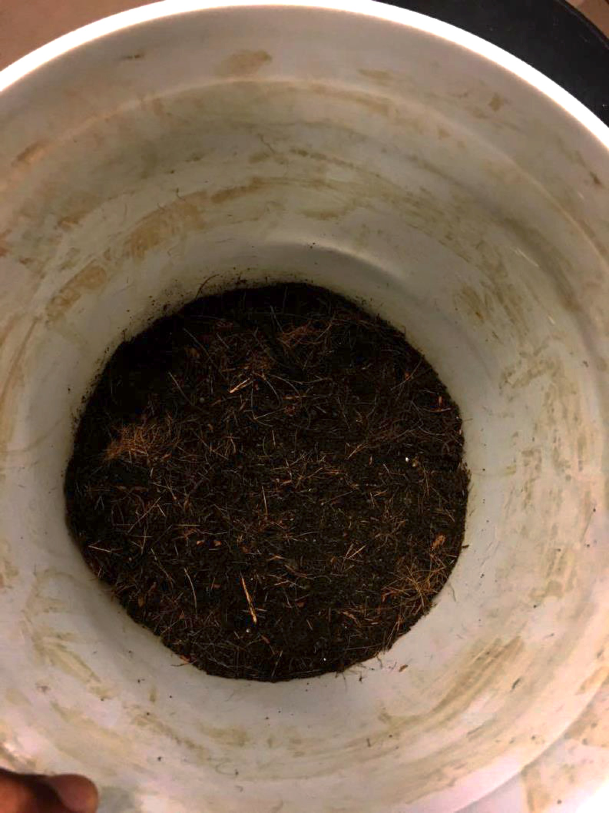
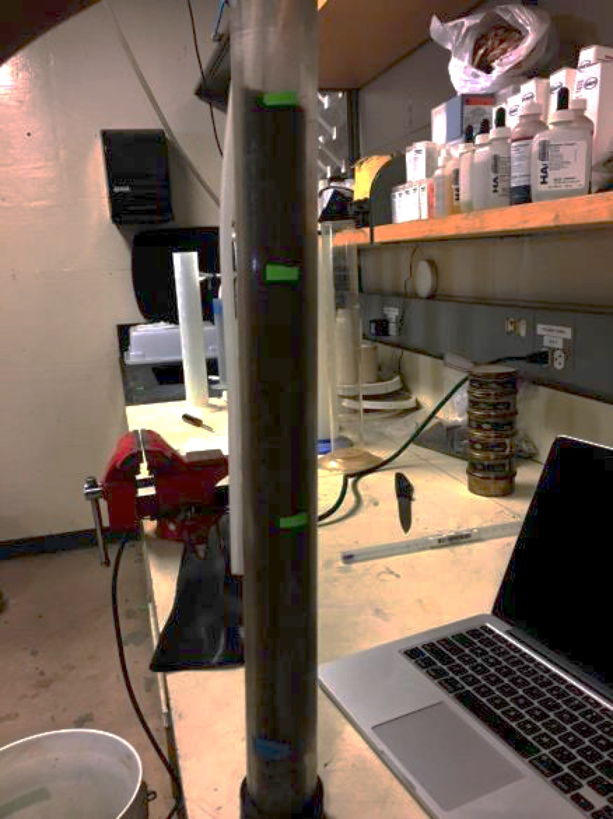
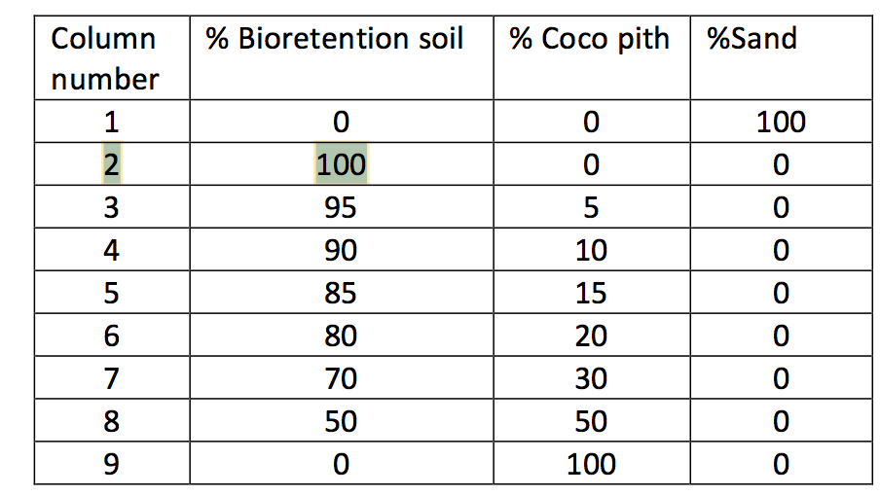
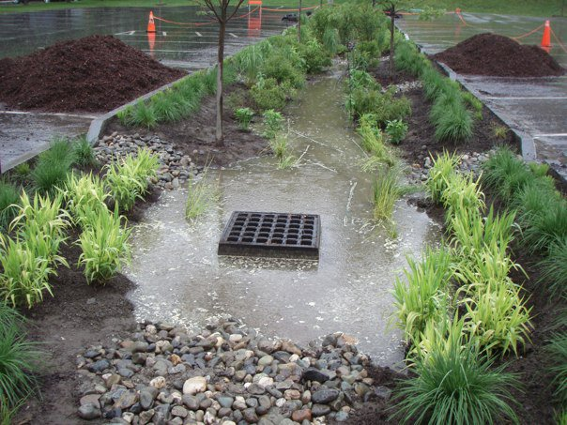
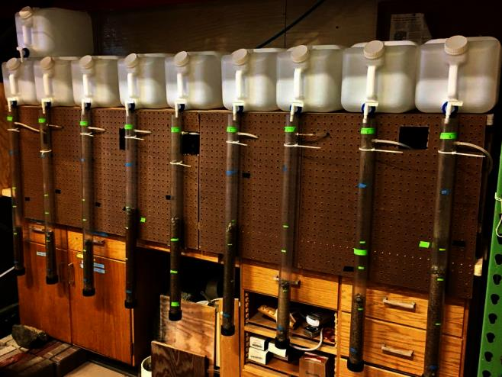
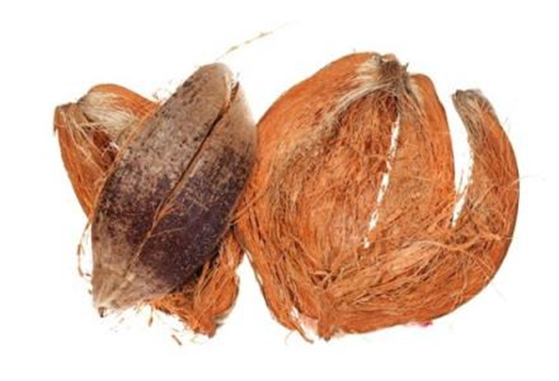
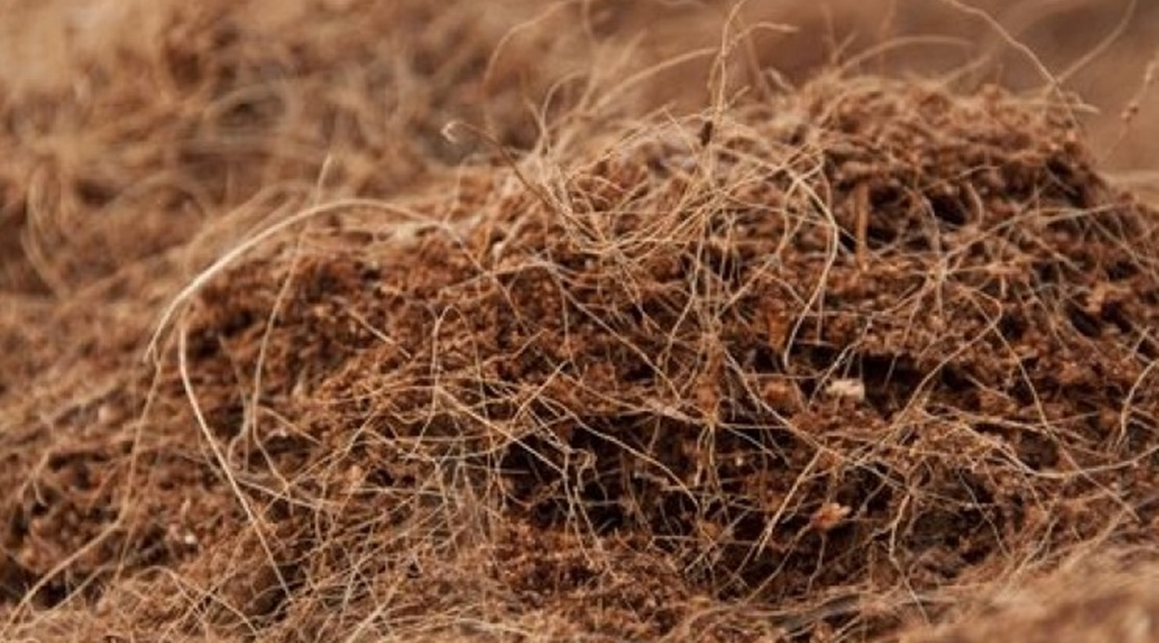
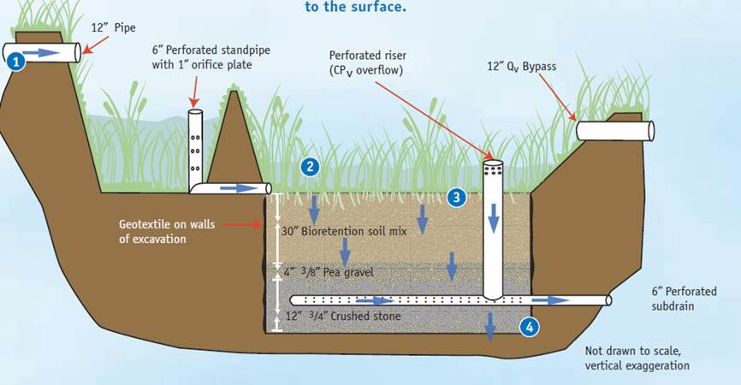
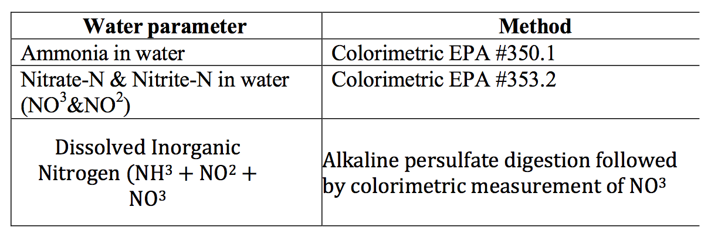
Investigation of Coco pith in Bioretention for treatment of nutrients (nitrogen)
From Storm water Runoff
Rezwan Ali, Mentor: Dr. Thomas P. Ballestero
Department of Civil end Environmental Engineering, University of New Hampshire, Durham NH
Introduction:
Methods: A column study was conducted to study the nitrogen removal characteristics of coco pith mixed into bioretention soil media
Nutrients are the key to plant growth however excessive nutrients can be bad for the environment and can cause eutrophication in water bodies. Eutrophication is the excessive growth and decay of plants which in turn directly affects the water quality and aquatic habitat.
One of the largest causes of excessive nutrients in receiving water is stormwater runoff, which washes away nutrients from human habitat to surface water sources.
In order to remove nitrogen and other nutrients from water, green infrastructure, like bioretention systems, must be designed and implemented. To remove nitrogen, green infrastructure systems typically have pools of water in them with very low oxygen levels. This component may be challenging to include at many sites, and therefore an alternative would be helpful.
Different soil media have been used in bioretention systems to effectively remove phosphorus from runoff, however none to date have been reported in peer-reviewed literature, that remove nitrogen . Recently at stormwater conferences, coco pith has been proposed to be used in bioretention systems for nitrogen removal.
Future Work:
Preparing columns
If the data shows enough evidence that cocopith can remove nitrogen from stormwater runoff, the next step will be testing for how long it can perform before getting exhausted and needing to be replaced.
Then coco pith will be used in an actual bioretention systems which will be monitored to see how it performs throughout different seasons and whether vegetation can grow on it.
A vertical column study was conducted.
Total 9 columns, each representing different amounts of coco pith and bioretention soil
1L of inflow solutions of a known nitrate concentration is run through each of the columns with a retention time about 8-12 hours.
Effluent solutions collected from each column and sent to a water analysis laboratory for analysis
Step 1: Shred the cocopith into small pieces
Step 2: Mix cocopith with the bioretention soil
Step 3: Fill the columns with the mixture
Cocopith :
% Cocopith in each columns
Vertical columns
A typical bioretention system
Data Analysis:
Samples are analyzed for the following compounds:
Total dissolved nitrogen (TDN) dissolved organic
Nitrogen (DON)
Dissolved inorganic nitrogen (DIN),
Nitrate (NO₃⁻)
Nitrite (NO₂⁻)
Ammonium (NH₄⁺),
Dissolved organic carbon (DOC)
Data results (influent and effluent concentrations), will be converted to nitrogen removal:
  (C_{in} – C_{out})/C_{in}.
Next the nitrogen removal of columns will be determined. Any removal attributed to the controls will be subtracted from the coco pith column removal in order to isolate the nitrogen removal.
Regression will be employed to determine if there is a relation between coco pith percent and nitrogen removal
Cocopith is the outside layer that surrounds the shell of the coconut. It is mainly made of fibers. These fibers are commonly used to manufacture rope, carpets, doormats, upholstery stuffing, brushes, and erosion control products.
Coco pith has a great water holding capacity. It also has a consistent uniform texture composed of millions of capillary micro-sponges that absorb and hold up to eight times their weight in water and nutrients
Cross-sectional area of a bioretention system
References:
Erickson, A. J., Gulliver, J. S., & Weiss, P. T. (2007). Enhanced sand filtration for storm water phosphorus removal. Journal of Environmental Engineering, 133(5), 485-497.
Morgan, J., Hozalski, R. M., & Gulliver, J. S. When Do We Need to Replace Bioretention Media? Water Environment Federation and the American Society of Civil Engineers (W.E.F. and A.S.C.E), 1998.
University of New Hampshire Stormwater Center (UNHSC), (2009). Biennial Report - 2009.
University of New Hampshire, Durham, NH. University of New Hampshire Stormwater Center (UNHSC), (2012). Biennial Report - 2012. University of New Hampshire, Durham, NH.
Mitsch, W. J., and Gosselink, J. G. (2000). "The value of wetlands: importance of scale and landscape setting." Ecological Economics, 35(1), 25-33.
Mitsch, W. J.,and Gosselink, J. G. (2000). Wetlands, 3rd edition. John Wiley & Sons, Inc.
Iulia Barbu,(2014) Investigation of Bioretention Soil Media and Amendments for Treatment of Nutrients from Stormwater Runoff, University of New Hampshire, Durham, NH.
"At the Forefront of Bioretention Media Specifications: An Interview with Curtis Hinman." Interview by Nathalie Shanstrom. GREEN INFRASTRUCTURE. N.p., 26 Jan. 2015. Web. 26 Mar. 2017.
Hypothesis:
Expected results:
Cocopith can remove nitrogen from stormwater runoff when it is used in the Bioretention as a media.
Based on background research and reviewing the properties of cocopith, it is expected that columns with more cocopith will remove more nitrogen from inflow solutions.
Analytical methods (EPA certified)

