Slide 1
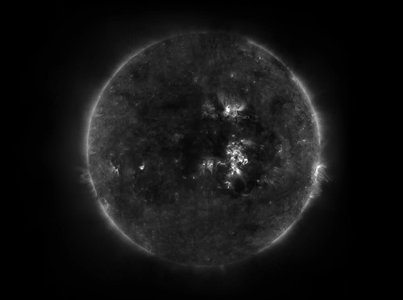


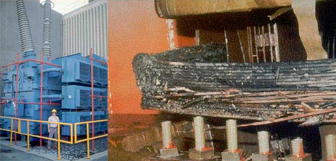
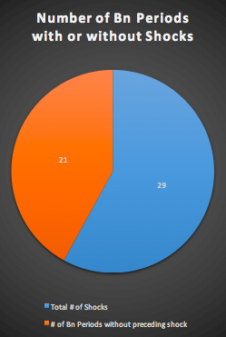
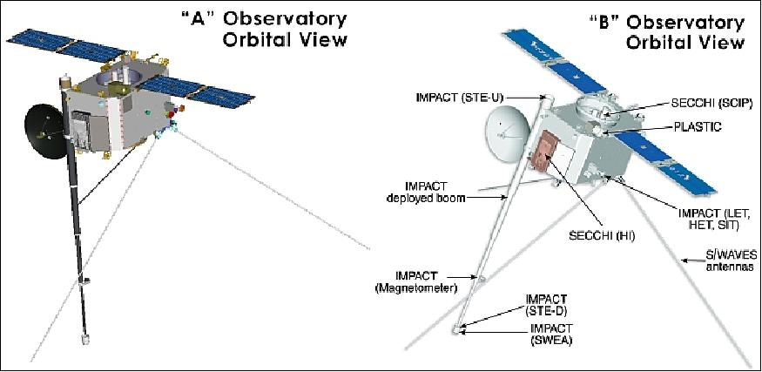
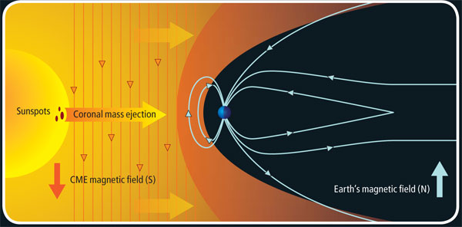
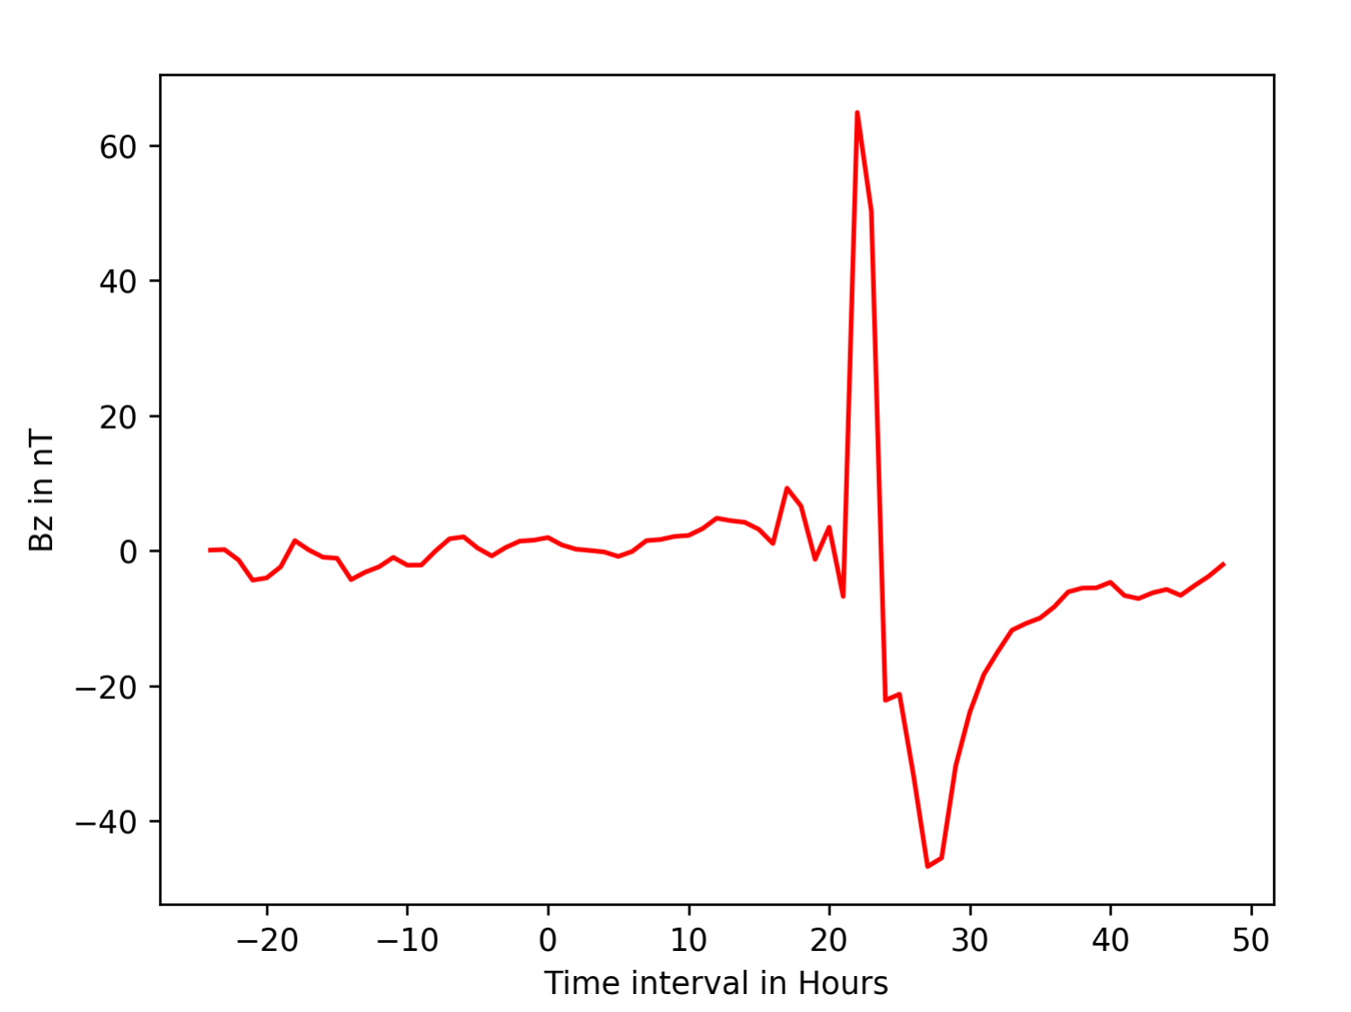
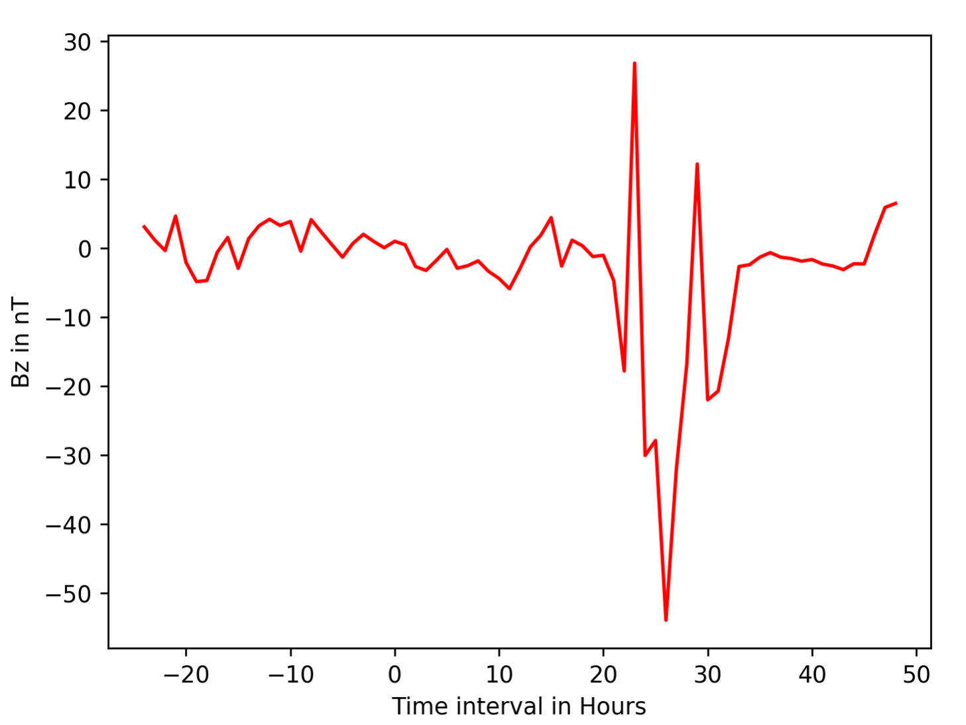
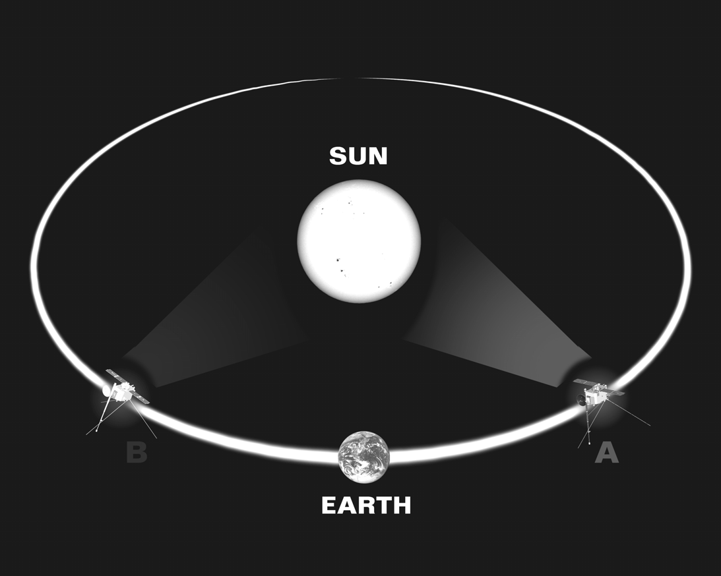
Quantifying CMEs and CIRs to predict future events
By: Shreya Dua, Concord High School; Eliott Wallace, Buckingham Brown and Nichols
Advised by: Noé Lugaz and Tarik Mohammad Salman
The Solar Winds
STEREO A Event and Shock Classifications
The Sun constantly sends out streams of solar plasma, protons and electrons, also called Solar Wind. During Solar Maxima, period of high activity, the Sun sends out large bursts of plasma clouds drenched in magnetic fields called Coronal Mass Ejections (CME) for short, everyday. As they reach the Earth’s magnetic field, they deform it and if large enough, cause auroras to appear in the sky, damage satellites, endanger astronauts, and even overload power grids. Co-rotating Interaction Regions (CIR) are the areas in which a fast moving, low density solar wind is sandwiched between two slow moving, high density solar winds. These also cause disturbances in Earth’s magnetic field, but more gently. Through studying these events and the shocks preceding them, it might be possible to predict a major Bn event and protect vulnerable assets.
Start time | End time | Min Bn | Type of Event
21/11/07 0:00:00 | 21/11/07 2:00:00 | -15.6800 | CIR w/o Shock
5/2/10 21:00 | 6/2/10 1:00 | -11.8100 | CIR w/ Shock
3/6/10 21:00 | 3/6/10 23:00 | -12.5300 | CME w/ Shock
24/7/12 1:00:00 | 24/7/12 11:00:00 | -46.7400 | CME w/ Shock
STEREO B Events and Shocks Classifications
Start Time | End Time | Min Bn | Event Type
7/5/07 15:00 | 7/5/07 17:00 | -12.2500 | CME w/ Shock
14/4/10 3:00:00 | 14/4/10 8:00:00 | -12.6800 | CIR w/ Shock
3/8/10 6:00 | 3/8/10 9:00 | -23.2400 | Shock
25/9/14 19:00:00 | 25/9/14 23:00:00 | -53.9600 | CIR w/ Shock
Space Probe Positions and Data Collections
STEREO (Solar Terrestrial Relations Observatory) A and B are two space probes in the same orbit as Earth around the Sun. Stereo A is placed ahead of Earth in the orbit while Stereo B is placed behind. These probes record data of shocks and Bn events coming from the Sun during their orbits. Through different graphs and measurements such as Solar Wind Proton Number Density, Proton Bulk Speed, Proton Temperature, Magnetic Field Vector in RTN Coordinates, and Total Magnetic Field, Shocks and and Bn events can be identified either as CMEs or CIRs.
Percentages and Predictability ranges of Bn events
Only 58% of the events recorded had a shocks associated with them and thus, any prediction of a large event would be uncertain. Further reducing predictability rates, many of the events aren’t the powerful CME’s that cause the most damage. Those who had a match with a shock recorded on Earth were those that were CMEs or CIRs that were followed by a shock.
References:
-CDAweb
-IP Shocks
-UCLA
STEREO A Bn vs Time
STEREO B Bn vs Time

