Slide 1

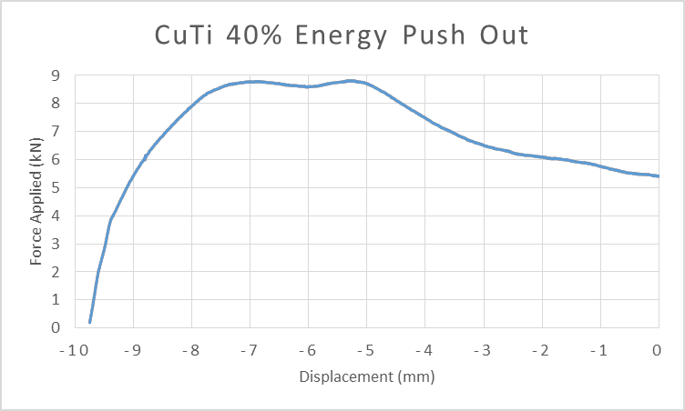
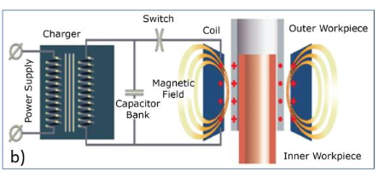
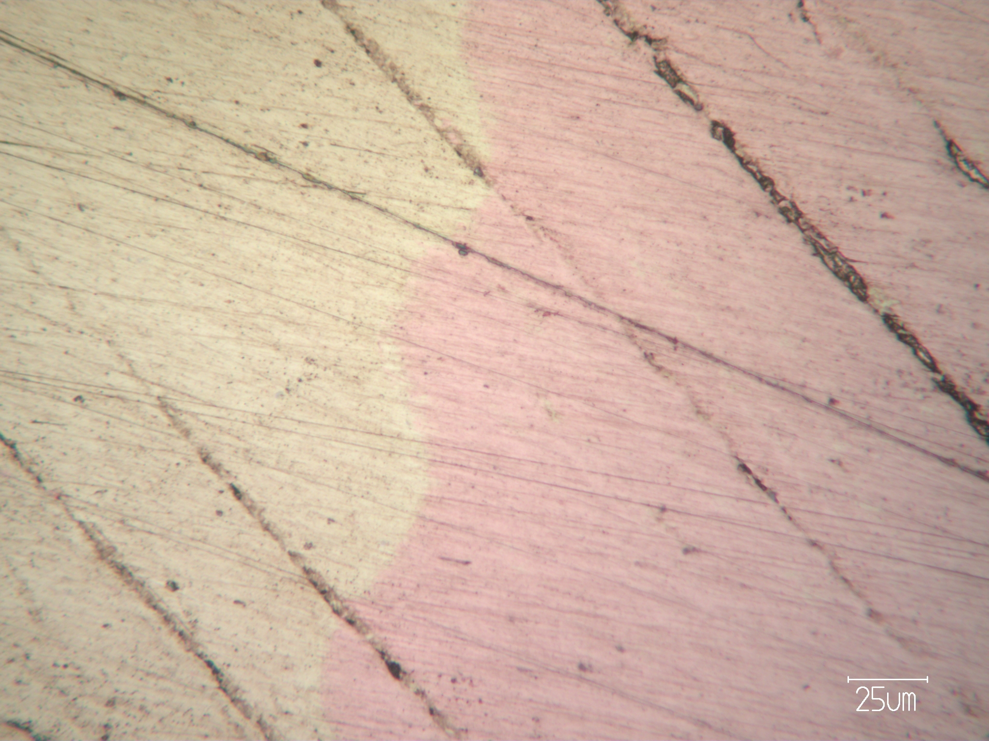
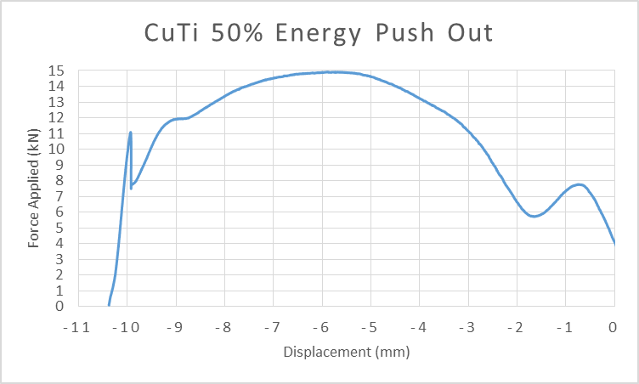
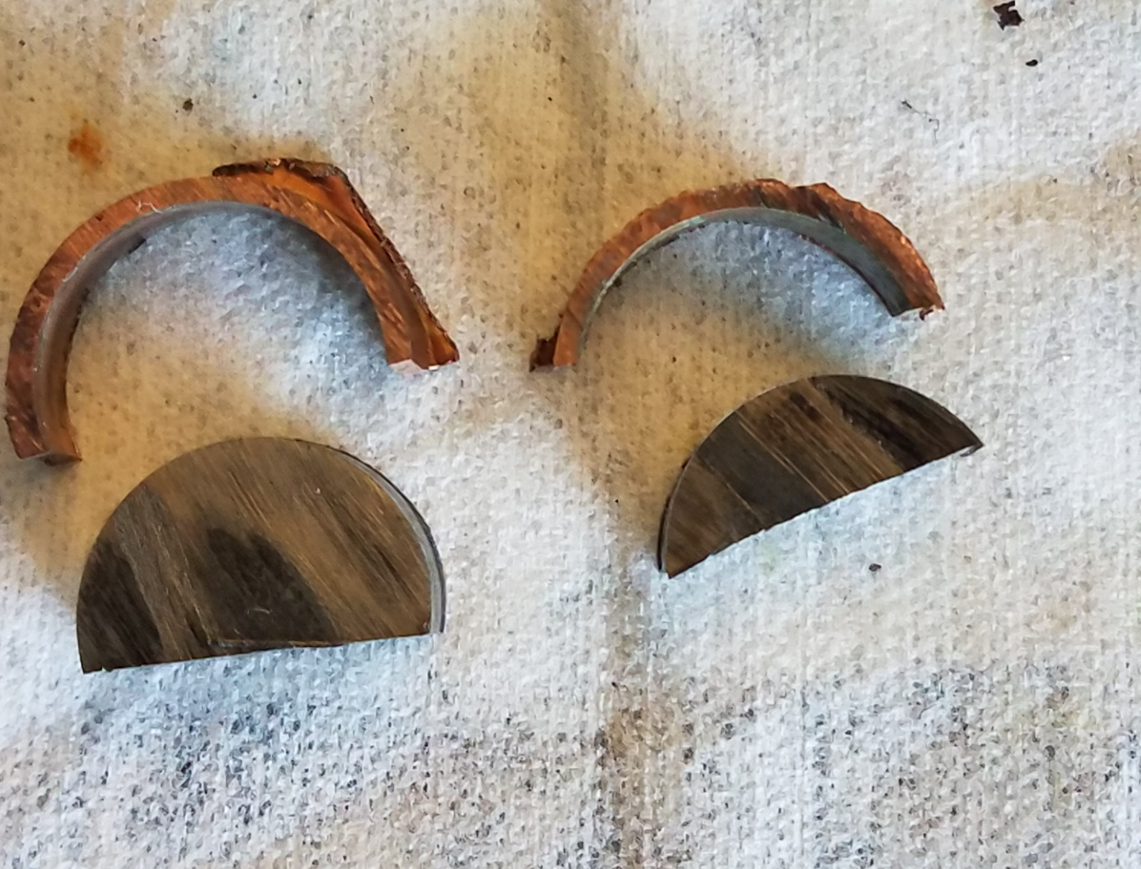
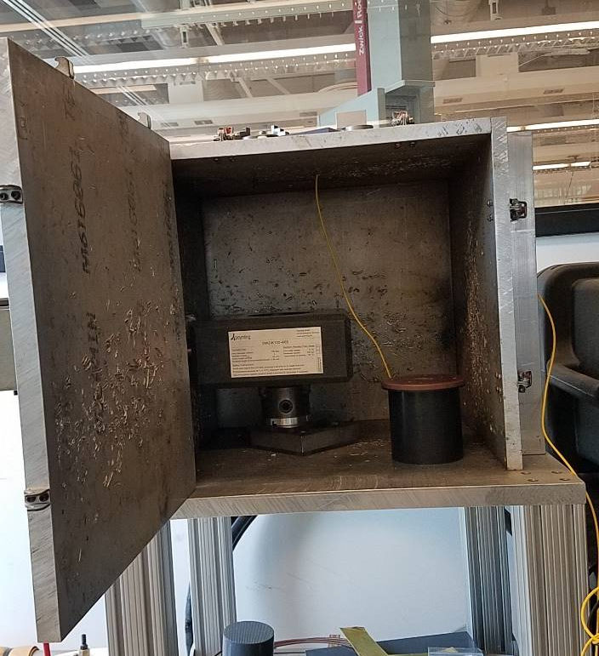
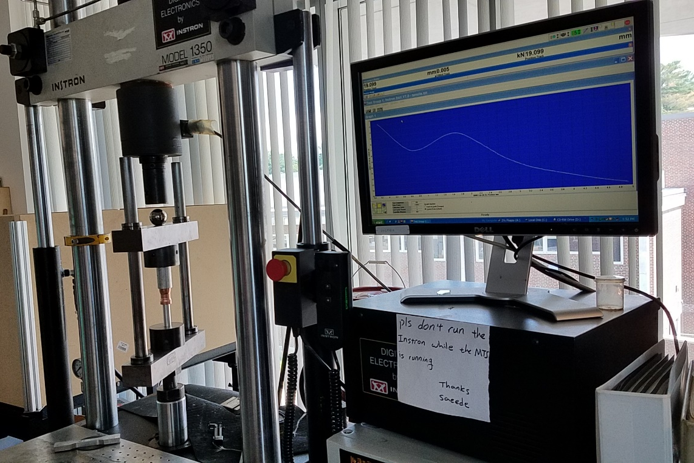
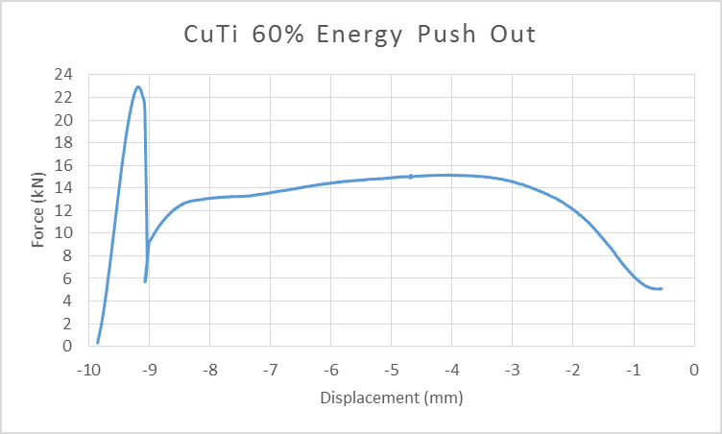
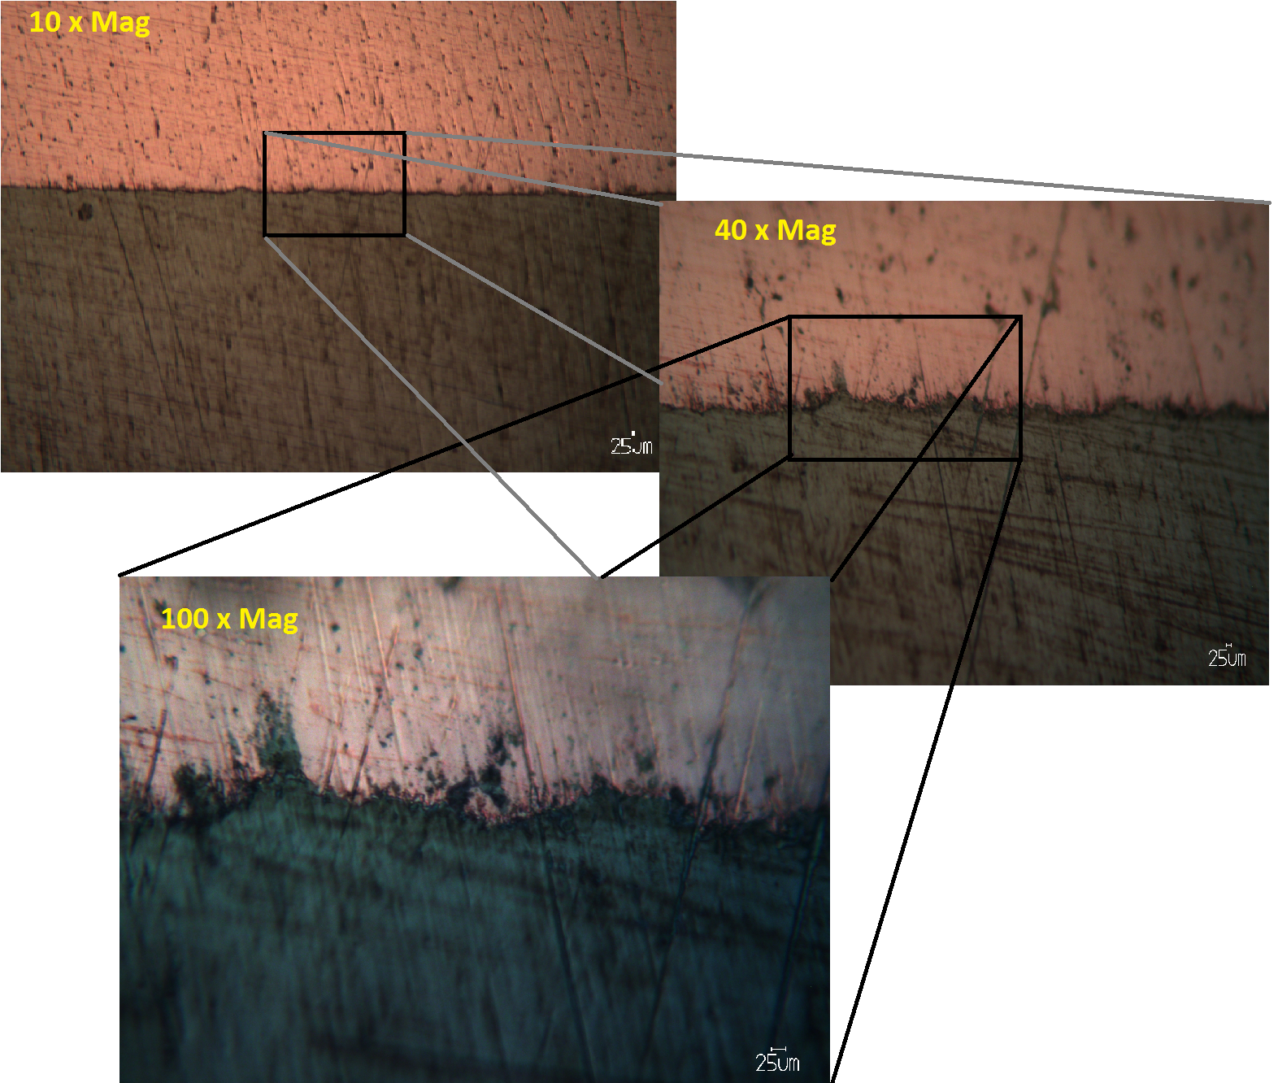
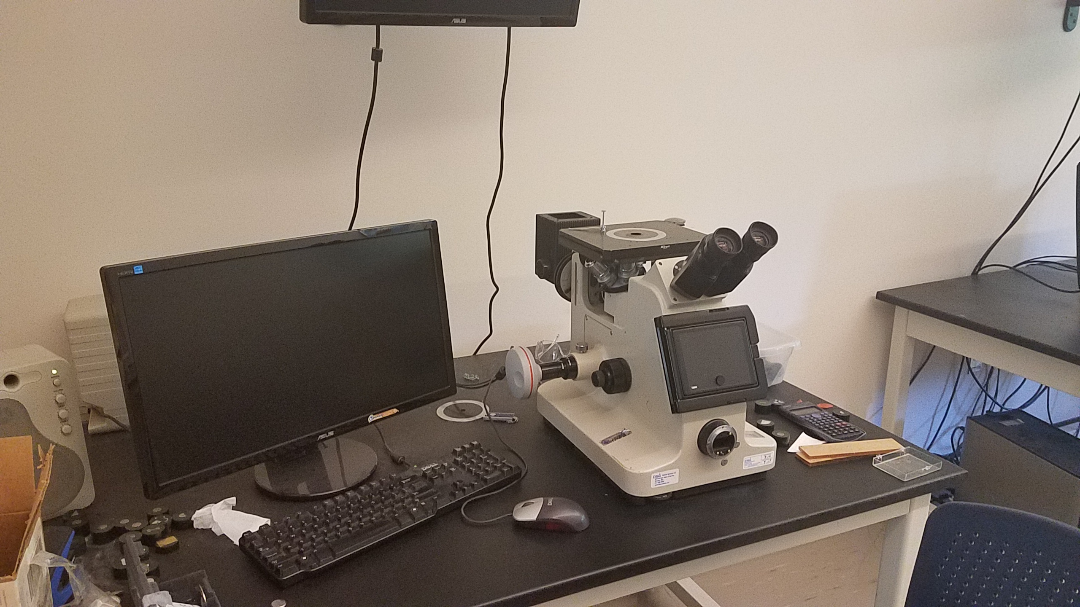
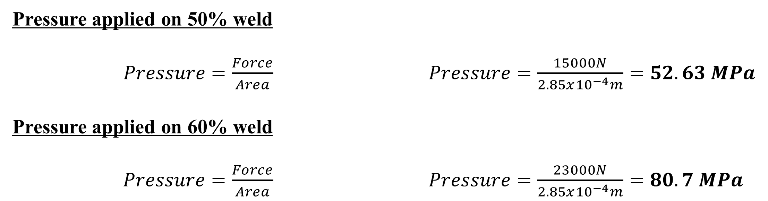
Quality of MPW welds with Variable Energy Input in Cu to CuTi Welding
Andrew Sturm ◊ North Middlesex Regional High School ◊ sturmat92@gmail.com
Introduction/Background
Results
Results Con.
MPW (Magnetic Pulse Welding) is a welding process that is classified as a solid state weld.
Solid state welding implies that the interface materials will not reach sufficient temperature for
melting as found in traditional welding methods. In MPW the materials upon collision begin to
interact on an atomic level without having to melt them. MPW is conducted often in two methods;
Plate to Plate and Tube to Shaft. The primary applications for MPW are in the automotive industry
and electronics industry to combine similar and dissimilar materials at a faster rate than conventional
Welding (Shanthala & Sreenivasa, 2016; Raoelison, 2015).
The experiment was a Tube to Shaft method, with reference to the tube as a flyer becasue
it is the material that is moving. Our particular apparatus uses a 12 Kilojoule capacitor that applies a
current to a coil inside of which our sample is placed. The induced current creates an opposing
magnetic field generating a force on the flyer (see Image 1 for schematic of apparatus). Variable
energies are used through the process in order to change the properties of the impact. If the energy
applied from the capacitor to the coil increases the velocity of the impact between flyer and shaft
increases, and therefore the kinetic energy increases. The amount of kinetic energy will influence the
overall strength of the weld which can be measured experimentally and also visually. An ideal MPW
weld shows a signature wavy weld pattern(see Image 2)(Nassiri, 2016). The goal for the experiment
is to apply three energies to a sample of Cu (Flyer) and CuTi (Shaft) and identify if a weld has formed.
Percent Energy | 40% (4.8 kJ) | 50% (6 kJ) | 60% (7.2 kJ)
Weld Measured? | No | Yes | Yes
Method of Confirmation (confirmed Y or N) | Push Out N Microscope N | Push Out Y Microscope N | Push Out Y Microscope Y
Pressure applied on 50% weld
$Pressure=\frac{Force}{Area}$ $Pressure=\frac{15000N}{2.85x{10}^{−4}m}=52.63 MPa$
Pressure applied on 60% weld
$Pressure=\frac{Force}{Area}$ $Pressure=\frac{23000N}{2.85x{10}^{−4}m}=80.7 MPa$
Evidence of Confirmation of Welds
40%
Graph 1: graph of 40% energy push out
test. Shows no major peak indicating a
weld likely did not form and force shown
measures the friction of the tubes sliding
50%
Graph 2: graph of 50% energy push out test Approx. force Image 6: 50% sample failed during cut
of 15 kN before failure of weld
60%
Graph 3: graph of 60% energy push out test Approx. force Image 7: 10x,40x, 100x mag image of
of 23 kN before failure of weld 60% sample interface
Discussion/ Summary of Data
40% sample weld was found to be unsuccessful
  Sample fell apart during cutting process and scoring marks (impact location) show no indication of material attachment
  Push out test was run but showed no indication of a weld failure found on 50% and 60% signified by a sharp peak (Graph 1)
50% sample weld was successful
  Sample fell apart during last stage of cutting (see image 6), but showed material attachment on flyer material
  Push out test showed a peak force of 15 kN indicating a pressure of 52.63 MPa before failure (Graph 2)
60% sample weld was successful
  Sample survived cutting process and images were taken of the interface. Wavy pattern was partially observable (see image 7 ), although lowered in quality by the polishing phase.
  Push out test showed a peak force of 23 kN indicating pressure of 80.7 MPa before failure (Graph 3)
Image 1: Schematic of MPW apparatus
(Nassiri, 2016)
Image 2: Signature wavy pattern of MPW
Conclusion
The conclusion of this project lead to measureable MPW welds in Cu to CuTi samples at both 50
and 60% energy from a 12kJ capacitor. The goal was to identify if a weld was formed at the energies
decided upon and it was observed that two of three energy choices likely succeeded.
The experiment although a success, has areas for future improvement. One area in particular that
would improve the results would be to measure the highest possible velocity for the impact at a given
energy. In particular, the 50% and 60% samples used a constant standoff gap between the flyer and the
shaft meaning that the velocities, although increasing in value with increasing energy, were not the
highest obtainable velocities for the materials. This implies that the welds could have been even better
than what we measured and observed.
A few sources of argumentation and lacking clarity can be found because the pressure
measurements do not Indicate the shear strength of the weld as we are pushing perpendicular to the
interface while doing our push out tests. To find the true strength of the weld one would need the area
of the interface. Pressures were calculated under the assumption that the highest peak on the graph was
the force indicating the strongest portion of the weld.
Ideally, the experiment would be run over a longer period of time allowing for more samples at
each energy. This would provide multiple push out tests, multiple microscope interface viewings and a
greater accuracy in results and understanding of the weld characteristics. MPW is a method that is
beneficial for its uses of combining dissimilar materials, and should be a key focus for material
engineering in the future.
Methods
Obtain and cut all samples for use to specific measurements of
40 mm in length for both flyer material (Cu) an shaft (Ti), flyer
outside diameter of 25.4mm and a thickness of 1.245 mm, and shaft diameter
19.05 mm.
Mount samples in MPW machine (Image 3) and run two samples at 40%,
two at 50% and two more at 60%.
Prepare Instron (Image 4) machine for push out tests on one
sample from the 40%, 50% and 60% energy ranges. Samples
should be run at a rate of 0.02mm of compression per second
and be allowed to run for approx. 10 mins to compile data on the
failure points of the weld.
Remaining samples should be prepared by being cut,
Mounted, polished and finally imaged with a 10x, 40x
(or 50x) and 100x magnification.(see Image 5 and 7)
Calculate the Pressure needed to break the weld in the 50%
and 60% samples and compare to other known values.
Image 3: MPW
machine
Image 4: Instron Machine used for
Push out tests
References/ Resources
K. SHANTHALA,T. N. SREENIVASA. Review on electromagnetic welding of dissimilar materials[J].
Front. Mech. Eng., 2016, 11(4): 363-373
R.N.Raoelison. Magnetic Pulse welding of Al/Al and Al/Cu Metal Pairs. Journal of manufacturing
Processes.,2015, Vol 20 pt 1:112-127
A. Nassiri et al. Shear instability of plastically- deforming metals in high velocity impact welding.
J. Mech. Phys. Solids 95 (2016) 351
Image 5: Microscope used for
imaging of interfaces
Acknowledgements – This research was supported with funding from the National Science Foundation’s Research Experience for Teachers in Engineering Grant (ENG-1132648). I would also like to extend my sincere gratitude to Donald Wason, Ava Rohacek, Shunyi Zang, Ben Mitchell, Dr. Brad Kinsey, and Dr. Stephen Hale.

