Slide 1
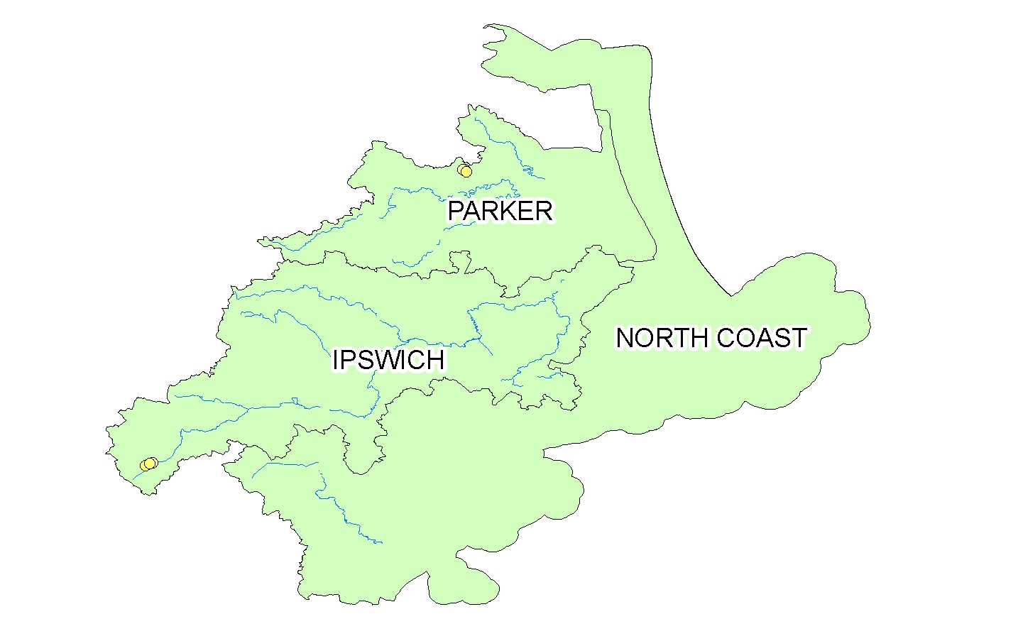
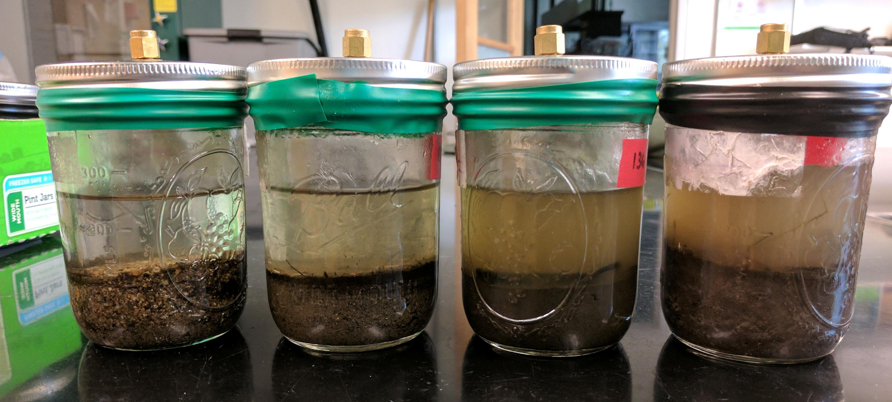
Greenhouse Gas Emissions from Aquatic Sediment Incubations
Kyle Hacker¹, Andrew Robison², Wilfred Wollheim²
¹ Department Natural Resources and the Environment (NREN), Environmental Science Major ² NREN
Background
Carbon dioxide (CO₂), methane (CH₄), and nitrous oxide (N₂O) are the three most abundant greenhouse gases (GHG’s) in Earth’s atmosphere. It is widely accepted that temperate rivers and streams are regionally significant sources of CO₂, yet their role as CH₄ and N₂O emitters is less well defined. (Campeau and del Giorgio, 2014). Benthic sediments are metabolically active, making them one of the primary sources of GHG’s in fluvial networks. A number of factors play a role in determining GHG production including organic matter (OM) content, temperature, and nutrient availability (Stanley et al 2016). Understanding the drivers of GHG production in aquatic sediments allows one to accurately predict GHG emissions on a larger scale.
Table 1. Average greenhouse gas production at pooled and channelized sampling locations
Flow class | Avg CO₂ production (μg/g sed/day) | Avg CH₄ production (mg/g sed/day) | Avg N₂O production (mg/g sed/day)
Pool | 0.025 | 0.392 | 0.004
Channel | 0.013 | 0.087 | 0.001
Research Questions
How does sediment GHG production vary over a segment of two headwater streams?
  Do flowing streambed sediments emit similar amounts of GHGs relative to pooled streambed sediments?
Is GHG production consistent over time?
Hypotheses
Pools will exhibit greater GHG emissions than flowing channel locations because of increased OM content.
OM will be highly influential on GHG production
  Microbes consume OM and respire CO₂ under aerobic conditions and CH₄ under anoxic conditions
GHG production will plateau after several days
Study Locations:
Cart Creek
Sawmill Brook
Methods
Two study locations: Cart Creek (CC) in the Parker River watershed and Sawmill Brook (SB) in the Ipswich river watershed
Sediment samples were gathered in the field twice (6/27 and 7/17) using mason jars
Overlying water was replaced with de-ionized water, the jars were sealed, and the incubation period began
Gas samples were collected on long term and short term time scales
  Long term samples were collected about every four days
  Short term samples were drawn twice daily
Samples were analyzed for CH₄ using a Gas Chromatograph, N₂O using an ECD, and CO₂ using a Licor machine
Discussion
Pools emitted more GHGs than channelized locations
GHG production increased over time
Headwater streams may be significant contributors to GHG emissions on a watershed scale
Short term incubation data will be normalized by sediment mass
% OM data is being processed to assess the relationship with OM content and GHG production
Works Cited
Campeau, A. and del Giorgio, P. A. (2014), Patterns in CH₄ and CO₂ concentrations across boreal rivers: Major drivers and implications for fluvial greenhouse emissions under climate change scenarios. Global Change Biology, 20: 1075–1088.
Stanley, E. H., Casson, N. J., Christel, S. T., Crawford, J. T., Loken, L. C. and Oliver, S. K. (2016), The ecology of methane in streams and rivers: patterns, controls, and global significance. Ecological Monographs, 86: 146–171.

