Slide 1



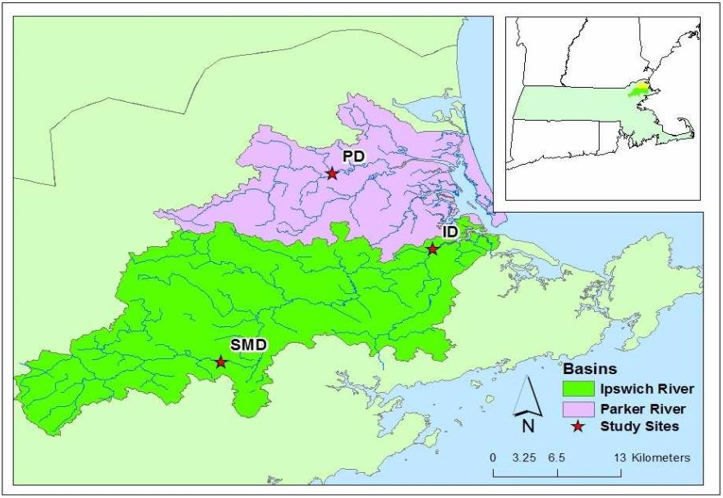
Delivery of total suspended solids (TSS) to the Plum Island estuary during storm events
Mason Caceres¹*, Wilfred Wollheim^{1,2}, Andrew Robison², Christopher Whitney²
*mec2025@wildcats.unh.edu
¹University of New Hampshire, Department of Natural Resources; ²University of New Hampshire, Earth Systems Research Center
Abstract
Coastal marshes are at risk due to climate change-induced sea level rise. Coastal marshes are important because they act as a protective barrier against coastal storms and incoming tidal waves, so without them, residents are at a greater risk of flood events. Tidal marsh elevations must keep up with rising sea levels through a combination of the burial of organic matter produced in situ, and the trapping of suspended sediments (Fagherazzi et. al. 2013). Watersheds play an important role in sediment delivery to coastal marshes, but the elevation of the marsh is regulated through a complex set of feedbacks. Sediments, vegetation, and sea level interact with additional suppliers of sediment to prevent the coastal marsh from deteriorating into tidal flats and open water (Reed 1990). Current estimates of riverine sediment exported to the estuary neglect fluxes resulting from storm flows which potentially underestimates total yearly fluxes (Fagherazzi et. al. 2013). During rainstorms, the gradual increase of velocity, rise in base flow, and other factors that affect concentration – discharge relationships were taken into consideration when quantifying the total amount of suspended sediment that reaches the Plum Island estuary from the watershed. The total amount of suspended solids (TSS) during storm flows was compared to previously collected baseflow data in order to determine the difference in annual fluxes. Annual data of predictor variables such as discharge, runoff, and precipitation were regressed with the annual load estimates in order to identify potential correlations between datasets. By including storm flow data, we found that there was no significant difference in annual fluxes of sediment from the Ipswich Dam, but there was a difference in exported sediment from the Parker and South Middleton Dams.
Methods
Sigma autosamplers were deployed at the outflows of three dams on the Parker and Ipswich Rivers in northeastern MA, USA during the summer of the 2017 field season, to take samples during storm events (Figure 1)
  The Parker Dam reservoir in Byfield, MA (PD)
  The Ipswich Dam reservoir in Ipswich, MA (ID)
  The South Middleton Dam, upstream of the Ipswich R. in South Middleton, MA (SMD)
TSS concentrations in samples from 3 storms/site were quantified to determine TSS mobilization at different flow levels
A statistical model (LOADEST, USGS) was used to combine storm and baseflow TSS data, (collected from 2007 to 2016), in order to estimate the exported annual loads (Figure 3)
Comparison of each site with and without storm data using two different LOADEST models
Best fit model automatically selected one of nine LOADEST models (varied by site) that calculated annual loads of TSS based on the entire record of storm and baseflow TSS data
LOADEST model 1 (Ln(Load) = a0 + a1 Ln(Q)) estimated annual fluxes of TSS based on discharge as a function of TSS concentrations that was expected to influence the instantaneous loads.
Regression statistics were determined by comparing load estimates to predictor variables (Figures 5, 6, 7)
Results
Regression Statistics – Annual Amount of TSS Exported (tons/year) vs. Predictor Variables
Best Fit Model
Model 1
Results
Figure 5. Regression statistics comparing annual load estimates of exported TSS (tons) to annual precipitation (inches)
Best Fit Model
Model 1
Study Area
Figure 6. Regression statistics comparing annual load estimates of exported TSS (tons) to annual runoff (depth in cm)
Figure 2. 2017 rainstorm comparing hourly discharge to corresponding TSS concentrations (mg/L)
Best Fit Model
Model 1
Best Fit Model
Model 1
Figure 7. Regression statistics comparing annual load estimates of exported TSS (tons) to annual runoff (depth in cm)
Conclusions & Future Work
Annual sediment fluxes estimated with TSS storm flow data are different than the fluxes estimated without the storm flow data.
Load estimates using the best fit model vs. model 1 suggest that annual exports of sediment neglect a proportion of annual fluxes resulting from storm flows at the Parker and South Middleton reservoirs, but not so much at the Ipswich reservoir (Figure 4)
Model 1 LOADEST data have stronger correlations with predictor variables than the best fit model
Annual precipitation, runoff and discharge are all very strong predictors of exported loads of sediment
On going collection of storm flow data would provide a more accurate estimate of annual TSS fluxes
Monitoring input/output budgets at each reservoir would help us better understand how much is withheld as the annual loads pass through each site
Figure 1. Locations of the three TSS sampling sites within the Parker and Ipswich River watersheds in Northeastern MA
Research Questions
Q1: What effect do storms have on the delivery of suspended sediments to the coast?
H1: Storm sediment fluxes comprise a substantial proportion of the total yearly fluxes of sediments to the coast.
Q2: What predictor variables explain fluctuations in annual TSS loads over the entire record of data?
H2: Annual discharge, runoff and precipitation have strong correlations with the total amount of suspended sediment transported to the coast.
Figure 3. Results from LOADEST - annual load estimates of TSS (tons/year) comparing best fit and discharge only models
Best Fit Model
Model 1
Acknowledgements
This work was funded and supported by the Weeks Undergraduate Research Fellowship.
Works Cited
[1] Fagherazzi S., D.M. FitzGerald D.M., R.W Fulweiler, Z. Hughes, P.L. Wiberg, K.J. McGlathery, J.T. Morris, T.J. Tolhurst, L.A. Deegan, and D.S. Johnson. 2013. Ecogeomorphology of Tidal Flats. In: John F. Shroder (ed.) Treatise on Geomorphology, 12: 201-220. [2] Reed, D. J., 1990. The impact of sea-level rise on coastal salt marshes. Progress in Physical Geography, 14: 465-481.
Figure 4. Differences in annual TSS flux estimates (storm data – baseflow data) comparing best fit and discharge only models

