Slide 1
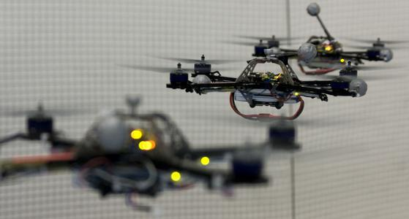
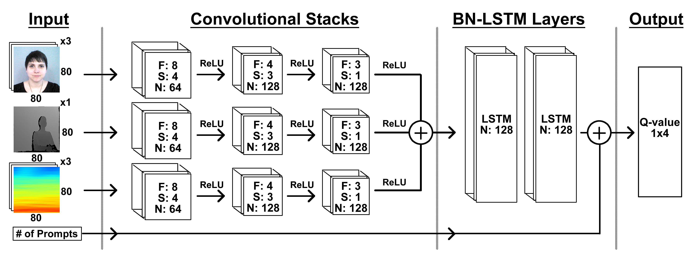
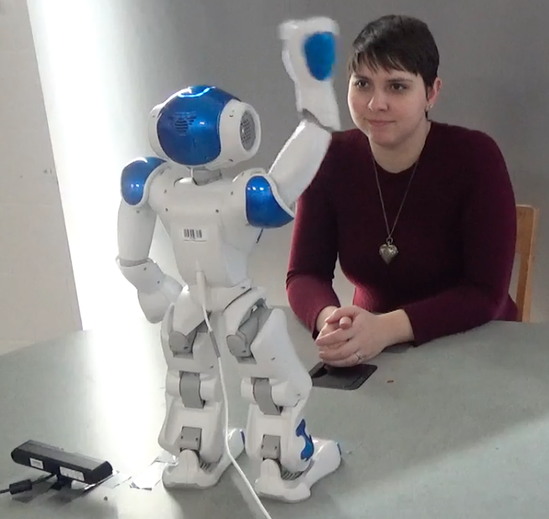
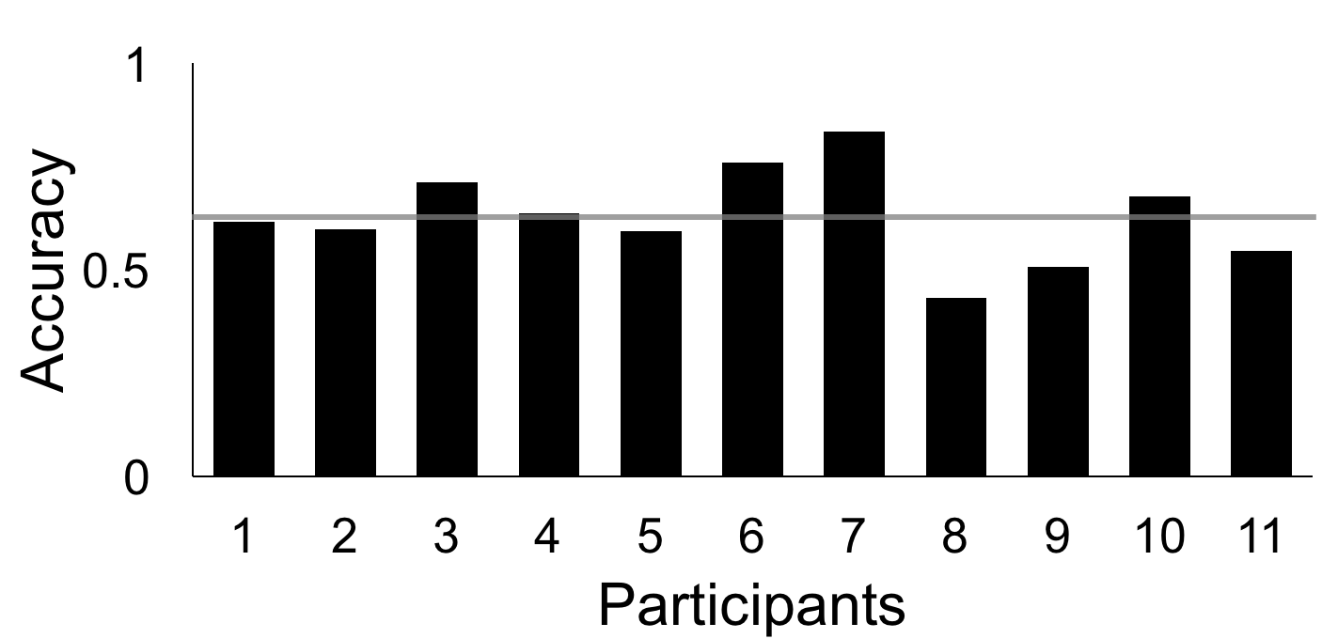
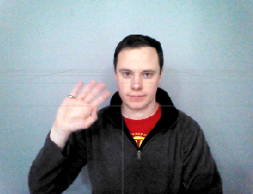
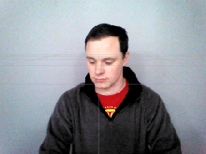
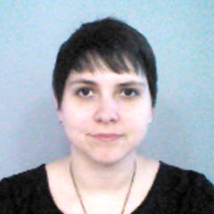
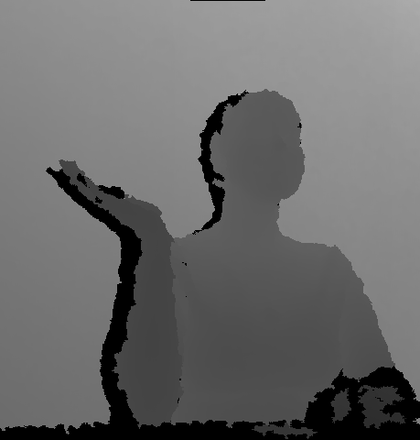
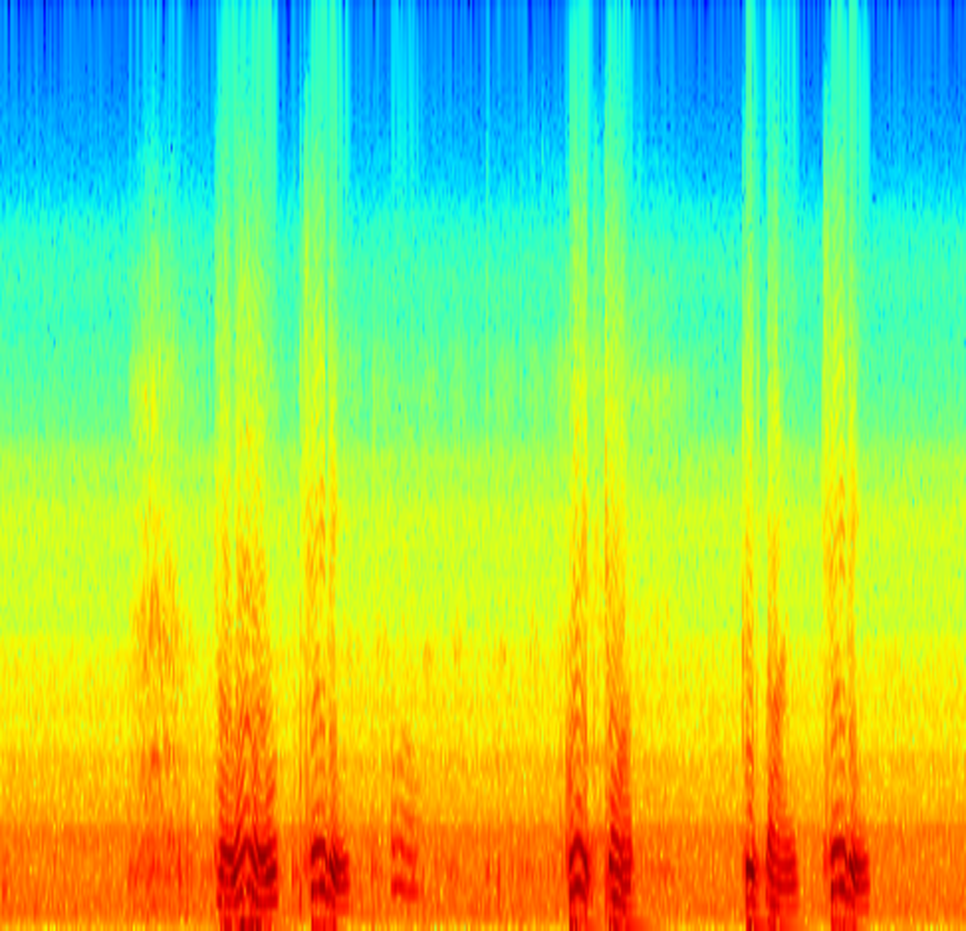
Deep Recurrent Q-Learning of Behavioral Intervention
Delivery by a Robot from Demonstration Data
Madison Clark-Turner and Momotaz Begum
@ UNH
Overview
We present a Deep Recurrent Q-Network (DRQN) model for learning behavioral interventions (BIs) from demonstrations
By using the DRQN we are able to identify the features necessary to understand how to perform the intervention autonomously without the use of hand-picked features.
We evaluate our system in simulation with promising results.
Deep Recurrent Q-Network
Applied Behavior Analysis
Applied Behavior Analysis has proven popular for designing BIs for IwASD to teach new skills such as social greetings. The intervention we investigated asked the participant to respond in a particular manner, rewarding them if they complied and prompting them further if they did not.
Data Collection
We performed an IRB User Study with 11 Participants without ASD
Interactions in the study were tele-operated in order to show the desired function of the trained system.
Participants performed in a combination of compliant and non-compliant sessions.
Cross-validation
Performed leave-one-out cross-validation using all of the data from a single participant. Testing was performed on individual not in the trained set.
Accuracy of random choice was 43.3%
We obtained an average accuracy of 62.8%
Highest accuracy (participant 7) was 83.3%
Conclusions
We presented a model for learning from demonstrations that uses a DRQN in order to identify important features relevant to action selection from video data.
We reinforce this claim by showing a use case that involved human participants and was able to obtain greater than 80% accuracy on a partial dataset.
Future Direction: Testing on human subjects and improvements such as transfer learning
Compliant
Non-compliant
Participant interacting with the NAO robot
Inputs
RGB Image: cropped image of face
Depth: greyscale image of full body
Spectrogram: depiction of smoothed audio
Number of Prompts: single boolean
Contact Information
Email: mbc2004@cs.unh.edu
GitHub: https://github.com/AssistiveRoboticsUNH/DQN-ASD
Phone: +1 (610) 563 5333
Image Depth Audio

