Slide 1





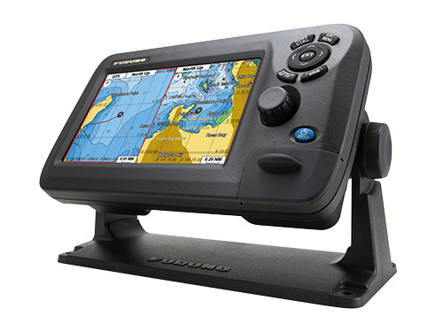
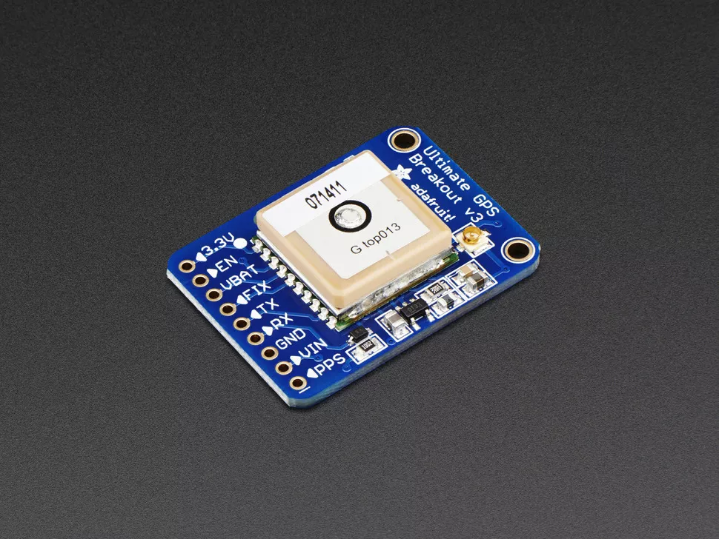
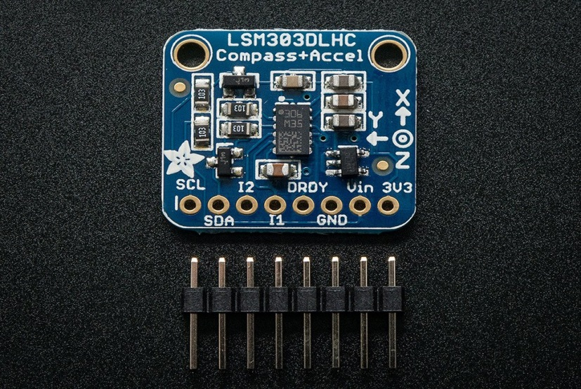
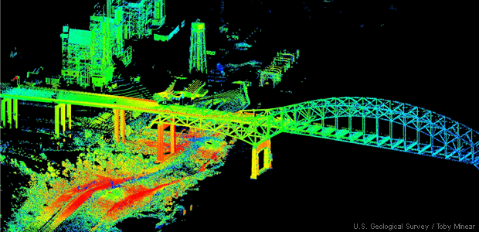
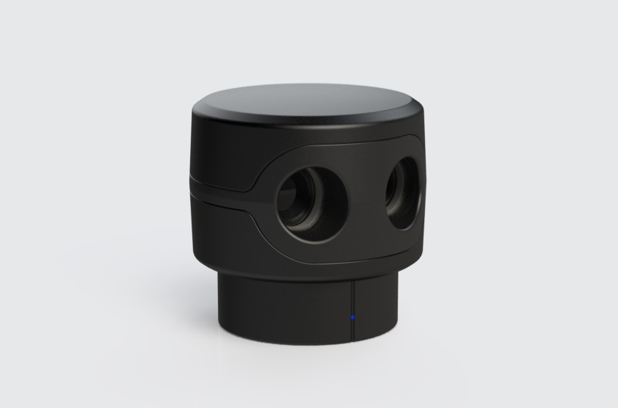
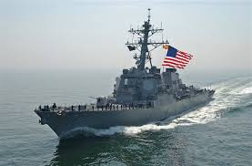
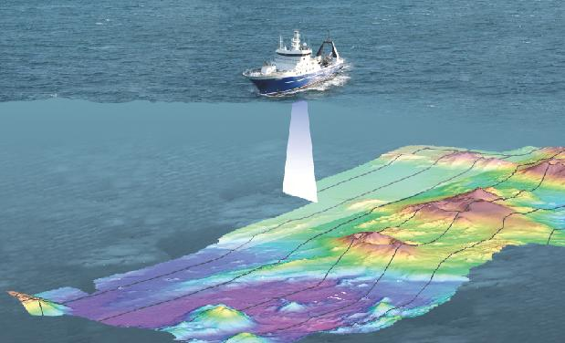
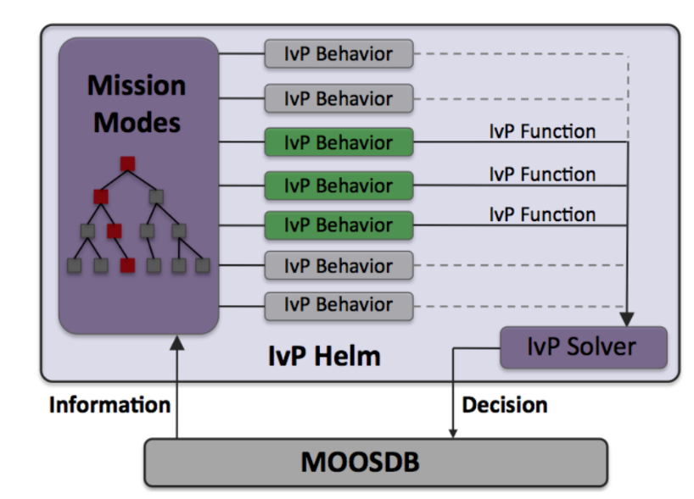
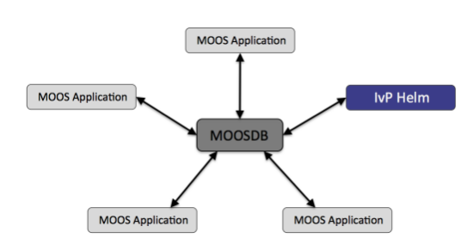
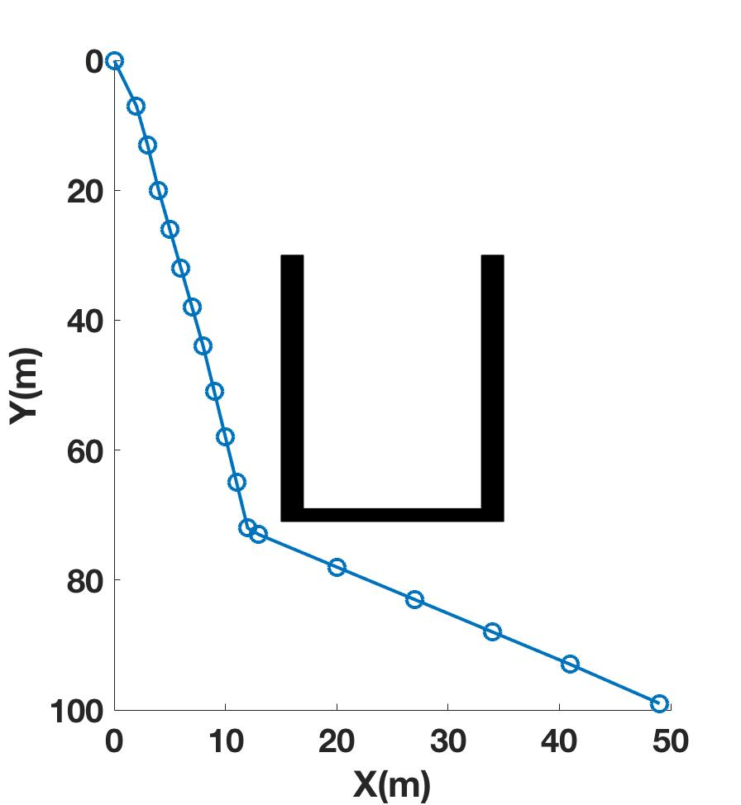
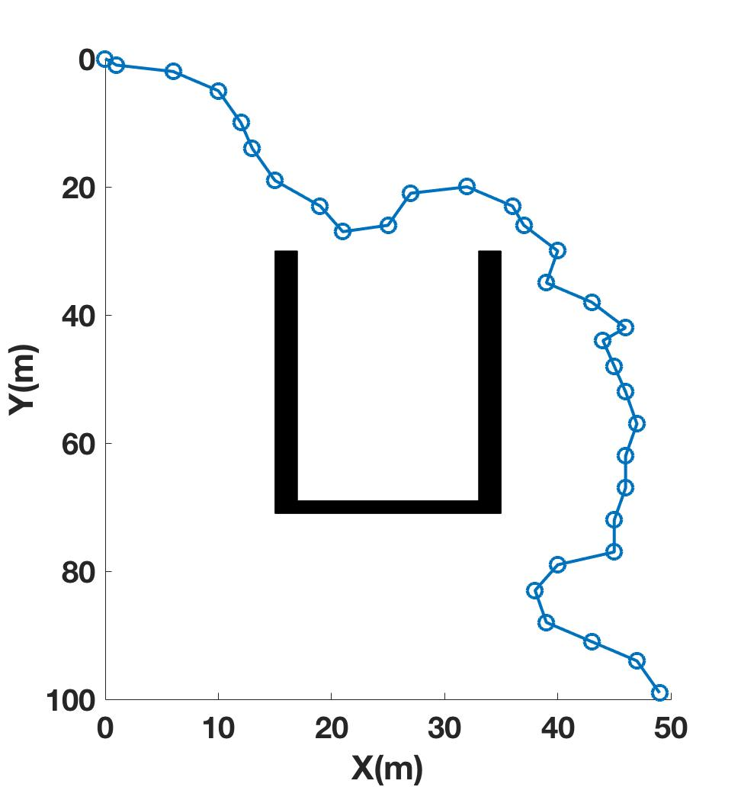
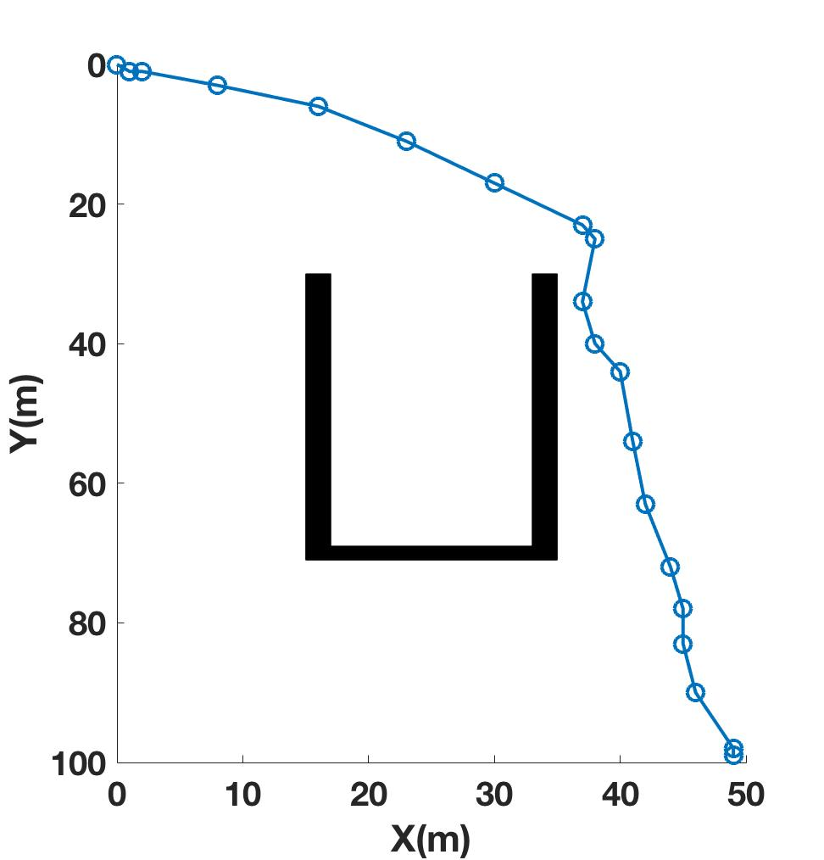

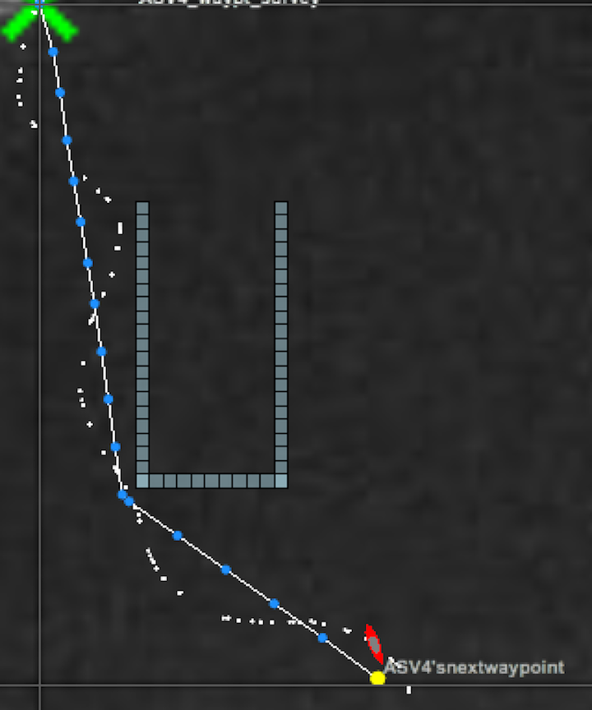
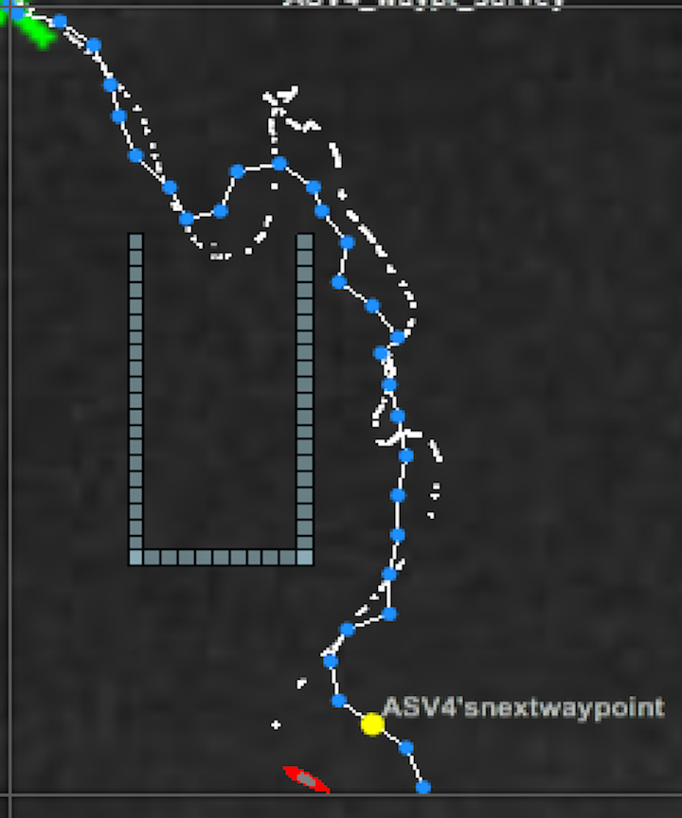
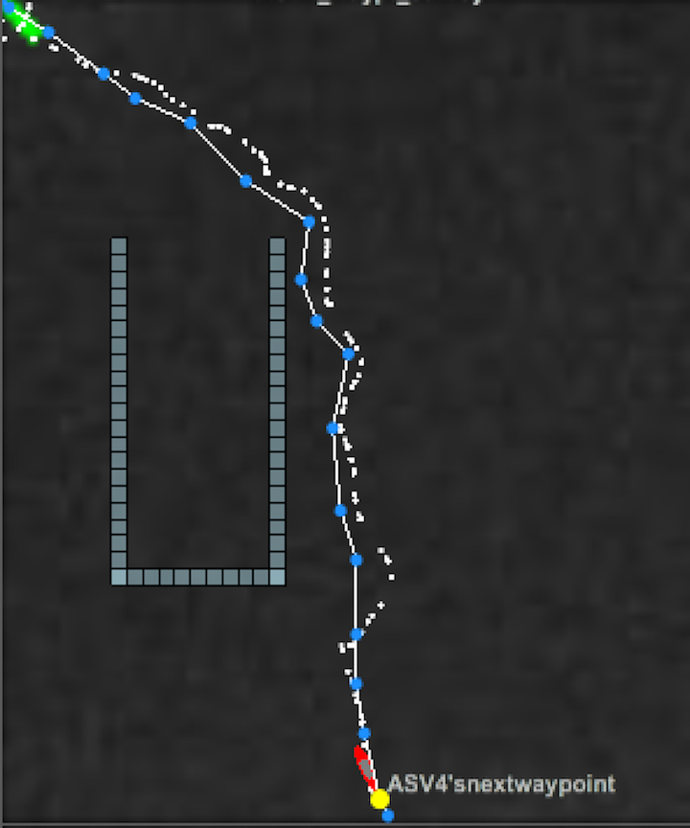
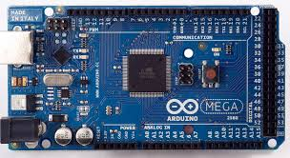
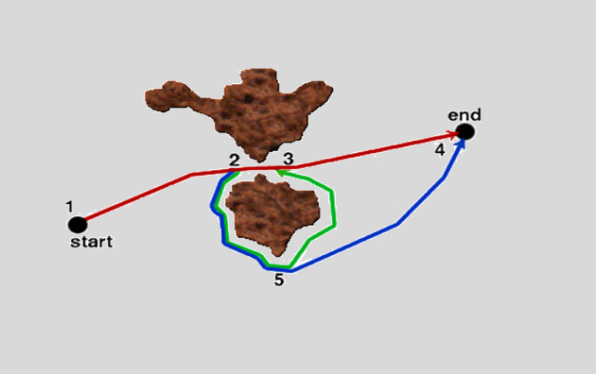
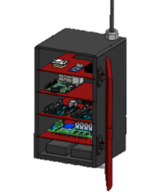
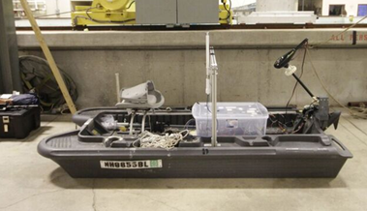
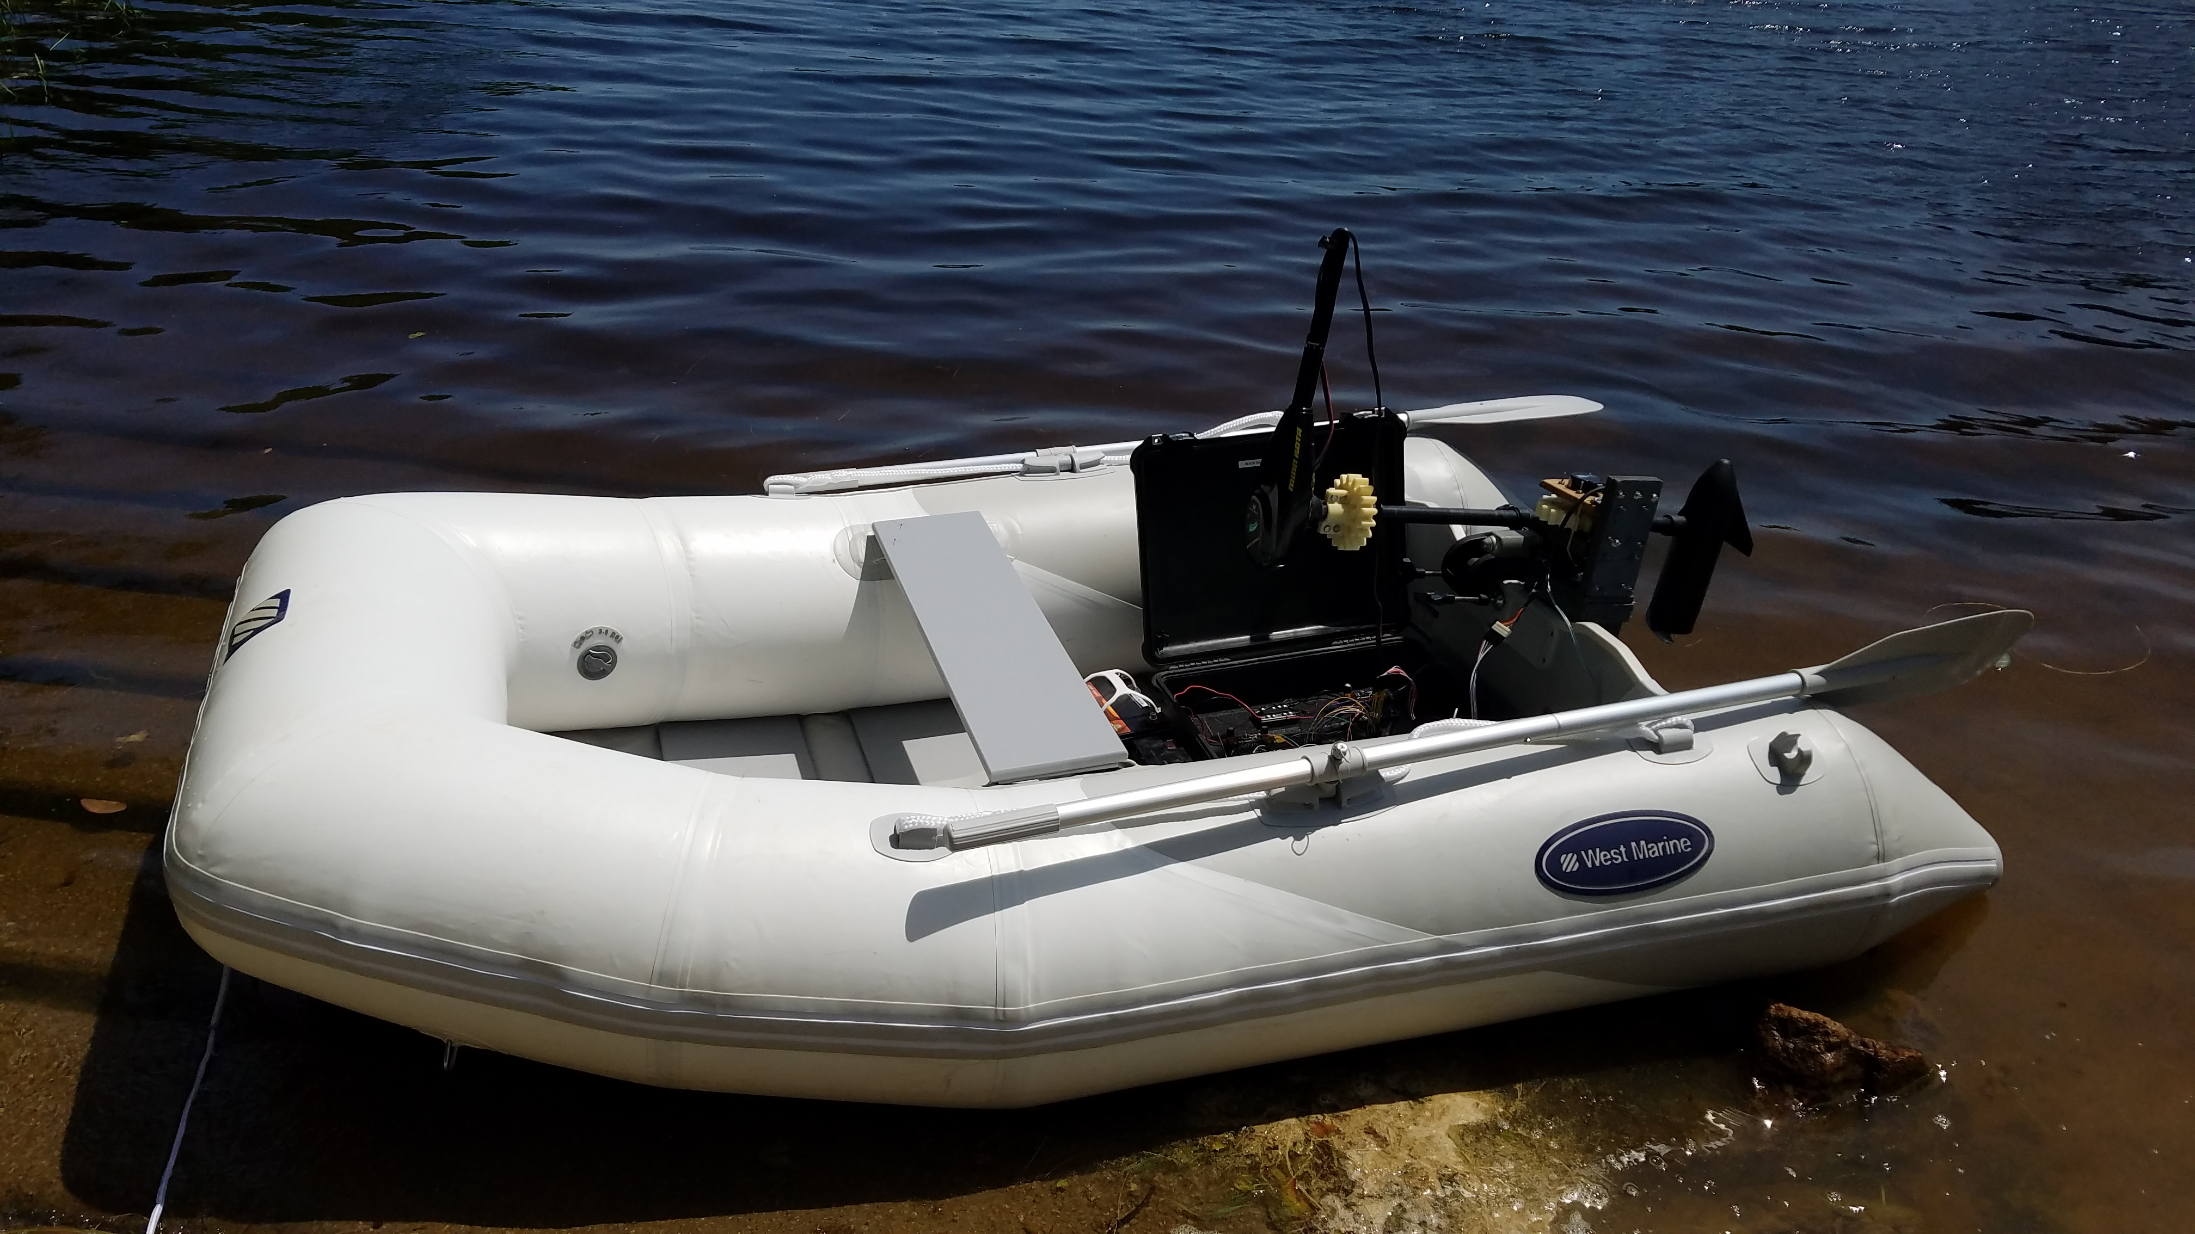
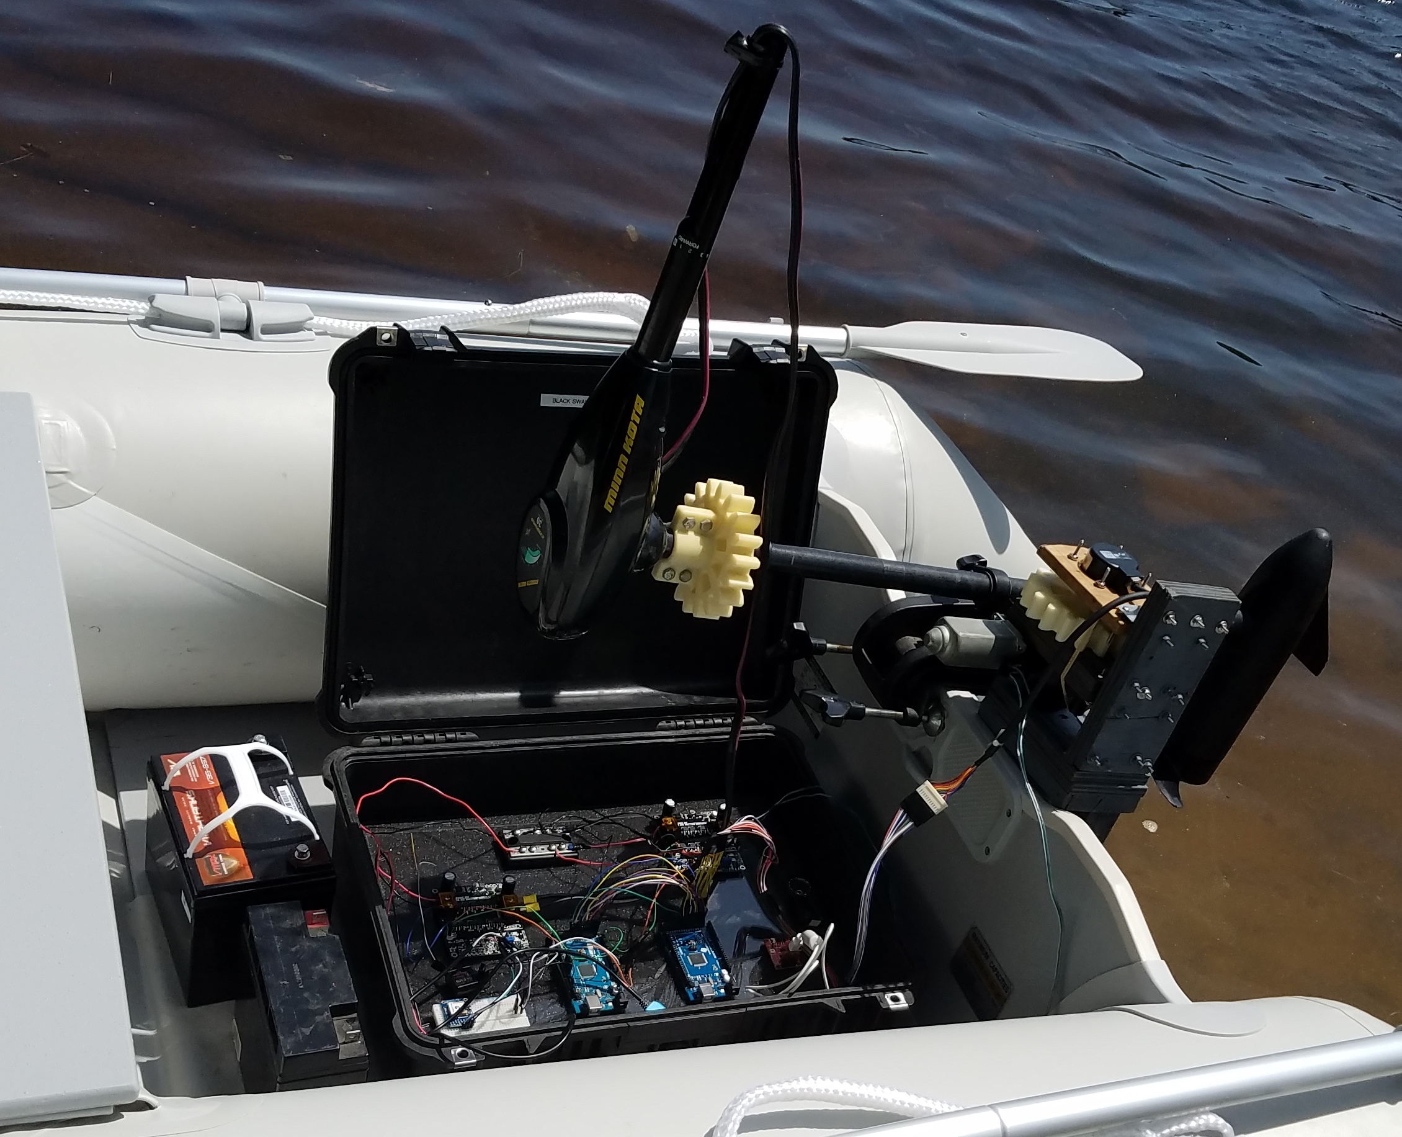
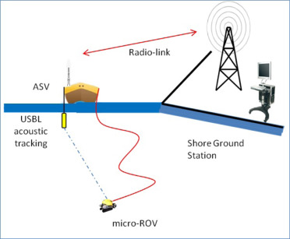
Development of Autonomous Control for Multiple Vehicle Platforms
Autonomous Surface Vehicle
Collin Gagnon, Alexander Roemer, Steven Hurley, Robert Mitchell, Jeffrey Hensel, Allisa Dalpe
Team Members: Collin Gagnon, Alexander Roemer,
Steven Hurley, Robert Mitchell, Jeffrey Hensel
Graduate Researcher: Allisa Dalpe
Advisor: Dr. May-Win Thein
University of New Hampshire
Abstract
Materials & Methods
Path Planning
The Autonomous Surface Vehicle (ASV) is a self-driving, self-aware boat that requires integration of multiple fields of engineering (e.g., mechanical, electrical, and software). The team used the Mission Orientated Operating Suite-Interval Programming (MOOS-IvP) software platform to integrate multiple vehicle sensors and actuators along with user-defined command inputs. Advanced modeling and control techniques were implemented to ensure high performance, reliability, and robustness for autonomous obstacle avoidance and path planning. The platform was designed to also incorporate graduate level research.
Potential uses for ASVs include: national defense, research like ocean floor mapping, commercial shipping, and fishing opportunities.
Sensor Suite & Functionality
Global Methods
Information stored as a map
Information exists in memory
Long computation time
Example: GPS
Local Methods
Takes into account immediate environment
Reactive
No memory
Shorter computation time
Example: Lidar
GPS:
Adafruit Ultimate GPS Breakout used for vehicle position and speed. Also acts as the basis for developing global path planning methods.
GPS
IMU:
Inertial Measurement Unit: Adafruit triple-axis accelerometer + magnet board LSM303 is used to provide heading information. (9 DOF)
LiDAR:
Light detection and ranging system. Implementation of a Scanse Sweep LiDAR for local (reactive) object detection and avoidance is in progress.
(Range: 40 m)
Lidar
Results
Stage 1 autonomy has been completed and implemented on the ASV4 platform. This allows the ASV4 platform to self-navigate to pre-programed points using the GPS and IMU sensor inputs along with MOOS software.
Stage 2 compares A*, Rapidly Exploring Random Tree (RRT) and Probabilistic Road Map (PRM) algorithms to explore and determine the most practical, easy to use, yet effective global path planner for future use.
Stage 3 autonomy will begin when the LiDAR sensor has been successfully interfaced with MOOS-IvP.
MOOS-IvP
The MOOS-IvP framework is capable of building highly capable autonomous systems. It allows all the sensors and components onboard the ASV to work together to achieve autonomy. It will later aid in communication between ASV and ROV platforms.
Objectives
This project was the start of a three year long research effort to ultimately perform cross platform communication and multivehicle operation between ASVs and Remotely Operated Vehicles (ROVs). The current focus is to prove that any low cost surface vehicle can be retrofitted with the system developed by this research team to become a fully autonomous vehicle. Specific objectives are outlined below.
IvP Helm:
The IvP helm is able to take information from MOOS and make control decisions for the ASV. Complex autonomous scenarios can be developed from pre-made or custom behaviors.
MOOSDB:
Stores information related to its operating mission and coordinates communication between sensors and other processes. MOOS applications can interface with the MOOS database.
Autonomy:
First Stage: Basic point to point navigation using GPS positioning with Inertial Measurement Unit (IMU) for heading.
Second Stage: Second stage autonomy involves pairing point to point navigation with obstacle avoidance, thereby creating a self sufficient navigation algorithm to serve as a platform for more complex tasks. This stage will incorporate global navigation methods and comparison between various path planning algorithms .
Third Stage: Target recognition, tracking, and trailing. This allows for more advanced behaviors and aids in multi-platform coordination and swarm optimization.
Simulation output comparing A* (left), RRT (center), and PRM (right) algorithms.
Data Processing & Controls
HP Pavilion Notebook:
The “Brain”, stores sensor drivers, performs data processing, and runs MOOS-IVP.
ArduinoMega2560:
Stores both manual (RC) and automated steering and rudder control.
Field test results of the above simulations with A* (left), RRT (center), and PRM (right) algorithms.
Platform
References
Modularity:
Modularity is defined as the degree to which a system’s components may be separated and recombined on other similar systems.
The main goal of this year’s ASV is to create an entirely modular design so that any component necessary for autonomy may be taken off an existing vessel and placed on a similar one with minimal adjustments.
ASV 3:
7’ Bass Fishing Boat
ASV 4:
8’ West Marine Rigid Inflatable
DC Brushless Trolling Motor
Easily deployed by two people
Saves space
Conte, G., De Capua, G., Scaradozzi, D. (2016). Designing the NGC system of a small ASV for tracking underwater targets. Robotics and Autonomous Systems, 76, 46-57.
Loe, O. (2008). Collision Avoidance for Unmanned Surface Vehicles. Master’s Thesis, Norwegian University of Science and Technology, Trondheim, Norway.
An Overview of MOOS-IvP and a Users Guide to the IvP Helm - Release 13.5 (2013). http://oceanai.mit.edu/moos-ivp-pdf/moosivp- helm.pdf
L. E. Kavraki, P. Svestka, J. C. Latombe and M. H. Overmars, "Probabilistic roadmaps for path planning in high-dimensional configuration spaces," in IEEE Transactions on Robotics and Automation, vol. 12, no. 4, pp. 566-580, Aug 1996.
Olzhas Adiyatov and Huseyin Atakan Varol. Rapidly-exploring random tree based memory efficient motion planning. In Mechatronics and
Automation (ICMA), 2013 IEEE International Conference on, pages 354–359, 2013. DOI: http://dx.doi.org/10.1109/ICMA.2013.6617944
Ueland, Einar (2017). A* (Astar / A Star) search algorithm(https://www.mathworks.com/matlabcentral/fileexchange/56877-a---astar---a- star--search-algorithm-easy-to-use), MATLAB Central File Exchange. Retrieved January 12, 2017.
Mathworks, Inc. (2017). Path Planning in Environments of Different Complexity. Retrieved January, 2017 from https:// www.mathworks.com/help/robotics/examples/path-planning-in-environments-of-different-complexity.html
http://www.furuno.com/en/products/chartplotter
https://gcn.com/articles/2013/03/12/lidar-revolutionizing-maps-geospatial-data.aspx
ASV3
Communication:
Strategies for the establishment of acoustic communication between an ASV and ROV platform will be developed and suitable sensors will be researched to accomplish this task.
Acknowledgments
Many thanks to Dr. Martin Renken (Keyport NUWC), NAVSEA, NEEC, and to the New Hampshire Sea Grant for their respective contributions to the development of this research and for their time spent ensuring our success.
ASV4
ASV4

