Slide 1




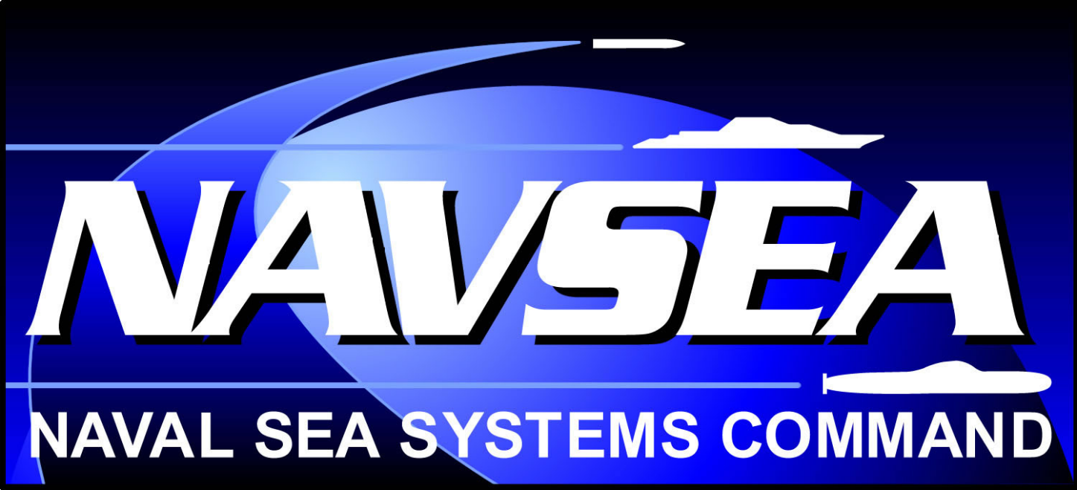
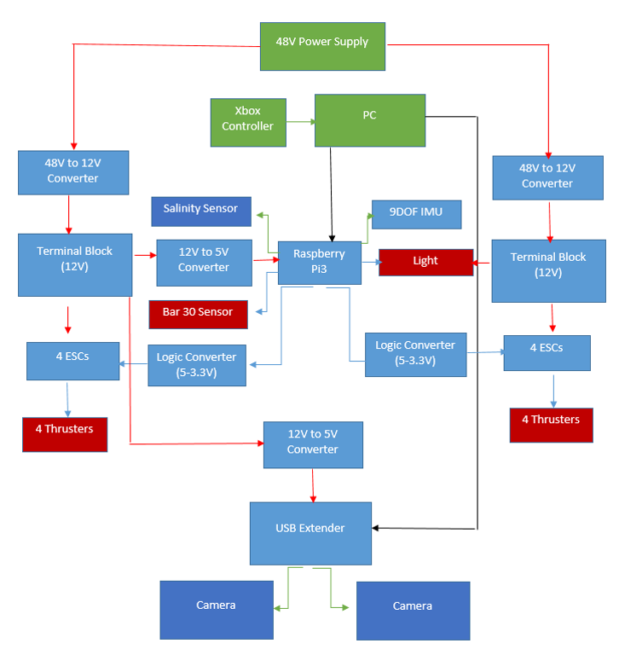
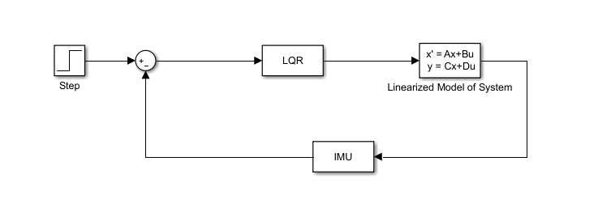
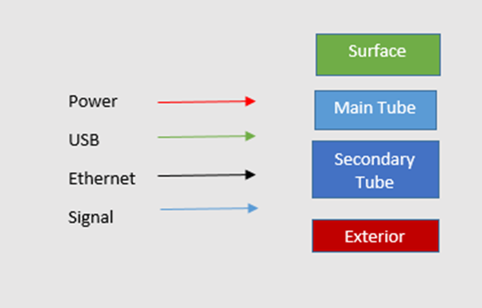
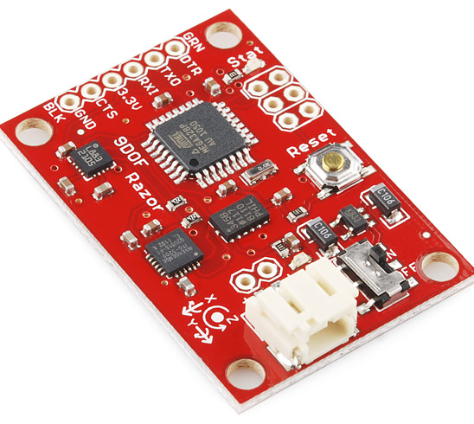
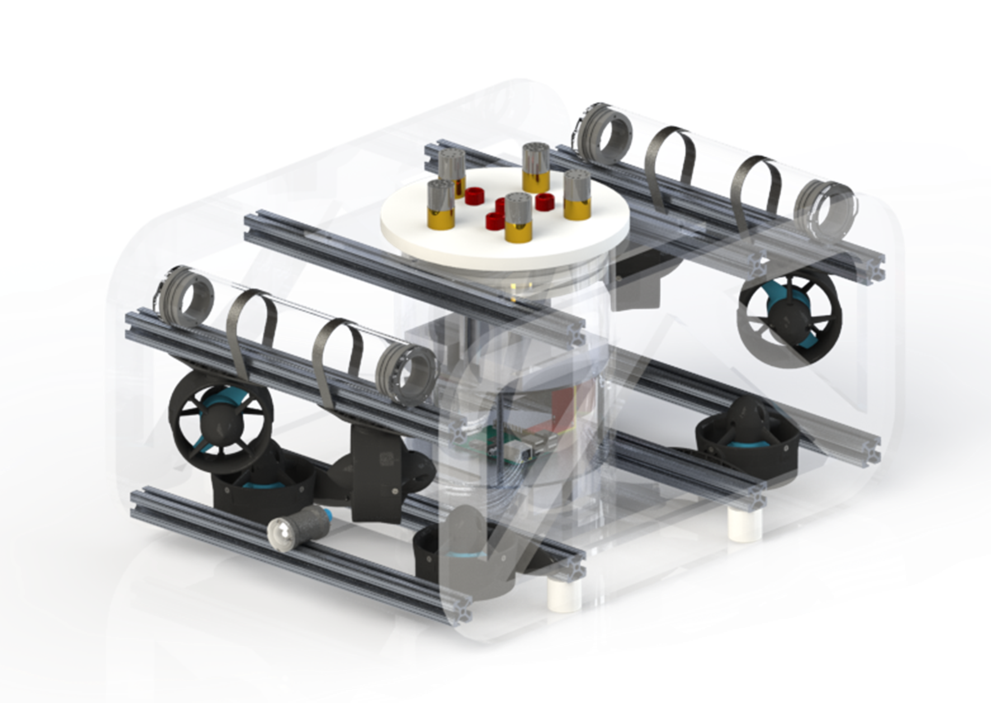
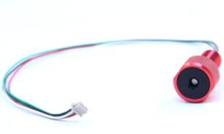
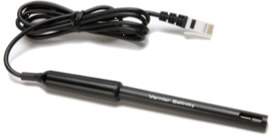
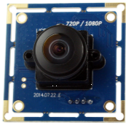
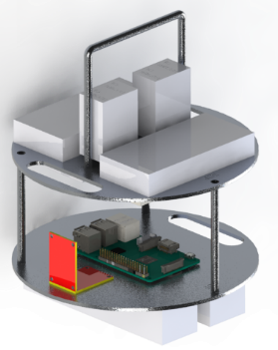
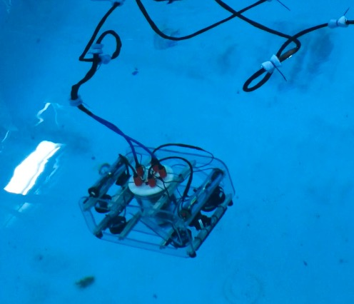


Development of Autonomous Control for Multiple Vehicle Platforms
Autonomous Surface Vehicle
Collin Gagnon, Alexander Roemer, Steven Hurley, Robert Mitchell, Jeffrey Hensel, Allisa Dalpe
Nate Bredow, Aaron Cordova, Brandon Wong, Daniel Cohen, Kara Graney, Brian Ellis, Chris Chin, Kim Radzelovage
Advisor: Dr. May-Win Thein
Graduate Researcher: Allisa Dalpe
Graduate Advisors: John McCormack, Sital Khatiwada
University of New Hampshire
Abstract
Stability Feedback Control
Electrical System
UNH ROV is an interdisciplinary engineering team dedicated towards the design and fabrication of an underwater remotely operated vehicle. This year, ROV 006, known as Njord, was designed for the use and implementation of graduate and doctoral research. Computer-aided modeling software, SolidWorks, was the platform for the design model of this year’s ROV. The use of both acrylic sides and 80/20 aluminum connectors in the chassis were inspired from both ROV 003 ‘Viper’ and ROV 005 ‘Siren’. Innovations to improve Njord from previous year’s designs include a vertical electronics tube, two electronics tiers for more compact wiring, multiple cameras, improved user-friendly computer coding, and an expandable wiring platform for the possible addition to the sensor array on board. Current ongoing tasks include implementing a stabilizing control code and communication with the Autonomous Surface Vehicle (ASV). With new and innovative ideas, various engineering programs, and a unique and expandable design, Njord establishes its role as an advanced underwater ROV platform for many aspects of research, industrial application, and the marketable world.
Will allow the ROV to maintain position and orientation while experiencing external disturbances
Linear-quadratic regulator allows for the control of a non-linear system
Minimizes a cost function with user supplied weighting factors
9DOF IMU allows for the system to detect and compensate for changes in position and orientation
Stability system can be adapted to aid in future autonomy systems
Will be able to aid in future track-and-trail operations
The LQR controller will be constructed using a Python Control System Library.
The function call is “lqr(A, B, Q, R)”, where A and B are 2-D dynamic and input matrices, and Q and R are state and input weight matrices.
Objectives
Sensors
As a senior design project team working to influence graduate research, the goal for the team is to design and build a working underwater remotely operated vehicle that can be used as a research platform. The ultimate goal for years to come is to create a fleet of Autonomous Underwater Vehicles (AUV), Autonomous Surface Vehicles (ASV) and Unmanned Aerial Vehicles (UAV) to communicate together and accomplish a goal. The primary goal of the ROV team this year is to produce a research based ROV that is technologically and computationally superior to previous year’s models by adding new advancements. This new design provides a working base model to further establish communication with an ASV.
Future AUV Goals
Razor 9 DOF IMU contains a gyroscope, accelerometer, and magnetometer. The IMU will be utilized in the stabilization control
Once communication is perfected between the ROV and ASV, future years’ ROV teams will establish a fully autonomous ROV. From there, fleets of AUVs and ASVs will have full communication with one another for various research opportunities
Blue Robotics Bar30 sensor. Measures pressure and temperature
Vernier salinity sensor
ROV-ASV Communication
2 board cameras mounted on the front of the ROV. Provide a live video to the surface. Allow for future members to explore the ROV’s computer vision capabilities
Currently researching acoustic options for ROV tracking relative to the ASV platform
Acoustic signals travel well through water
Future researchers will be able to coordinate movement and share data between ROV and ASV systems
The ASV will provide broad search capability while the ROV will be deployed to examine the seafloor in higher resolution
Chassis Design
Electronics Trays
Acknowledgments
Cast Acrylic Plastic and 80/20 T-slotted Aluminum Frame
Lightweight design for easy transportation
Slide fastener system allows for easy attachment of components
8 Thrusters with a maximum thrust of 5.2 lbf each
Vertically-oriented watertight electronics enclosure
Two (2’’ dia.) watertight tube enclosures for sensors/cameras
Many thanks to Dr. Martin Renken (Keyport NUWC), NAVSEA, NEEC, and to the New Hampshire Sea Grant for their respective contributions to the development of this research and for their time spent ensuring our success. We would also like to thank Joseph Gabriel (Form 3D), Scott Campbell (UNH Machine Shop), and Tara Hicks Johnson (UNH Ocean Engineering).
Two tier cylindrical design to reduce wiring
6061 aluminum plates chosen for thermal properties
Plates connected with removable stainless steel rods
Handle added for easy removal from tube

