Slide 1
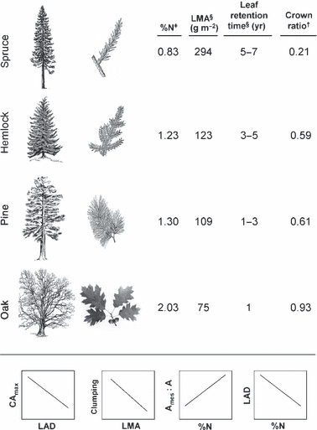
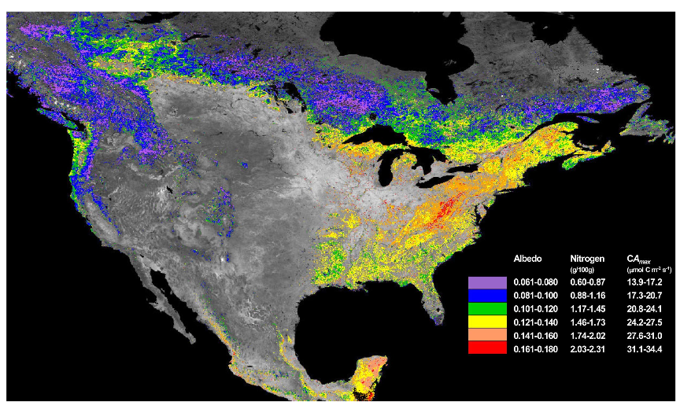
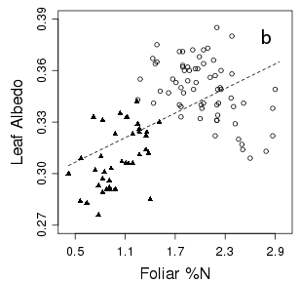
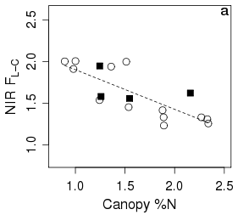
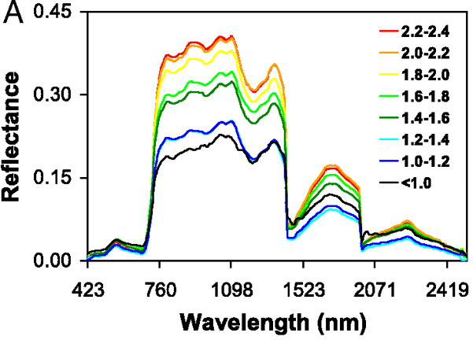
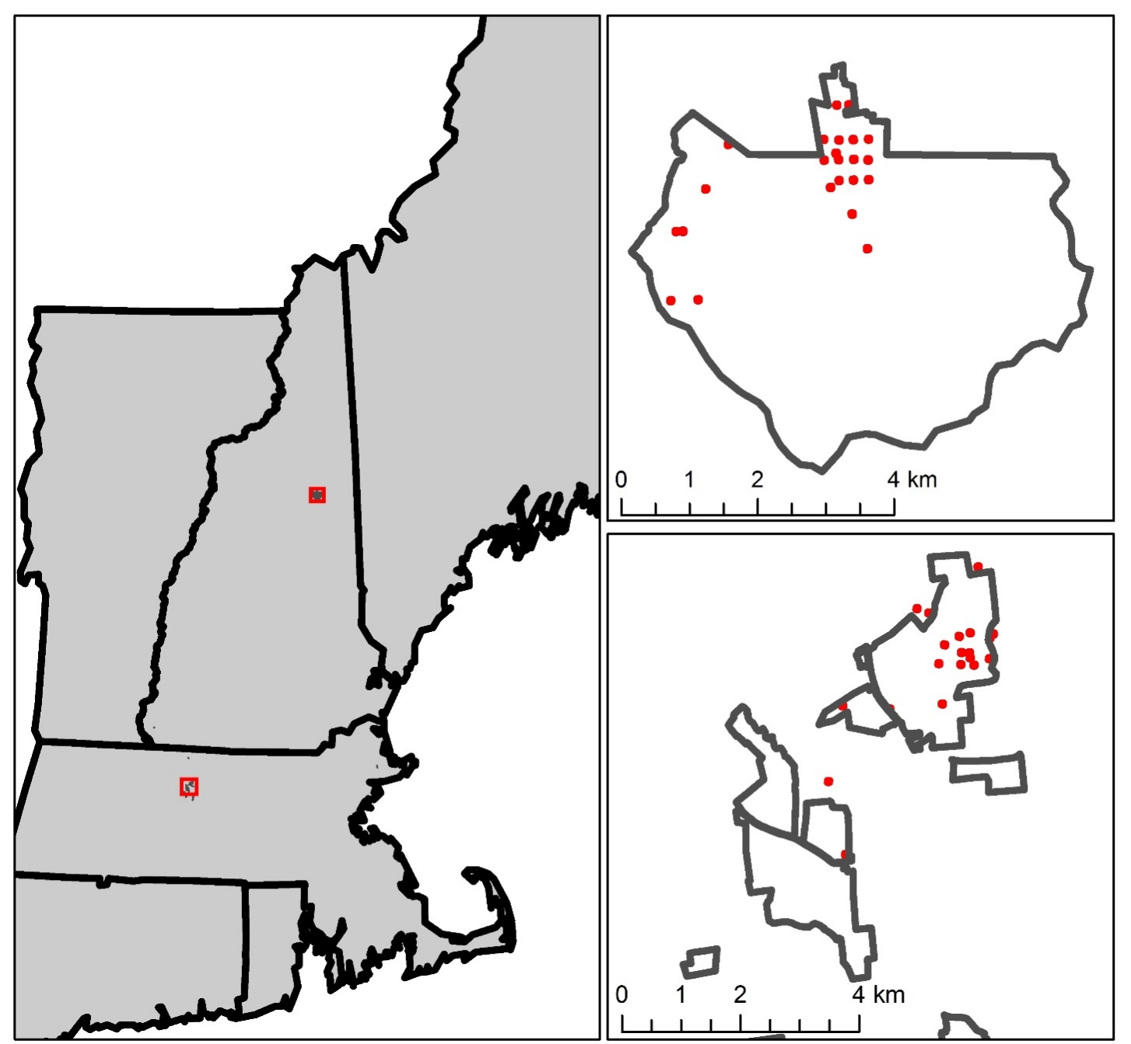
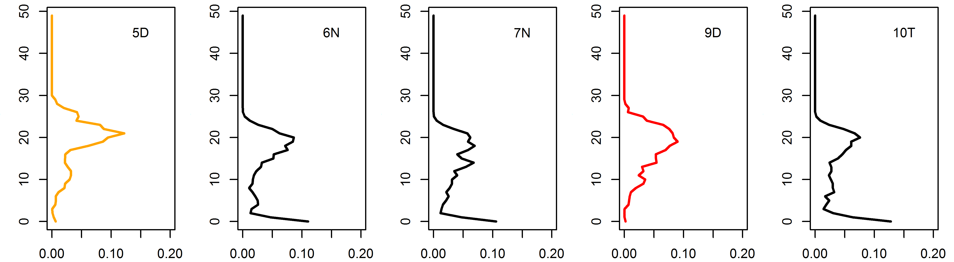
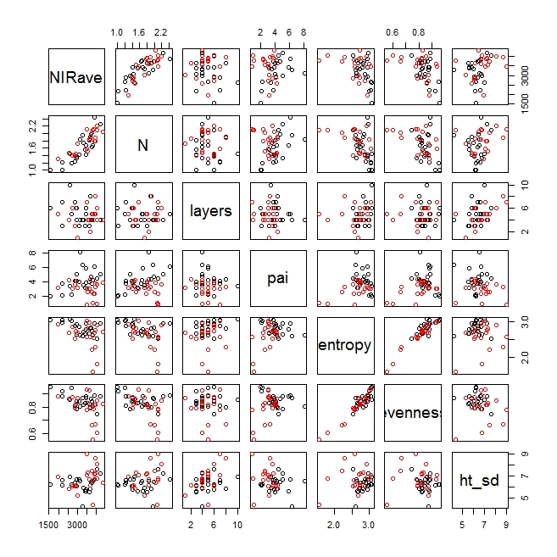
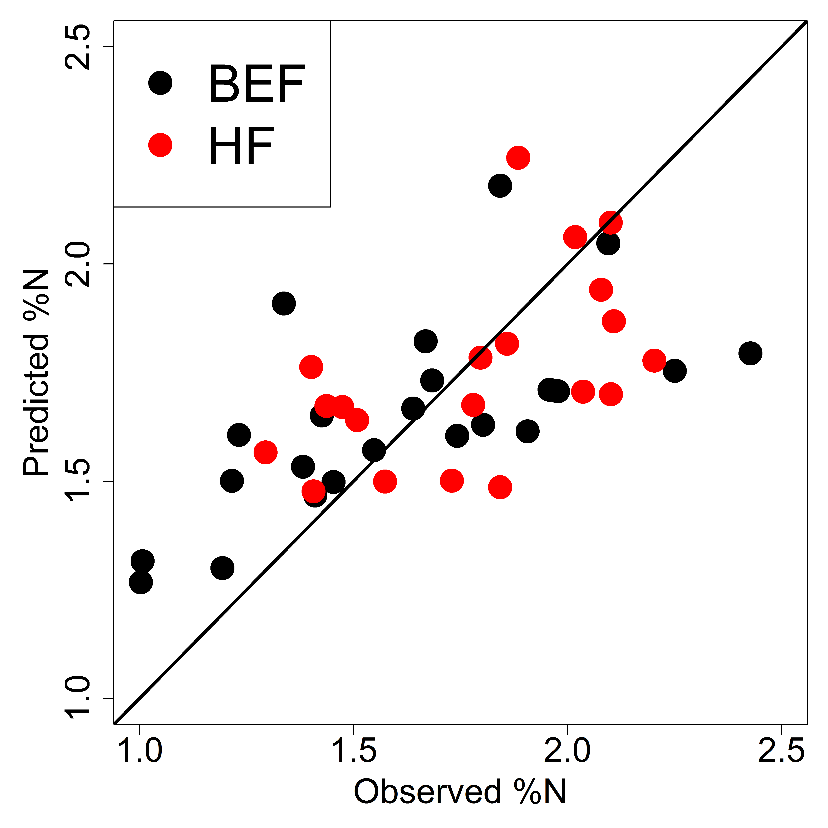
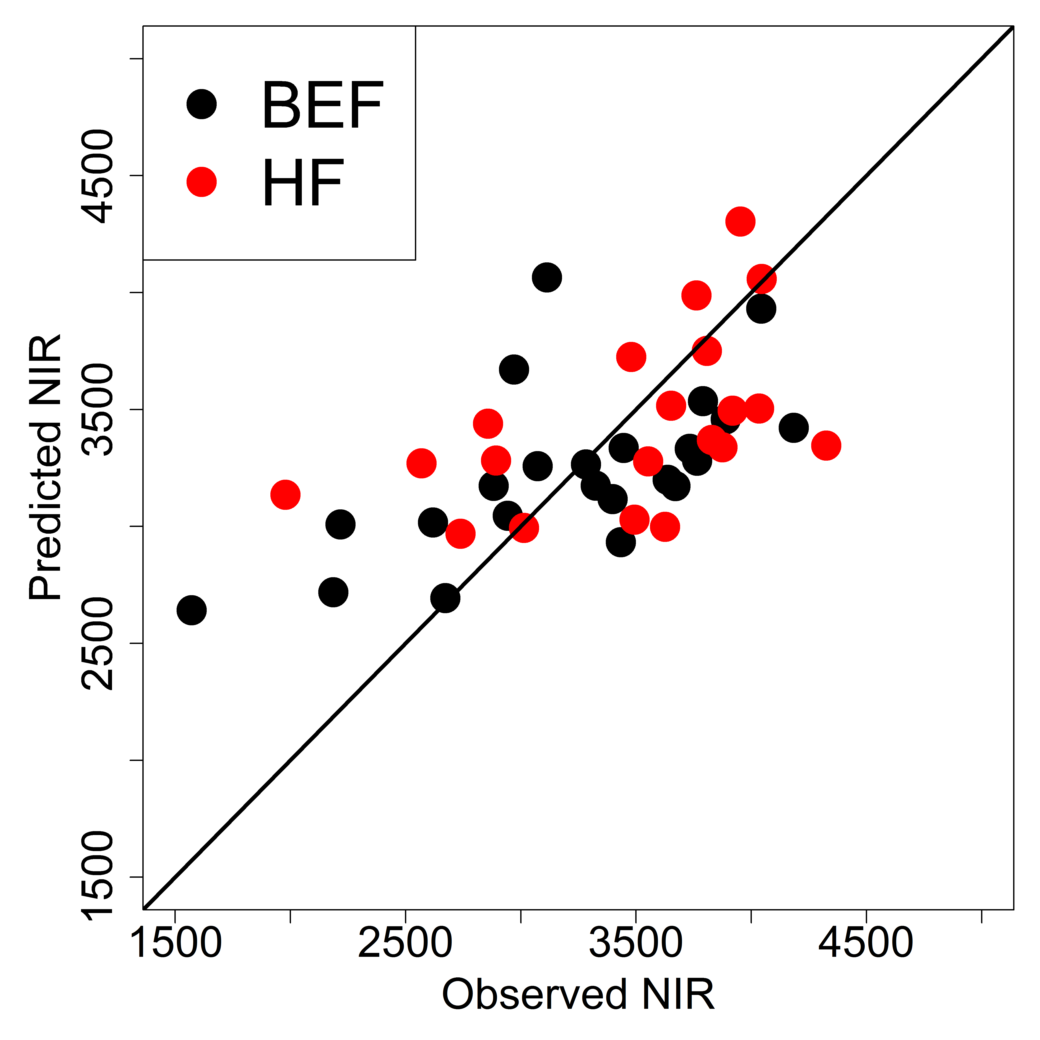
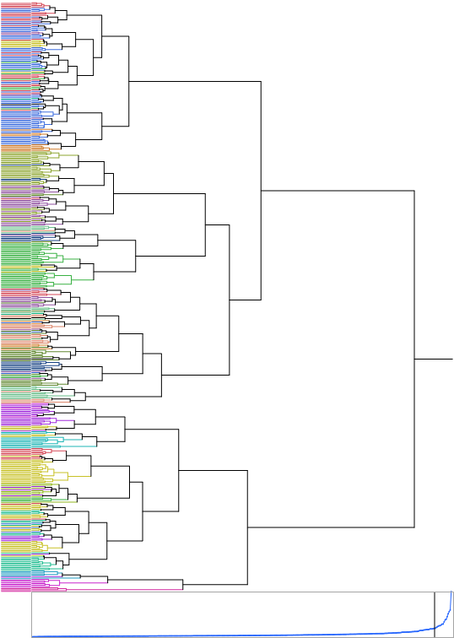
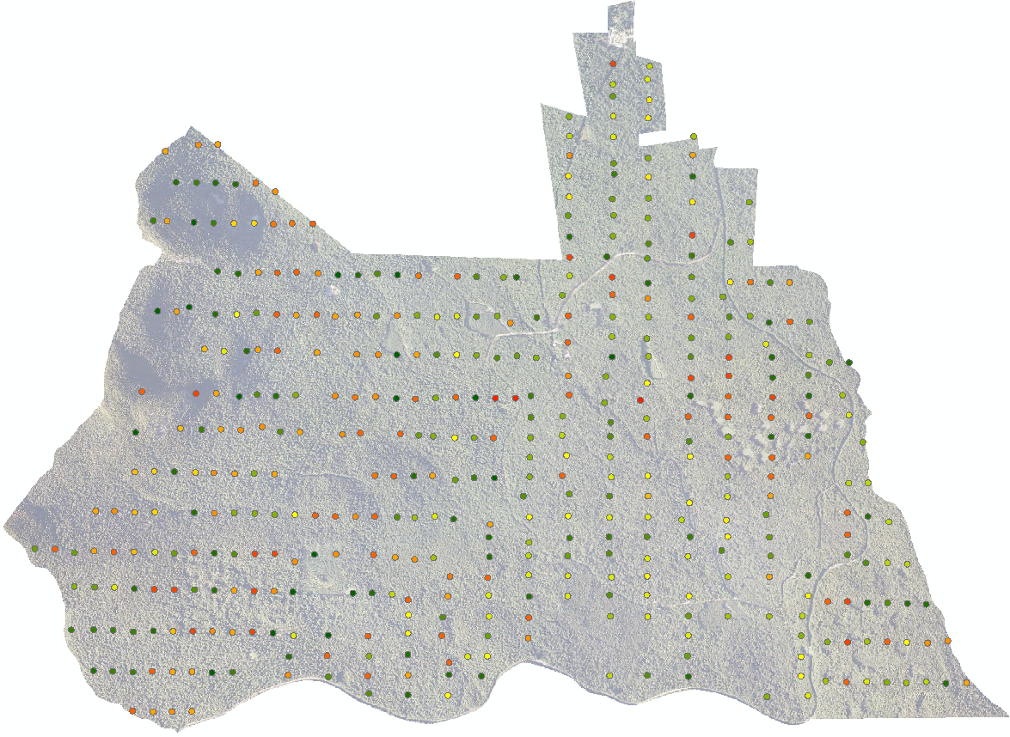
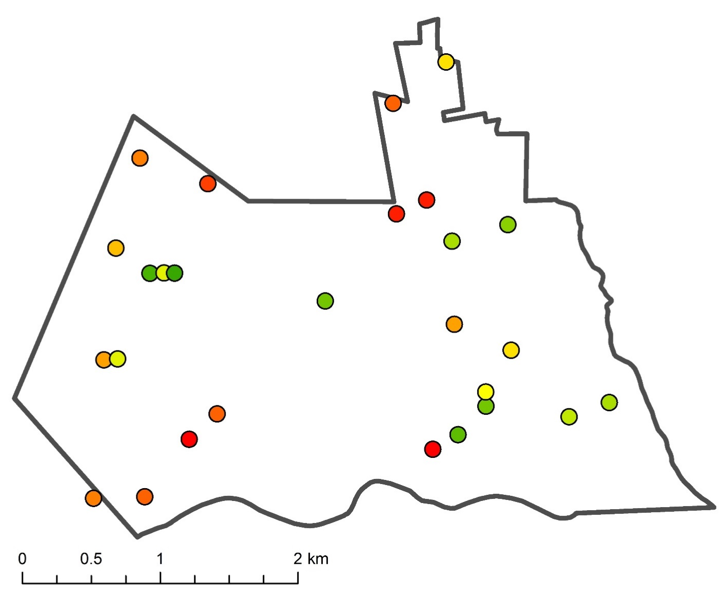
Exploring the influence of canopy structure on the link between canopy nitrogen concentration and near-infrared reflectance using airborne LiDAR
Franklin B Sullivan, Scott V Ollinger, Michael W Palace, Andrew Ouimette, Rebecca Sanders-DeMott, and Lucie C Lepine
Earth Systems Research Center, Institute for Earth, Oceans, and Space, University of New Hampshire
Contact: franklin.sullivan@unh.edu; Tel.: +01-603-862-4035
Abstract: The correlation between near-infrared reflectance and canopy nitrogen concentration has been repeatedly demonstrated at varying scales and using a range of sensors on airborne and satellite platforms. Although the mechanisms at play are not fully understood, the relationship is hypothesized to be a result of optimal growth strategies that link plant form and function, leading to covariation of canopy nitrogen with canopy structure. In this study, we used airborne lidar data to explore interrelationships between canopy nitrogen concentration, near-infrared reflectance, and canopy structure on 43 plots at Bartlett Experimental Forest in the White Mountain National Forest, New Hampshire, and Harvard Forest in Petersham, Massachusetts. Over each plot, we developed a 1-meter resolution vegetation profile and a 1-meter resolution canopy height model. From vegetation profiles and canopy height models, we calculated a set of metrics describing the plot-level variability, breadth, depth, and arrangement of lidar returns: (1) number of canopy layers, (2) plant area index, (3) entropy, (4) evenness, and (5) standard deviation of heights. This combination of metrics was used in order to describe both vertical and horizontal variation in structure. We assessed relationships between structural metrics, near-infrared reflectance and canopy nitrogen concentration using multiple linear regression in R. Consistent with the hypothesis, we found moderately strong relationships between both near-infrared reflectance and canopy nitrogen concentration with lidar-derived structural metrics (nitrogen: r²=0.4, p<0.001; nir: r²=0.34, p<0.001). For both relationships, three variables were included in regression models: plant area index, entropy, and standard deviation of heights, accounting for canopy structure variability in both the vertical and horizontal dimensions. While the results of this study support our hypothesis, the variables we used describe only plot-level characteristics of canopy structure. We suspect that finer scale structural characteristics could account for additional variability in relationships.
Keywords: canopy height metrics; structural variability; multiple scattering
Sullivan et al. 2013 found that two structural variables, a clumping index and canopy leaf bulk density, were important drivers of NIR reflectance. While both leaf and canopy reflectance scale positively with nitrogen content, the extent to which leaf and canopy reflectance differ within a pixel/plot varies with canopy nitrogen content (i.e. in high nitrogen canopies, canopy reflectance appears more tightly coupled with leaf effects, near 1:1 ratio, while in low nitrogen canopies, canopy reflectance is influenced to a greater extent by coarser scale characteristics, 2:1 ratio). This observation has guided our investigation into the effects of structure on the relationship between canopy nitrogen and NIR reflectance.
Motivation
Ollinger et al. 2008 observed relationships between canopy nitrogen, carbon assimilation, and reflectance at the landscape scale
At the scale of whole canopies, reflectance patterns represent the integrated effects of leaf water content, biochemical constituents and various components of plant structure, often influenced by presence of multiple species and functional groups.
canopy structure moderating effects of N-NIR:
Ollinger 2011 presented the hypothesis that the canopy nitrogen-reflectance relationship is biologically-driven, a result of the convergent evolution of tree properties that also influence reflectance.
Study Sites:
Lidar Structural Metrics:
Approach
Data:
Field estimates of canopy nitrogen for a total of 43 plots distributed across two forest sites in New England were used to develop PLS regression-based equations to estimate canopy nitrogen using optical remote sensing data. The optical remote sensing data were collected in 2003 by Airborne Visible/Infrared Imaging Spectrometer (AVIRIS). For this preliminary investigation, we made the assumption that canopy nitrogen content does not change considerably year-to-year. In addition, we calculated a suite of structural metrics using airborne lidar collected on board the NEON AOP during the summer of 2014. Within the extent of each of the 43 32 m x 32 m plots, we used all lidar returns to calculate vegetation profiles and we clipped canopy height models. All variables calculated are coarser resolution than leaves (i.e. measured at plot scale) and calculated from lidar data
Bartlett Experimental Forest
Harvard Forest
Above: Lidar vegetation profiles for five plots at Bartlett Experiment Forest. From vegetation profiles and canopy height models, we calculated five variables: (1) number of layers, estimated by a local maximum count; (2) Plant Area Index (-ln(gap fraction)); (3) entropy of height classes (Shannon’s diversity index); (4) evenness of height classes; and (5) standard deviation of heights in the canopy height model. We performed a stepwise multiple regression using these variables to evaluate the relationship of canopy structure with canopy nitrogen content and with canopy near-infrared reflectance.
Below: Observed vs predicted plots from stepwise AIC multiple regression analysis performed in R. We found significant empirical relationships for both canopy nitrogen concentration (r²=0.4) and NIR reflectance (r²=0.35) using three of the five lidar-derived structural metrics: PAI, entropy, canopy height standard deviation.
Results
Left: Scatter plots showing relationships between mean NIR reflectance, canopy nitrogen concentration, and lidar metrics. Canopy nitrogen and NIR reflectance are highly positively correlated (r=0.84), while both are moderately correlated with entropy (r=-0.42, r=-0.45), evenness (r=-0.46, r=-0.44) and standard deviation of canopy heights (r=0.24, r=0.22), with autocorrelation between entropy and evenness, and weaker correlations among other metrics.
NIR
reflectance
N
no. layers
PAI
Above and left:
Vegetation profiles for plots at Bartlett (top) and Harvard Forest (bottom) arranged by canopy %N, exhibiting structural variation between and within ranges of %N.
entropy
evenness
CHM height SD
Canopy %N = 2.29 +
0.09*PAI –
0.68*entropy + 0.13*SD
NIR refl = 42.8
+ 1.38*PAI – 11.4*entropy
+ 2.5*SD
Conclusions
Canopy nitrogen and NIR reflectance are highly correlated and their variation can be partially explained by select lidar-derived plot level structural metrics
It is likely that finer scale structural characteristics may explain additional variation in observed NIR and canopy nitrogen relationships
Continuing Work
Left: Guided by the cluster analysis, we semi-randomly selected 30 plots at Bartlett Experimental Forest for an intensive field sampling campaign in summer 2017 intended to temporally align with NEON AOP data. Plots were selected based on accessibility and to leverage existing field data. We successfully sampled at least one plot from each of seventeen clusters gleaned from the cluster analysis.
Building on our hypothesis that finer scale structural characteristics could account for additional variability, our field campaign consisted of leaf- and plot-scale measurements of leaf and crown characteristics. We measured reflectance, %N, leaf size, leaf mass per area, leaf area index, photosynthesis. More on these results at AGU Tuesday 12/12, 5:15pm Paper #B24C-06
Above: Following the results of multiple regression analysis, we calculated PAI, entropy, and standard deviation of canopy heights for the Bartlett Experimental Forest inventory plot network, in total 435 plots. We conducted a cluster analysis using these three variables, species diversity, percent conifer, and albedo calculated from 2012 SpecTIR data, resulting in eighteen distinct clusters.
Acknowledgements
This research was supported by NASA New Investigators in Earth Science (NNX10AQ82G), NASA Terrestrial Ecology (NNX08AL29G), NASA IDS (NNX14AD31G), and NSF Macrosystems (NSF Grant #1638688).

