Slide 1
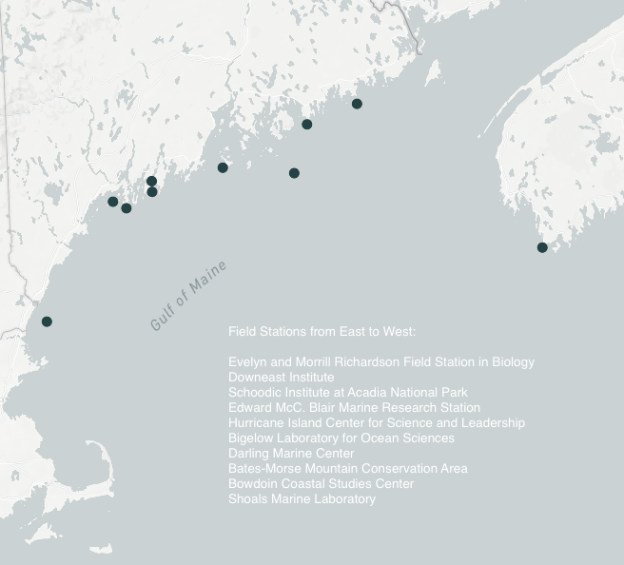
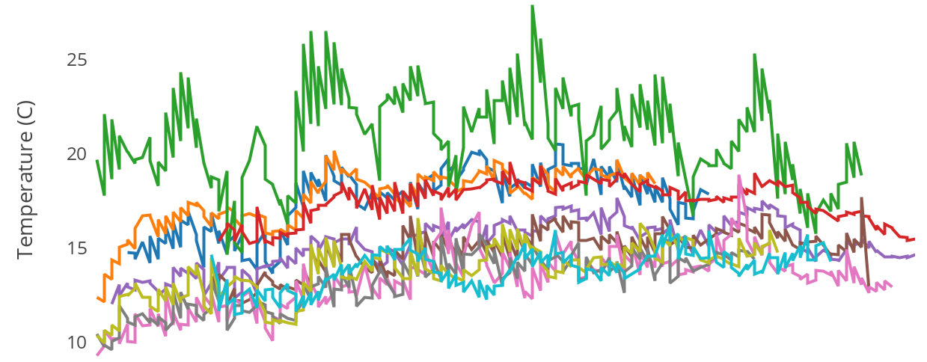
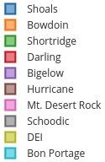
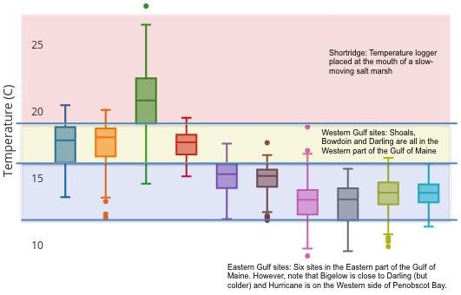
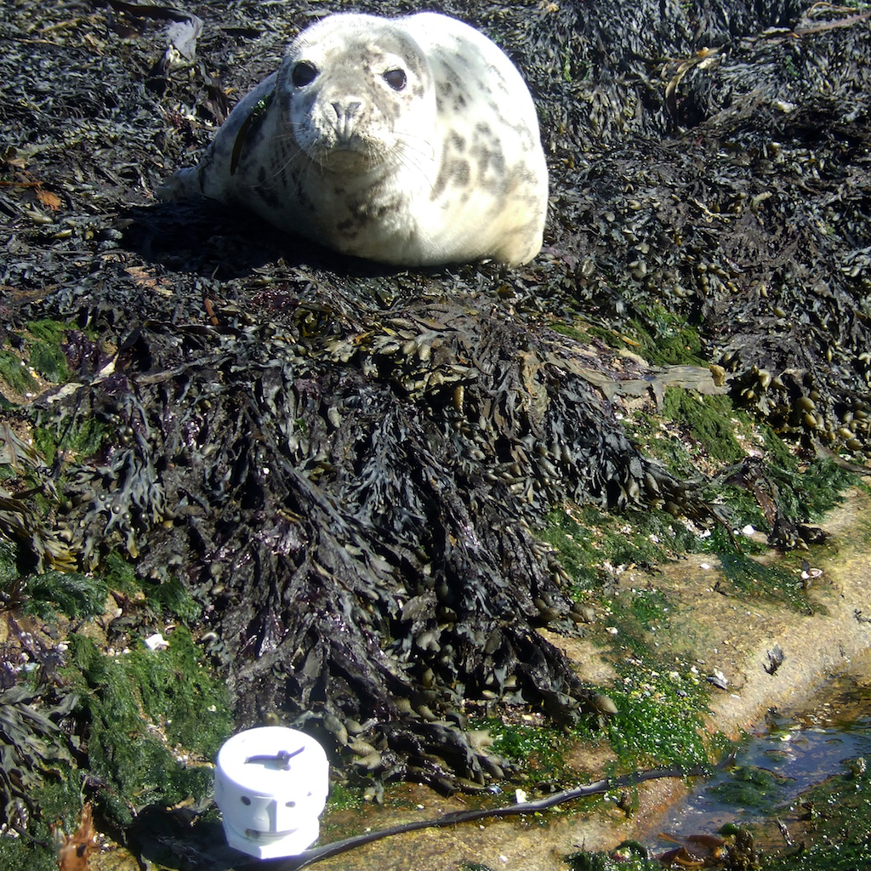
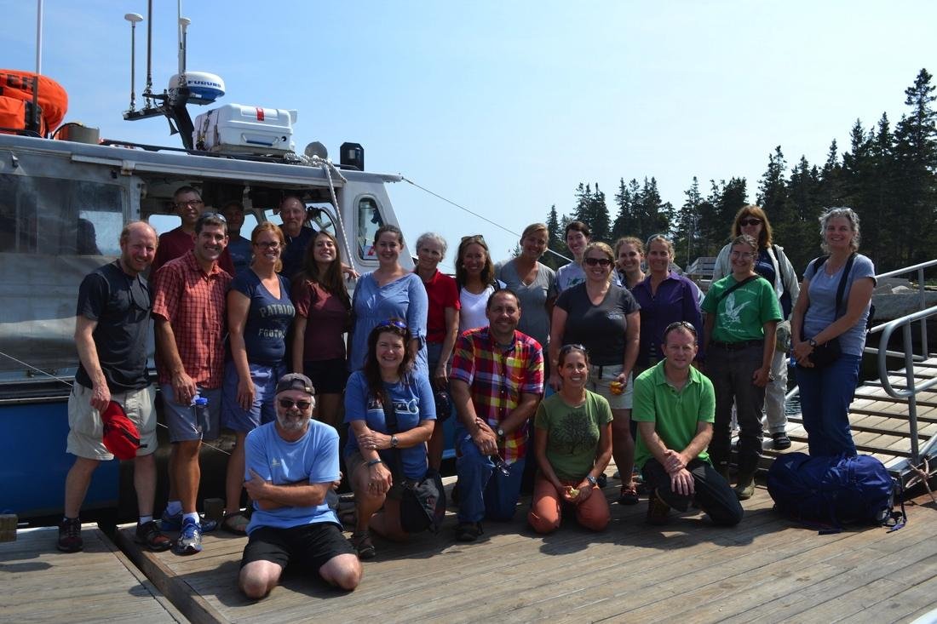
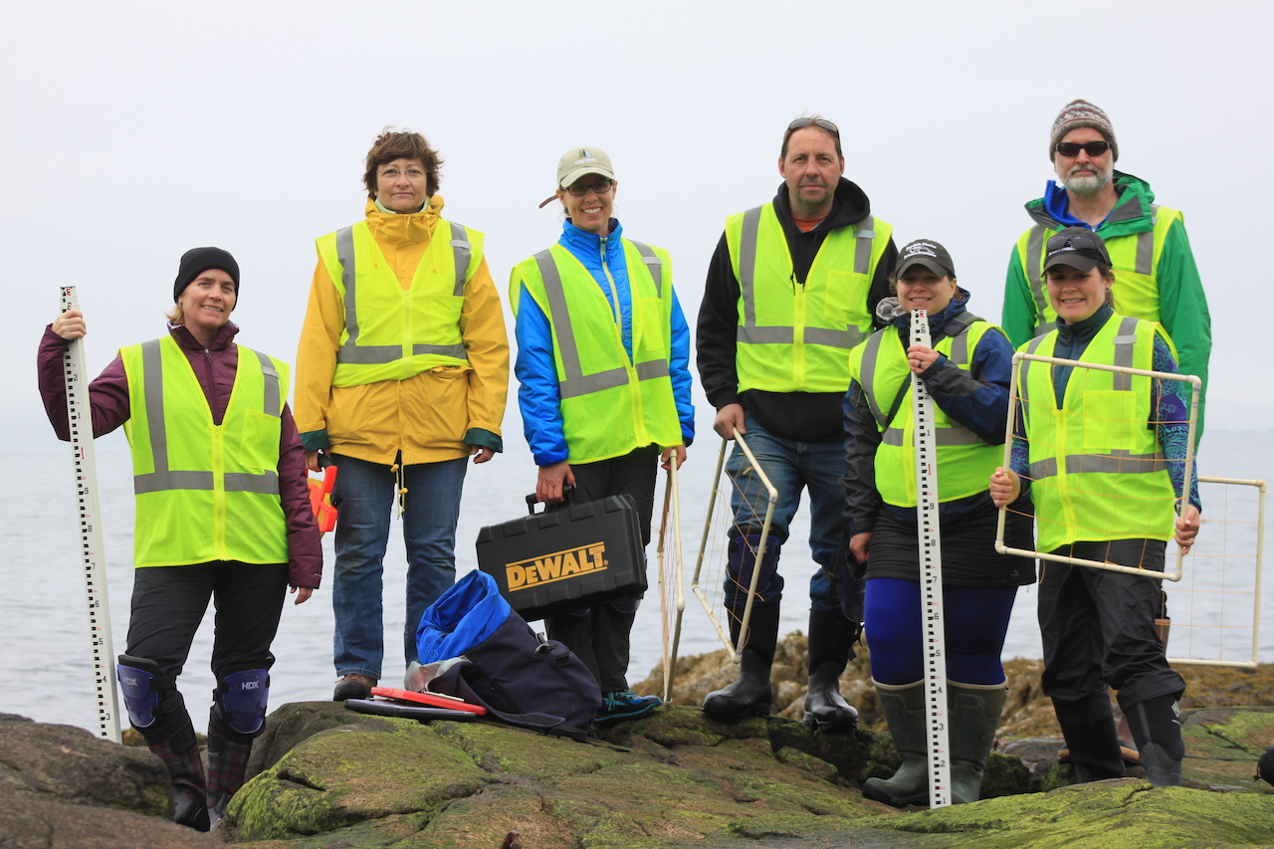
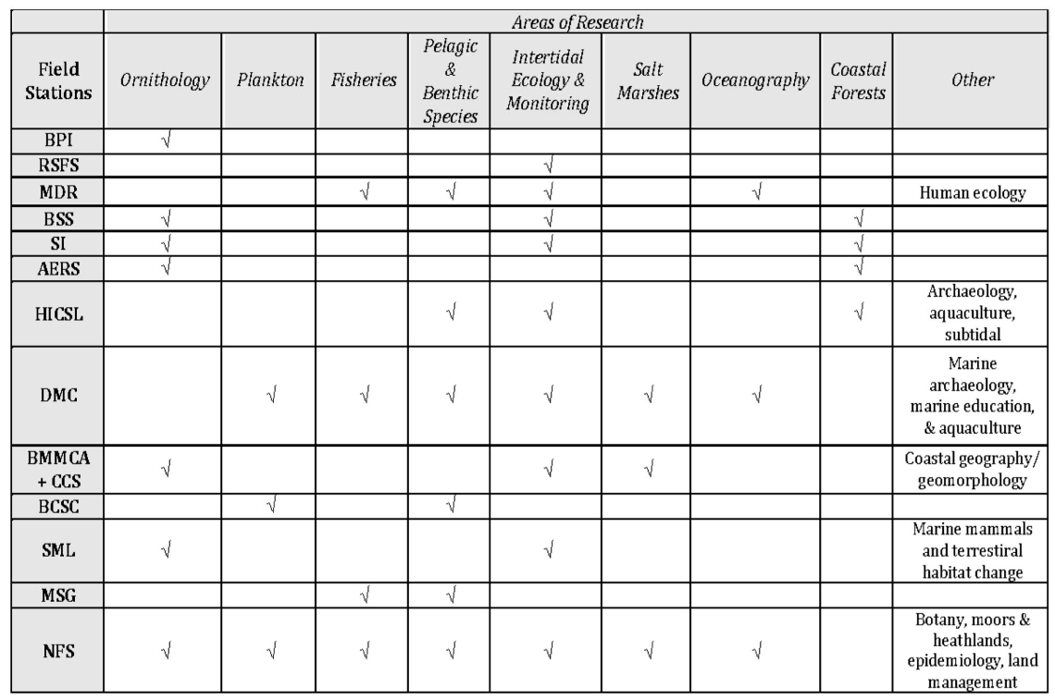
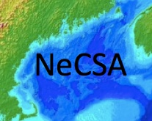
Networking across the Gulf of Maine: from the bottom up
Dr. Jennifer Seavey, Shoals Marine Lab, University of New Hampshire & Cornell University, Durham, NH; Hannah Webber, Schoodic Institute, Winter Harbor, ME; Dr. Laura Sewall, Bates Morse Mountain Conservation Area and Coastal Center at Shortridge, Bates College, Phippsburg, ME; Caitlin Cleaver, Hurricane Island Center for Science and Leadership, Rockland, ME
What is NeCSA
The Northeastern Coastal Stations Alliance (NeCSA) was formed to investigate and document environmental change across the Gulf of Maine (Figure 1). Member stations:
Support and conduct field-based, coordinated and transdisciplinary research;
Commit to collecting long-term environmental data; and,
Train students of all ages.
Mission
To gain an ecosystem scale understanding of the nearshore Gulf of Maine in the context of climate change, and to translate this knowledge to the public.
Testing our ability to implement coordinated research, and iterating...
Year 1. Test coordinated data collection and management with water temperature.
Year 2. Develop shared protocols for biota. Provide training for rocky intertidal monitoring. Gather observations and get data.
Field Stations from East to West:
Evelyn and Morrill Richardson Field Station in Biology
Downeast Institute
Schoodic Institute at Acadia National Park
Edward McC. Blair Marine Research Station
Hurricane Island Center for Science and Leadership
Bigelow Laboratory of Ocean Sciences
Darling Marine Center
Bates-Morse Mountain Conservation Area
Bowdoin Coastal Studies Center
Shoals Marine Laboratory
Figure 1. Member stations spanning from Appledore Island on the ME/ NH border to Bon Portage Island in Nova Scotia, Canada collected temperature data in 2016.
Gaps and synergies across stations
Discussion focused on research/monitoring gaps & synergies (Table 1)
Prioritized action based on feasibility & common ground
Lessons learned
Focus on initiatives that are enhanced by combined efforts
Start small and grow organically
Find what people are passionate about and let them lead that area of work
Recognize the importance of data management and staffing for coordination
Celebrate the successes and learn from the setbacks
What’s next?
November meeting to discuss rocky intertidal data
Establish web presence
Solve data management question
Maintain communications
Find small and large funding sources
First NeCSA meeting on Hurricane Island in 2015.
What can you do better together than alone?
Increase and attract intellectual capital
Pool and attract resources
Work on an ecologically meaningful scale
Building a community
Meeting in-person and at different facilities allowed for team building and to learn from how other stations operate
Making a plan: jump in, reassess, and adapt
Initial meetings focused on developing a shared vision & potential network activities
Table 1. NeCSA member stations are listed in geographic order from north to south with identified monitoring/research programs.

