Slide 1



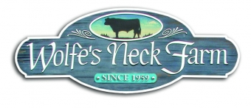
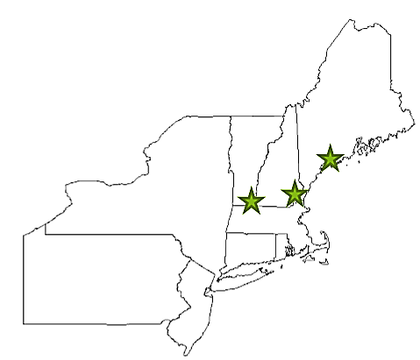
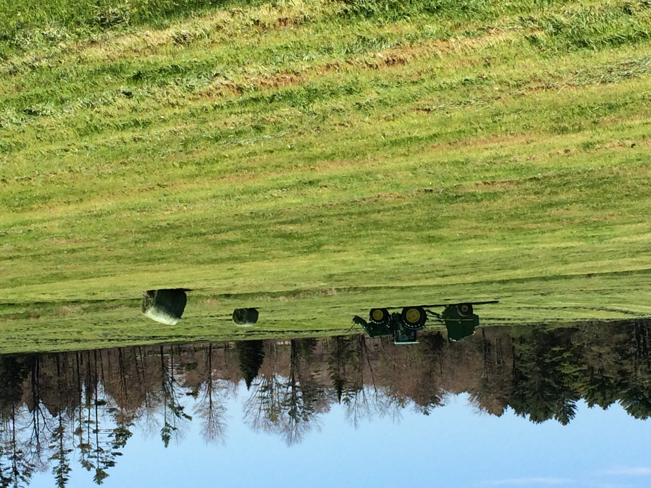
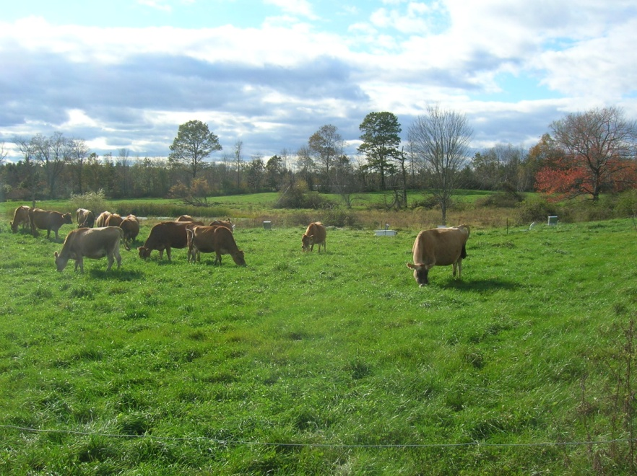
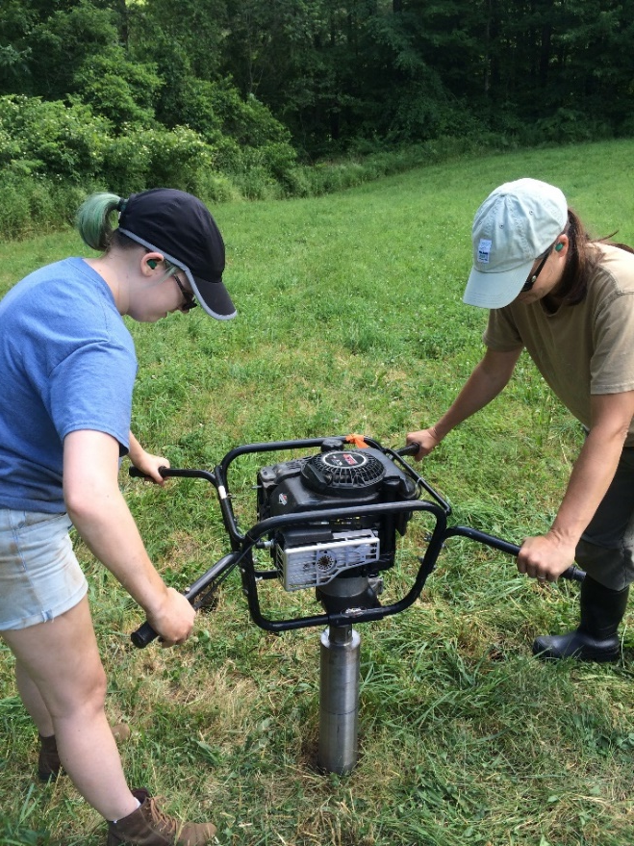
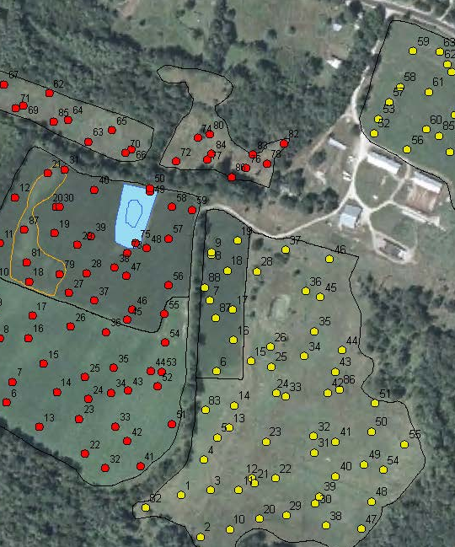
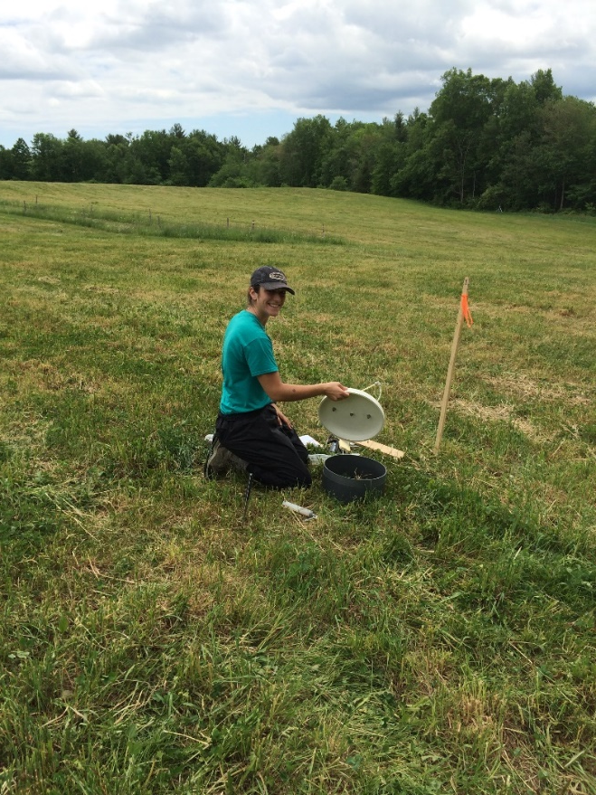
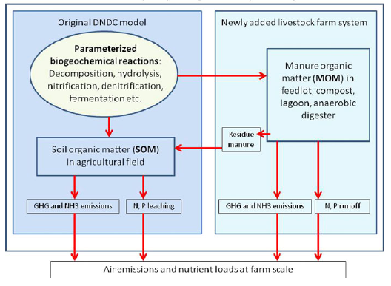
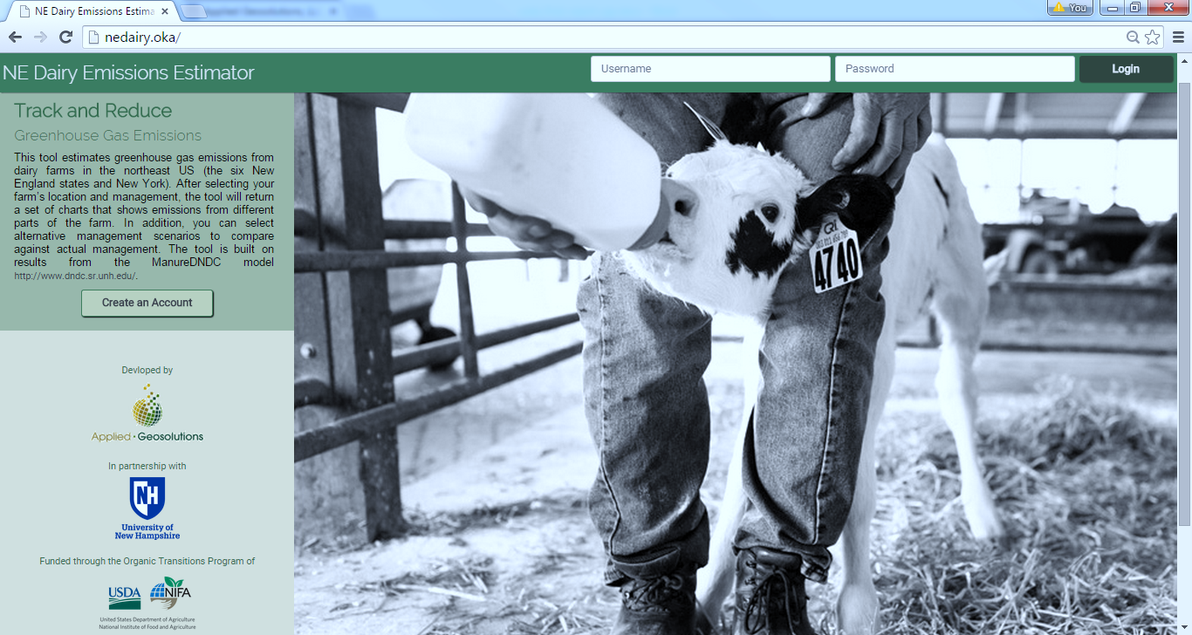
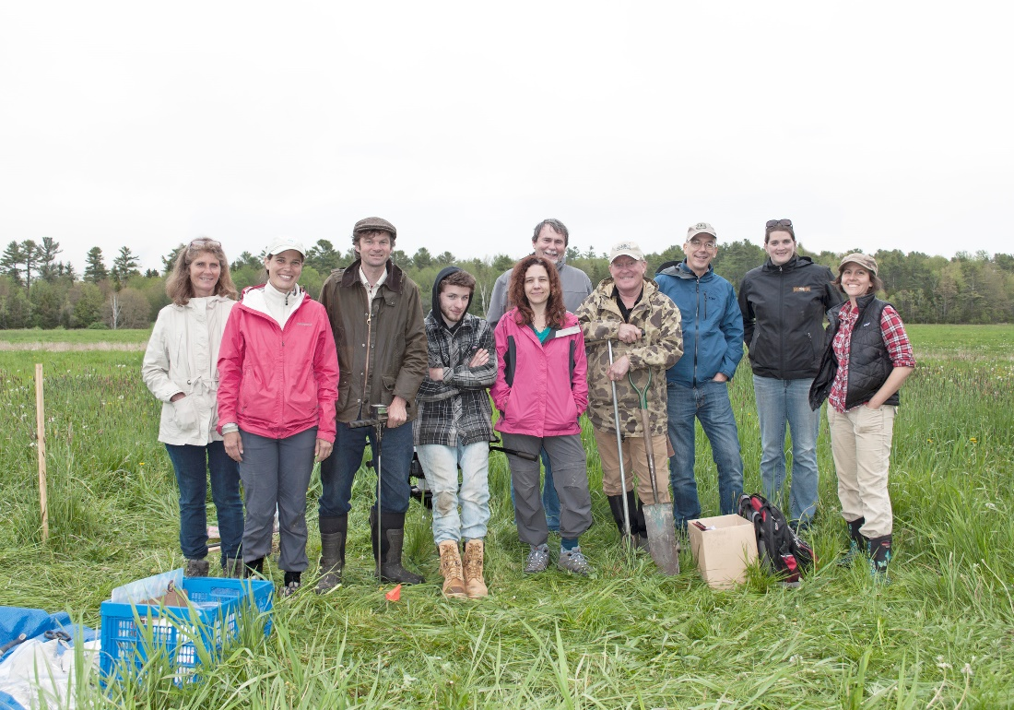
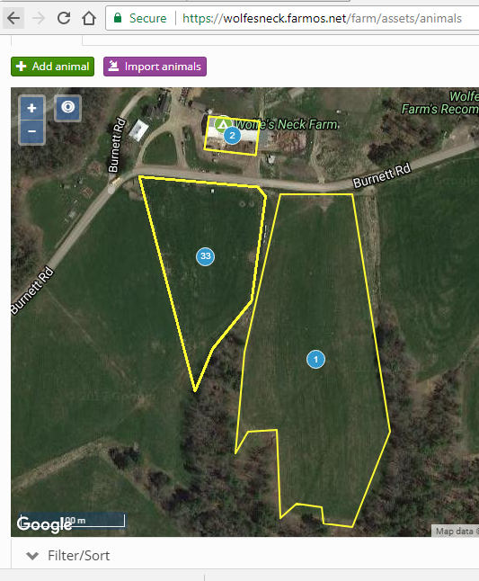
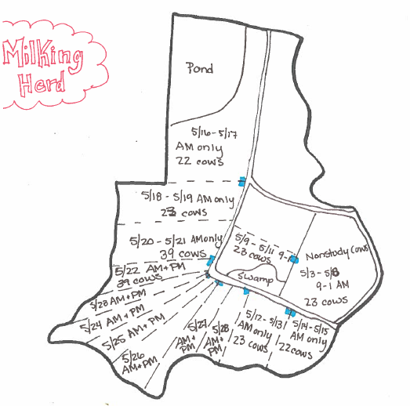
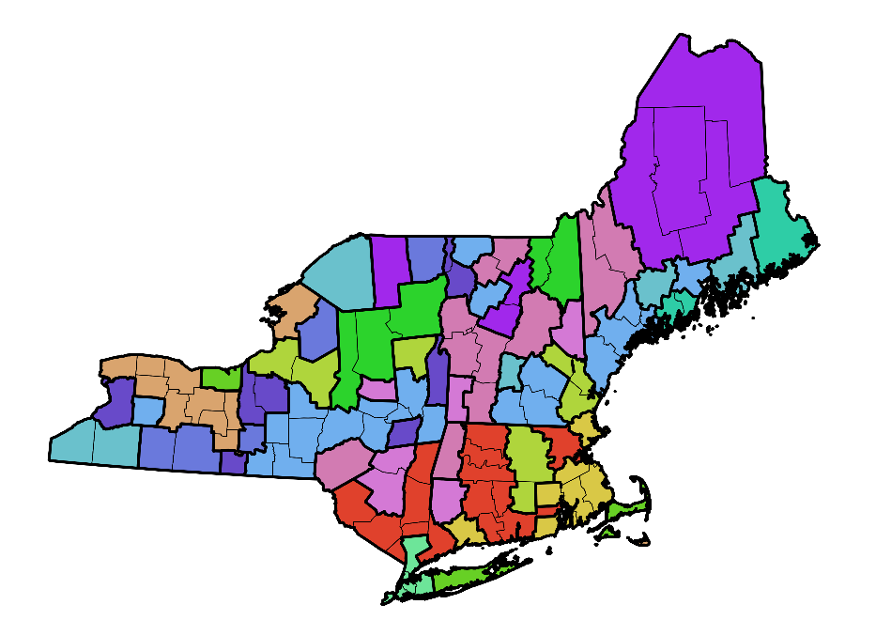
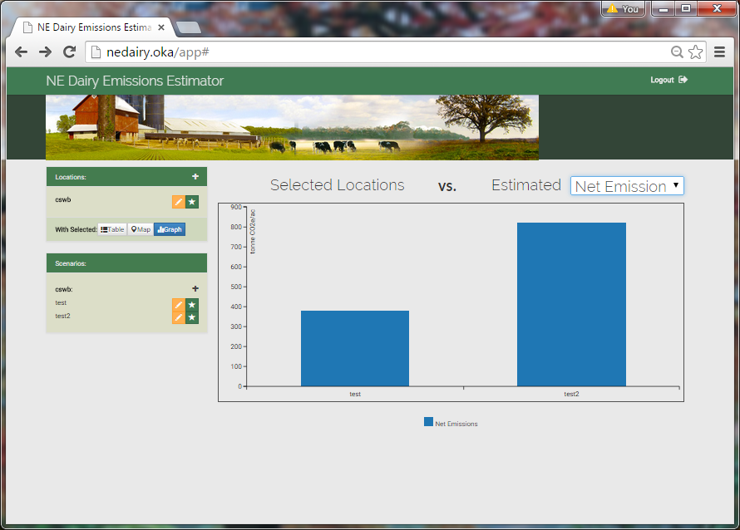
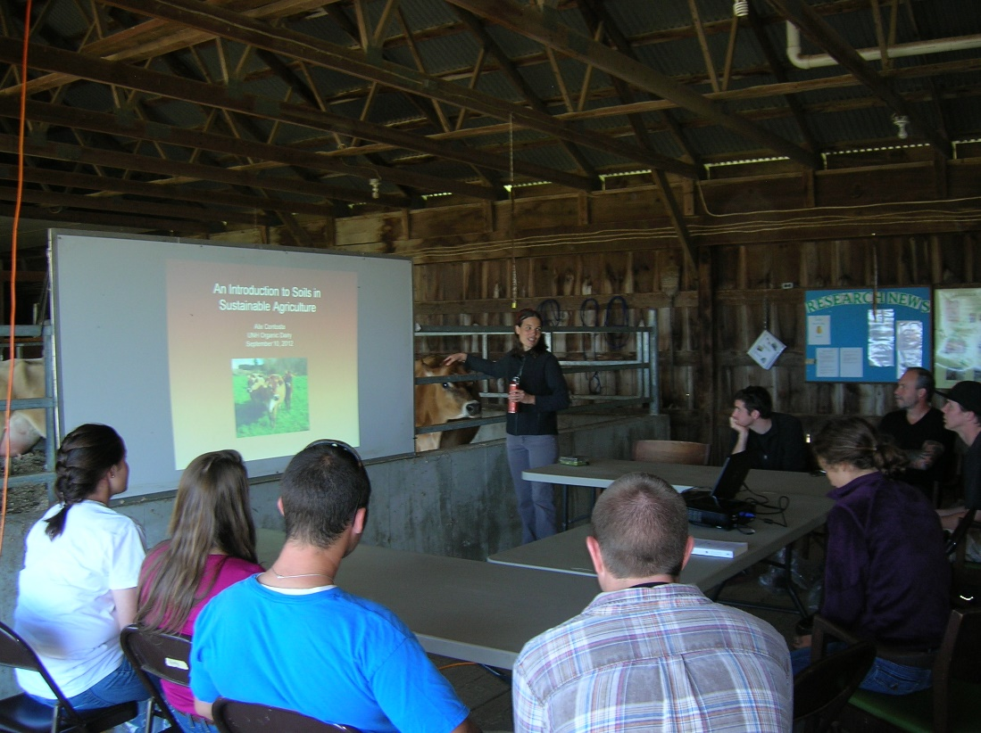
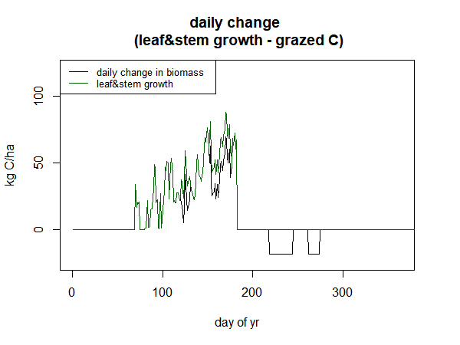
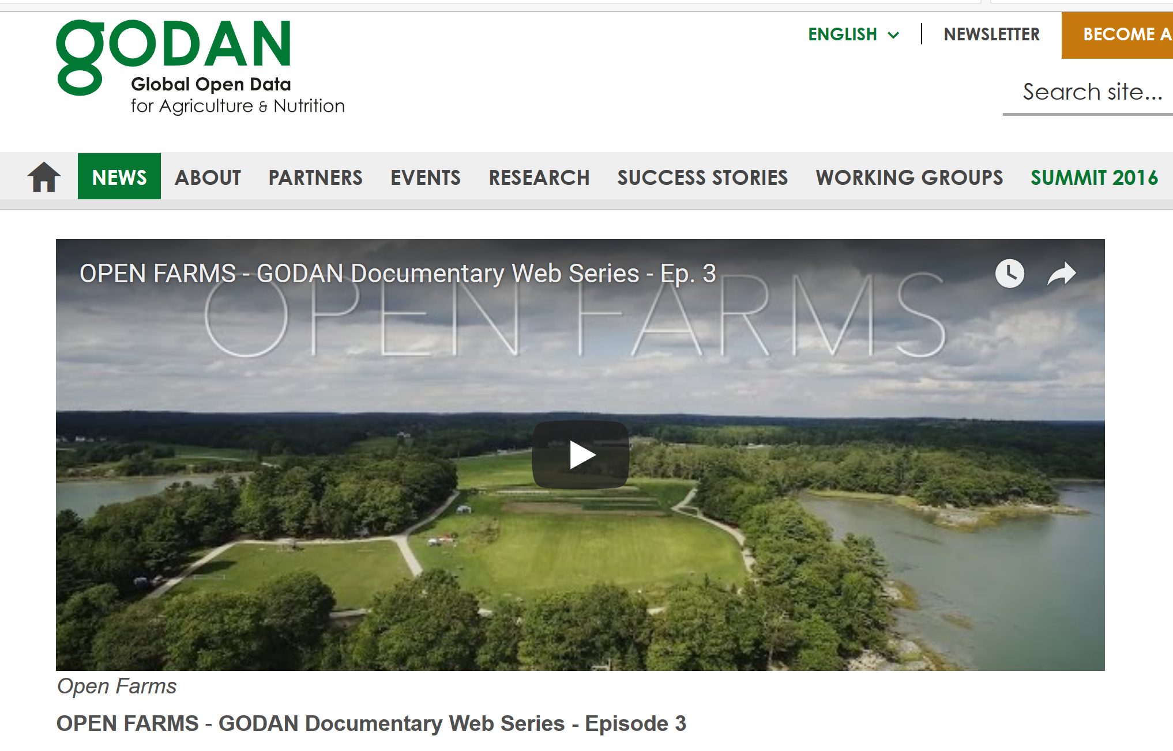
Tradeoffs Between Soil Carbon Sequestration and Greenhouse Gas Emissions in Grazed Pastures of Northeastern US Organic Dairy Farms
Alexandra Contosta¹, Ruth K. Varner¹, Stuart Grandy², Eleanor Campbell¹
¹Institute for the Study of Earth, Oceans and Space, ²Department of Natural Resources and the Environment, University of New Hampshire
Goal 1: advance scientific understanding of tradeoffs among forage production, soil carbon (C) storage, and soil greenhouse gas (GHG) losses in pastures managed for hay (left) or management intensive grazing (right).
Activity 1: Measure soil carbon stabilization and greenhouse gas emissions and their drivers
Figure 1. Samples obtained from three farms in different
stages of transition to organic.
(a) Total Seasonal N₂O flux
(b) Total Seasonal CO₂ flux
(c) Carbon Mineralization
g N₂O-N m⁻² season⁻¹
g CO₂-C m⁻² season⁻¹
mg CO₂-C g⁻¹ soil
Figure 2. Soil cores collected to 50 cm in two grazed fields and two hayed fields per farm and analyzed for total C.
24 Years
10 Years
1 Year
24 Years
10 Years
1 Year
24 Years
10 Years
1 Year
Figure 5. Total seasonal GHG fluxes measured in the field did not vary with pasture management. However, a lab incubation under optimal conditions showed that soil C mineralization was higher in fields managed for hay.
Goal 2 : use scientific understanding to provide decision-support tools to farmers and industry.
Figure 6. An intensive resampling campaign at one of our sites may illuminate spatiotemporal changes in soil C and N with management.
Figure 3. Forage biomass and GHG fluxes sampled weekly in the same areas as soil collection.
Activity 2: Simulate soil carbon and greenhouse gas dynamics with grazing
Figure 4. Soil C and N stocks vary more among farms than with management
Figure 7. We are using the Manure-DNDC model to simulate the manure life-cycle across farm facilities and biogeochemical processes in pasture areas.
Activity 3: Update the Northeast Dairy Emissions Estimator
Activity 4: Disseminate Research Findings Through
Figure 10. The Northeast Dairy Emissions Estimator uses a meta-model based on DNDC to simulate farm-level emissions.
Research and Education on a field day for NRCS soil conservationists, directors of the USDA Northeast Climate Hub, American Farmland Trust, and Wolfe’s Neck Farm staff
Figure 8. Cows move across a heterogeneous field through a variety of climatic conditions, and record keeping of these movements varies.
Archetype
Medium
Large
Half grazing
Full grazing
Rotational grazing
Management
Head
Feed rate
Floor
Manure
Cropping
Grazing
Professional Development with a summer institute of Earth science teachers for developing novel, hands-on curricula involving soils and sustainable agriculture.
Figure 9. Another challenge is that the model does a poor job simulating plant productivity and regrowth under high stocking rates.
Figure 11. Inputs include archetypal farms, climate and soils data aggregated into county clusters, and a variety of management practices. Users can estimate farm GHG emissions under different scenarios. The updated tool will include rotational grazing as one of the archetypes and scenarios of grazing management.
A Short Film on Open Data featuring our collaboration with open source agro-ecological monitoring to inform decision-support.

