Slide 1

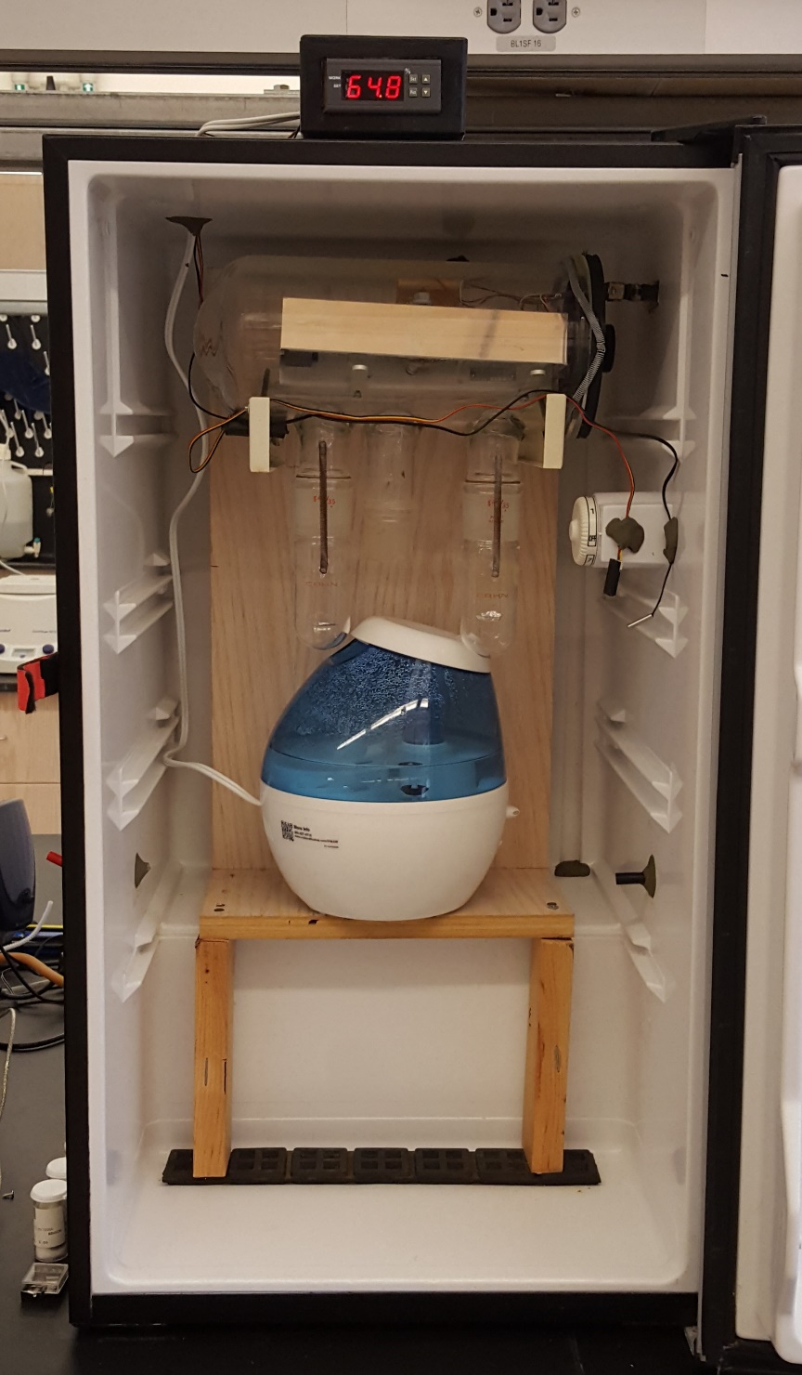
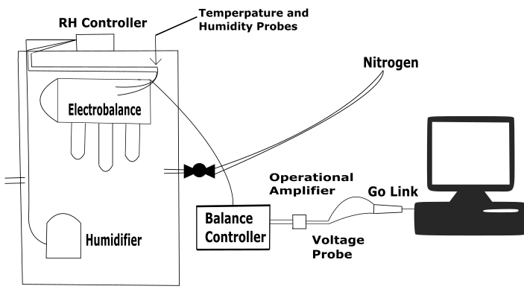

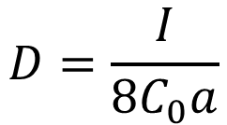
The Evaporation or Growth Rates of Dicarboxylic Acid
Solution Droplets as a Function of Relative Humidity
Jackson Kaspari and Margaret E. Greenslade
University of New Hampshire Chemical Engineering and Chemistry Departments
Durham, NH, 03824
Introduction
EVAP-HC
Discussion
Aerosols are a fundamental component of Earth’s climate system.
The energy balance of the atmosphere is impacted directly by how aerosols scatter and absorb incoming solar radiation and indirectly by how they modify cloud formation.
The evaporation and growth of malonic and glutaric acid are linearly related to RH.
The DRH predicted for glutaric acid was 91±3%. This matches the DRH determined by Parsons et al. for a glutaric acid solution droplet of a similar size at the same temperature of 20°C.⁶
The DRH predicted for malonic acid was 83±3%, which falls above but close to the modelled DRH of 79% reported by Clegg et al. at 25 °C.⁷
Malonic and glutaric acid diffusion rates are inversely proportional to RH.
With current concentrations, glutaric acid showed consistently higher rates of diffusion when compared to malonic acid at the same RHs using the RITP model.
Using derivative analysis of the TGA results, the amount of dicarboxylic acid loss is correlated to the time the acid spends as solution droplet at RHs under the DRH.
Influences on the direct and indirect aerosol radiative effect, include, but are not limited to, particle size, shape and complex refractive index.
The organic fraction of aerosols is typically 30-50% depending on location, but can be as much as 90% of a sample.¹
Malonic acid (C₃H₄O₄) and glutaric acid (C₅H₈O₄) are water soluble organic compounds (WSOCs), which are crucial components of the organic fraction, and are frequently observed in ambient aerosols.²
DRH Predictions
DRH is determined by setting the change in weight percent over time (y term) of the linear fit equal to zero which yields the RH (x term) where evaporation transitions to growth.
Future Work
http://environment.nationalgeographic.com/wallpaper/environment/photos/urban-threats/los-angeles-smog/
When a particle containing WSOCs reaches a certain relative humidity (RH), the particle takes up water and becomes a solution droplet. This transition is known as the deliquescence relative humidity (DRH).
Repeat malonic and glutaric acid evaporation and growth experiments using fixed 7.2 M solutions to better compare experimental diffusion coefficients and confirm current DRH predictions.
Perform more trials above the DRHs to examine acid evaporation in these regions.
Expand study to oxalic and succinic acid which are a similar molecular size, but much less hydrophilic dicarboxylic acids.
A few studies have noted evaporation of dicarboxylic acids at high RH may be the source of some of unexpected results.^{3,4}
Diffusion coefficients describe the level and mechanics of acid the significant role RH plays.
Goal: Understand the evaporation or growth of dicarboxylic acids in water as a function of RH by studying the diffusion mechanisms behind evaporation and the DRHs that results in growth.
Acknowledgments
A
B
Dr. Greenslade and the Greenslade group.
Dr. Tillinghast and Dr. Townley for gifting the CAHN 2000 Electrobalance.
Jim Abare from UNH TSC who constructed the operational amplifier.
Dr. Tsavalas and his students for training on and use of the TGA.
Funding from the UNH Hamel Center and CEPS.
Figure 1. Change in weight percent over change in time as a function of RH recorded for t=0 50µL droplets of 41.2wt% glutaric acid (A) and malonic acid (B) in water solutions. R² values of 0.9863 and 0.9912 are obtained for linear fits with slopes equal to 0.0026±0.0001, 0.0023±0.0001 and intercepts of -0.24±0.01 and -0.19±0.01 respectively.
Measurement Technique
References
Malonic and glutaric acid were desiccated to remove any water contamination.
Trials used 50µL of 41.2wt% dicarboxylic acid in water single use solutions.
A custom built Electrobalance with Variable Active Particle Humidity Control (EVAP-HC) allows for the experimental correlation between RH and droplet growth/evaporation by recording mass change over time at a set RH.
Within the EVAP-HC RH was controlled using a humidity controller (AGPtek WH8040) in conjunction with nitrogen gas and a cool mist humidifier.
Output potential from CAHN 2000 Electrobalance, the main component of EVAP-HC, is amplified from millivolt to voltage signal with an operational amplifier. This signal is then read, digitized and written to a computer file using a Vernier voltage probe.
TGA (TA Instruments Q5000) preformed post EVAP-HC trial composition analysis.
Diffusion
Kanakidou, M.; Seinfeld, J. H.; Pandis, S. N.; Barnes, I.; Dentener, F. J.; Facchini, M. C.; Van Dingenen, R.; Ervens, B.; Nenes, A.; Nielsen, C. J.; Swietlicki, E.; Putaud, J. P.; Balkanski, Y.; Fuzzi, S.; Horth, H.; Moortgat, G. K.; Winterhalter, T.; Myhre, C. E. L.; Tsigaridis, K.; Vignati, E.; Stephanou, E. G.; Wilson, G. Organic aerosol and global climate change modelling: a review. Phys. Chem. A. 2005, 5, 1053-1123.
Pope, F. D.; Dennis B. J.; Griffiths, P. T.; Clegg, S. L.; & Cox, R. A. Studies of Single Aerosol Particles Containing Malonic Acid, Glutaric Acid, and Their Mixtures with Sodium Chloride. I. Hygroscopic Growth. Phys. Chem. A. 2010, 114, 5335-5341.
Xue, H.; Khalizovv, L. W.; Wang, L.; Zheng, J.; Zhang, R. Effects of Coating Dicarboxylic Acids on the Mass-Mobility Relationship of Soot Particles. Environ. Sci. Technol. 2009, 43, 2787-2792.
Mikhailov, E.; Vlasenko, S.: Matrin, S. T.: Koop, T.: Amorphous and crystalline aerosol particles interacting with water vapor: conceptual framework and experimental evidence for restructuring, phase transitions and kinetic limitations. Atms. Chem and Phys. 2009,9, 9491-9522
Fuchs, N. A. Evaporation and Droplet Growth in Gaseous Media; PERGAMON PRESS: London, Oxford, New York and Paris, 1959.
. Parsons, M. T.; Mak, J.; Lipetz, S. R.; Bertram, A. K.; Deliquescence of malonic, succinic, glutaric and adipic acid particles. Geophys. Res. 2004, 109, 2156-2202.
Clegg, S. L.; Seinfeld, J. H.; Thermodynamic Models of Aqueous Solutions Containing Inorganic Electrolytes and Dicarboxylic Acid at 298.15K. 1. The Acids as Nondissociating Components. Phys. Chem. A. 2006, 110(17), 5692-5717.
Round Infinitely Thin Plate
(RITP) ⁵
$$D=\frac{I}{8C_{0}a}$$
D: Diffusion Coefficient (cm²/s)
I: Evaporation Rate (g/s)
C₀: Water Vapor Concentration (g/cm³)
a: Droplet Radius (cm)
Figure 2. Diffusion coefficients for 41.2wt% malonic and glutaric acid solutions as a function of RH calculated using RITP model.

