Slide 1

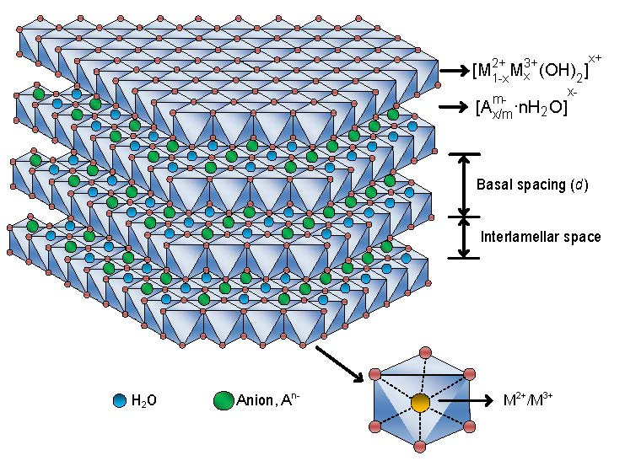
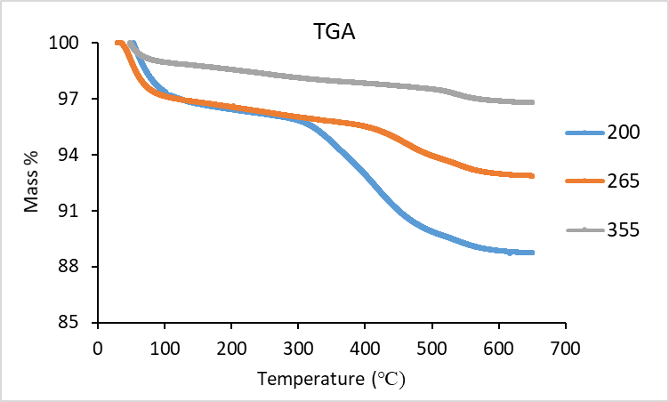
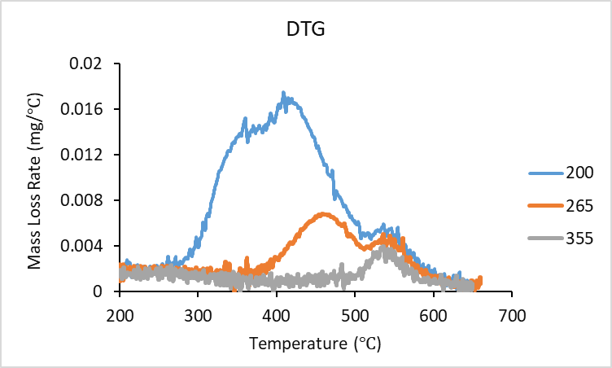
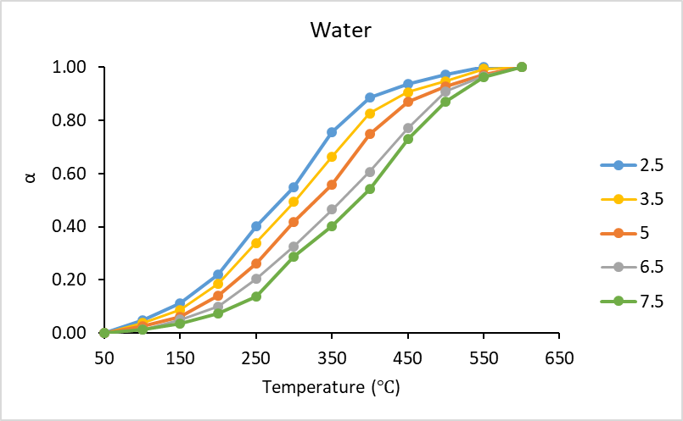
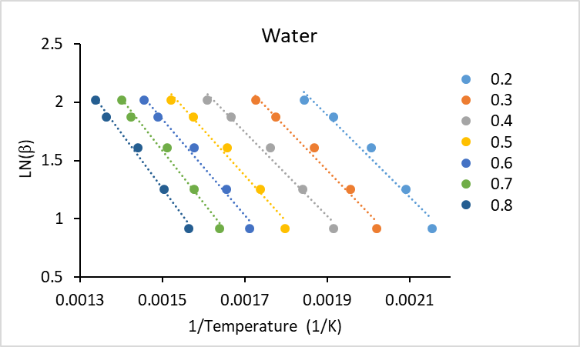
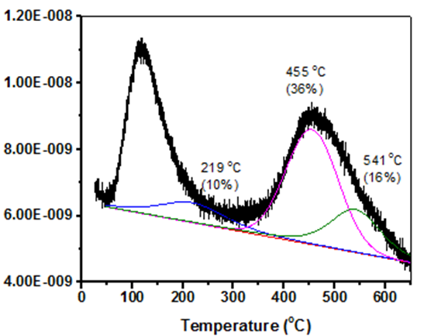
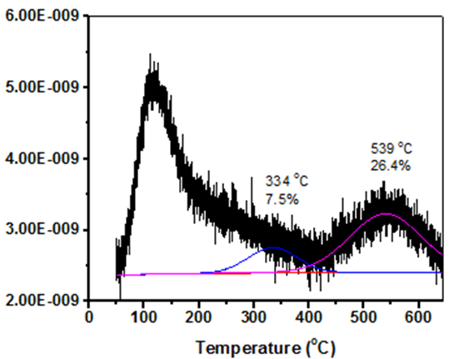
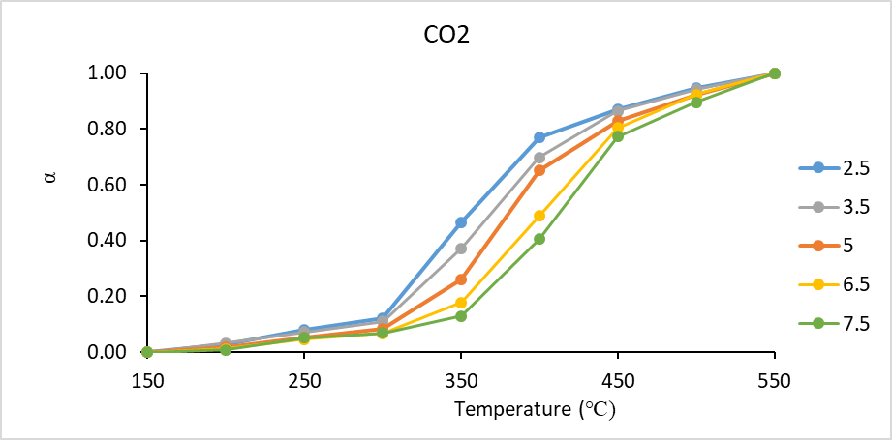
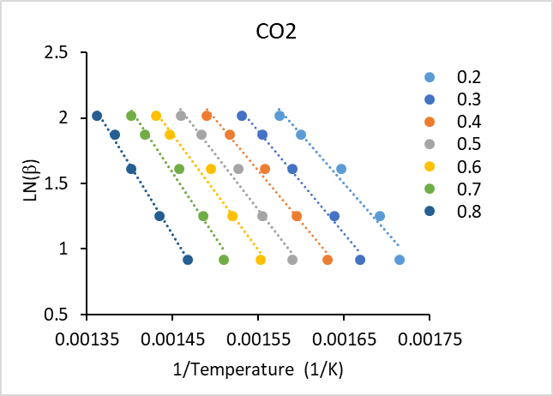
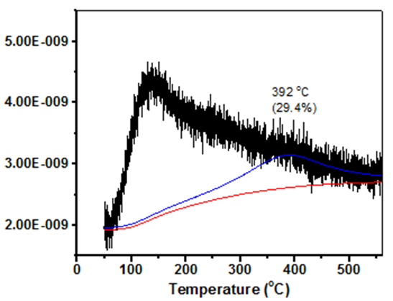

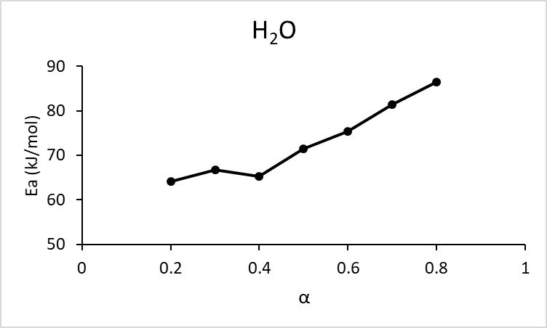
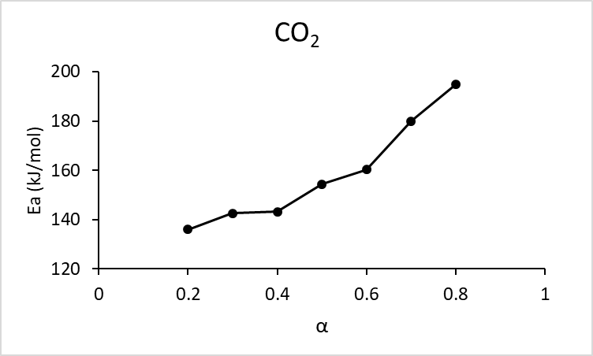
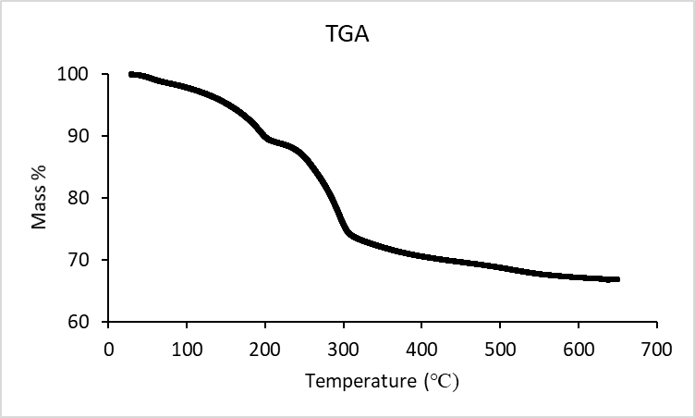
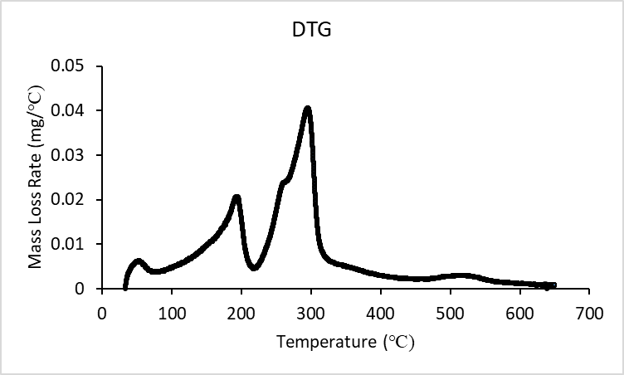
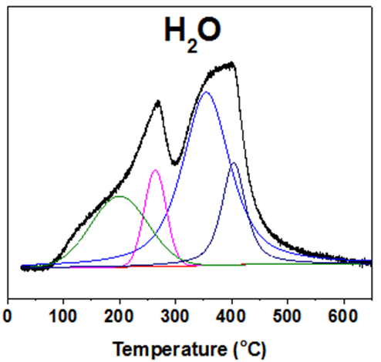
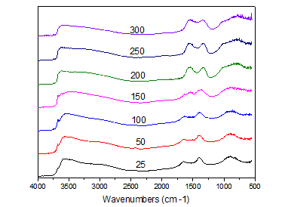
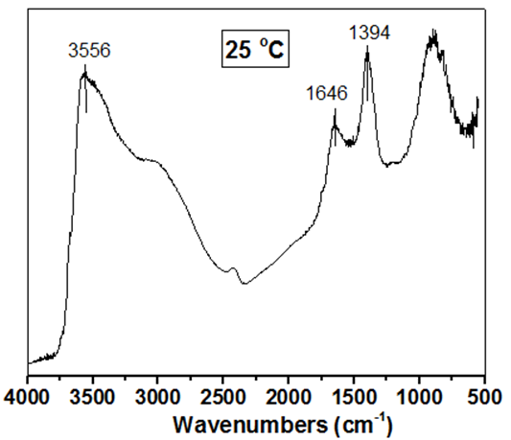
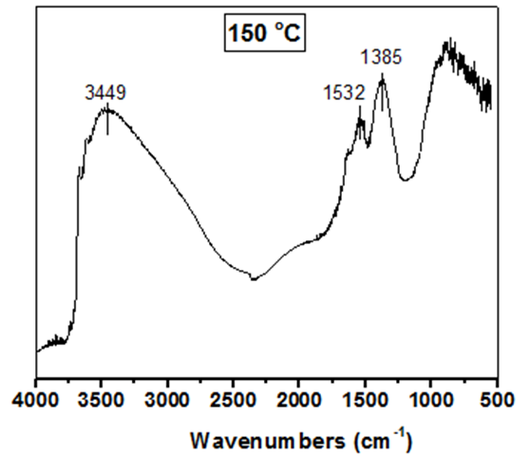
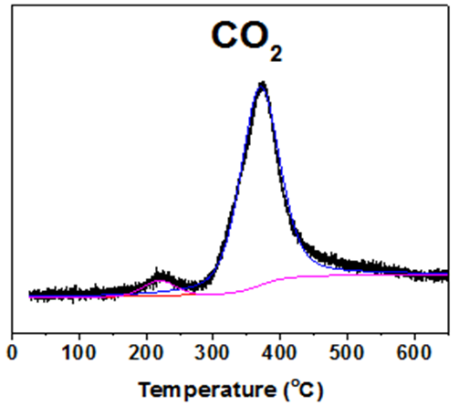
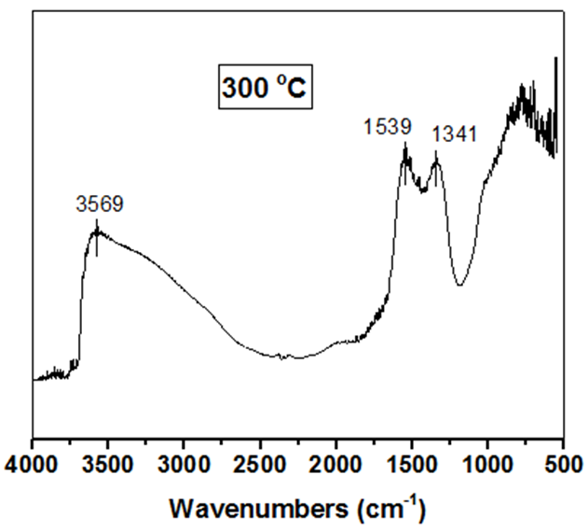

Mechanistic Studies of Thermal Decomposition of Nickel-Gallium Layered Double Hydroxides
Lorenzo Milani
Department of Chemical Engineering, University of New Hampshire, Durham, NH 03824
Introduction
Thermal Decomposition
Kinetic Model
Layered Double Hydroxides (LDHs)^{[1]}:
LDHs are a class of anionic clays being used in catalysis for different applications
Each layer is composed of di-and tri-valent metal cations
The spacing between each layer is filled with anions and water molecules
Objectives:
Mechanistic studies of thermal decomposition of Nickel-Gallium Layered
Double Hydroxides (Ni-Ga LDHs)
Synthesis:
The hydrothermal method involves:
Slowly mixing of nickel nitrate (Ni(NO₃)₂) and gallium nitrate (Ga(NO₃)₃) (3:1 Ni²⁺/Ga³⁺ molar ratio)
Adding sodium carbonate (Na₂CO₃) and sodium hydroxide (NaOH) to maintain the pH=9
Stirring at room temperature for 4 hours
Heating in a hydrothermal autoclave at 125 ᵒC for 24 hours
Three Calcination Temperatures:
200 ᵒC (Sample A)
265 ᵒC (Sample B)
355 ᵒC (Sample C)
Kinetic models and activation energies were calculated based on α (extent of reaction) and β (heating rate).
Activation energies (Ea) can be calculated by plotting ln(β) versus 1/T (in K⁻¹) ^{[5]}
Figure 4. Thermogravimetric Analysis (TGA) profiles for the calcined samples. Heating rate: 5 ℃/min.
Figure 5. Differential Thermogravimetric Analysis (DTG) profiles for the calcined samples. Heating rate: 5 ℃/min.
Figure 9. Plot of α vs. T for water at different heating rates (β).
Figure 10. Plot of ln(β) vs. 1/T for water at different extents of reaction (α).
A
B
C
Thermal Analysis
Results:
  Three major weight loss occurred at around 195, 260, and 295 ℃ (Fig. 1 and Fig. 2)
  For H₂O, the first peak is attributed to physically absorbed water. The second one is related to dehydration, while the last two are related to dehydroxylation (Fig.3A)
  The major CO₂ peak is attributed to decarbonation (Fig. 3B)
Figure 11. Plot of α vs. T for CO₂ at different heating rates (β).
Figure 12. Profile of ln(β) vs. 1/T for CO₂ at different extents of reaction (α).
Test Conditions:
He (18 mL/min) as the flowing gas.
Temperature Range (25 – 650 ᵒC)
Heating Rates: 2.5, 3.5, 5, 6.5, and 7.5 ᵒC/min
Figure 6. Peak temperatures and relative areas (in parenthesis) of water devolution from mass spectrometer for the three calcined samples. Heating rate: 5 ℃/min.
Ozawa-Fynn-Wall method was applied to calculate overall apparent Ea.^{[5]}
Results:
No major water losses are detected below the calcination temperature for each sample (Fig. 5)
29% of water content is still present after heating at 355 ℃ (Fig. 6C)
Below 200 ℃, the weight loss is attributed to removal of interlayer water (dehydration)
Above 200 ℃ dehydroxylation occurs, and it is completed around 550 ℃ ^{[2]}
Above 300 ℃ carbonate ions are removed from the layered structure ^{[2]}
A
B
Figure 13. Plot of activation energies Ea obtained by OFW method for H₂O (A), and CO₂ (B)
FT-Infrared Spectroscopy
Results:
H₂O removal occurred in three different steps (Fig. 13A), with Ea of 60~70 kJ/mol, 70~80 kJ/mol, and 80~90 kJ/mol, respectively.
CO₂ removal occurred in two steps (Fig. 13B), one with Ea of 130~160 kJ/mol, and the other one with Ea of 160~200 kJ/mol
Figure 1. Thermogravimetric Analsys (TGA) for the
Ni-Ga LDH. Heating rate: 5 ℃/min.
Figure 2. Differential Thermogravimetric Analysis (DTG)
for the Ni-Ga LDH. Heating rate: 5 ℃/min.
A
B
A
B
Conclusions
C
Kinetics analysis in terms of activation energies (Ea) suggested that the decomposition mechanism is a complex process that involves the decomposition of several species and phase transformations
Water formations were attributed to the removal of physical absorbed water, and the reactions of dehydration and dehydroxylation
Carbon dioxide was formed mainly through decarboxylation reaction
Figure 7. In situ FT-IR spectra for Ni-Ga LDH in pure helium at different temperatures (25, 50, 100, 150, 200, 250, and 300 ℃).
Figure 8. In situ FT-IR spectra in pure helium for Ni-Ga LDH at 25 ℃ (A),
150 ℃ (B), and 300 ℃ (C).
Figure 3. Mass spectroscopy profile of water (A) and carbon dioxide (B) for the Ni-Ga LDH heated in pure helium. Heating rate: 5 ℃/min.
Results:
The intensity of the band around 3500 cm⁻¹ decreases, indicating the occurrence of partial dehydroxylation ^{[3]}
The carbonate band at 1394 cm⁻¹ (Fig. 8A) splits into two bands at 1341 cm⁻¹ and at 1539 cm⁻¹ (Fig. 8C), indicating removal of interlayer water ^{[3]}
The disappearance of the band at 1646 cm⁻¹ (Fig. 8A) above 200 ℃ is due to the loss of H-bonding between H₂O and CO₃²⁻ in the interlayer ^{[4]}
References
[1] F. Li, X. Duan. Structure and Bonding 119 (2005) 27.
[2] F. Rey, V. Fornes, J.M. Rojo. Journal of Chemical Society, Faraday Trans 88 (1992) 2233.
[3] J.T. Kloprogge, R.L. Frost. Applied Catalysis A: General 184 (1999) 51.
[4] J. Perez-Ramirez, G. Mul, F. Kapteijn, J.A. Moulijn. Applied Catalysis A: General 184 (1999) 61.
[5] L. Wang, Z. Lu, F. Li, X. Duan. Industrial & Engineering Chemistry Research 47 (2008) 7216.
Acknowledgement
  Summer Undergraduate Research Fellowship from The Hamel Center for Undergraduate Research, UNH
  Dr. Nan Yi, UNH, Department of Chemical Engineering

