Slide 1


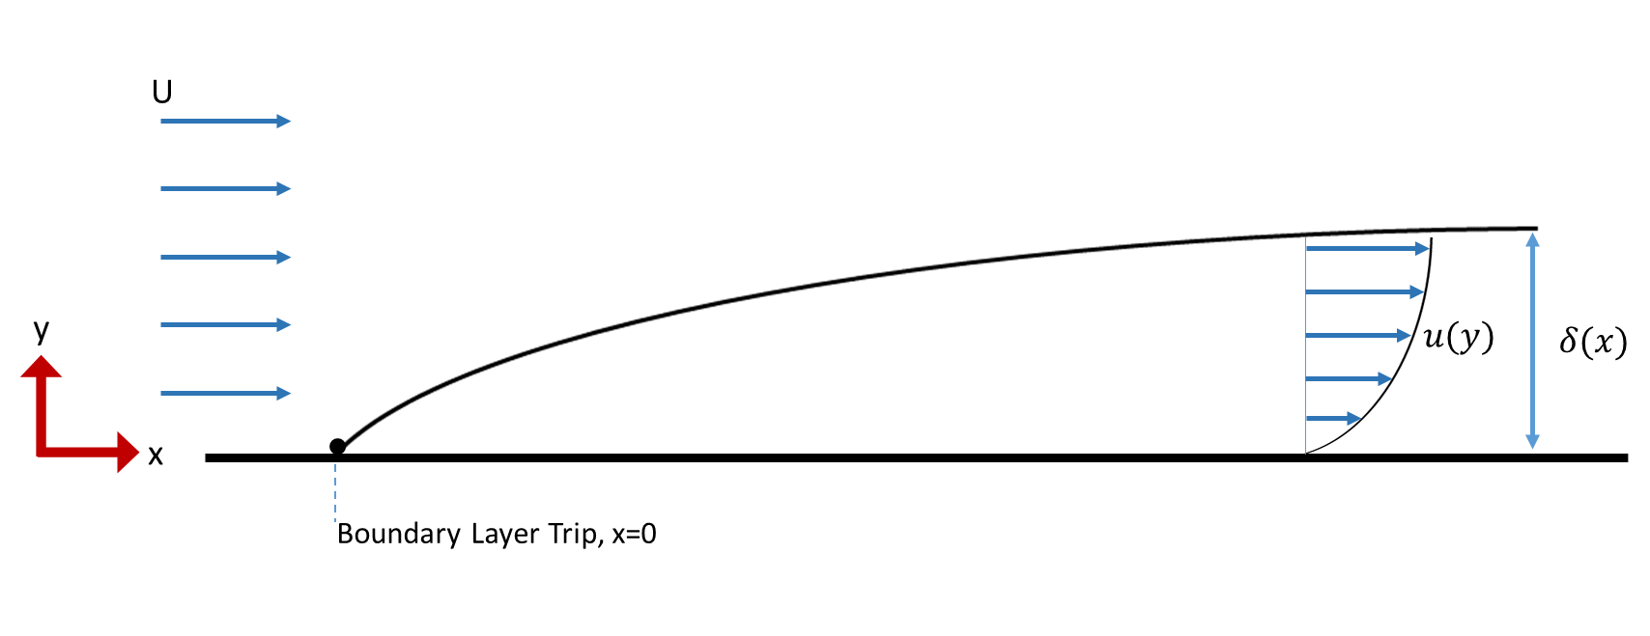
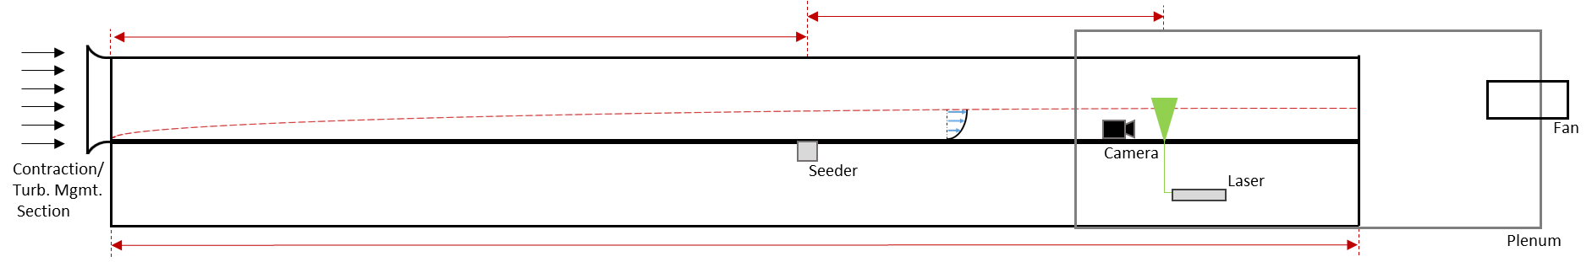
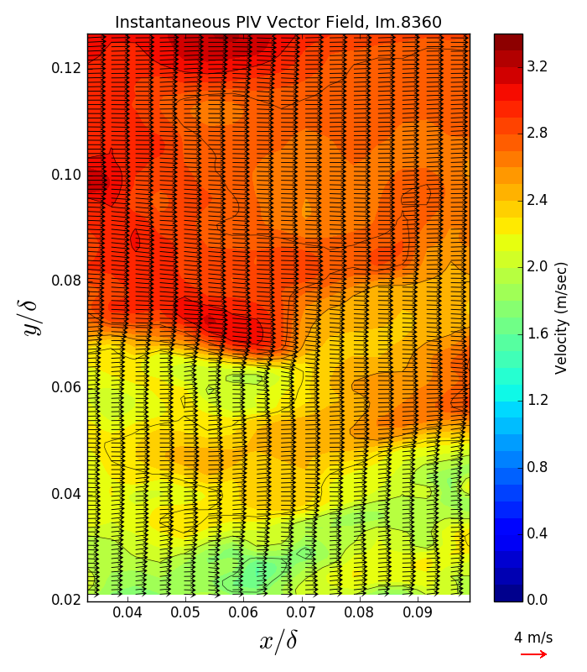
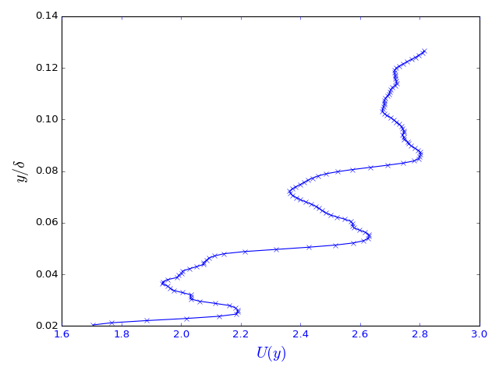
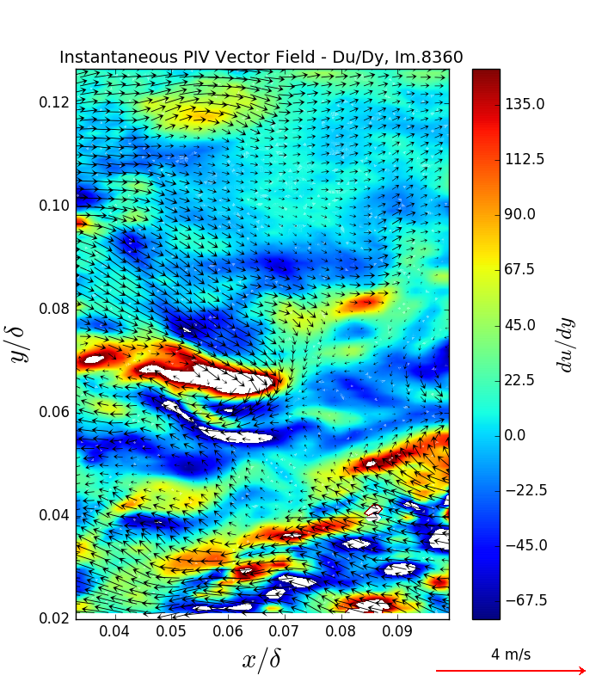
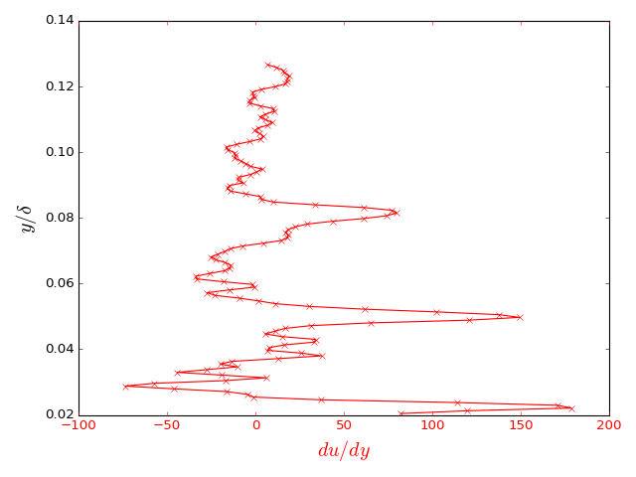
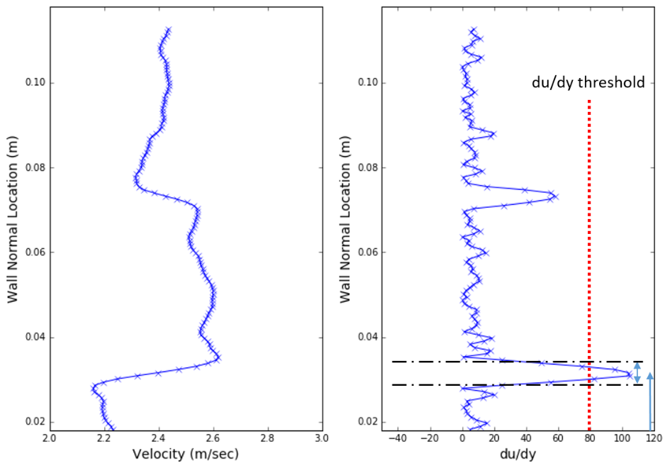
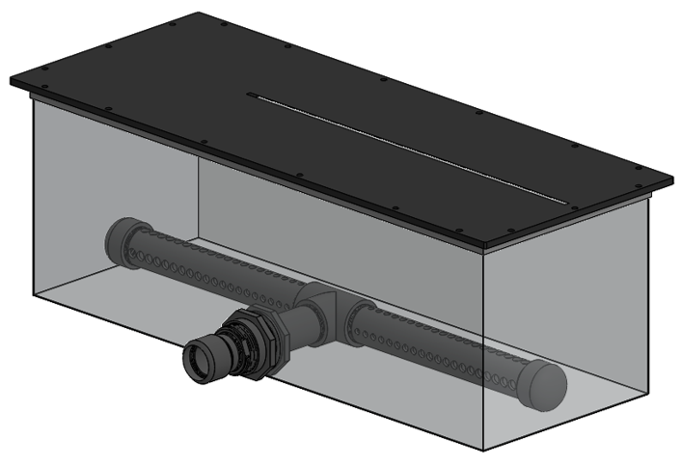
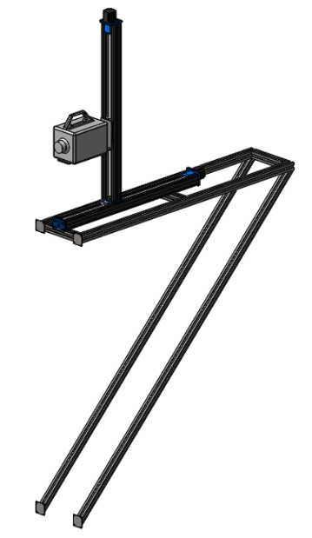
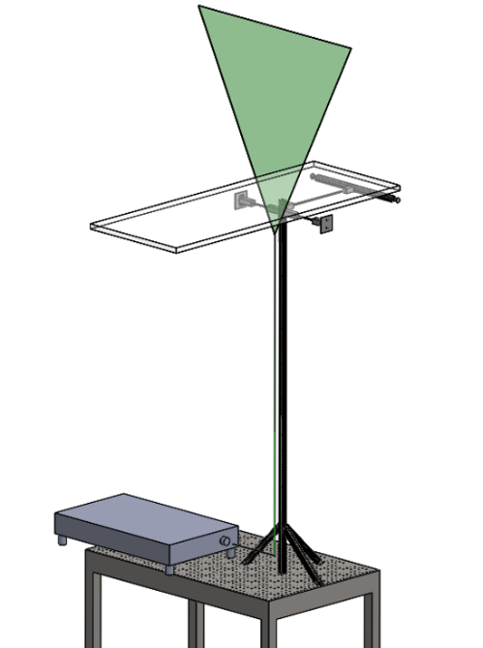
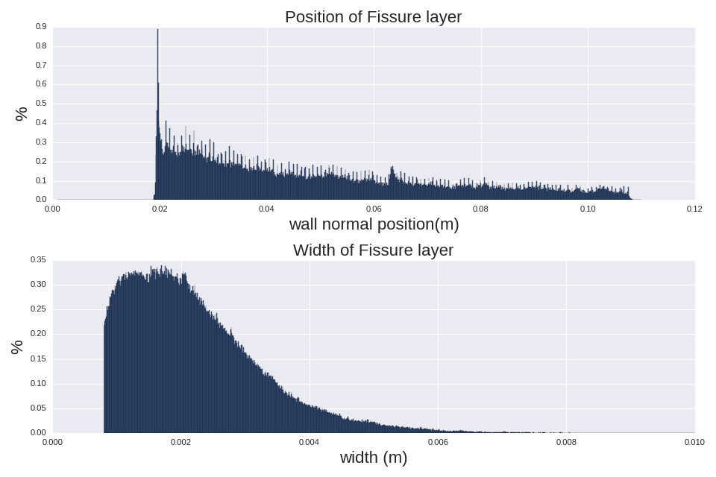
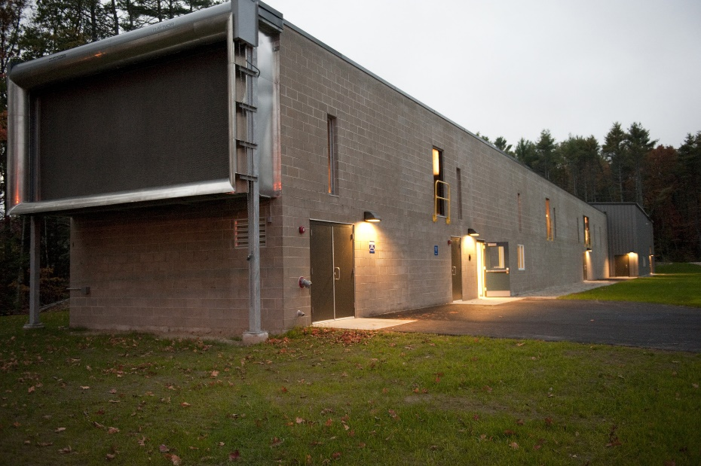
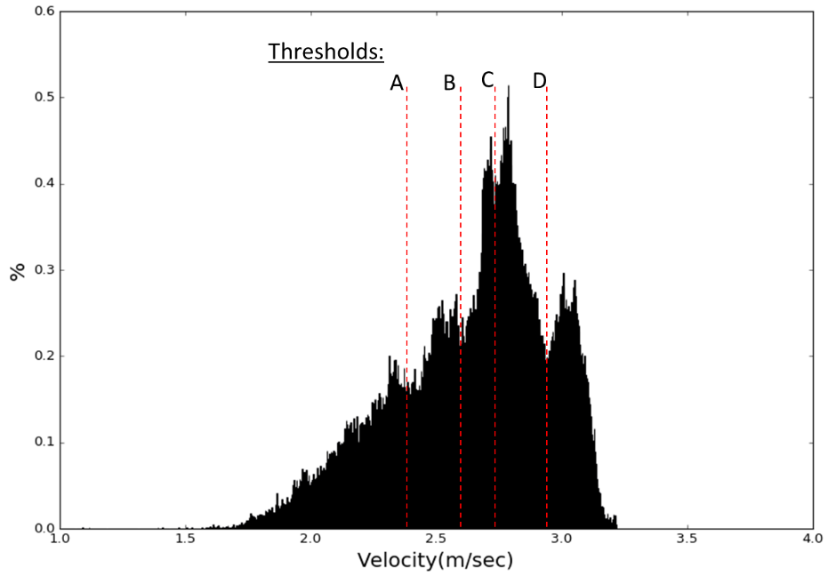
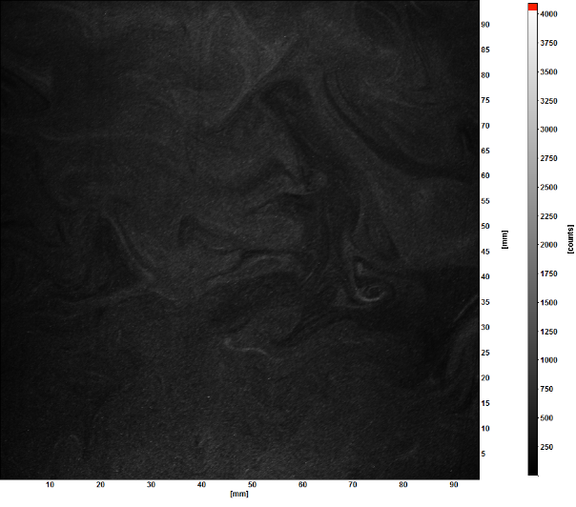
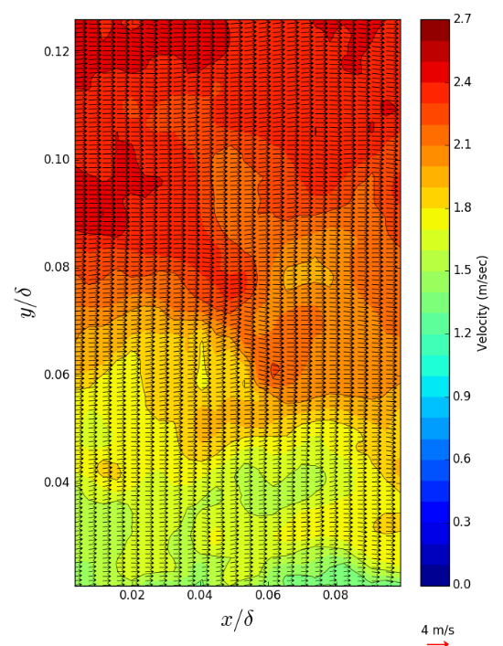
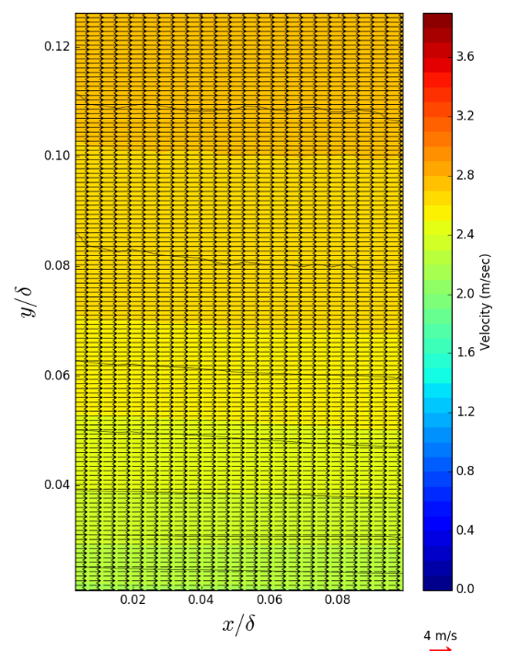
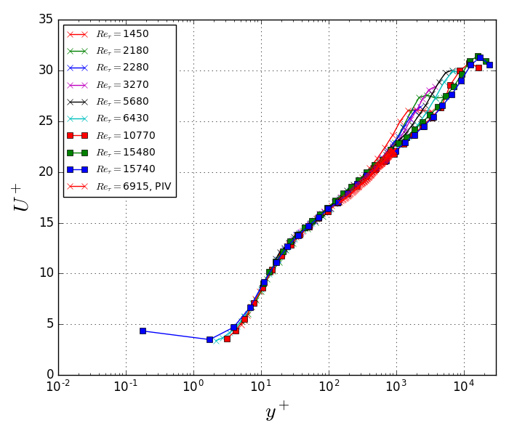
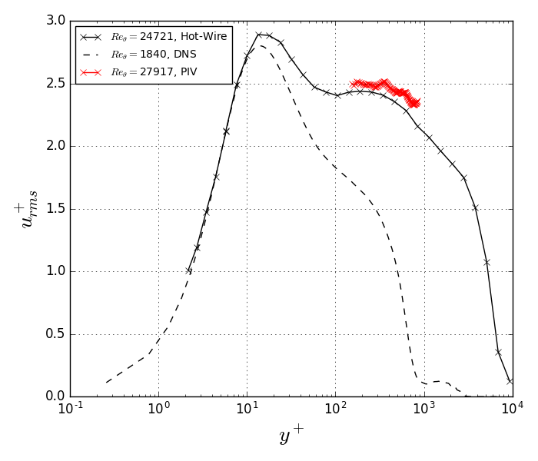
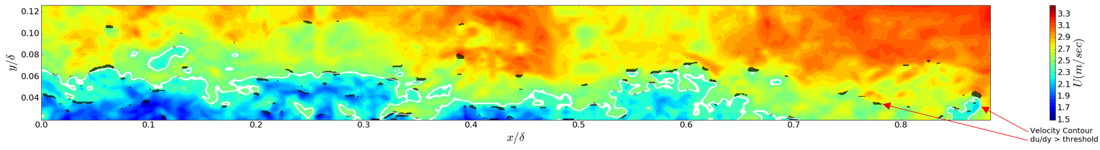
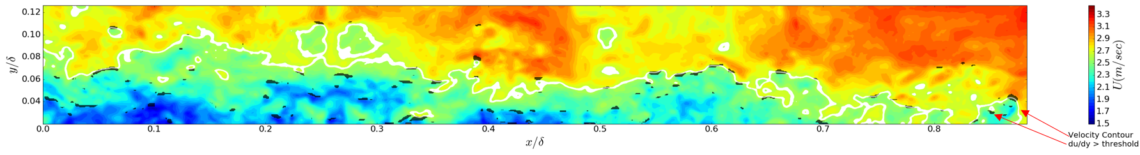
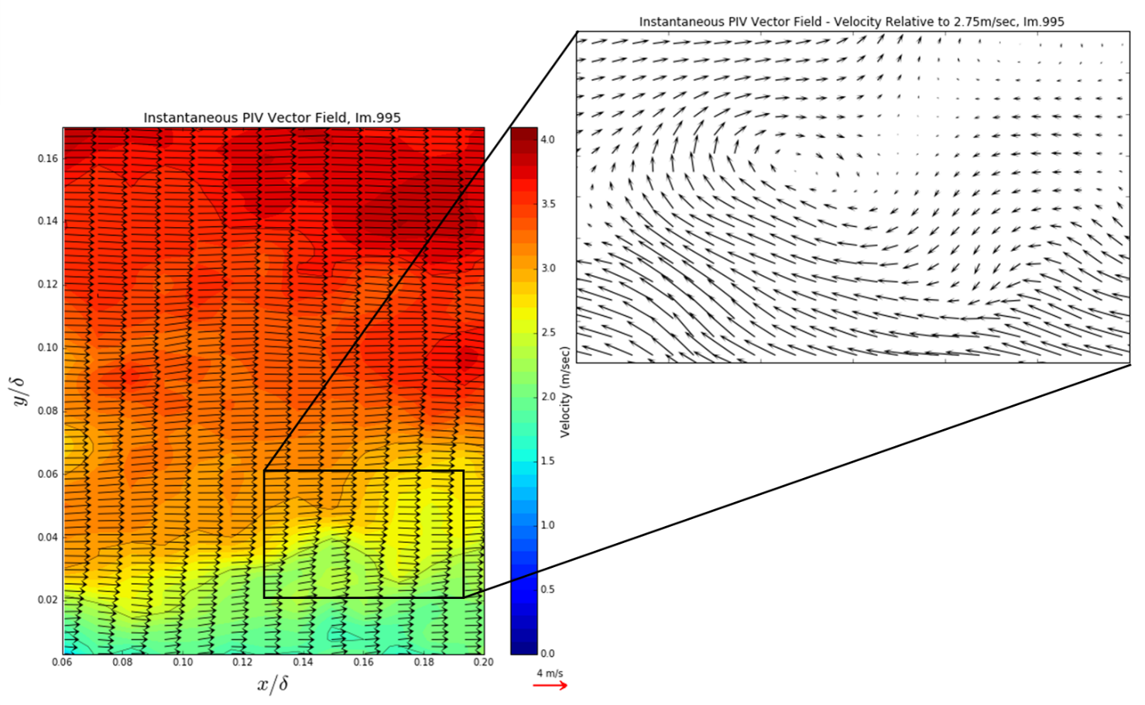
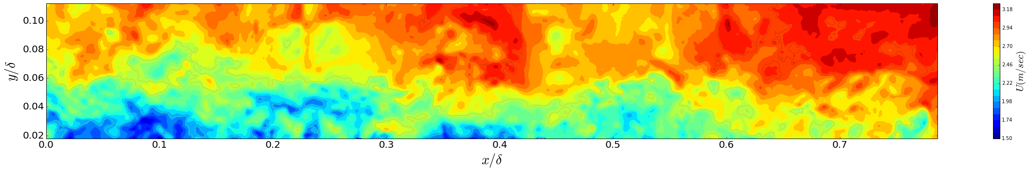
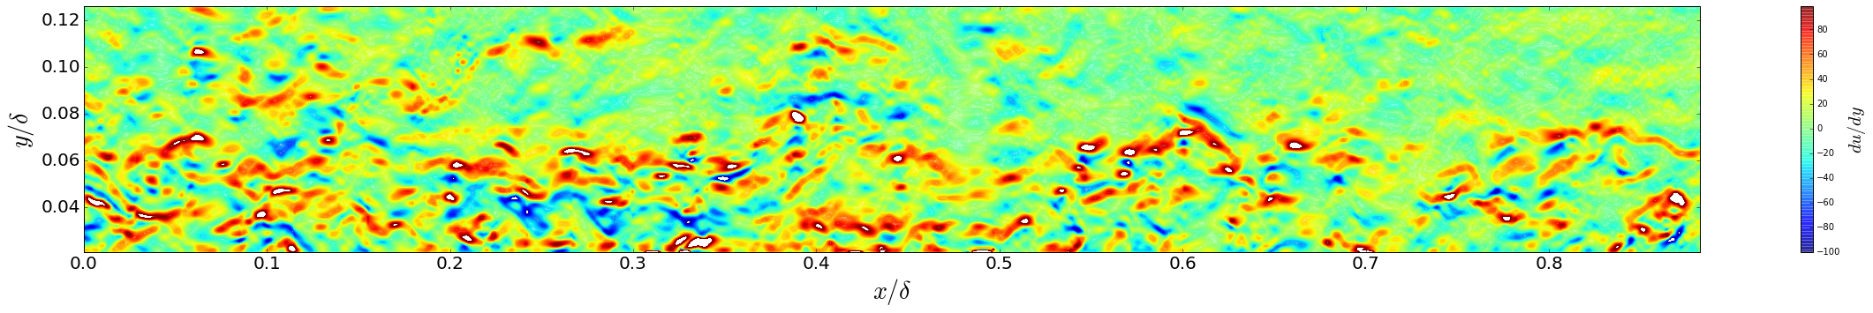
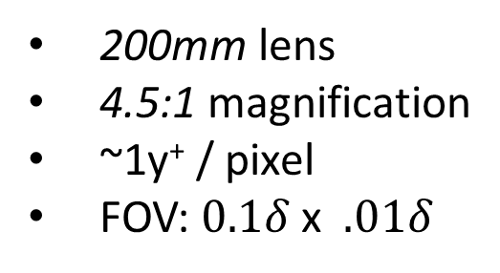
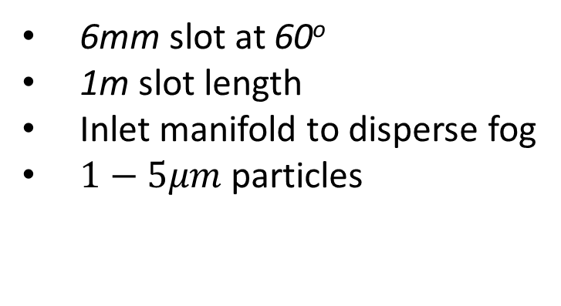

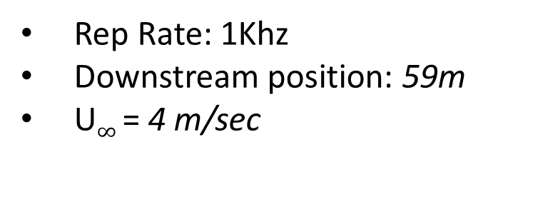
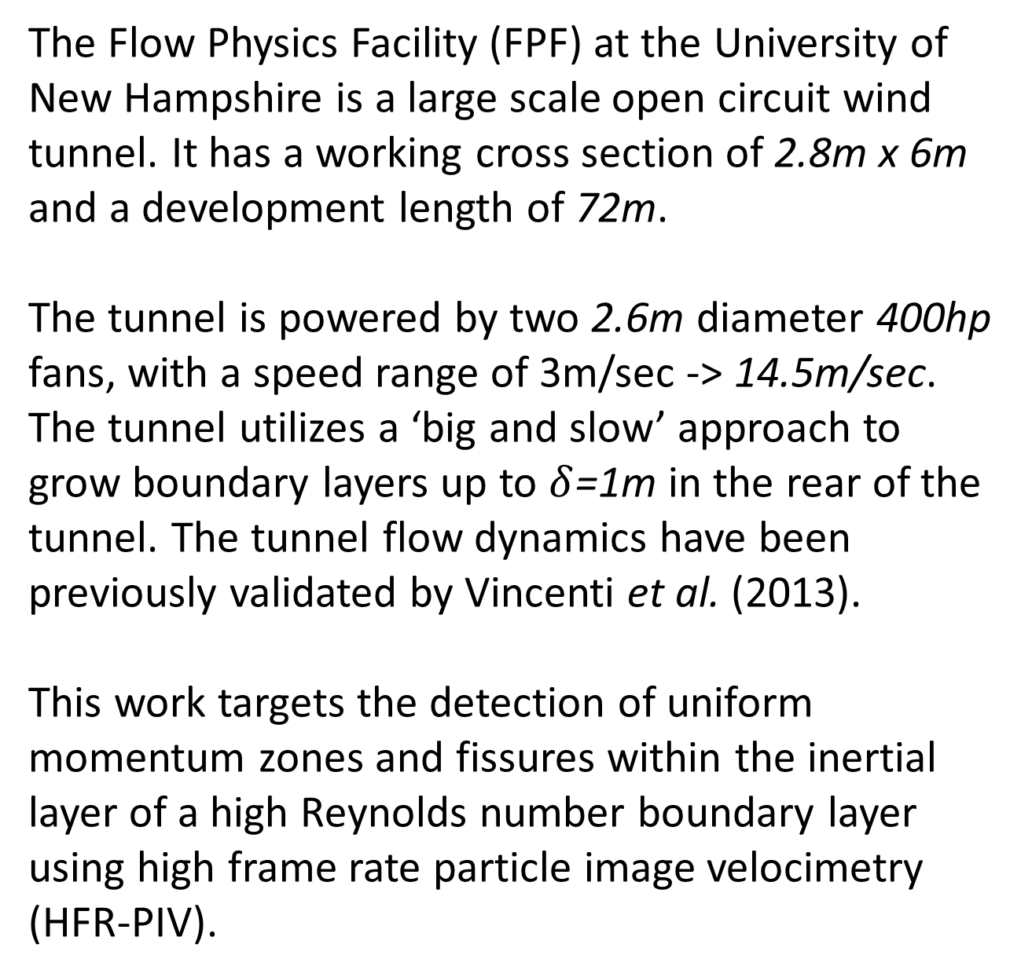
High-Fidelity PIV of a Naturally Grown High Reynolds Number
Turbulent Boundary Layer
D. Biles, C. Klewicki, N. Marino, C. White, J. Klewicki, and G. Chini
t
Data Collection
Structures – (UMZ/Fissure)
Intro
14m
45m
Instantaneous images of the velocity field are examined for internal structures such as uniform momentum zones and vortical fissures. This is achieved by computing dU/dy and comparing the location of spikes in this term with specific contours of velocity.
Example fissure detection
High-fidelity measurements acquired at high Reynolds number are important towards the development of high accuracy physics based models of the turbulent boundary layer. This poster describes particle image velocimetry (PIV) measurements acquired in the Flow Physics Facility (FPF) at the University of New Hampshire.
70m
Velocity
Du/dy
Seeding Mechanism
High Speed Camera
By thresholding Du/dy, these jumps can be detected and the location and size of the supposed fissure is computed.
6mm slot at 60º
1m slot length
Inlet manifold to disperse fog
$1−5μm$ particles
200mm lens
4.5:1 magnification
~1y⁺ / pixel
FOV: $0.1δ$ x $.01δ$
Laser / Optics Train
Background and Motivation
Spherical focusing lens
Cylindrical sheet optics
Adjustable laser position
Experimental Parameters
= 6915
Rep Rate: 1Khz
Downstream position: 59m
U$∞$ = 4 m/sec
Re
10,000 images captured
Varied wall normal position 17mm – 357mm
A histogram of velocity is shown below to understand how to discretize the stitched FOV into section of uniform momentum. This method has been utilized previously by de. Silva et al. (2017) to identify uniform momentum zones.
$$δ+$$
Vector Processing
Data Validation
Threshold positions of A-D are determined by examining for valleys in the histogram.
Experimental data collected is plotted against experimental datasets taken using hotwire anemometry and DNS datasets.
The Flow Physics Facility (FPF) at the University of New Hampshire is a large scale open circuit wind tunnel. It has a working cross section of 2.8m x 6m and a development length of 72m.
The tunnel is powered by two 2.6m diameter 400hp fans, with a speed range of 3m/sec -> 14.5m/sec. The tunnel utilizes a ‘big and slow’ approach to grow boundary layers up to $δ$=1m in the rear of the tunnel. The tunnel flow dynamics have been previously validated by Vincenti et al. (2013).
This work targets the detection of uniform momentum zones and fissures within the inertial layer of a high Reynolds number boundary layer using high frame rate particle image velocimetry (HFR-PIV).
Threshold A
Processing Details:
Threshold B
Pre-processing: count inversion + normalization
Processing: multi-pass with decreasing interrogation area
Post-processing: STD filter to remove spurious images and vectors
Temporal Stitching
Conclusion
Ten consecutive HFR-PIV images are stitched together using a least-square root-mean-square matching technique. The stitching allows evaluation of the spatial development of the boundary layer in the spirit of a Taylor's frozen flow hypothesis.
HFR-PIV measurements of a turbulent boundary layer at high Reynolds number have been acquired in the FPF at UNH.
Vortical fissures measuring ~1mm have been detected and are distributed across the FOV examined with a slight bias towards lower wall normal locations.
Uniform momentum zones (UMZ) were identified using the histogram method of de Silva. The interface between adjacent UMZ correlate well with regions of large dU/dy.
Instantaneous Stitched Images
Computed dU/dy of Stitched Image
Drummond Biles – drummond.biles@gmail.com

