Slide 1






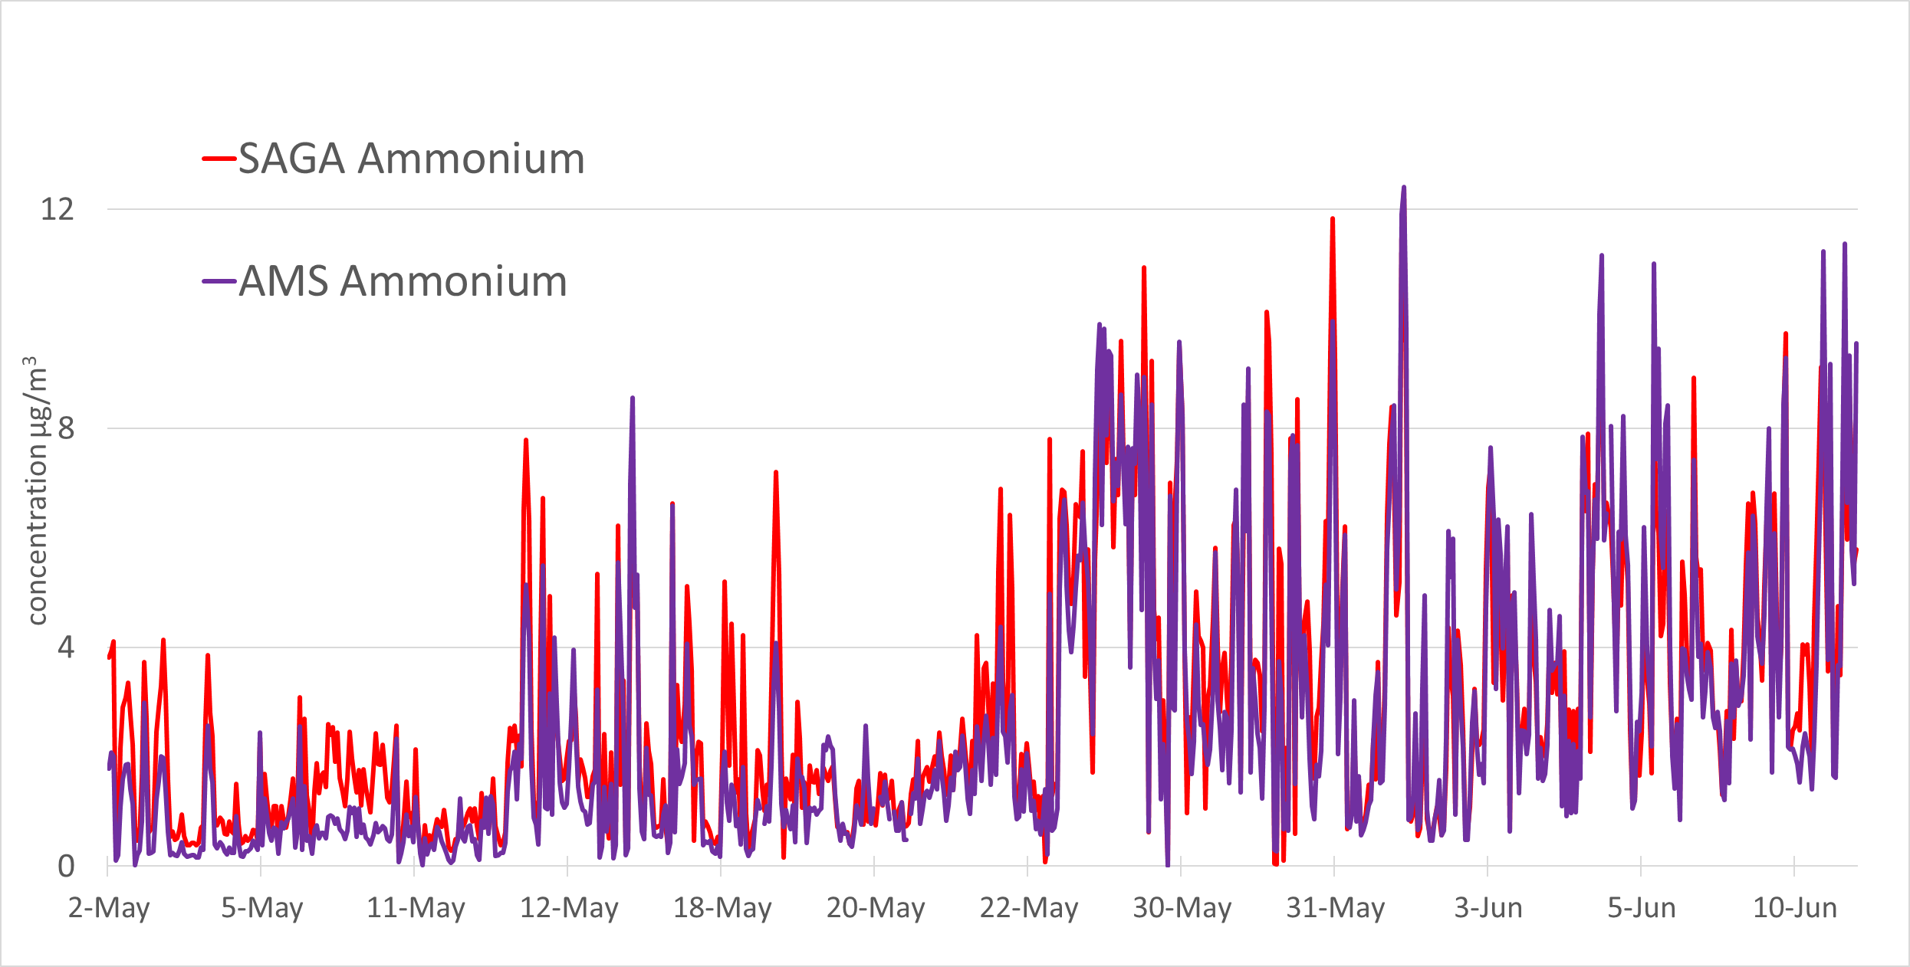
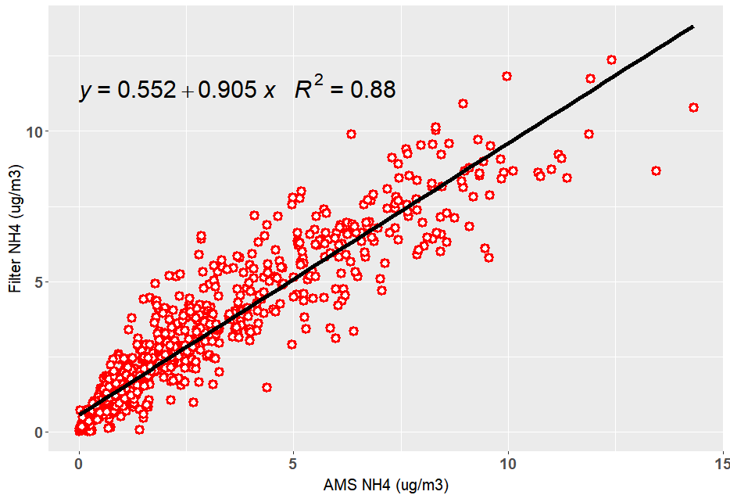
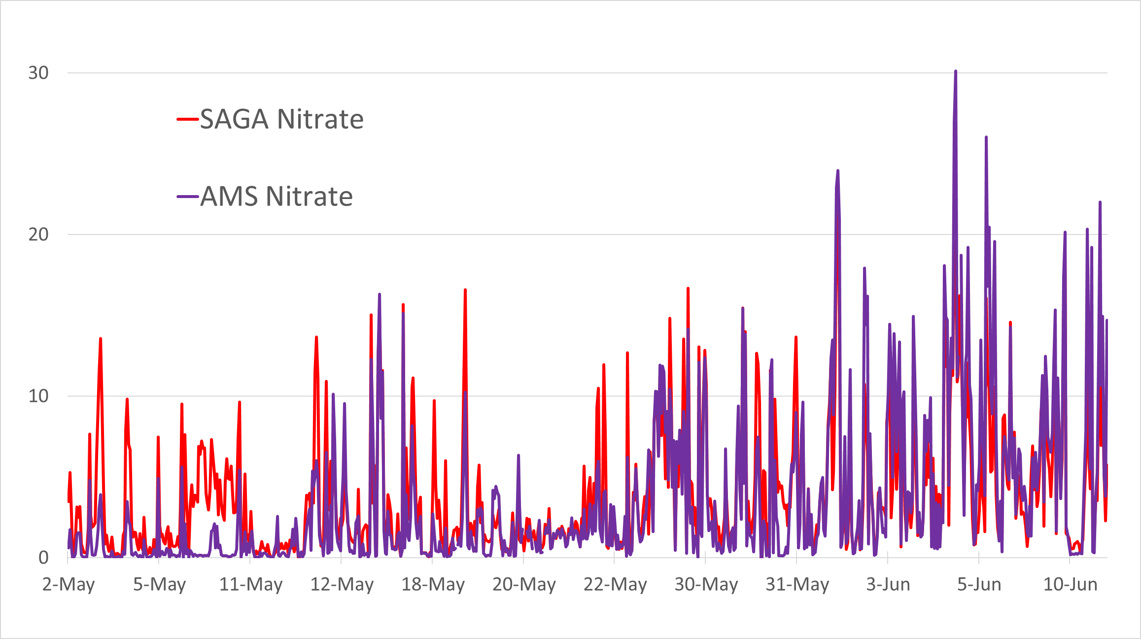
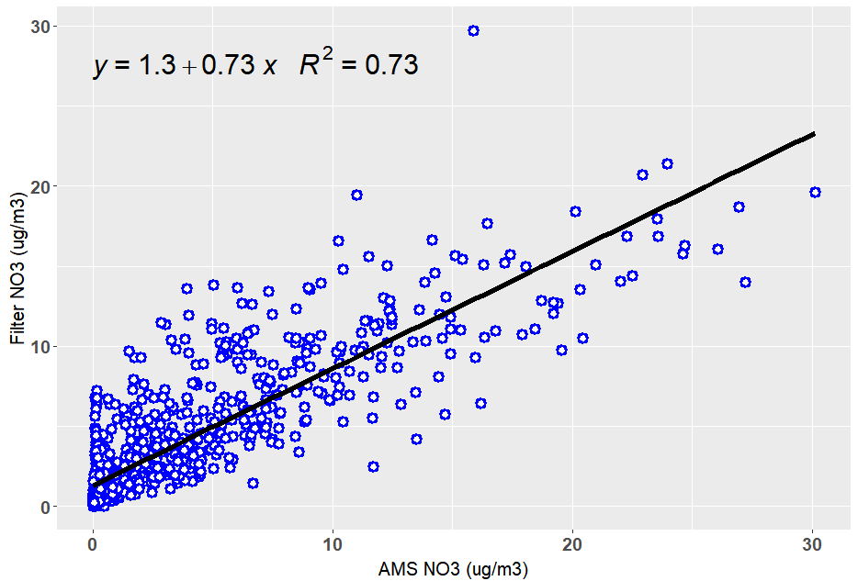
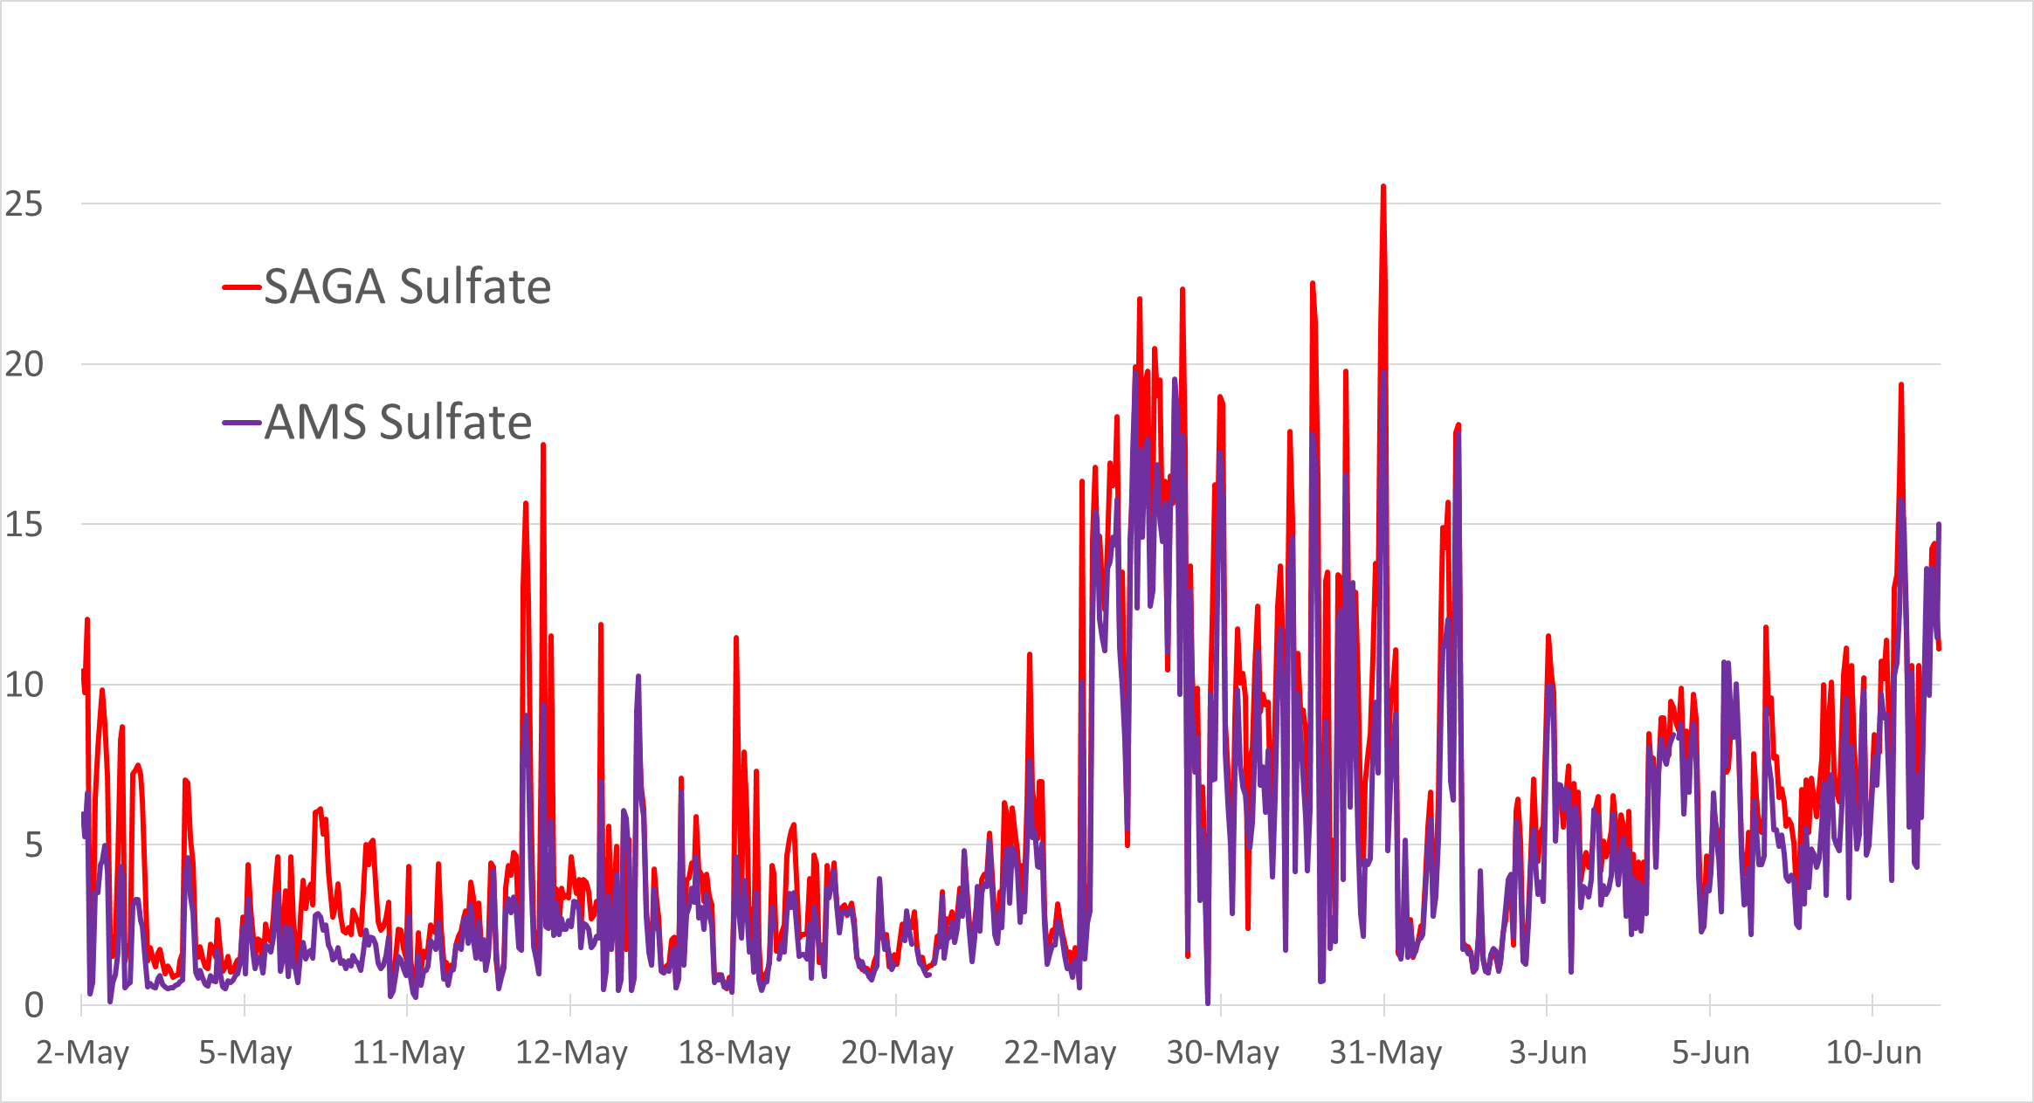
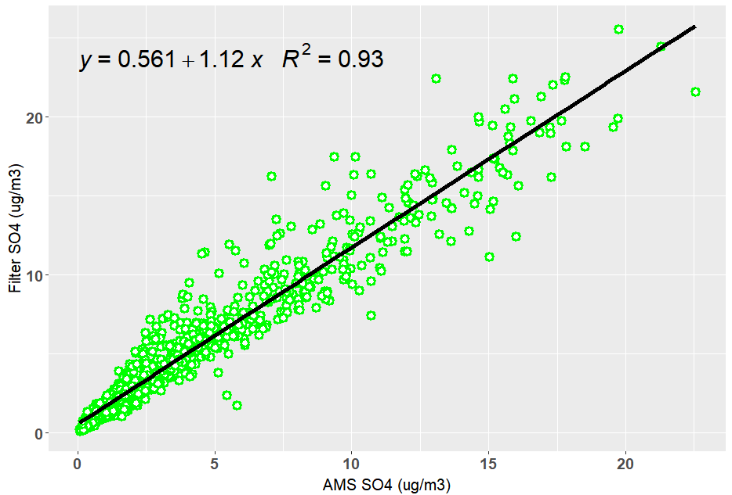




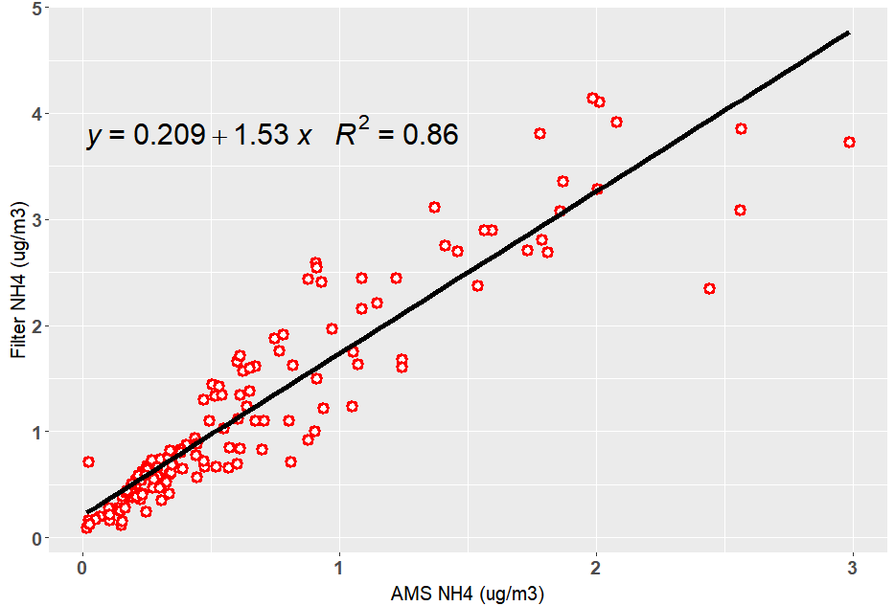
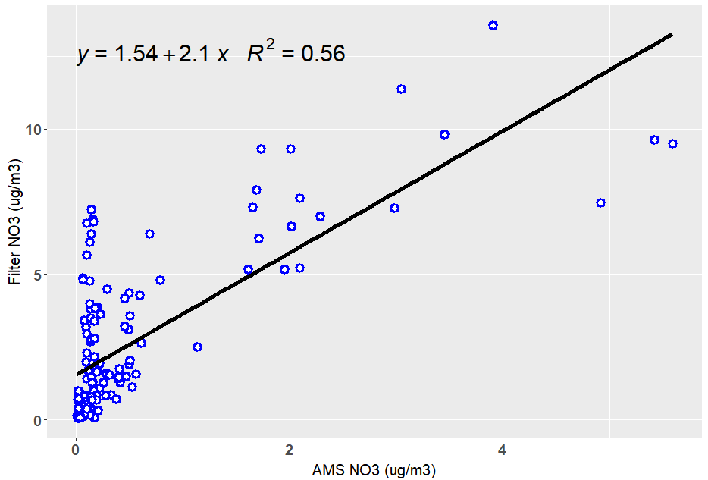
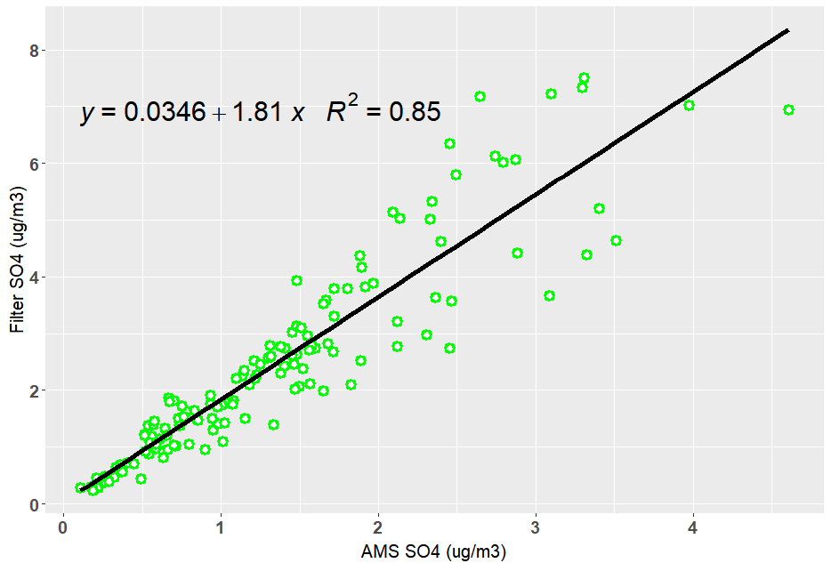
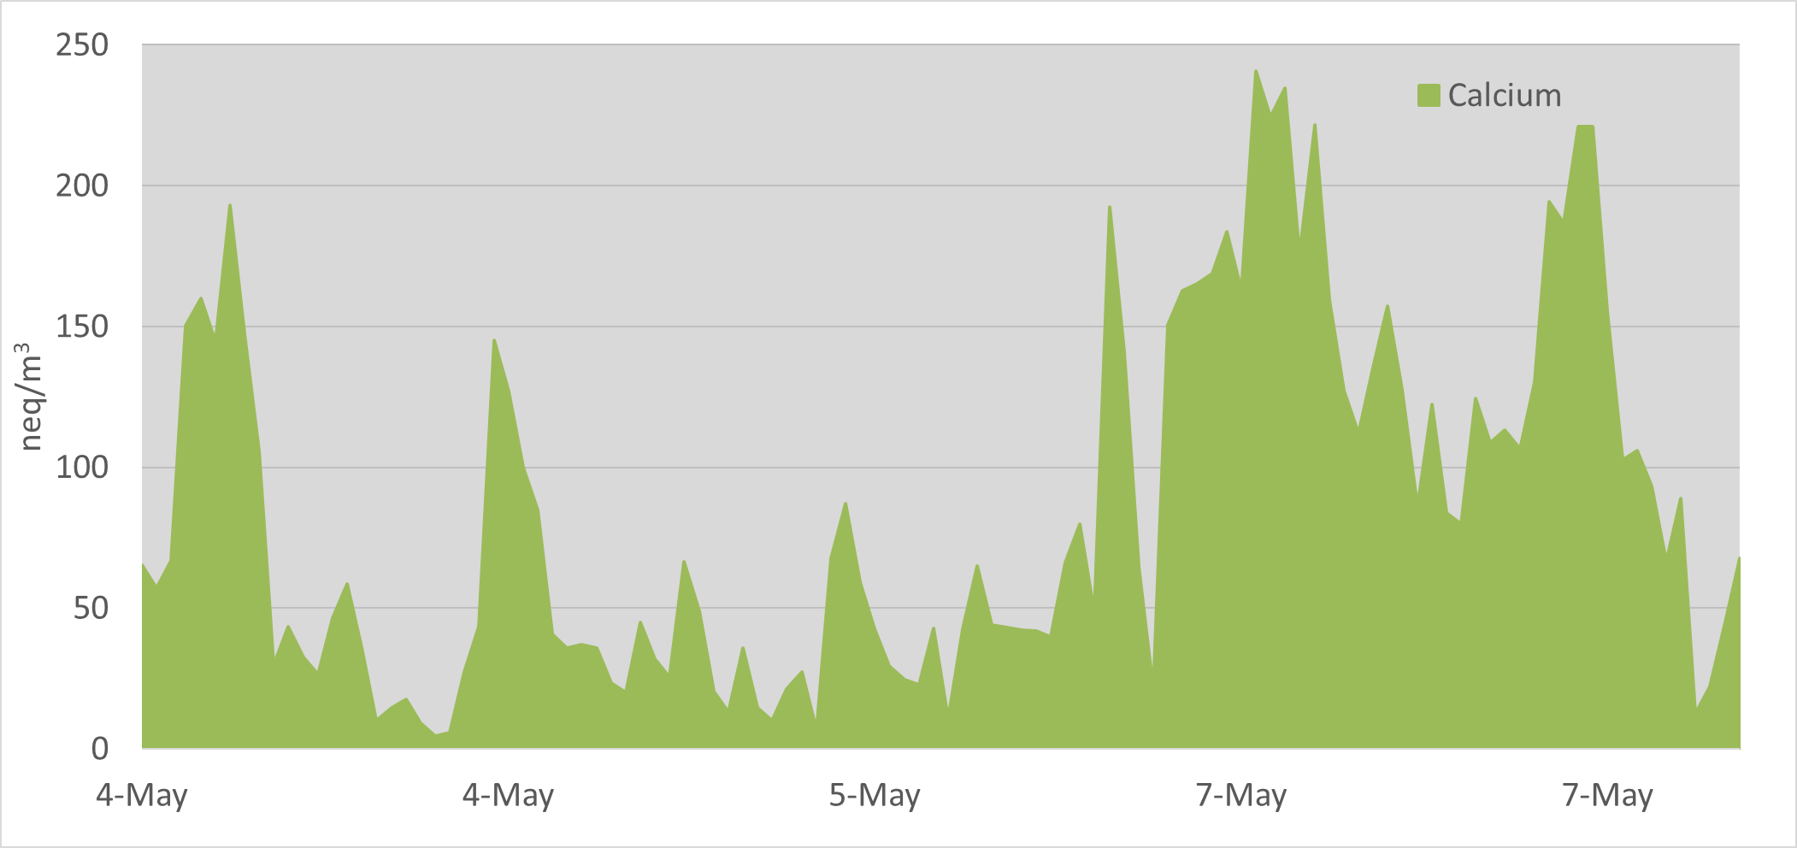
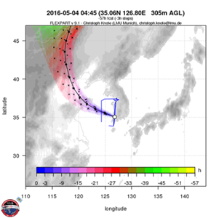
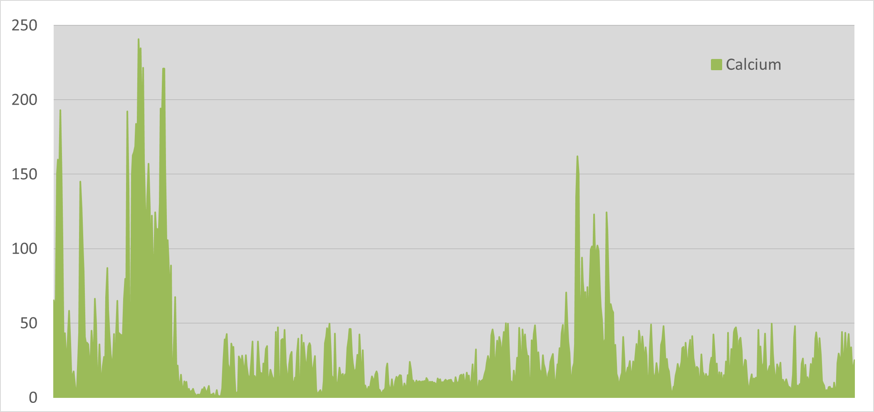
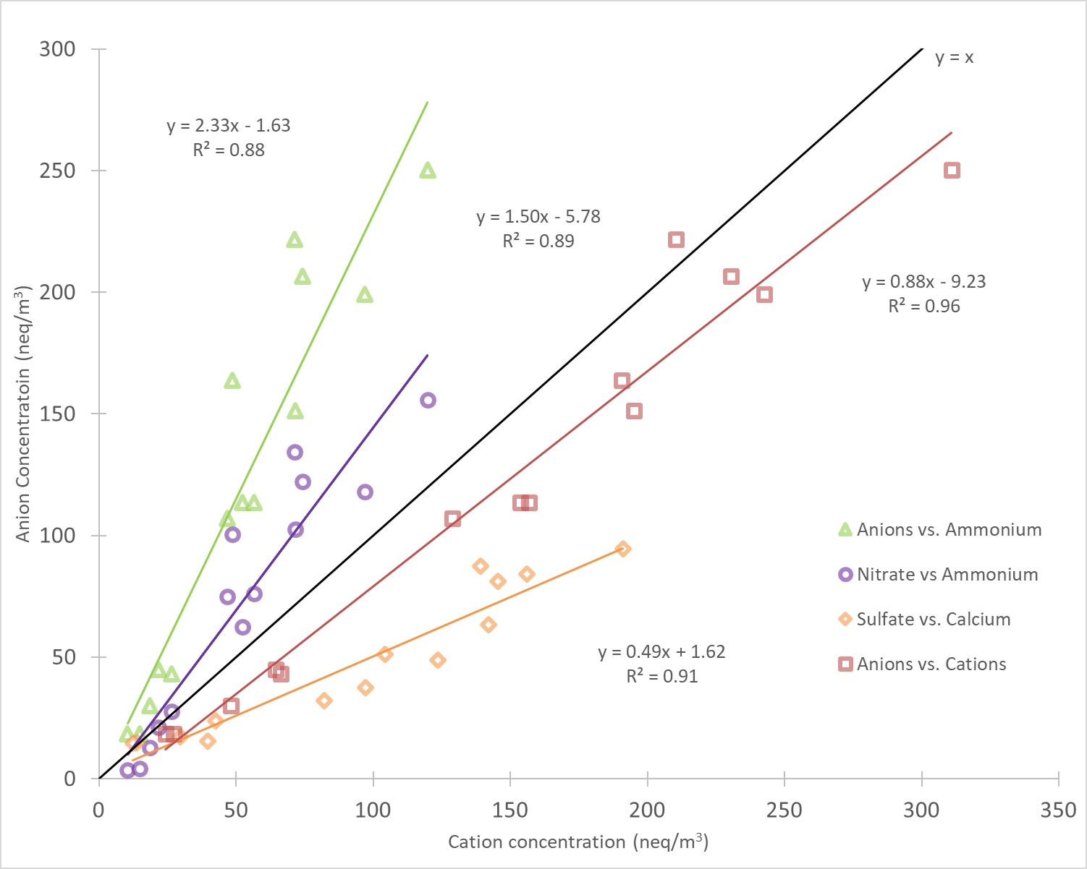
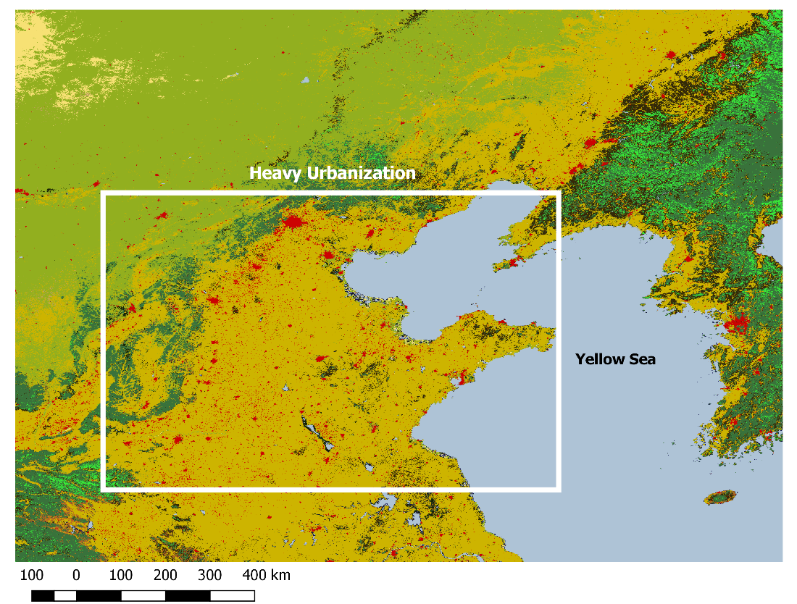
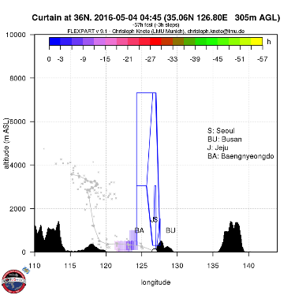
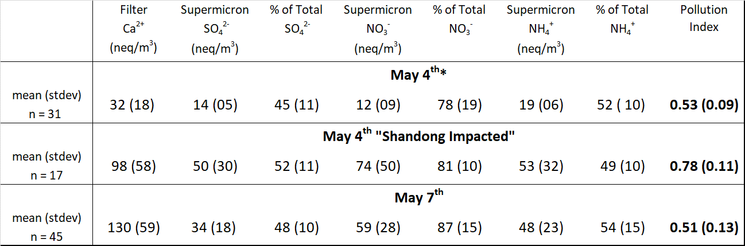
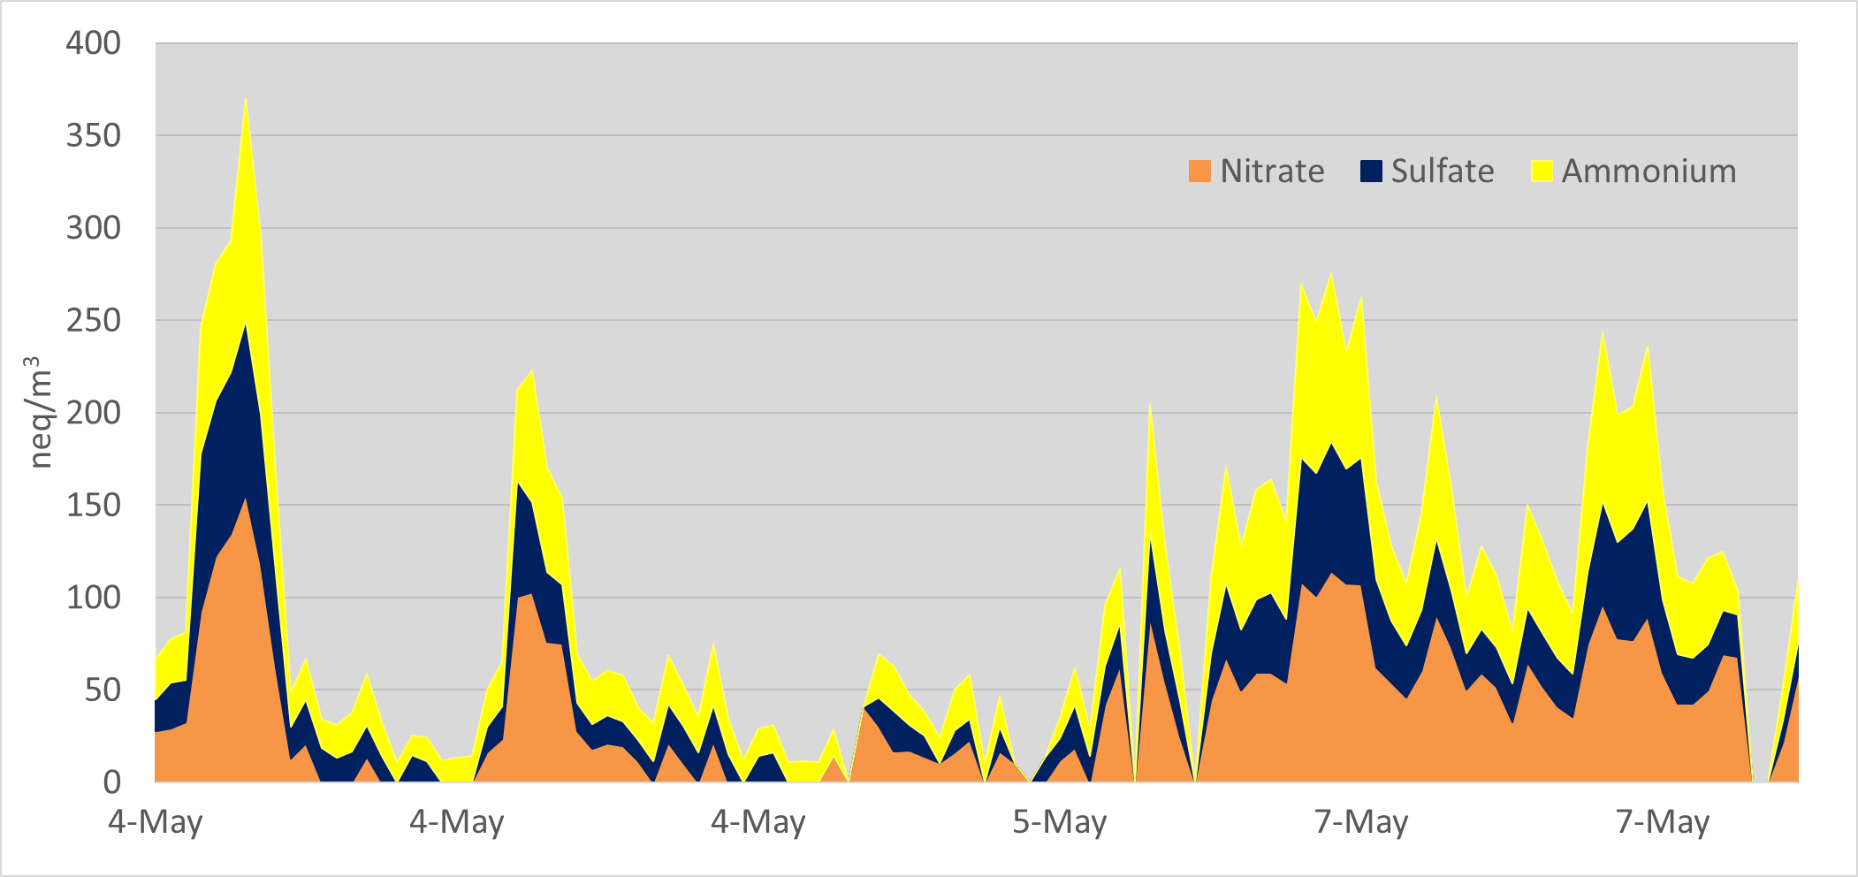
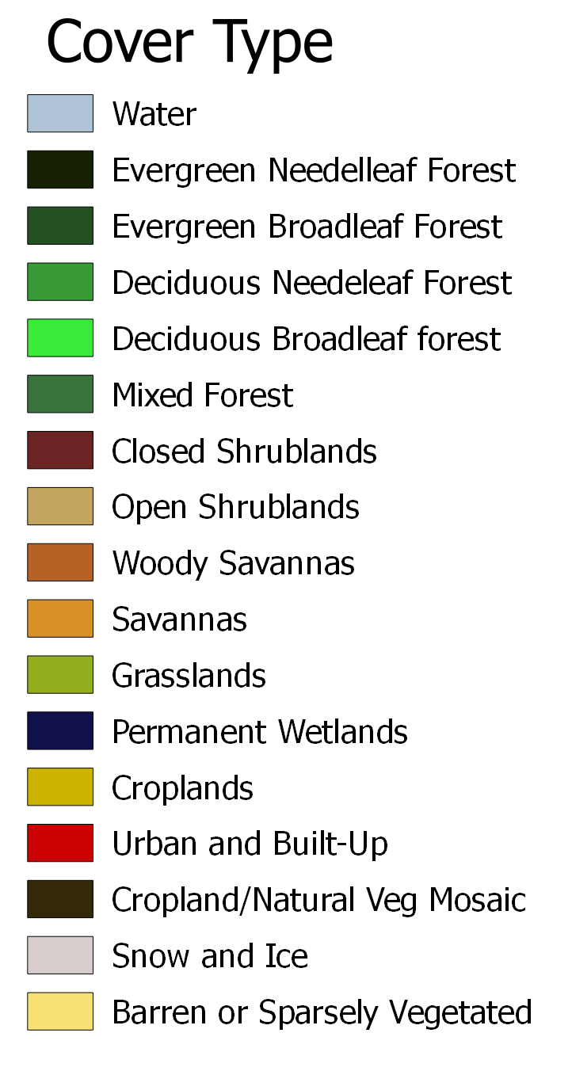
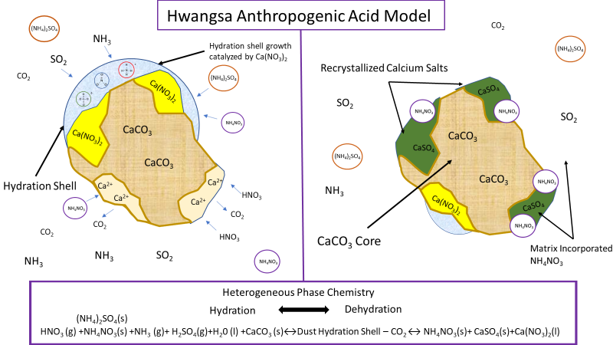
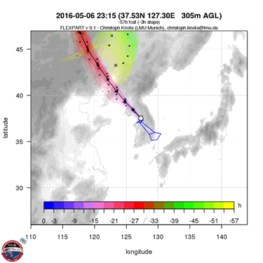
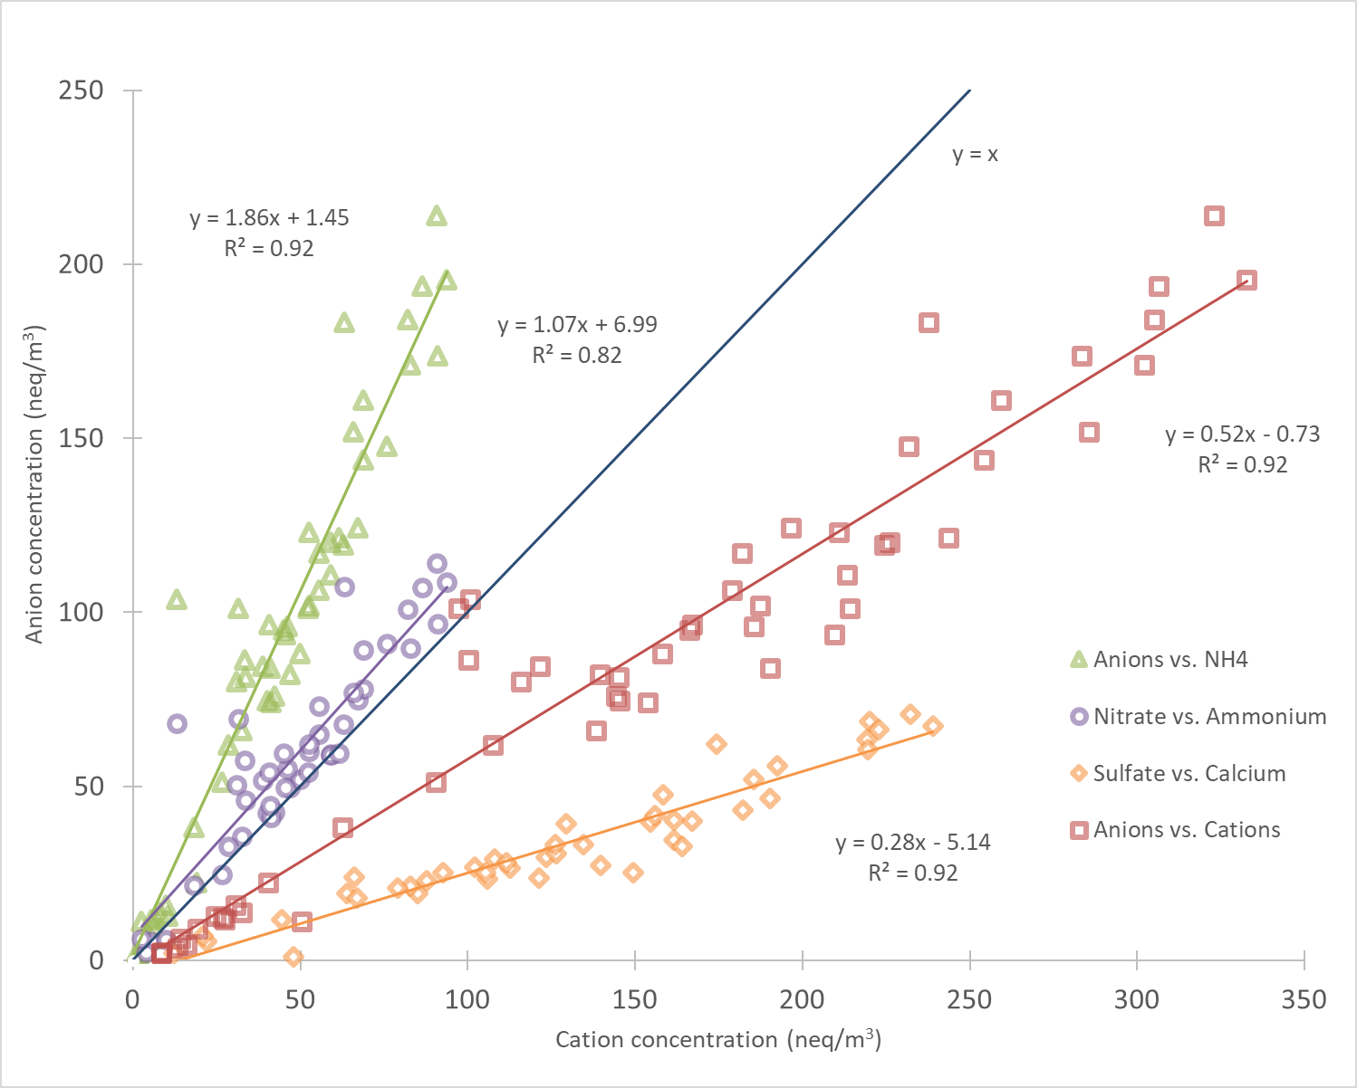

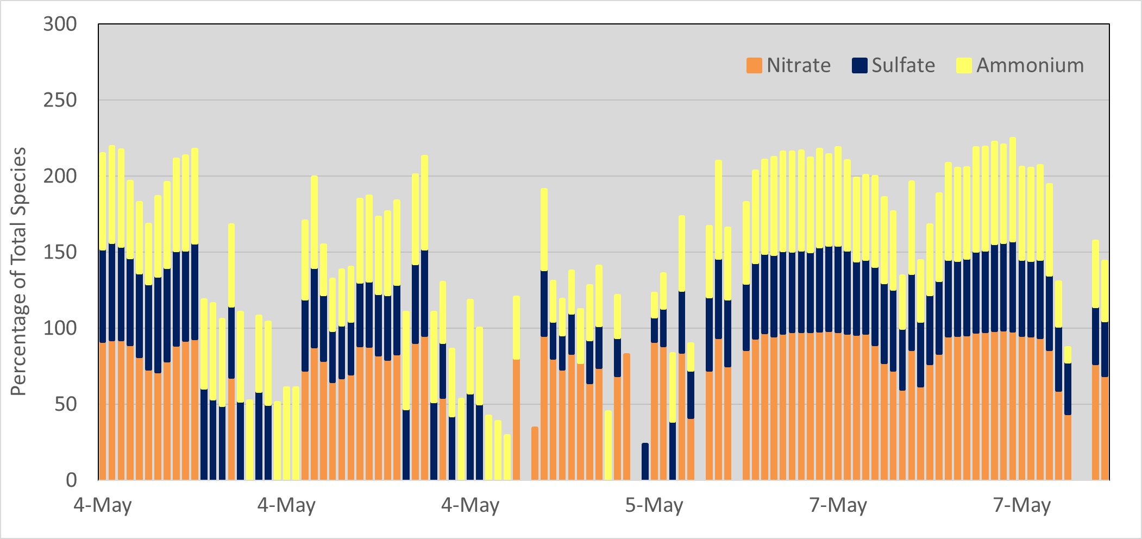
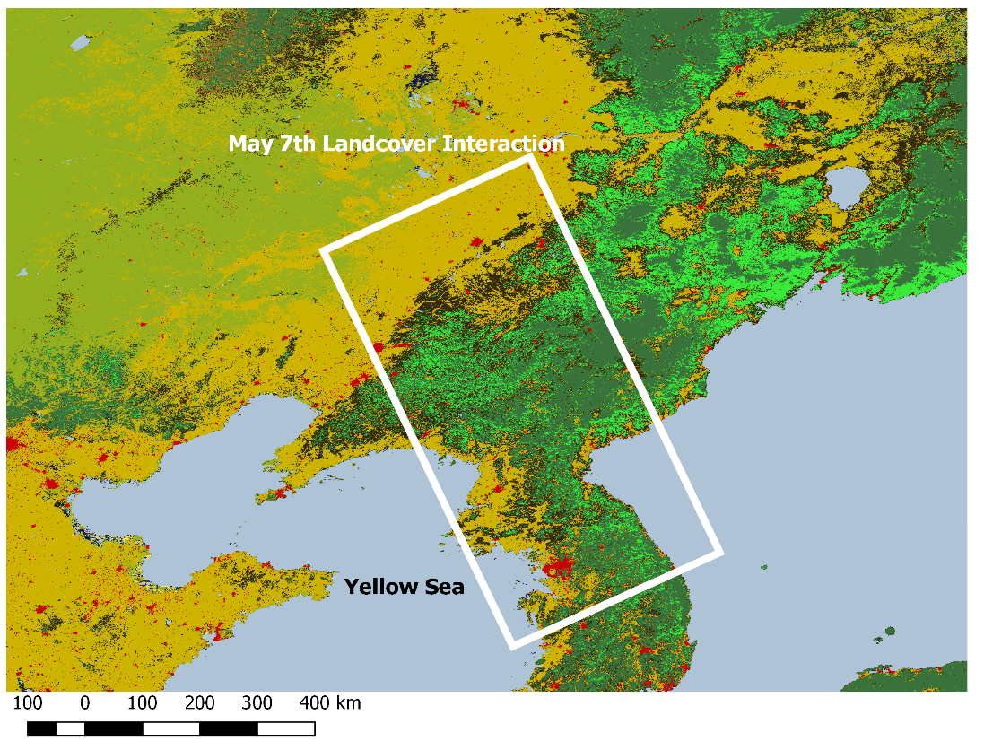
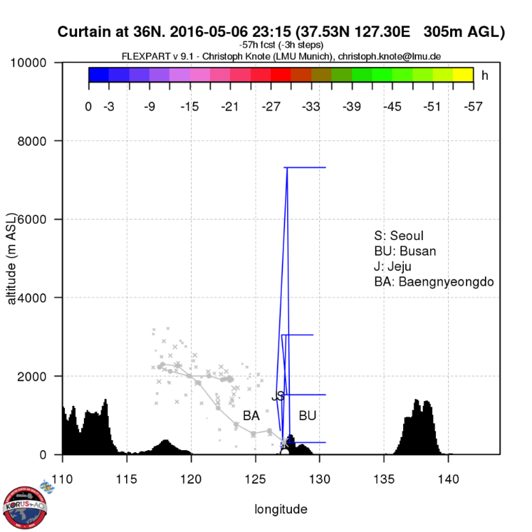

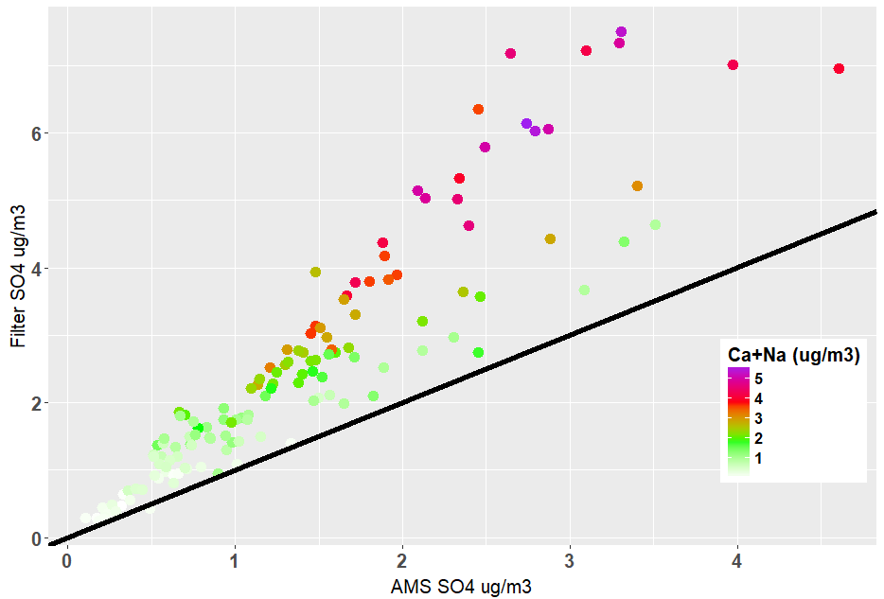
Asian Dust Observed during KORUS-AQ Facilitates the Uptake and Incorporation of Soluble Pollutants
E. Heim¹, J. Dibb¹, E. Scheuer¹, P. Campuzano Jost², B. Nault², J. L. Jimenez² , D. Peterson³, C. Knote⁴, with the rest of the Korus-AQ science team
1. Institute for the Study of Earth, Oceans, and Space, University of New Hampshire, Durham NH, USA. 2. Cooperative Institute for Research in Environmental Sciences, University of Colorado, Boulder CO, USA. 3. Naval Research Laboratory, Monterey CA, USA. 4. Ludwig Maximilians University of Munich, Munich Germany.
AGU #A33F-2424
Abstract
Results
The KORUS-AQ (Korean-US air quality) mission was a collaborative research project between NASA and South Korea’s National Institute of Environmental Research . The mission was designed to characterize spatial and temporal variability in air quality above and upwind of South Korea in late spring early summer, after peak outflow of Asian dust over the Pacific. The synoptic meteorology during the campaign included an initial dynamic period (May 2nd – 13th), stagnant and local conditions (May 17th – 22nd), Chinese transport (May 25th – 31st) and a final blocking pattern (June 1st -10th), see D. Peterson’s talk AGU #A11Q-03. This study focuses on the initial dynamic period, characterized by enhanced silica-calcium rich dust; derived from the deserts of central Asia. Soluble Ca²⁺, a dust proxy, was elevated during this dynamic period, aerosol filter samples (< 3 km altitude) (mean 1.06 = µg/m³, stdev. = 1.19, n=198). Dust decreases significantly after the dynamic period, with the final blocking pattern having (mean =0.42 µg/m³, stdev. = 0.24, n=217). This dust presents a basic surface for the abundant anthropogenic acids (HNO₃, H₂SO₄) to interact with, forming a shell of acid-base reaction products that also take up NH₃. The extent of these reactions are described by a dust pollution index which utilizes the ratio of supermicron SO₄²⁻ + NO₃⁻ and supermicron NH₄⁺ + Ca²⁺per individual aerosol filter. Samples having trajectories passing over industrial centers in eastern China approached index ratios near 1, indicating complete displacement of dust carbonate. In contrast dust samples that avoid heavy pollution maintain index rations about 0.5. This suggests that dust can act as an important carrier of Chinese pollution to Korea when transport routes incorporate Chinese anthropogenic plumes upwind of Korea. A conceptual model describing the heterogenous reactions occurring on Asian dust during transport is presented.
Dominant Aerosols During Korus
Dynamic Stagnant/Local Chinese Transport Blocking
Figures 2. Mixing ratios of dominant ions measured in bulk and submicron aerosol during the KORUS AQ campaign. Dynamic meteorological period with high Ca²⁺ highlighted by yellow box. Regression plots are the relationship between SAGA filters and AMS for each species. The top regression models were generated from total mission and the bottom regression is generated from the high Ca²⁺ dynamic period.
Dynamic Period Dust (May 4th–7th)
Dynamic Period Case Studies
Dust Pollution Index
May 4th Chinese Impacted Dust
Equation 1.
MODIS landcover 500m (2013)
Table1. Supermicron aerosol data for May 4th and May 7th. Index ratios are calculated from equation 1. *All fllters from May4th except Shandong Impacted.
Methods
Figure 3. Ca²⁺ observed on aerosol filters during the first half of the dynamic period. Inlay figure is total mission Ca^{2+.}
The DC-8 conducted 20 flights between May 1st and June 10th of 2016. The average flight was completed in 7.7 hours during which time samples were collected from near surface to 8.5 km of altitude. To avoid restricted military operation areas and commercial jetways several repeated transects were incorporated into the flights. These included transects between Seoul and Busan, Seoul and Jeju Island, transects in the Yellow Sea.
Concentrations of bulk water-soluble aerosol species Cl⁻, NO₃²⁻, Br⁻, SO₄²⁻, NH₄⁺, Mg²⁺. Ca²⁺,K⁺, Na⁺, and C₂O₄⁻² were determined in aqueous extracts of particles collected on Teflon filters(<4.5µm aerodynamic size) ; techniques described in detail in (Dibb et al., 1996; Dibb et al., 2000). In synopsis, filters were collected while the DC-8 maintained constant altitude having average exposure time of 6.30 minutes, N= 719. All filters used in this analysis were collected below 3km.
Submicron concentrations of SO₄²⁻, NO₃⁻ and NH₄⁺ were measured using HR-TOF-AMS. Detailed methods can be reviewed in (Canagaratna et al., 2007; Decarlo et al., 2008; DeCarlo et al., 2006).
Concentrations of supermicron SO₄²⁻, NO₃⁻ and NH₄⁺ were calculated as bulk - submicron measurements with AMS measurements averaged over filter integration times. These supermicron observations validate with abundance of species known to be supermicron, Na⁺ and Ca²⁺ (Figure 1).
Figures 6. Backtrajectories indicate that dust passed over the highly industrialized Shandong peninsula during transport on May 4th. Regression models of aerosol filter supermicron species collected from this transport route indicate substantial dust pollution interaction, average ratio of anions to cations = 0.78.
May 7th North Korean Impacted Dust
Figure 4. Estimated concentration of supermicron SO₄²⁻, NO₃⁻ and NH₄⁺ during the dust impacted portion of the meteorological dynamic first week of KORUS AQ.
Figure 8. Conceptual model of heterogenous reactions taking place on Hwangsa (Asian dust) during transport from interior Asia to sampling on the DC-8. Lab work by Al-Hosney et al., (2005) validates phase states of CaNO₃ and CaSO₄ on aerosol dust.
Lagrangian backtrajectory calculations were done with the FLEXPART model
(Seibert et al., 2004; Stohl et al., 2005)
version 9.2.
Figure 5. Percentages of aerosol NH₄⁺, NO₃⁻, and SO₄²⁻ contained in the supermicron mode. Individual tricolor bars represent stacked percentages per individual aerosol filter, where 300% would indicate that all NH₄⁺, NO₃⁻, and SO₄²⁻ was supermicron.
Eric W. Heim
ewh1000@wildcats.unh.edu
www.linkedin.com/in/eric-w-heim
Figures 7. Backtrajectories indicate that dust collected on May 7th avoids the heavily industrialized centers of eastern China. This dust passes over N Korea prior to reaching the KORUS AQ study region. Average cation to anion ratios = 0.51.
Research Summary
.
Figure 1. Relationship between filter and AMS SO₄²⁻ for the high Ca²⁺ dynamic period. Samples colored by sum of filter Ca²⁺ and Na⁺; species which maintain average sizing above the AMS inlet.
Synoptic meteorology during the initial portion of KORUS-AQ was conducive to transport of Asian Dust.
Supermicron NH₄⁺ and NO₃⁻ observed during KORUS-AQ was contained on aerosol dust as incorporated NH₄NO₃, Supermicron SO₄²⁻ was contained as CaSO₄.
Supermicron fraction represents a significant portion of bulk aerosol during these dust events, average ≈ 50% for NH₄⁺ and SO₄²⁻, ≈ 85% for NO₃⁻.
The loading of anthropogenic pollution on dust is a function of transport routes; these chemical reactions are characterized by the Hwangsa Conceptual model.
Dust pollution index ratios can be a useful parameter of air quality when studying pollution plumes and quantifying impacts of dust aerosol.
Theoretically, these dust chemical processes should impact optical and hygroscopic dynamics in aerosol loading. In continuation of this work we will investigate these claims using the greater KORUS-AQ data archive.
References
Al-Hosney, H. A., & Grassian, V. H. (2005). Water, sulfur dioxide and nitric acid adsorption on calcium carbonate: a transmission and ATR-FTIR study. Physical Chemistry Chemical Physics : PCCP, 7(6), 1266–1276. https://doi.org/10.1039/b417872f
Canagaratna et al., (2007). Chemical and Microphysical Characterization of ambient aerosols with the aerodyne aerosol mass spectrometer. Mass Spectrometry Reviews, 26, 185–222. https://doi.org/10.1002/mas
Decarlo et al., (2008). Fast airborne aerosol size and chemistry measurements above Mexico City and Central Mexico during the MILAGRO campaign. Atmos. Chem. Phys. Atmospheric Chemistry and Physics, 8, 4027–4048. https://doi.org/10.5194/acp-8-4027-2008
DeCarlo et al., (2006). Field-deployable, high-resolution, time-of-flight aerosol mass spectrometer. Analytical Chemistry, 78(24), 8281–8289. https://doi.org/10.1021/ac061249n
Dibb, J. E. et al., (1996). Asian influence over the western North Pacific during the fall season: inferences from lead 210, soluble ionic species and ozone. Journal of Geophysical Research, 101(D1), 1779–1792. https://doi.org/10.1029/94JD03117
Dibb, J. E. et al., (2000). Composition and distribution of aerosols over the North Atlantic during the Subsonic Assessment Ozone and Nitrogen Oxide Experiment (SONEX). Journal of Geophysical Research, 105(D3), 3709–3717. https://doi.org/10.1029/1999JD900424
Seibert, P. et al., (2004). Source-receptor matrix calculation with a Lagrangian particle dispersion model in backward mode. Atmospheric Chemistry and Physics, 4(1), 51–63. https://doi.org/10.5194/acp-4-51-2004
Stohl, A. et al., (2005). Technical note: The Lagrangian particle dispersion model FLEXPART version 6.2. Atmospheric Chemistry and Physics, 5(9), 2461–2474. https://doi.org/10.5194/acp-5-2461-2005

