Slide 1
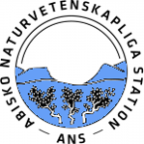
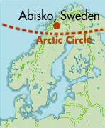



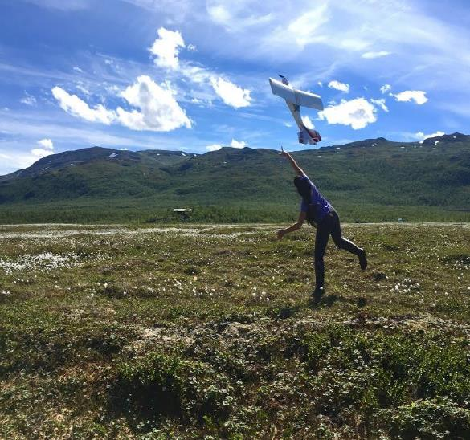
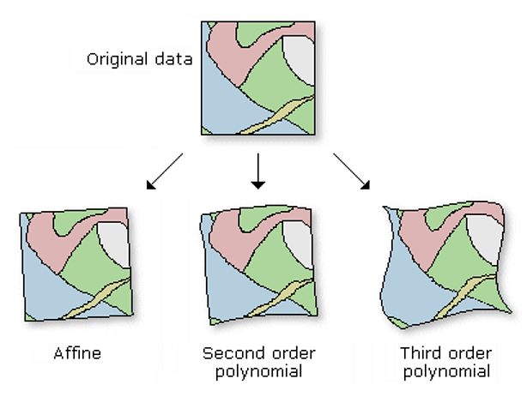
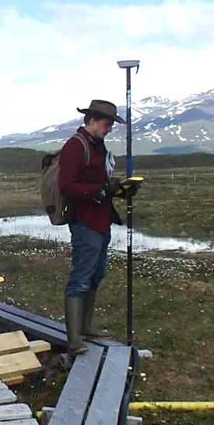
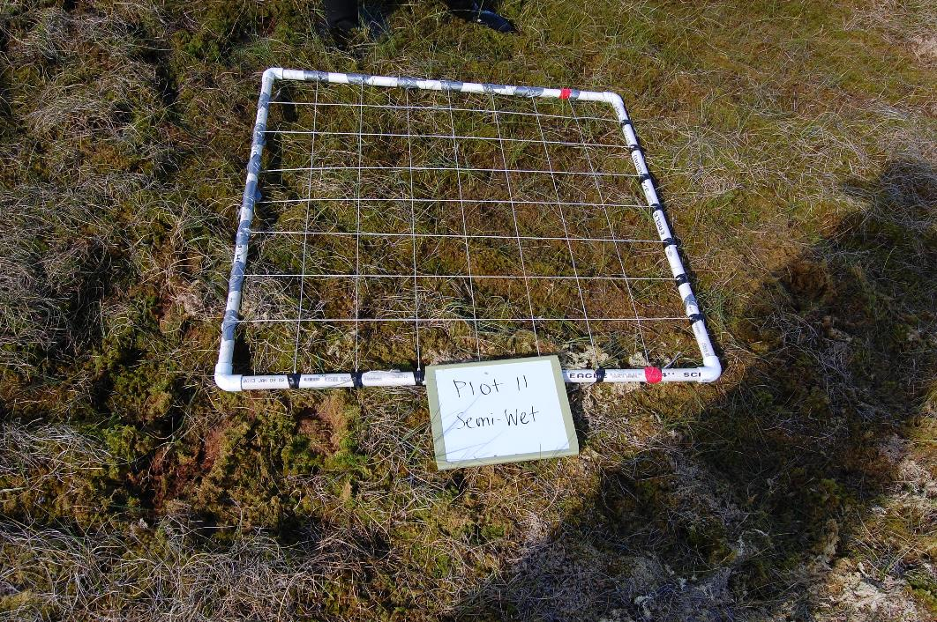
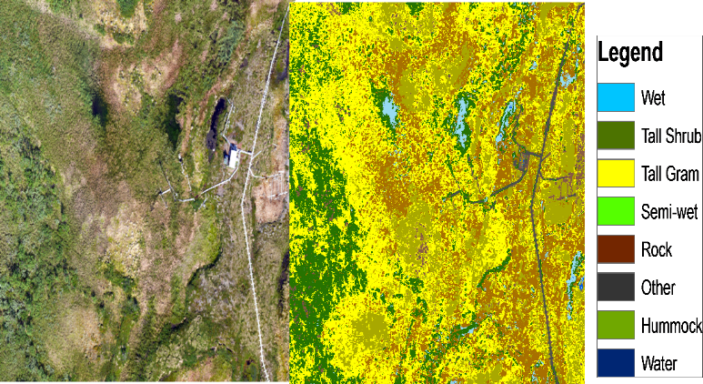
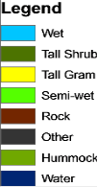
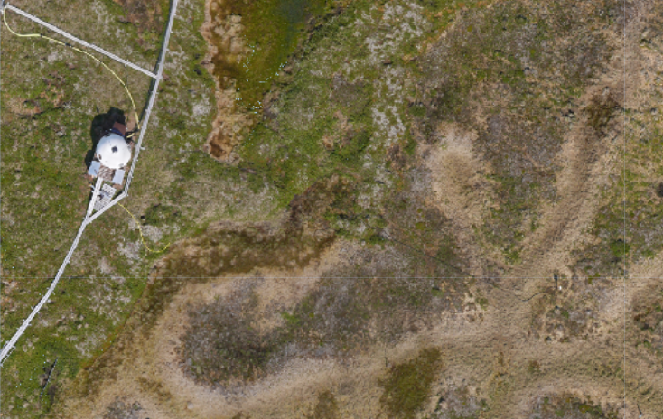
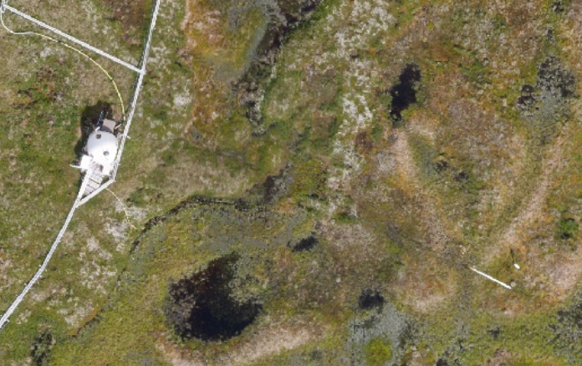
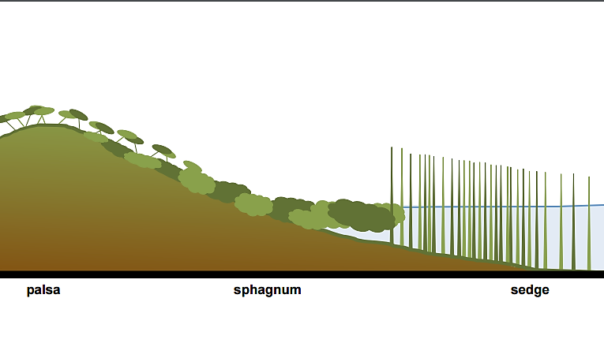
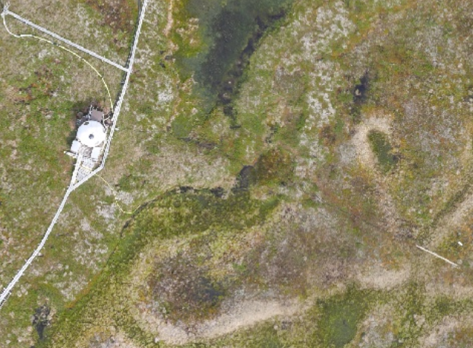
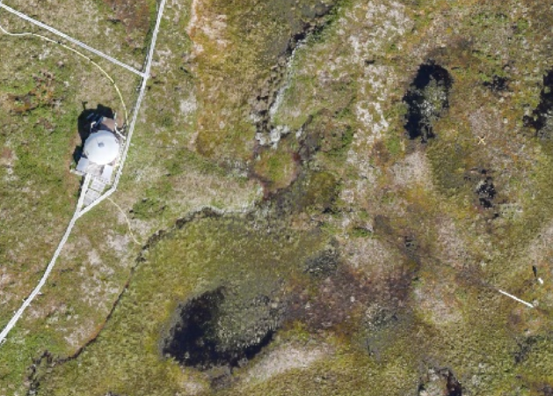
Four Years of UAS Imagery Reveals Vegetation Change
Due to Permafrost Thaw
AGU # B43G-2218
Jessica DelGreco¹, Christina Herrick², Kellen McArthur¹, Ruth Varner² , Anthony John Garnello³, Daniel Finnell⁴, Carmody McCalley⁵, Michael W Palace²
¹University of New Hampshire, ²Institute for the Study of Earth, Oceans, and Space (EOS) UNH, ³University of Arizona, ⁴Virginia Commonwealth University, ⁵Rochester Institute of Technology
Contact Information: Jlq294@wildcats.unh.edu
Summary
Methodology
Warming trends in sub-arctic regions have resulted in thawing of permafrost which in turn induces change in vegetation across peatlands both in areal extent and composition. Collapse of palsas (i.e. permafrost plateaus) have also been correlated to increases in methane (CH₄) emissions to the atmosphere. By quantifying the changes in vegetation at the landscape scale, we will be able to understand the impact of thaw on CH₄ emissions in these complex and climate sensitive northern ecosystems. We combine field-based measurements of vegetation composition and high resolution Unmanned Aerial Systems (UAS) imagery to characterize vegetation change in a sub-arctic mire. At Stordalen Mire, Abisko, Sweden, we flew a fixed-wing UAS in July of each year between 2014 and 2017 over a 1 km x 0.5 km area. Hummock sites, representing intact permafrost, decreased coverage by 10% from 2014-2017, while semi-wet sites increased coverage by 23%. This four year comparison of vegetation cover has indicated a rapid response to permafrost thaw.
Research Objective
Analyze how vegetation from Stordalen Mire has changed from 2014-2017 in response to permafrost thaw.
1. Fly UAS over Stordalen
Mire (1 km x 0.5 km)
2. Georectify imagery using GPS control points
3. Collect vegetation data (training data for classification)
4. Classify imagery using Random Forest classification
UAS Image (RGB)
Classified UAS Image
Results
2014 UAS Image
Intact permafrost
2016 UAS Image
Figure 1: Cover Type Classification
Image credit: M. Palace, C. Herrick, c.herrick@unh.edu
2015 UAS Image
2017 UAS Image
O₂
High CH₄ flux
Active Layer
Conclusions
Hummock sites, representing intact permafrost, decreased coverage by 10% from 2014-2017, while Semi-Wet sites increased coverage by 23%.
Estimation of vegetation cover types is vital in our understanding of the evolution of northern peatlands and its future role in the global carbon cycle.
Our estimates of vegetation change may be used to parameterize simulation models and create future scenarios of how the vegetation cover will change in response to climate change.
Due to high spatial resolution of imagery, accurate GPS ground control points are vital for linking the imagery to the field based measurements
Permafrost
CH₄ CH₄ CH₄
Tall shrub/Hummock Semi-Wet Wet Tall Graminoid
Increased thaw, water table, and CH₄ flux
Image credit: Clarice Perryman
Acknowledgements
Thank you to the ANS research and maintenance staff. Also, thank you to Clarice Perryman, Chris Horruitiner and Apryl Perry for assistance during flights. This research has been supported by the National Science Foundations REU program: Northern Ecosystems Research for Undergraduates (EAR#1063037).

