Slide 1
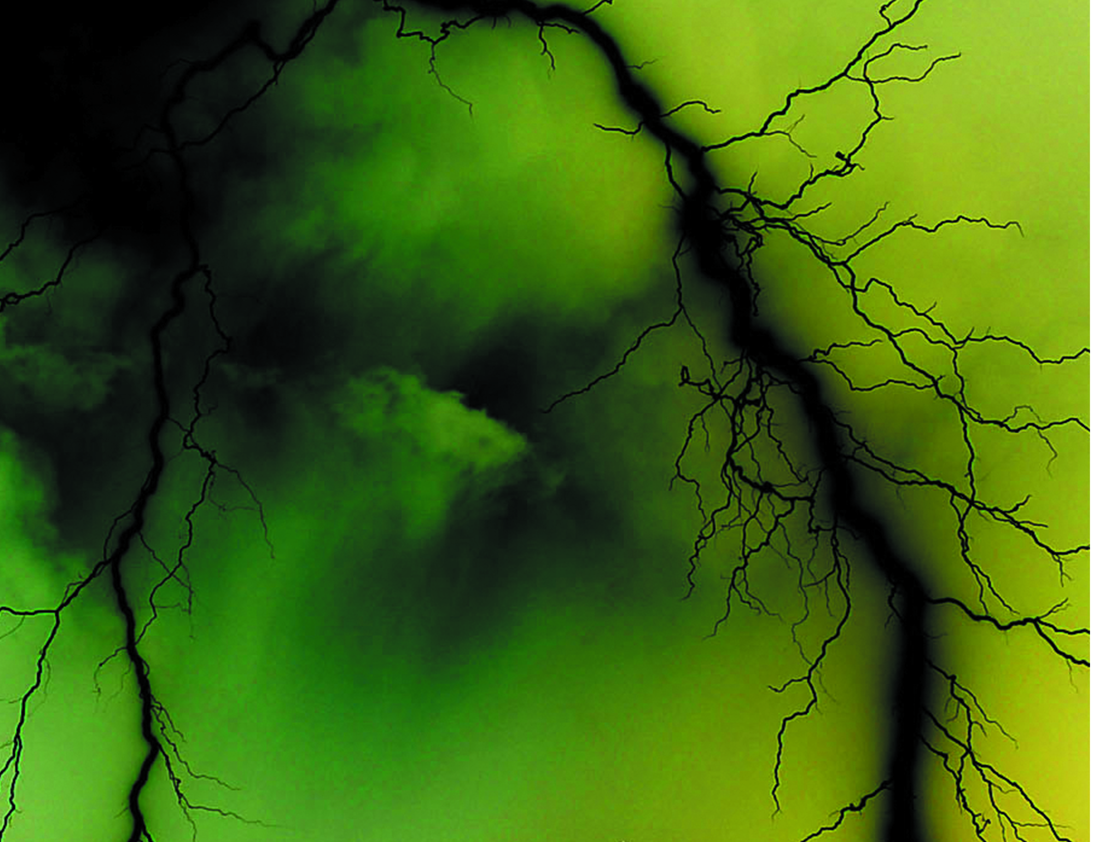

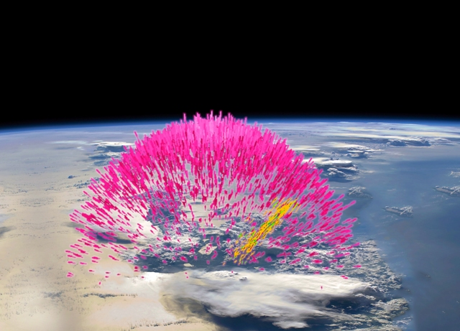
Lightning leader models of terrestrial gamma-ray flashes
AE33B-2552
Joseph R. Dwyer, Ningyu Liu, and Kevin M. A. Ihaddadene
Department of Physics and Space Science Center (EOS), University of New Hampshire, Durham, NH
Introduction
Terrestrial gamma-ray flashes (TGFs) are bright sub-millisecond bursts of gamma rays that originate from thunderstorms. Because lightning leaders near the ground have been observed to emit x-rays, presumably due to runaway electron production in the high-field regions near the leader tips [1], models of TGFs have been developed by several groups that assume a similar production mechanism of runaway electrons from lightning leaders propagating through thunderclouds. However, it remains unclear exactly how and where these runaway electrons are produced, since lightning propagation at thunderstorm altitudes remains poorly understood. An alternative mechanism for explaining TGFs is the relativistic feedback discharge, caused by back-scattered x-rays and backward propagating positrons. Because relativistic feedback discharges require large potential differences, it has been argued that the lightning leader mechanism may operate in a lower voltage regime than needed for feedback.
In this poster, spacecraft observations are used to estimate the charge moment changes produced by TGFs inside thunderclouds. These charge moment changes are, in turn, shown to require large potential differences consistent with the feedback mechanism. At the very least, this suggests that the two TGF mechanisms may be operating at the same time during the production of TGFs.
Standard TGF grammage
The total number of runaway electrons is often used to describe the size of TGFs, 10¹⁷ runaway electrons being a typical number [1]. However, this number is model dependent, depending on the electric field configuration used. A better choice for describing the runaway electrons in the source region is the total grammage (units of g/cm²) traversed by all the runaway electrons, Ξ [2]. Using REAM Monte Carlo simulations [1], the total grammage, Ξ, for TGFs is inferred from the gamma-ray fluence at the spacecraft. Other TGF properties such as the charge moment change may then be calculated directly from Ξ.
Figure 2 shows the grammage versus atmospheric column depth for a typical TGF fluence of 0.1 cm⁻² (>100 keV) between 30° and 40°, corresponding to lateral spacecraft distances of about 290 km to 420 km for a 500 km altitude. As can be seen, at polar angles between 30° and 40°, for a given fluence at the spacecraft, the grammage is approximately independent of the TGF beam width.
Potential difference in the avalanche region
Radio sferic observations suggest that 12 km is a typical TGF source altitude [3, 4], giving a charge moment change of 2 C-km (Figure 3). A 2 C-km charge moment change requires a large volume of the avalanche region to be partially discharged. The change in the average electric field in the avalanche region due to the runaway electron discharge may be estimated with the simple analytical expression for a uniformly polarized ellipsoid.
where p is the charge moment change, R is the characteristic radius of the avalanche region, Z is the length of the avalanche region, and a is a dimensionless number that depends upon the shape of the avalanche region. For instance, if the avalanche region is approximately spherical, then a = 1/3.
For the case of a spherical avalanche region,
and the change in potential in the avalanche region prior to the discharge is found to be:
Figure 4 shows a the potential difference in the avalanche region using this simple analytical model for p = 2 C-km (2000 C-m), and a = 1/3 as a function of the average electric field in the avalanche region prior to the discharge, E_{tot}. The vertical dotted line is the Relativistic Runaway Electron Avalanche (RREA) threshold field, E_{th}. The red curve shows the potential required for a relativistic feedback discharge to become self-sustaining, resulting in a TGF. As can be seen, for many electric field values, the charge moment change inferred from spacecraft observations implies that the source region was above the feedback threshold, suggesting that relativistic feedback played a role in the TGF.
PIC simulation of the leader mechanism
To further explore properties of TGFs produced by the leader mechanism, a particle-in-cell (PIC) code was used to simulate a TGF and the associated discharge. A lightning leader is simulated propagating through a uniform field with magnitude of 0.7E_{th}. Seed particles are inject with a peak rate of 5×10¹⁹ s⁻¹, 500 times larger than the largest rate ever observed from lightning leaders near the ground [5]. The electric field profile, particle rates and charge moment changes calculated from the simulation are shown in Figures 5-7.
Figure 5 Electric field prior to the lightning (blue), at the start of the TGF (red) and after the TGF (black).
Figure 2. The total grammage versus atmospheric column depth for a standard TGF with a fluence of 0.1 cm⁻² (>100 keV) at a spacecraft altitude of 500 km for polar angles between 30° and 40°. The dotted line corresponds to a source altitude of 12 km.
Figure 6 Gamma-ray rate (black) and seed particle injection rate (red).
Figure 1. Artist’s impression of a TGF.
NASA
Acknowledgements
This material is based upon work supported by the Air Force Office of Scientific Research under award number FA9550-16-1-0396
References
¹Dwyer, J. R., D. Smith and S. A. Cummer (2012), High Energy Atmospheric Physics: Terrestrial Gamma-ray Flashes and Related Phenomena, Space Science Rev, DOI 10.1007/s11214-012-9894-0.
²Dwyer, J. R., et al. (2017), Characterizing the source properties of terrestrial gamma ray flashes, J. Geophys. Res. Space Physics, 122, 8915–8932, doi:10.1002/2017JA024141.
³Cummer, S. A., et al. (2014), The source altitude, electric current, and intrinsic brightness of terrestrial gamma ray flashes, Geophys. Res. Lett., 41, 8586–8593, doi:10.1002/2014GL062196.
⁴Lyu, F., S. A. Cummer, and L. McTague (2015), Insights into high peak current in-cloud lightning events during thunderstorms, Geophys. Res. Lett., 42, 6836–6843, doi:10.1002/2015GL065047.
⁵Schaal, M. M., J. R. Dwyer, Z. H. Saleh, H. K. Rassoul, J. D. Hill, D. M. Jordan, and M. A. Uman (2012), Spatial and energy distributions of X-ray emissions from leaders in natural and rocket triggered lightning, J. Geophys. Res., 117, D15201, doi:10.1029/2012JD017897.
Figure 4. Potential difference in a RREA avalanche region required to produce a 2 C-km discharge versus the average electric field in the avalanche region. For most field values, the potential is above the threshold required for relativistic feedback to produce a TGF. For the field values below this threshold, it is plausible that continued propagation of the leader would push the system above the feedback threshold.
Figure 3. The total charge moment change associated with the runaway electrons versus atmospheric column depth for a standard TGF with a fluence of 0.1 cm⁻² (>100 keV) at a spacecraft altitude of 500 km for polar angles between 30° and 40°. The dotted line corresponds to a source altitude of 12 km.
Figure 7 Charge moment charge produced by the TGF. Note that even for a very large seed particle injection rate, the charge moment charge is small compared to that inferred by spacecraft observations.

