Slide 1






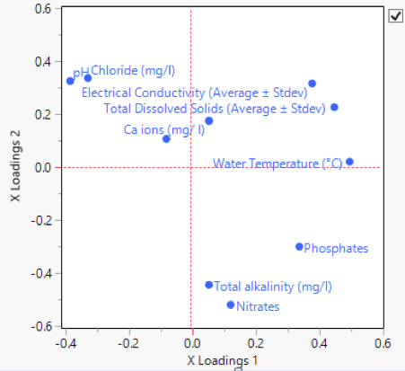
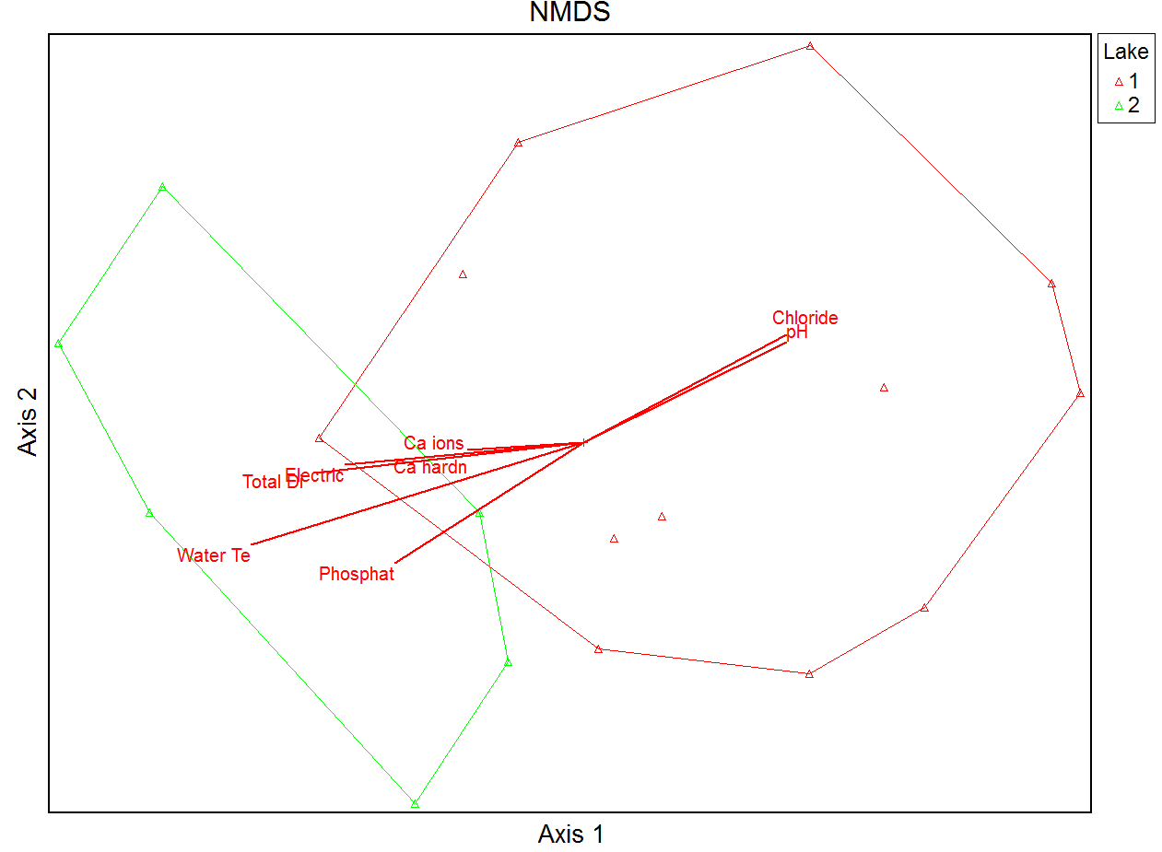
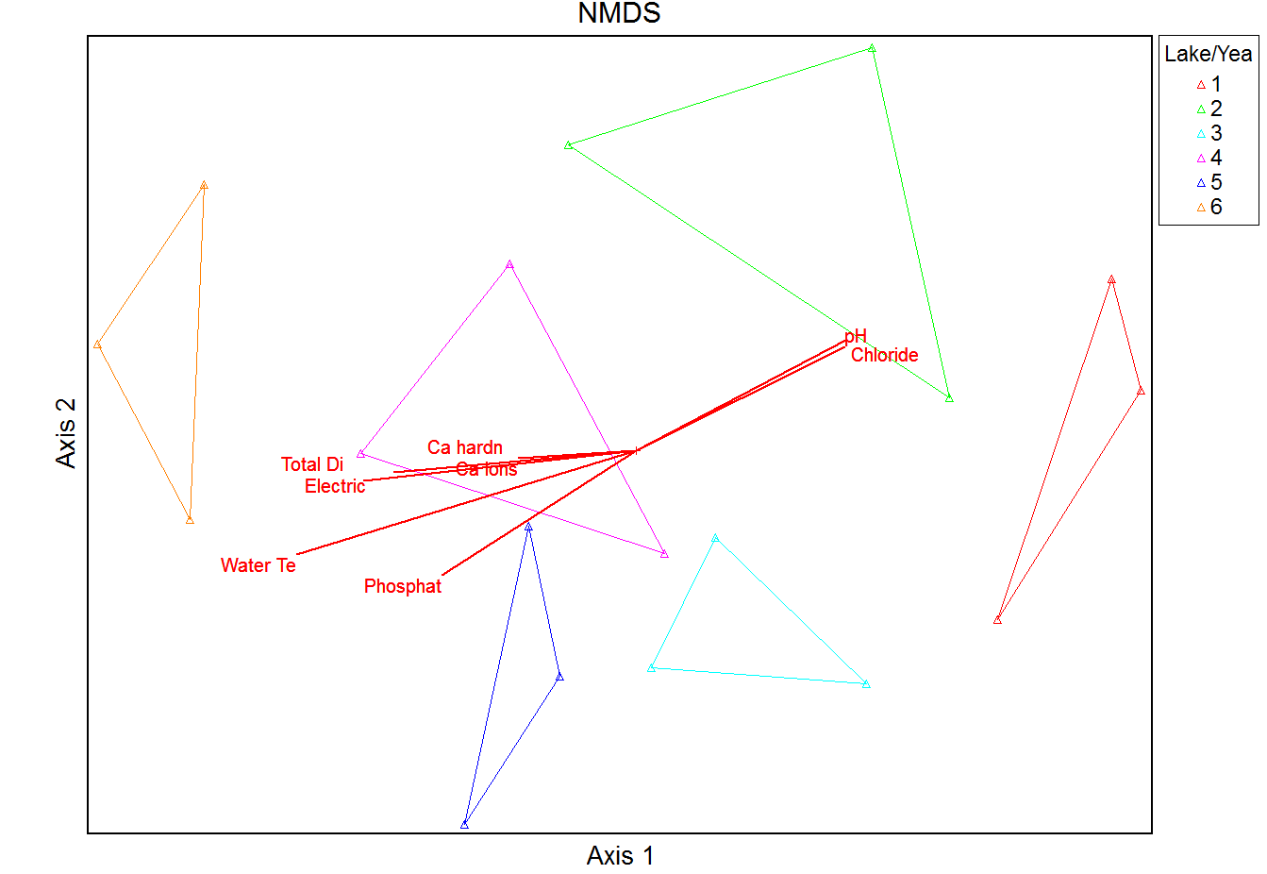
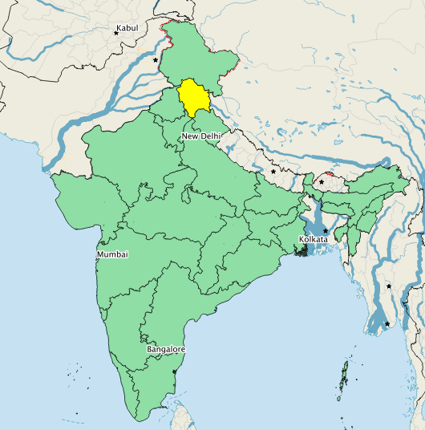
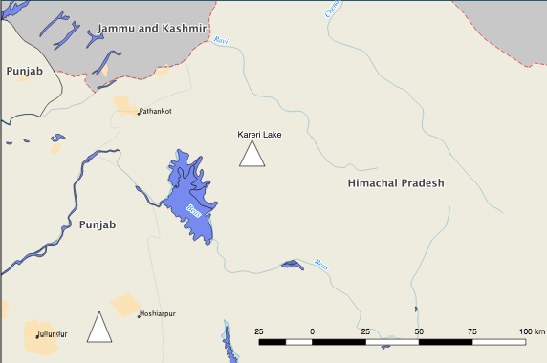
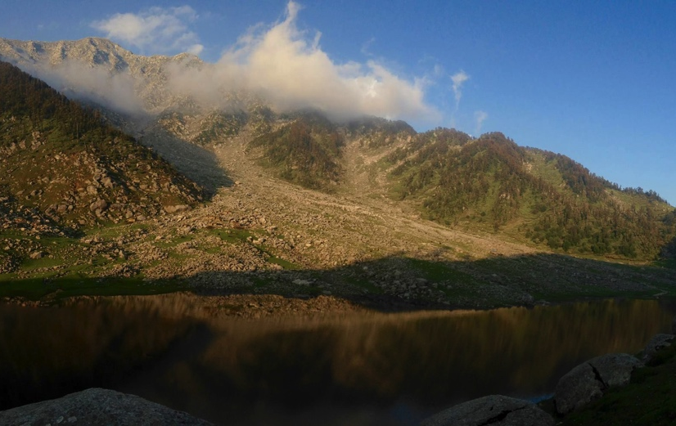
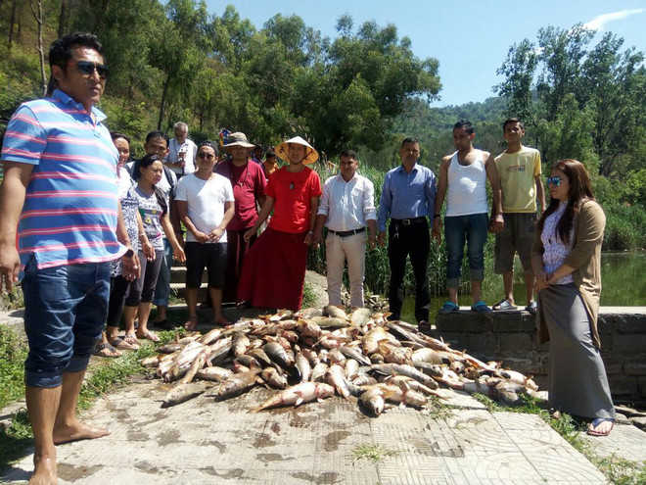
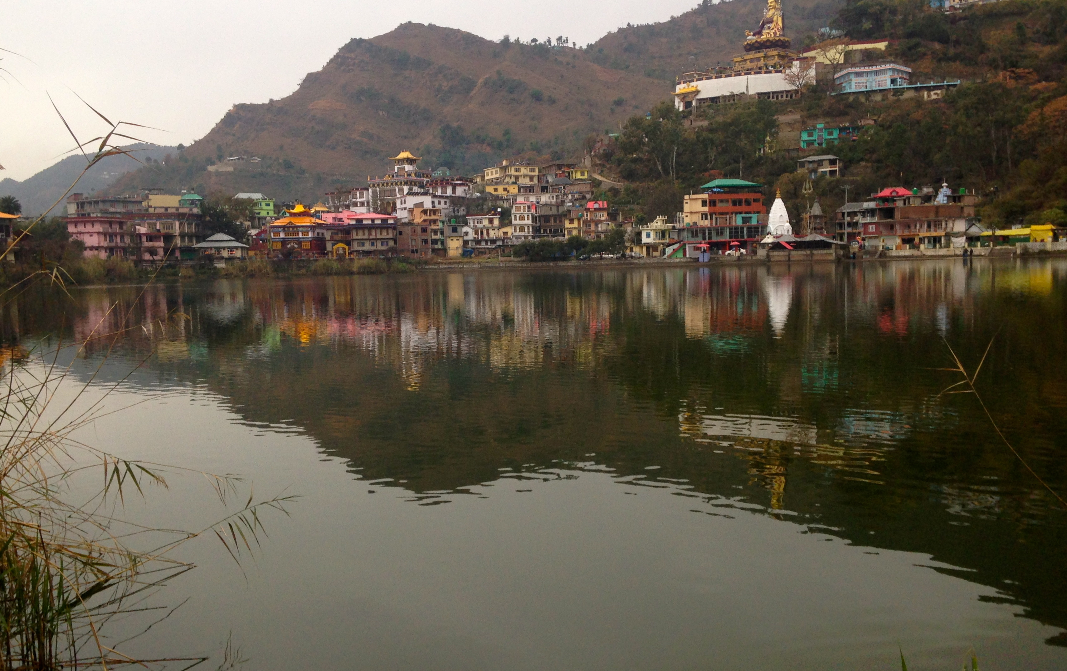
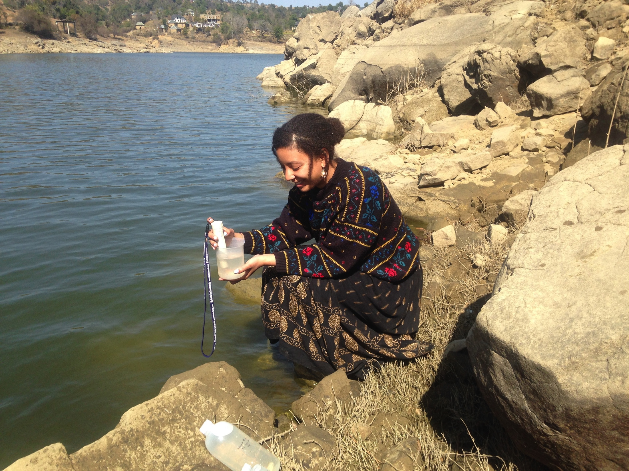
Characterizing anthropogenic impacts on two mid-altitude Himalayan lakes in the Western Himalaya: A look at shifts in water chemistry and phytoplankton communities
Tamara Marcus¹, Sudha Tiwari², Jay Prakash Bhatt², Maharaj K. Panit², Ruth Varner¹
Earth Systems Research Center, Inst. For the Study of Earth, Oceans and Space and Dept. of Earth Sciences University of New Hampshire¹,
University of Delhi, Centre for Interdisciplinary Studies of Mountain and Hill Environment²
Background
Results
Despite concerns for environmental degradation, lack of empirical investigations and quantitative data are major constraints in understanding these events.
Understanding and quantifying anthropogenic impacts in the Himalaya is important because these water bodies serve as a source of water for 1.4 billion people while 80% of people use these water resources for agricultural purposes, making maintaining the health of these aquatic systems paramount in national issues of food security.
Local economies depend upon these lake systems via the large tourist industry based on Himalayan treks making conserving these natural resources an economic and environmental priority.
2.
3.
4.
pH
Dissolved Oxygen
Chloride
Electrical Conductivity
Nitrates
Total Dissolved Solids
Axis 2 (78.26%)
Phosphates
Ca²⁺ ions
pH
Water Temperature
-0.25 0.00 0.25
X Loadings 2
Research Questions
Chloride
Total Alkalinity
Phosphates
Temperature
Kareri
Rewalsar
To determine the impact of human development on Himalayan lakes, we investigated Rewalsar, a spring-fed lake (1500m) and Kareri (3000m) a glacial-fed lake in the state of Himachal Pradesh, India (Fig. 1).
Is there a significant change in lake water chemistry of Rewalsar and Kareri Lake from 2012 to 2016?
Is there a significant change in phytoplankton species composition in each lake from 2012 to 2016?
Is lake chemistry influencing species composition? If so, which variables have the most influence?
Total Dissolved Solids
Total Alkalinity
Axis 1 (41.01%)
Ca²⁺ Hardness
Electrical Conductivity
Nitrates
5.
-0.50 -0.25 0.00 0.25
X Loadings 1
6a.
6b.
6c.
5b.
5c.
Axis 2 (78.26%)
go
0 20 40 60 8 0
0 50 100 150 200 250 300 350
0 2 4 6 8 10 12 14
1.
Kareri (pb)-12
Kareri (pp)-12
Kareri (pb)-16
Kareri (pp)-16
Rewal (pb)-16
Rewal (pp)-16
Water Temp. Chloride Ca²⁺ Hardness Ca²⁺ ions
Electrical Conductivity Total Dissolved Solids Total Alkalinity
pH Dissolved Oxygen Nitrates Phosphates
Figure 2. PCA of communities by season/year: Data was transformed and Correlation matrix was used. First two axes were significant so data is grouping by year and altitude, longitude, and latitude. Sample units are grouping by fall and spring season which means there is some seasonal variation responsible for changes in lake chemistry. Figure 3. Partial Least Squares Regression: Analysis shows that water temperature and pH have the highest influence on phytoplankton communities, explaining 77.98% of variance. Axis scores from previous NMDS analysis were used. Figure 4. NMDS of communities by lake: NMDS shows phytoplankton communities in Kareri Lake in 2012 and Rewalsar are distinct. Bray-Curtis distance measure was used. Figure 5. NMDS of communities by season/year: NMDS shows a shift in phytoplankton communities in Kareri Lake in 2012 to begin to resemble the community observed in Rewalsar by 2016. Bray-Curtis distance measure was used. Figure 6a-c.Boxplots of lake chemistry data: Boxplots show range of lake chemistry data over the 2012-2016 sampling period.
pH Dissolved Oxygen Nitrates Phosphates
Axis 1 (41.01%)
Rewalsar Lake
7a.
7c.
Discussion/Future Work
Figure 1. Location of Sample Sites: Kareri and Rewalsar Lake are located in the Indian state of Himachal Pradesh a little more than 100 km away from each other.
Results showed a significant change in water chemistry and phytoplankton communities.
Rewalsar Lake showed an increase in pollutant tolerant algae over the sample period.
PCA showed that the 2016 data from Kareri Lake had phytoplankton communities and chemical data resembling the urban lake of Rewalsar.
TDS measurements were highest in Rewalsar Lake (200.11 ppm in spring 2016) compared to the TDS levels of Kareri (21.66 ppm), indicating a higher amount of surface runoff from the surrounding area in Rewalsar.
Abundance of Microcystis and other pollution indicating taxa is on the rise, suggesting progressive eutrophication of Rewalsar Lake emanating from anthropogenic impacts.
NMDS and PLSR provide support for potential acidification events in these water bodies.
Figure 3. Partial Least Squares Regression: Analysis shows that water temperature and pH have the highest influence on phytoplankton communities, explaining 77.98% of variance. Axis scores from previous NMDS analysis were used.
Methods
Measurements taken at each lake in the spring periods of 2013 and 2016.
Water samples were analyzed for major ions, nitrates, phosphates, DO, pH, temperature, turbidity, and TDS.
Planktonic algal samples were collected from each lake by filtering 50 L of surface water through a 25μm sieve.
Benthic diatom species were collected by taking 5 cm x 5 cm quadrant scrapings from three rocks located around the lake.
Species were counted and identified using standard taxonomic literature.
Statistical analysis was performed using PC-ORD and R.
Figure 7a. Kareri Lake: (3000m) a glacial-fed lake in the state of Himachal Pradesh. Figure 7b. Rewalsar Lake: is a spring-fed lake (1500m) surrounded by a rapidly growing town and agricultural fields. Figure 7c. Fish kills in Rewalsar: The fish kills in Rewalsar during the summer monsoon have been getting progressively more extreme, lasting a longer period of time and now occurring every summer. Figure 7d. Sampling Rewalsar Lake: Taking water total dissolved measurements in Rewalsar.
7b.
7d.
Acknowledgements
I would like to thank the scientists and staff at the University of Delhi Centre for Interdisciplinary Studies of Mountain and Hill Environment and Mark Edlund for his mentorship through a University of Minnesota Undergraduate Research grant. Thank you to my funding sources: Rotary International, Fulbright, and the University of Minnesota. I would also like to thank the field team based in India that ensured the success of our sampling seasons.
Notes:
Results section: PCA by lake
PCA by time & transition
NMDS

