Slide 1


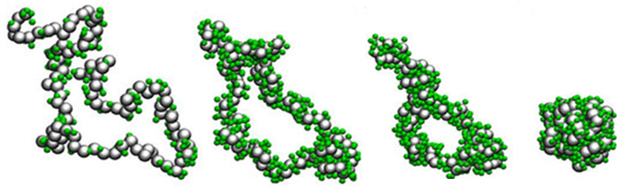
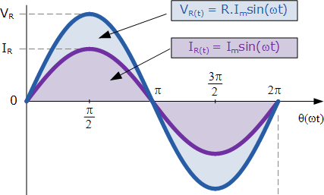
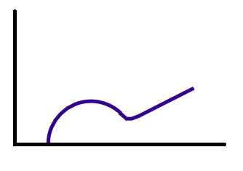
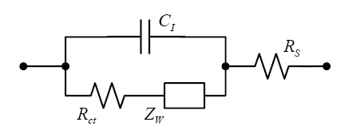

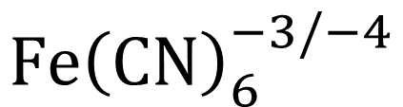
Stimulus Response Characterization of Surface-Immobilized Elastin-Like-Polymers using Electrochemical Impedance Spectroscopy
Marissa A. Morales¹, Eva Rose M. Balog², Jeffrey M. Halpern¹
Contact: mm1452@wildcats.unh.edu or jeffery.halpern@unh.edu
¹Chemical Engineering, University of New Hampshire ²Chemistry and Physics, University of New England
BACKGROUND
Elastin-Like-Polymers
Electrochemical Impedance Spectroscopy
Inverse Phase Transition
Conformational change occurs at transition temperature
  Minimize unfavorable interactions between hydrophobic residues and aqueous environment
Impedance is a measure of resistance to flow of electrons
Alternating Voltage Potential
Randles Circuit
Charge Transfer Resistance
(R_{ct})
Nyquist Plot
$T_{c}$
Transition temperature (T_{c}) affected
  Environmental stimuli
  Hydrophobic surface area
Commonly used in drug delivery
  Translate technology to biosensor field
Charge Transfer
Z” (Imaginary Impedance)
Mass Transfer
Soluble Protein
Increasing pH, ionic strength, temperature
Insoluble Protein Aggregate
Redox Couple
Ferri/Ferrocyanide
Hydrophilic Residues
Hydrophobic Residues
$$Fe{\left(CN\right)}_{6}^{−3/−4}$$
Z’ (Real Impedance)
METHODS
Protein Constructs
Surface Functionalization
Stimulus Response
Elastin-Like-Polymer [VPGXG]
Negative Control
1 mM ferri/ferrocyanide
V_{AC} = 1 mV rms
V_{DC} = 0.226 V vs. Ag/AgCl
Thiol Chemistry
Au electrode ~24 hour soak 0.05 mg/mL ELP-C in 3.5 mM TCEP
Hydrophobic Surface Area
ELP-C modified Au electrode 10 minute soak in 0.01 mg/mL ELP-K in UHP
Ionic Strength
ELP-C modified Au electrode 10 min soak in 0.01 mg/mL ELP-K in 1.5 M NaCl
Reversibility
ELP-C modified Au electrode 1 hour soak in DMSO
25 pentapeptide repeats, 13.6 kDa
X = Isoleucine (I)
ELP-C
ELP-K
Step 0
Step 1
Step 2
Step 3
Step 4
e-
e-
e-
e-
e-
e-
e-
e-
e-
e-
e-
e-
e-
e-
e-
e-
C-[VPGIG]₂₅
K-[VPGIG]₂₅
e-
e-
e-
e-
Au Sensor Surface
Au Sensor Surface
Au Sensor Surface
Au Sensor Surface
Au Sensor Surface
RESULTS
Surface Functionalization
Stimulus Response
CONCLUSIONS
FUTURE WORKS
ACKNOWLEDGMENTS
Increasing trend of impedance indicates
  Protein surface functionalization
  Development of protein matrix due to stimulus
Poor fit to experimental data
  Inability to quantify trend
Variability within trials
Reproducibility of results
  Optimization of electrochemical impedance spectroscopy settings
Improvement of circuit for data analysis
This author would like to acknowledge NSF EAGEAR (CBET 1638896) and the Graduate School at UNH for funding this work, Halpern’s Surface Enhanced Electrochemical Diagnostic Sensors Lab and Balog Lab.

