Slide 1

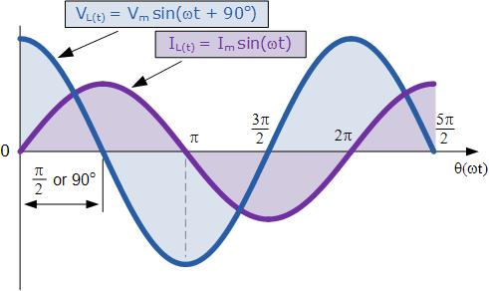
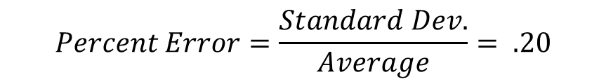

Parameter Optimization for the Detection of Nucleotides using Electrochemical Impedance Spectroscopy
Caroline A. Ladegard and Jeffrey M. Halpern
Contact: cal2003@wildcats.unh.edu or Jeffrey.Halpern@unh.edu
Chemical Engineering Department, University of New Hampshire
background
Static vs. flow cell reproducibility control comparison
DNA methylation is an important marker for many diseases
      Bisulfate treatment and aPCR changes nucleotides in sequence with methylation presence (Koo et al., 2014)
Nucleic acid bases can be distinguished using gold affinity interactions following the pattern A > C ≥ G > T (Kimura-Suda et al., 2003)
Previously established using infrared spectroscopy
Electrochemical impedance spectroscopy (EIS) is a sensitive and applicable to point-of-care diagnostic sensing
      EIS has difficulties in reproducibility
Goal: Fundamental approach to determine optimal conditions for reproducible data sensing nucleic acids using EIS.
Average R_{CT} = 2,000 ± 400
Average R_{CT} = 7,900 ± 1,300
$$Percent Error=\frac{Standard Dev.}{Average}= .20$$
$$Percent Error=\frac{Standard Dev.}{Average}= .16$$
methods
EIS applies alternating potential to determine impedance present on working electrode
http://www.electronics-tutorials.ws/accircuits/ac-inductance.html
Gold electrode soaked in nucleotides dissolved into UHP water for
5 minutes
Used 5 mM Ferri/Ferrocyanide (FFCN) solution for conducting EIS
Conditions Tested:
  Static cell compared to flow cell at 15 mL/hr
  Adsorbance of A, C, and G compared to control:
    Single nucleic acid bases
    17-base repeat oligonucleotides
R_{CT} was determined by fitting model to a Randles Circuit
Trials done in triplicate to determine significance
Figure 1: Comparison of Triplicate Reproducibility between Static (A) and Flow Cell (B) Systems in 5 mM Ferri/Ferrocyanide on Gold
Comparing R_{CT} IN Nucleic acid base sensing and 17-base repeat oligonucleotide sensing
 | Control | Adenine | Cytosine | Guanine
Average | 7,900 | 22,300 | 25,300 | 30,500
Standard Deviation | 1,300 | 2,700 | 2,300 | 8,700
p-value (n = 3) |  | 0.001 | 0.0003 | 0.01
 | Control | Adenine | Cytosine | Guanine
Average | 7,900 | 10,900 | 34,000 | 28,700
Standard Deviation | 1,300 | 3,400 | 2,400 | 11,400
p-value (n = 3) |  | 0.22 | 0.0001 | 0.034
C_{dl}
Figure 2: Statistical R_{CT} comparison of 750 µM single nucleic acid bases in 5 mM Ferri/Ferrocyanide on gold electrode at 15 mL/hr flow rate. The p-value compares the nucleic acid base R_{CT} to the control trials.
Figure 3: Statistical R_{CT} comparison of 1 µM 17-base repeat oligonucleotides in 5 mM Ferri/Ferrocyanide on gold electrode at 15 mL/hr flow rate. The p-value compares the repeating oligonucleotide base to the control trials.
R_{S}
R_{CT}
Z_{W}
Acknowledgements
CONCLUSIONS
Future work
Thanks to the Hamel Center for Undergraduate Research, Halpern’s Surface Enhanced Electrochemical Diagnostics Sensors Laboratory, and Marissa Morales
Similar reproducibility between static and flow cell
High variability of adenine and guanine possibly due to base stacking in aqueous solvent
Significant difference between A, C, G, and control for single nucleic acid bases and C, G, and control for 17-base repeat oligonucleotides
Continuing experiments on static and flow cell to further differentiate
Reproducing with different buffers to monitor base stacking
Sensing of DNA sequence using bisulfate treatment and asymmetric PCR
References
 | Methylated | Unmethylated
Initial Strand | CC^{M}GC^{M}GGAC^{M}GC^{M}GG | CCGCGGACGCGG
After Bisulfate | UCGCGGACGCGG | UUGUGGAUGUGG
After aPCR | AGCGCCTGCGCC | AACACCTACACC
Kimura-Suda H., et al., Journal of American Chemical Society, 2003, Volume 125, page 9014-9015
Koo, K.M., Ibn Sina, A.A., Carrascosa, L.G., Shiddiky, M.J. a., and Trau, M. (2014). eMethylsorb: rapid quantification of DNA methylation in cancer cells on screen-printed gold electrodes. Analyst 139, 6178–6184.

