Slide 1


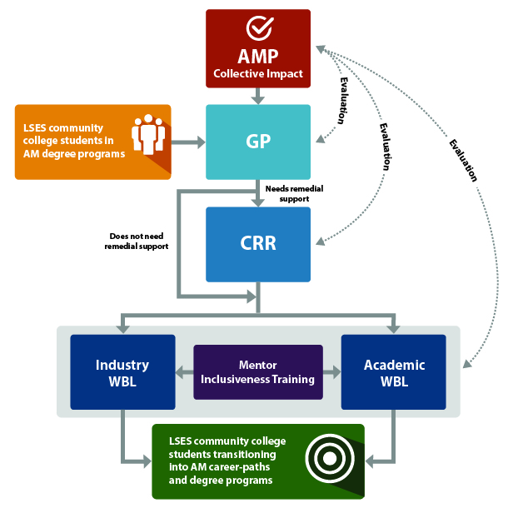
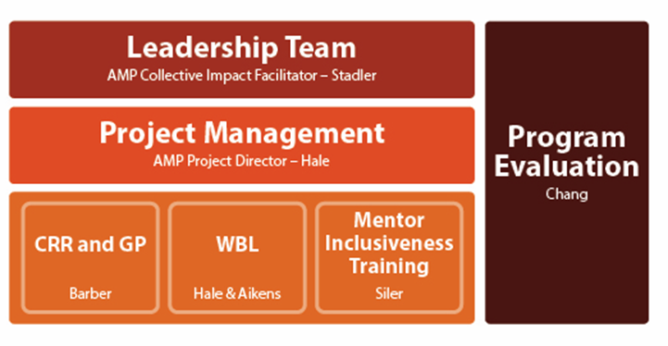
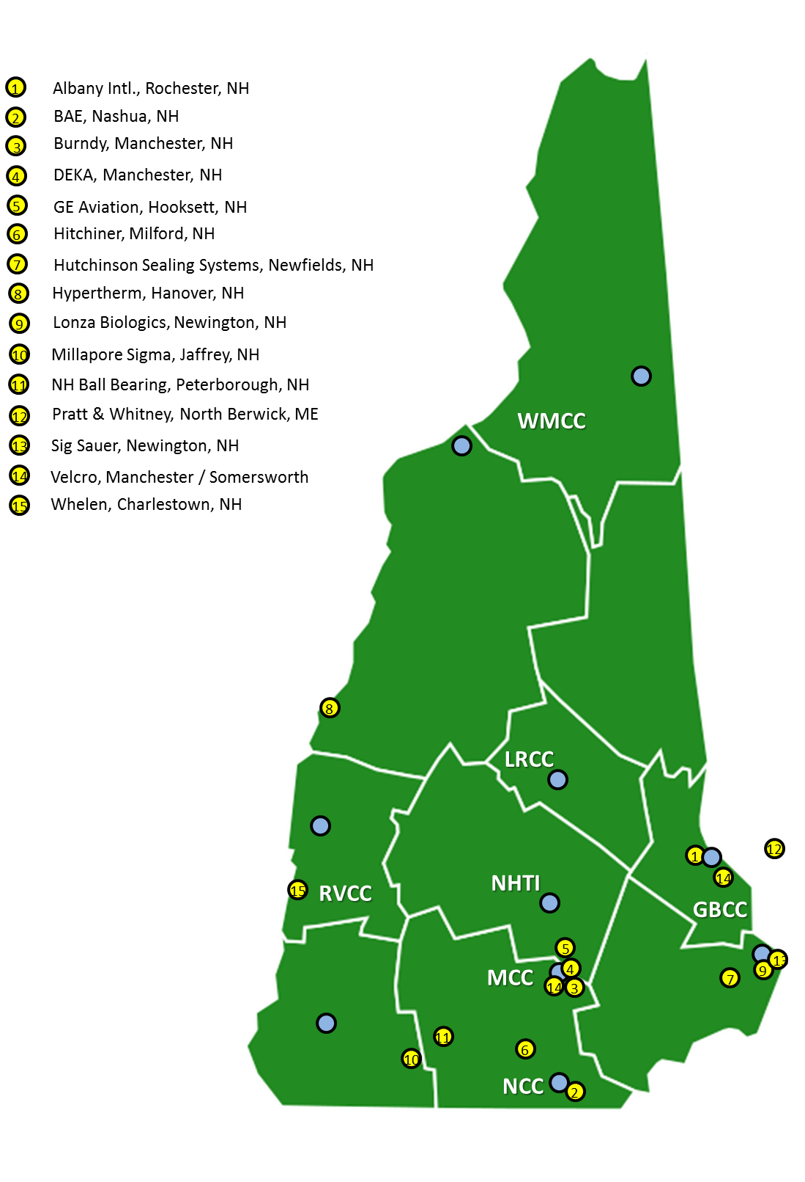
New Hampshire Advanced Manufacturing Partnership (NH-AMP)
NSF #174491; Cohort #2
PI – P. T. Vasudevan¹; CoIs – M. Aikens¹, L. Barber², S. Hale¹, B. Kinsey¹
¹University of New Hampshire – Durham
²Community College System of New Hampshire
Vision
Goals and Metrics
Leadership and Communication
Pilot Goals: This pilot project addresses the following goals toward increasing LSES student retention in Advanced Manufacturing programs at NH community colleges
Central coordinating entity that ensures Collective Impact for all AMP participants.
Clear GP for LSES CC students to obtain AM placements in paid WBL.
Implement CRR strategies to promote retention in AM pathways.
Mentorship training for supervisors
Paid Work-based Learning and Research Internships
Increase AM student retention to 50% (from current 25%).
Pilot Metrics: Mixed-methods interviews, institutional data, student academic records, pre/post surveys, and program documentation review
Track and quantify AMP students’ intention to persist on AM pathway and impacting factors
Pre-survey/Post-survey
  Level of interest to remain on pathway
  Confidence in STEM abilities
  Intention to persist
Interviews/Focus Groups
  Challenges to persist
  Formative Feedback
Student Records
  Academic GPA
  Work History
  Applications
    AM Employment
    UNH Transfer
Collective Impact – Leadership Team + Implementation Team + CI Facilitator
Trellis – Private Site (in development)
NH-AMP Website (in development)
NH-AMP Theory of Change
Increase Low Socio-Economic Status (LSES) student retention through
Guided Pathways (GP) mentorship
Co-requisite Remediation (CRR)
Work-based Learning and Research Internships
Supervisor Mentorship Training
Expansion, Sustainability, and Scale
1) Beyond Low Socio-economic Status
Nationwide, community colleges students are 49% white, 22% Hispanic, 14% Black, 6% Asian/Pacific Islander, and 1% Native American; and 57% are women – making community colleges more diverse than other institutions of higher education.
2) Beyond Advanced Manufacturing
While specific stakeholder partners and industry sectors may change, AMP provides an adaptable framework for developing shared goals, and aligning activities and resources in support of those goals through Collective Impact.
3) Beyond Community Colleges
To fully address this grand challenge requires input from the entire spectrum of organizations that affect the workforce: employers, community and technical colleges, community-based service providers, job search services, unions, trade/professional associations, and more. The AMP Collective Impact framework provides a flexible structure to support collaboration and coordination across a range of challenges and partners.
4) Beyond New Hampshire
The NH-AMP collaboration model will be transferable and scalable to other states’ systems of community and junior colleges.
Partnerships
Leadership Team Members
Sr. Vice Provost Academic Affairs, UNH
Chancellor, Community College System of New Hampshire
Director, NH Manufacturing Extension Partnership
Director, Economic Development, NH Dept. of Bus. and Econ. Affairs
Chief Workforce Officer, Advanced Regenerative Medicine Institute
Chair, Dept. Mechanical Engineering, UNH
Community College Alumni in Advanced Manufacturing
Assoc. VP of Community, Equity, Diversity, UNH
NH-AMP Community Colleges (blue) and industry partners (yellow)

