Slide 1


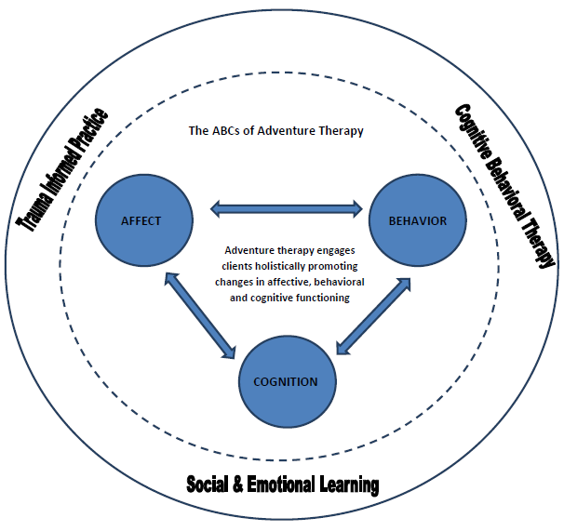
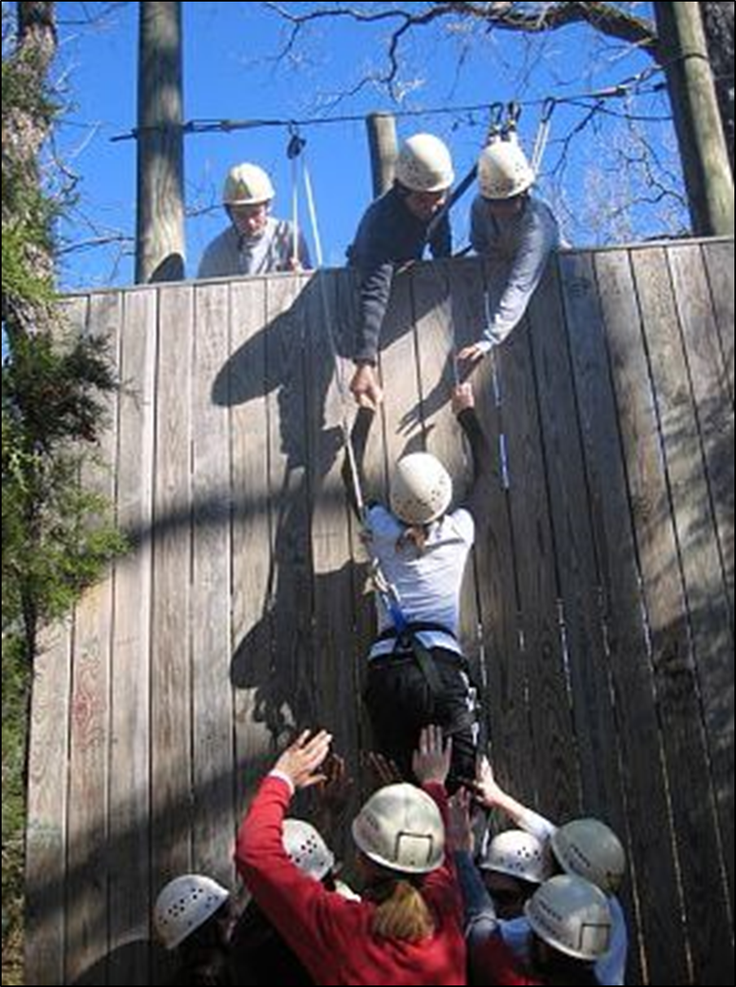
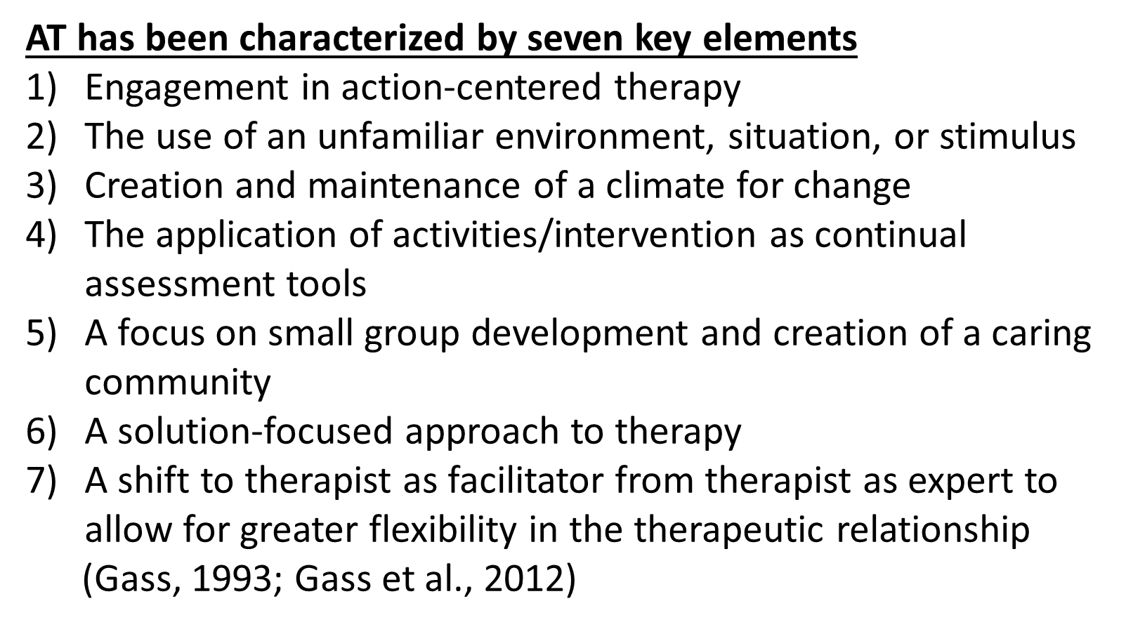
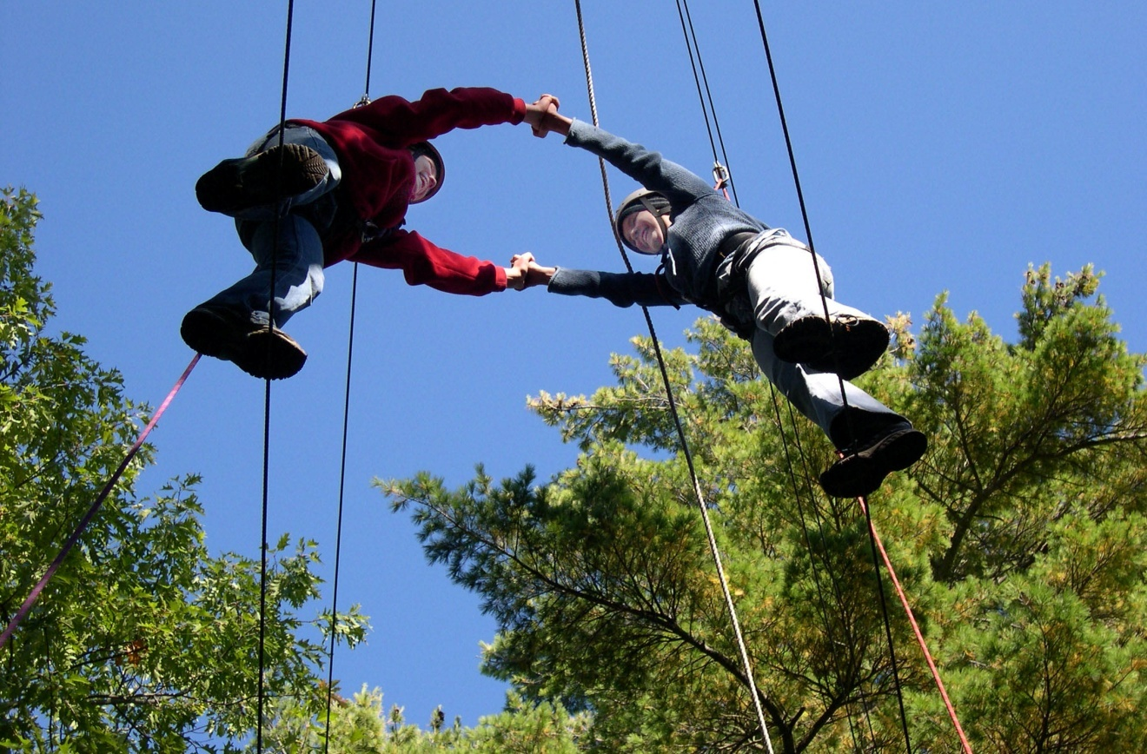
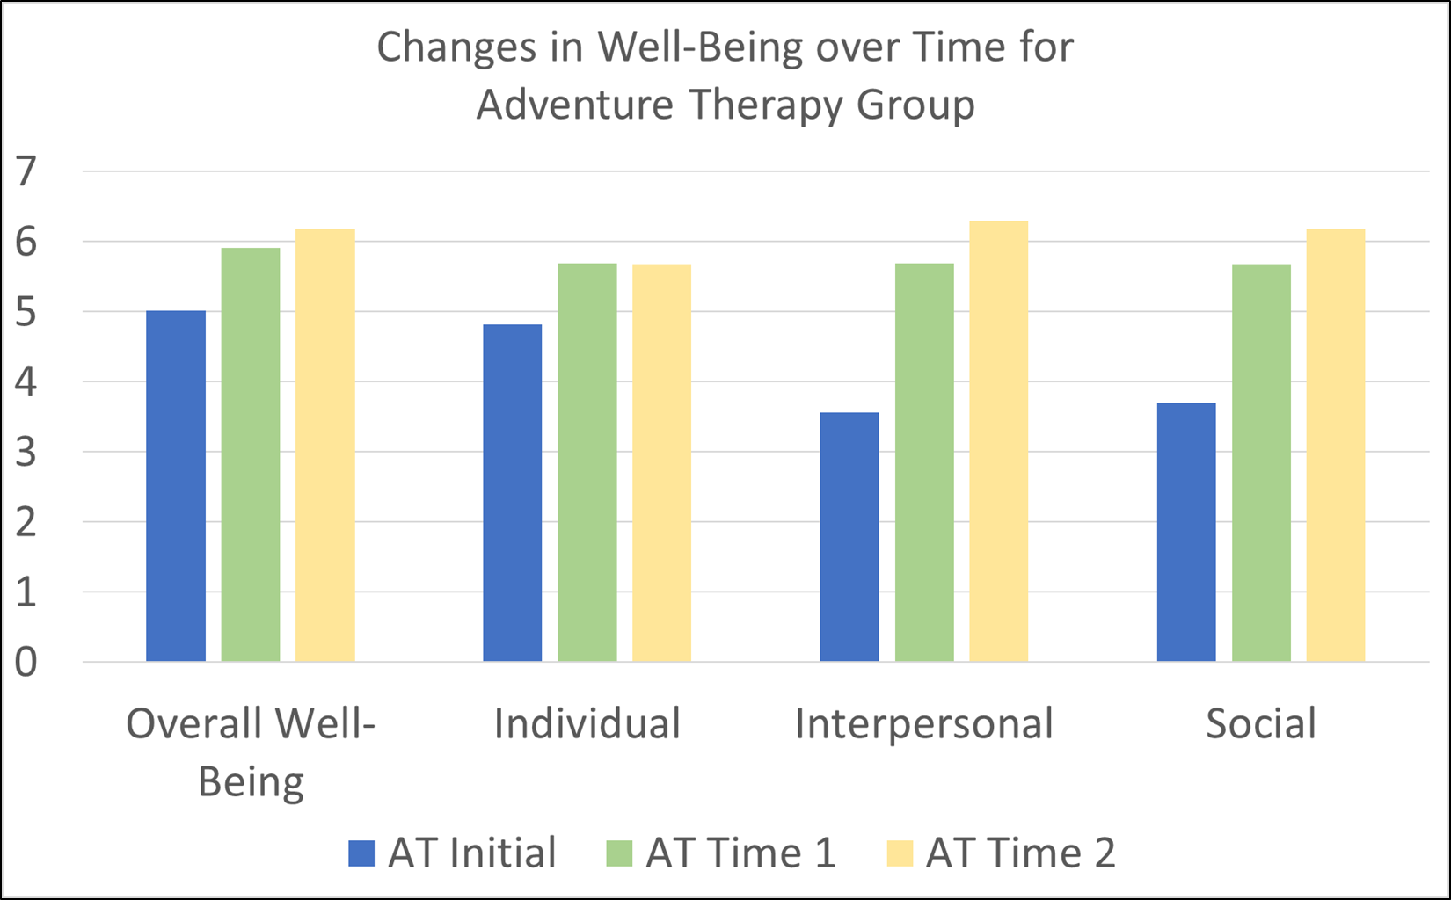
Utilizing Adventure Therapy to Increase Hope and
Well-Being among Shelter Residents
Dr. Anita R. Tucker, The University of New Hampshire, Department of Social Work
Dr. Christine Lynn Norton, Texas State University, School of Social Work
ADVENTURE THERAPY: WHAT IS IT?
SAMPLE
Adventure Therapy (AT) is “the prescriptive use of adventure experiences provided by mental health professionals that kinesthetically engage clients on cognitive, affective, and behavioral levels” (Gass, Gillis, & Russell, 2012, p. 1)
HOPE ADVENTURE THERAPY
RESULTS
A pilot program developed and implemented at the Austin, TX Shelter for Women and Children-Salvation Army
Tailored to serving women and children experiencing homelessness.
The program utilized outdoor, experiential activities with children and families, such as archery, geocaching, rock climbing, and hiking
Adventure Therapy uses an integrative approach called the ABC-R model: emotional response (Affect), acting out or withdrawn (Behavior), or irrational or problematic thoughts (Cognition), integrated around the systematic Relationship(s) of the individual and those around them.
METHODOLOGY
IMPLICATIONS FOR PRACTICE
Study Design
An exploratory, quasi-experimental, nonequivalent groups longitudinal design
Measures
1. Outcomes Rating Scale
Subscales: Overall, Interpersonal, Intrapersonal, and Social
2. Hope Scale
Subscales: Agency & Pathways
Adventure Therapy may be a viable option for clinical social workers working with women with histories of trauma.
As AT grows in social work, training in this intervention should be highlighted both in the literature as well as in MSW curricula and continuing education post MSW.
In addition, more research is needed to further understand how AT impacts adults, beyond the current areas studied in this study.

