Slide 1


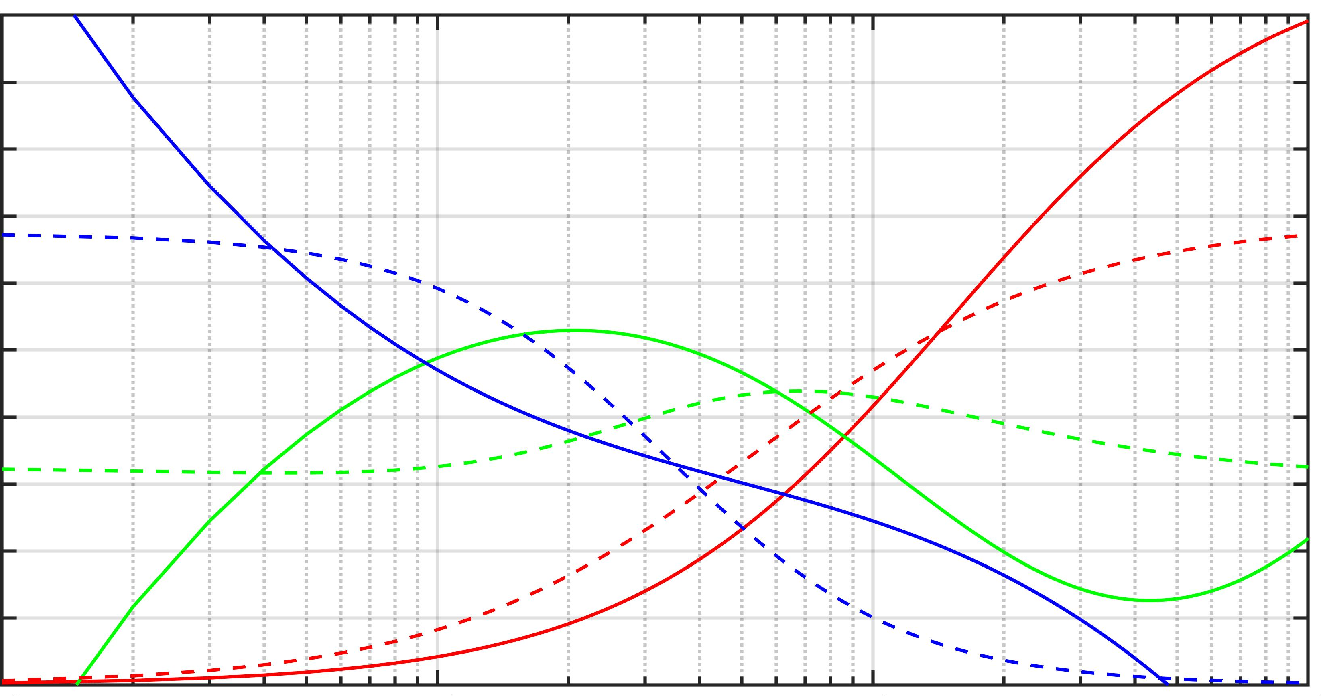
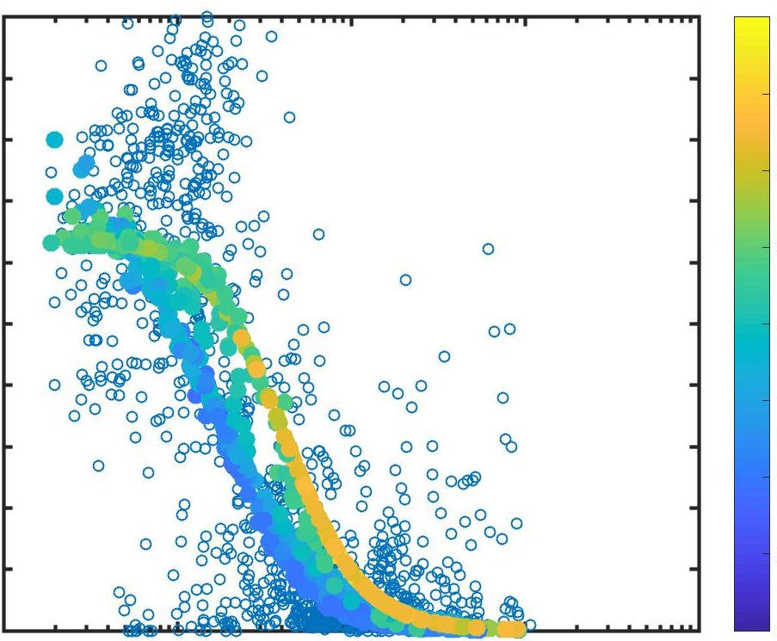
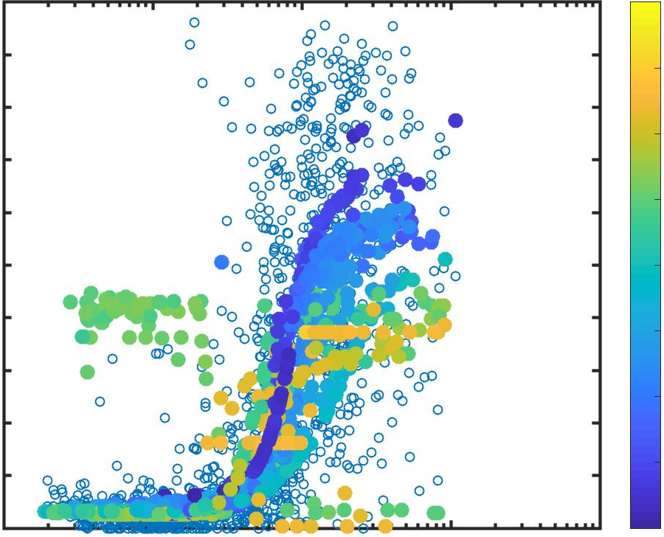
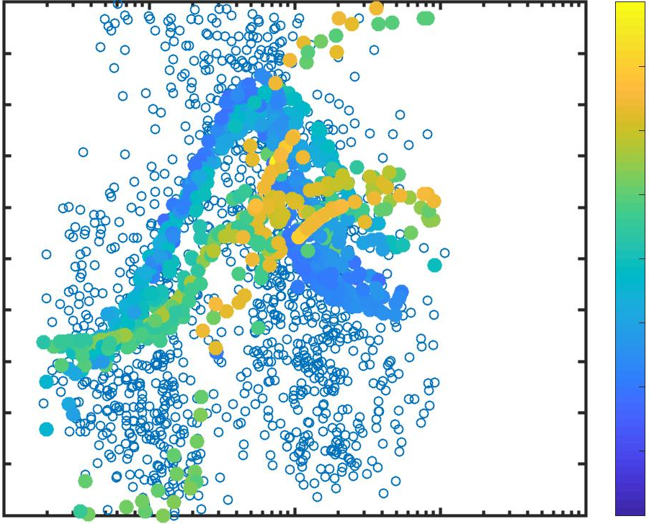
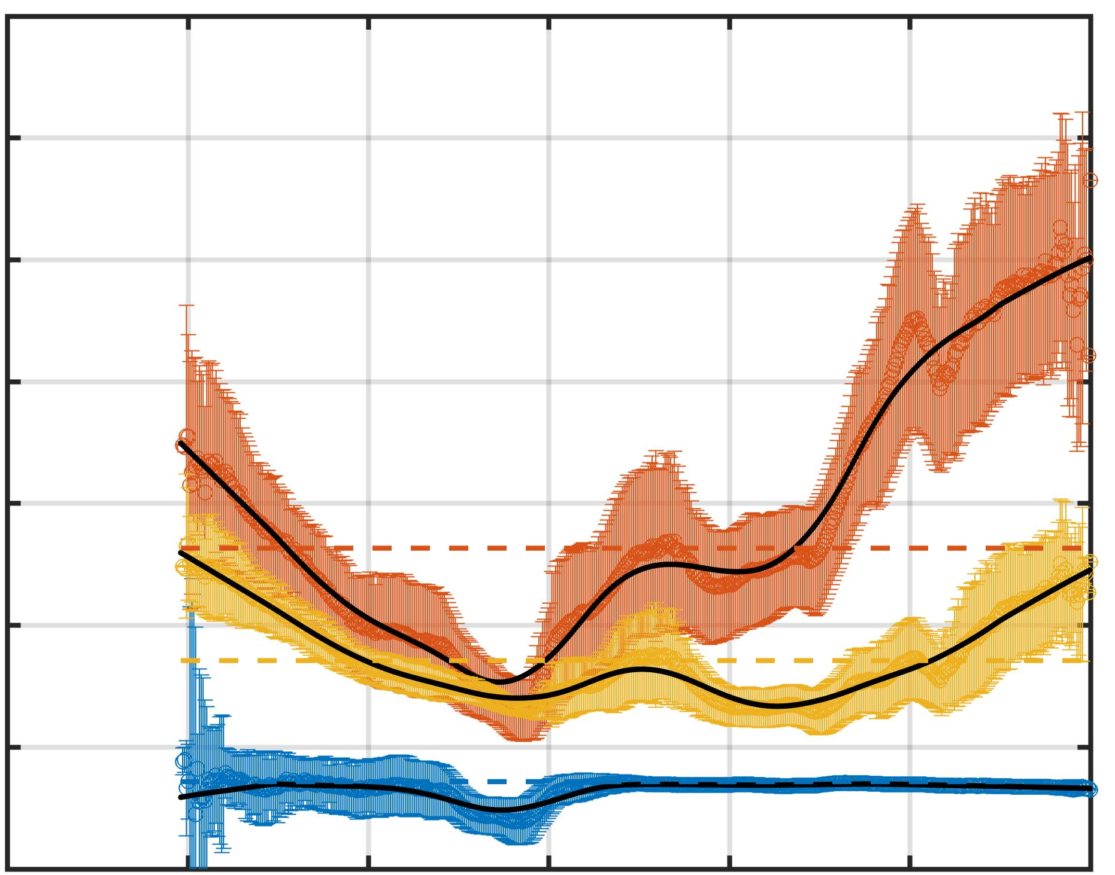
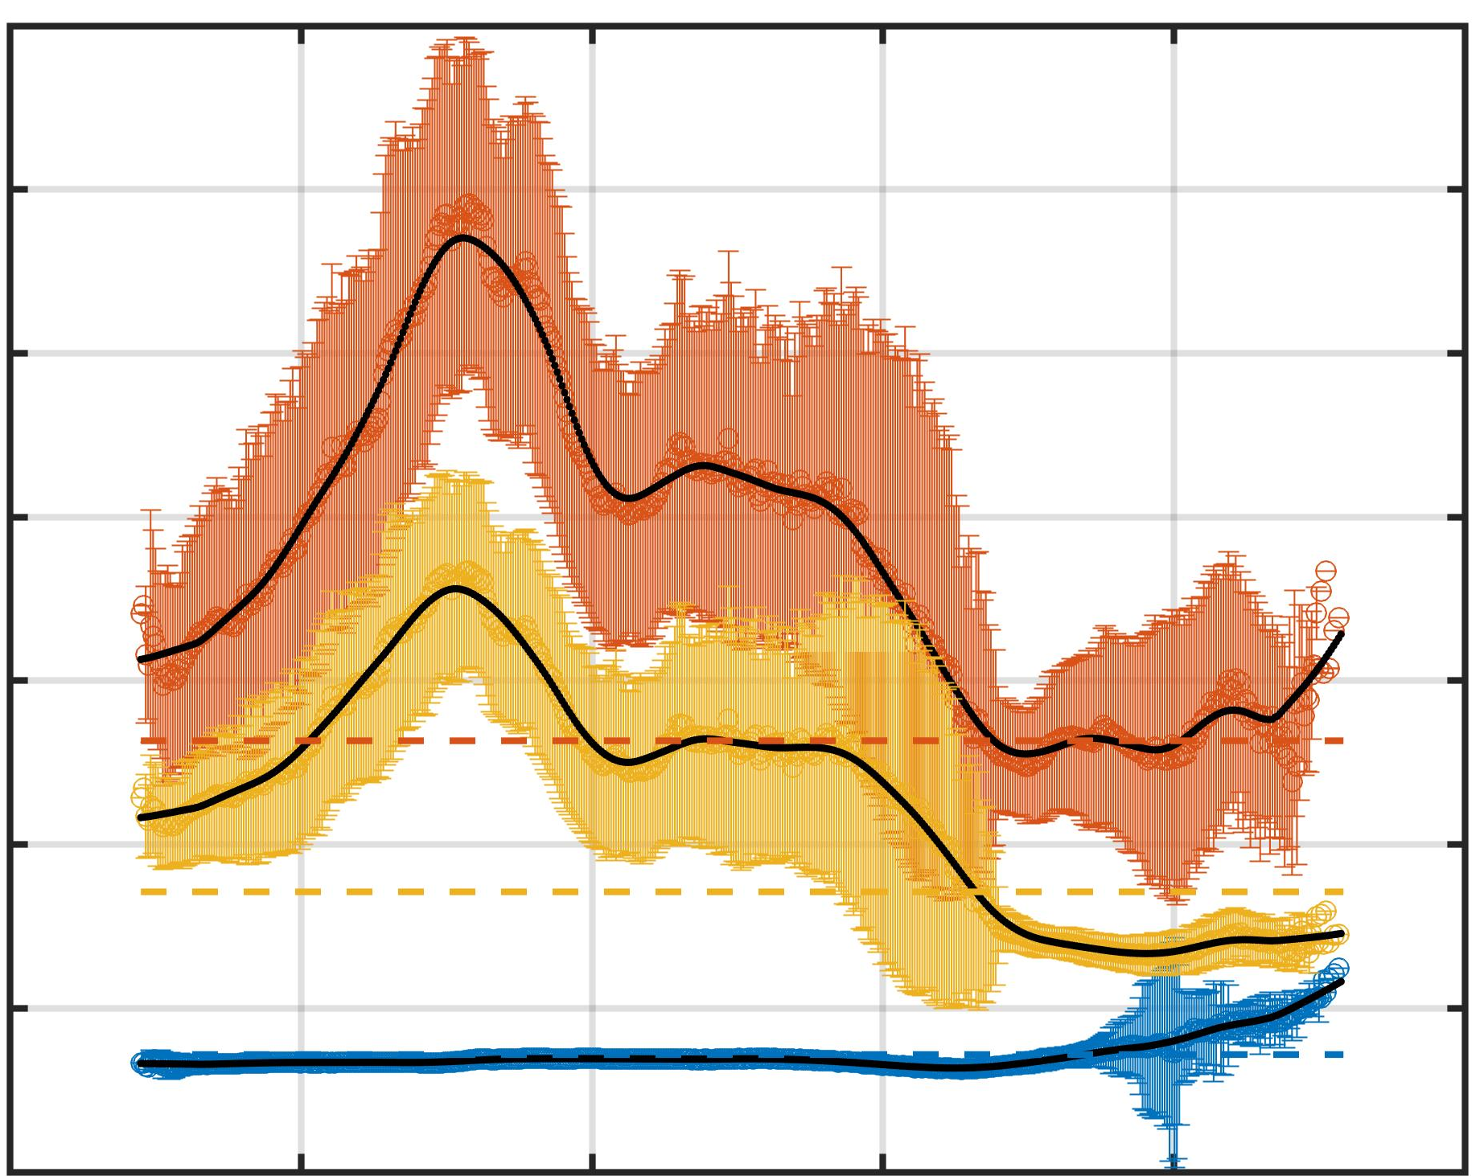
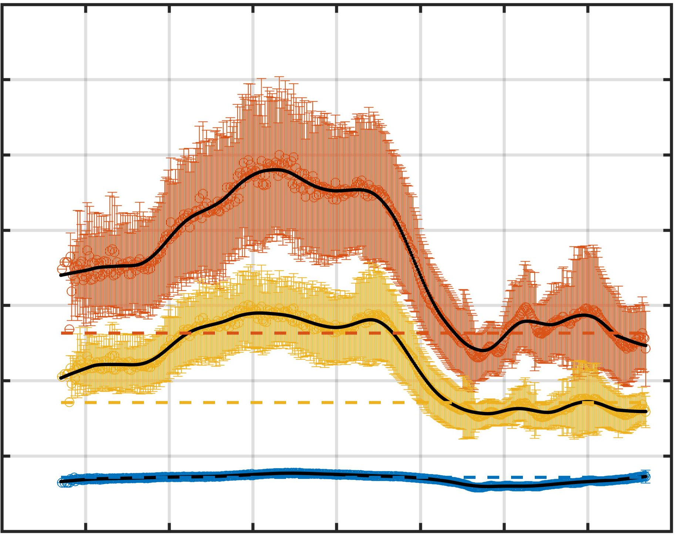
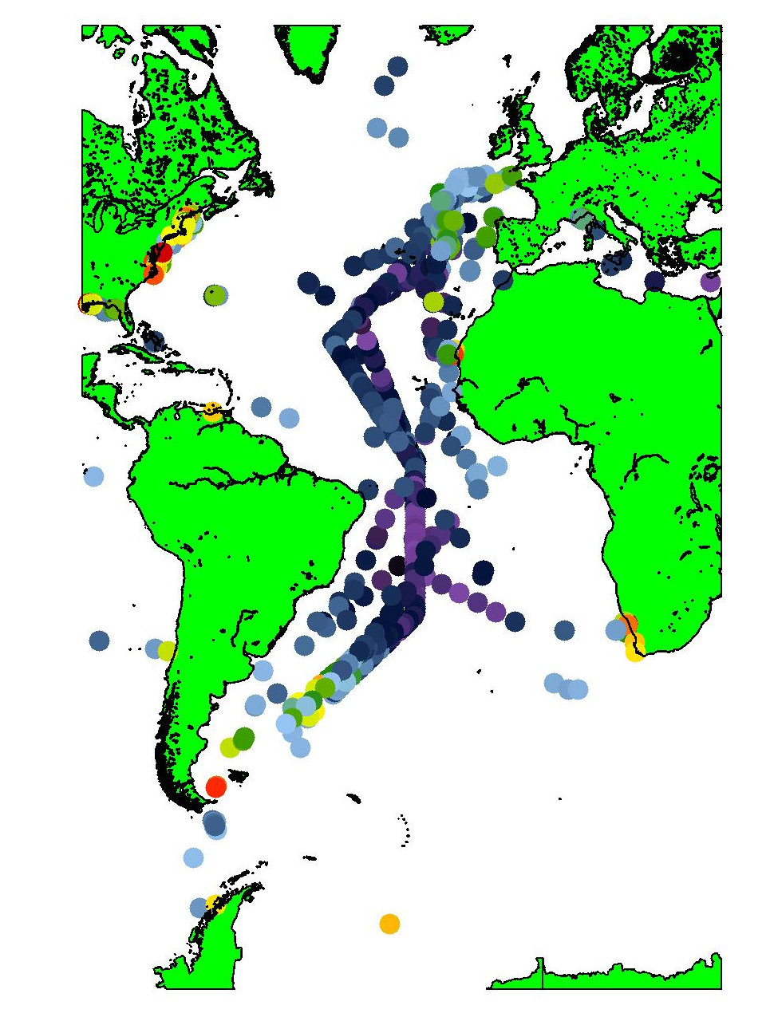
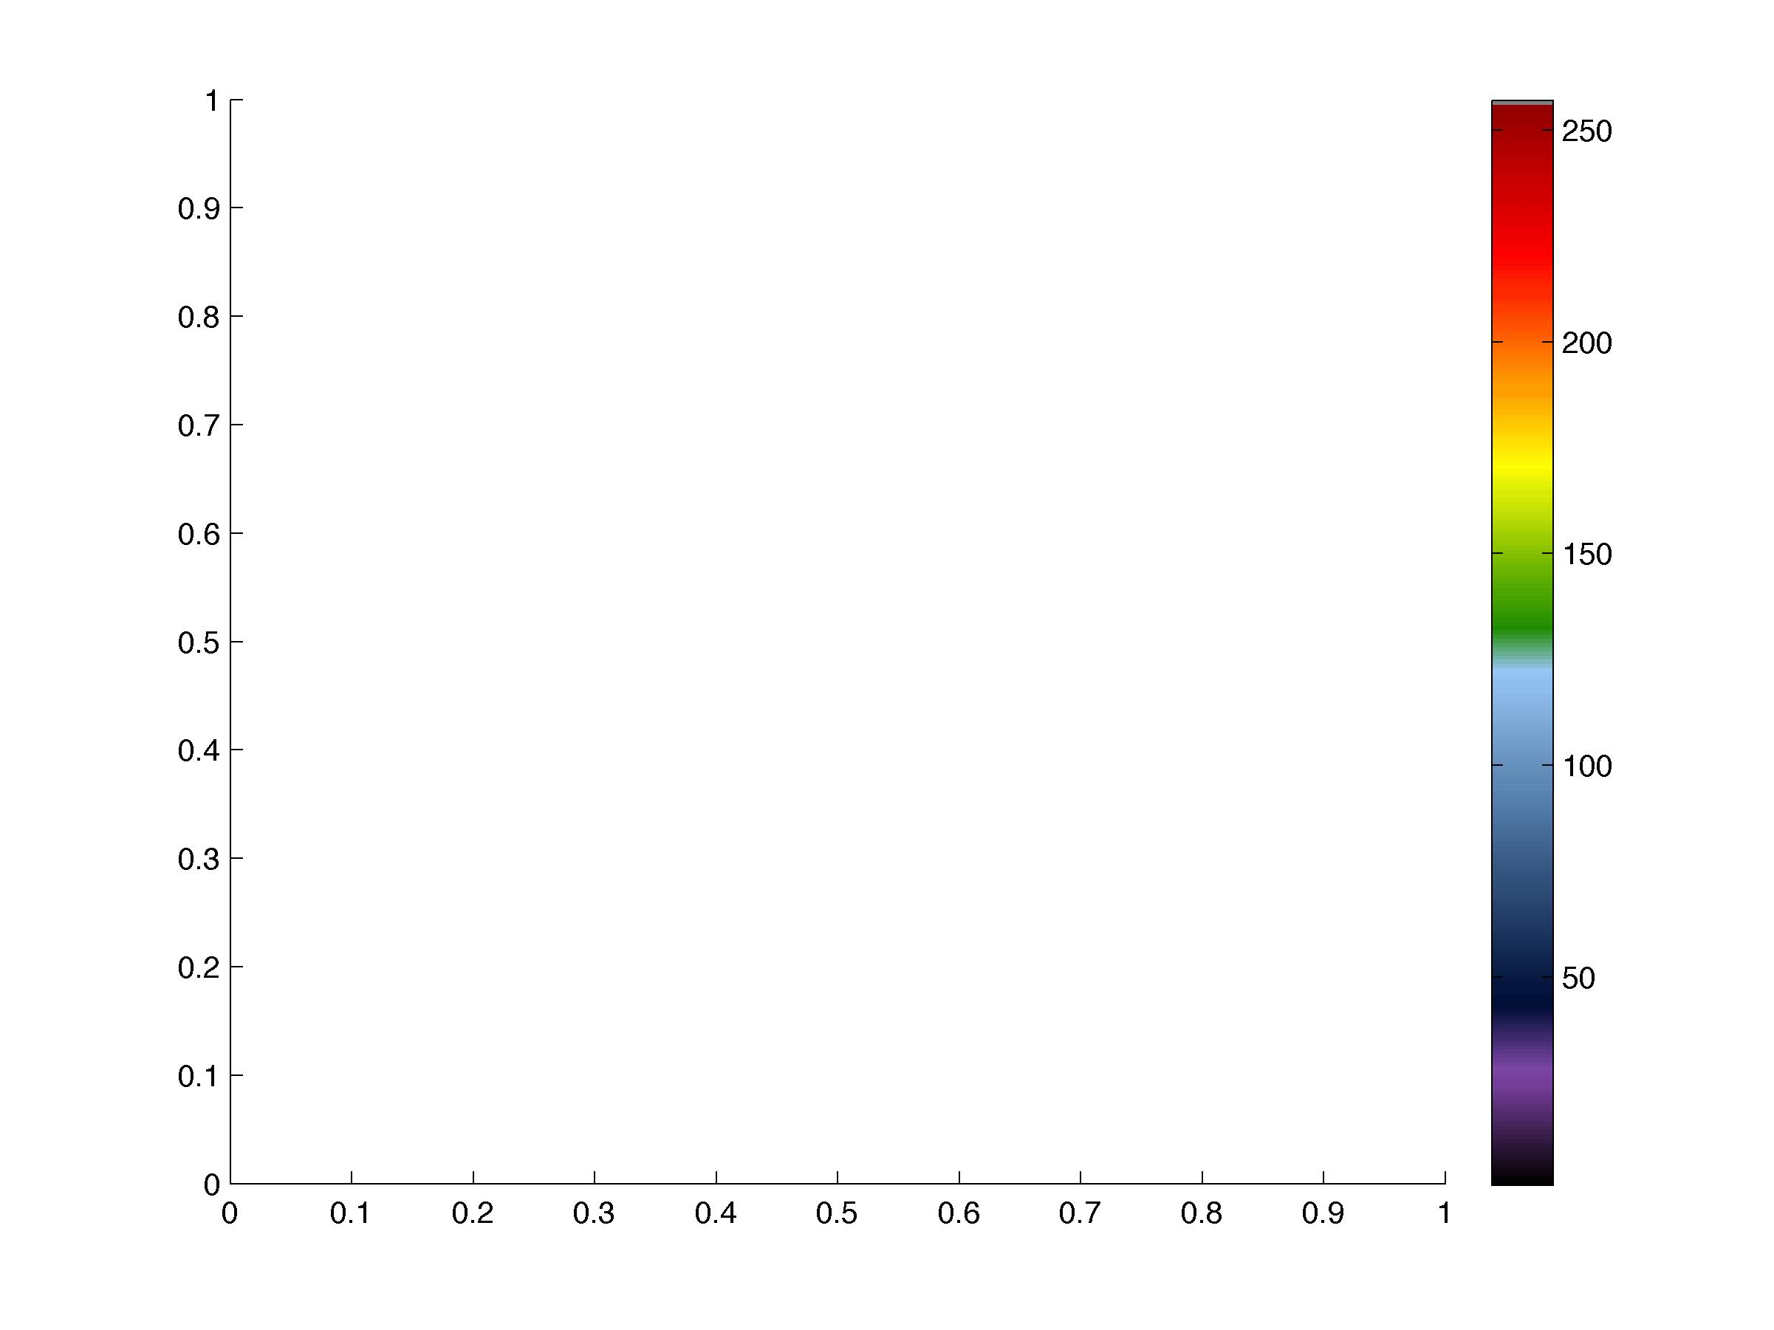
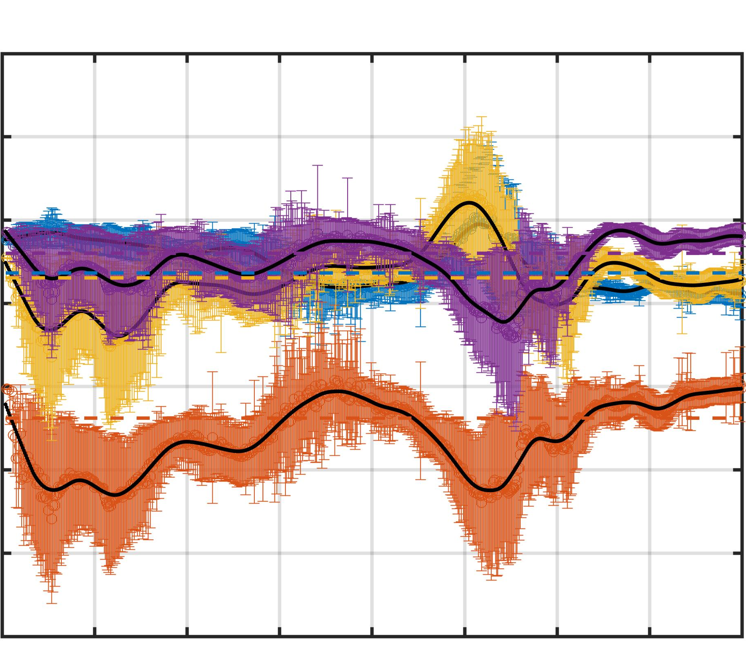
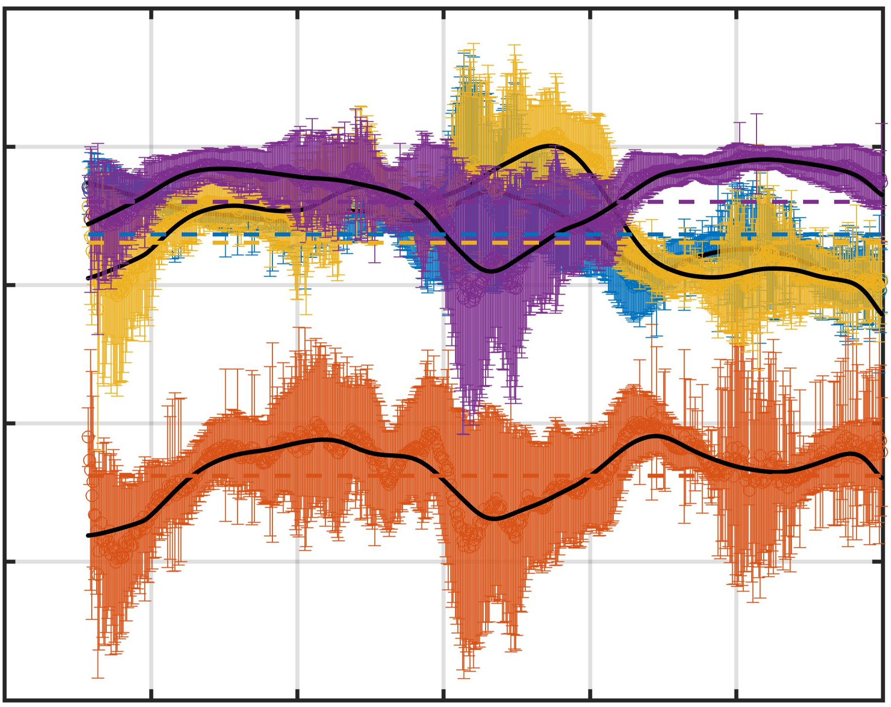
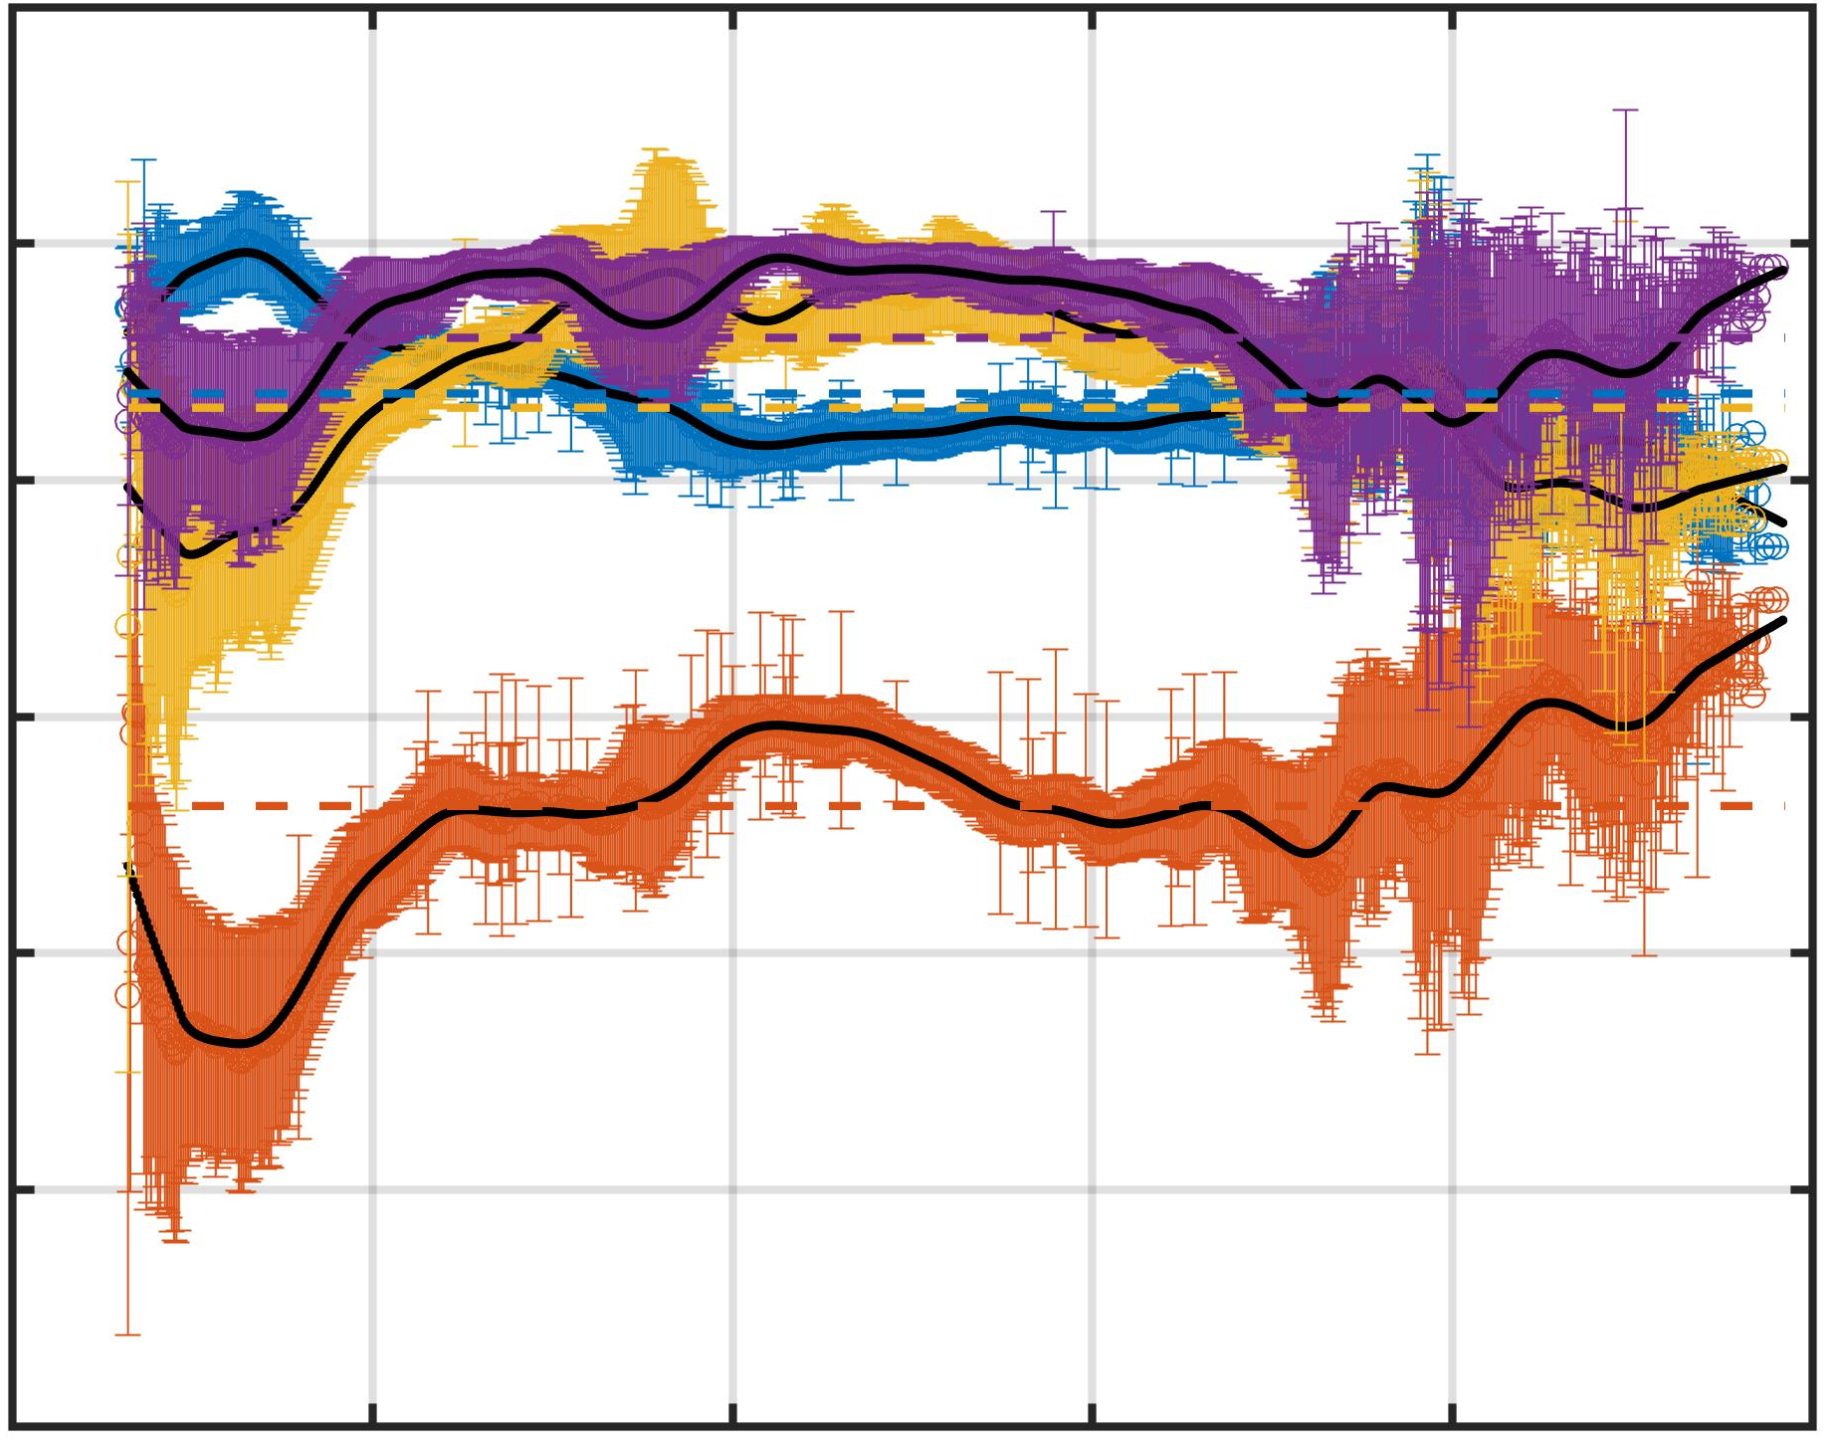
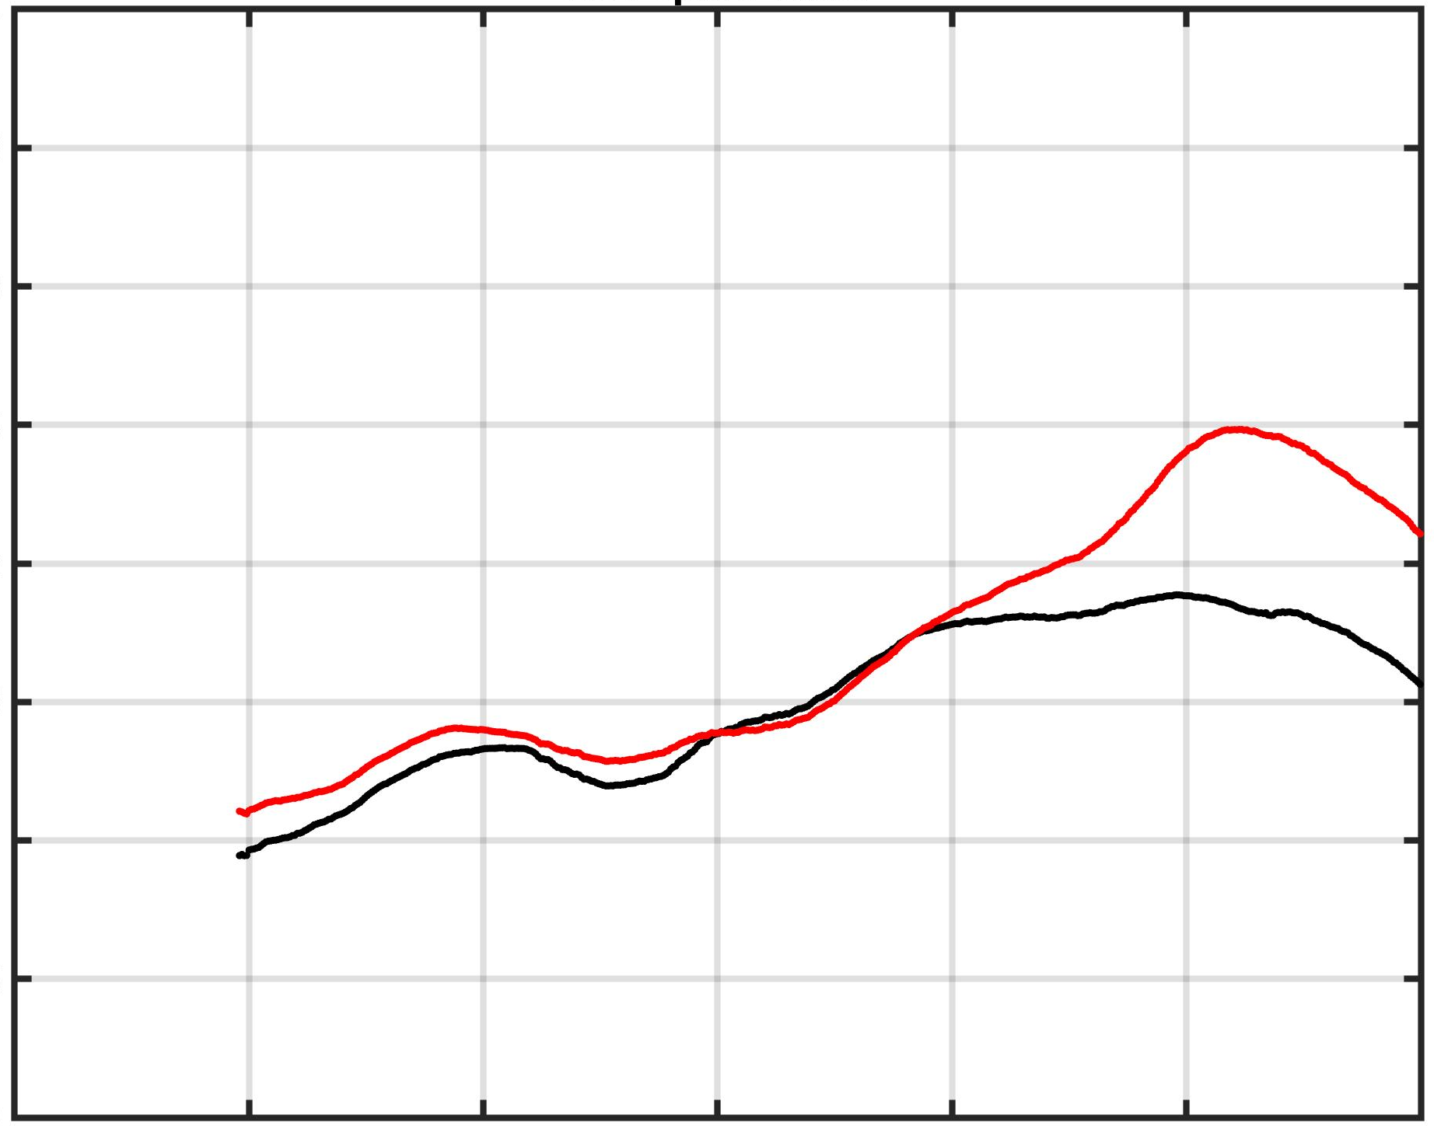
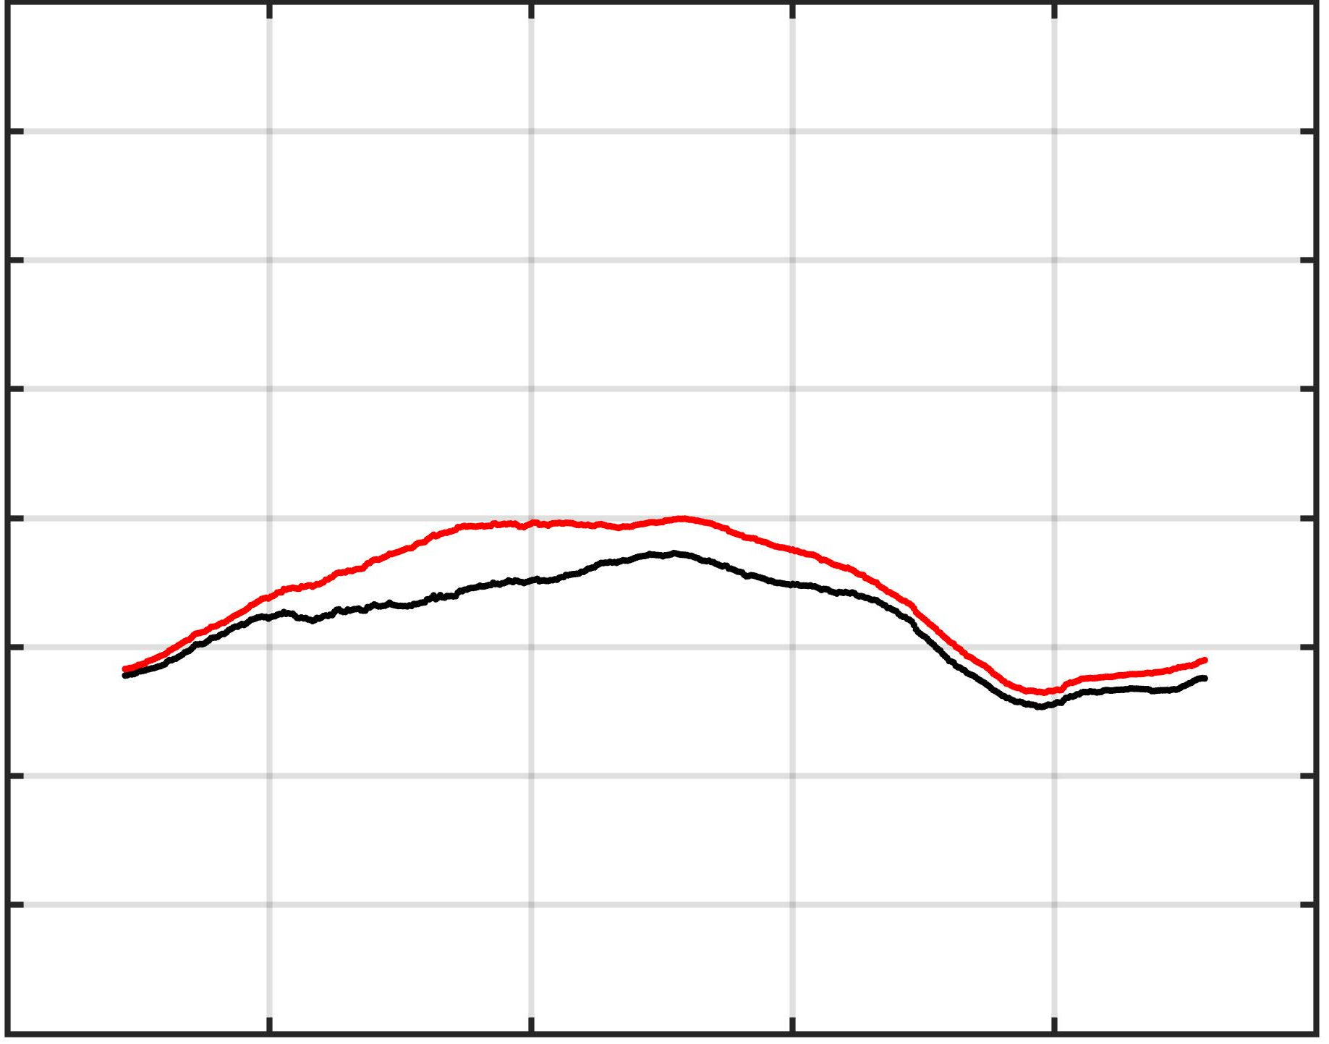
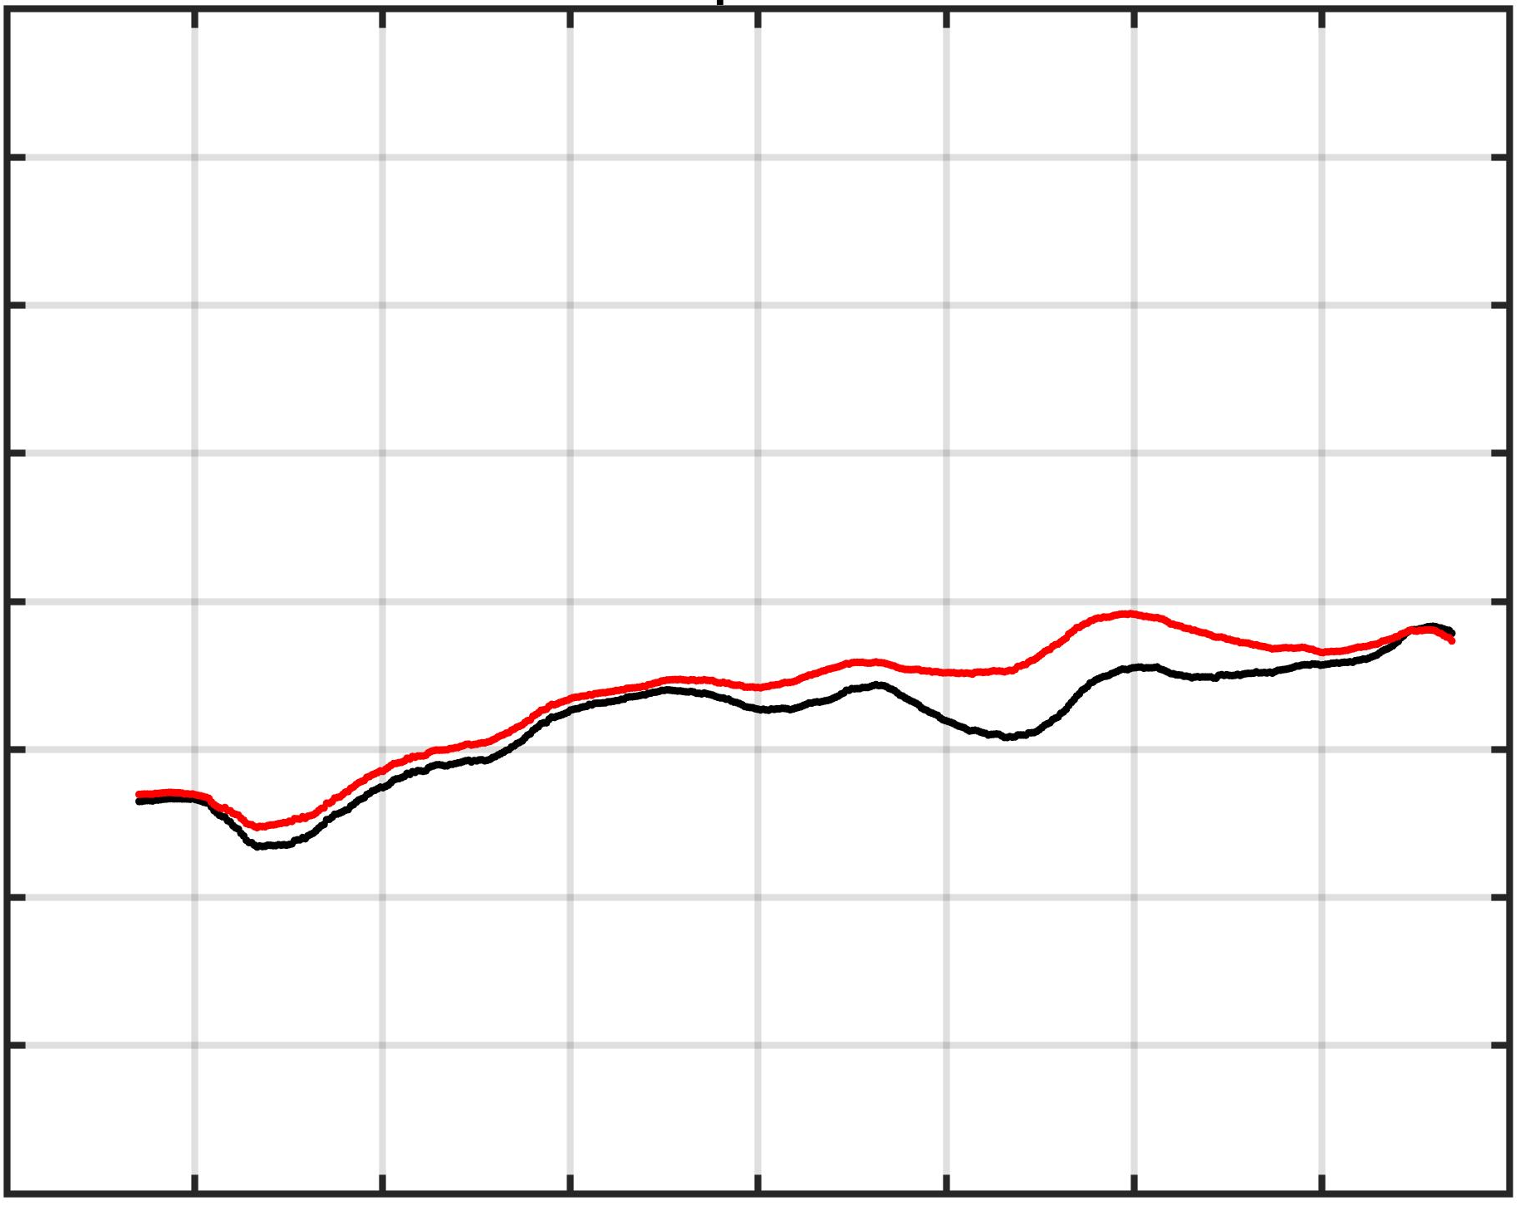
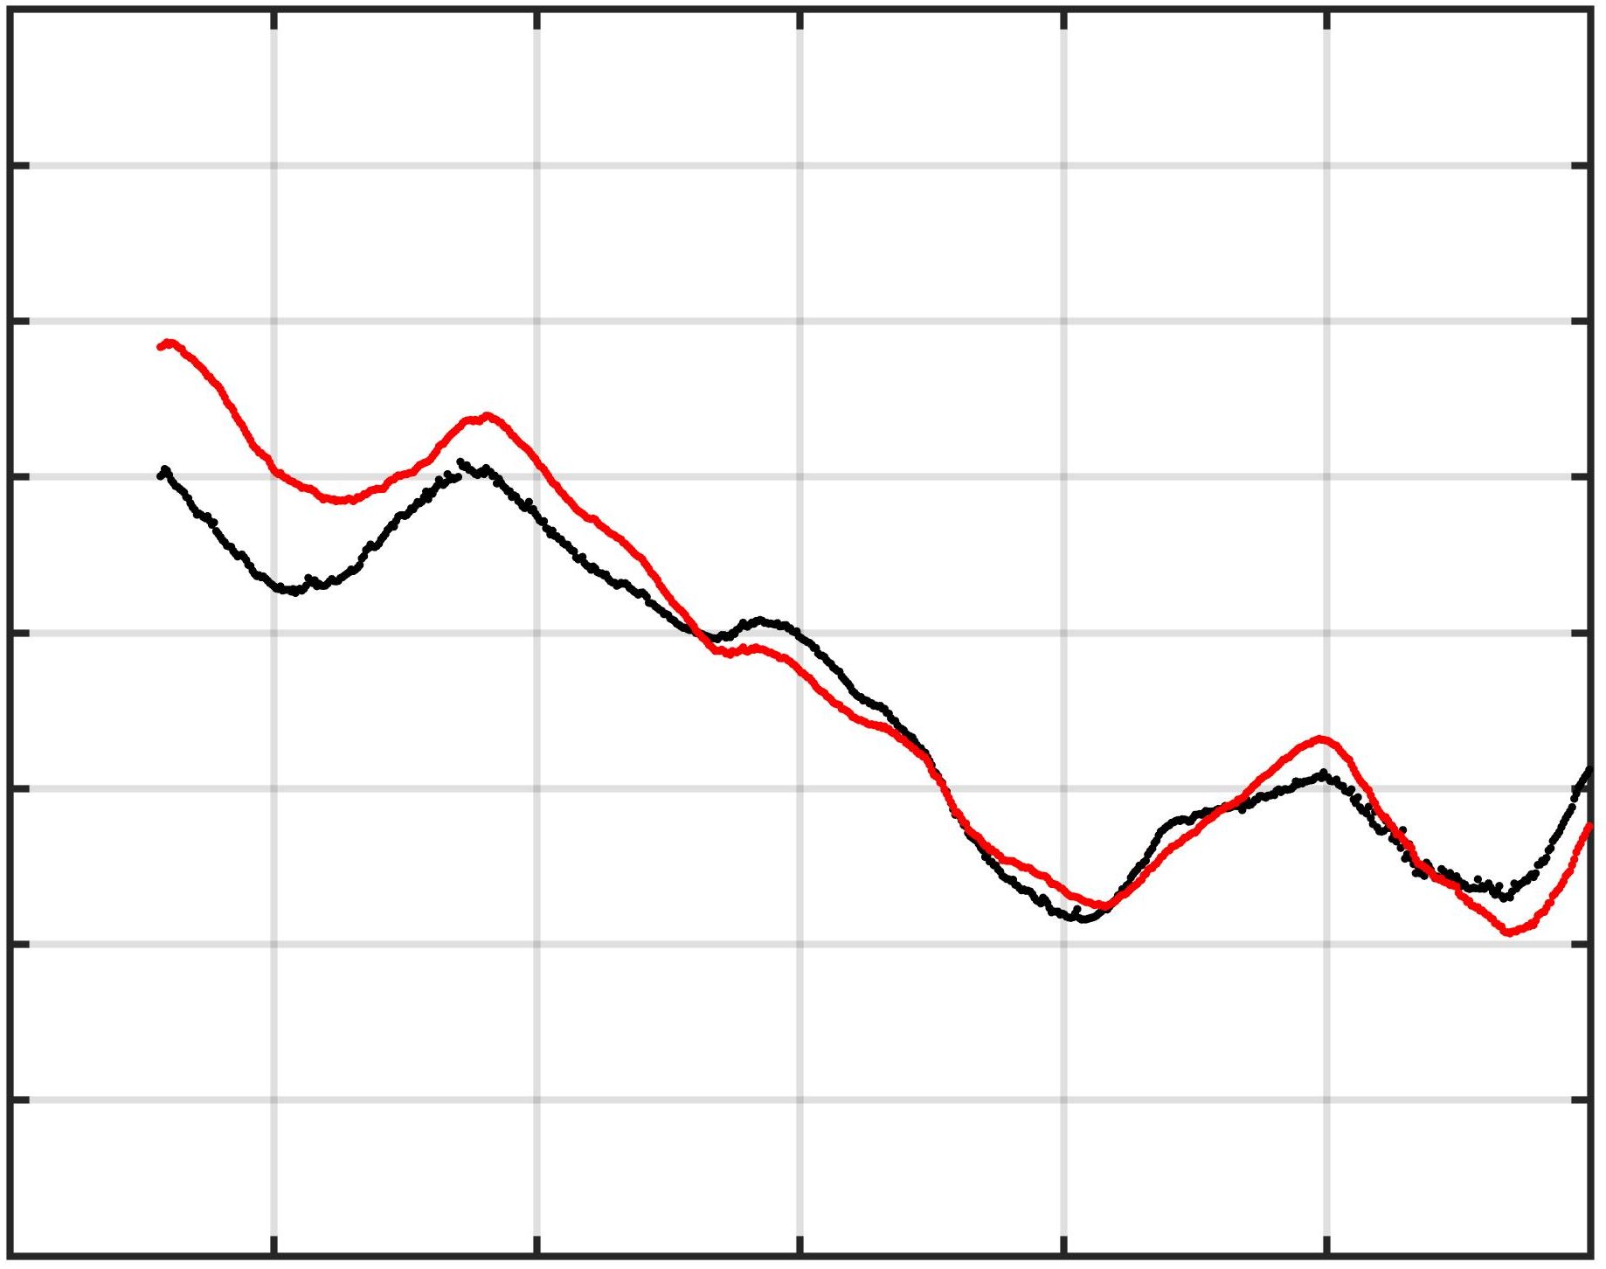
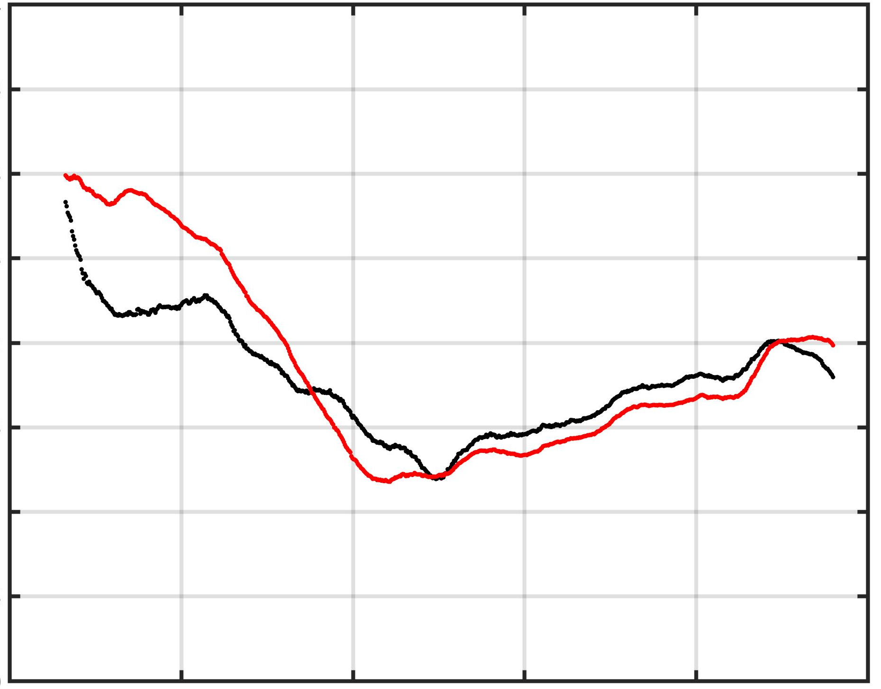
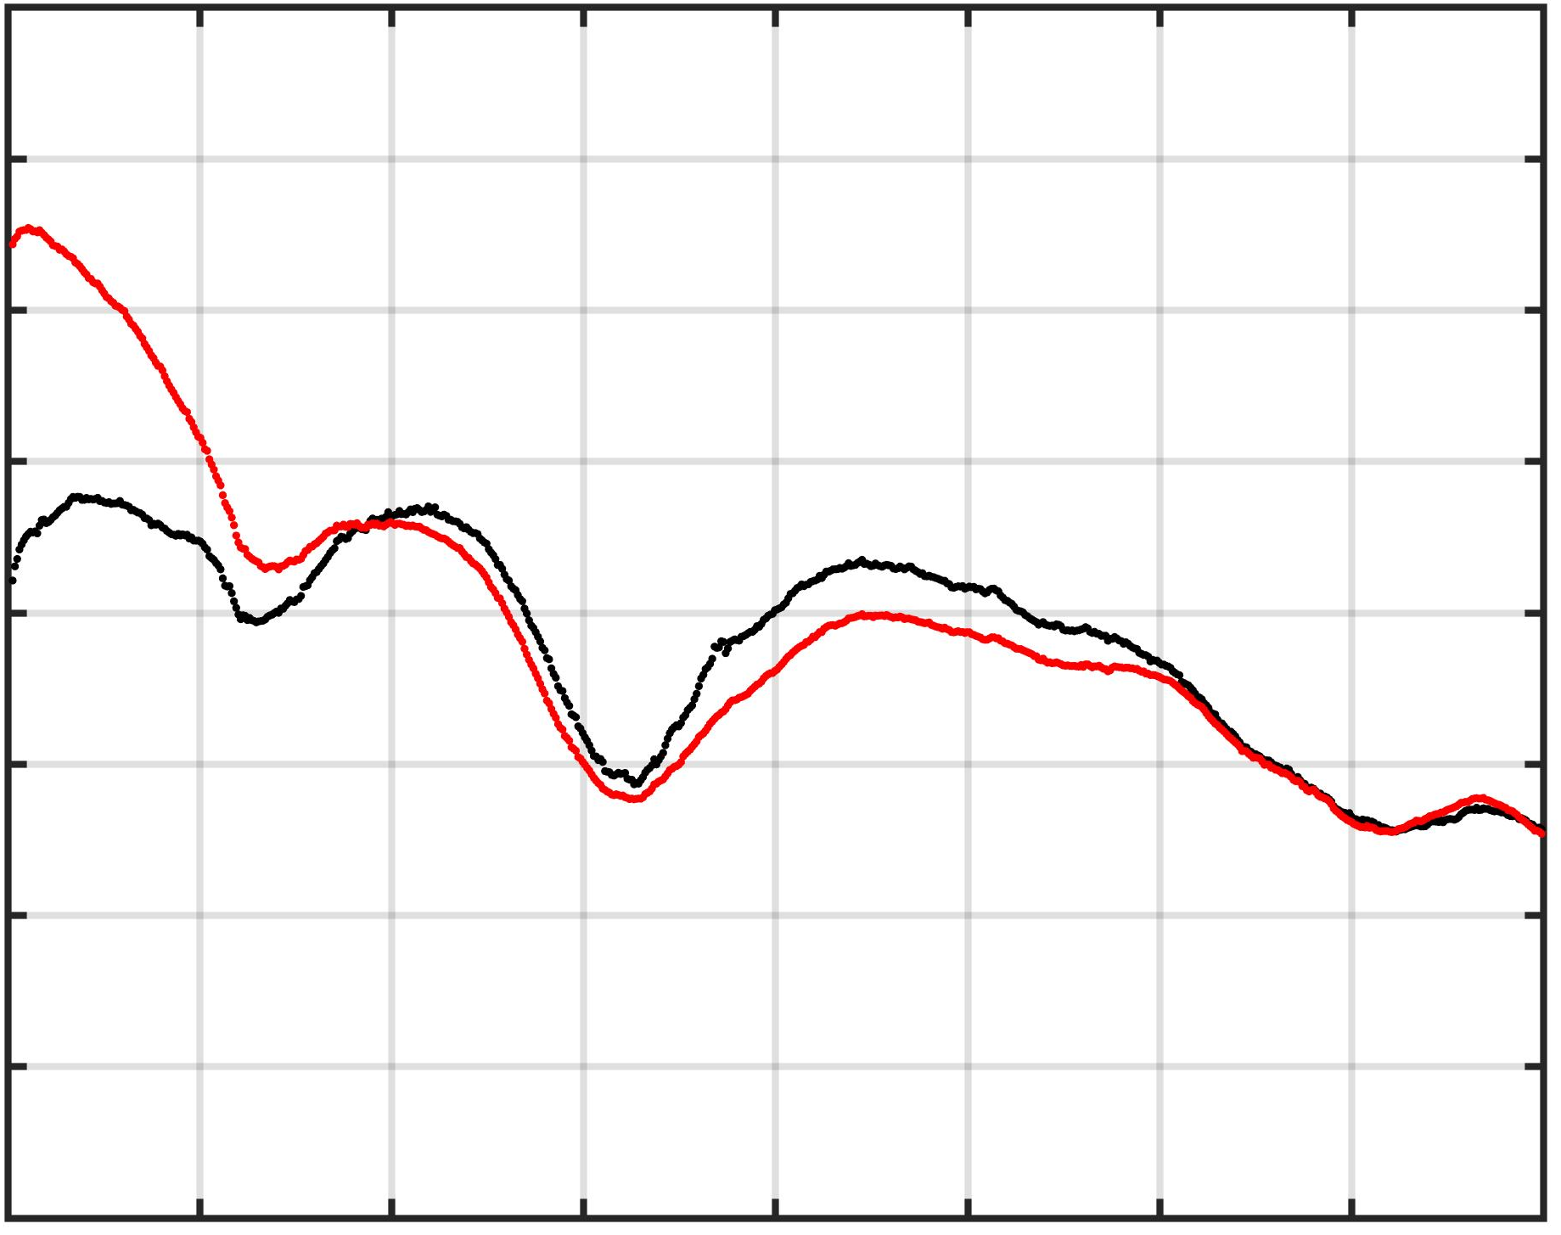
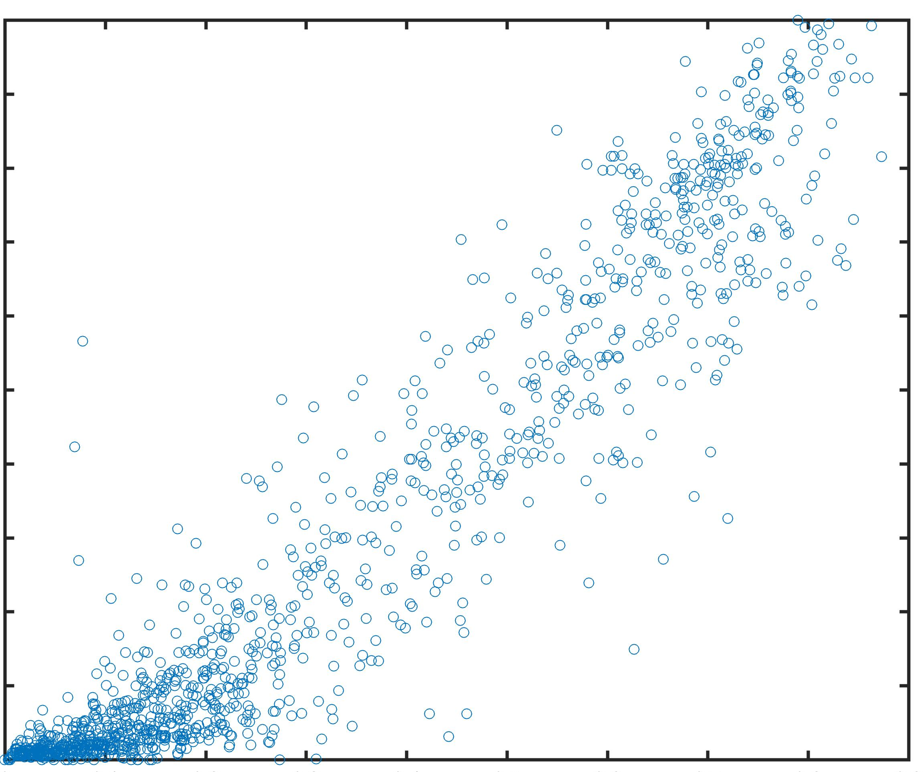
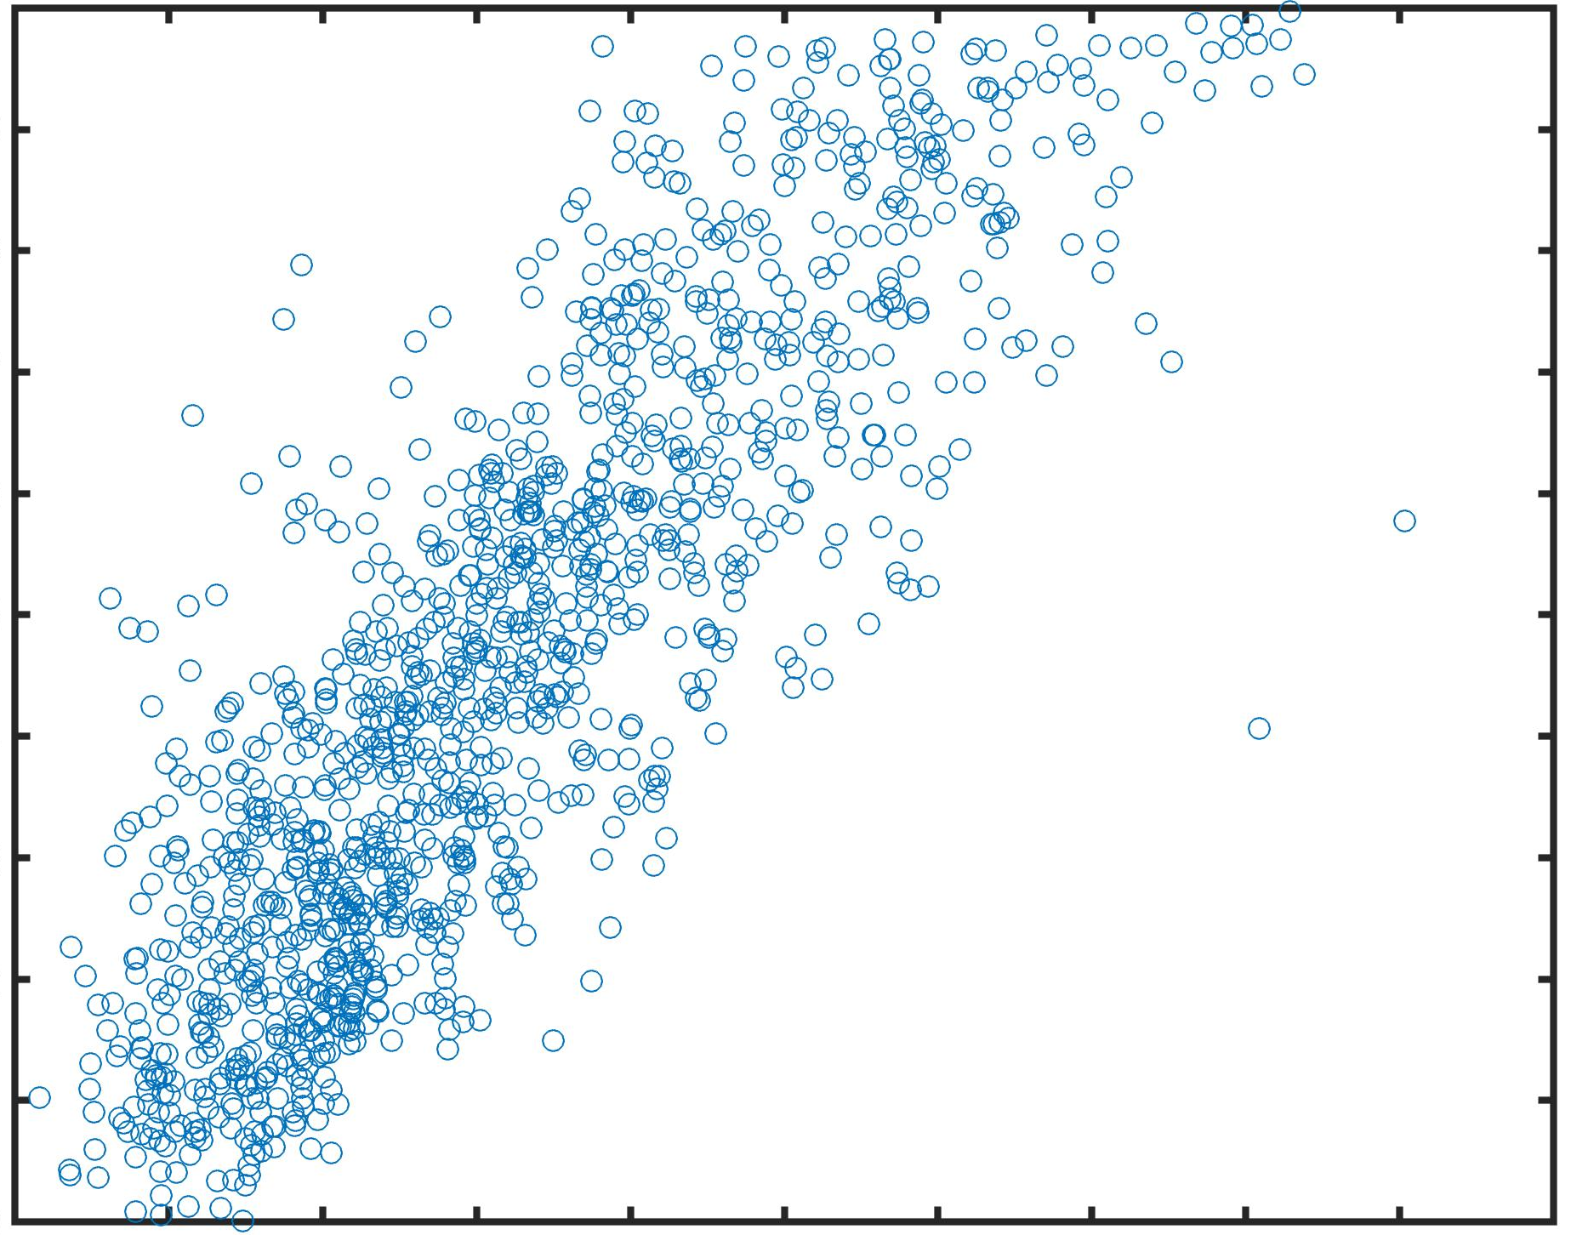
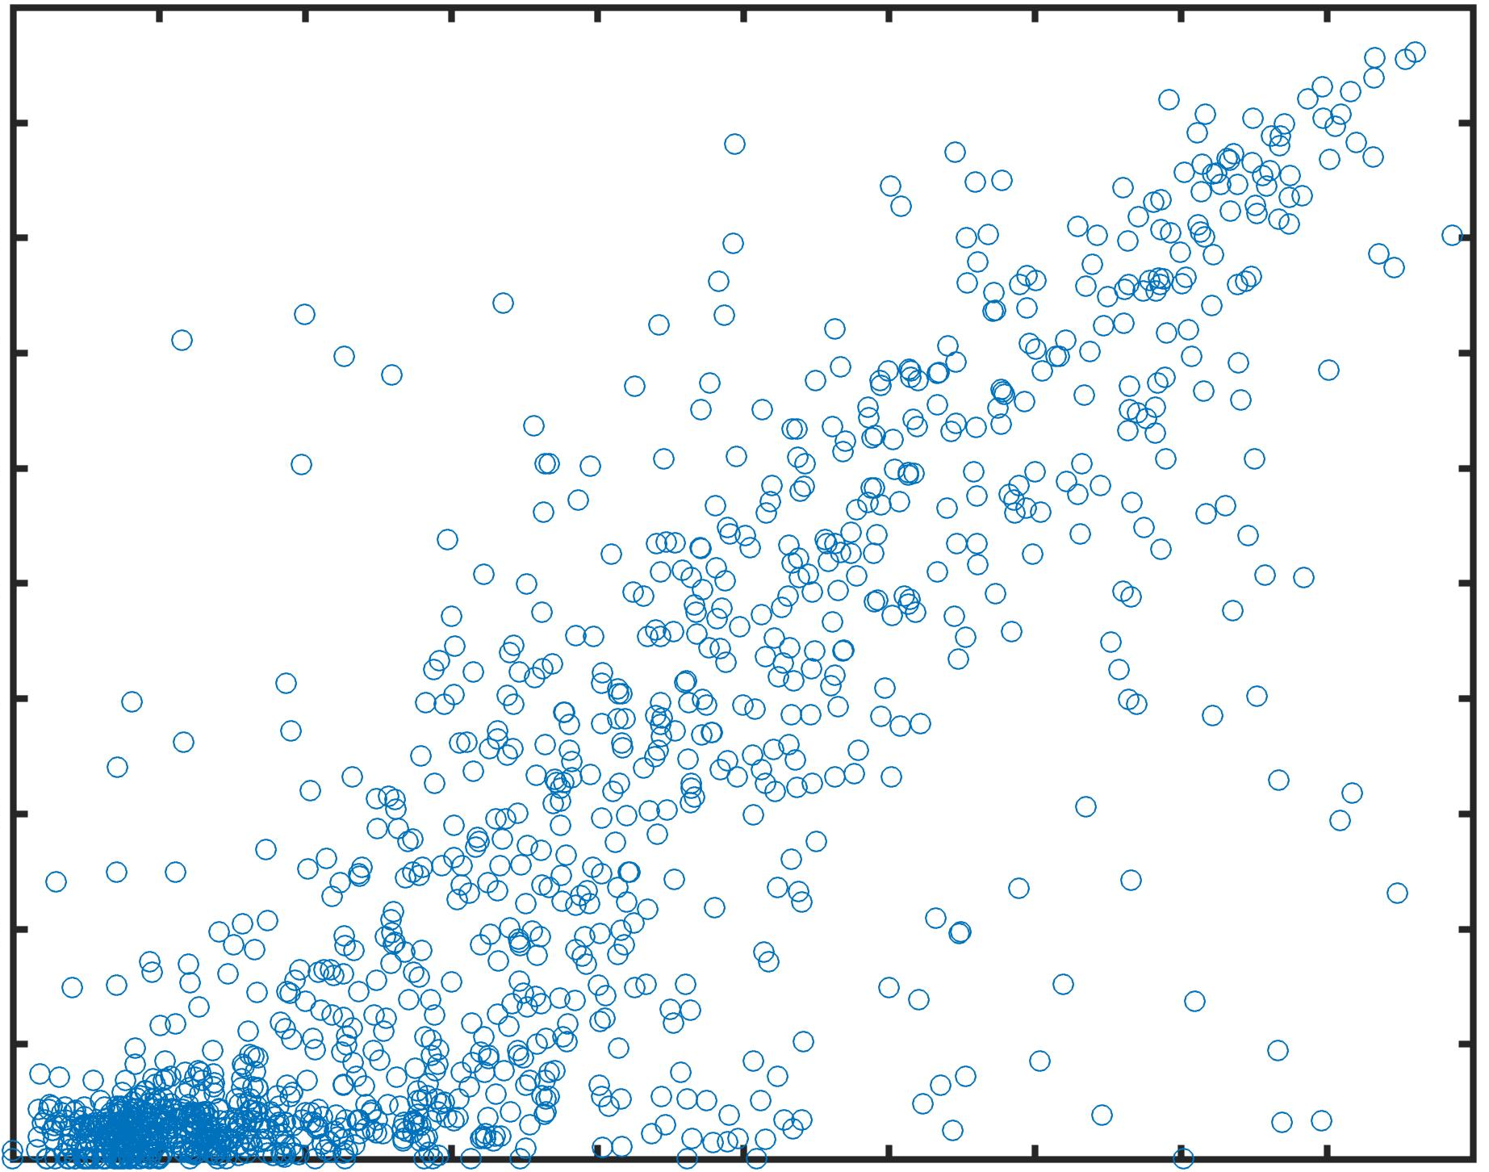
Retrieving Open Ocean Phytoplankton Size Distributions
as a Function of Chlorophyll and Environmental Parameters
Timothy S. Moore¹ and Christopher W. Brown²
¹ Ocean Process Analysis Laboratory, University of New Hampshire, Durham, NH, ² Center for Satellite Applications and Research, NOAA, College Park, MD
1.0
Pico
Model Output – SST Variant
Abstract Phytoplankton size structure and biomass have traditionally been linked, setting general guidelines for trophic characteristics. Several published phytoplankton size algorithms use chlorophyll-a (CHL) as a biomass index to derive size components and biomass fractions of phytoplankton populations. We combined the methods of Hirata et al. (2011) and Brewin et al. (2017) to examine a regional phytoplankton size model for the Atlantic Ocean based on in situ HPLC data. We derive the biomass fraction of pico- and micro-phytoplankton as a function of satellite-derived CHL, and incorporate environmental variables to assess the impact on model improvement when more information is known on the state of the ecosystem. Our approach is a hybrid of these two models and is based on size classes determined by the HPLC-based model CHEMTAX as opposed to the diagnostic pigment (DP) method. This approach can be applied to satellite imagery to derive phytoplankton size distributions for the open ocean.
0.8
1.0
SST °C
1.0
Micro
SST °C
1.0
Nano
SST °C
40
40
40
0.6
0.8
35
0.8
35
0.8
35
Biomass Fraction
30
30
30
0.4
0.6
25
0.6
25
0.6
25
CHL Fraction
20
20
0.4
20
0.2
0.4
15
0.4
15
15
0.01
0.2
10
0.2
10
0.2
10
0.1
CHL mg/m³
1
10
0.01
0.1
1
10
5
0.01
0.1
1
10
5
0.01
0.1
1
10
5
Figure 3. Base model outputs: solid – original Hirata model; dashed: re-fits to CHEMTAX data for this study. Blue = Pico, Green = Nano, Red = Micro
CHL mg/m³
CHL mg/m³
CHL mg/m³
Parameter-space Coefficient
Figure 6. Model output from SST variant. Open blue points: CHEMTAX-derived fractions vs. CHL. Closed points: model output.
12
b1
12
12
Model Forms: We based our models on Hirata and Brewin, although we used different logistic models. Note: Brewin fit models to the size fraction of CHL, Hirata fit to the fraction itself.
Picoplankton: A 3-parameter logistic model was used to fit CHL to the fraction of biomass (from 0 to 1).
Pico fraction = 1/(b1 + exp(b2*logCHL + b3))
Microplankton: A 4-parameter logistic model was used to fit CHL to the fraction of biomass (from 0 to 1).
Micro fraction = b1 + b2/(1 + exp((b2*logCHL + b3)/b4))
Nanoplankton: Derived (forcing unity) from pico and micro fractions as:
Nano fraction = 1 – pico – micro.
10
b2
10
10
PICO
8
b3
8
8
HPLC In situ Data
(AMT, SeaBASS, CLIVEC)
HPLC-based Size Groups
(CHEMTAX)
6
6
6
4
4
4
Chl a mg/m3
2
2
2
50
0
0
0
0
5
10
15
20
25
30
0
5
10
15
20
25
15
20
25
30
35
40
45
50
55
10.0
Environmental Data (and Source)
SST (NOAA AVHRR)
PAR (SeaWiFS)
MLD (HYCOM)
Function/ parameter
fitting
0.5
SST °C
0.5
IRR_{MLD}
1
PAR (mol quanta m⁻² d⁻¹)
1.70
model
bootstrap
0
0
0.5
0.30
-0.5
-0.5
0
0.05
MICRO
-1
-0.5
0.01
-1
-1.5
-1
CHL-based models adjusted by environment for size fractions
b1
-1.5
-1.5
-2
b2
-2
b3
-2
0
5
10
b4
15
20
25
-2.5
0
5
10
15
20
25
30
IRR_{MLD} (mol quanta m⁻² d⁻¹)
15
20
25
30
35
40
45
50
55
SST °C
PAR (mol quanta m⁻² d⁻¹)
Figure 1. Map of sample locations and schematic of overall method.
Figure 4.Model coefficients for different parameters. Standard deviations bars derived from bootstrap runs; black line is mean value per bin; dashed line is mean for entire range.
Parameters are denoted as b1, b2, b3.
Methods & Data
1235 stations in the Atlantic Ocean were assembled from various cruises with HPLC and environmental data (Figure 1).
HPLC data were used to produce three phytoplankton size fractions for pico-, nano- and microplankton based on the Diagnostic Pigment method (Uitz et al, 2006) and CHEMTAX (Figure 2).
Functional models were fit to relate total CHL to pico- and microplankton classes independently.
A bootstrap method was used to iterate over random splits of data to generate model coefficients and generate validation statistics.
The data were ranked to ascending environmental variables (SST, PAR and IRR_{MLD}).
Model coefficients were re-derived across a moving boxcar window to investigate impact of environment on model fits.
SST
RMS Errors Distributions
PAR
Results/Summary
Phytoplankton size assessments from two different treatments of HPLC data show similar trends but some differences (Figure 2).
Size is related to overall algal biomass, but unclear if size determines biomass or biomass determines size (Figure 3).
Model parameters show some variability across environmental ranges (Figure 4).
Logistic transfer functions between biomass and size show improvement when environmental data are included (Figure 5).
Full model show adjustment of size fraction retrieval from logistic fit (Figure 6).
Unclear if these relationships extend across global domains or restricted to regional geography (Table 1).
0.4
No SST
0.4
IRR_{MLD}
0.3
With SST
0.3
PICO
0.2
0.2
0.1
0.1
0
5
10
15
20
25
30
0
5
10
15
20
25
15
25
35
45
55
0.4
SST °C
0.4
IRR_{MLD}
0.4
PAR
0.3
0.3
0.3
MICRO
0.2
0.2
0.2
0.1
0.1
0.1
1.0
1.0
1.0
Micro
0
5
10
15
20
25
30
0
5
10
15
20
25
15
25
35
45
55
0.9
0.9
Nano
0.9
SST °C
IRR_{MLD} (mol quanta m⁻² d⁻¹)
PAR (mol quanta m⁻² d⁻¹)
0.8
Pico
0.8
0.8
Figure 5. RMS errors from bootstrap runs binned to ascending environmental parameter.
0.7
0.7
0.7
References
Brewin, R. et al. “Uncertainty in Ocean-Color Estimates of Chlorophyll for Phytoplankton Groups”, Frontiers in Marine Science, 4, doi:10.3389/fmars.2017.00104, 2017.
Hirata, T., et al.. “Synoptic relationships between surface Chlorophyll-a and diagnostic pigments specific to phytoplankton functional types”, Biogeosciences, 8, 311-327, 2011.
Mackey, M.D., Mackey, D.J., Higgins, H.W. and S.W. Wright. “CHEMTAX—A program for estimating class abundances from chemical markers: Application to HPLC measurements of phytoplankton”, Marine Ecology Progress Series, 144:265– 283, 1996.
Uitz, J., Claustre, H., Morel A. and Hooker, S. “Vertical distribution of phytoplankton communities in open ocean: An assessment based on surface chlorophyll”, Journal of Geophysical Research, 111, doi:10.1029/2005JC003207, 2006.
0.6
0.6
0.6
Chemtax Fraction
0.5
0.5
0.5
Table 1. RMS errors from bootstrap runs.
0.4
0.4
0.4
0.3
0.3
0.3
0.2
0.2
0.2
 | SST | SST0 | PAR | PAR0 | IRR | IRR0
Pico
ATL | .151 | .170 | .161 | .181 | .159 | .171
NATL only | .147 | .160 | .153 | .181 | .150 | .160
Micro
ATL | .178 | .185 | .180 | .188 | .177 | .186
NATL only | .200 | .212 | .200 | .210 | .193 | .209
Nano
ATL | 0.245 | 0.260 | 0.247 | 0.260 | 0.240 | 0.260
0.1
0.1
0.2
0.3
0.4
0.5
RMSE = 0.11
0.1
RMSE = 0.20
0.1
RMSE = 0.22
0.6
0.7
0.8
0.9
1.0
0.1
0.2
0.3
0.4
0.5
0.6
0.7
0.8
0.9
1.0
0.1
0.2
0.3
0.4
0.5
0.6
0.7
0.8
0.9
1.0
DP fraction
Figure 2. Size fractions derived using CHEMTAX vs Diagnostic Pigment (DP). CHEMTAX was run with pigment matrices from literature on North Atlantic Ocean. Higher variability in microplankton derivations.
Acknowledgment
We graciously acknowledge the support of NOAA Center for Satellite Applications and Research funding.

