Slide 1

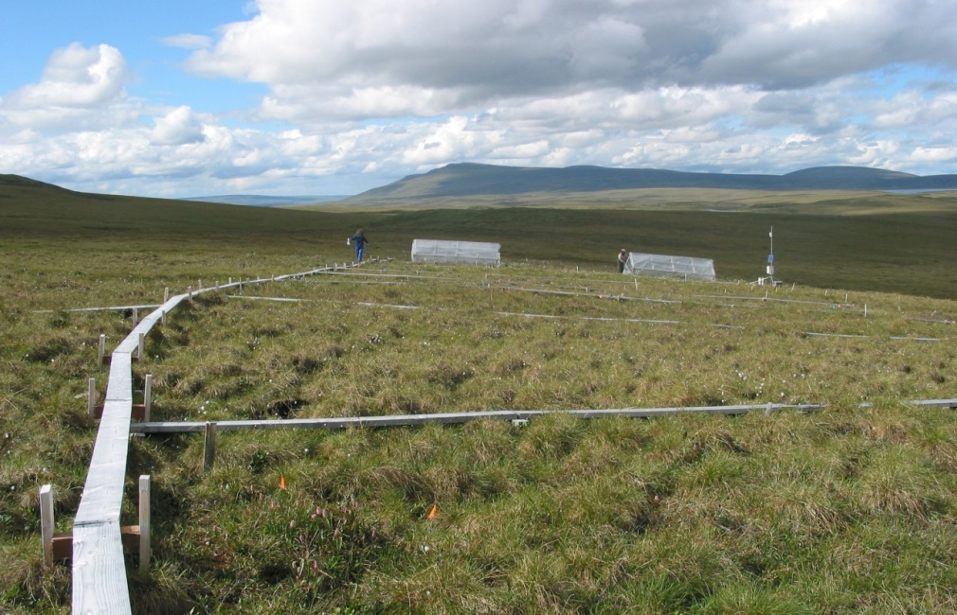
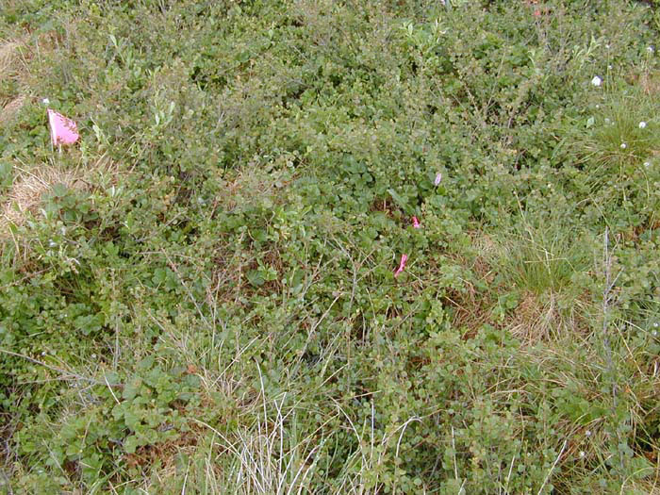
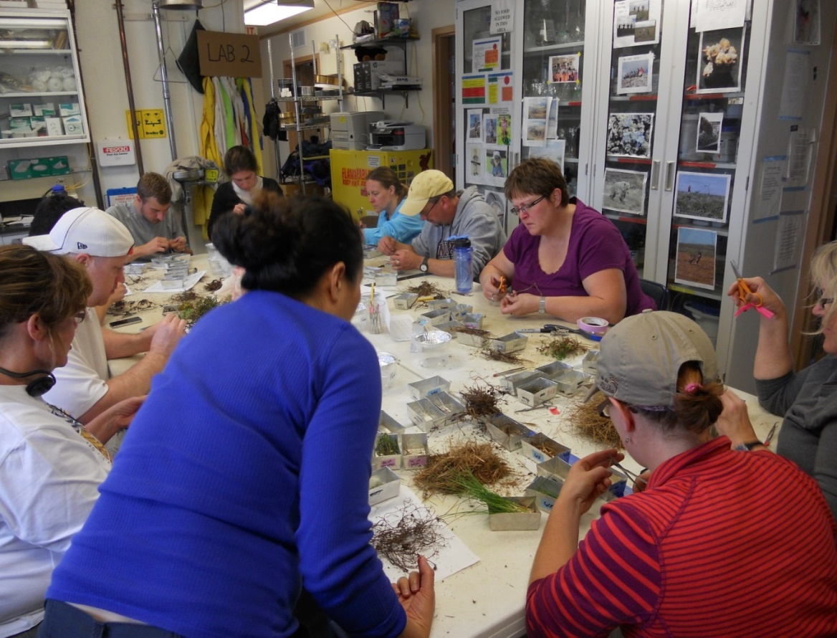
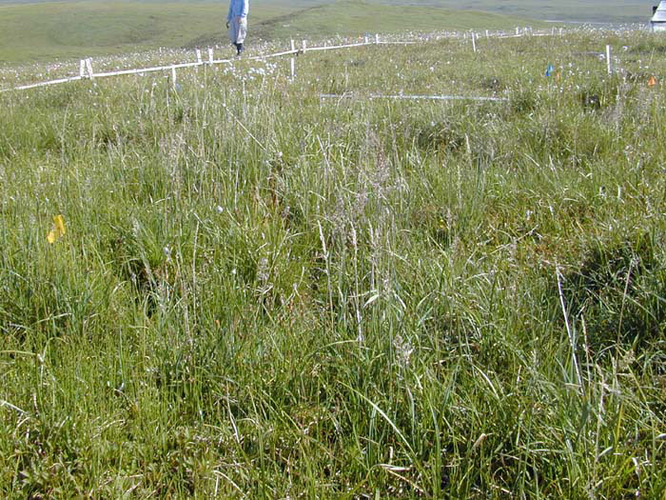
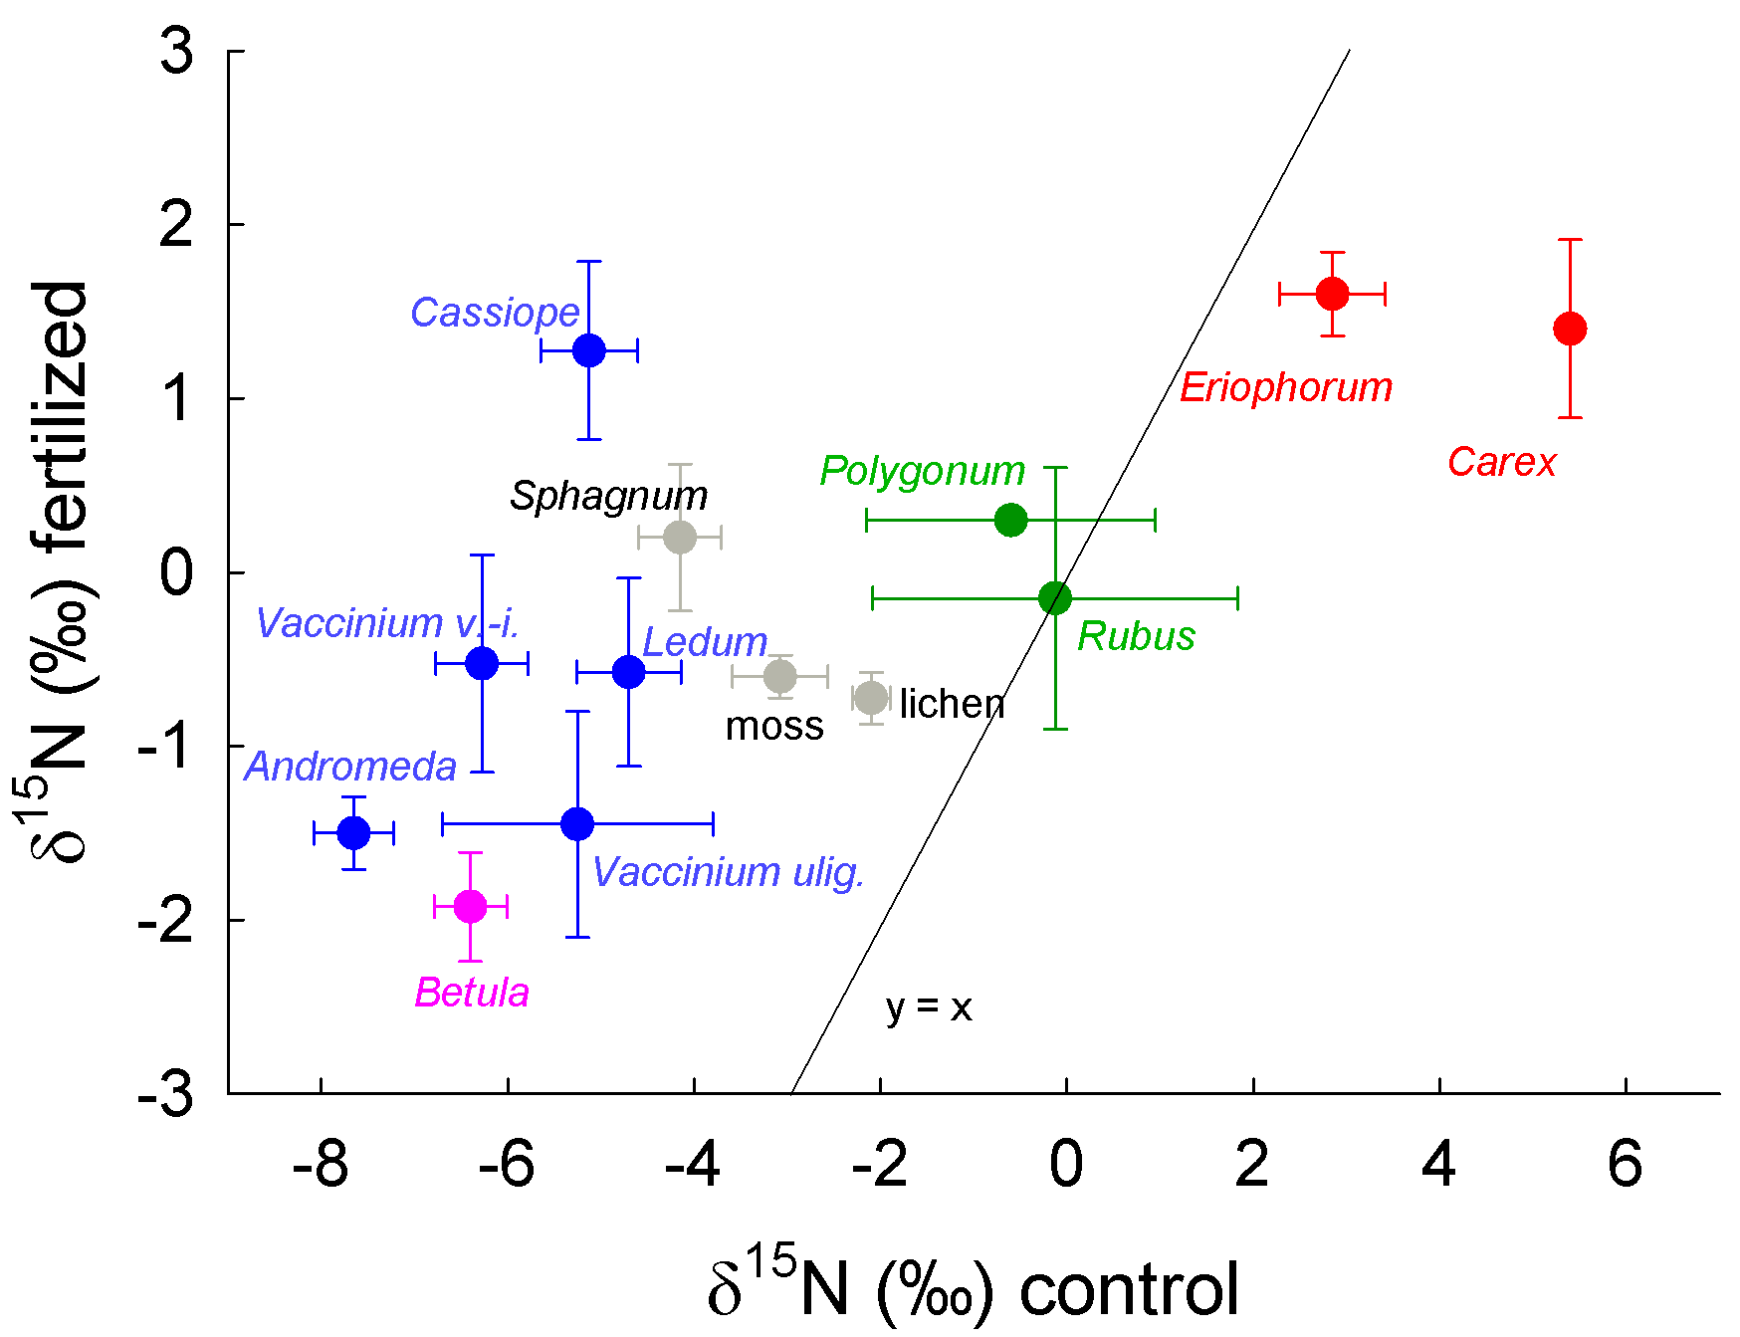
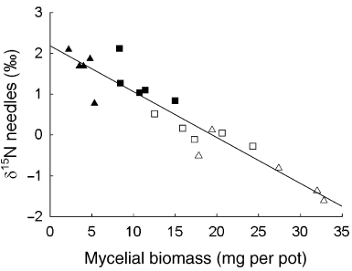


Mycorrhizal Type and Rooting Depth Influence N Acquisition Patterns in Moist Tundra in Response to N Fertilization, P Fertilization, and Warming
Erik Hobbie¹, Laura Gough², Sarah Hobbie³, Gaius Shaver⁴
¹University of New Hampshire, ²Towson State University, ³University of Minnesota, ⁴Ecosystems Center, Marine Biological Laboratory
Introduction
∙ Responses to climate change in the Arctic may be mediated through shifts in nutrient dynamics of plants and the associated mycorrhizal fungi that supply plants with N and P.
∙ Mycorrhizal fungi vary in enzymatic abilities and extent of spatial exploration; accordingly, the nutrient resources available for uptake vary among nonmycorrhizal (NON), arbuscular mycorrhizal (AM), ectomycorrhizal (ECM), and ericoid mycorrhizal fungi (ERM).
∙ Fertilization changes C allocation patterns in plants and often N and P supply can control allocation to mycorrhizal fungi.
∙ N isotope patterns (expressed as δ¹⁵N) are influenced by plant N sources and the linked partitioning of C and N in mycorrhizal symbioses.
∙ Soil δ¹⁵N at Toolik increases with depth (unpublished data, Michelle Mack); rooting depths of taxa are known (Iversen et al. 2015, New Phytologist, 205: 34-58).
∙ Based on responses to N fertilization in temperate and boreal regions, we predicted:
δ¹⁵N differences between NON and AM plants versus ECM and ERM plants should diminish with fertilization. This reflects decreased C allocation to ECM/ERM fungi, decreased importance of recalcitrant organic matter as a nutrient source, and diminished transfer of ¹⁵N-depleted N by ECM and ERM fungi.
Warming should increase SOM turnover but nutrient availability may not increase.
δ¹⁵N in nonmycorrhizal plants should reflect bioavailable N and the depth of N acquisition.
δ¹⁵N should correlate with rooting depth.
∙ A warming (greenhouse, GH) and fertilization (N & P) experiment (Figure 1) in moist non-acidic tussock (MNT; Figure 2) and moist acidic tussock (MAT; Figure 3) tundra began in 1997; N and P were added at 10 g N/m²/yr (δ¹⁵N = 2.2‰) or 5 g P/m²/yr.
∙ A biomass harvest (pluck) in 2000 (Figure 4) was used to study plant responses to fertilization.
∙ Here, we report δ¹⁵N patterns across the treatments and species for insights into how warming and fertilization altered C and N dynamics.
Methods
∙ Treatments: control, N, P, NP, GH, GHxNP in MNT plots (n=3); control and NP in MAT plots (n=4).
∙ Samples classified by tissue type, species, and probable functional/mycorrhizal type (Table 1).
∙ After measurement at KSU, δ¹⁵N patterns were analyzed using multiple regression with functional type (ERM/ECM/NON), rooting depth, and treatment (N, P, or warming) as independent variables; interactive effects were included. Tissue and species were random factors.
Results
∙ The most important controls over plant δ¹⁵N were N and functional type, with interactions of 1) rooting depth and N, 2) functional type and P, and 3) functional type and rooting depth of secondary importance (Table 3, overall adjusted r² = 0.830). Warming was not a significant factor.
ECM and ERM plants were lower in δ¹⁵N than NON plants. Added N and P increased δ¹⁵N more in ECM plants than other plants (Tables 2&3). P fertilization decreased δ¹⁵N in NON plants (Table 3).
∙ Increased rooting depth increased δ15N in ERM plants under ambient conditions and decreased δ¹⁵N in ECM and NON plants with N fertilization.
In MAT tundra, δ¹⁵N of ECM and ERM plants increased similarly with NP fertilization (Figure 5).
∙ NON plants declined in δ¹⁵N with added N.
Discussion/Conclusions
∙ Increased δ¹⁵N with fertilization in ECM and ERM plants suggests that host plants reduce C flux to their symbionts (as demonstrated in prior culture studies, Figure 6). These fungi transfer less ¹⁵N-depleted N to host plants, and retain less ¹⁵N-enriched N as their biomass declines.
∙ ECM plants were more sensitive than ERM plants to N or P fertilization, suggesting that C flux to partner fungi was more responsive to fertilization in ECM than in ERM plants. ERM δ¹⁵N responses to rooting depth under ambient conditions reflect the acquisition of shallow N by these taxa.
∙ Graminoid δ¹⁵N declined with fertilization, indicating parallel declines in the δ¹⁵N of available N.
;
Figure 1. Study site, Toolik LTER.
Figure 3. MAT tundra, NP plot 1.
Figure 4. Happy days during the harvest of 2012.
Table 2. Mean δ¹⁵N values for foliage of plants from MNT tundra after four years of treatment. ulig. = uligonosum, ang. = angustifolium, and vag. = vaginatum. Treatments: GH, greenhouse; N, N fertilization; P, P fertilization; NP, fertilization with both. Values are ± SE (‰), n is usually 3. ¹appeared nonmycorrhizal in Denali (Treu et al. 1996).
Figure 2. MNT tundra, NP plot 1.
Table 1. Plants classified by probable functional/mycorrhizal type.
(A), in MAT tundra; (N), in MNT tundra; (B), in both tundra types, rooting depth (cm) given after tundra type designation.
Ericoid mycorrhizal: Andromeda polifolia (A, 6), Cassiope tetragona (B, 10), Ledum palustre (A, 10), Vaccinium uligonosum (B, 10), V. vitis-idaea (A, 6)
Ectomycorrhizal: Betula nana (A, 20), Salix pulchra (N, 20), Dryas integrifolia (N, 10), Polygonum bistorta (B, 20)
Arbuscular mycorrhizal: Rubus chamaemorus (A, 20) Nonmycorrhizal: Carex bigelowii (B, 40), Eriophorum angustifolium (B, 30), Eriophorum angustifolium (A, 30), Eriophorum vaginatum (B, 30) (graminoids) Moss: Tomenthypnum (N), Sphagnum (A), “other moss” (B). Lichens: Mixed (B)
Table 3. Multiple regression analysis of δ¹⁵N. Lrd = Log_{e} rooting depth. Units in ‰. Ct = control treatment.
Figure 5. δ¹⁵N values for plant foliage from MAT tundra. Mycorrhizal type: blue, ERM; pink, ECM; green, AM/Polyg.; red, nonmycorrhizal.
Term Value±se P Term Value±se P Term Value±se P
Site[MAT] 0.26±0.09 0.007 Log_{e} rooting depth -0.90±0.70 0.270 Ecm x N[Ct] -0.31±0.11 0.005
N[Ct] -1.02±0.08 <0.001 (Lrd-2.73) x N[Ct] 1.84±0.31 <0.001 Erm x N[Ct] 0.29±0.20 0.152
P[Ct] -0.18±0.08 0.017 (Lrd-2.73) x P[Ct] -1.20±0.31 <0.001 Non x N (Ct) 0.01
Ecm -2.19±0.55 0.014 Ecm x (Lrd-2.73) -1.17±0.84 0.236 Ecm x P[Ct] -0.71±0.11 <0.001
Erm -2.04±0.61 0.025 Erm x (Lrd-2.73) 2.29±0.85 0.051 Erm x P[Ct] -0.32±0.20 0.112
Non 4.23 Non x Lrd] -1.13 Non x P (Ct) 1.04
Figure 6. δ¹⁵N values for plant foliage correlate with allocation to ECM fungi
in culture (Hobbie EA, Colpaert JV. 2003. New Phytologist 157: 115-126).
Acknowledgements
This study was supported by NSF OPP-1108074, OPP-0909441, OPP-0909507, OPP-0312186, DRL-0832173, and the NSF LTER network. We thank all the volunteer teachers and technicians who participated in the plant harvest.

